Slide 1
IMPLEMENTATION OF MULTIPLE-PRECISION MODULAR MULTIPLICATION ON GPU
Presented by ZHAO Kaiyong
Supervisor: Dr. CHU XiaoWen

Slide 2
OUTLINE
1.Background
2.Implementation Modular Multiplications on GPU
3.Improving the Montgomery Modular Multiplication on GPU
5.Q&A
4.Summary
Notes:
Insert a map of your country.

Slide 3
1.Background
Network coding
Originally proposed to improve throughput
Pollution attack
A malicious node sends bogus data packets to others
Homomorphic hash function
The hash of an encoded packet should be easily derived from the hashes of the original packets and the encoding coefficient vector.
Information is coded at potentially every node.
A field of information theory and coding theory for attaining maximum information flow in a network
The effect is far more serious with network coding
The bogus packet is mixed into other packets and propagates to the whole network.
Assume the original blocks are b_{i}, i = 1, …, n
The encoded block is e = c₁b₁ + … +c_{n}b_{n} → The coefficient vector is (c₁, c₂, …, c_{n})
The homomorphic hash function h(·) → h(e) = h^{c1}(b₁)h^{c2}(b₂)…h^{cn}(b_{n})
Notes:
Insert a picture of one of the geographic features of your country.

Slide 4
1.Background (why?)
Security issues
RSA
Homomorphic hash function
Multiple-precision
Multiple-precision Add
Multiple-precision Sub
Multiple-precision Modular Exponentiation
Multiplication
Modular reduction
…
Multiple-precision Multiplication
Multiple-precision Division
Multiple-precision Modular
Multiple-precision Modular Multiplication
…
Multiple-precision Modular Multiplication
Notes:
Insert a picture of one of the geographic features of your country.

Slide 5
1.Background (Karatsuba multiplication)
hi.y1
hi.x1
lo.x0
lo.y0
X->
Y->
x1*y1
x0*y0
x1*y1
(x1-x0)*(y1-y0)
x0*y0
add
add
sub
Karatsuba Multiplication O(N^1.585)[1]
Base Case Multiplication O(N^2)
hi.x1
lo.x0
hi.y1
lo.y0
X0*y0
X1*y0
X1*y1
X0*y1
[1] A. Karatsuba and Yu. Ofman (1962). "Multiplication of Many-Digital Numbers by Automatic Computers". Proceedings of the USSR Academy of Sciences 145: 293–294.
Notes:
Insert a picture illustrating a season in your country.

Slide 6
1.Background (Montgomery multiplication)
Algorithm 1 Multiple-precision Montgomery Reduction
INPUT: integer m with n radix b digits and gcd(m, b) = 1, R = b^{n} , m’=-m⁻¹ mod b, and integer A with 2n radix b digits and A<m •R.
OUTPUT: T = A•R⁻¹ mod m.
1: T<-A ;
2: for ( i from 0 to n-1 )
3: u_{i} <-Ti*m’ mod b;
4: T <- T +u_{i} *m*b^{i} ;
5: end for
6: T <- T/b^{n} ;
7: if ( T >= m) then T <- T - m;
8: return T;
Algorithm 2 Multiple-precision Montgomery Multiplication
INPUT: non-negative integer m, x, y with n radix b digits, x <m, y<m, and gcd(m, b) = 1, R=b^{n}, m’= - m⁻¹ mod b.
OUTPUT: T = x*y*R⁻¹ mod m.
1: T <- 0;
2: for ( i from 0 to n-1)
3: ui <- (T0 +xi*y0)*m’ mod b;
4: T <- (T +xi*y + ui*m)/b;
5: end for
6: if ( T>=m) then T <-T-m;
7: return T;
[2] Montgomery, P., 1985. Multiplication without trial division, Math. Computation, vol. 44, 1985, 519-521.
Notes:
Insert a picture of an animal and/or plant found in your country.

Slide 7
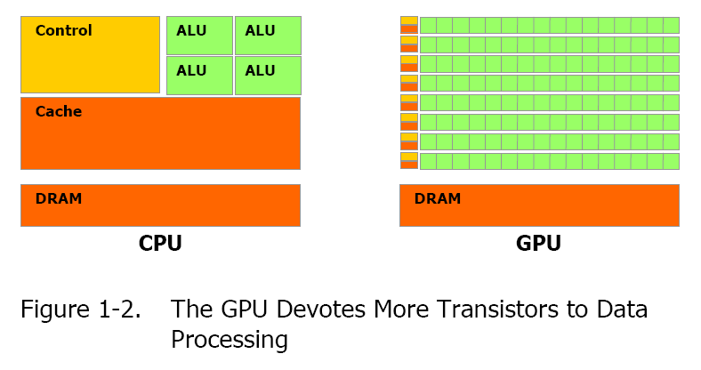
1.Background (GPU computing & CUDA)
GPU/CPU architecture
Notes:
Add key points in the history of your country to the timeline.

Slide 8
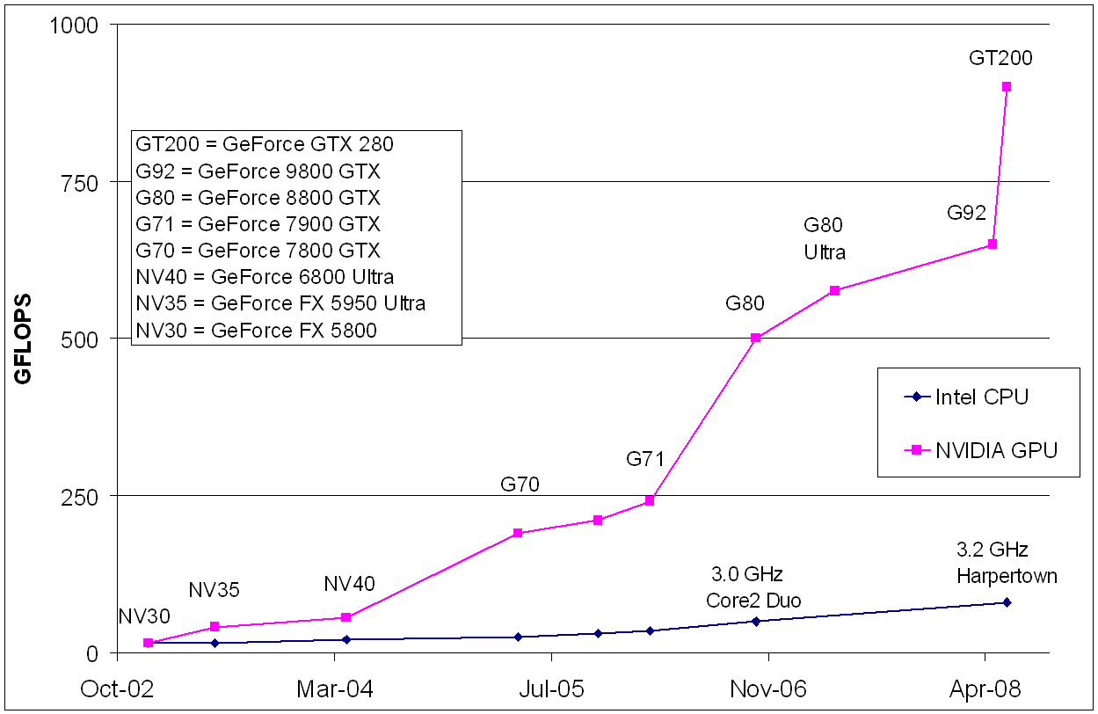
1.Background (GPU computing & CUDA)
GPU powerful computing
Computing Capability
Memory Bandwidth
Notes:
Add key points in the history of your country to the timeline.

Slide 9
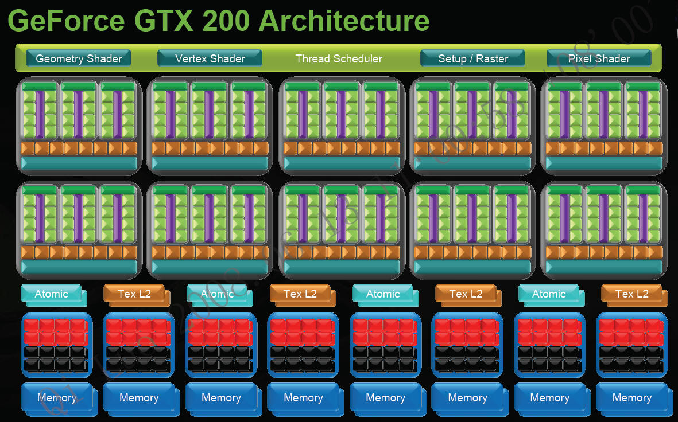
1.Background (GPU computing & CUDA)
Notes:
Add key points in the history of your country to the timeline.

Slide 10
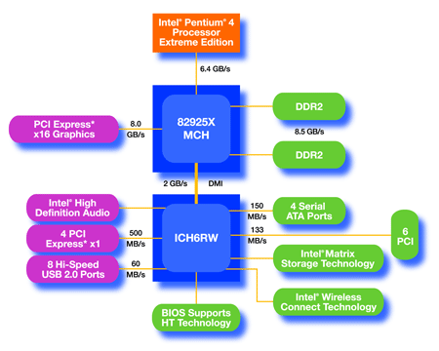
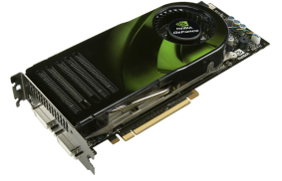
1.Background (GPU computing & CUDA)
CPU + GPU
CUDA: CPU + GPU C Program
  CPU: Flying serial
  GPU = Parallel processing Large Data
    Parallel Launching Large Thin Threads
CPU Serial Code
kernel 0
. . .
GPU Parallel Code
Concurrent execution!
CPU Serial Code
kernel 1
. . .
GPU Parallel Code

Slide 11
2.Implementation Modular Multiplications on GPU
1.Multiple-precision comparison
2.Multiple-precision subtraction
3.Multiple-precision modular addition
4.Multiple-precision modular subtraction
5.Multiple-precision multiplication
6.Multiple-precision division
7.Multiple-precision multiplicative inversion
8.Multiple-precision modular exponentiation
…
Design and Implementation of Multiple-Precision Modular Arithmetic Library for CUDA
Notes:
Insert a picture illustrating a custom or tradition.

Slide 12
2.Implementation Modular Multiplications on GPU
1.CIOS Montgomery Modular Multiplication
2.Karatsuba Montgomery Modular Multiplication
Modular Exponentiation always exchange to Modular Multiplication
We will present the implementation detail in the two Montgomery Modular Multiplication
Notes:
Insert a picture illustrating a custom or tradition.

Slide 13
2.Implementation Modular Multiplications on GPU
Algorithm 3 Multiple-precision Montgomery multiplication
INPUT: integer m with n radix b digits and gcd(m, b) = 1, , positive integer x and y with n radix b digits and .
OUTPUT: x*y*R⁻¹ mod m.
for (i from 0 up to s-1)
C: = 0
for ( j from 0 up to s-1)
(C,S) := t[j] + a[j]*b[i] + C
t[j] := S
end for
(C,S) := t[s] + C
t[s] := S
t[s+1] := C
C := 0
m := t[0]*n'[0] mod W
for (j from 0 up to s-1)
(C,S) := t[j] + m*n[j] + C
t[j] := S
end for
(C,S) := t[s] + C
t[s] := S
t[s+1] := t[s+1] + C
for (j from 0 up to s)
t[j] := t[j+1]
end for
end for
CIOS (Coarsely Integrated Operand Scanning) Montgomery Modular Multiplication
Notes:
Insert a picture illustrating a custom or tradition.

Slide 14
2.Implementation Modular Multiplications on GPU
Algorithm 4 Multiple-precision Karatsuba and Montgomery Multiplication
INPUT: integer m with n radix b digits and gcd(m, b) = 1, , positive integer x and y with n radix b digits and .
OUTPUT: x*y*R⁻¹ mod m.
Karatsuba(x,y)
for (i from 0 up to s-1)
C := 0
m := t[i]*n'[0] mod W
for (j from 0 up to s-1)
(C,S) := t[i+j] + m*n[j] + C
t[i+j] := S
end for
ADD (t[i+s],C)
end for
for (j from 0 up to s)
u[j] := t[j+s]
end for
B := 0
for (i from 0 up to s-1)
(B,D) := u[i] - n[i] - B
t[i] := D
end for
(B,D) := u[s] - B
t[s] := D
if B=0 then return t[0], t[1], ... , t[s-1]
else return u[0], u[1], ... , u[s-1]
Karatsuba Montgomery Modular Multiplication:
  In this method, we choose the Karatsuba multiplication to implement the multiplication, and then perform Montgomery reduction.
Notes:
Insert a picture illustrating a custom or tradition.

Slide 15
2.Implementation Modular Multiplications on GPU
CPU
CPU(Intel(R) Core(TM)2 Quad CPU Q6600 @2.40GHz
GPU
GTX 295
1.24GHz
240 cores
Integer parameters
Integer:
1024bits x 1024bits
Module 1024bits
Using 32bit integer as the base
Notes:
Insert a picture illustrating a custom or tradition.

Slide 16
2.Implementation Modular Multiplications on GPU
Comparing Karatsuba Method and CIOS Method
  K-MM:
  60 registers, 5132 local memories.
  CIOS :
  14 register, no local memory at all.
Notes:
Insert a picture illustrating a custom or tradition.

Slide 17
3.Improving the Montgomery Modular Multiplication on GPU
Algorithm 5 32bit integer multiplication
INPUT: 32bit integer A multiplicative with 32bit integer B.
OUTPUT: A*B.
}
return out;
asm("mul.wide.u32 %0, %1, %2;" : "=l"(out) : "r"(A), "r"(B));
unsigned __int64 out;
static inline __device__ unsigned __int64 mul_32x32(unsigned A, unsigned B) {
ASM of Integer Multiplication
  MULT64X64LO need more than 20 instructions
  MULT32X32WIDE only need 10 instructions.
Notes:
Insert a picture illustrating a custom or tradition.

Slide 18
3.Improving the Montgomery Modular Multiplication on GPU
20% faster
The inside ASM function used to solve the 32bit multiplicative 32bit integer.
In the decuda code we can see that each loop the CIOS-ASM method is 11 instructions less than the CIOS method.
Notes:
Insert a picture illustrating a custom or tradition.

Slide 19
3.Improving the Montgomery Modular Multiplication on GPU
GPU VS CPU (GPU 20 times faster than CPU)
Total instructions:
CPU: 14s^2+16s+5= 14850
GPU: 10~15times more than CPU & memory latency
times = 1/40~1/60
CPU:4 cores
GPU:240 cores
times = 240*4/4 = 240
2~3
Almost 2-3 times faster than the 4 core CPU
CPU:2.4GHz
GPU:1.24GHz
times = 1/2*1/40~1/60 = 1/80~1/120
Notes:
Insert a picture illustrating a custom or tradition.

Slide 20
4.Summary
Due to Security issues
Hash function is based on multiple-precision
GPU is good at parallel computing
Implementation multiple-precision for CUDA
Improve the Montgomery Modular Multiplication

Slide 21
5. Q&A
Q&A
Thanks!

