Slide 1
PhD Programme
Computer Science, HKBU

Slide 2
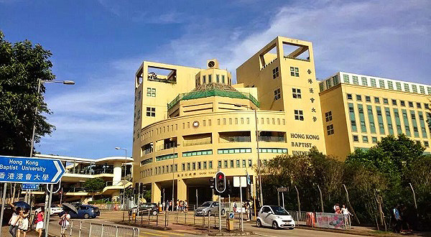
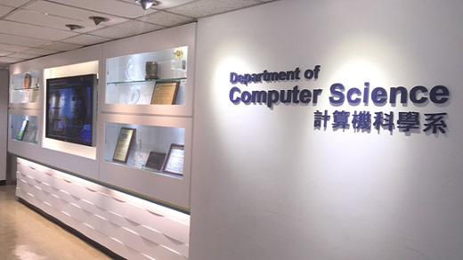
Hong Kong Baptist University (HKBU)
HKBU: Established in 1956 – the 2nd oldest university in Hong Kong
One of 8 public universities in HK
Ranked 19th worldwide in 2016 QS Top 50 under 50
Ranked 49th in Asia in 2017 Times Higher (THE) Ranking
More at http://baike.baidu.com/item/%E9%A6%99%E6%B8%AF%E6%B5%B8%E4%BC%9A%E5%A4%A7%E5%AD%A6?sefr=cr

Slide 3
Faculty Profile of Computer Science
18 highly-qualified professors with Ph.D. degrees awarded by world renowned universities in Australia, Canada, Switzerland, the United States, the United Kingdom, and Hong Kong
http://www.comp.hkbu.edu.hk/v1/?page=faculty
3 IEEE Fellows
8 IEEE / ACM Senior Members
Associate Editors of various top-tier journals
IEEE Access
IEEE Internet of Things Journal
IEEE Transactions on Cybernetics
IEEE Transactions on Information Forensics and Security
IEEE Transactions on Knowledge and Data Engineering
IEEE Transactions on Neural Networks and Learning Systems
Pattern Recognition
Proceedings of the VLDB Endowment (PVLDB)

Slide 4
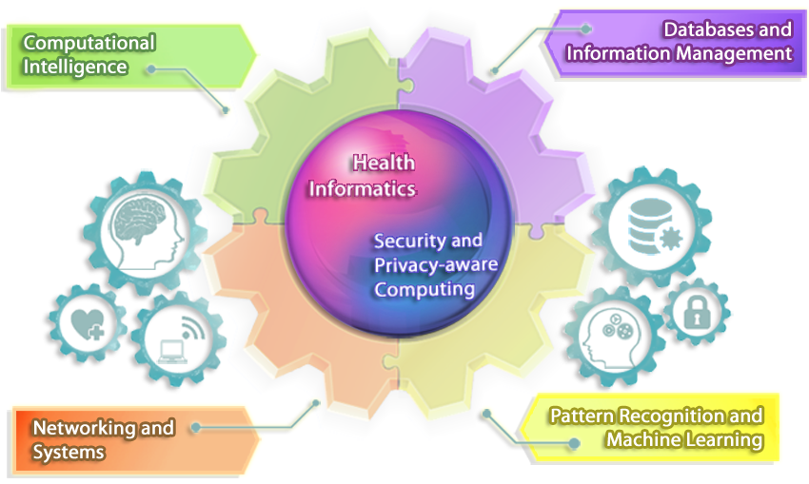
Focused Research Areas

Slide 5
Research Outputs
Over half of research outputs are recognized as world leading or internationally excellent
4-Star: world leading
3-Star: internationally excellent
2-Star: internationally standing
1-Star: regional standing

Slide 6
High-tech and Advanced Computer Facilities
Big Data Cluster
Hadoop + Spark
More than 200TB of storage
GPU Cluster
12 nodes with 24 Nvidia Tesla K80
Research Cluster
More than 40 dual-Xeon servers
Top-500 Supercomputer (256-nodes)
under the Science Faculty

Slide 7
PhD Programme Structure
Normal period of study
4 years for students without a master degree
Requirement: 15 units course work + a research project
Typically, 3 units @ course
Guaranteed overseas exchange
Perform research in an overseas university and have a cultural exchange with students/researchers in other countries
Overseas post-doctoral scheme
Support fresh graduates to gain more research experience at renowned overseas universities or research institute for half to one year

Slide 8
Scholarship and Financial Support
Studentships are provided to full-time PhD students
Current stipend: HK$16,330 per month for 3 years
The 4th year’s support is subject to satisfactory performance
Financial support for carrying out research-related activities such as attending overseas conferences and joining exchange programmes / attachments in world-renowned universities
At least HK$40,000 during the study period
More details on the incentive schemes:
http://www.comp.hkbu.edu.hk/v1/?page=rpg_scheme

Slide 9
Hong Kong PhD Fellowship Scheme (HKPFS)
Outstanding applicants (e.g., national scholarship awardees and/or top 1-2% of the class) will be recommended for nomination to the HKPFS scheme
HKPFS Applicants | Scholarship (per year)
Nominated by HKBU and awarded by HK Government | Approx. HKD 500,000*
Nominated by HKBU but not awarded by HK Government | Approx. HKD 250,000*
* Visit http://www.comp.hkbu.edu.hk/hkpfs for a detailed breakdown

Slide 10
Where Our PhD Graduates Go?
Academia
Industry

Slide 11
Enquiry: Ms. Kristina Tsang Email: kristina@comp.hkbu.edu.hk Website: http://www.comp.hkbu.edu.hk/

