Slide 1
ACM/ICPC Introduction
Zhu Xuliang

Slide 2
Outlines
About me
ICPC Introduction
Training
Basic knowledge
Some problems

Slide 3
About me
Second year phd student
The ICPC Asia-East Continent Final Gold Medal
Writers of EOJ Monthly / Multi-University Training / Regional Contest
Homepage: https://www.comp.hkbu.edu.hk/~csxlzhu/
Wechat: 15921519435

Slide 4
ICPC Introduction
International Collegiate Programming Contest
One team of three person
11~13 problems
Lasting 5 hours
Top 10% Gold / Top 30% Silver / Top 60% Bronze
About 6 Regional Contest, 1 EC-Final and 1 World Final every year
Each person attends at most 2 Regional Contest each year, and attends at most 2 World Final in career.

Slide 5
ICPC Introduction
Benefits:
Funny
Stretch brain
Learn classical algorithms
Strengthen coding ability
Solve interview problem easily
More ideas for research works

Slide 6
ICPC Introduction
Requirement:
Strong interest of algorithms and coding (Most important)
Long-term training
A few talents

Slide 7
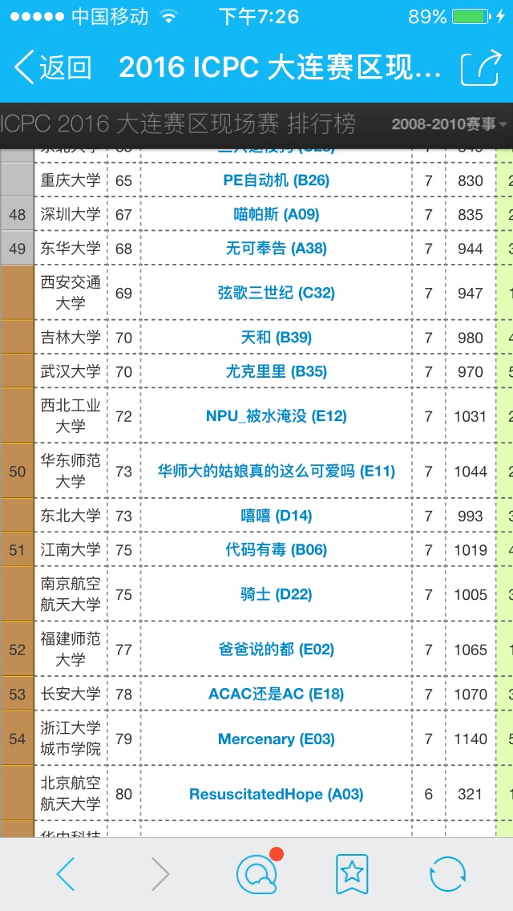
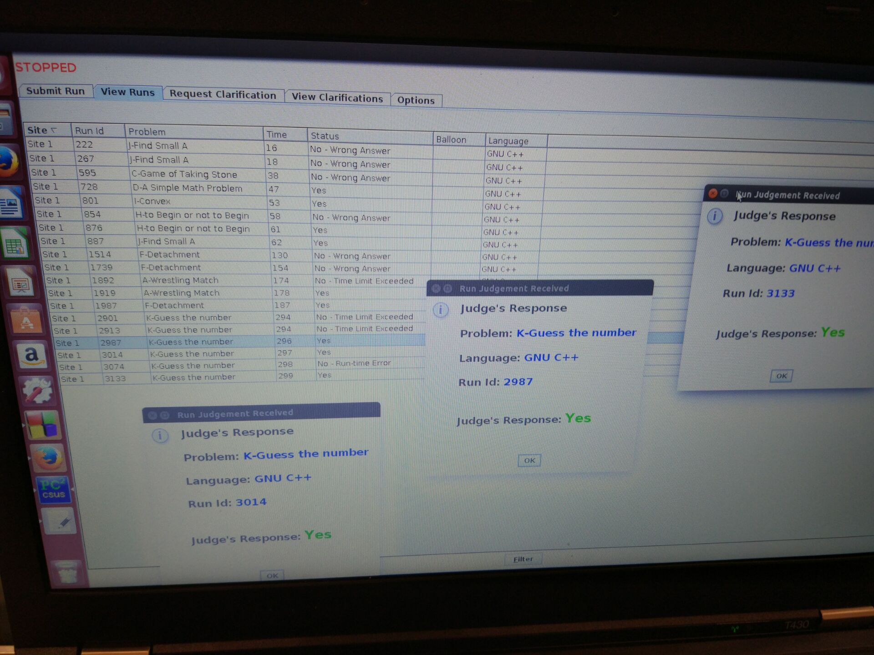
ICPC Introduction
Some pictures

Slide 8
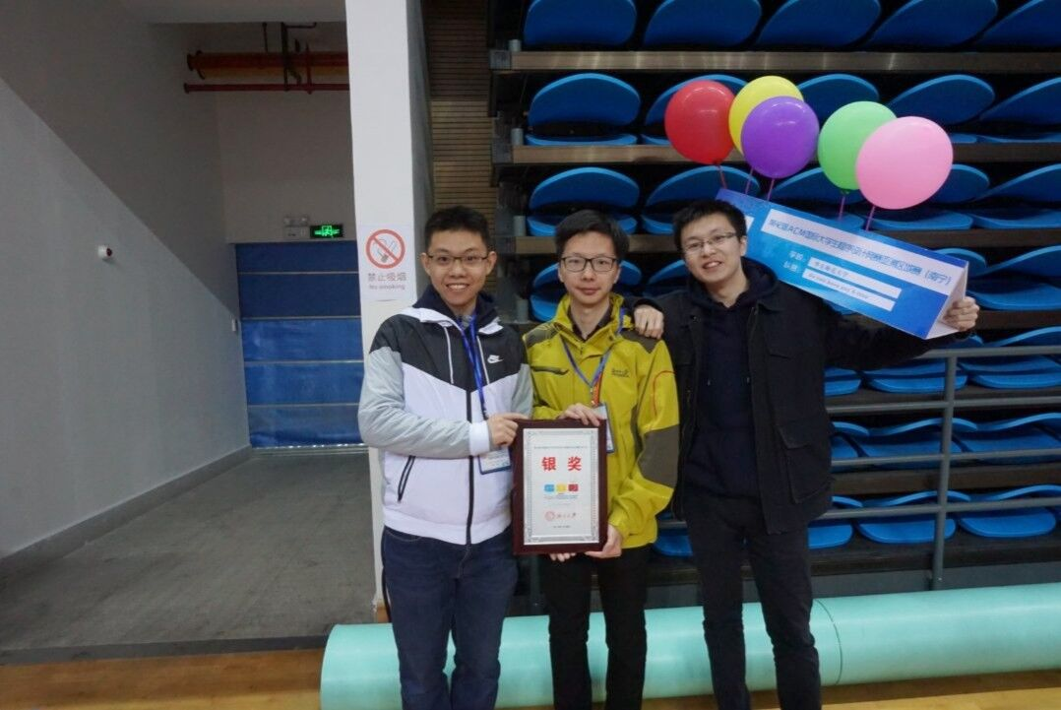
ICPC Introduction
Some pictures

Slide 9
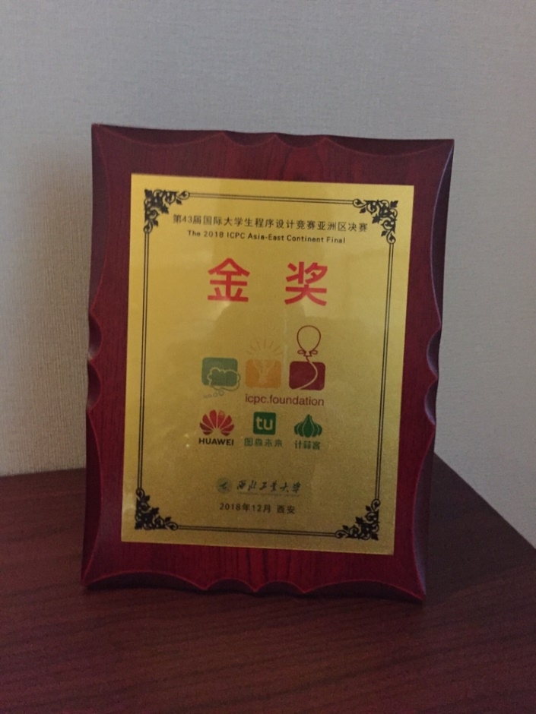
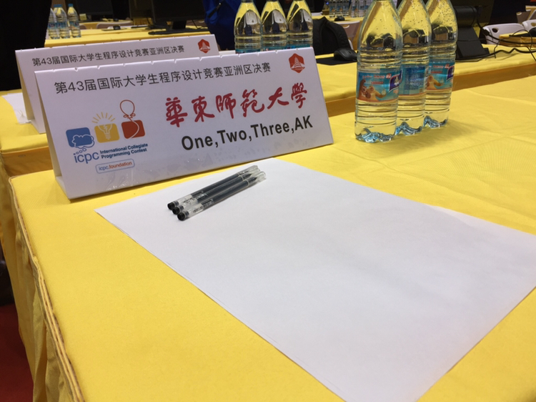
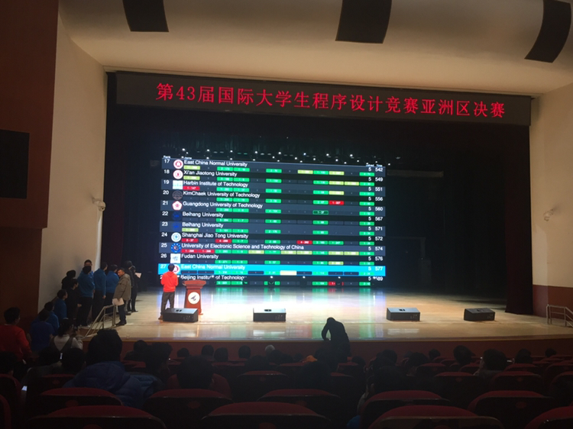
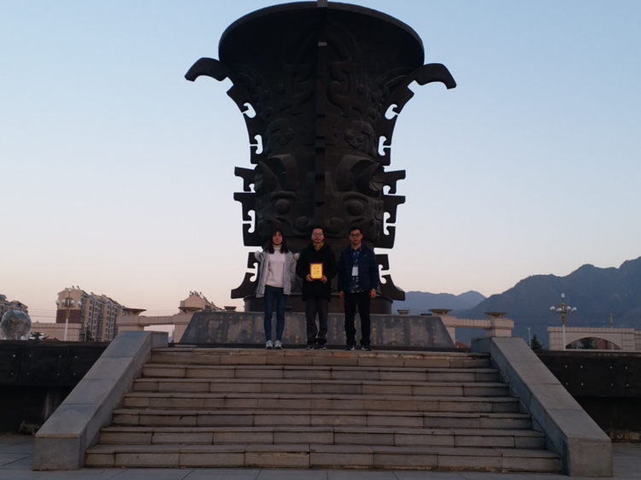
ICPC Introduction
Some pictures

Slide 10
Training
Seminar
Online judge (OJ)
Books
Others

Slide 11
Training
Seminar
Algorithm
Coding
Q&A (debug)
Training contests

Slide 12
Training
Online judge (OJ)
For personal
Codeforces / Atcoder / LeetCode / 牛客网&计蒜客
ECNUOJ: https://acm.ecnu.edu.cn/
For team
Codeforces gym / Vjudge
https://acm.ecnu.edu.cn/wiki/index.php?title=One,Two,Three,AK_(2018)

Slide 13
Training
Books
《挑战程序设计竞赛》
Introduction to Algorithms (算法导论)

Slide 14
Training
Others
Blogs（codeforces / CSDN / 博客园）
OI Wiki (https://oi-wiki.org/)
LeetCode solutions (https://github.com/hqztrue/LeetCodeSolutions/)

Slide 15
Basic Knowledge
Language
Verdict of solution
Algorithms

Slide 16
Basic Knowledge
Language
C/C++
IDE: codeblocks / vscode / CLion
JAVA/Python (Slower than C/C++)

Slide 17
Basic Knowledge
Verdict of solution
Accept: You pass the problem.
Wrong Answer: Your output is wrong.
CE(Compilation Error): Your program compiles failed.
TLE(Time Limit Exceeded): Wrong time complexity.
MLE(Memory Limit Exceeded): Wrong space complexity.
RE(Runtime Error): Access invalid address or divide zero.
PE(Presentation Error): More space or other presentation error.

Slide 18
Basic Knowledge
Algorithms
Brute force
Greedy & DP
Graph
Data structure & String
Math
……

Slide 19
Basic Knowledge
Try to pass your first problem.
https://vjudge.net/contest/462504#problem/A

Slide 20
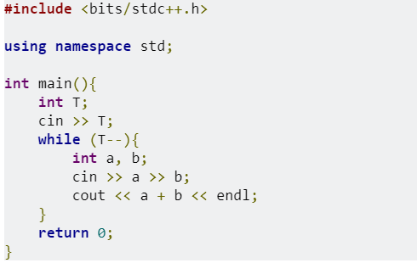
Basic Knowledge
C++:

Slide 21
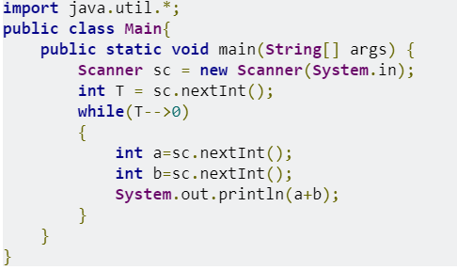
Basic Knowledge
Java 11:

Slide 22
Basic Knowledge
Python 3:

Slide 23
Some problems
1、How to calculate a + a^2 + a^3 + …… + a^n?
sum = 0;
for (int i = 1; i <= n; i++){
tmp = 1;
for (int j = 1; j <= i; j++)
tmp *= a;
sum += tmp;
}
return sum;

Slide 24
Some problems
1、How to calculate a + a^2 + a^3 + …… + a^n?
sum = 0, tmp = 1;
for (int i = 1; i <= n; i++){
tmp *= a;
sum += tmp;
}
return sum;

Slide 25
Some problems
1、How to calculate a + a^2 + a^3 + …… + a^n?
a + a^2 + a^3 + …… + a^n = a *（a^n - 1） / (a - 1)
Is it true?

Slide 26
Some problems
How to calculate a^n quickly? (For example, n = 11)
11 = (1011)2
a^11 = a^(1 * 8 + 0 * 4 + 1 * 2 + 1 * 1)
= a^8 * a^2 * a
a^2 = a * a, a^4 = a^2 * a^2, a^8 = a^4 * a^4
Time complexity: Log2(n)

Slide 27
Some problems
2、Give an array with 2n + 1 numbers, which has n numbers for twice and one special number for once. How to find the special number? (Leetcode 136)
Quick Sort: Time complexity O(nlogn), Space complexity O(n)
Hash: Time complexity O(n), Space complexity O(n)

Slide 28
Some problems
2、Give an array with 2n + 1 numbers, which has n numbers for twice and one special number for once. How to find the special number?
Special number = a_1 xor a_2 xor …… a_{2n+1}
Time complexity O(n), Space complexity O(1)

