Slide 1
Top-k Graph Summarization on Hierarchical DAGs
Xuliang Zhu, Xin Huang, Byron Choi, Jianliang Xu
Hong Kong Baptist University
Hong Kong, China

Slide 2
Outlines
Motivations
Related Work
KDAG-Problem
Algorithms
Experiments
Conclusions

Slide 3
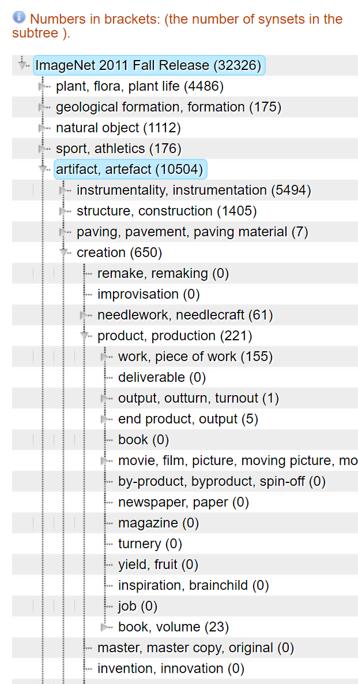
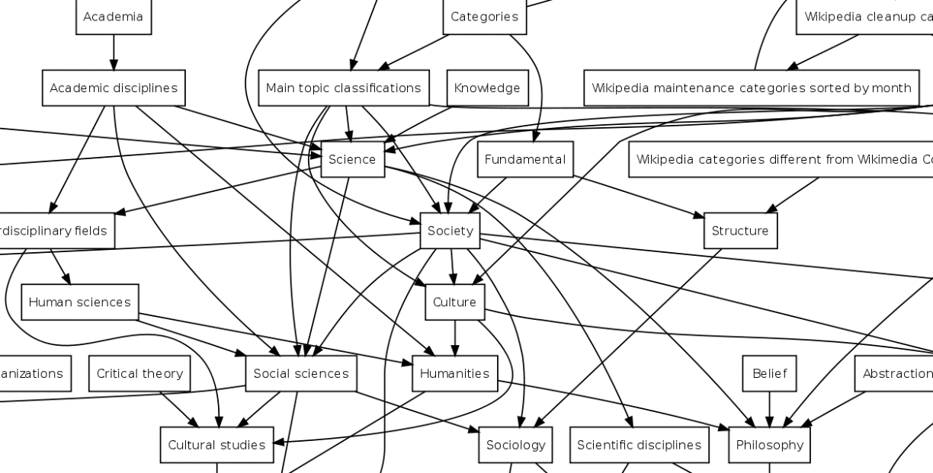
Motivations
Hierarchical DAGs are everywhere (e.g. Disease Ontology, ImageNet, Wikipedia Categories)
Node Weights
Disease Ontology
The occurrences of diseases
ImageNet
The number of pictures
Wikipedia Categories
The views under the categories
Disease Ontology
ImageNet
Wikipedia Categories

Slide 4
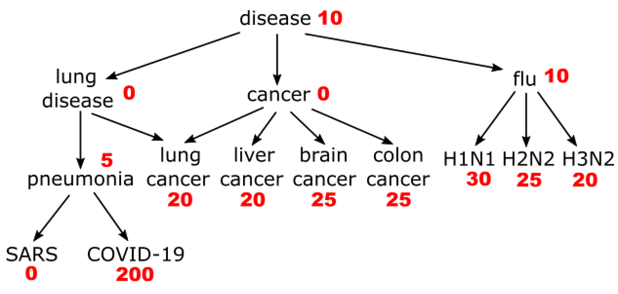
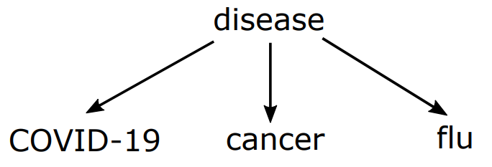
Motivations
Top-k summarization
Massive terminologies and complex structures
Difficult to understand or visualize
An example (k=4)
disease: general concept
COVID-19: the most important disease
cancer & flu: two categories of multiple diseases with large weights
Disease Ontology
Top-4 Summarization

Slide 5
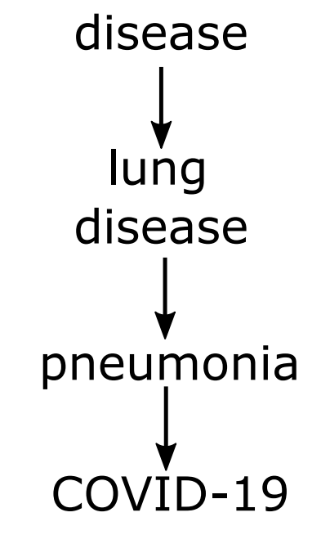
Related Work
Aggregate method
[X Jing et al. 2014]
Select top-k vertices with maximum aggregate value.
Lack diversity
GVDO Model
Tree
Disease Ontology
Our method
Aggregate method

Slide 6
Related Work
Graph summarization
Graph stream summarization [X Gou et al. ICDE’19]
RDF graph summarization [S Cebiric et al. PVLDB’15]
Summarization for keyword search [G Fakas et al. SIGMOD’15]
Top-k diversification
Top-k maximum clique [L Yuan et al. VLDBJ’ 16]
Top-k diversified subgraph [Z Yang et al. SIGMOD’16]

Slide 7
Outlines
Motivations
Related Work
KDAG-Problem
Algorithms
Experiments
Conclusions

Slide 8
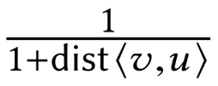
kDAG-Problem
Summary Score
Here, S is the selected set, V is the set of all vertices and feq(u) is the weight of vertex u.
The score is determined by the weight and distance from the selected vertices.
KDAG-problem
Find the set

Slide 9
kDAG-Problem Analysis
Diversity
The selected vertices are not similar.
Small Scale
The size of selected vertices is small.
Large Coverage
The selected vertices can reach many important vertices.
High Correlation
The representative correlation of selected vertices to an important vertex is high.
Our kDAG-Problem is NP-hard
Reduction from 3-SAT problem

Slide 10
Outlines
Motivations
Related Work
KDAG-Problem
Algorithms
Experiments
Conclusions

Slide 11
Greedy+
1
1
1
37
Marginal Gain
L
Add maximum marginal gain into S greedily.
0
24
46
39
2
3
2
3
4
5
6
7
4
5
6
7
42
18
6
6
42
18
6
6
Running Example
Marginal Gain

Slide 12
Greedy+
1
1
1
37
Marginal Gain
L
Add maximum marginal gain into S greedily.
0
24
46
39
2
3
2
3
4
5
6
7
4
5
6
7
42
18
6
6
42
18
6
6
Running Example
Marginal Gain

Slide 13
Greedy+
1
1
1
37
Marginal Gain
L
Add maximum marginal gain into S greedily.
0
24
39
2
3
2
3
4
5
6
7
4
5
6
7
42
18
6
6
42
18
6
6
Running Example
Marginal Gain

Slide 14
Greedy+
1
1
1
37
Marginal Gain
L
Add maximum marginal gain into S greedily.
0
24
39
2
3
2
3
4
5
6
7
4
5
6
7
42
18
6
6
21
18
6
6
Running Example
Marginal Gain

Slide 15
Greedy+
1
1
1
37
Marginal Gain
L
Add maximum marginal gain into S greedily.
0
24
14
2
3
2
3
4
5
6
7
4
5
6
7
42
18
6
6
21
18
6
6
Running Example
Marginal Gain

Slide 16
Greedy+
1
1
1
1
Marginal Gain
L
Add maximum marginal gain into S greedily.
0
24
14
2
3
2
3
4
5
6
7
4
5
6
7
42
18
6
6
21
18
6
6
Running Example
Marginal Gain

Slide 17
Greedy+
Monotone
Submodular
(1 – 1/e)-approximation guarantee

Slide 18
EXT-Greedy
1
1
Extract subtree based on greedy+ answer.
Apply optimal method[1] on the subtree.
0
24
2
3
4
5
6
7
42
18
6
6
Running Example
[1] Ontology-based Graph Visualization for Summarized View. X Zhu et al. 2020. arXiv:arXiv:2008.03053

Slide 19
EXT-Greedy
1
1
Extract subtree based on greedy+ answer.
Apply optimal method[1] on the subtree.
0
24
2
3
4
5
6
7
42
18
6
6
Greedy+ answer
[1] Ontology-based Graph Visualization for Summarized View. X Zhu et al. 2020. arXiv:arXiv:2008.03053

Slide 20
EXT-Greedy
1
1
Extract subtree based on greedy+ answer.
Apply optimal method[1] on the subtree.
0
24
2
3
4
5
6
7
42
18
6
6
Subtree extraction
[1] Ontology-based Graph Visualization for Summarized View. X Zhu et al. 2020. arXiv:arXiv:2008.03053

Slide 21
EXT-Greedy
1
1
Extract subtree based on greedy+ answer.
Apply optimal method[1] on the subtree.
0
24
2
3
4
5
6
7
42
18
6
6
Optimal solution
in subtree
[1] Ontology-based Graph Visualization for Summarized View. X Zhu et al. 2020. arXiv:arXiv:2008.03053

Slide 22
EXT-Greedy
1
1
Extract subtree based on greedy+ answer.
Apply optimal method[1] on the subtree.
0
24
2
3
4
5
6
7
42
18
6
6
Optimal solution
in the original DAG
[1] Ontology-based Graph Visualization for Summarized View. X Zhu et al. 2020. arXiv:arXiv:2008.03053

Slide 23
K-PCGS
1
22
1
22 22
Compress DAG
Compress the DAG into a new graph by removing useless vertices.
Pruning Candidates
Prune the vertices from candidates whose upper bound is smaller than the top-k lower bound.
0
24
0 0
12 24
2
3
2
3
4
5
6
7
4
5
6
7
0
0
6
6
0 0
0 0
3 6
3 6
8
60
8
30 60
Compressed DAG
Pruned Candidates (Black)
Candidates (Blue)
Lower Bound (Green) Upper Bound (Red)

Slide 24
K-PCGS
1
22
1
22 22
Compress DAG
Compress the DAG into a new graph by removing useless vertices.
Pruning Candidates
Prune the vertices from candidates whose upper bound is smaller than the top-k lower bound.
0
24
0 0
12 24
2
3
2
3
4
6
7
4
6
7
0
6
6
0 0
3 6
3 6
8
60
8
30 60
Compressed DAG
Pruned Candidates (Black)
Candidates (Blue)
Lower Bound (Green) Upper Bound (Red)

Slide 25
K-PCGS
1
22
1
22 22
Compress DAG
Compress the DAG into a new graph by removing useless vertices.
Pruning Candidates
Prune the vertices from candidates whose upper bound is smaller than the top-k lower bound.
0
(24, 12)
0 0
14 30
2
3
2
3
4
4
0
0 0
8
60
8
30 60
Compressed DAG
Pruned Candidates (Black)
Candidates (Blue)
Lower Bound (Green) Upper Bound (Red)

Slide 26
K-PCGS
1
22
1
22 22
Compress DAG
Compress the DAG into a new graph by removing useless vertices.
Pruning Candidates
Prune the vertices from candidates whose upper bound is smaller than the top-k lower bound.
0
(24, 12)
0 20
14 30
2
3
2
3
4
4
0
0 0
8
60
8
30 60
Compressed DAG
Pruned Candidates (Black)
Candidates (Blue)
Lower Bound (Green) Upper Bound (Red)

Slide 27
K-PCGS
1
22
1
22 53
Compress DAG
Compress the DAG into a new graph by removing useless vertices.
Pruning Candidates
Prune the vertices from candidates whose upper bound is smaller than the top-k lower bound.
0
(24, 12)
0 20
14 30
2
3
2
3
4
4
0
0 0
8
60
8
30 60
Compressed DAG
Pruned Candidates (Black)
Candidates (Blue)
Lower Bound (Green) Upper Bound (Red)

Slide 28
Complexity Comparison
Method | Time Complexity | Space Complexity
Greedy+ | O(nkm) | O(m)
EXT-Greedy | O(nkm+nk³h) | O(nk²h)
k-PCGS | O(mh + nlogn + k|C|m’) | O(m)
Here, n is the size of vertices, m is the size of edges,
h is the height of DAG (length of longest shortest path).
|C| is smaller than n and m’ is smaller than m.

Slide 29
Outlines
Motivations
Related Work
KDAG-Problem
Algorithms
Experiments
Conclusions

Slide 30
Datasets
Dataset | Hierarchical DAG | Weight | n | m
LATT | Medical Entity Dictionary | Number of queries from patients | 4,226 | 8,190
LNUR | Medical Entity Dictionary | Number of queries from nurses | 4,226 | 8,190
ANIM | “Anime" catalog in Wikipedia | Number of views | 15,135 | 24,498
IMAGE | ImageNet (WordNet) | Number of pictures | 73,298 | 74,732
YAGO3 | Wikipedia + WordNet | Synthetic | 5,699,254 | 17,512,754
UCI | Social Network Only for efficiency test | Synthetic | 58,790,783 | 92,208,196

Slide 31
Evaluation metrics
Summary Score
Average Distance
1-hop Weighted Coverage

Slide 32
Methods compared
FEQ [X Jing et al. 2014]
Select k nodes with the highest weight.
CAGG [X Jing et al. 2014]
Aggregate method with a contribution ratio.
LASP [G Fakas et al. SIGMOD’15]
Add the largest averaged score path greedily.

Slide 33
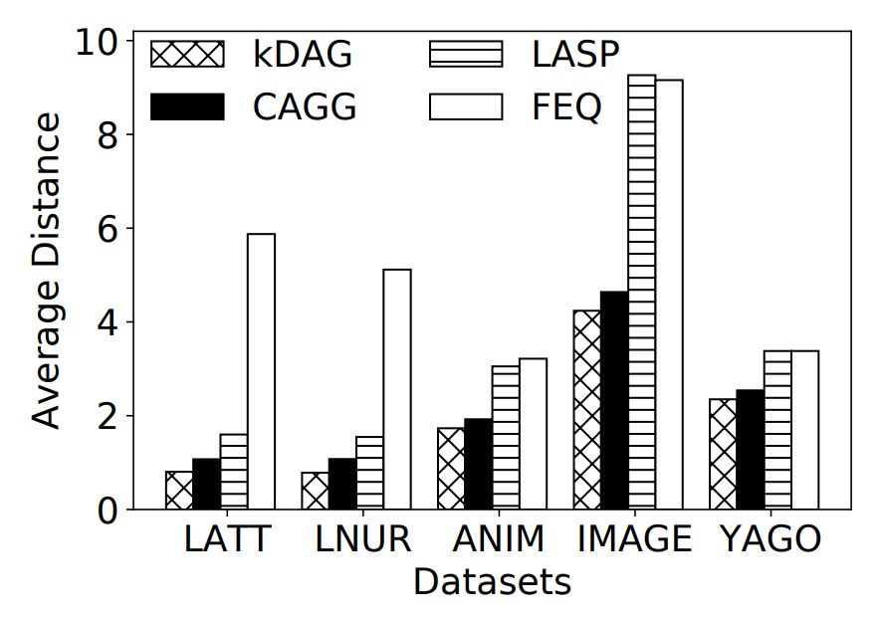
Effectiveness Evaluations
Average Distance of different models.
Our kDAG model outperforms state-of-the-art models with the smallest average distance.

Slide 34
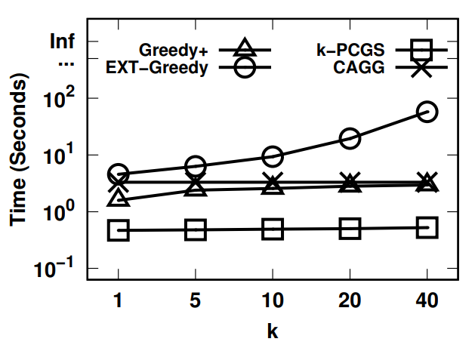
Efficiency Evaluations
Efficiency evaluation of Greedy+, EXT-Greedy, k-PCGS and CAGG methods on ImageNet.
The k-PCGS runs fastest among all methods and EXT-Greedy is the slowest.

Slide 35
Efficiency Evaluations
The size of candidates
The k-PCGS reduces at least 90% candidates in the worst case and more than 99% in most cases.

Slide 36
Outlines
Motivations
Related Work
KDAG-Problem
Algorithms
Experiments
Conclusions

Slide 37
Conclusions
We study the top-k graph summarization problem on large hierarchical DAGs.
We propose a novel model of kDAG-problem and proof its NP-hardness.
We develop three algorithms to tackle kDAG-problem:
Greedy+: A baseline greedy method.
EXT-Greedy: A more effective method.
k-PCGS: A more efficient method.

Slide 38
Thank you for watching!
Contact us: csxlzhu@comp.hkbu.edu.hk

