Slide 2
A Database Dependent Framework for K-Input Maximum Fanout-Free Window Rewriting
Xuliang Zhu, Ruofei Tang*, Lei Chen, Xing Li, Xin Huang, Mingxuan Yuan, Weihua Sheng, Jiangliang Xu

Slide 3
Outline
Preliminaries
Motivation
Challenges
Algorithm
Experiments

Slide 4
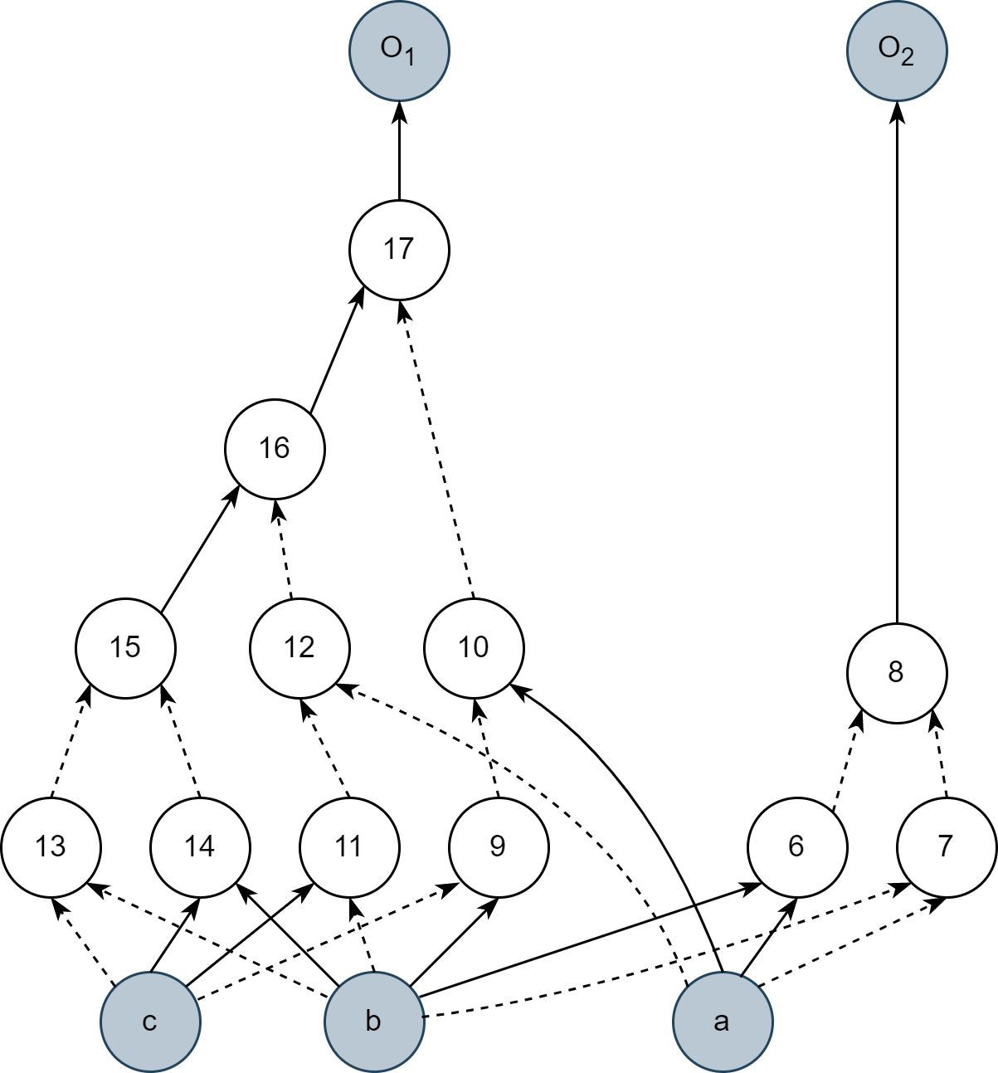
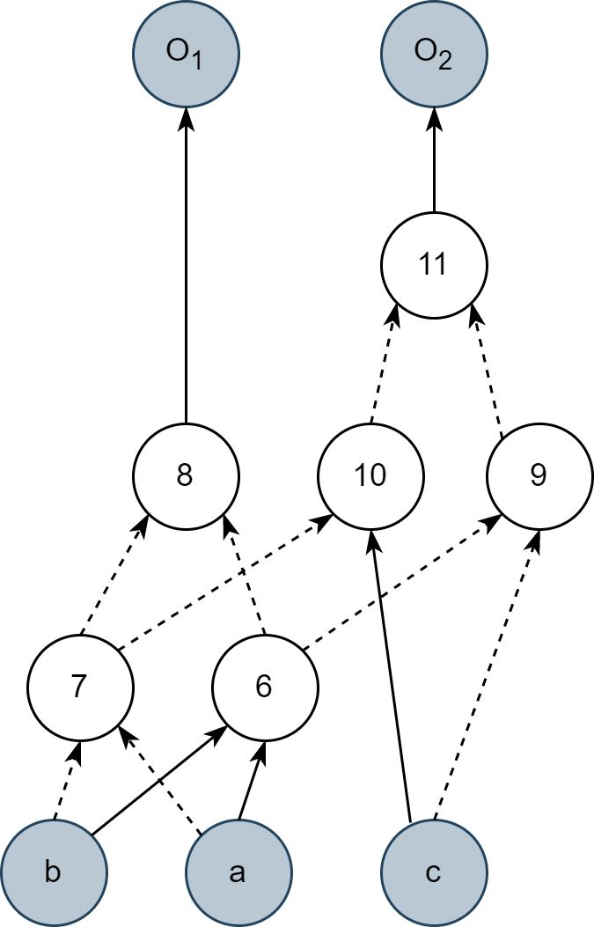
Preliminaries
And-Inverter Graph (AIG) & Technology-independent Logic Optimization
Goal: reducing the area¹ and delay² in the given AIG
1: Number of nodes
2: Longest path from primary inputs to primary outputs
Primary Output
Delay = 4
Area = 12
Delay = 3
Area = 6
optimize
NOT Gate on Edge
Primary Input
original AIG
optimized AIG

Slide 5
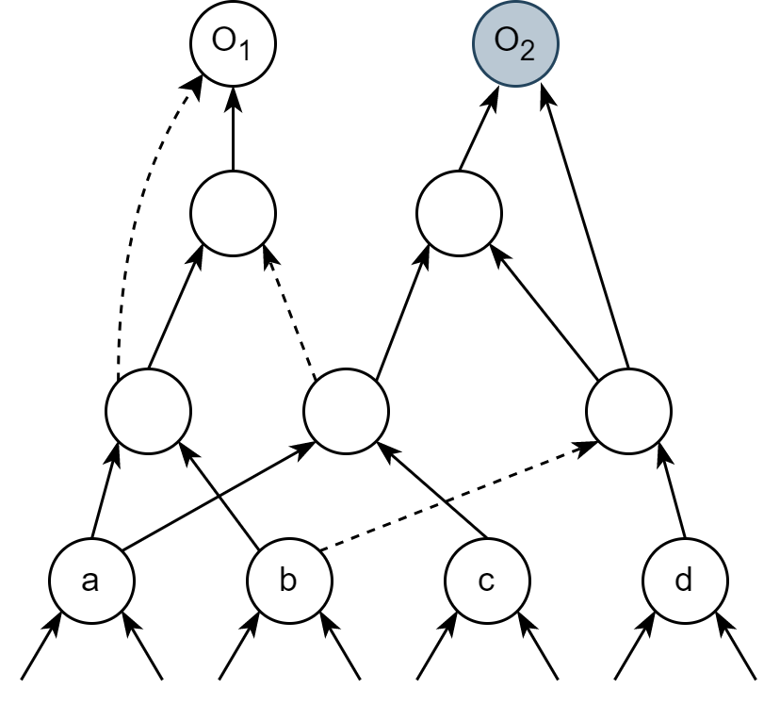
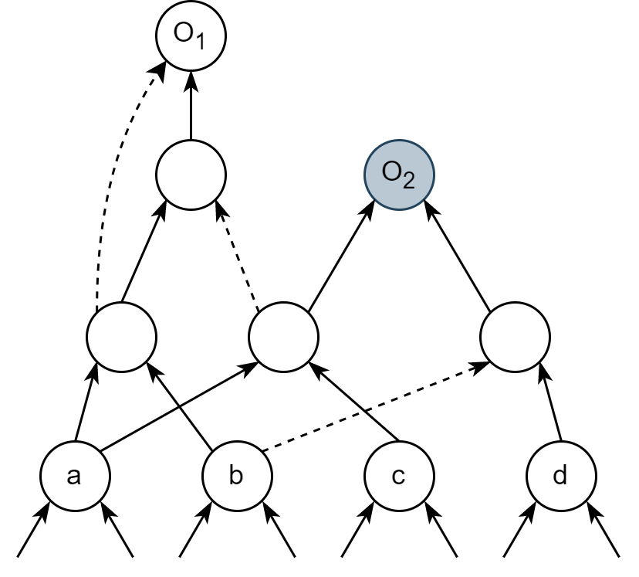
Existing Works – Database Dependent Rewriting
Rewriting is an area optimization algorithm by replacing sub-structures of the AIG.
In existing works of database dependent rewriting, there are three main components:
Cuts Enumeration
Equivalent Structure Matching
Database Construction
replace
root
calculate
cut
database
truth table w.r.t node a, b, c, d
match
leave nodes = {a, b, c, d}

Slide 6
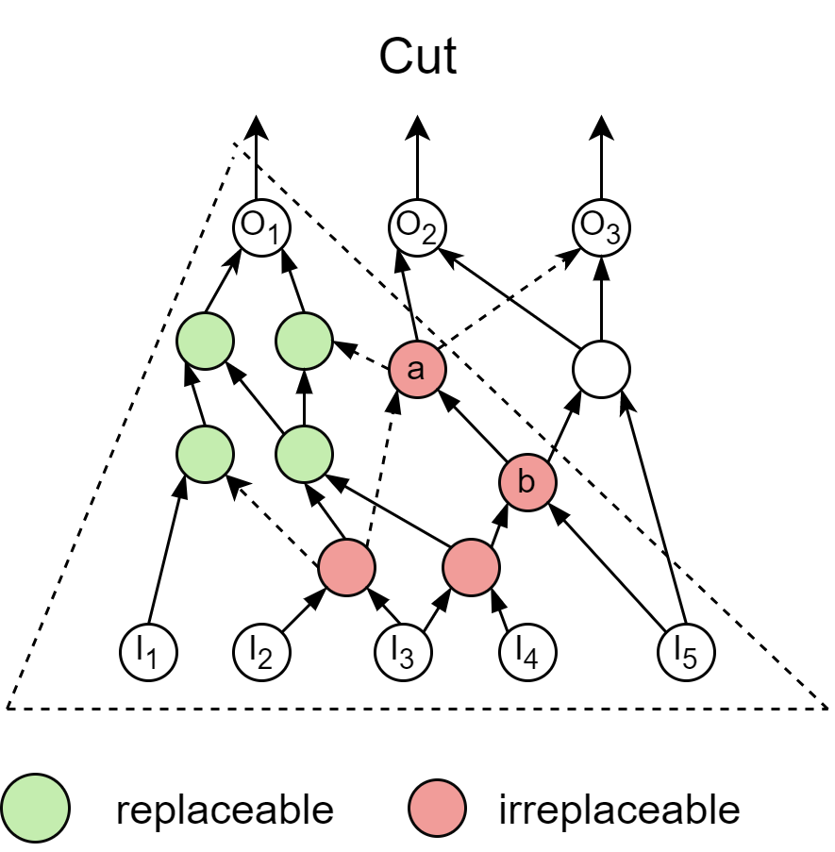
Motivation
Cut-based database dependent rewriting have some limitations:
Cut as the peephole is too small
The selected cuts are often already optimal implementations.
There is only the algorithm for single truth table matching
Freeze many nodes from being replaced in order to guarantee equivalence
Node a and b are not matched by the algorithm

Slide 7
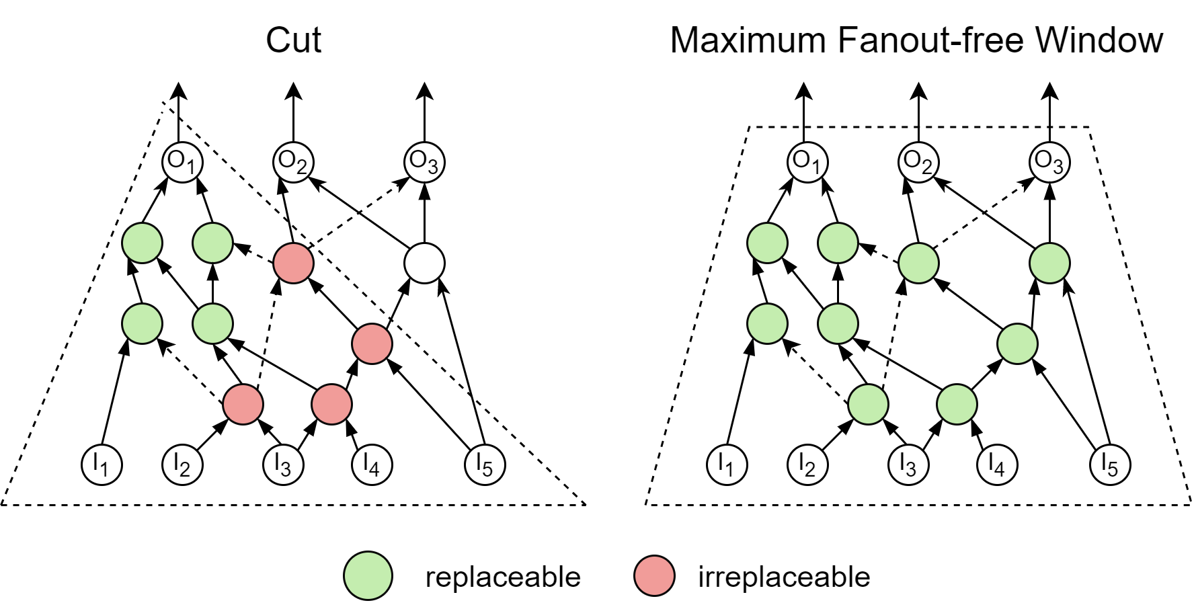
Maximum Fanout-Free Windows (MFFW)
To increase the effectiveness of rewriting, we expand the cuts and extend the matching algorithm to multiple truth tables.
We call the expanded structure Fanout-Free Window (FFW):
All nodes in FFW can be fully expressed in function by inputs
If an FFW cannot be expanded anymore, then it is a Maximum Fanout-Free Window (MFFW).

Slide 8
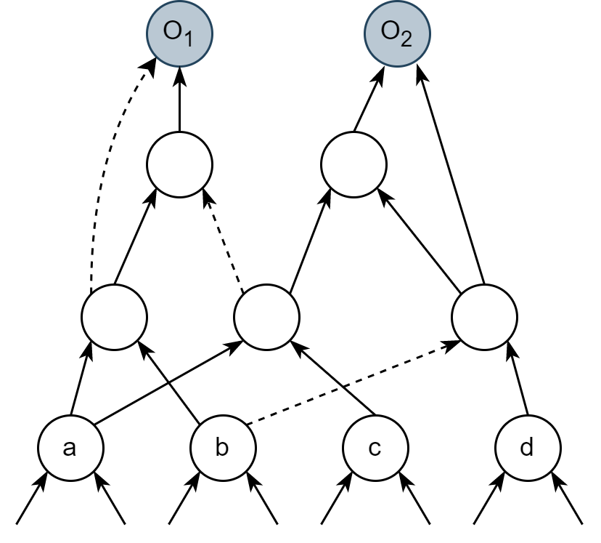
Challenges
Cuts cannot be substituted by MFFWs directly, all the components should be modified to suit the new structure.
Cuts Enumeration → MFFWs Enumeration
Single Output Matching → Multiple Outputs Matching
Cuts Database Construction → MFFWs Database Construction
How to build MFFW?
Efficient Cut Enumeration:
cut(a) = {a}, cut(b) = {b},
cut(c) = {c}, cut(d) = {d}
cut(1) = cut(a)×cut(b)∪{{1}} = {{a, c}, {1}}
cut(2) = cut(b)×cut(d) ∪{{2}} = {{b, d}, {2}}
cut(3) = cut(1)×cut(2)∪{{3}} = ……
cut(O₂) = ……
To get all the cut nodes, just expand towards PI till leave nodes.

Slide 9
Challenges
Cuts cannot be substituted by MFFWs directly, all the components should be modified to suit the new structure.
Cuts Enumeration → MFFWs Enumeration
Single Output Matching → Multiple Outputs Matching
Cuts Database Construction → MFFWs Database Construction
truth tables w.r.t a, b, c, d
?
canonical form of the truth tables
truth table w.r.t a, b, c, d
canonical form of the truth table
match
cut
database

Slide 10
Challenges
Cuts cannot be substituted by MFFWs directly, all the components should be modified to suit the new structure.
Cuts Enumeration → MFFWs Enumeration
Single Output Matching → Multiple Outputs Matching
Cuts Database Construction → MFFWs Database Construction
1 output
$$2^{2^{4}}$$
different structures
2 output
$${(2^{2^{4}})}^{2}$$
different structures
3 output
$${(2^{2^{4}})}^{3}$$
different structures
different structures
Big trouble for construction and maintaining the database.
4 output
$${(2^{2^{4}})}^{4}$$
4 input variable
5 output
$${(2^{2^{4}})}^{5}$$
different structures
……

Slide 11
Framework
MFFWs Enumeration
Multiple Outputs Matching
MFFWs Database Construction
enumerate
MFFW
database
extract
Original MFFW
Calculate canonical forms of outputs’ truth tables
Key
match
AIG
Compare
Found MFFW
reply
Better MFFW
AIG Optimize
Replace
Optimized MFFW
Update

Slide 12
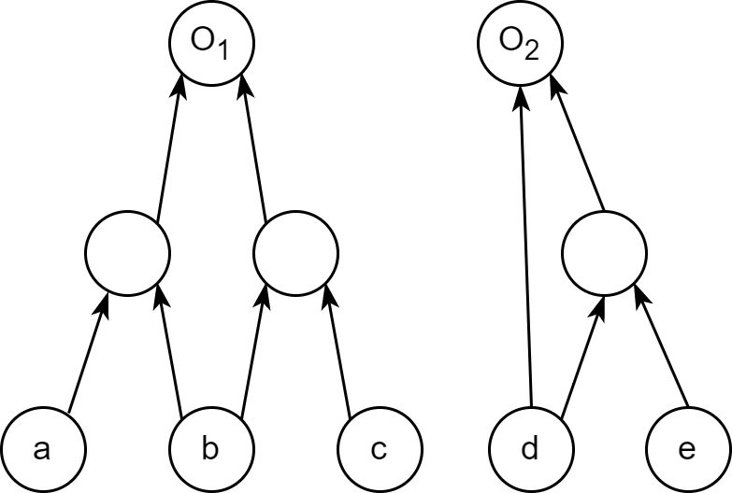
MFFW Enumeration
We build MFFWs based on cuts. A k-input MFFW should be built upon a k-input cut.
This is to reduce the number of MFFWs we need to enumerate.
Later added nodes
which can be expressed by
{a, b, c, d}
The original cut
with leave nodes
{a, b, c, d}
Invalid Case

Slide 13
Multiple outputs matching
Similar to the fast matching algorithm for single output, we generate the semi-canonical form of the truth tables from 3 features:
Number of 1s of each truth table
Determine whether to negate the truth table.
Number of 1s when positive and negative of each input
Determine the order of the input, and determine whether to negate the input.
The numerical value of each truth table
Determine the order of truth tables in the final key.
We conduct experiments on the EPFL benchmark.
The algorithm greatly reduce the size of our database and prompt the effectiveness of rewriting.
MFFW Input # | Original | After Semi-canon | Compression
3 | 397,722 | 817 | 99.79%
4 | 931,072 | 7,948 | 99.15%
5 | 2,286,595 | 43,327 | 98.11%

Slide 14
MFFW Database Construction
There are too many different MFFWs, so pre-computation is impossible.
We construct MFFW database by collecting good implementations from existing circuits.
To improve the quality of the database, we apply AIG optimization algorithms to MFFW in the database.
MFFW
database
select MFFWs
update
cut rewrite
balance
refactor
……

Slide 15
Experimental Results
All the experiments are conducted on the EPFL Combinational Benchmark Suite.
We compare our algorithms with window rewriting and ABC drw. For the sake of fairness, all basic units (window, MFFW, cuts) are 4-input.
Benchmark |  | State-of-the-art Methods |  |  |  |  |  | Our Method
 |  | Drw Rewriting |  |  | Window Rewriting
Name | Size | Time | Size | Improv. | Time | Size | Improv. | Time | Size | Improv.
Adder | 1,020 | 0.01 | 1,020 | 0.00% | 0.00 | 892 | 12.55% | 0.03 | 892 | 12.55%
Barrel shifter | 3,336 | 0.02 | 3,141 | 5.85% | 0.01 | 3,141 | 5.85% | 0.07 | 3,141 | 5.85%
Divisor | 57,247 | 0.69 | 41,197 | 28.04% | 0.01 | 41,267 | 27.91% | 1.15 | 40,432 | 29.37%
Hypotenuse | 214,335 | 2.29 | 213,149 | 0.55% | 0.61 | 210,402 | 1.83% | 4.13 | 206,794 | 3.52%
Log2 | 32,060 | 0.33 | 29,761 | 7.17% | 0.12 | 30,294 | 5.51% | 0.78 | 29,494 | 8.00%
Max | 2,865 | 0.02 | 2,862 | 0.10% | 0.00 | 2,862 | 0.10% | 0.06 | 2,862 | 0.10%
Multiplier | 27,062 | 0.25 | 24,764 | 8.49% | 0.09 | 25,706 | 5.01% | 0.06 | 24,279 | 10.28%
Sine | 5,416 | 0.06 | 5,191 | 4.15% | 0.02 | 5,158 | 4.76% | 0.15 | 5,092 | 5.98%
Square-root | 24,618 | 0.79 | 18,481 | 24.93% | 0.10 | 18,719 | 23.96% | 0.51 | 18,369 | 25.38%
Square | 18,484 | 0.16 | 17,758 | 3.93% | 0.06 | 17,502 | 5.31% | 0.38 | 17,081 | 7.59%
Arbiter | 11,839 | 0.09 | 11,839 | 0.00% | 0.01 | 11,839 | 0.00% | 0.21 | 11,839 | 0.00%
Cavlc | 693 | 0.00 | 684 | 1.30% | 0.00 | 693 | 0.00% | 0.04 | 672 | 3.03%
Ctrl | 174 | 0.00 | 122 | 29.89% | 0.00 | 116 | 33.33% | 0.03 | 97 | 44.25%
Dec | 304 | 0.00 | 304 | 0.00% | 0.00 | 304 | 0.00% | 0.03 | 304 | 0.00%
I2c | 1,342 | 0.01 | 1,280 | 4.62% | 0.00 | 1,340 | 0.15% | 0.04 | 1,280 | 4.62%
Int2float | 260 | 0.00 | 222 | 14.62% | 0.00 | 258 | 0.77% | 0.03 | 217 | 16.54%
Mem_ctrl | 46,836 | 0.34 | 46,291 | 1.16% | 0.10 | 46,617 | 0.47% | 0.58 | 46,137 | 1.49%
Priority | 978 | 0.01 | 852 | 12.88% | 0.00 | 788 | 19.43% | 0.05 | 499 | 48.98%
Router | 257 | 0.00 | 246 | 4.28% | 0.00 | 244 | 5.06% | 0.03 | 244 | 5.06%
Voter | 13,758 | 0.14 | 10,384 | 24.52% | 0.05 | 9,593 | 30.27% | 0.27 | 8,611 | 37.41%
Average |  | 0.26 |  | 8.83% | 0.06 |  | 9.13% | 0.43 |  | 13.50%

Slide 16
Experimental Results
To further explore the effect of database, we conduct experiments under three conditions:
No database, runtime-built database and pre-built database.
It is interesting that AIG optimization can work effectively on MFFW, but without database the runtime is unacceptable.
Benchmark |  | Without DB |  |  | Runtime DB |  |  | Pre-built DB
Name | Size | Time | Size | Improv. | Time | Size | Improv. | Time | Size | Improv.
Adder | 1,020 | 1.03 | 893 | 12.45% | 0.00 | 892 | 12.55% | 0.03 | 892 | 12.55%
Barrel shifter | 3,336 | 6.21 | 3,141 | 5.85% | 0.01 | 3,141 | 5.85% | 0.07 | 3,141 | 5.85%
Divisor | 57,247 | 155.24 | 40,860 | 28.63% | 0.01 | 40,793 | 28.74% | 1.15 | 40,432 | 29.37%
Hypotenuse | 214,335 | 536.77 | 206,846 | 3.49% | 0.61 | 206,801 | 3.52% | 4.13 | 206,794 | 3.52%
Log2 | 32,060 | 86.59 | 29,520 | 7.92% | 0.12 | 29,518 | 7.93% | 0.78 | 29,494 | 8.00%
Max | 2,865 | 5.00 | 2,862 | 0.10% | 0.00 | 2,862 | 0.10% | 0.06 | 2,862 | 0.10%
Multiplier | 27,062 | 59.86 | 24,325 | 10.11% | 0.09 | 24,323 | 10.12% | 0.06 | 24,279 | 10.28%
Sine | 5,416 | 14.00 | 5,094 | 5.95% | 0.02 | 5,094 | 5.95% | 0.15 | 5,092 | 5.98%
Square-root | 24,618 | 51.63 | 18,369 | 25.38% | 0.10 | 18,369 | 25.38% | 0.51 | 18,369 | 25.38%
Square | 18,484 | 39.59 | 17,802 | 3.69% | 0.06 | 17,801 | 3.70% | 0.38 | 17,081 | 7.59%
Arbiter | 11,839 | 36.53 | 11,839 | 0.00% | 0.01 | 11,839 | 0.00% | 0.21 | 11,839 | 0.00%
Cavlc | 693 | 1.20 | 672 | 3.03% | 0.00 | 672 | 3.03% | 0.04 | 672 | 3.03%
Ctrl | 174 | 0.15 | 97 | 44.25% | 0.00 | 97 | 44.25% | 0.03 | 97 | 44.25%
Dec | 304 | 0.00 | 304 | 0.00% | 0.00 | 304 | 0.00% | 0.03 | 304 | 0.00%
I2c | 1,342 | 1.94 | 1,281 | 4.55% | 0.00 | 1,280 | 4.62% | 0.04 | 1,280 | 4.62%
Int2float | 260 | 0.43 | 217 | 16.54% | 0.00 | 217 | 16.54% | 0.03 | 217 | 16.54%
Mem_ctrl | 46,836 | 76.37 | 46,156 | 1.45% | 0.10 | 46,138 | 1.49% | 0.58 | 46,137 | 1.49%
Priority | 978 | 2.14 | 499 | 48.98% | 0.00 | 499 | 48.98% | 0.05 | 499 | 48.98%
Router | 257 | 0.67 | 244 | 5.06% | 0.00 | 244 | 5.06% | 0.03 | 244 | 5.06%
Voter | 13,758 | 25.25 | 8,749 | 36.41% | 0.05 | 8,611 | 37.41% | 0.27 | 8,611 | 37.41%
Average |  | 55.03 |  | 13.38% | 0.95 |  | 13.45% | 0.43 |  | 13.50%

Slide 17
Conclusions & Future Work
In this work, we propose a novel rewriting framework based on Maximum Fanout-Free Window. Our contribution can be summarized as follows:
Based on cuts, we propose the enumeration method for MFFW.
We propose a fast NPN-equivalence checking algorithm for multiple-output structure.
We propose a practical way to effectively improve the quality of our MFFW database.
The experiments result show the effectiveness and efficiency of our proposed framework.
However, there is still much to do to improve the running speed of our framework.
It is a also a very interesting problem to explore the usage of MFFWs in other synthesis steps.

Slide 18
References
Mishchenko, A., Chatterjee, S., & Brayton, R. (2006, July). DAG-aware AIG rewriting a fresh look at combinational logic synthesis. In Proceedings of the 43rd annual Design Automation Conference (pp. 532-535).
Yang, W., Wang, L., & Mishchenko, A. (2012, November). Lazy man's logic synthesis. In Proceedings of the International Conference on Computer-Aided Design (pp. 597-604).
Riener, H., Lee, S. Y., Mishchenko, A., & De Micheli, G. (2022, January). Boolean rewriting strikes back: Reconvergence-driven windowing meets resynthesis. In 2022 27th Asia and South Pacific Design Automation Conference (ASP-DAC) (pp. 395-402). IEEE.
Huang, Z., Wang, L., Nasikovskiy, Y., & Mishchenko, A. (2013, December). Fast Boolean matching based on NPN classification. In 2013 International Conference on Field-Programmable Technology (FPT) (pp. 310-313). IEEE.
Amarú, L., Gaillardon, P. E., & De Micheli, G. (2015). The EPFL combinational benchmark suite. In Proceedings of the 24th International Workshop on Logic & Synthesis (IWLS) (No. CONF).
Brayton, R., & Mishchenko, A. (2010). ABC: An academic industrial-strength verification tool. In Computer Aided Verification: 22nd International Conference, CAV 2010, Edinburgh, UK, July 15-19, 2010. Proceedings 22 (pp. 24-40). Springer Berlin Heidelberg.

Slide 19
Appendix

Slide 20
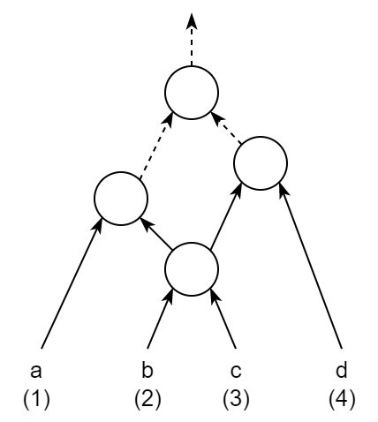
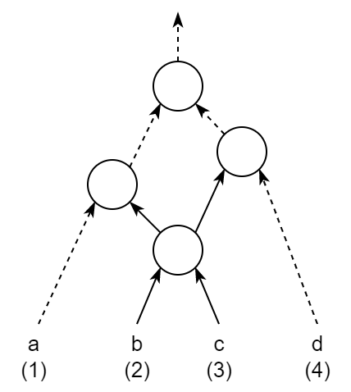
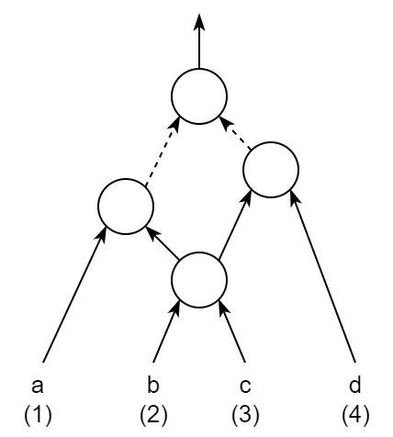
Multiple outputs matching
In past works of rewriting, NPN canonical form is used as the key of the database.
NPN refers to the Negation and Permutation of the input, and the Negation of the output.
original structure
negation of inputs
permutation of inputs
negation of output
Truth Table =
1100 0000 1000 0000
Truth Table =
0100 0000 1100 0000
Truth Table =
1110 0000 0000 0000
Truth Table =
0011 1111 0111 1111
If a truth table A can be transformed into truth table B by NPN operations, then A and B are in the same NPN class,
and we say that A and B are NPN-equivalent.
Notes:
NPN operations change the truth table of the sub-circuit, but do not change the internal structure.

Slide 21
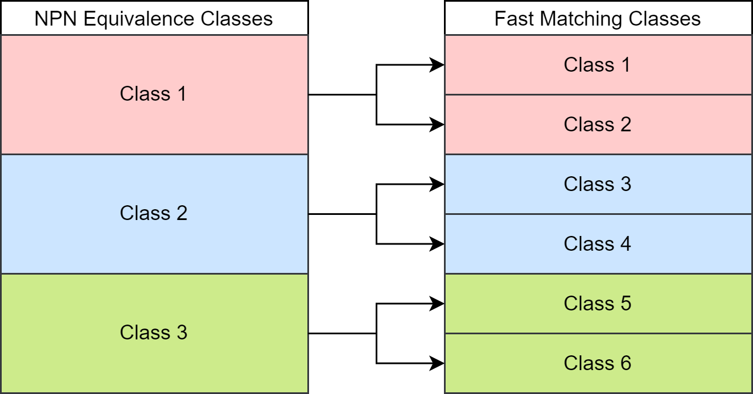
Semi-canonicalization
To confirm if A and B are NPN-equivalent, all possible combinations of NPN operations should to applied to A and check the results. For a truth table with n inputs, there are $2{∙n!∙2}^{n}$ possible combinations of NPN, making it impractical to check NPN-equivalence runtime.
Thus, a fast matching approach of fast NPN-equivalence matching was proposed, in trade of the number of generated classes.
The approach transforms a truth table into a canonical form upon its own data features.
Three factors are considered for generating the semi-canonical form:
Number of 1s in the truth table – Output Negation
Number of 1s when a variable is positive and negative – Inputs Negation
Number of 1s when a variable is positive – Inputs Permutation
However, this approach may lead to more equivalence classes than actual NPN-equivalence classes, so the method is
called semi-canonicalization.

Slide 22
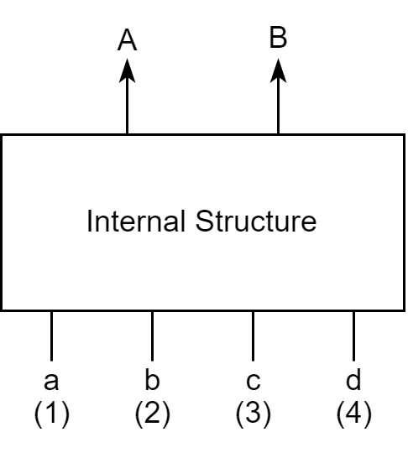
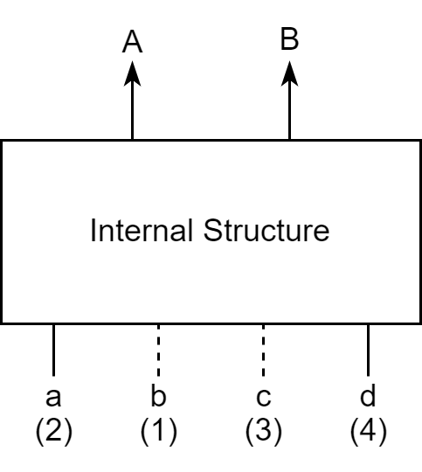
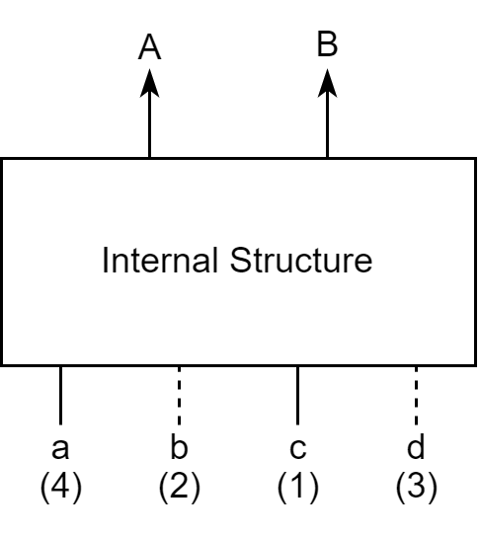
Key Generation
However, we cannot simply apply the semi-canonicalization algorithm to the outputs of MFFWs separately to generate key for searching in the database.
conflict
Original MFFW
Semi-canonicalize on A
Semi-canonicalize on B
As all the outputs share the same set of inputs, they may not be in the canonical form in the same time.
Thus, based on existing work of single truth table semi-canonicalization algorithm, we propose a semi-canonicalization for multiple truth tables.

Slide 23
Multiple outputs matching
The key used in the database for searching MFFWs must guarantee the equivalence of the found MFFW and the original MFFW.
The most intuitive way is to use the truth tables of the original MFFW as the key.
Considering only 3-output 4-input MFFWs, we will have $2^{2^{4}}$ possible different keys for individual output, and ${{(2}^{2^{4}})}^{3}$ = possible different keys for the complete MFFW.
Then considering there will be 1, 2, 3, ······ n – output 4-input MFFWs, the huge number of possible keys making the hit rate almost 0 for the database and make the size of the database super giant.
Thus we explore another way of generating keys to compress the database.

