Slide 1
Maximum Fanout-Free Window Enumeration: Towards the Local Multi-Output Sub-structure Synthesis
Ruofei Tang*, Xuliang Zhu,
Lei Chen, Xing Li, Xin Huang, Mingxuan Yuan, Weihua Sheng and Jianliang Xu
Notes:
Hello I am Ruofei Tang, my presentation topic today is Maximum Fanout-Free Window Enumeration: Toward the Local Multi-Output Substructure Synthesis.

Slide 2
Outline
Preliminaries
Motivation
Maximum Fanout-Free Windows & Enumeration Algorithms
Experimental Results
Application - Rewriting
Notes:
In this work, we propose a novel substructure that is better for multiple functions synthesis in AIG than cuts. I will start with preliminaries related to AIG, then I will introduce the Motivation for this work. Next, I will introduce the concept of Maximum Fanout-Free Window and its enumeration algorithms. Finally, I will show the test on the efficiency of our proposed algorithms and corresponding application.

Slide 3
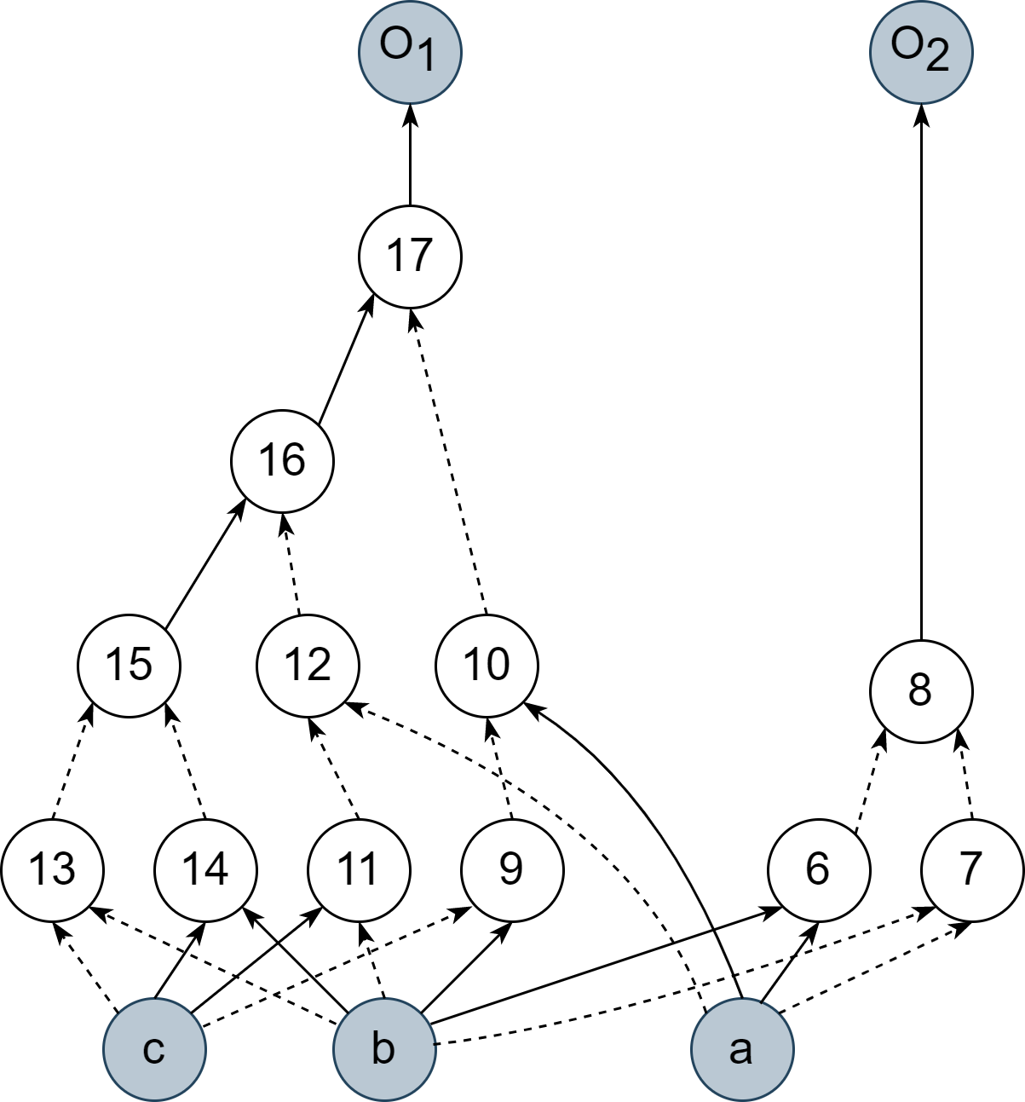
And-Inverter Graph (AIG)
A classical and scalable representation of combinational circuits
Primary Output
Solid Line for Direct Pass of Signal
Logic AND Gate
Dashed Line for Negation of Signal
Primary Input
Notes:
And-Invertor Graph, is one of the most common combinational circuits representation in logic synthesis. A node in the AIG represents a logic AND gate, it has two fanin nodes and one or more fanout nodes. NOT gates are on the directed edges, solid line for direct pass of signal and dashed line for negation of the signal. There are two kinds of terminal nodes, primary inputs and primary outputs. Primary inputs have no fanin while primary outputs have no fanout.

Slide 4
Cuts
A cone-shaped area in AIG
The same in graph algorithms
Root
Notes:
Cuts is a cone-shaped sub-structure of AIG. The concept of cuts comes from graph algorithms. The cone-shaped area is extended from a root node. Let's take the cut rooted at node 17 as an example.

Slide 5
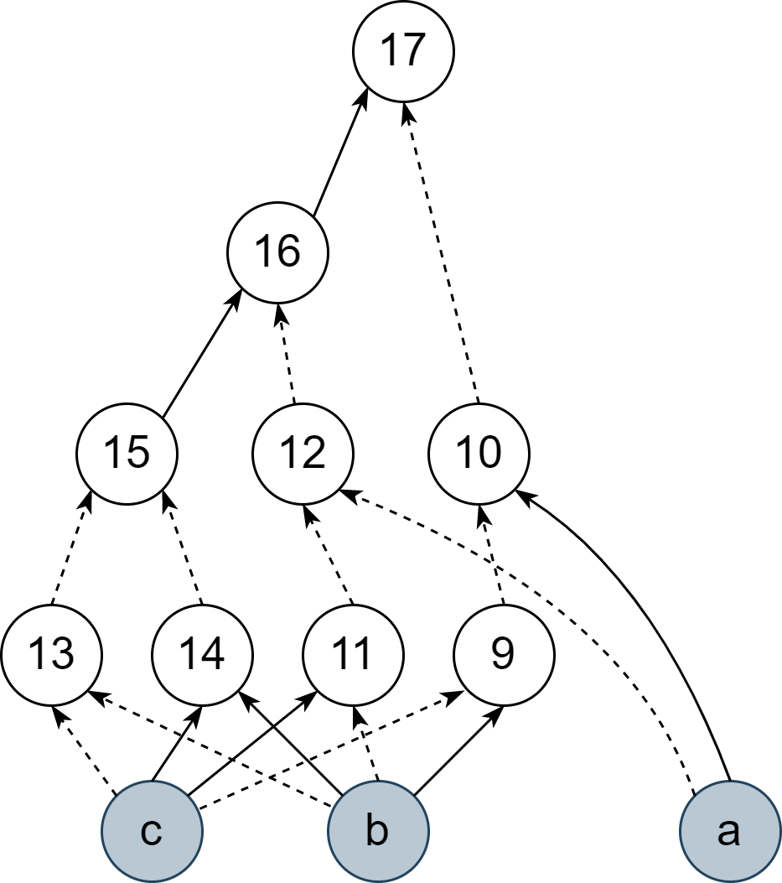
Cuts
A cone-shaped area in AIG
Denoted as (r, L) = (17, {10, 12, 15})
(r, L) is called k-feasible if |L|≤ k
Root
Leaf-nodes
(input nodes)
Notes:
First, we extract all the predecessors of the root node and form a subgraph. Then we divide the subgraph into two by cutting the edges. The nodes on the other side of the cut line are called leaf-nodes of the cut, we also call them input nodes of the cut. The cut can be denoted as a tuple of root node and leaf-nodes set, and a cut is called k-feasible of the cardinality of leaf-nodes set is less than k

Slide 6
Applications of Cuts
Cuts are proposed for LUT-mapping.
Widely used for efficient enumeration methods
I₄
I₃
I₁
I₂
I₃
I₃
I₁
I₂
I₁
I₂
I₃
I₄
I₅
I₆
I₁
I₂
I₁
I₂
I₃
I₄
LUT Mapping
Rewriting
Balancing
Notes:
Cuts were first proposed for LUT Mapping, for cuts were in the , which was exactly the shape of LUT. Several enumeration methods for cuts were proposed for further improvement in efficiency of the mapping framework. These methods made cuts popular in other peephole synthesis algorithms such as rewriting and balancing and so on.

Slide 7
Motivation
Cuts only supports a single-output substructure
Scale of cuts is small
→ Hard to apply multiple output synthesis algorithms on cuts.
Notes:
However, if we want to expand synthesis algorithms to a multiple-output scale we will meet problems using cuts. Cuts support only a single-output sub-structure and the scale of cuts is obviously too small. These make it hard to apply multiple output synthesis algorithms to cuts . Thus, we propose a novel sub-structure for multi-output synthesis algorithms.

Slide 8
Maximum Fanout-Free Window (MFFW)
Expand upon cuts and enable multiple outputs
An MFFW contains all nodes that can be expressed by input nodes
9
10
9
10
8
8
7
5
6
7
5
6
I₁
I₂
I₃
I₄
I₁
I₂
I₃
I₄
Notes:
Maximum Fanout-Free Window, abbreviated as MFFW. MFFW is expanded upon cuts and enable multiple output nodes. The figure on the left is a cut that enables multiple output, we call such structure fanout free window. We want to expand it without introducing more input nodes since the scale of problem, like truthtables, grow exponentially with the increase of input nodes. If we expand a fanout free window till no more nodes can be added without introducing more input nodes, then it is maximum. We can say that a MFFW contains all nodes that can be expressed by input nodes.

Slide 9
MFFW Enumeration
MFFW need efficient enumeration methods for synthesis
Propose two enumeration methods: Dynamic and Static
Cut Enumeration
Synthesis Algorithm
AIG
MFFW Enumeration
Notes:
In the framework of peephole optimization synthesis, we usually extract cuts by enumeration algorithms and do synthesis on the cut. For MFFW based enumeration algorithms, it would be the same. So the efficiency of MFFW enumeration is very important. We propose two ways of enumeration, that is Dynamic and Static.

Slide 10
Dynamic Enumeration
Step 1: Select a set of leaf-nodes as inputs of MFFW
9
10
8
7
5
6
I₁
I₂
I₃
I₄
Notes:
I will first introduce the process of dynamic enumeration. The step one is to select a set of k-input cut leaf-nodes, we will generate MFFW upon them.

Slide 11
Dynamic Enumeration
Step 2. Initialize set S = {}, queue Q = leaf-nodes
9
10
Q = { I₁, I₂, I₃, I₄ }
Nodes to process
8
S = {}
Processed Nodes
7
5
6
I₁
I₂
I₃
I₄
Notes:
We will initialize a set S for processed nodes as empty, and a queue Q for nodes to process with the leaf-nodes.

Slide 12
Dynamic Enumeration
Step 3. Process until Q = {}, S contains all nodes of MFFW in the end
Q = { I₁, I₂, I₃, I₄ }
9
10
8
fanout(I₁)= {5, 7}
7
5
6
Another fanin in S?
If Y: Push node to Q
Move I₁ to S
I₁
I₂
I₃
I₄
S = {I₁}
Notes:
We will continue processing the nodes in Q until Q is empty. In the process, we pop the first node in Q and put it into set S and enumerate all the fanouts of the node. We will check whether another fanin of the fanout belong to the set S. If so, push the fanout into Q.

Slide 13
Dynamic Enumeration
Step 3. Process until Q = {}, S contains all nodes of MFFW in the end
Q = {I₂, I₃, I₄, 5}
9
10
8
fanout(I₂)= {5}
7
5
6
Another fanin in S?
If Y: Push node to Q
Move I₂ to S
I₁
I₂
I₃
I₄
S = {I₁, I₂}
Notes:
In the second round, we check the fanout of node I2, and find that another fanin I1 already in the set S, so we push node 5 to Q.

Slide 14
Dynamic Enumeration
Step 3. Process until Q = {}, S contains all nodes of MFFW in the end
Q = {I₃, I₄, 5, 7}
9
10
8
fanout(I₃)= {6, 7}
7
5
6
Another fanin in S?
If Y: Push node to Q
Move I₃ to S
I₁
I₂
I₃
I₄
S = {I₁, I₂, I₃}
Notes:
In this way, we will check the node in Q one by one and finally build up the complete MFFW.

Slide 15
Dynamic Enumeration
Step 3. Process until Q = {}, S contains all nodes of MFFW in the end
9
10
8
Q = {I₄, 5, 7, 6}
S = {I₁, I₂, I₃, I₄}
7
5
6
I₁
I₂
I₃
I₄

Slide 16
Dynamic Enumeration
Step 3. Process until Q = {}, S contains all nodes of MFFW in the end
9
10
8
Q = {5, 7, 6, 8}
S = {I₁, I₂, I₃, I₄, 5}
7
5
6
I₁
I₂
I₃
I₄

Slide 17
Dynamic Enumeration
Step 3. Process until Q = {}, S contains all nodes of MFFW in the end
9
10
8
Q = {7, 6, 8}
S = {I₁, I₂, I₃, I₄, 5, 7}
7
5
6
I₁
I₂
I₃
I₄

Slide 18
Dynamic Enumeration
Step 3. Process until Q = {}, S contains all nodes of MFFW in the end
9
10
8
Q = {6, 8, 10}
S = {I₁, I₂, I₃, I₄, 5, 7, 6}
7
5
6
I₁
I₂
I₃
I₄

Slide 19
Dynamic Enumeration
Step 3. Process until Q = {}, S contains all nodes of MFFW in the end
9
10
8
Q = {8, 10, 9}
S = {I₁, I₂, I₃, I₄, 5, 7, 6, 8}
7
5
6
I₁
I₂
I₃
I₄

Slide 20
Dynamic Enumeration
Step 3. Process until Q = {}, S contains all nodes of MFFW in the end
9
10
8
Q = {10, 9}
S = {I₁, I₂, I₃, I₄, 5, 7, 6, 8}
7
5
6
I₁
I₂
I₃
I₄

Slide 21
Dynamic Enumeration
Step 3. Process until Q = {}, S contains all nodes of MFFW in the end
9
10
8
Q = {}
S = {I₁, I₂, I₃, I₄, 5, 7, 6, 8, 9, 10}
7
5
6
I₁
I₂
I₃
I₄

Slide 22
Problem
Consider a node with super large fanout……
Have to enumerate all fanout
Tend to appear in many MFFWs, have to enumerate it many times
······
······
Notes:
However, in this way we will meet a problem. There are some nodes with large fanout number, and we have to enumerate their fanouts. These kind of nodes tend to appear many times in different MFFWs, making things even worse.

Slide 23
Solution: Structural Hashing
Each node is assigned an unique number
Each node will be recorded to a hash table depending on 4 elements
n
3
4
a
b
1
2
strash( number(a) ,number(b) , is_compl(a) , is_compl(b) )
Notes:
We use structural hashing to tackle this problem. In strashing, each node will be assigned an unique number, and each node will be recorded to a hash table upon 4 elements. That is the number of two fanins and the polarities of fanins.

Slide 24
Dynamic Enumeration
Step 3. Process until Q = {}, S contains all nodes of MFFW in the end
Two choices:
Enumerate fanout
Query structural hashing table
9
10
Q = {5, 6}
S = { I₁, I₂, I₃, I₄, 7}
8
fanout(5) = {8, 10}
Check another fanin of {8, 10}
For each $n∈S$, check
strash($n,5$),
strash($¬n,5$),
strash($n,¬5$),
strash($¬n,¬5$)
existence in AIG
7
5
6
depend on the cost
I₁
I₂
I₃
I₄
Notes:
Back to step three of dynamic enumeration, we now have two different ways to deal with large fanout nodes and select the better one depending on the cost. We can either enumerate the fanout, or query the structural hashing table. In this example, we can check the fanins of node 5’s fanouts, that is node number 8 and number 10. Or we can check the node in S and query the hash table. The choice depends on the cost.

Slide 25
Static Enumeration
Lemma: Given a set of MFFW input nodes S, for any cut c=(r, L) where $L⊆S,$ r belongs to the MFFW
10
e.g.
9
8
7
5
6
I₁
I₂
I₃
I₄
Notes:
Another way of enumeration, we call it static enumeration, is built upon a lemma. So given as set of MFFW input S, for any cut c where leaf-nodes set is a subset of S, the root node must belong to the MFFW. This may be a little hard to understand, I will show you the example.

Slide 26
Static Enumeration
Lemma: Given a set of MFFW input nodes S, for any cut c=(r, L) where $L⊆S,$ r belongs to the MFFW
10
e.g.
9
Cut: (5, {I₁, I₂})
8
7
5
6
I₁
I₂
I₃
I₄
Notes:
So we have the cut rooted at node 5, and has fanins I1 and I2. I1 and I2 is the subset of the input nodes, so node 5 must belong to the MFFW.

Slide 27
Static Enumeration
Lemma: Given a set of MFFW input nodes S, for any cut c=(r, L) where $L⊆S,$ r belongs to the MFFW
10
e.g.
9
Cut: (5, {I₁, I₂})
8
Cut: (6, {I₃, I₄})
7
5
6
I₁
I₂
I₃
I₄
Notes:
For node number 6, this is the same because the leaf-nodes I3 and I4 is as subset of input nodes.

Slide 28
Static Enumeration
Lemma: Given a set of MFFW input nodes S, for any cut c=(r, L) where $L⊆S,$ r belongs to the MFFW
10
e.g.
9
Cut: (5, {I₁, I₂})
8
Cut: (6, {I₃, I₄})
7
5
6
Cut: (8, {I₁, I₂, I₄})
I₁
I₂
I₃
I₄
Notes:
And we can check node 8, still the same for we find the cut.

Slide 29
Static Enumeration
Step 1: Compute all k-feasible cuts for each node
Cache them in a hash table, indexed by leaf-nodes
Compute All 4-feasible cut of node 9:
3-input: (10, {5, 7, I₄})
hash: {5, 7, I₄} → {9}
4-input: (9, {I₁, I₂, I₃, I₄})
hash: {I₁, I₂, I₃, I₄} → {9}
9
10
8
7
5
6
I₁
I₂
I₃
I₄
Notes:
So for static enumeration, how we build MFFW is very obvious. First we will compute all k-feasible cuts for each node. We will cache them in a hash table, indexed by leaf-nodes. Here we do this to node 9.

Slide 30
Static Enumeration
Step 1: Compute all k-feasible cuts for each node
Cache them in a hash table, indexed by leave-nodes
Compute All 4-feasible cut of node 9:
3-input: (10, {5, 7, I₄})
hash: {5, 7, I₄} → {9}
4-input: (9, {I₁, I₂, I₃, I₄})
hash: {I₁, I₂, I₃, I₄} → {9}
9
10
8
7
5
6
Compute All 4-feasible cut of node 10:
4-input: (10, {I1, I2, I3, I4})
hash: {I1, I2, I3, I4} → {9, 10}
I₁
I₂
I₃
I₄
Notes:
But it comes to node 10, we find that the set I1, I2, I3 and I4 points to both 9 and 10, so we put them in a set and cache.

Slide 31
Static Enumeration
Step 2: Select a set of cut leaf-nodes with K elements
9
10
8
7
5
6
I₁
I₂
I₃
I₄
Notes:
The step 2 is the same as in Dynamic Enumeration, that we select the input nodes.

Slide 32
Static Enumeration
Step 3: Enumerate subsets of selected leaf-nodes
Add nodes by hash table
9
10
Query {I₁, I₂} → {5}
Query {I₁, I₃} → {7}
8
Query {I₃, I₄} → {6}
7
5
6
Query {I₁, I₂, I₄} → {8}
Query {I₁, I₂, I₃, I₄} → {9, 10}
I₁
I₂
I₃
I₄
Notes:
In the final step, we will enumerate all the subsets of the input nodes, and we will add nodes by hash table, as is shown in the right. And of course we will skip the empty set.

Slide 33
Differences: Static & Dynamic Enumeration
Static Enumeration:
All cuts are pre-computed and cached
Limited modification on structure of AIG during enumeration
Works significantly faster on some circuits
Dynamic Enumeration:
All cuts are computed during enumeration
Arbitrary modification on structure of AIG during enumeration
Notes:
We have introduced the two enumeration methods so far, and they are different in features. In static enumeration, all cuts are pre-computed and cached, while in Dynamic Enumeration, cuts can be computed during enumeration. Static Enumeration allows only limited modification on structure of AIG during enumeration, while Dynamic Enumeration is more flexible, allows arbitrary modification on the AIG structure. However, Static Enumeration works obviously faster on some circuits, as we will see late in the experiments part.

Slide 34
Experiments Setup
Relative large circuits form EPFL Combinational Suite and IWLS 2005
All the circuits have more than 10,000 nodes
Three enumeration algorithms:
Basic: Dynamic Enumeration without structural hash
Dynamic
Static
Notes:
We conducted our

Slide 35
Experimental Results
Benchmarks |  | K=4 |  |  | K=5 |  |  | K=6
 |  | Basic | Dynamic | Static | Basic | Dynamic | Static | Basic | Dynamic | Static
name | size | time(s) | time(s) | time(s) | time(s) | time(s) | time(s) | time(s) | time(s) | time(s)
div | 57,247 | 0.69 | 0.55 | 0.96 | 3.32 | 3.04 | 4.96 | 17.31 | 15.91 | 32.58
hyp | 214,335 | 4.47 | 3.49 | 4.77 | 32.58 | 29.15 | 35.38 | 465.19 | 442.62 | 496.99
log2 | 32,060 | 1.10 | 0.92 | 0.94 | 17.83 | 15.59 | 12.90 | 83.94 | 79.28 | 82.82
multiplier | 27,062 | 0.78 | 0.72 | 0.67 | 14.58 | 13.10 | 10.50 | 75.39 | 72.42 | 74.38
square | 18,484 | 0.34 | 0.37 | 0.40 | 6.33 | 6.81 | 6.01 | 46.40 | 47.95 | 49.29
b17 | 52,323 | 1.60 | 1.40 | 0.90 | 14.05 | 14.06 | 4.73 | 43.50 | 45.70 | 27.72
b17_1 | 52,166 | 1.61 | 1.40 | 0.89 | 13.81 | 13.83 | 4.78 | 43.04 | 46.72 | 27.90
b18 | 133,081 | 4.13 | 3.56 | 2.51 | 37.57 | 37.16 | 14.86 | 136.75 | 147.81 | 96.68
b18_1 | 133,391 | 4.08 | 3.54 | 2.50 | 35.19 | 35.84 | 14.63 | 133.71 | 140.97 | 98.18
b19 | 261,297 | 8.52 | 7.01 | 5.08 | 75.72 | 72.70 | 27.77 | 262.13 | 261.49 | 178.40
b19_1 | 261,371 | 8.56 | 7.05 | 5.09 | 75.26 | 74.31 | 28.85 | 260.94 | 250.06 | 177.21
des_perf | 83,792 | 3.16 | 1.84 | 1.60 | 20.43 | 11.34 | 9.31 | 144.69 | 73.82 | 60.31
leon2 | 792,039 | 46.51 | 9.83 | 13.88 | 156.68 | 56.98 | 63.29 | 559.53 | 271.80 | 304.31
netcard | 864,603 | 524.92 | 9.17 | 14.20 | 1,366.95 | 46.19 | 57.88 | INF | 208.94 | 281.80
vga_lcd | 134,866 | 33.36 | 1.39 | 2.06 | 89.61 | 6.10 | 7.78 | 251.44 | 23.10 | 31.23
sixteen | 16,216,836 | INF | 2,691.97 | 583.40 | INF | 16,469.18 | 2,147.21 | INF | INF | 6,959.78
twenty | 20,732,893 | INF | 3,932.82 | 786.37 | INF | 19,814.40 | 2,571.32 | INF | INF | 8,680.80
twentythree | 23,339,737 | INF | 4,471.13 | 1,056.62 | INF | 22,514.85 | 2,867.43 | INF | INF | 9,911.83
INF means over 10 hours
Notes:
We conducted the experiments with 4, 5, 6 inputs MFFWs respectively. On some of the circuits, like those from EPFL benchmarks, the three methods perform the same. We did some analysis on the feature of circuits, we think it has something to do with the number of large fanout nodes. But on larger circuits from IWLS2005, Static Enumeration shows impressive efficiency and Dynamic Enumeration’s efficiency can be very high when there are many large fanout nodes.

Slide 36
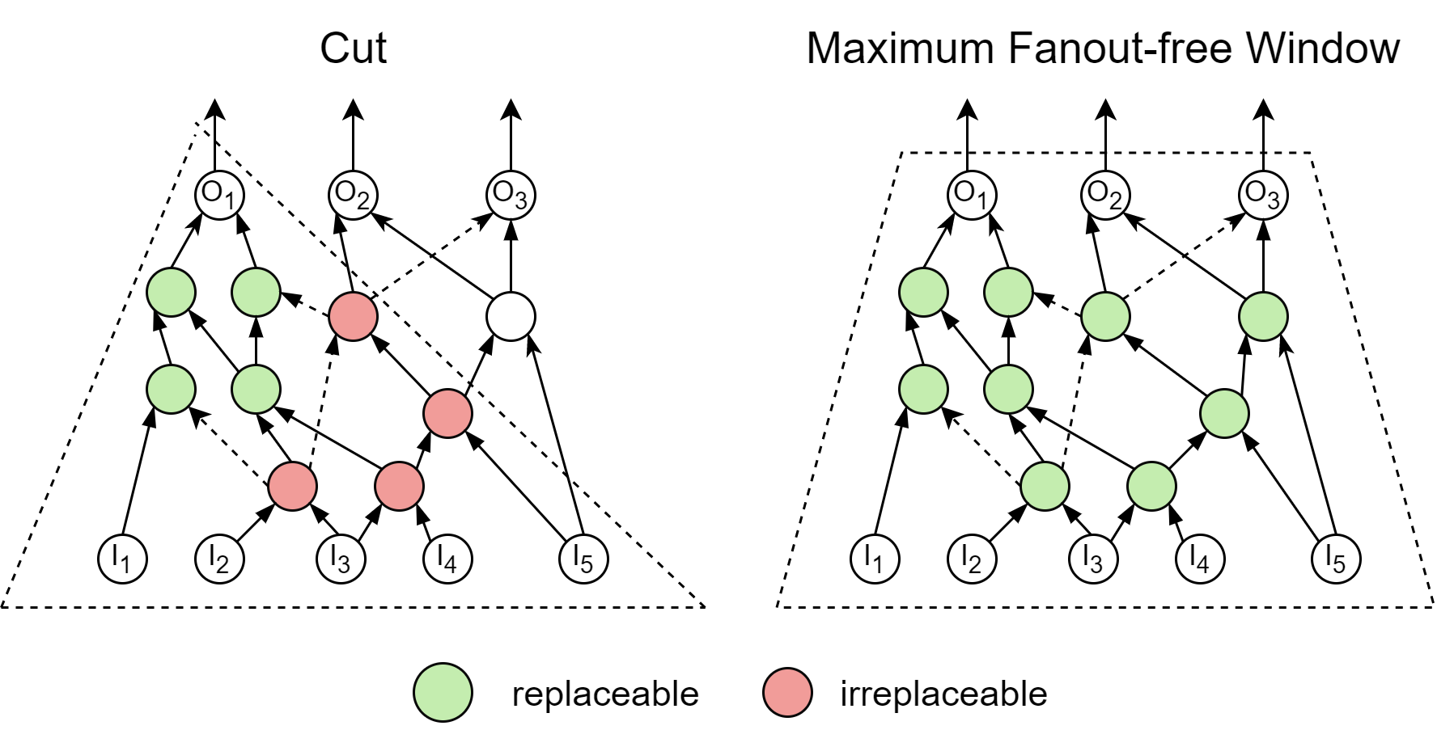
Application: Rewriting
MFFW allows more nodes to be replaced in one replacement than cuts
Notes:
To prove the potential of MFFW, we propose a database dependent MFFW rewriting framework. As you can see in this example, MFFW allows much more nodes to be replaced in one replacement than cuts.

Slide 37
Rewriting Framework
MFFW
database
Original MFFW
Calculate canonical forms of outputs’ truth tables
Key
match
enumerate
extract
Compare
Found MFFW
reply
AIG
Better MFFW
AIG Optimize
Replace
Optimized MFFW
Update
Notes:
In our framework, we will first calculate the key for fetching good implementaions in the database. Of couse we can use truthtables directly, but that will cause the size of the database to explode. Instead, based on the fast matching algorithms for single truthtable, we propose a way to calculate the semi-canonical form of multiple truth tables in polynomial time. After…., we will compare the MFFWs and choose the better one. The better one will be optimized using AIG optimization algorithms and we will use it to update the database and replace the original MFFW in the AIG.

Slide 38
Experimental Results for Rewriting
Benchmark |  | State-of-the-art Methods |  |  |  |  |  | Our Method
 |  | Drw Rewriting |  |  | Window Rewriting
Name | Size | Time | Size | Improv. | Time | Size | Improv. | Time | Size | Improv.
Adder | 1,020 | 0.01 | 1,020 | 0.00% | 0.00 | 892 | 12.55% | 0.03 | 892 | 12.55%
Barrel shifter | 3,336 | 0.02 | 3,141 | 5.85% | 0.01 | 3,141 | 5.85% | 0.07 | 3,141 | 5.85%
Divisor | 57,247 | 0.69 | 41,197 | 28.04% | 0.01 | 41,267 | 27.91% | 1.15 | 40,432 | 29.37%
Hypotenuse | 214,335 | 2.29 | 213,149 | 0.55% | 0.61 | 210,402 | 1.83% | 4.13 | 206,794 | 3.52%
Log2 | 32,060 | 0.33 | 29,761 | 7.17% | 0.12 | 30,294 | 5.51% | 0.78 | 29,494 | 8.00%
Max | 2,865 | 0.02 | 2,862 | 0.10% | 0.00 | 2,862 | 0.10% | 0.06 | 2,862 | 0.10%
Multiplier | 27,062 | 0.25 | 24,764 | 8.49% | 0.09 | 25,706 | 5.01% | 0.06 | 24,279 | 10.28%
Sine | 5,416 | 0.06 | 5,191 | 4.15% | 0.02 | 5,158 | 4.76% | 0.15 | 5,092 | 5.98%
Square-root | 24,618 | 0.79 | 18,481 | 24.93% | 0.10 | 18,719 | 23.96% | 0.51 | 18,369 | 25.38%
Square | 18,484 | 0.16 | 17,758 | 3.93% | 0.06 | 17,502 | 5.31% | 0.38 | 17,081 | 7.59%
Arbiter | 11,839 | 0.09 | 11,839 | 0.00% | 0.01 | 11,839 | 0.00% | 0.21 | 11,839 | 0.00%
Cavlc | 693 | 0.00 | 684 | 1.30% | 0.00 | 693 | 0.00% | 0.04 | 672 | 3.03%
Ctrl | 174 | 0.00 | 122 | 29.89% | 0.00 | 116 | 33.33% | 0.03 | 97 | 44.25%
Dec | 304 | 0.00 | 304 | 0.00% | 0.00 | 304 | 0.00% | 0.03 | 304 | 0.00%
I2c | 1,342 | 0.01 | 1,280 | 4.62% | 0.00 | 1,340 | 0.15% | 0.04 | 1,280 | 4.62%
Int2float | 260 | 0.00 | 222 | 14.62% | 0.00 | 258 | 0.77% | 0.03 | 217 | 16.54%
Mem_ctrl | 46,836 | 0.34 | 46,291 | 1.16% | 0.10 | 46,617 | 0.47% | 0.58 | 46,137 | 1.49%
Priority | 978 | 0.01 | 852 | 12.88% | 0.00 | 788 | 19.43% | 0.05 | 499 | 48.98%
Router | 257 | 0.00 | 246 | 4.28% | 0.00 | 244 | 5.06% | 0.03 | 244 | 5.06%
Voter | 13,758 | 0.14 | 10,384 | 24.52% | 0.05 | 9,593 | 30.27% | 0.27 | 8,611 | 37.41%
Average |  | 0.26 |  | 8.83% | 0.06 |  | 9.13% | 0.43 |  | 13.50%
Notes:
We conducted the experiments on the EPFL benchmarks. We compare our methods with state-of-the-art algorihms, that is Drw rewriting and window rewriting. For the sake of fairness, we limited the size of input for each basic unit to 4 nodes. On almost all benchmarks our methods perform better, and the Average improment reaches 13.5 %. However, our method suffers from the efficiency problem, and we are trying to optimize the running time.

Slide 39
Summary
Maximum Fanout Free Window:
A novel structure for local multi-output synthesis algorithms
Two enumeration methods, Static and Dynamic
Experimental results show the efficiency of the algorithms
MFFW-based Rewriting:
Experimental results show the effectiveness of our proposed rewriting framework

Slide 40
References
Martinello O, Marques F S, Ribas R P, et al. KL-cuts: a new approach for logic synthesis targeting multiple output blocks[C]//2010 Design, Automation & Test in Europe Conference & Exhibition (DATE 2010). IEEE, 2010: 777-782.
Chatterjee, S., Mishchenko, A., & Brayton, R. (2006, November). Factor cuts. In Proceedings of the 2006 IEEE/ACM international conference on Computer-aided design (pp. 143-150).
Mishchenko, A., Chatterjee, S., & Brayton, R. (2006, July). DAG-aware AIG rewriting a fresh look at combinational logic synthesis. In Proceedings of the 43rd annual Design Automation Conference (pp. 532-535).
Yang, W., Wang, L., & Mishchenko, A. (2012, November). Lazy man's logic synthesis. In Proceedings of the International Conference on Computer-Aided Design (pp. 597-604).
Riener, H., Lee, S. Y., Mishchenko, A., & De Micheli, G. (2022, January). Boolean rewriting strikes back: Reconvergence-driven windowing meets resynthesis. In 2022 27th Asia and South Pacific Design Automation Conference (ASP-DAC) (pp. 395-402). IEEE.
Huang, Z., Wang, L., Nasikovskiy, Y., & Mishchenko, A. (2013, December). Fast Boolean matching based on NPN classification. In 2013 International Conference on Field-Programmable Technology (FPT) (pp. 310-313). IEEE.
Amarú, L., Gaillardon, P. E., & De Micheli, G. (2015). The EPFL combinational benchmark suite. In Proceedings of the 24th International Workshop on Logic & Synthesis (IWLS) (No. CONF).
Brayton, R., & Mishchenko, A. (2010). ABC: An academic industrial-strength verification tool. In Computer Aided Verification: 22nd International Conference, CAV 2010, Edinburgh, UK, July 15-19, 2010. Proceedings 22 (pp. 24-40). Springer Berlin Heidelberg.

Slide 41
Thank you!

Slide 42
Appendix 1
Benchmark | Size | Cut node # | MFFW node # | MFFW output #
Adder | 1,020 | 3.93 | 10.47 | 2.73
Barrel shifter | 3,336 | 3.24 | 9.23 | 4.49
Divisor | 29,040 | 3.57 | 8.47 | 5.13
Hypotenuse | 214,306 | 4.35 | 9.34 | 3.81
Log2 | 31,707 | 5.03 | 9.10 | 4.30
Max | 2,865 | 3.23 | 8.14 | 4.28
Multiplier | 27,060 | 5.10 | 9.60 | 3.81
Sine | 5,372 | 4.66 | 9.04 | 4.61
Square-root | 24,506 | 3.35 | 8.00 | 4.87
Square | 18,483 | 4.79 | 9.44 | 3.87
Arbiter | 11,839 | 3.00 | 7.13 | 5.02
Cavlc | 690 | 3.23 | 11.29 | 8.42
Ctrl | 169 | 4.23 | 14.73 | 9.95
Dec | 304 | 3.00 | 11.56 | 10.02
I2c | 1,321 | 3.11 | 10.01 | 6.33
Int2float | 258 | 3.15 | 10.01 | 6.33
Mem_ctrl | 46,719 | 3.24 | 8.16 | 5.49
Priority | 978 | 3.59 | 7.78 | 4.36
Router | 257 | 3.99 | 8.86 | 4.08
Voter | 11,952 | 4.52 | 10.10 | 4.08

Slide 43
Appendix 2
dot-product vs. set insert
{3, 4}
n
a
b
{1, 3, 4}
{2, 3, 4}

Slide 44
Appendix 3
LUT-Mapping
MFFW 1
FFW 1
MFFW 2
Overlap Zone
MFFW 2
Cache MFFWs
Cache Node Index

