Slide 1
Budget Constrained Interactive Search for Multiple Targets
Xuliang Zhu*, Xin Huang*, Byron Choi*, Jiaxin Jiang*, Zhaonian Zou⁺, Jianliang Xu*
*Hong Kong Baptist University, Hong Kong, China
⁺Harbin Institute of Technology, Harbin, China

Slide 2
Outlines
Motivations
Algorithms
Single Target Search
Multiple Targets Search
Experiments
Conclusion

Slide 3
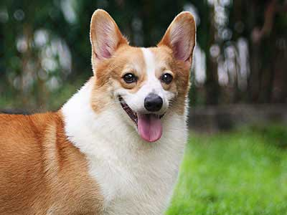
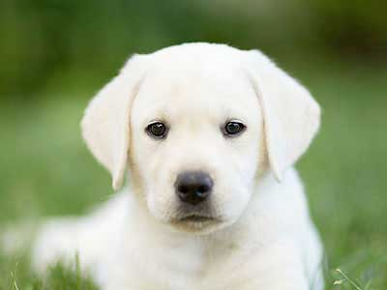
Motivations
A hierarchical tree consists of entities and their hierarchical relations.
disease
pet
database
infection
dog
HIV
H1N1
COVID-19
Corgi
Labrador
relational
database
temporal
database
graph
database
ACM Computing Classification System
Disease Ontology
ImageNet

Slide 4
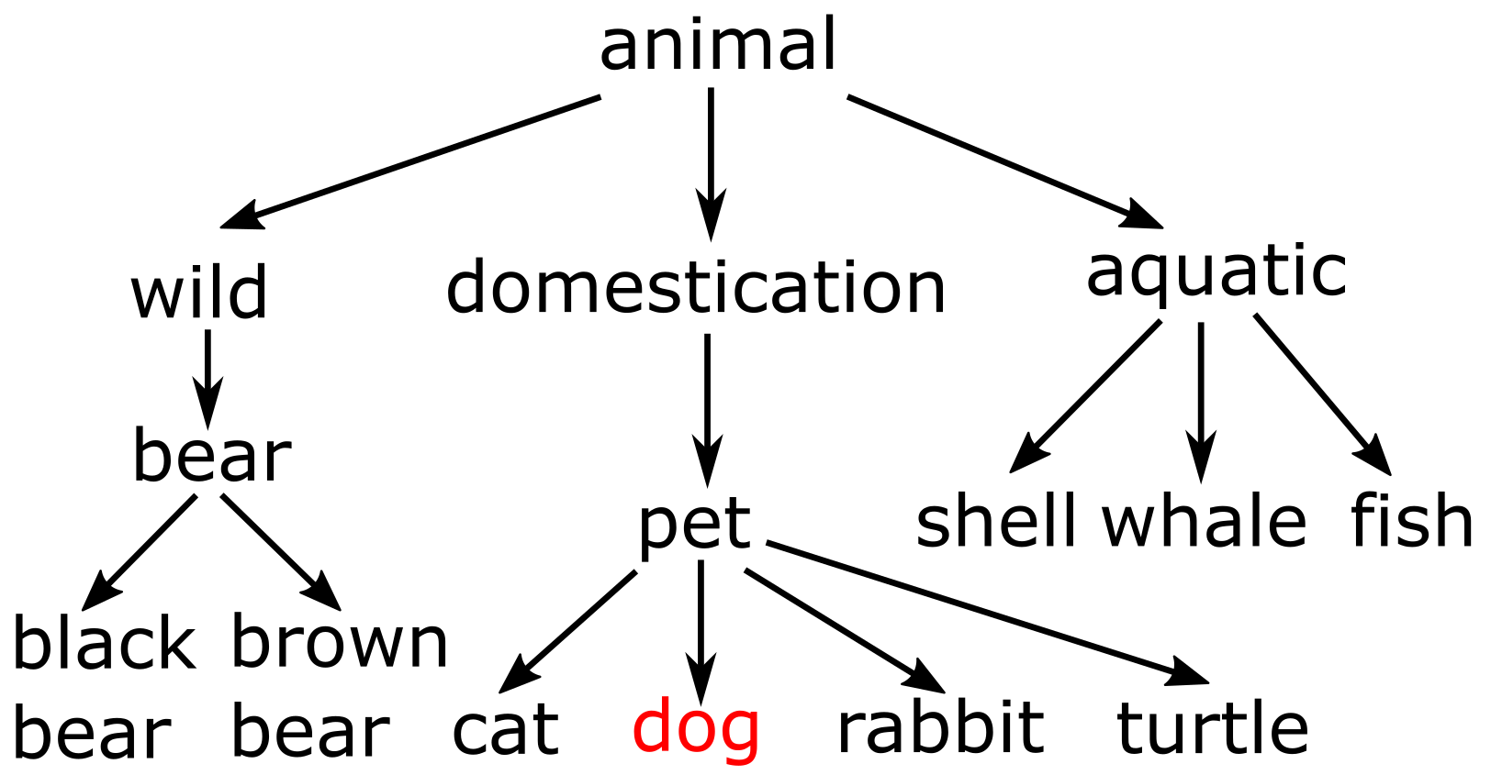
Interactive Graph Search
Three important concepts:
Target T: dog
A hierarchical tree H
An uncategorized image

Slide 5
Interactive Graph Search
Three important concepts:
Target T: dog
Interactive questions Q(x): can x represent the target?
Given a query vertex x in tree H, can vertex x reach the target T in H
Q1
Yes
A hierarchical tree H
An uncategorized image

Slide 6
Interactive Graph Search
Three important concepts:
Target T: dog
Interactive questions Q(x): can x represent the target?
Given a query vertex x in tree H, can vertex x reach the target T in H
Q2
No
A hierarchical tree H
An uncategorized image

Slide 7
Interactive Graph Search
Three important concepts:
Target T: dog
Interactive questions Q(x): can x represent the target?
Given a query vertex x in tree H, can vertex x reach the target T in H
Objective: ask a few questions to identify the exact target
A hierarchical tree H
An uncategorized image

Slide 8
Interactive Graph Search
Three important concepts:
Target T: dog
Interactive questions Q(x): can x represent the target?
Given a query vertex x in tree H, can vertex x reach the target T in H
Objective: ask fewer questions to identify the target
Q3
Yes
A hierarchical tree H
An uncategorized image

Slide 9
Interactive Graph Search
Three important concepts:
Target T: dog
Interactive questions Q(x): can x represent the target?
Given a query vertex x in tree H, can vertex x reach the target T in H
Objective: ask fewer questions to identify the target
Q4
No
A hierarchical tree H
An uncategorized image

Slide 10
Interactive Graph Search
Three important concepts:
Target T: dog
Interactive questions Q(x): can x represent the target?
Given a query vertex x in tree H, can vertex x reach the target T in H
Objective: ask fewer questions to identify the target
Q5
Yes
A hierarchical tree H
An uncategorized image

Slide 11
Interactive Graph Search
Three important concepts:
Target T: dog
Interactive questions Q(x): can x represent the target?
Given a query vertex x in tree H, can vertex x reach the target T in H
Objective: ask fewer questions to identify the target
A hierarchical tree H
An uncategorized image

Slide 12
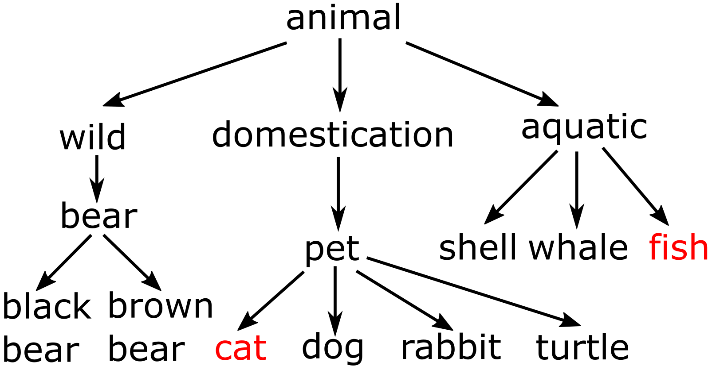
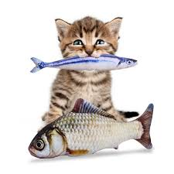
kBM-IGS problem
Multiple targets
Targets T: cat, fish
Budget constrained
Control budget:
Ask at most b questions to find nearly-optimal targets
A hierarchical tree H
An uncategorized image

Slide 13
kBM-IGS problem
Problem definition
Given a hierarchical tree H and a set of unknown targets T, the objective is to ask at most b questions and then select at most k vertices S to represent targets T as close as possible.
An example (b=4, k=2)
A hierarchical tree H
An uncategorized image

Slide 14
kBM-IGS problem
Problem definition
Given a hierarchical tree H and a set of unknown targets T, the objective is to ask at most b questions and then select at most k vertices S to represent targets T as close as possible.
An example (b=4, k=2)
Q1
Yes
A hierarchical tree H
An uncategorized image

Slide 15
kBM-IGS problem
Problem definition
Given a hierarchical tree H and a set of unknown targets T, the objective is to ask at most b questions and then select at most k vertices S to represent targets T as close as possible.
An example (b=4, k=2)
Q2
Yes
A hierarchical tree H
An uncategorized image

Slide 16
kBM-IGS problem
Problem definition
Given a hierarchical tree H and a set of unknown targets T, the objective is to ask at most b questions and then select at most k vertices S to represent targets T as close as possible.
An example (b=4, k=2)
Q3
No
A hierarchical tree H
An uncategorized image

Slide 17
kBM-IGS problem
Problem definition
Given a hierarchical tree H and a set of unknown targets T, the objective is to ask at most b questions and then select at most k vertices S to represent targets T as close as possible.
An example (b=4, k=2)
Q4
Yes
A hierarchical tree H
An uncategorized image

Slide 18
kBM-IGS problem
Problem definition
Given a hierarchical tree H and a set of unknown targets T, the objective is to ask at most b questions and then select at most k vertices S to represent targets T as close as possible.
An example (b=4, k=2)
A hierarchical tree H
An uncategorized image

Slide 19
kBM-IGS problem
Problem definition
Given a hierarchical tree H and a set of unknown targets T, the objective is to ask at most b questions and then select at most k vertices S to represent targets T as close as possible.
An example (b=4, k=2)
Penalty distance f(S, T) = 1
A hierarchical tree H
An uncategorized image

Slide 20
Related works
IGS /BinG [Tao et al. SIGMOD’19] [Li et al. PVLDB’20]
-- Only for single target
-- Lots of questions in the worst cases
HGS [Parameswaran et al. PVLDB’11]
-- Not interactive
-- High time complexity
Here, b is the budget of questions, n is the number of vertices, d is the maximum out-degree, and h is the height in the hierarchy.

Slide 21
Outlines
Motivations
Algorithms
Single Target Search
Multiple Targets Search
Experiments
Conclusion

Slide 22
kBM-IGS framework
Key idea: Select a vertex with maximum expected gain to ask the question.

Slide 23
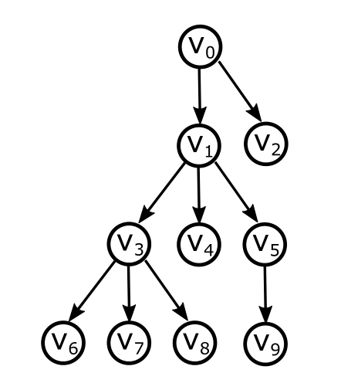
kBM-IGS framework
Key idea: Select a vertex with maximum expected gain to ask the question.
Yes: High probability, low gains
No: Low probability, high gains
Yes: Low probability, high gains
No: High probability, low gains

Slide 24
kBM-IGS framework
Key idea: Select a vertex with maximum expected gain to ask the question.
Expected gain

Slide 25
kBM-IGS framework
Key idea: Select a vertex with maximum expected gain to ask the question.
Expected gain
Probability of vertex v to get Yes/No answer

Slide 26
kBM-IGS framework
Key idea: Select a vertex with maximum expected gain to ask the question.
Expected gain
Penalty distance reduction after vertex v get Yes/No answer

Slide 27
kBM-IGS framework
Key idea: Select a vertex with maximum expected gain to ask the question.
Expected gain
Penalty distance f(Y, P)
--the minimum distance between the best selection in yes-candidates and potential targets

Slide 28
kBM-IGS framework
Key idea: Select a vertex with maximum expected gain to ask the question.
Expected gain
Penalty distance f(Y, P)
--the minimum distance between the best selection in yes-candidates and potential targets
Yes-candidates Y
--the vertices can reach the targets after questions
Potential targets P
--the vertices may be the targets after questions

Slide 29
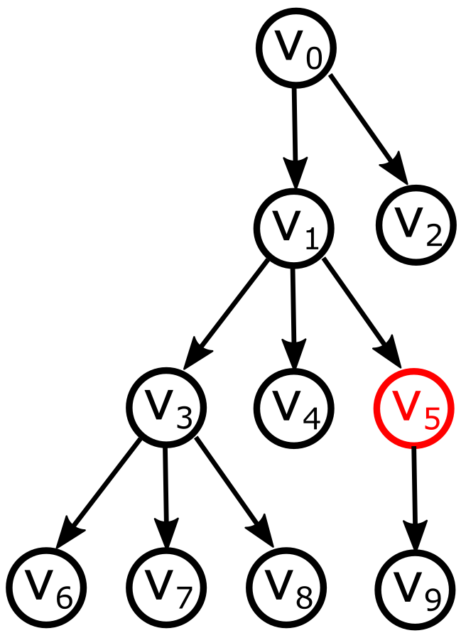
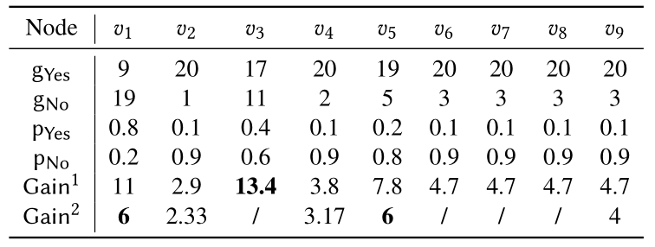
Single Target Search
An example (target T={v₅}, b=2）
Step0: Y = {v₀}, P = {v₀, v₁, …, v₉}

Slide 30
Single Target Search
An example (target T={v₅}, b=2）
Step0: Y = {v₀}, P = {v₀, v₁, …, v₉}
Step1: Y = {v₀}, P = {v₀, v₁, v₂, v₄, v₅, v₉}
Q1
No

Slide 31
Single Target Search
An example (target T={v₅}, b=2）
Step0: Y = {v₀}, P = {v₀, v₁, …, v₉}
Step1: Y = {v₀}, P = {v₀, v₁, v₂, v₄, v₅, v₉}
Step2: Y = {v₀, v₁, v₅}, P = {v₅, v₉}
Q2
Yes

Slide 32
Single Target Search
An example (target T={v₅}, b=2）
Step0: Y = {v₀}, P = {v₀, v₁, …, v₉}
Step1: Y = {v₀}, P = {v₀, v₁, v₂, v₄, v₅, v₉}
Step2: Y = {v₀, v₁, v₅}, P = {v₅, v₉}
After asking b questions, we use the best vertex v₅ in yes-candidates as the selection.

Slide 33
Single Target Search
An example (target T={v₅}, b=2）
Step0: Y = {v₀}, P = {v₀, v₁, …, v₉}
Step1: Y = {v₀}, P = {v₀, v₁, v₂, v₄, v₅, v₉}
Step2: Y = {v₀, v₁, v₅}, P = {v₅, v₉}
After asking b questions, we use the best vertex v₅ in yes-candidates as the selection.
The best selection is always Y∩P with theoretical guarantee.

Slide 34
Outlines
Motivations
Algorithms
Single Target Search
Multiple Targets Search
Experiments
Conclusion

Slide 35
Multiple Targets Search
Key idea: Select a vertex with maximum expected gain.
Penalty distance f(Y, P): the minimum penalty distance between the best k selections in yes-candidates and potential targets
Challenge: k > 1
kBM-DP: the dynamic programming algorithm to calculate the optimal penalty distance

Slide 36
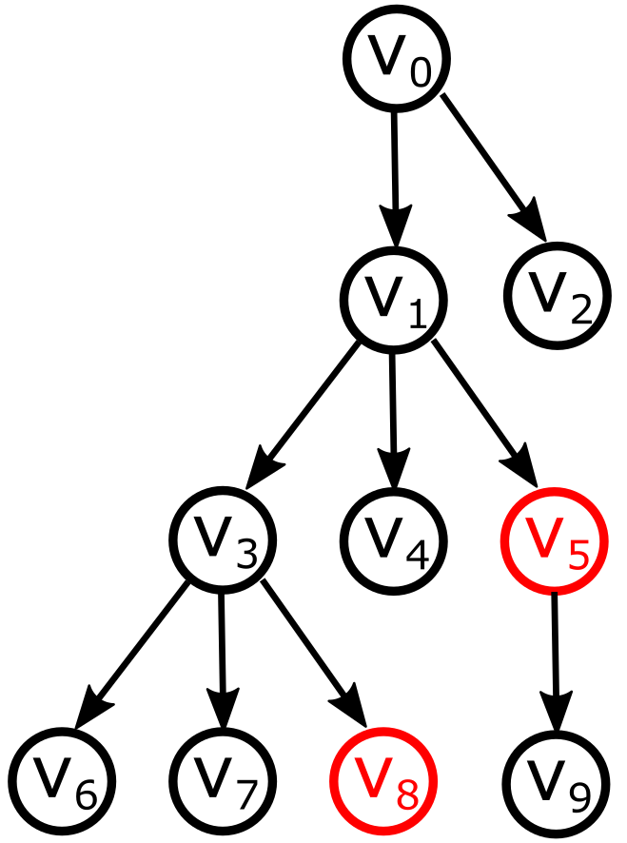
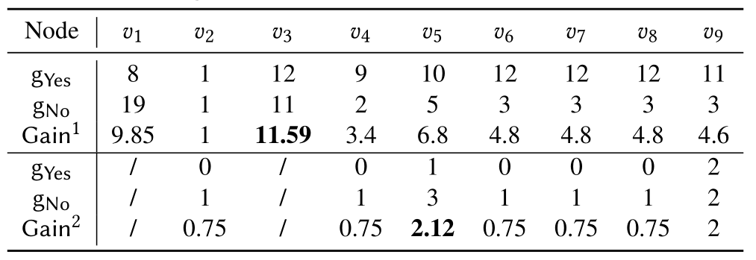
Multiple Targets Search
An example (target T={v₅,v₈}, b=2, k=2）
Step0: Y = {v₀}, P = {v₀, v₁, …, v₉}

Slide 37
Multiple Targets Search
An example (target T={v₅,v₈}, b=2, k=2）
Step0: Y = {v₀}, P = {v₀, v₁, …, v₉}
Step1: Y = {v₀, v₁, v₃}, P = {v₂, v₃, …, v₉}
Q1
Yes

Slide 38
Multiple Targets Search
An example (target T={v₅,v₈}, b=2, k=2）
Step0: Y = {v₀}, P = {v₀, v₁, …, v₉}
Step1: Y = {v₀, v₁, v₃}, P = {v₂, v₃, …, v₉}
Step2: Y = {v₀, v₁, v₃, v₅}, P = {v₂, v₃, …, v₉}
Q2
Yes

Slide 39
Multiple Targets Search
An example (target T={v₅,v₈}, b=2, k=2）
Step0: Y = {v₀}, P = {v₀, v₁, …, v₉}
Step1: Y = {v₀, v₁, v₃}, P = {v₂, v₃, …, v₉}
Step2: Y = {v₀, v₁, v₃, v₅}, P = {v₂, v₃, …, v₉}
After asking b questions, we use the best k vertices {v_{3,} v₅} in yes-candidates as the selection.

Slide 40
Multiple Targets Search
An example (target T={v₅,v₈}, b=2, k=2）
Step0: Y = {v₀}, P = {v₀, v₁, …, v₉}
Step1: Y = {v₀, v₁, v₃}, P = {v₂, v₃, …, v₉}
Step2: Y = {v₀, v₁, v₃, v₅}, P = {v₂, v₃, …, v₉}
After asking b questions, we use the best k vertices {v_{3,} v₅} in yes-candidates as the selection.
We apply kBM-DP algorithm to select the best k vertices optimally.

Slide 41
Algorithm conclusion
kBM-IGS framework
--a framework for both single target and multiple targets
STBIS
--an algorithm of single target search based on the framework
kBM-DP
--an algorithm of multiple targets search based on the framework
kBM-Topk / kBM-DP+
--two fast heuristic algorithms to optimize kBM-DP on the calculations of f(Y, P) by adopting a new gain function and lazy update.
For details, refer to our paper.

Slide 42
Outlines
Motivations
Algorithms
Single Target Search
Multiple Targets Search
Experiments
Conclusion

Slide 43
Experiments
Datasets
Image-COCO/ImageNet
--Images with multiple labels in WordNet
Yago
--Entitles with multiple types extracted from wikipedias

Slide 44
Experiments
Completive methods
HGS [Parameswaran et al. PVLDB’11]
-- non-interactive multiple target search.
IGS [Tao et al. SIGMOD’19]
-- algorithm with binary searches on paths of tree.
BinG [Li et al. PVLDB’20]
-- greedy based algorithm of pruning largest number of vertices.
Parameter settings
Budget b: 50
k: 1 (for single), 3 (for multiple)

Slide 45
Result (Single target)
The averaged penalty in single target problem with varied b.
Our STBIS method outperforms state-of-the-art algorithms with the smallest penalty in most cases.

Slide 46
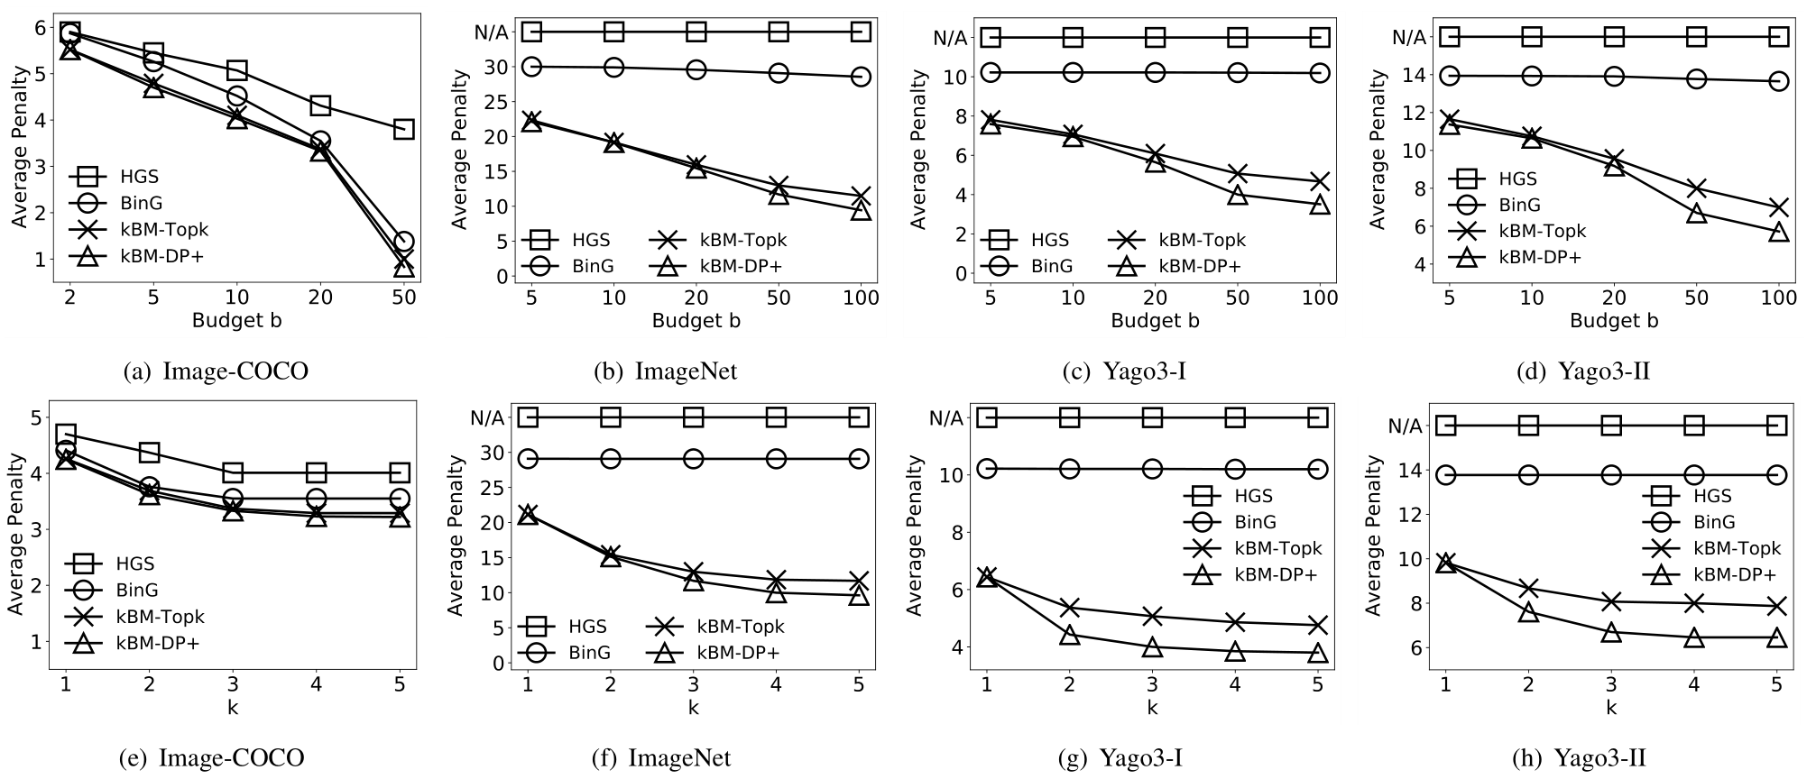
Result (Multiple targets)
The averaged penalty in multiple targets problem with varied b and k.
Our kBM-Topk and kBM-DP+ methods outperform state-of-the-art algorithms by achieving an average of 2.1x better results.

Slide 47
Result (Running time)
The averaged running time in multiple targets problem with varied b.
Fast heuristic algorithms kBM-Topk and kBM-DP+ run much faster than kBM-DP. And kBM-Topk is competitive with BinG.

Slide 48
Outlines
Motivations
Algorithms
Single Target Search
Multiple Targets Search
Experiments
Conclusion

Slide 49
Conclusions
We study the problem of budget constrained interactive search for multiple targets and propose a novel kBM-IGS framework to tackle it.
Based on the framework, we propose STBIS algorithm for single target and kBM-DP for multiple targets.
We also propose kBM-Topk and kBM-DP+ to improve the efficiency of kBM-DP.

Slide 50
Thank you for watching!
Contact us: csxlzhu@comp.hkbu.edu.hk

