Slide 1
Data Summarization with Hierarchical Taxonomy
Xuliang Zhu
Hong Kong Baptist University
Hong Kong, China

Slide 2
Outlines
Motivations
Related Work
HSD Problem
Algorithms
Experiments
Conclusions

Slide 3
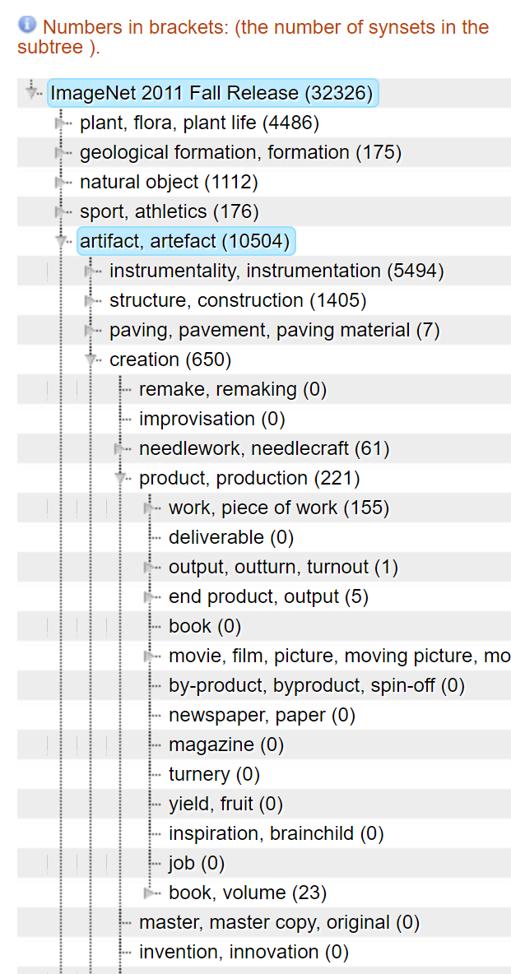
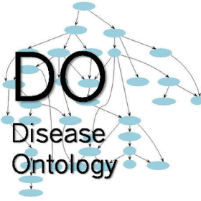
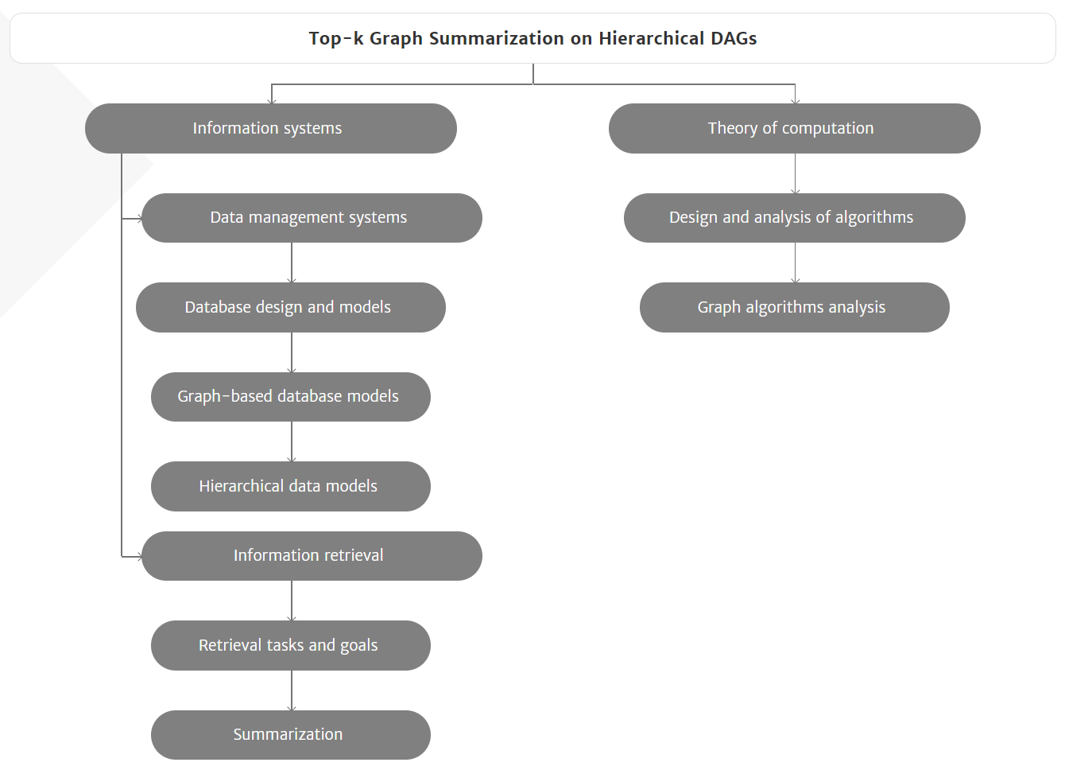
Motivations
Hierarchical DAGs are everywhere
Vertices are general concepts or certain items.
Directed Edges are the relationships that a general concept can summarize another concept or item.
Disease Ontology
ImageNet
ACM Computing Classification System

Slide 4
Motivations
disease
Hierarchical DAGs are everywhere
Vertices are general concepts or certain items.
Directed Edges are the relationships that a general concept can summarize another concept or item.
Disease Ontology
Concepts: disease, infection
Items: SARS, COVID-19
infection
SARS
COVID-19
Disease Ontology
ImageNet
ACM Computing Classification System

Slide 5
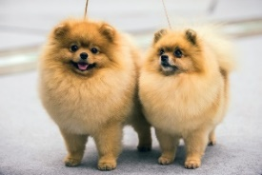
Motivations
animal
disease
Hierarchical DAGs are everywhere
Vertices are general concepts or certain items.
Directed Edges are the relationships that a general concept can summarize another concept or item.
ImageNet
Concepts: animal, pet, dog
Items: images
pet
infection
dog
SARS
COVID-19
Disease Ontology
ImageNet
ACM Computing Classification System

Slide 6
Motivations
animal
disease
Hierarchical DAGs are everywhere
Vertices are general concepts or certain items.
Directed Edges are the relationships that a general concept can summarize another concept or item.
ACM CCS
Concepts: database, graph database, data summarization
Items: papers
pet
infection
dog
SARS
COVID-19
Disease Ontology
ImageNet
database
graph
database
data
summarization
“Top-k Graph Summarization on Hierarchical DAGs”
ACM Computing Classification System

Slide 7
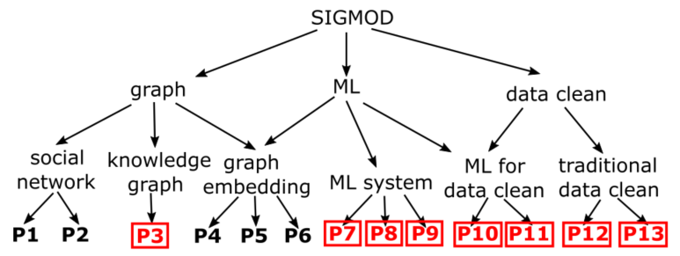
Motivated Example
Popular papers summarization in SIGMOD

Slide 8
Motivated Example
Popular papers summarization in SIGMOD
paper downloads
more than 500

Slide 9
Motivated Example
Popular papers summarization in SIGMOD
paper downloads
less than 500

Slide 10
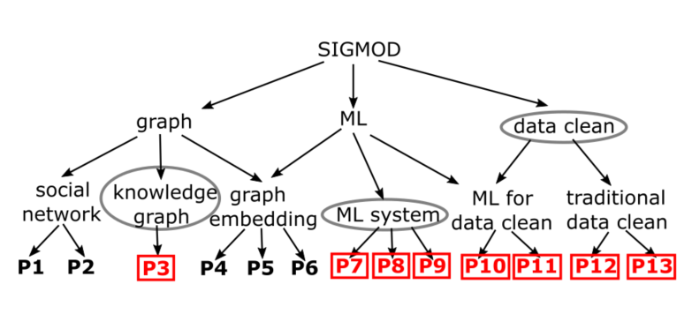
Motivated Example
Popular papers summarization in SIGMOD
Some papers are popular and others are unpopular.
Select k topics to summarize popular papers.
Cover more popular papers, cover less unpopular papers.
An example (k=3)
data clean: P10, P11, P12, P13
ML system: P7, P8, P9
knowledge graph: P3
Papers in red are popular.
Papers in black are unpopular.

Slide 11
Applications
Attributes filter
Input: A query set of popular items (e.g. diseases, papers), a hierarchical taxonomy.
Objective: Filter the top-k attributes of query set.
Image set labeling
Input: A set of images, a hierarchical taxonomy.
Objective: Label the given image set with at most k labels.
Personalized recommendation
Input: A query set of items (e.g. videos, images) the user like and unlike, a hierarchical taxonomy.
Objective: Recommend top-k topics the user like (cover more like items and cover less unlike items).

Slide 12
Outlines
Motivations
Related Work
HSD Problem
Algorithms
Experiments
Conclusions

Slide 13
Related Work
Aggregate method [X Jing et al. 2014]
Select top-k topics with maximum aggregate popular papers.
Limitation: Lack diversity (ML & ML system)
5 popular papers
4 popular papers
3 popular papers

Slide 14
Related Work
K-PCGS Method [X Zhu et al. CIKM 2020]
Select top-k diverse topics with maximum summary score greedily.
Limitation: Cover several unpopular papers (P4, P5, P6)

Slide 15
Outlines
Motivations
Related Work
HSD Problem
Algorithms
Experiments
Conclusions

Slide 16
HSD Problem
Summary Score
S is the selected set.
cov(S) is the items that S cover.
Q is the query item set.
The larger summary score is, the better selection is.
HSD problem
Find the set
HSD Problem is NP-hard
Reduction from set cover problem.

Slide 17
HSD Problem
Methods compare
Aggregate method
f(S) =$\frac{|\left\{P7, P8, P9,P10,P11,P12,P13\right\}|}{|\left\{P3,P4,P5,P6,P7, P8, P9,P10,P11,P12,P13\right\}|}$= $\frac{7}{11}$ = 0.636
K-PCGS method
f(S) =$\frac{|\left\{P3,P7, P8, P9,P10,P11,P12,P13\right\}|}{|\left\{P3,P4,P5,P6,P7, P8, P9,P10,P11,P12,P13\right\}|}$= $\frac{8}{11}$ = 0.727
Our method
f(S) =$\frac{|\left\{P3,P7, P8, P9,P10,P11,P12,P13\right\}|}{|\left\{P3,P7, P8, P9,P10,P11,P12,P13\right\}|}$= $\frac{8}{8}$ = 1

Slide 18
Outlines
Motivations
Related Work
HSD Problem
Algorithms
Experiments
Conclusions

Slide 19
Algorithm Overview
Transform HSD problem to maximum weighted coverage problem
Optimal solution on tree cases
A heuristic method to transfer HDAG to tree

Slide 20
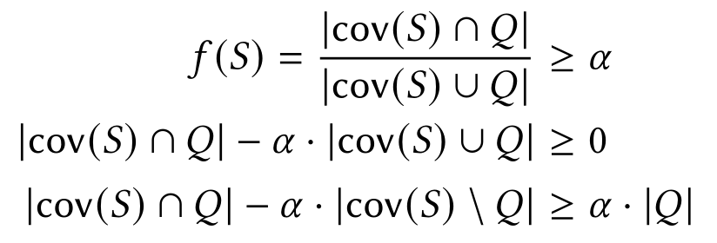
Transformation
Score function
Maximum weighted coverage
Binary search α
w(x) may be negative, so g(S) is not submodular

Slide 21
DP on tree
DP(v, k) the maximal weighted coverage with selecting no more than k vertices in subtree T_{v}.
DP_{Y}(v, k) the maximal weighted coverage selected v.
DP_{N}(v, k) the maximal weighted coverage not selected v.
Time Complexity: O(nlognk³) Space Complexity: O(nk²)

Slide 22
Algorithm on HDAG
Assign vertex to the in-neighbor with maximal value
Example Assume α=1:
Then, apply tree algorithm
Time Complexity: O(nlognk³+mn) Space Complexity: O(nk²+m)
1-5=-4
5-3=2
4-0=4

Slide 23
Outlines
Motivations
Related Work
HSD Problem
Algorithms
Experiments
Conclusions

Slide 24
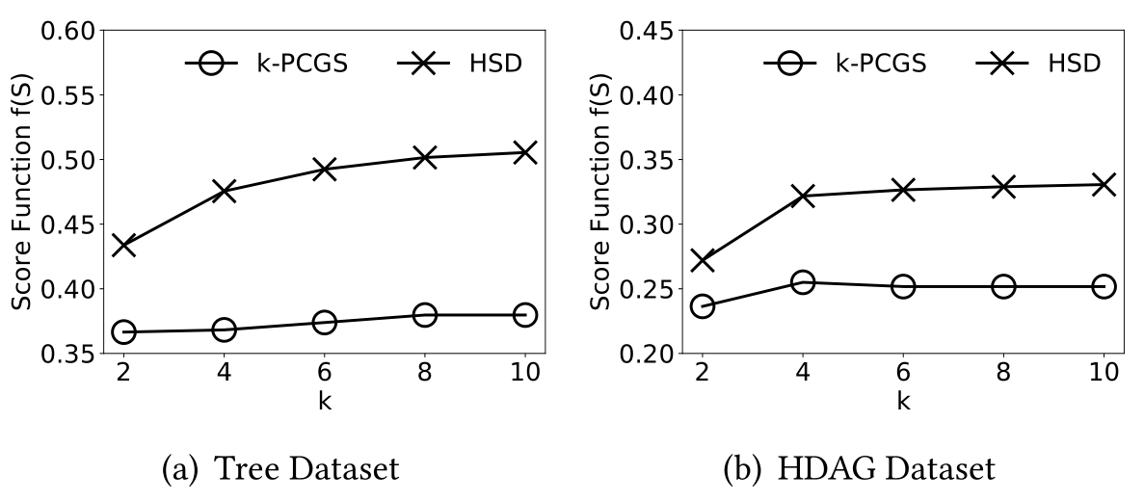
Experiments
Datasets:
Disease Ontology 4,227 vertices, 8,190 edges
Evaluation metrics: f(s)
Methods compared: k-PCGS (CIKM’20)
Result:

Slide 25
Outlines
Motivations
Related Work
HSD Problem
Algorithms
Experiments
Conclusions

Slide 26
Conclusions
We study the data summarization problem using hierarchical taxonomy.
We propose a novel model of HSD problem and prove its NP-hardness.
We develop a DP based algorithm to tackle the problem on tree and a heuristic method to achieve a high-quality approximate solution on HDAG.

Slide 27
Thank you for watching!
Contact us: csxlzhu@comp.hkbu.edu.hk

