Slide 1
Top-k Graph Summarization on Large Hierarchical Graphs
Xuliang Zhu
Hong Kong Baptist University
Hong Kong, China
Supervisor: Dr. Xin Huang

Slide 2
Outlines
Motivations
KDAG-Problem
Algorithms
Experiments
Conclusions

Slide 3
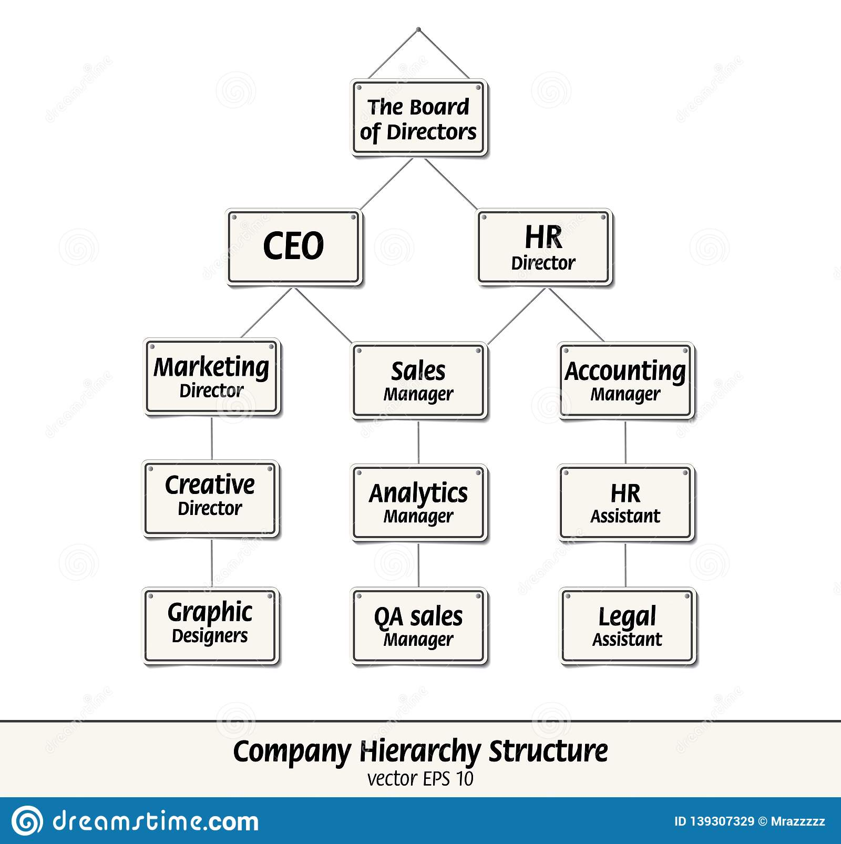
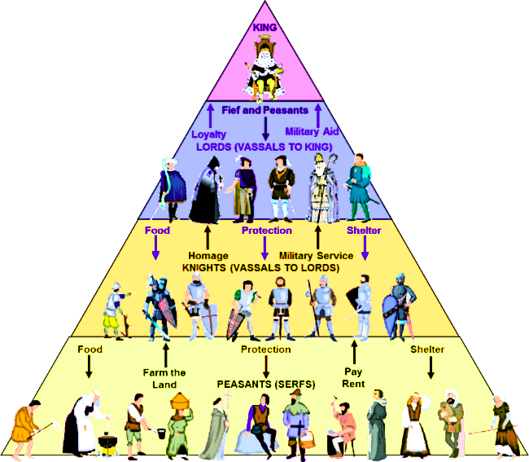
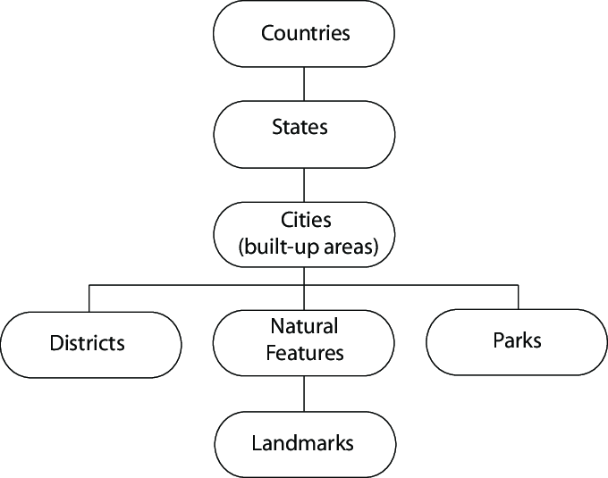
Introduction
Hierarchies are everywhere in real world.
Company Hierarchy
Middle-ages Hierarchy
Regional Hierarchy

Slide 4
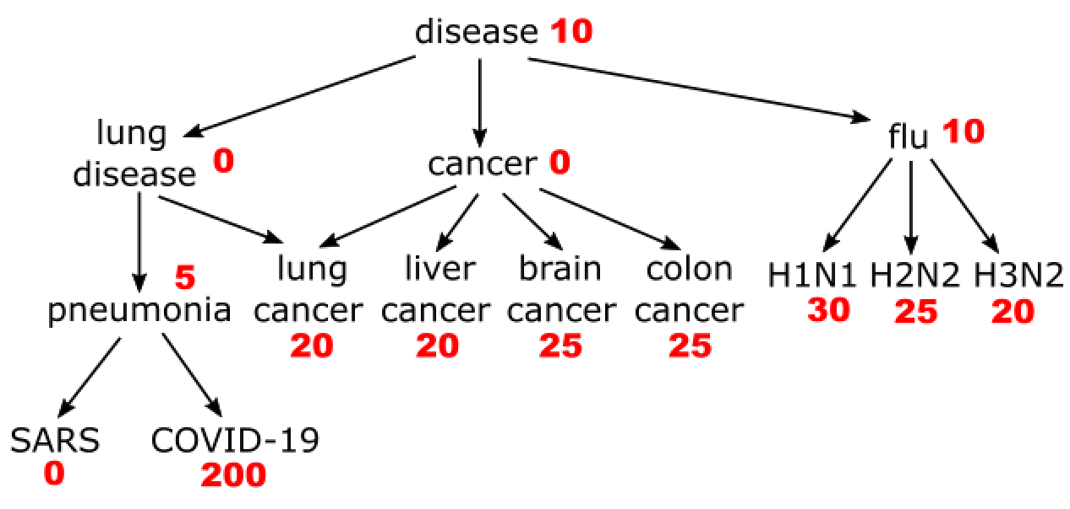
Introduction
Hierarchical graphs
Vertices are entities and concepts.
Directed Edges are the representative relationships between entities.
Vertices Weights are importance of vertices
Disease Ontology
Entities: Type of diseases
Weights: Occurrences of diseases
Disease Ontology

Slide 5
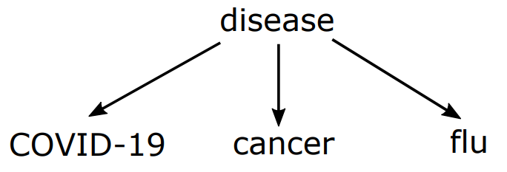
Top-k summarization
Large hierarchical graphs
Massive terminologies and complex structures
Difficult to understand or visualize
Top-4 Summarization
Disease Ontology

Slide 6
Applications
Summarized popular topics&papers in SIGMOD’19
T2
P7 Downloads: 1887

Slide 7
Applications
Summarized popular topics&papers in SIGMOD’19
Weight: Downloads of paper/papers under the topic
Objective: Select top-6 popular topics&papers

Slide 8
Applications
Summarized popular topics&papers in SIGMOD’19
Top-6 papers: P7, P104, P68, P38, P39, P69
Weakness: Lack popular topics T11, T1 (with most papers)

Slide 9
Applications
Summarized popular topics&papers in SIGMOD’19
Top-6 topics: T11, T8, T2, T15, T1, T12
Weakness: Topics T2, T12, T15 have high weight because of one popular paper. Other papers are not popular.

Slide 10
Applications
Summarized popular topics&papers in SIGMOD’19
Aggregate method: T11, T8, T2, T15, P7, P104
Weakness: T2, P7 and T15, P104 are similar and lack diversity

Slide 11
Applications
Summarized popular topics&papers in SIGMOD’19
Our method: T11, T8, T1, P7, P68, P104
Cover all popular papers and popular topics.

Slide 12
Outlines
Motivations
KDAG-Problem
Algorithms
Experiments
Conclusions

Slide 13
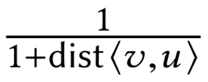
kDAG-Problem
Summary Score
The score is determined by the weight and distance from the selected vertices.
KDAG-problem
Find the set

Slide 14
kDAG-Problem
feq(u): weight of vertex u
Summary Score
The score is determined by the weight and distance from the selected vertices.
KDAG-problem
Find the set

Slide 15
kDAG-Problem
feq(u): weight of vertex u
Summary Score
The score is determined by the weight and distance from the selected vertices.
KDAG-problem
Find the set
S: selected set

Slide 16
kDAG-Problem
feq(u): weight of vertex u
Summary Score
The score is determined by the weight and distance from the selected vertices.
KDAG-problem
Find the set
S: selected set
dist<v,u>: distance from the selected vertex v

Slide 17
kDAG-Problem
feq(u): weight of vertex u
Summary Score
The score is determined by the weight and distance from the selected vertices.
KDAG-problem
Find the set
Distance function can be changed.
S: selected set
dist<v,u>: distance from the selected vertex v

Slide 18
kDAG-Problem Analysis
kDAG-Problem is NP-hard (Reduction from NP-Completed 3-SAT problem)
The summary selection of kDAG-problem enjoys:
Diversity: dissimilar of selected vertices
Small scale: small size of selection
Large coverage: cover important vertices
High correlation: high correlation between selection to important vertices

Slide 19
Outlines
Motivations
KDAG-Problem
Algorithms
Experiments
Conclusions

Slide 20
Algorithms Overview
Greedy+ (GTS on tree)
A greedy based algorithm with theoretical approximate guarantee.
OTS
An optimal method on tree datasets.
EXT-Greedy
A heuristic method combined Greedy+ and OTS.
The result is no worse than Greedy+ in theory.
K-PCGS
An efficient greedy method by compressing and pruning.

Slide 21
Greedy+
1
1
1
37
Marginal Gain
L
Add maximum marginal gain into S greedily.
0
24
46
39
2
3
2
3
4
5
6
7
4
5
6
7
42
18
6
6
42
18
6
6
Running Example
Marginal Gain

Slide 22
Greedy+
1
1
1
37
Marginal Gain
L
Add maximum marginal gain into S greedily.
0
24
46
39
2
3
2
3
4
5
6
7
4
5
6
7
42
18
6
6
42
18
6
6
Running Example
Marginal Gain

Slide 23
Greedy+
1
1
1
37
Marginal Gain
L
Add maximum marginal gain into S greedily.
0
24
39
2
3
2
3
4
5
6
7
4
5
6
7
42
18
6
6
42
18
6
6
Running Example
Marginal Gain

Slide 24
Greedy+
1
1
1
37
Marginal Gain
L
Add maximum marginal gain into S greedily.
0
24
39
2
3
2
3
4
5
6
7
4
5
6
7
42
18
6
6
21
18
6
6
Running Example
Marginal Gain

Slide 25
Greedy+
1
1
1
37
Marginal Gain
L
Add maximum marginal gain into S greedily.
0
24
14
2
3
2
3
4
5
6
7
4
5
6
7
42
18
6
6
21
18
6
6
Running Example
Marginal Gain

Slide 26
Greedy+
1
1
1
1
Marginal Gain
L
Add maximum marginal gain into S greedily.
0
24
14
2
3
2
3
4
5
6
7
4
5
6
7
42
18
6
6
21
18
6
6
Running Example
Marginal Gain

Slide 27
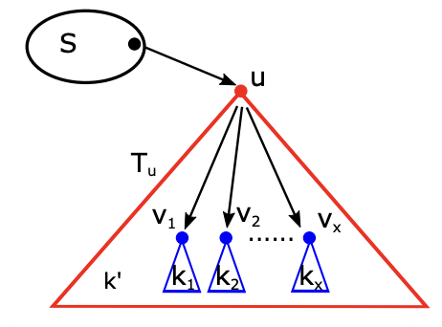
OTS
DP based method
DP state OTS(u, k, S):
The optimal solution in the subtree T_{u} with selecting additional k vertices from T_{u} into summary set S.
Optimal solution: OTS(r, k, $φ$)
Overview of OTS

Slide 28
EXT-Greedy
1
1
Extract subtree based on Greedy+ answer.
Apply OTS on the subtree.
The result must be no worse than Greedy+ in theory.
0
24
2
3
4
5
6
7
42
18
6
6
Running Example

Slide 29
EXT-Greedy
1
1
Extract subtree based on Greedy+ answer.
Apply OTS on the subtree.
The result must be no worse than Greedy+ in theory.
0
24
2
3
4
5
6
7
42
18
6
6
Greedy+ answer

Slide 30
EXT-Greedy
1
1
Extract subtree based on Greedy+ answer.
Apply OTS on the subtree.
The result must be no worse than Greedy+ in theory.
0
24
2
3
4
5
6
7
42
18
6
6
Subtree extraction

Slide 31
EXT-Greedy
1
1
Extract subtree based on Greedy+ answer.
Apply OTS on the subtree.
The result must be no worse than Greedy+ in theory.
0
24
2
3
4
5
6
7
42
18
6
6
Optimal solution
in subtree

Slide 32
EXT-Greedy
1
1
Extract subtree based on Greedy+ answer.
Apply OTS on the subtree.
The result must be no worse than Greedy+ in theory.
0
24
2
3
4
5
6
7
42
18
6
6
Optimal solution
in the original DAG

Slide 33
K-PCGS
1
22
1
22 22
Compress DAG
Compress the DAG into a new graph by removing useless vertices.
Pruning Candidates
Prune the vertices from candidates whose upper bound is smaller than the top-k lower bound.
0
24
0 0
12 24
2
3
2
3
4
5
6
7
4
5
6
7
0
0
6
6
0 0
0 0
3 6
3 6
8
60
8
30 60
Compressed DAG
Pruned Candidates (Black)
Candidates (Blue)
Lower Bound (Green) Upper Bound (Red)

Slide 34
K-PCGS
1
22
1
22 22
Compress DAG
Compress the DAG into a new graph by removing useless vertices.
Pruning Candidates
Prune the vertices from candidates whose upper bound is smaller than the top-k lower bound.
0
24
0 0
12 24
2
3
2
3
4
6
7
4
6
7
0
6
6
0 0
3 6
3 6
8
60
8
30 60
Compressed DAG
Pruned Candidates (Black)
Candidates (Blue)
Lower Bound (Green) Upper Bound (Red)

Slide 35
K-PCGS
1
22
1
22 22
Compress DAG
Compress the DAG into a new graph by removing useless vertices.
Pruning Candidates
Prune the vertices from candidates whose upper bound is smaller than the top-k lower bound.
0
(24, 12)
0 0
14 30
2
3
2
3
4
4
0
0 0
8
60
8
30 60
Compressed DAG
Pruned Candidates (Black)
Candidates (Blue)
Lower Bound (Green) Upper Bound (Red)

Slide 36
K-PCGS
1
22
1
22 22
Compress DAG
Compress the DAG into a new graph by removing useless vertices.
Pruning Candidates
Prune the vertices from candidates whose upper bound is smaller than the top-k lower bound.
0
(24, 12)
0 20
14 30
2
3
2
3
4
4
0
0 0
8
60
8
30 60
Compressed DAG
Pruned Candidates (Black)
Candidates (Blue)
Lower Bound (Green) Upper Bound (Red)

Slide 37
K-PCGS
1
22
1
22 53
Compress DAG
Compress the DAG into a new graph by removing useless vertices.
Pruning Candidates
Prune the vertices from candidates whose upper bound is smaller than the top-k lower bound.
0
(24, 12)
0 20
14 30
2
3
2
3
4
4
0
0 0
8
60
8
30 60
Compressed DAG
Pruned Candidates (Black)
Candidates (Blue)
Lower Bound (Green) Upper Bound (Red)

Slide 38
Outlines
Motivations
KDAG-Problem
Algorithms
Experiments
Conclusions

Slide 39
Datasets
Dataset | Hierarchical DAG | Weight | n | m
LATT | Medical Entity Dictionary | Number of queries from patients | 4,226 | 8,190
LNUR | Medical Entity Dictionary | Number of queries from nurses | 4,226 | 8,190
ANIM | “Anime" catalog in Wikipedia | Number of views | 15,135 | 24,498
IMAGE | ImageNet (WordNet) | Number of pictures | 73,298 | 74,732
YAGO3 | Wikipedia + WordNet | Synthetic | 5,699,254 | 17,512,754
UCI | Social Network Only for efficiency test | Synthetic | 58,790,783 | 92,208,196

Slide 40
Evaluation metrics
Average Distance
1-hop Weighted Coverage

Slide 41
Methods compared
FEQ [X Jing et al. 2014]
Select k nodes with the highest weight.
CAGG [X Jing et al. 2014]
Aggregate method with a contribution ratio.
LASP [G Fakas et al. SIGMOD’15]
Add the largest averaged score path greedily.

Slide 42
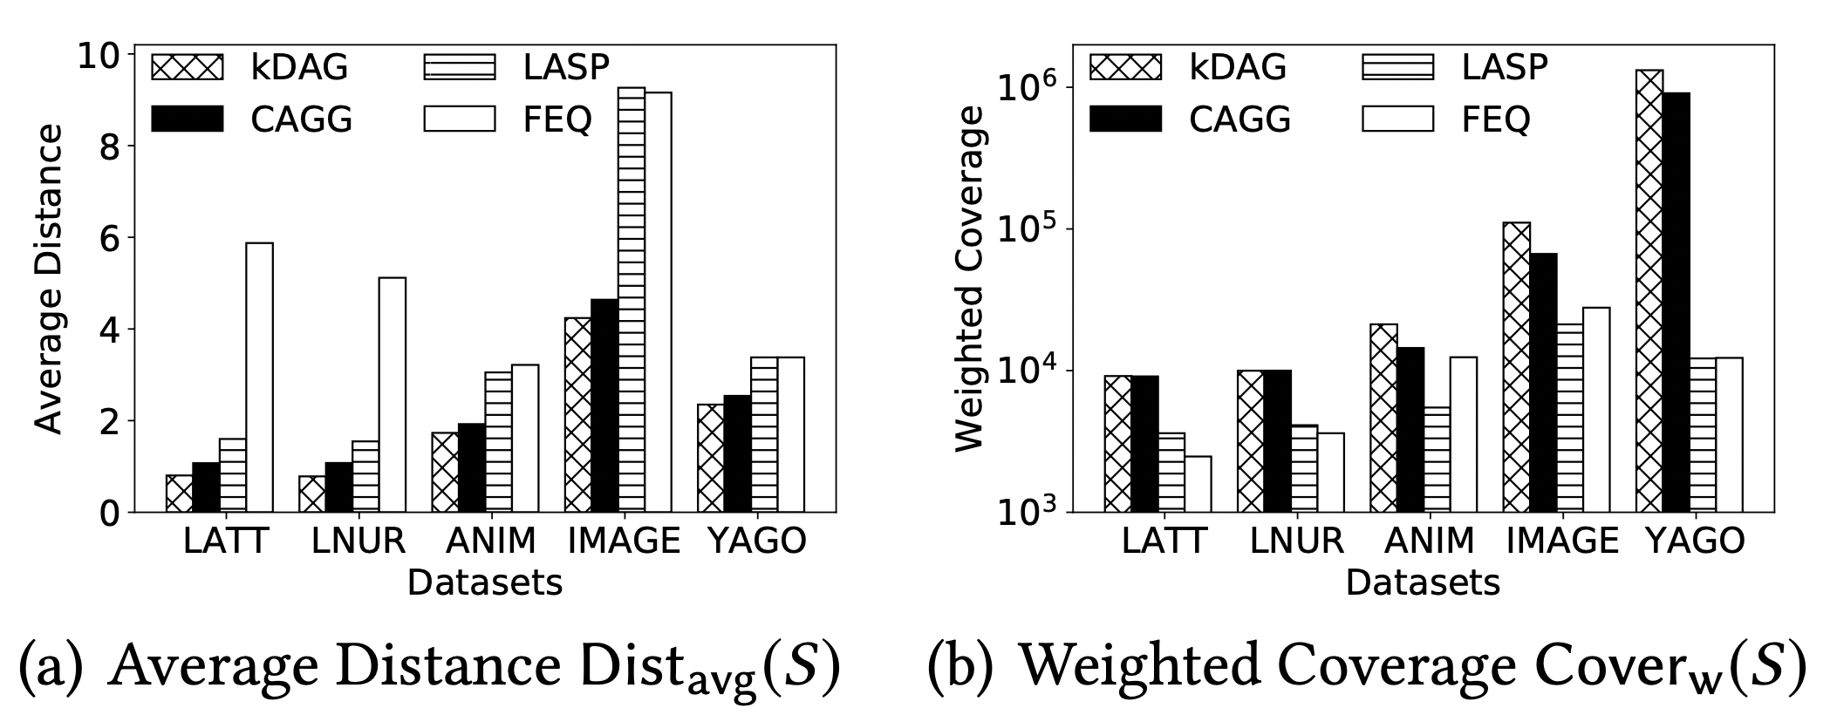
Effectiveness Evaluations
Our kDAG model outperforms state-of-the-art models with the smallest average distance.

Slide 43
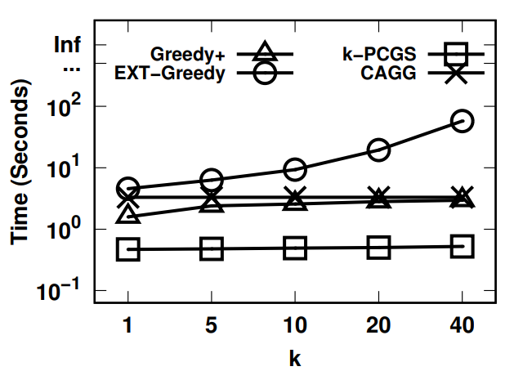
Efficiency Evaluations
Efficiency evaluation of Greedy+, EXT-Greedy, k-PCGS and CAGG methods on ImageNet.
The k-PCGS runs fastest among all methods and EXT-Greedy is the slowest.

Slide 44
Outlines
Motivations
KDAG-Problem
Algorithms
Experiments
Conclusions

Slide 45
Conclusions
We study the top-k graph summarization problem on large hierarchical DAGs.
We propose a novel model of kDAG-problem and proof its NP-hardness.
We develop four algorithms to tackle kDAG-problem:
Greedy+: A baseline greedy method.
OTS: An optimal method on tree datasets.
EXT-Greedy: A more effective method.
k-PCGS: A more efficient method.

Slide 46
Publications
1. Xuliang Zhu, Xin Huang, Jinbin Huang, Byron Choi, and Jianliang Xu. "HDAG-explorer: a system for hierarchical DAG summarization and exploration." Proceedings of the VLDB Endowment (PVLDB’20), Demo Track, Tokyo(Online), Japan, August 2020.
2. Xuliang Zhu, Xin Huang, Byron Choi, and Jianliang Xu. "Top-k Graph Summarization on Hierarchical DAGs." ACM International Conference on Information and Knowledge Management (CIKM’20), Galway(Online), Ireland, October 2020. (Best Paper Nominee)
3. Xuliang Zhu, Xin Huang, Byron Choi, Jiaxin Jiang, Zhaonian Zou, and Jianliang Xu. "Budget Constrained Interactive Search for Multiple Targets." Proceedings of the VLDB Endowment (PVLDB’21), Copenhagen, Denmark, 2021.
4. Qing Liu, Xuliang Zhu, Xin Huang, and Jianliang Xu. "Local Algorithms for Distance-generalized Core Decomposition over Large Dynamic Graphs." Proceedings of the VLDB Endowment (PVLDB’21), Copenhagen, Denmark, 2021.

Slide 47
Publications
5. Xuliang Zhu. "Data Summarization with Hierarchical Taxonomy." SIGMOD Student Research Competition (SIGMOD SRC’21), Xian, China, 2021.
6. Xuliang Zhu, Xin Huang, Byron Choi, Jianliang Xu, William K. Cheung, Yanchun Zhang, and Jiming Liu. "Ontology-based graph visualization for summarized view." IEEE Transactions on Knowledge and Data Engineering (TKDE 2022)
7. Xuliang Zhu, Xin Huang, Longxu Sun, and Jiming Liu. "A Novel Graph Indexing Approach for Uncovering Potential COVID-19 Transmission Clusters." ACM Transactions on Knowledge Discovery in Data (TKDD 2022)

Slide 48
Thank you for watching!
Contact me: csxlzhu@comp.hkbu.edu.hk

Slide 49
Related Works
Graph summarization
[Y Wu et al. PVLDB 2017]
[X Gou et al. SIGMOD 2019]
[A Kim et al. ICDE 2020]
Hierarchical graph search
[Y Tao et al. SIGMOD 2019]
[X Zhu et al. PVLDB 2021]

Slide 50
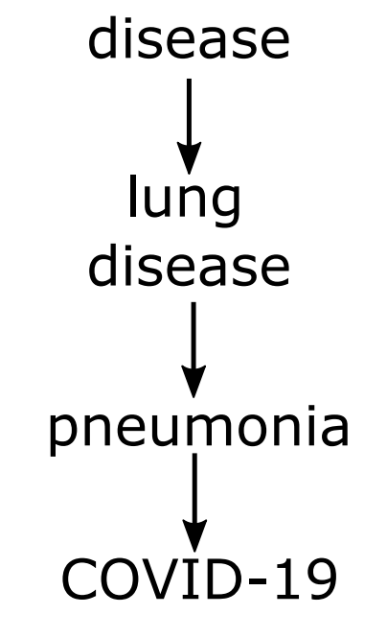
Related Works
Aggregate method
[X Jing et al. 2014]
Select top-k vertices with maximum aggregate value.
Lack diversity
GVDO model
[X Huang et al. 2017]
Greedy based method on tree datasets
Disease Ontology
Our method
Aggregate method

Slide 51
Greedy+
Monotone
Submodular
(1 – 1/e)-approximation guarantee

Slide 52
OTS
1
1
1
1
1
1
0
24
0
24
0
24
2
3
2
3
2
3
4
5
6
7
4
5
6
7
4
5
6
7
42
18
6
6
42
18
6
6
42
18
6
6
Running Example
Greedy+ result with g(S) = 64
Optimal result with g(S) = 81

Slide 53
OTS
DP based method
DP state OTS(u, k, S):
The optimal solution in the subtree T_{u} with selecting additional k vertices from T_{u} into summary set S.
Optimal solution: OTS(r, k, $φ$)
Overview of OTS

Slide 54
OTS
Transfer equation:
Overview of OTS

Slide 55
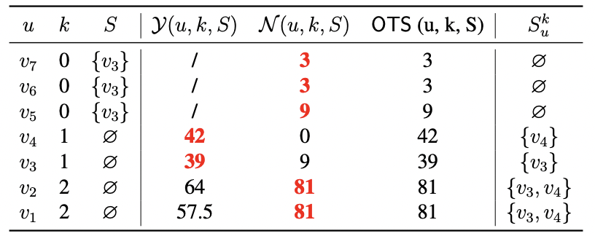
OTS
The DP states of OTS(u, k, S)
1
1
0
24
2
3
4
5
6
7
42
18
6
6
Running Example

Slide 56
Optimization of OTS
OTS(u, k, S):
k: Reduce #k-assign by Knapsack Dynamic Programming.
S: Reduce #S by the nearest ancestor.
Overview of OTS

Slide 57
Complexity Comparison
Method | Time Complexity | Space Complexity
Greedy+ | O(nkm) | O(m)
OTS | O(nk³h) | O(nk²h)
EXT-Greedy | O(nkm+nk³h) | O(nk²h)
k-PCGS | O(mh + nlogn + k|C|m’) | O(m)
Here, n is the size of vertices, m is the size of edges,
h is the height of DAG (length of longest shortest path).
|C| is the size of compressed tree and smaller than n.
m’ is smaller than m.

Slide 58
Effectiveness Evaluations
Summary Score of all methods
EXT-Greedy performs best on all datasets expect YAGO. It fails to get the result with time limit.

Slide 59
Efficiency Evaluations
The size of candidates
The k-PCGS reduces at least 90% candidates in the worst case and more than 99% in most cases.

Slide 60
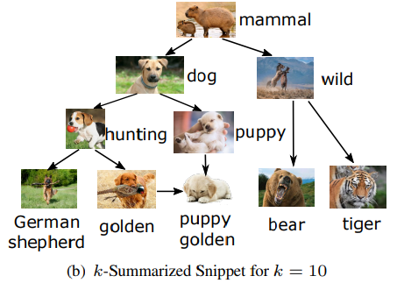
Case study (ImageNet)

Slide 61
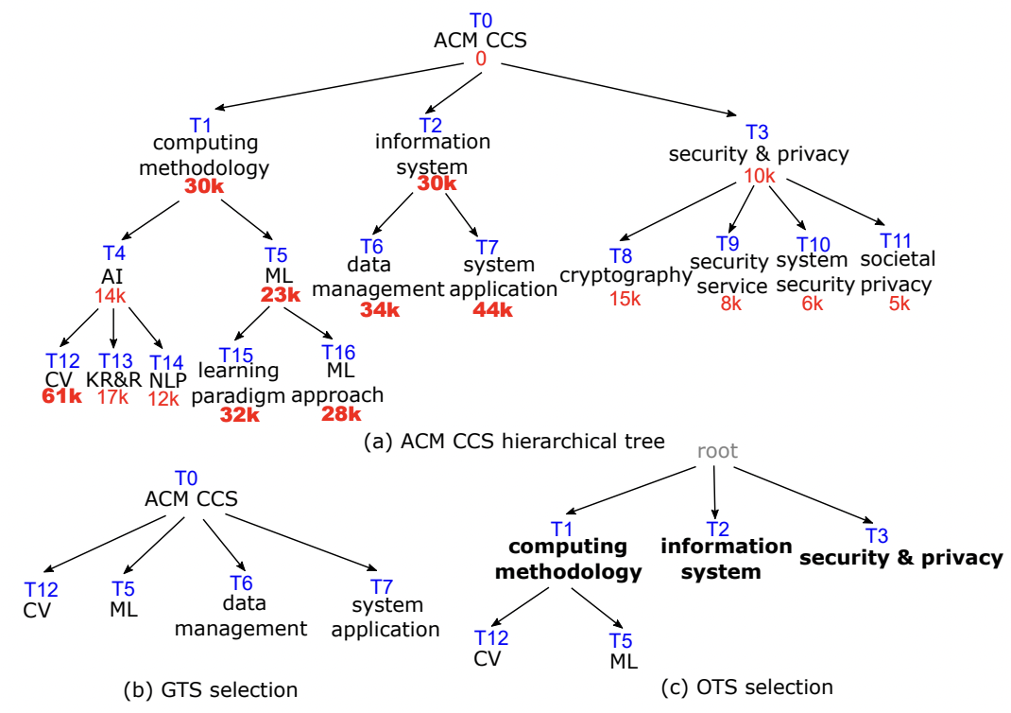
Case study (ACM CCS)

Slide 62
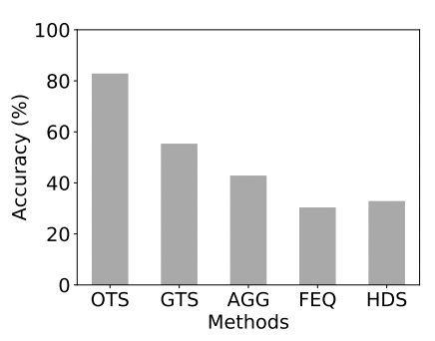
User study (ACM CCS)
The accuracy of top-5 selection compared with users’ selections.
OTS achieves more than 80% accuracy, which is much better than other methods.

Slide 63
Future works
Construct index for query problems.
kDAG-problem with incremental (dynamic) weights.
Summary difference between two hierarchical graphs (negative) weight.
Change the structure of hierarchical graphs.

