Slide 1
A Complexity-Optimized Solution for Large-scale Kernel Density Visualization

Slide 2
Introduction

Slide 3
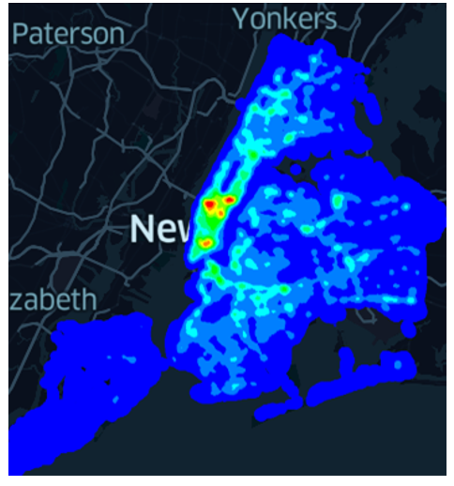
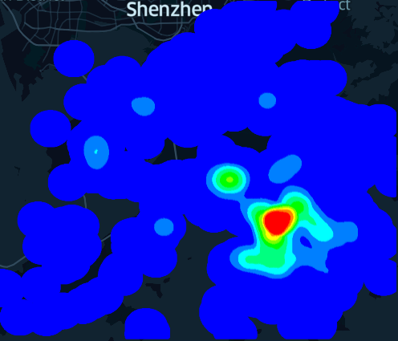
Why Data Visualization?
Find hidden patterns (e.g., hotspots) from a dataset.
Provide an intuitive way to understand a dataset (by visualizing it).
A heatmap (or hotspot map) for the New York traffic accident dataset
Hong Kong COVID-19 hotspot map

Slide 4
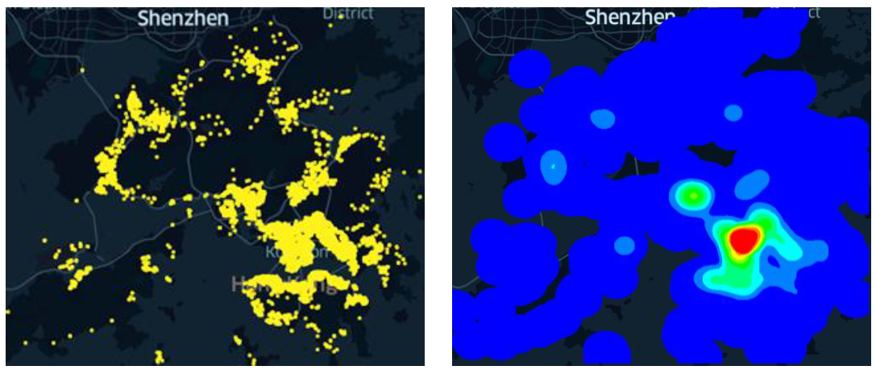
Why Kernel Density Visualization (KDV)?
KDV can provide better visualization quality compared with many traditional software tools.
Scatter plot of Hong Kong COVID-19 cases
Hotspot map of Hong Kong COVID-19 cases (based on KDV)

Slide 5
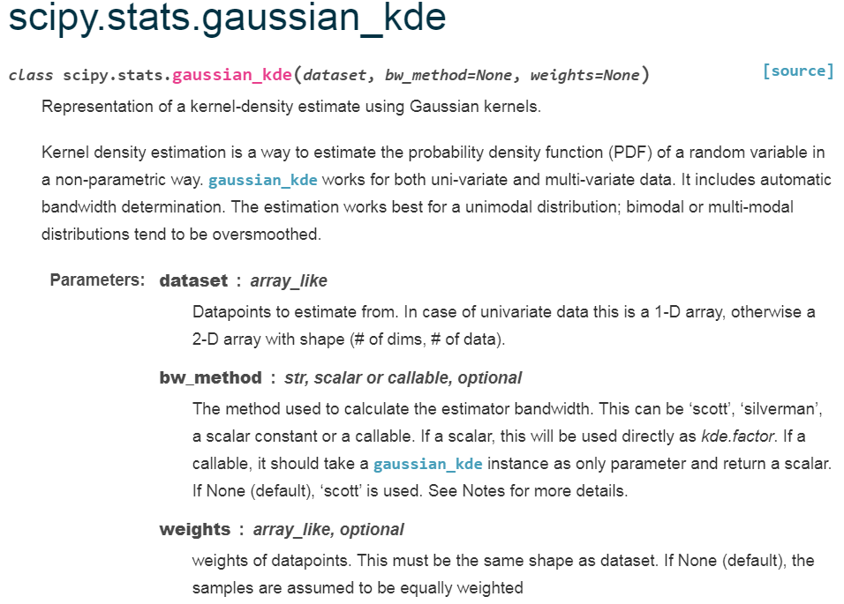
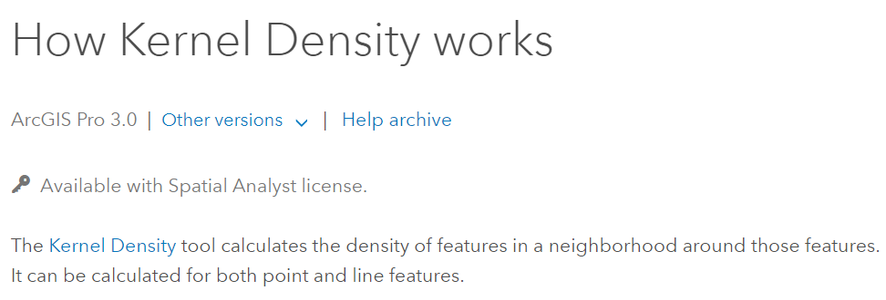
Why Kernel Density Visualization (KDV)?
A de facto method
Supported by many software packages
Scikit-learn
ArcGIS
Scipy

Slide 6
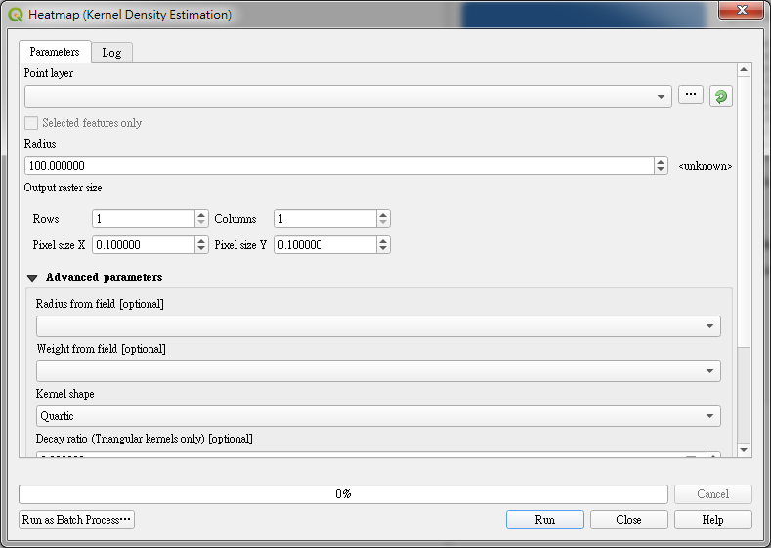
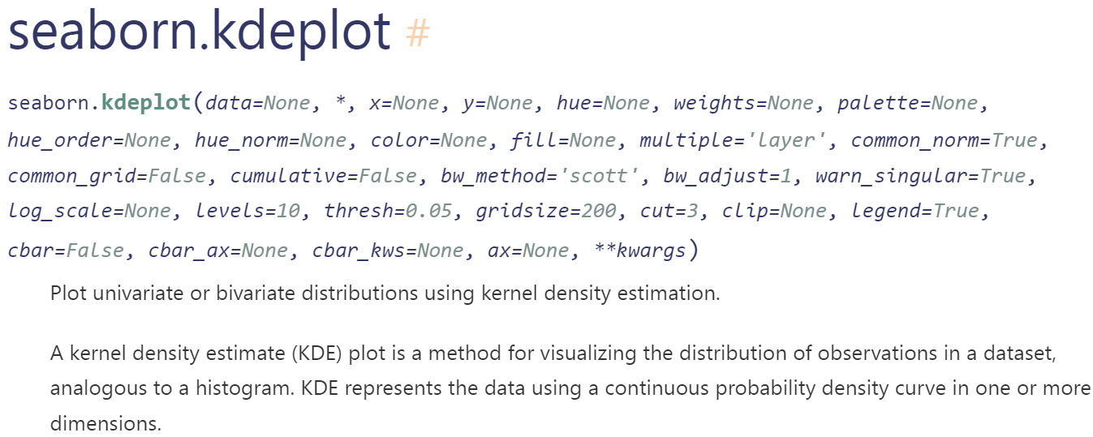
Why Kernel Density Visualization (KDV)?
A de facto method
Supported by many software packages
Deck.gl
QGIS
Seaborn

Slide 7
Kernel Density Visualization (KDV)

Slide 8
What is KDV?
Each p (yellow dot) represents the location of a COVID-19 case.
Predict the risk of a given location q by computing the kernel density function $ℱ_{P}\left(q\right)$.
2D pixel
weighting
Euclidean distance
$$ℱ_{P}\left(q\right)=\sum_{p∈P}{w}∙\left\{\begin{matrix}1−\frac{1}{b^{2}}{dist(q,p)}^{2} \\ 0\end{matrix}\right.$$
If $dist\left(q,p\right)≤b$
Otherwise
dataset
bandwidth

Slide 9
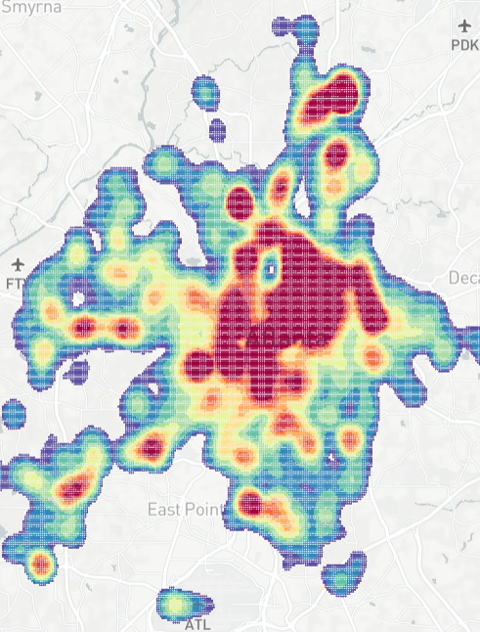
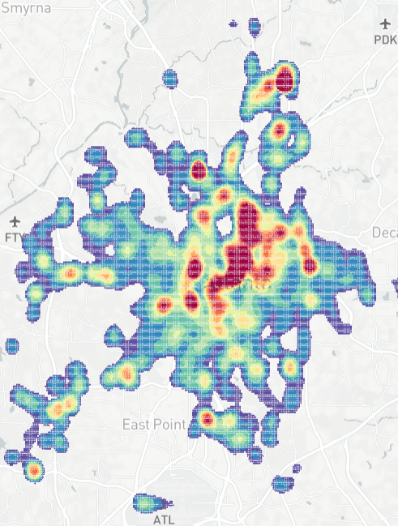
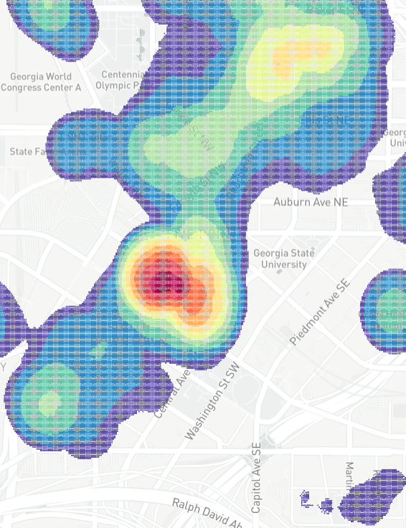
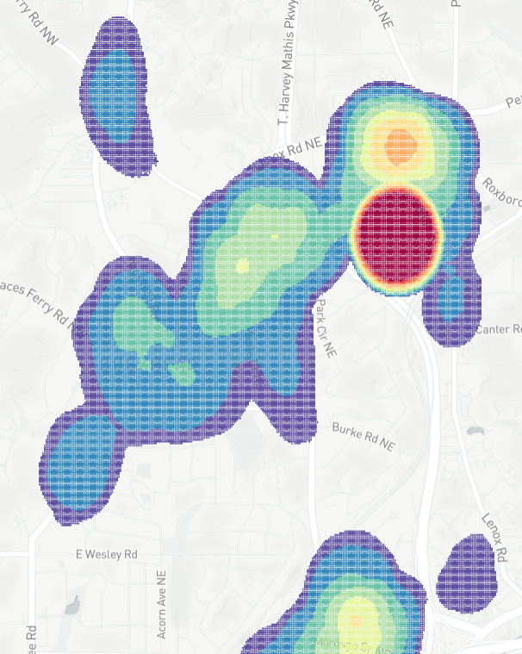
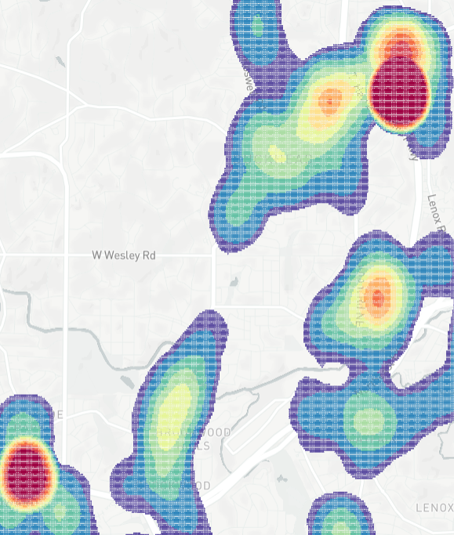
KDV is Slow!
Time complexity: $O(XYn)$
Resolution size: $X×Y$
Number of data points in $P$: $n$
Domain experts need to generate multiple KDVs.
B
Bandwidth
selection
Zoom in
Panning
Zoom out
Many exploratory
operations
(e.g., filtering)

Slide 10
KDV is Slow!
Complaints:
Gan et al. [1] “...the total runtime cost of density estimation is quadratic in dataset size...”
Gramacki et al. [2] “However, many (or even most) of the practical algorithms and solutions designed in the context of KDE are very time-consuming with quadratic computational complexity being a commonplace.”
[1] Edward Gan and Peter Bailis. Scalable Kernel Density Classification via Threshold-Based Pruning. In SIGMOD 2017. 945–959.
[2] A. Gramacki. Nonparametric Kernel Density Estimation and Its Computational Aspects. Springer International Publishing 2017.

Slide 11
Range-Query-based Solution
$$ℱ_{P}\left(q\right)=\sum_{p∈P}{w}∙\left\{\begin{matrix}1−\frac{1}{b^{2}}{dist(q,p)}^{2} \\ 0\end{matrix}\right.$$
If $dist\left(q,p\right)≤b$
b
Otherwise
q
$$ℱ_{P}\left(q\right)=\sum_{p∈R(q)}{w∙}\left(1−\frac{1}{b^{2}}{dist(q,p)}^{2}\right)$$
$$R(q)$$
Simple ☺
Many tree structures are available to improve the practical efficiency ☺
Cannot reduce the worst-case time complexity ($b→∞$) ☹

Slide 12
Our Solution: SLAM
The first work for generating a single KDV that can:
Reduce the worst-case time complexity ☺
Retain the same space complexity ☺
Achieve one to two-order-of-magnitude speedup for supporting KDV, using large-scale datasets ☺
[a] Tsz Nam Chan, Leong Hou U, Byron Choi, Jianliang Xu: “SLAM: Efficient Sweep Line Algorithms for Kernel Density Visualization” SIGMOD 2022, pages 2120-2134.

Slide 13
Core Ideas of SLAM
Core idea 1: two consecutive pixels can share many data points (white circles) in the range set.
Core idea 2: $ℱ_{P}\left(q\right)$ can be decomposed into this expression.
$$ℱ_{P}\left(q\right)=\sum_{p∈R(q)}{w∙\left(1−\frac{1}{b^{2}}{dist(q,p)}^{2}\right)}$$
b
$$=w\left|R\left(q\right)\right|−\frac{w}{b^{2}}\left(\left|R\left(q\right)\right|×{\left\|q\right\|}_{2}^{2}−2q^{T}A_{R_{q}}+S_{R_{q}}\right)$$
q
q’
$$\sum_{p∈R(q)}{p}$$
$$\sum_{p∈R(q)}{{\left\|p\right\|}_{2}^{2}}$$
$$R(q)$$
$$R(q′)$$
Can we share computations between two consecutive pixels?
How to efficiently maintain $\left|R(q)\right|$, $A_{R_{q}}$, and $S_{R_{q}}$?

Slide 14
Envelope for A Row of Pixels
X
…
$$b$$
…
…
…
…
$$\left(q_{1}.x,k\right)$$
$$\left(q_{3}.x,k\right)$$
…
q₁
q₂
q_{X-1}
q_{X}
Y
$$E(k)$$
…
$$\left(q_{2}.x,k\right)$$
$$\left(q_{X}.x,k\right)$$
…
…
…
…
$$q_{1}.y=q_{2}.y=…=q_{X}.y=k$$
$$X$$
Use $O(n)$ time to find the envelope $E(k)$.

Slide 15
Lower and Upper Bound Functions
Consider the blue data points $p$ that are within the range $b$ of the pixel $q$.
We can let:
$O(n)$ time to find the bound functions for all data points in $E(k)$.
p₁
$$b$$
p₂
$$\left(q.x,k\right)$$
p₃
p₄

Slide 16
Range Search Problem = Interval Stabbing Problem
q.x
p₁
LB_{k}(p₁)
UB_{k}(p₁)
p₁
$$b$$
p₂
p₂
LB_{k}(p₂)
UB_{k}(p₂)
p₃
$$\left(q.x,k\right)$$
LB_{k}(p₃)
UB_{k}(p₃)
p₃
p₄
p₄
LB_{k}(p₄)
UB_{k}(p₄)
x-axis

Slide 17
Sorting-based Sweep Line Algorithm (SLAM_{SORT})
q_{i-1}.x
$$ℓ$$
q_{i}.x
q_{i+1}.x
p₁
LB_{k}(p₁)
UB_{k}(p₁)
p₂
LB_{k}(p₂)
UB_{k}(p₂)
q_{i-1}
p₃
q_{i}
q_{i+1}
LB_{k}(p₃)
UB_{k}(p₃)
p₄
LB_{k}(p₄)
UB_{k}(p₄)
p₅
LB_{k}(p₅)
UB_{k}(p₅)
x-axis
Sort the x-coordinates of the end points of all intervals with $O(n\log{n})$ time.
Use the sweep line $ℓ$ to maintain $\left|R(q)\right|$, $A_{R_{q}}$, and $S_{R_{q}}$ and calculate $ℱ_{P}\left(q\right)$ for each pixel $q$ with $O(X+n)$ time. (Refer to the paper for more details)
Overall time complexity for processing a row of pixels: $O(X+n\log{n})$.
SLAM_{SORT} takes $O(Y(X+n\log{n}))$ time ☺

Slide 18
Bucket-based Sweep Line Algorithm (SLAM_{BUCKET})
Can remove the sorting step (How? Refer to the paper [a] for more details).
SLAM_{BUCKET} takes $O(Y(X+n))$ time ☺
[a] Tsz Nam Chan, Leong Hou U, Byron Choi, Jianliang Xu: “SLAM: Efficient Sweep Line Algorithms for Kernel Density Visualization” SIGMOD 2022, pages 2120-2134.

Slide 19
Our Experiment

Slide 20
LIBKDV: A Versatile Kernel Density Visualization Library for Heatmap Analytics

Slide 21
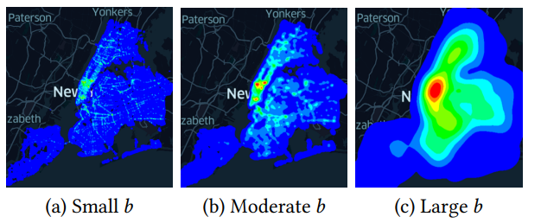
What is LIBKDV?
A python library for supporting KDV (based on SLAM).
Webpage: https://github.com/libkdv/libkdv
Generate multiple KDVs (based on LIBKDV) with different bandwidths b for the New York traffic accident dataset.
[b] Tsz Nam Chan, Pak Lon Ip, Kaiyan Zhao, Leong Hou U, Byron Choi, Jianliang Xu: “LIBKDV: A Versatile Kernel Density Visualization Library for Geospatial Analytics” PVLDB 2022 (vol 15), pages 3606-3609

Slide 22
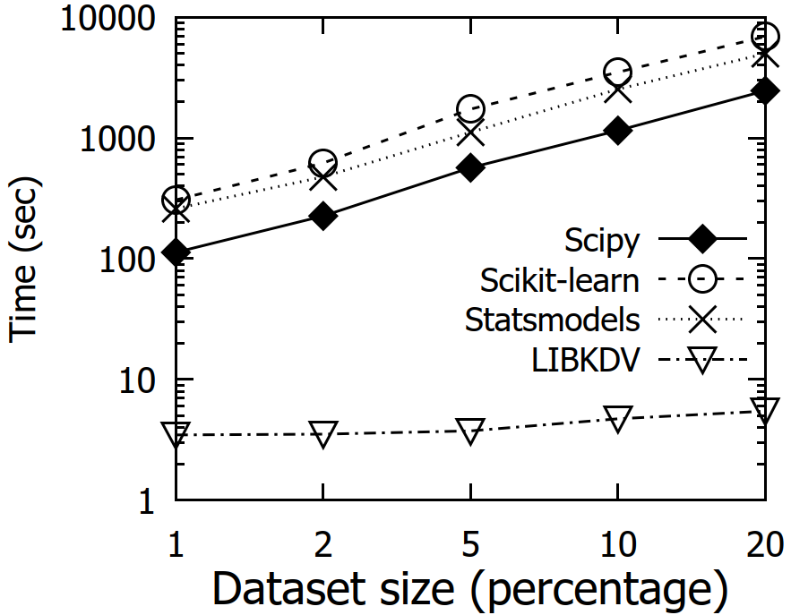
LIBKDV is All You Need!
Fast ☺
Easy to use (three lines of code) ☺

Slide 23
Use Cases: Hong Kong and Macau COVID-19 Hotspot Maps

Slide 24
Hong Kong and Macau COVID-19 Hotspot Maps
Websites:
Hong Kong version (https://covid19.comp.hkbu.edu.hk/)
Macau version (http://degroup.cis.um.edu.mo/covid-19/)
Powered by LIBKDV (https://github.com/libkdv/libkdv)
Can achieve real-time performance (< 0.5 sec) for computing KDV ☺

Slide 25
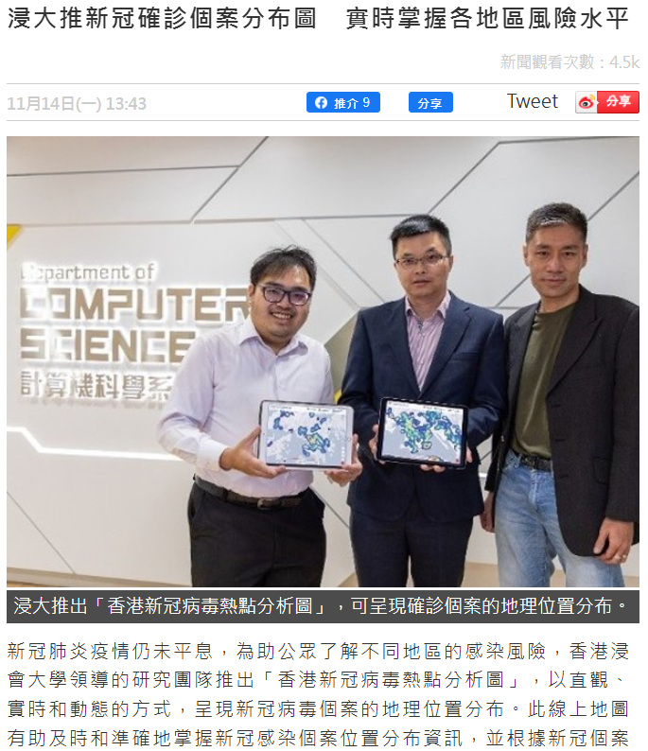
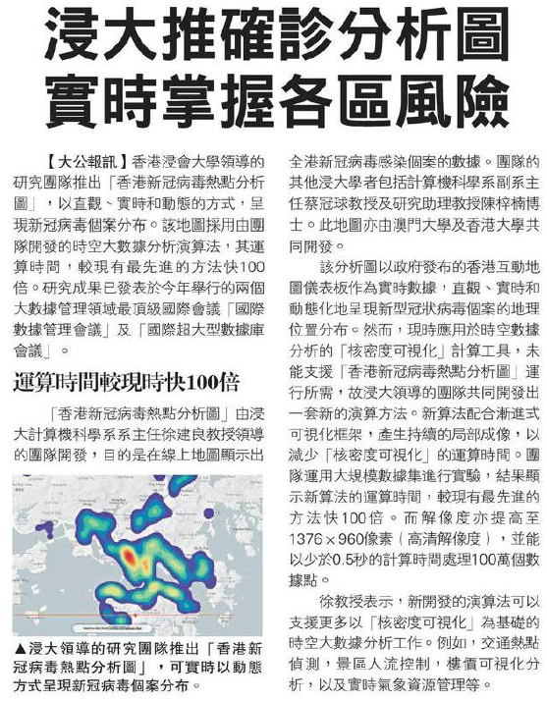
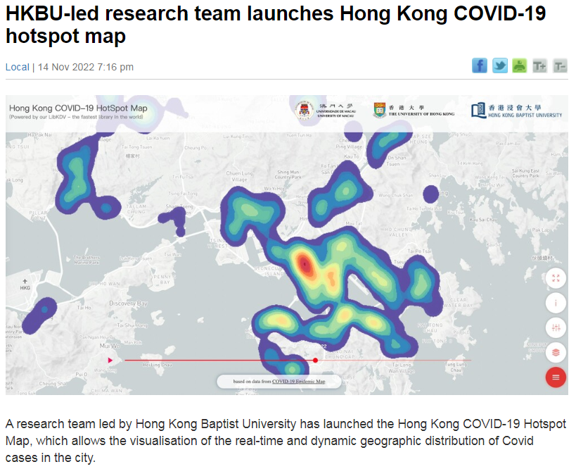
Publicity of Hong Kong COVID-19 Hotspot Map
The standard
Oriental Daily Hong Kong (in Chinese)
Ta Kung Pao News (in Chinese)

Slide 26
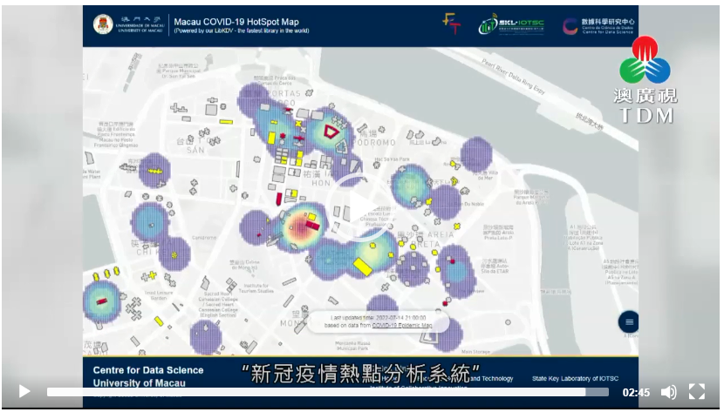
Publicity of Macau COVID-19 Hotspot Map
Macau TDM (Video news in Cantonese)
Newswires

Slide 27
Future Work

Slide 28
Future Work for Research
Can we further develop the optimal solution for KDV?
Current lower bound time complexity: $Ω\left(XY+n\right)$.
State-of-the-art upper bound time complexity: $O\left(Y(X+n)\right)$/ $O\left(X(Y+n)\right)$.
Can we extend our solutions to other kernel functions (e.g., Gaussian kernel and exponential kernel)?

Slide 29
Future Work for Research
Can we extend our solution to support other types of spatial visualization tasks?
Kriging
Inverse distance weighting (IDW)
Can we extend our solution to support other spatial analysis tasks?
K-function
DBSCAN clustering

Slide 30
Future Work for Software Development
Can we further extend our python library LIBKDV to support more visualization tools and data analysis operations (e.g., Kriging, IDW, and K-function)?
Can we further integrate our library in (1) into the commonly used software packages?
Develop plugins for QGIS and ArcGIS
Integrate our methods into Scikit-learn and Scipy.
Can we further develop an R package for supporting those operations in (1)?

Slide 31
Future Work for Software Development
Can we further extend our web-based system (Hong Kong COVID-19 hotspot map) to support more visualization tools and data analysis operations?
(Long-term goal) Develop a software package (like ArcGIS and Scikit-learn) that includes our complexity-reduced algorithms for different operations.

Slide 32
Questions?

