Slide 1
Fast Augmentation Algorithms for Network Kernel Density Visualization
(Edison) Tsz Nam Chan¹, Zhe Li², Leong Hou U³,
Jianliang Xu¹, Reynold Cheng⁴
¹Hong Kong Baptist University ²Hong Kong Polytechnic University
³University of Macau ⁴University of Hong Kong

Slide 2
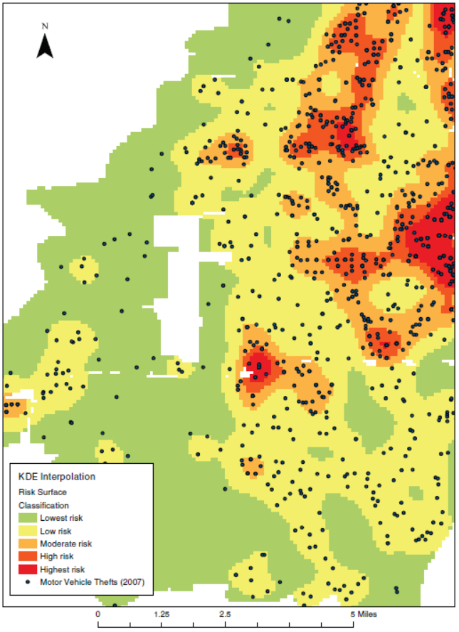
What is Kernel Density Visualization (KDV)?
Application: crime rate prediction
Each p (black dot) represents the location of a crime
e.g., robbery, commercial burglary, motor vehicle theft
Predict the crime rate of a given location (q) by computing the kernel density function $ℱ_{P}\left(q\right)$
weighting
Euclidean distance
2D pixel
$$ℱ_{P}\left(q\right)=\sum_{p_{i}∈P}{w}\left\{\begin{matrix}1−γ^{2}{dist(q,p_{i})}^{2} \\ 0\end{matrix}\right.$$
if $dist\left(q,p_{i}\right)≤\frac{1}{γ}$
otherwise
dataset
constant
[1] T. Hart and P. Zandbergen “Kernel density estimation and hotspot mapping Examining the influence of interpolation method, grid cell size, and bandwidth on crime forecasting”, International Journal of Police Strategies and Management 2014

Slide 3
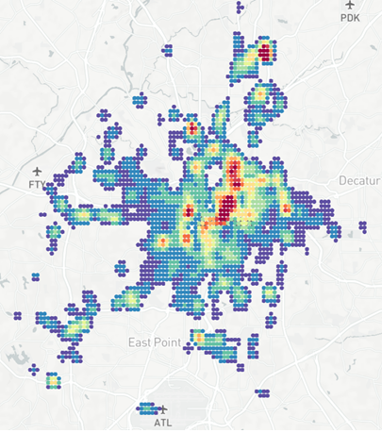
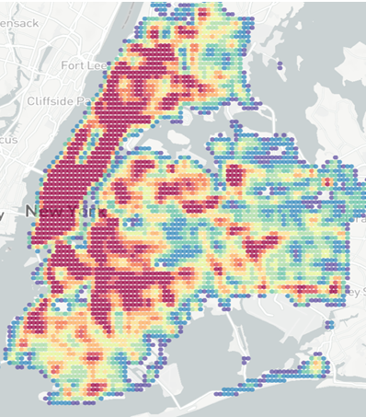
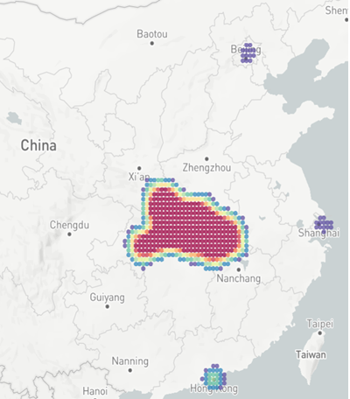
Why KDV?
Crime hotspot detection
Traffic accident hotspot detection
COVID-19 hotspot detection
[1] T. N. Chan, P. L. Ip, L. H. U, W. H. Tong, S. Mittal, Y. Li and R. Cheng. “KDV-Explorer: A Near Real-Time Kernel Density Visualization System for Spatial Analysis” PVLDB 2021 (demo track)

Slide 4
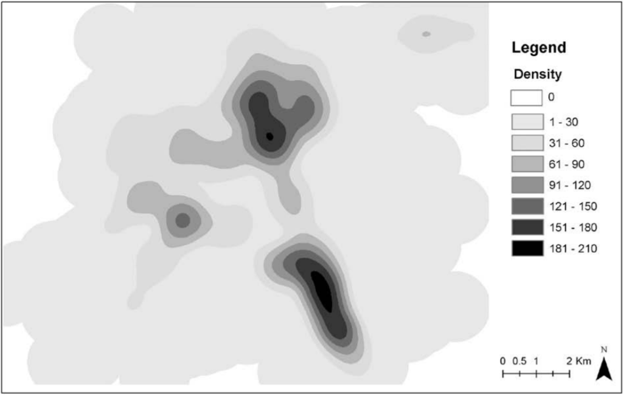
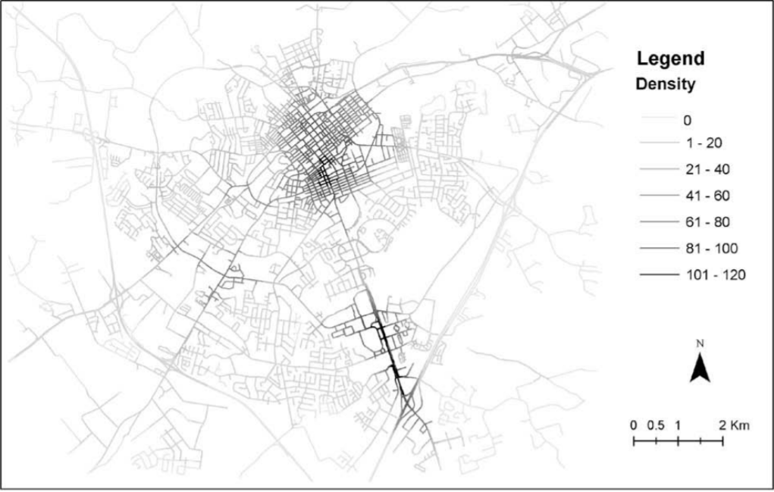
Weakness of KDV
KDV ignores the road network
Can overestimate the density value of some regions (e.g., q₂)
Cannot correctly identify which road segments are the hotspot. [1]
q₂
Road 1
Road 2
q₁
Kernel Density Visualization (KDV)
Network Kernel Density Visualization (NKDV)
[1] Z. Xie and J. Yan. Kernel density estimation of traffic accidents in a network space. Computers, Environment and Urban Systems, 32(5):396 – 406, 2008.

Slide 5
Network Kernel Density Visualization (NKDV)
Divide each road in the road network $G=(V,E)$ into a set of lixels
Color each lixel q, based on the modified kernel density function
weighting
shortest path distance
lixel
$$ℱ_{P}\left(q\right)=\sum_{p_{i}∈P}{w}\left\{\begin{matrix}1−γ^{2}{{dist}_{G}(q,p_{i})}^{2} \\ 0\end{matrix}\right.$$
if ${dist}_{G}\left(q,p_{i}\right)≤\frac{1}{γ}$
otherwise
dataset
constant
q₂
Road 1
Road 1
Road 2
q₁
Road 2
q
q₁
Can overcome the weakness of KDV ☺

Slide 6
NKDV is Slow ☹
Moradi et al. [1]: “...the shortest-path distance can be used as an alternative to the Euclidean one, and since this distance strongly depends on the structure of the linear network, it adds a point of difficulty to the computation. Hence, having efficient approaches to analyze spatial point patterns on linear networks is a welcome issue.”
Yu et al. [2]: “Previous implements on network kernel density estimation have so far been done, but due to the computational complexity of the shortest-path distance calculating, these methods all tend to be very time consuming, especially for large datasets.”
[1] M. M. Moradi, F. J. Rodríguez-Cortés, and J. Mateu. On kernel-based intensity estimation of spatial point patterns on linear networks. Journal of Computational and Graphical Statistics, 27(2):302–311, 2018.
[2] W. Yu, T. Ai, and S. Shao. The analysis and delimitation of central business district using network kernel density estimation. Journal of Transport Geography, 45:32–47, 2015.

Slide 7
Our Contributions
Time-complexity-optimized algorithms for generating exact NKDV ☺
Achieve at least 5 – 10x speedup, compared with the state-of-the-art methods ☺
Negligible space overhead ☺

Slide 8
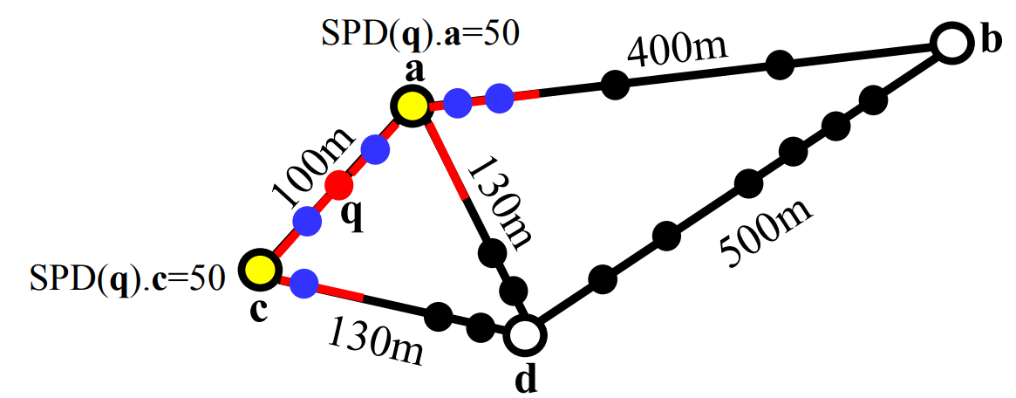
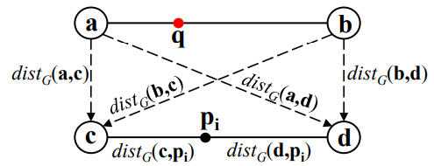
State-of-the-art Solutions
Range-Query-based Solution (RQS)
Avoids scanning data points with ${dist}_{G}\left(q,p_{i}\right)>\frac{1}{γ}$
Time complexity is: $O(L\left(T_{SP}+n\right))$
Shortest Path Sharing Solution (SPS)
Shares the shortest path distances for those lixels in the same edge
Time complexity is: $O\left(|E|T_{SP}+nL\right)$
$L$: number of lixels
$T_{SP}$: the time for the single source shortest path algorithm $n$: number of data points in the road network

Slide 9
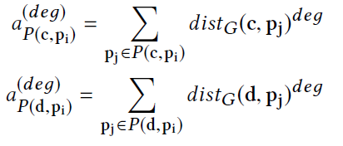
Our Solution: Aggregate Distance Augmentation (ADA)
Augment aggregate distance values for each data point $p_{i}$
Goal: Generate NKDV with $O\left(|E|\left(T_{SP}+L\log\left(\frac{n}{|E|}\right)\right)\right)$ time.
$$\left|P\left(c, p_{i}\right)\right|$$
$$\left|P\left(d, p_{i}\right)\right|$$
$$a_{P(c, p_{i})}^{(1)} \\ a_{P(c, p_{i})}^{(2)}$$
$$a_{P(d, p_{i})}^{(1)} \\ a_{P(d, p_{i})}^{(2)}$$

Slide 10
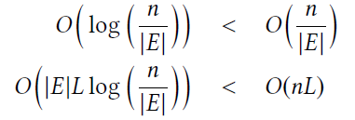
ADA is better than the SOTA
Time complexity of SOTA is:
$$O(\left|E\right|T_{SP}+nL)$$
Time complexity of ADA is:
ADA is better than the SOTA because:
$$O\left(|E|\left(T_{SP}+L\log\left(\frac{n}{|E|}\right)\right)\right)$$

Slide 11
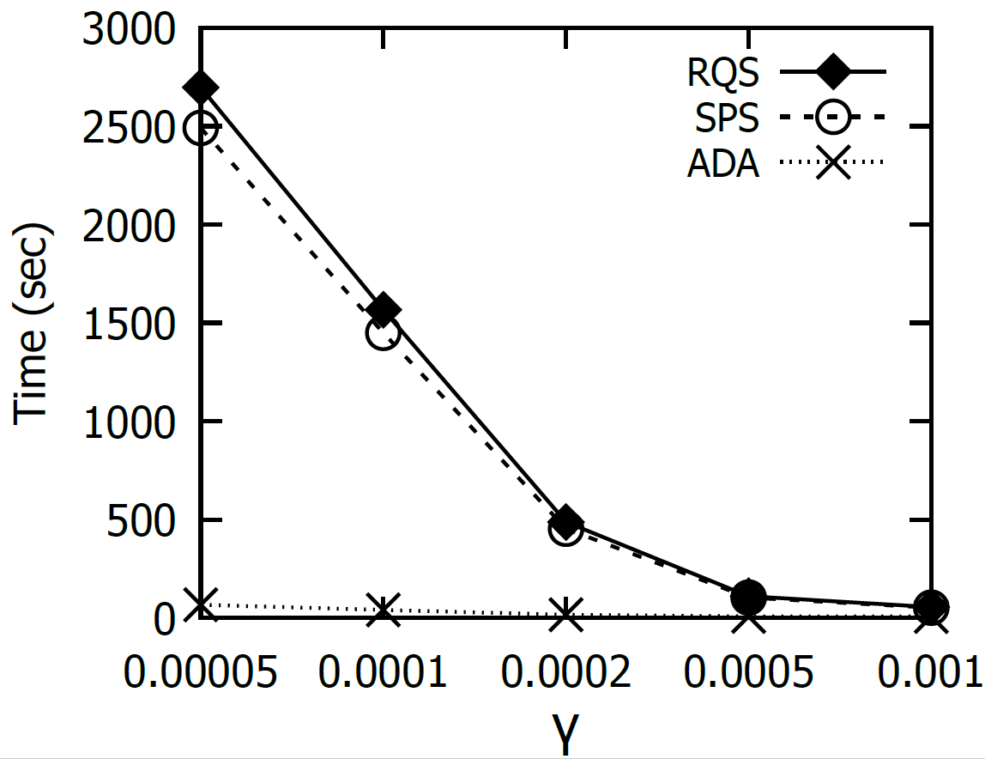
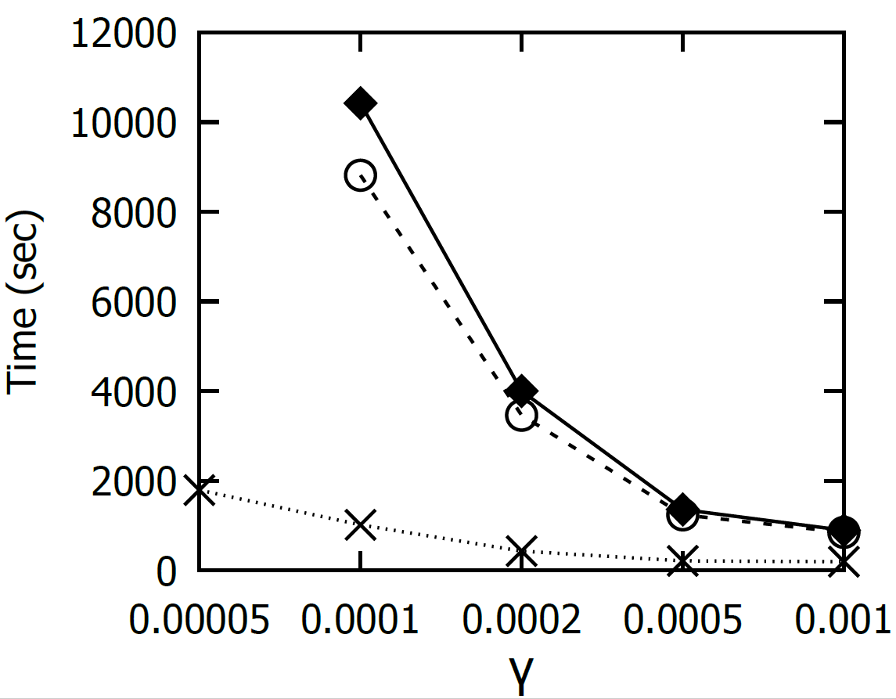
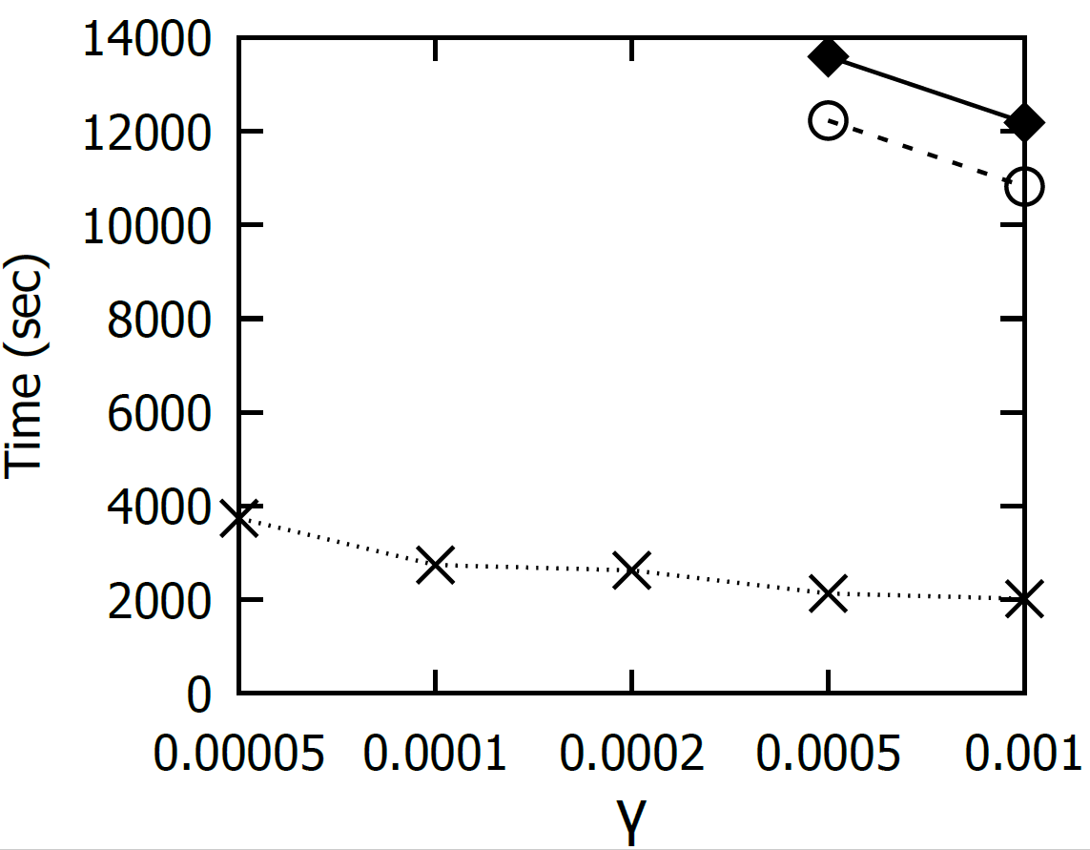
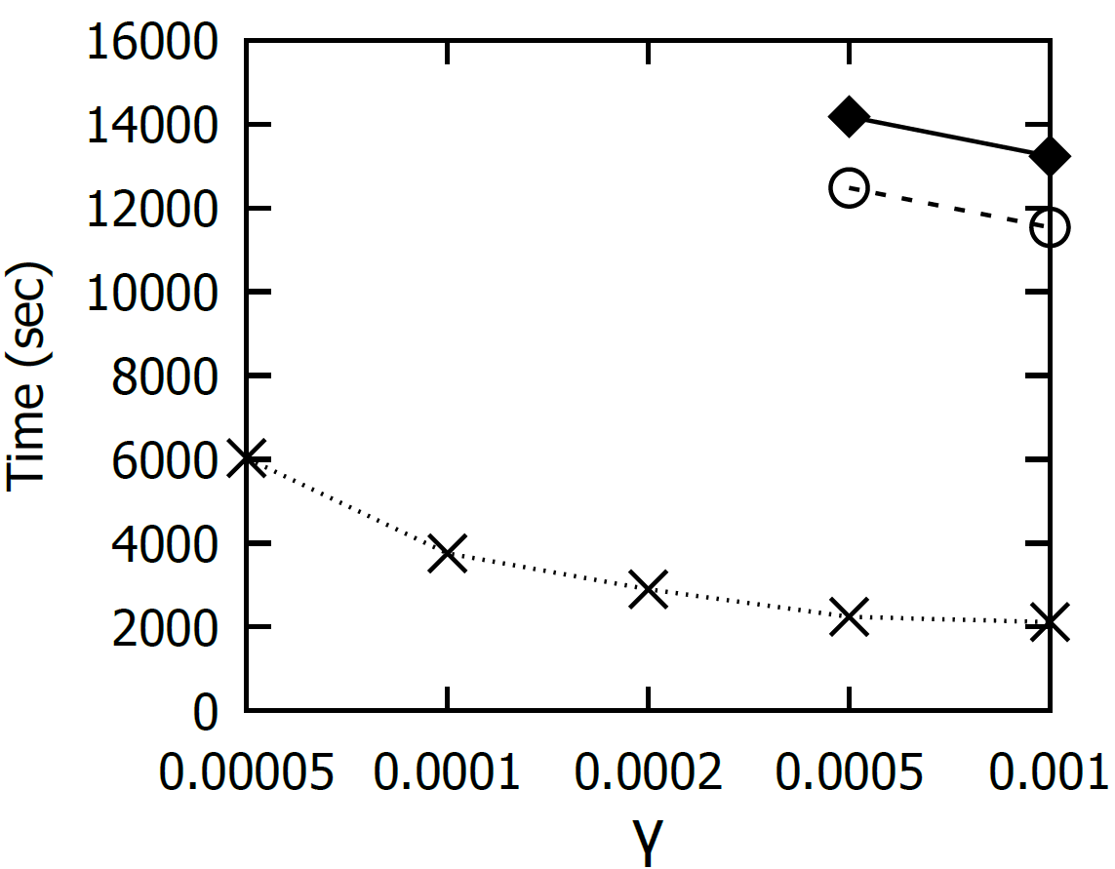
Datasets and Experimental Results
Johns Creek
Seattle
Los Angeles
New York

Slide 12
Conclusion and Future Work
Conclusion:
Develop efficient algorithms that can reduce the worst-case time complexity for generating NKDV
Achieve at least 5-10x speedup, compared with the state-of-the-art solutions
Future Work:
Develop parallel version of our algorithms to further improve the efficiency for generating NKDV
Develop efficient algorithms for spatial-temporal network kernel density visualization (STNKDV)
Develop efficient algorithms for other important GIS operations
Develop the plugin, which integrates the efficient algorithms of important GIS operations (e.g., NKDV), for QGIS and ArcGIS (like SANET [1])
[1] SANET. http://sanet.csis.u-tokyo.ac.jp/

