Slide 1
SLAM: Efficient Sweep Line Algorithms for Kernel Density Visualization
(Edison) Tsz Nam Chan¹ Leong Hou U²
Byron Choi¹ Jianliang Xu¹
¹Hong Kong Baptist University ²University of Macau

Slide 2
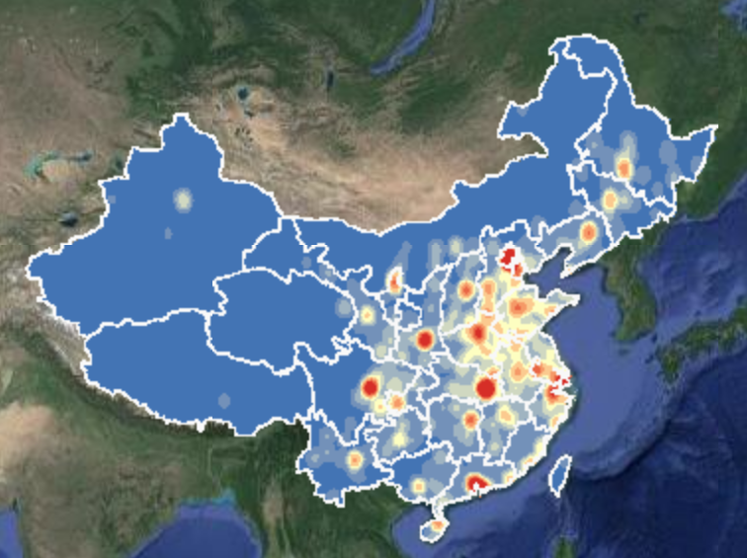
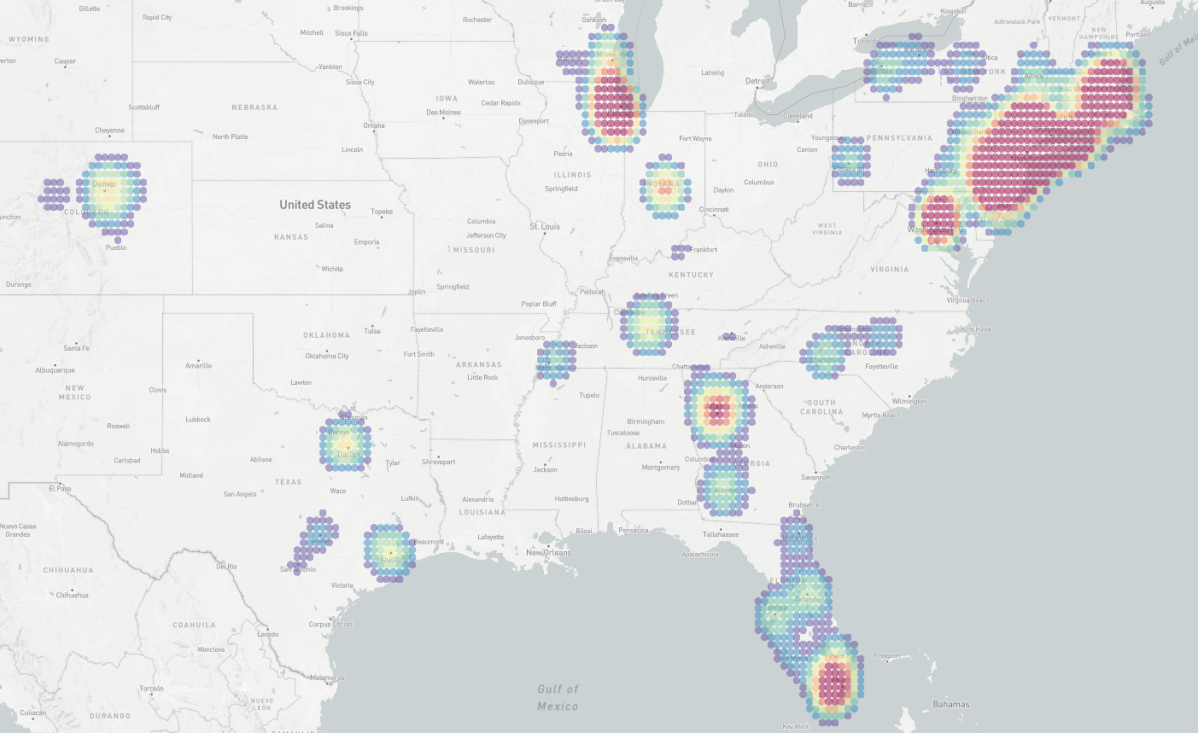
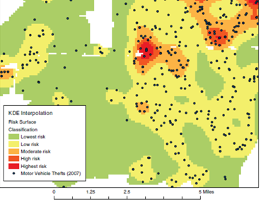
Why Kernel Density Visualization (KDV)?
(a) Density visualization of COVID-19 cases
(b) Density visualization of crime events
[1] http://drr.ikcest.org/knowledge_service/ncp.html
[2] T. N. Chan, P. L. Ip, L. H. U, W. H. Tong, S. Mittal, Y. Li, R. Cheng. "KDV-Explorer: A Near Real-Time Kernel Density Visualization System for Spatial Analysis" VLDB2021
[3] T. Hart and P. Zandbergen “Kernel density estimation and hotspot mapping Examining the influence of interpolation method, grid cell size, and bandwidth on crime forecasting”, International Journal of Police Strategies and Management 2014

Slide 3
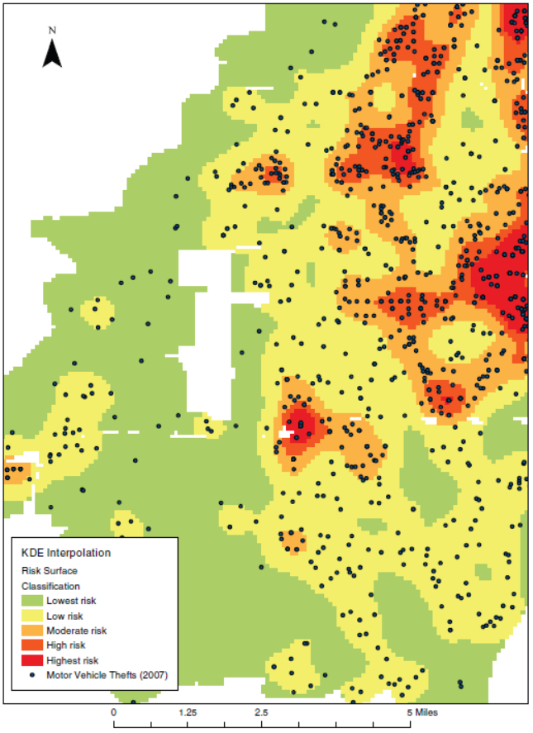
What is KDV?
Application: crime rate prediction
Each p (black dot) represents the location of a crime.
e.g., robbery, commercial burglary, motor vehicle theft
Predict the crime rate of a given location (q) by computing the kernel density function $ℱ_{P}\left(q\right)$.
2D pixel
weighting
Euclidean distance
$$ℱ_{P}\left(q\right)=\sum_{p∈P}{w}∙\left\{\begin{matrix}1−\frac{1}{b^{2}}{dist(q,p)}^{2} \\ 0\end{matrix}\right.$$
If $dist\left(q,p\right)≤b$
Otherwise
dataset
bandwidth
[1] T. Hart and P. Zandbergen “Kernel density estimation and hotspot mapping Examining the influence of interpolation method, grid cell size, and bandwidth on crime forecasting”, International Journal of Police Strategies and Management 2014

Slide 4
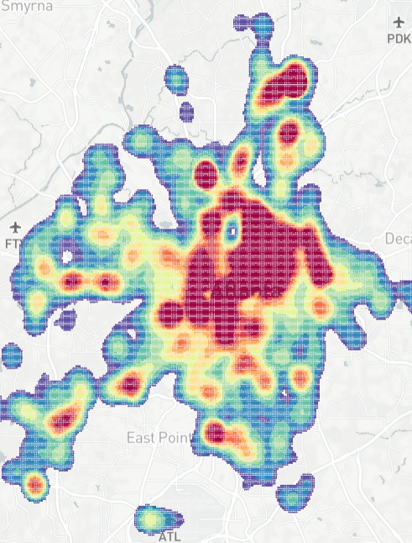
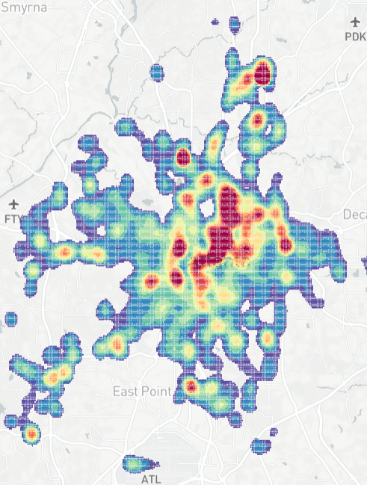
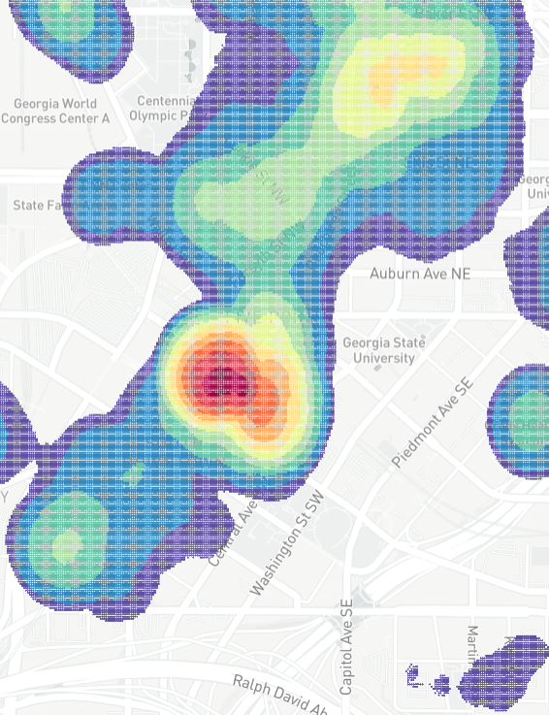
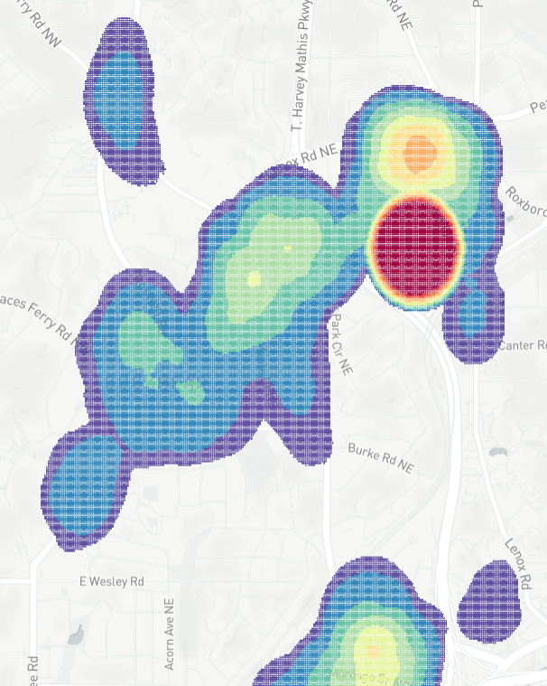
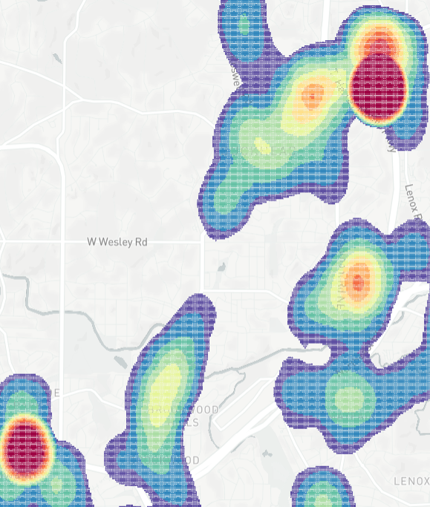
KDV is Slow!
Time complexity: $O(XYn)$
Resolution size: $X×Y$
Number of data points in $P$: $n$
Domain experts need to generate multiple KDVs.
B
Bandwidth
selection
Zoom in
Panning
Zoom out
Many exploratory
operations
(e.g., filtering)

Slide 5
KDV is Slow!
Complaints:
Gan et al. [1] “...the total runtime cost of density estimation is quadratic in dataset size...”
Gramacki et al. [2] “However, many (or even most) of the practical algorithms and solutions designed in the context of KDE are very time-consuming with quadratic computational complexity being a commonplace.”
[1] Edward Gan and Peter Bailis. Scalable Kernel Density Classification via Threshold-Based Pruning. In SIGMOD 2017. 945–959.
[2] A. Gramacki. Nonparametric Kernel Density Estimation and Its Computational Aspects. Springer International Publishing 2017.

Slide 6
Range-Query-based Solution
$$ℱ_{P}\left(q\right)=\sum_{p∈P}{w}∙\left\{\begin{matrix}1−\frac{1}{b^{2}}{dist(q,p)}^{2} \\ 0\end{matrix}\right.$$
If $dist\left(q,p\right)≤b$
b
Otherwise
q
$$ℱ_{P}\left(q\right)=\sum_{p∈R(q)}{w∙}\left(1−\frac{1}{b^{2}}{dist(q,p)}^{2}\right)$$
$$R(q)$$
Simple ☺
Many tree structures are available to improve the practical efficiency ☺
Cannot reduce the worst-case time complexity ($b→∞$) ☹

Slide 7
Our Contributions
The first work for generating a single KDV that can:
Reduce the worst-case time complexity ☺
Retain the same space complexity ☺
Achieve one to two-order-of-magnitude speedup for supporting KDV, using large-scale datasets ☺

Slide 8
Core Ideas of SLAM
Core idea 1: two consecutive pixels can share many data points (white circles) in the range set.
Core idea 2: $ℱ_{P}\left(q\right)$ can be decomposed into this expression.
$$ℱ_{P}\left(q\right)=\sum_{p∈R(q)}{w∙\left(1−\frac{1}{b^{2}}{dist(q,p)}^{2}\right)}$$
b
$$=w\left|R\left(q\right)\right|−\frac{w}{b^{2}}\left(\left|R\left(q\right)\right|×{\left\|q\right\|}_{2}^{2}−2q^{T}A_{R_{q}}+S_{R_{q}}\right)$$
q
q’
$$\sum_{p∈R(q)}{p}$$
$$\sum_{p∈R(q)}{{\left\|p\right\|}_{2}^{2}}$$
$$R(q)$$
$$R(q′)$$
Can we share computations between two consecutive pixels?
How to efficiently maintain $\left|R(q)\right|$, $A_{R_{q}}$, and $S_{R_{q}}$?

Slide 9
Envelope for A Row of Pixels
X
…
$$b$$
…
…
…
…
$$\left(q_{1}.x,k\right)$$
$$\left(q_{3}.x,k\right)$$
…
q₁
q₂
q_{X-1}
q_{X}
Y
$$E(k)$$
…
$$\left(q_{2}.x,k\right)$$
$$\left(q_{X}.x,k\right)$$
…
…
…
…
$$q_{1}.y=q_{2}.y=…=q_{X}.y=k$$
$$X$$
Use $O(n)$ time to find the envelope $E(k)$.

Slide 10
Lower and Upper Bound Functions
Consider the blue data points $p$ that are within the range $b$ of the pixel $q$.
We can let:
$O(n)$ time to find the bound functions for all data points in $E(k)$.
p₁
$$b$$
p₂
$$\left(q.x,k\right)$$
p₃
p₄

Slide 11
Range Search Problem = Interval Stabbing Problem
q.x
p₁
LB_{k}(p₁)
UB_{k}(p₁)
p₁
$$b$$
p₂
p₂
LB_{k}(p₂)
UB_{k}(p₂)
p₃
$$\left(q.x,k\right)$$
LB_{k}(p₃)
UB_{k}(p₃)
p₃
p₄
p₄
LB_{k}(p₄)
UB_{k}(p₄)
x-axis

Slide 12
Sorting-based Sweep Line Algorithm (SLAM_{SORT})
q_{i-1}.x
$$ℓ$$
q_{i}.x
q_{i+1}.x
p₁
LB_{k}(p₁)
UB_{k}(p₁)
p₂
LB_{k}(p₂)
UB_{k}(p₂)
q_{i-1}
p₃
q_{i}
q_{i+1}
LB_{k}(p₃)
UB_{k}(p₃)
p₄
LB_{k}(p₄)
UB_{k}(p₄)
p₅
LB_{k}(p₅)
UB_{k}(p₅)
x-axis
Sort the x-coordinates of the end points of all intervals with $O(n\log{n})$ time.
Use the sweep line $ℓ$ to maintain $\left|R(q)\right|$, $A_{R_{q}}$, and $S_{R_{q}}$ and calculate $ℱ_{P}\left(q\right)$ for each pixel $q$ with $O(X+n)$ time. (Refer to the paper for more details)
Overall time complexity for processing a row of pixels: $O(X+n\log{n})$.
SLAM_{SORT} takes $O(Y(X+n\log{n}))$ time ☺

Slide 13
Bucket-based Sweep Line Algorithm (SLAM_{BUCKET})
Can remove the sorting step (How? Refer to the paper for more details).
SLAM_{BUCKET} takes $O(Y(X+n))$ time ☺

Slide 14
Our Experiment

Slide 15
Ongoing Work and Future Opportunities
Develop the new software package LIBKDV (link), based on our fastest techniques.
Extend SLAM to all kernel functions, e.g., Gaussian kernel and exponential kernel (supported by Scikit-learn).
Can we further develop the optimal solution? (or is SLAM optimal?)
Current lower bound time complexity: $Ω\left(XY+n\right)$.
State-of-the-art upper bound time complexity: $O\left(Y(X+n)\right)$/ $O\left(X(Y+n)\right)$.
Support other types of KDV (e.g., NKDV and STKDV).

