Slide 1

Comp 7780 Special topics in Knowledge & information management
Hans Yip

Slide 2
Week 01
COMP 7780 Special topics in Knowledge & information management
Class Overview

Slide 3
COMP 7780 Special Topics in Knowledge & Information Management
Class Website: http://www.comp.hkbu.edu.hk/~hansyip
Download class syllabus: https://www.comp.hkbu.edu.hk/~hansyip/comp7780/syllabus/syllabus_comp7780_sem2_2021_22.doc
Administrative topics:
  Online/Inclass format
  Class format
We will review the trend of technologies from “how to improve daily work for business” to “how to improve daily life for individual”.

Slide 4
COMP 7780 Special Topics in Knowledge & Information Management
Internet/Network/Web Technologies
We will review and discuss the following topics and the future trend:
Internet/Network/Web technologies:
    Software (Web technologies) (Client/Server architecture):
          HTML -> CSS -> JavaScript -> Perl/PHP/Python/Node.js -> Mobile First/Responsive Web Design (RWD)
    Hardware:
      Computer:
          Mainframe ->Mini computer (mid-range) -> Server -> micro computer -> mobile -> Cloud Computing
      Network:
          (wired) LAN, MAN, WAN;
          (wireless) 1G, 2G, 3G, 4G, 4.5G, 5G, 6G

Slide 5
COMP 7780 Special Topics in Knowledge & Information Management
Database Technologies
Database technologies: (Big Data)
    Structured data: File ->Hierarchy database -> Relational database
    Semi-structured data: Email, XML, JSON data
    Unstructured data: Video, Audio, Images data

Slide 6
COMP 7780 Special Topics in Knowledge & Information Management
Programming Technologies
Programming technologies:
    Languages:
          Cobol (mainframe) -> C, C++ (server) -> Java -> mobile apps (Android, iOS)
    Interface:
          Remote Procedure Call (RPC) -> Application Programming Interface (API) -> microService

Slide 7
COMP 7780 Special Topics in Knowledge & Information Management
Project Management Technologies
Project management technologies:
    Spaghetti programming -> Software Development Life Cycle (SDLC) -> Agile development process

Slide 8
COMP 7780 Special Topics in Knowledge & Information Management
Future Technologies and Trends
Future technologies or trends:
    in-house/outsource, build/buy, IOTs [AI + Technology (Network/Internet) + Industries/software]
Put it all together (the big picture)

Slide 9
The big picture - Technologies that we should know in order to survive beyond the year of 2022.
3. Mobile First
5. Agile
2. API/mS
2. API/mS
4. Big Data
1. Cloud Computing

Slide 10
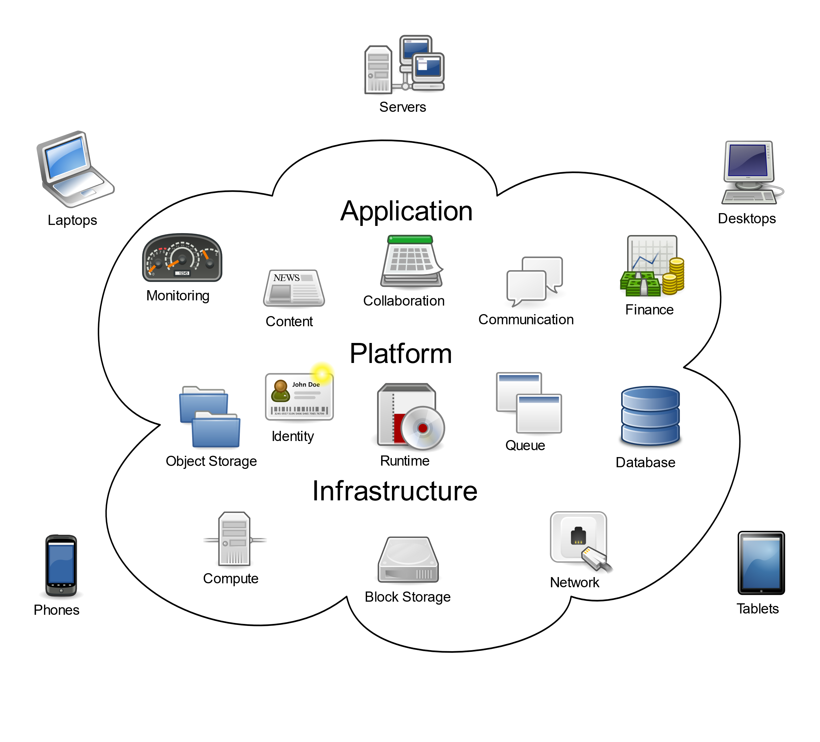
1. Cloud Computing

Slide 11
1. Cloud Computing
What is Cloud Computing?
  Cloud computing is set of resources and services offered through the Internet.
  Cloud services are delivered from data centers located throughout the world.
  Cloud computing facilitates its consumers by providing virtual resources via Internet.
Deployment Methods:
  Private cloud
  Public cloud
  Hybrid cloud
Service Models:
  IaaS (Infrastructure as a Service)
  PaaS (Platform as a Service)
  SaaS (Software as a Service)

Slide 12
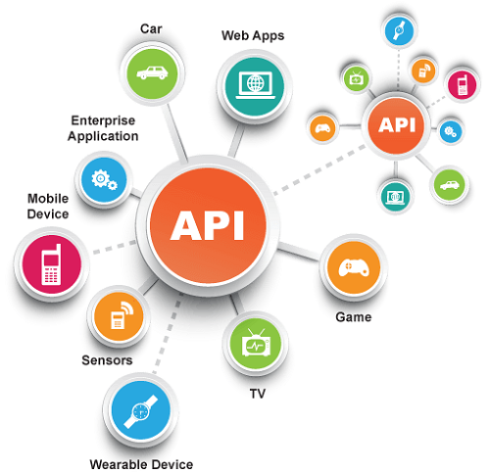
2. API

Slide 13
2. Application Programming Interface (API)
What is API?
  An API (Application Programming Interface) is a software-to-software interface, not a user interface.
  With API, applications talk to each other without any user knowledge or intervention.

Slide 14

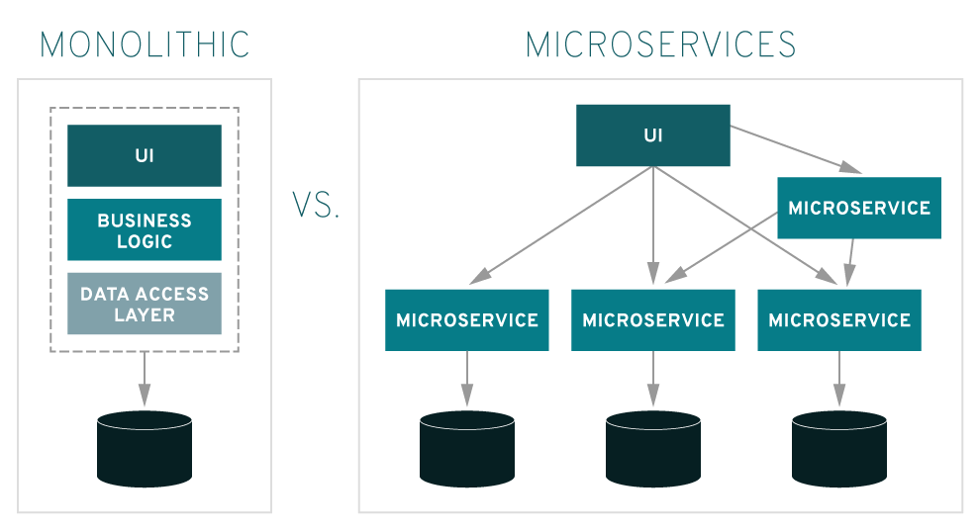
Microservices

Slide 15
microService (mS)
What is microService (mS)?
  microService is a new concept, an architectural style in which applications are composed from loosely coupled API services with automated lifecycles.

Slide 16
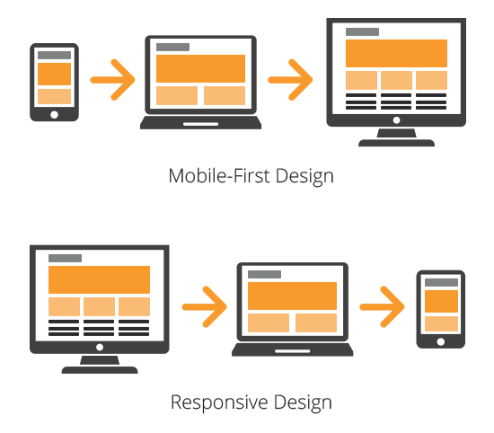
3. Mobile First

Slide 17
3. Mobile First
What is Mobile First?
  A strategy that highlights the need to prioritize the mobile context when creating and delivering user experiences.
What is RWD (Responsive Web Design)?
  Responsive Web Design is about creating web sites which automatically adjust themselves to look good on all devices, from small phones to large desktops
What is Bootstrap?
  Bootstrap is the most popular HTML, CSS, and JavaScript framework for developing responsive, mobile first web sites.

Slide 18

4. Big Data

Slide 19
4. Big Data
What is Big Data?
  Big data is an all-encompassing term for any collection of data sets so large and complex that it becomes difficult to process using on-hand data management tools or traditional data processing applications.
  Big data refers to extremely vast amounts of multi-structured data that typically has been cost prohibitive to store and analyze. (My view)

Slide 20
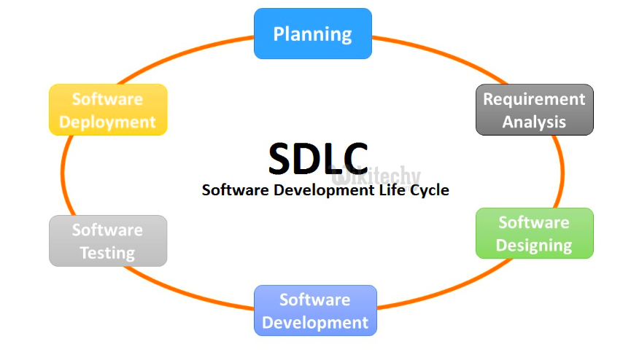
Software Development Life Cycle (SDLC)

Slide 21
Software Development Life Cycle (SDLC)
What is Software Development Life Cycle (SDLC)?
  Software Development Life Cycle (SDLC) is a process used by the software industry to design, develop and test high quality softwares. The SDLC aims to produce a high-quality software that meets or exceeds customer expectations, reaches completion within times and cost estimates.
  analysis phase – design phase -- coding phase – testing phase – migration phase

Slide 22
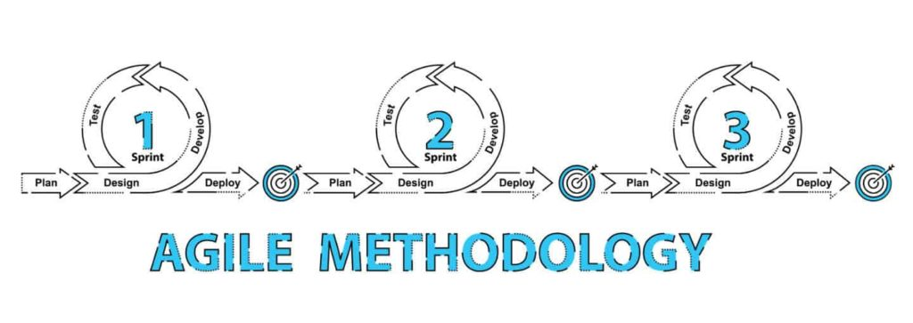
5. Agile

Slide 23
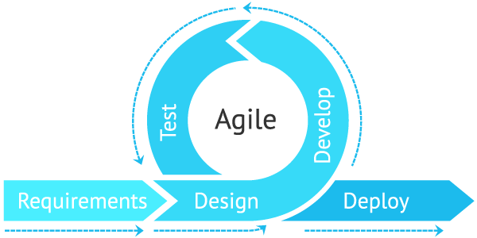
What is Agile?

Slide 24
5. Agile
What is Agile?
  Agile is a software development process under which requirements and solutions evolve through the collaborative effort of self-organizing cross-functional teams.

Slide 25
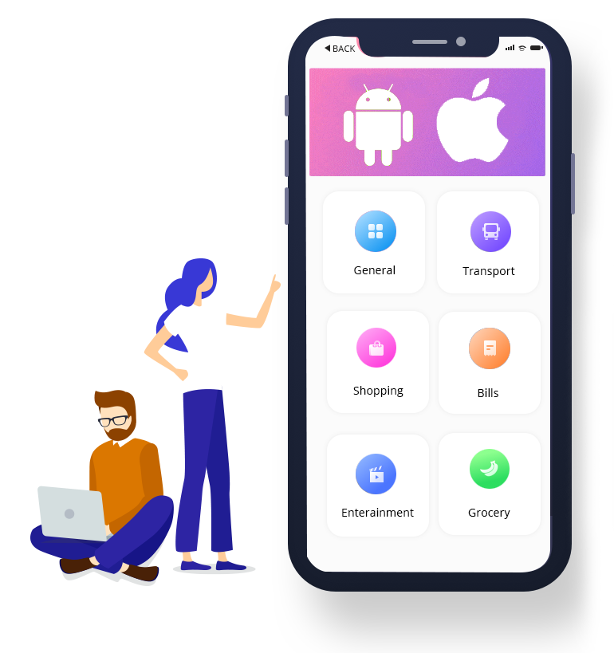
Mobile Apps

Slide 26
Mobile Apps
What is a Smartphone?
  A Smartphone is a cellular phone combined with a handheld computer in which you can make phone calls and other computer functions such as internet access and capable of running downloaded apps.
What is mobile operating system? (Mobile OS)
  A mobile operating system (Mobile OS) is an Operating System for Smartphones, tablets, or other mobile devices.
Platform | Developed by
iOS 15.x | Apple
Android 12.x | Goggle
Windows 10 Mobile (Dec 10, 2019 End of Support) | Microsoft

Slide 27


Slide 28
Node.js
What is Node.js?
  Node.js provides a non-blocking architecture using event loop processing based on single threaded JavaScript model and built on top of Google’s V8 JavaScript Engine.
We will learn a new server-side scripting language – Node.js by using the Agile development process to develop a new application. (No previous programming experience is required).

Slide 29
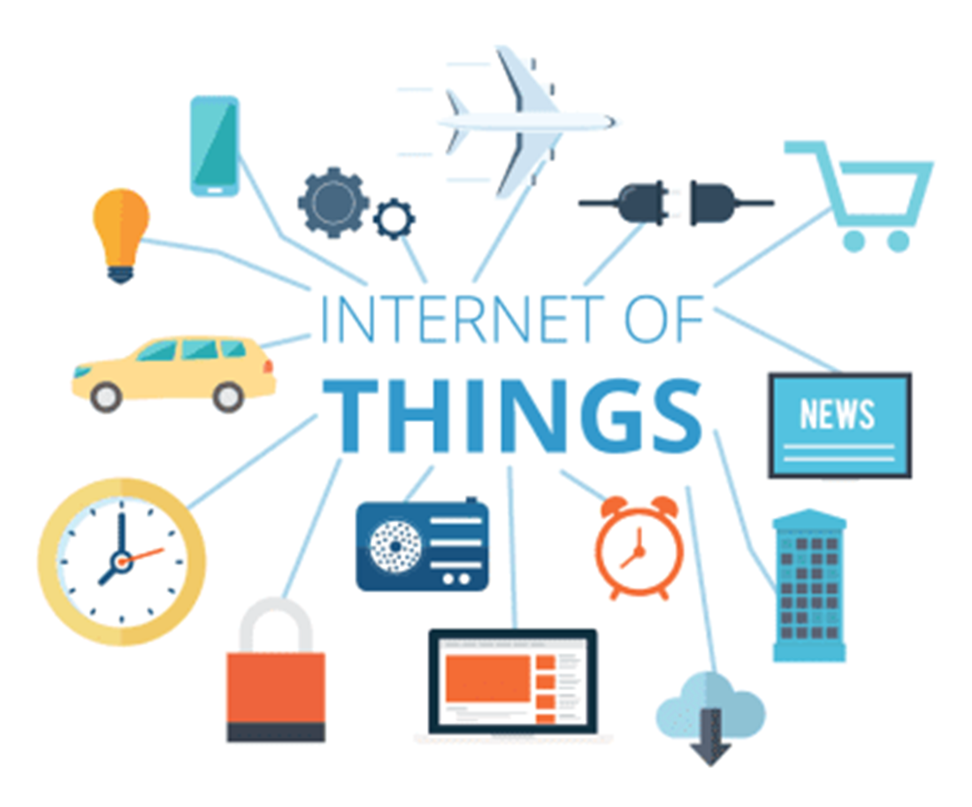
Internet of Things(IoTs)

Slide 30
Internet of Things (IoTs)
What is IoTs (Internet of Things)?
  The internet of thing (IoT) is a computing concept that describes the idea of everyday physical objects being connected to the internet and being able to identify themselves to other devices.
  The term is closely identified with RFID (Radio Frequency Identification) as the method of communication, although it also may include other sensor technologies, wireless technologies or QR codes

Slide 31
Technologies that other people also considered
Artificial Intelligence
Big data
Cloud computing
DevOps

