Slide 1

Web technologies
Hans Yip

Slide 2
Learning Objectives
Internet Review
HTML5 Review
JavaScript Review
HTTP
DOM
DOM Event
XML/JSON
AJAX
  Use XMLHttpRequest object
  Use jQuery
  Use fetch API

Slide 3
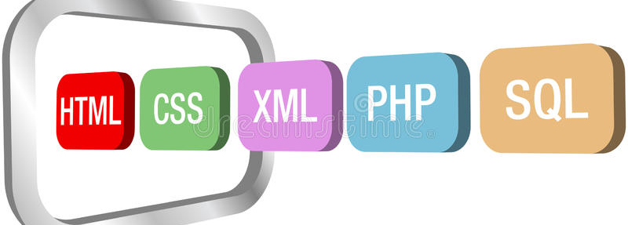
Web Technologies

Slide 4

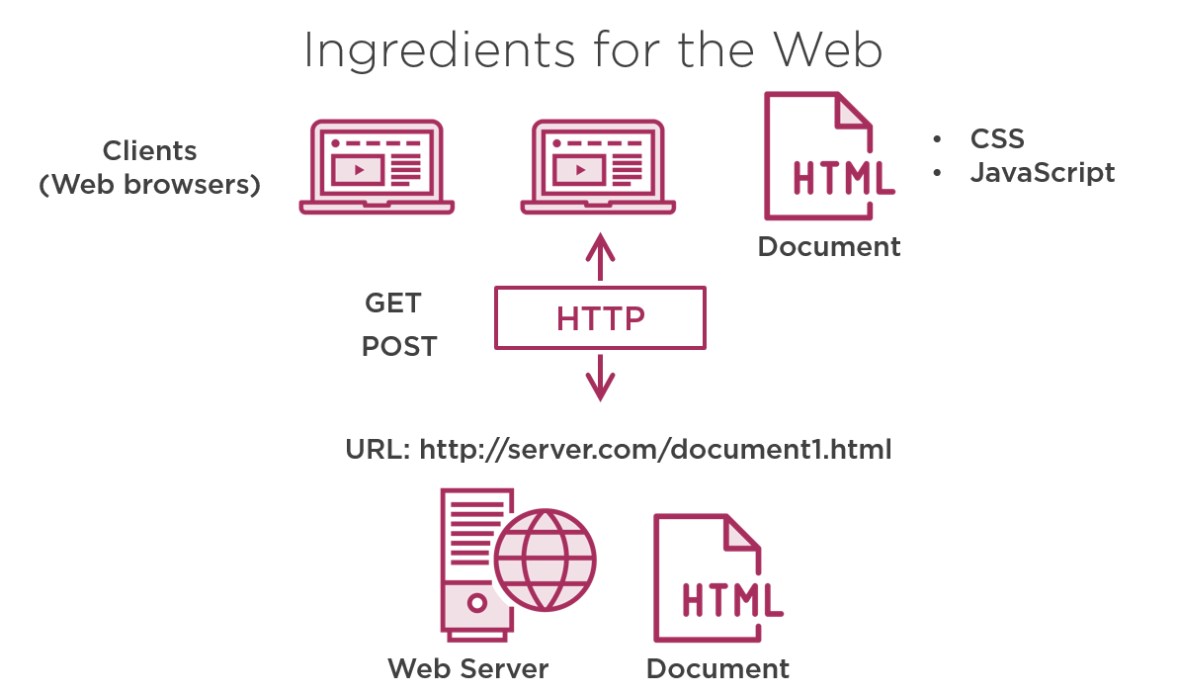
Ingredients For The Web

Slide 5
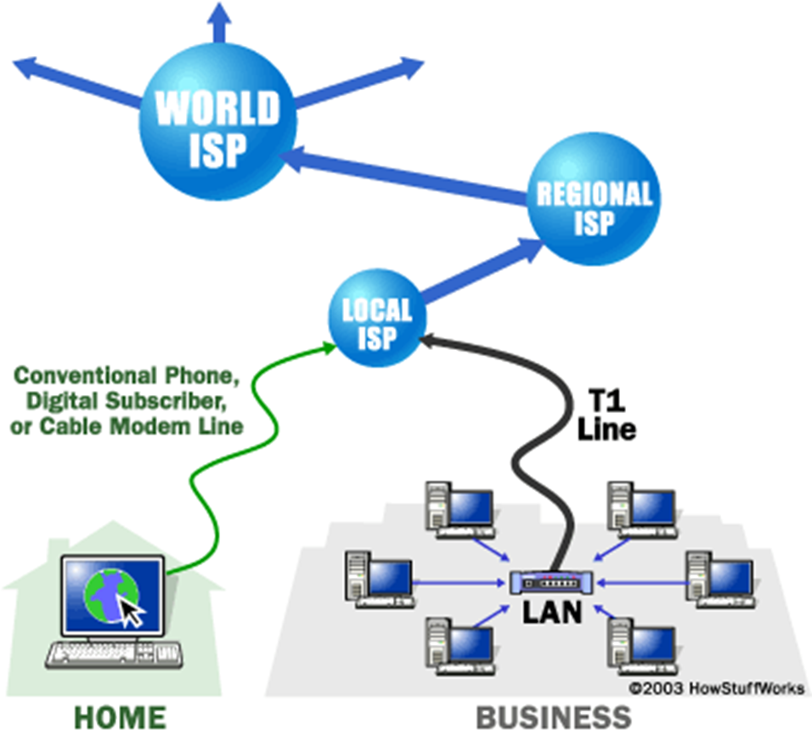
Internet Review

Slide 6
The Internet
The Internet is a worldwide collection of networks that connects millions of businesses, government agencies, educational institutions, and individuals
Network Architecture – Client/Server architecture.
  A client is defined as a requester of services.
  A server is defined as the provider of services.
PC + PC => LAN (Local Area Network)
LAN + LAN => WAN (Wide Area Network)
WAN + WAN => Internet
NOTE: Internet is the largest WAN in the world.

Slide 7
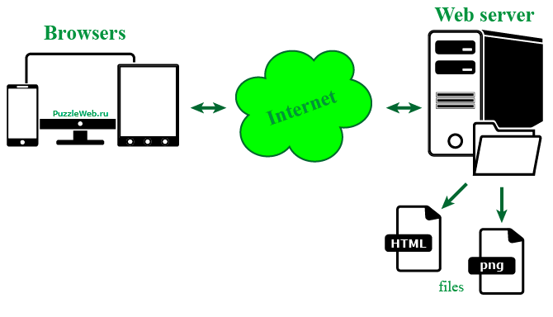
The Internet - How does Internet Work?

Slide 8
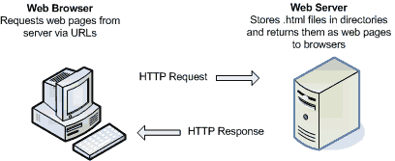
The Internet - How does Internet Work?

Slide 9
The Internet - How does Internet Work?
Internet uses a client/server networking principle
When you enter the URL (http://www.mywebpage.com/myfile.html) of a web page into your browser and click “GO”
The browser breaks the URL (Uniform Resource Locator) into three parts:
  The protocol (“http”)
  The server name (“www.mywebpage.com”)
  The file name (“myfile.html”)
The browser makes a request to the Domain Name Server with the server name which translates the server name www.mywebpage.com into an IP address.

Slide 10
The Internet - How does Internet Work?
The browser then uses the IP address connecting to the server machine on port 80.
Following the HTTP protocol, the browser creates a HTTP request with a GET request to the server, asking for the file myfile.html (cookies may be sent from browser to server with the HTTP request)
The web server then sent a HTTP response with the HTML text for the web page to the browser (cookies may also be sent from server to browser in the header for the page)
The browser reads and interprets the HTML tags and formats the page onto your screen.

Slide 11
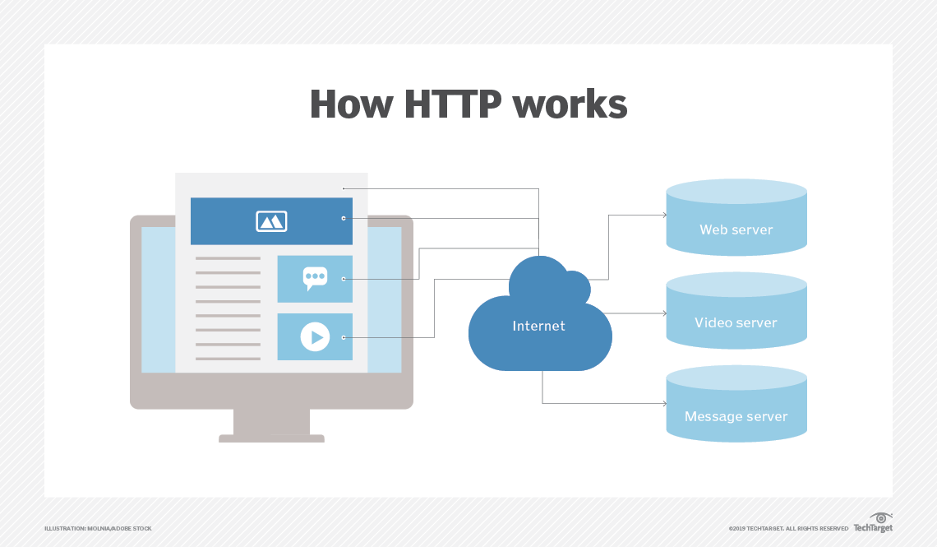
The Big Picture
Client (Browser) --> http request --> Internet --> Server (Web Server)
Server (Web Server) --> http response --> Internet --> Client (Browser)

Slide 12
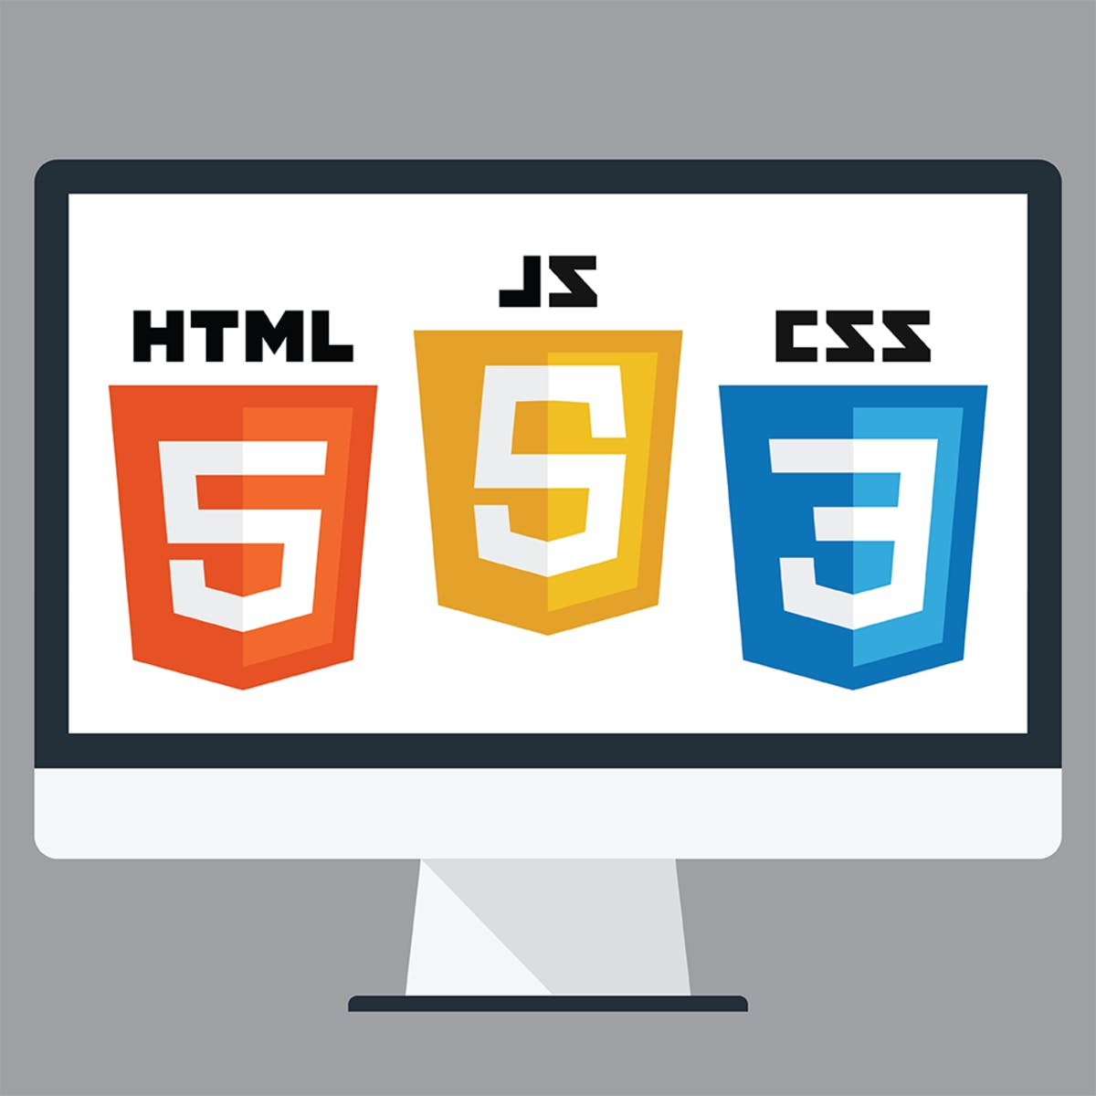
The Web Page

Slide 13
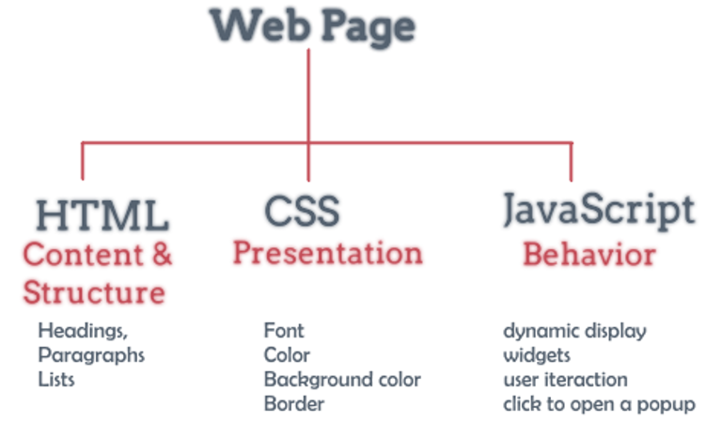
Ingredients For The Web Page

Slide 14
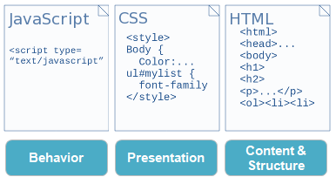
HTML CSS JS

Slide 15

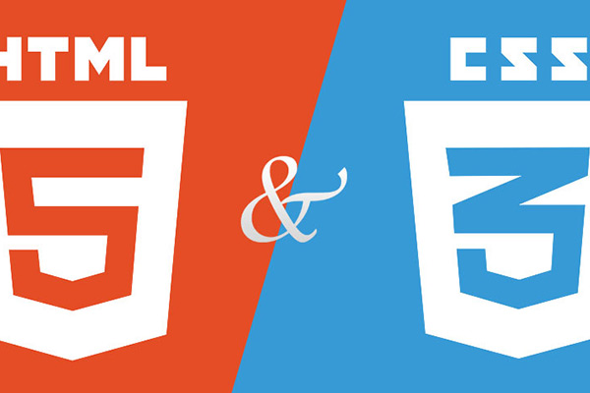
HTML5 & CSS3

Slide 16
HTML5
A Web page is simply a text file written in a language called Hypertext Markup Language (HTML)
Markup Language: is a language that describes a document’s structure and content
Hypertext Markup Language (HTML): is a nonproprietary markup language that a Web browser interprets and uses to display the content as a Web page.

Slide 17
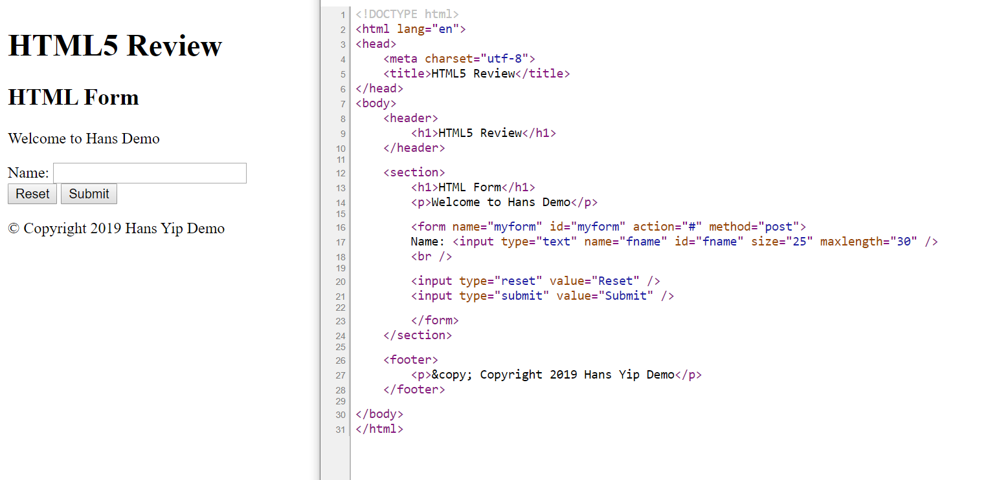
HTML5 Sample

Slide 18
Cascading Style Sheet (CSS)
Style Sheets are files or forms that describe the layout and appearance of a document
Cascading Style Sheet (CSS) is a style sheet language used on the Web
  CSS Statement
  selector { property: value; }
  p, address { color: red; }
  CSS Comments
  /* CSS multi-line comments */
  Three versions of CSS – CSS1, CSS2, CSS3

Slide 19
Define CSS id and class
CSS id: Uniquely identify an object in HTML (used only once in a document)
#id_name { property: value; }
#head { text-align: center; } /* css id defined in heading section */
<p id="head">Paragraph data</p> <!-- css id used in body section -->
CSS class: make a group of elements with a common identifier
.class_name { property: value; }
.title { color: blue; font-style: italic; } /* css class defined in heading section */
<h1 class="title">Header One Title</h1> <!-- css class used in body section -->
<h3 class="title">Header three Title</h3>

Slide 20
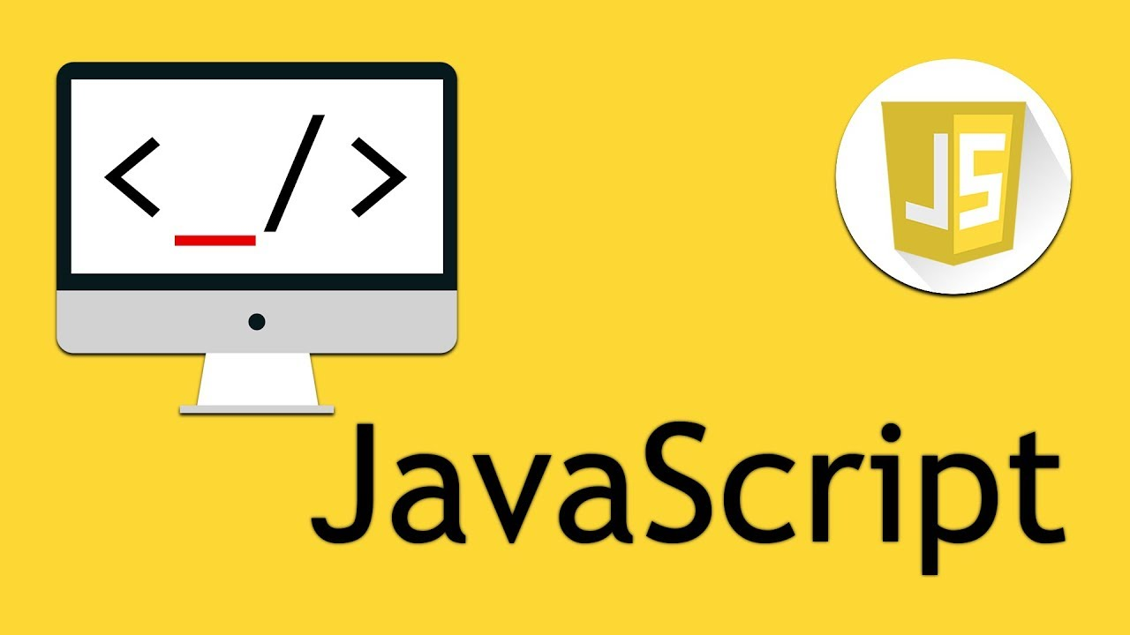
JavaScript Review

Slide 21
What is JavaScript?
JavaScript is an interpreted, object-based scripting language modeled after C++.
JavaScript is loosely typed language, which means that variables do not need to have a type specified.
JavaScript is a case-sensitive language.
JavaScript ignores “Whitespaces” (spaces, tabs, and newlines) that appear between token in programs.
JavaScript automatically inserts semicolons before a line break.
JavaScript statements are end with semicolon (;). (optional)
Omitting semicolon is not a good programming practice.
Single line comment: any text between a // and the end of a line is treated as a comment and is ignored by JavaScript.
Multiple lines comment: any text between the characters /* and */ is also treated as a comment.

Slide 22
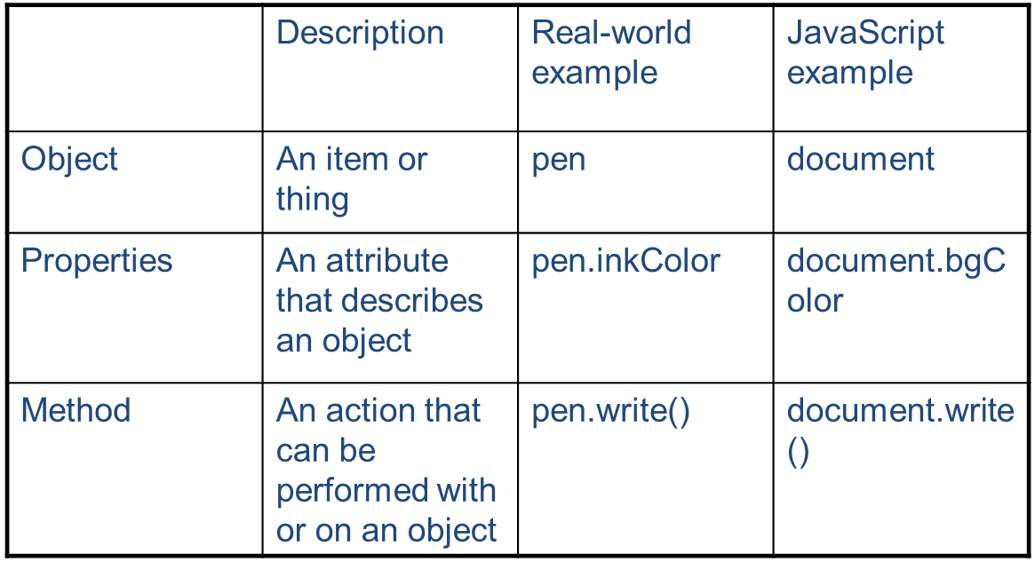
JavaScript – Object Oriented Concepts

Slide 23

HTTP

Slide 24
What is HTTP?
HTTP stands for Hyper Text Transfer Protocol
HTTP (Hypertext Transfer Protocol) is the set of rules for transferring files, such as text, graphic images, sound, video, and other multimedia files, on the World Wide Web.
Communication between client computers and web servers is done by sending HTTP Requests and receiving HTTP Responses
There are several methods:
  GET used to retrieve a resource.
  POST used to initiate an action on a server.
  DELETE used to delete resources on a server.
  PUT used to update resources on a server.

Slide 25
HTTP Status Codes
There are a lot of status codes. The most important ones are:
  1XX (Informational Response)
  2XX (Success) – 200 Everything OK.
  3XX (Redirection) – 301 Moved Permanently.
  4XX (Client Error)
    400 Bad Request
    401 Unauthorized
    402 Payment Required
    403 Forbidden
    404 Not Found
    405 Method Not Allowed
  5XX (Server Error) - 500 Internal Server Error

Slide 26
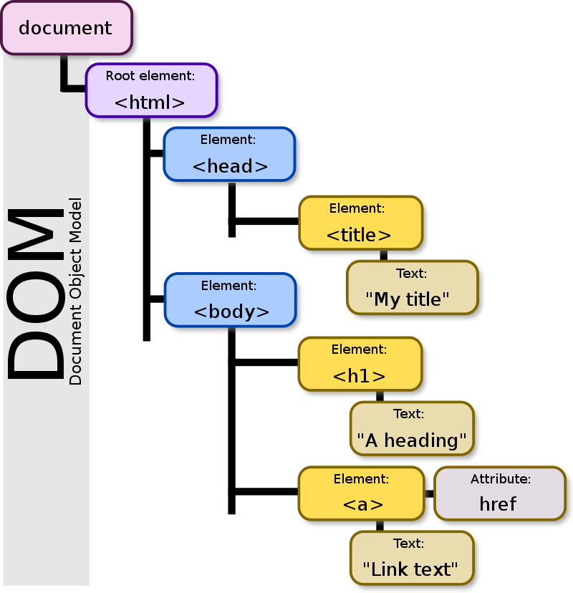
HTML DOM

Slide 27
Document Object Model (DOM)
DOM (Document Object Model): objects represent various components of the browser and the current HTML document.
It defines:
  HTML elements as object.
  Properties for all HTML elements
  Methods for all HTML elements
  Events for all HTML elements
NOTE: DOM is not part of the JavaScript language. It is an API (Application Programming Interface) build into the browser.
NOTE: The window object is the parent object for all of the objects. (See next diagram)
The HTML DOM is an API (Application Programming Interface) for JavaScript:
  JavaScript can add/change/remove HTML elements
  JavaScript can add/change/remove HTML attributes
  JavaScript can add/change/remove CSS styles
  JavaScript can react to HTML events
  JavaScript can add/change/remove HTML events

Slide 28
DOM Object Hierarchy

Slide 29
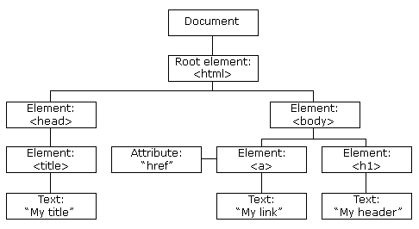
The HTML DOM
When a web page is loaded, the browser creates a Document Object Model of the page.
The HTML DOM model is constructed as a tree of Objects:

Slide 30
Finding Elements in a Document
Old Styles:
  document.getElementById(‘id-of-element’);
  document.getElementsByClassName(‘class-of-element’);
  document.getElementsByTagName(‘html-element’);
New Styles:
  document.querySelector(‘#id-of-element’);
  document.querySelectorAll(‘.class-of-element’);
  document.querySelectorAll(‘html-element’);

Slide 31
querySelector()
The querySelector() method returns the first element (single element, not an object, should apply CSS directly to it) that matches a specified CSS selector(s) in the document.
For multiple selectors, separate each selector with a comma. The returned element depends on which element that is first found in the document
Note: The querySelector() method only returns the first element that matches the specified selectors. To return all the matches, use the querySelectorAll() method instead.

Slide 32
querySelectorAll()
The querySelectorAll() method returns all elements in the document that matches a specified CSS selector(s), as a static NodeList object.
The NodeList object represents a collection of nodes. The nodes can be accessed by index numbers. The index starts at 0.
For multiple selectors, separate each selector with a comma. (multiple selectors will be affected)
Tip: You can use the length property of the NodeList object to determine the number of elements that matches the specified selector, then you can loop through all elements and extract the info you want.

Slide 33

DOM Event

Slide 34
Event and Event Handler
Events: are visitor and browser activities. (the phone rings)
Event handlers: are the mechanisms that allow us to capture and actually respond to those events with a scripting language. (pick up the phone and say, “Hello”)

Slide 35
Writing Event Handlers
Event handlers: are written inline with HTML, just like an HTML attribute. Therefore, Event handlers also called intrinsic event attributes. (the only different is that Event Handler executes JavaScript script or function).
HTML Tag: <img src="image.jpg" width="500" height="500">
Event handler/intrinsic event attribute: <body onload="alert('Hello')">

Slide 36
Sample Events
There are quite a few different events:
  Onblur
  onchange
  onclick
  onfocus
  onkeydown
  onkeypress
  onkeyup
  onload
  onmousedown
  onmousemove
  onmouseout
  onmouseover
  onmouseup
  onsubmit
  onunload

Slide 37


Slide 38
What is JSON?
JSON is short for JavaScript Object Notation.
JSON is a syntax for storing and exchanging data.
JSON is an easier-to-use alternative to XML.
Note:
Although JSON is an extension of JavaScript, it is also available in many different languages such as: C, Ruby, Python, etc.

Slide 39
JSON Object
JSON objects are written inside curly braces.
Just like JavaScript, JSON objects can contain multiple name/values pairs:
{'fname’: 'John', ‘lname’: 'Doe'}
JSON Object Rules:
  Enclosed in curly braces.
  Each name followed by : (colon) and name/value pairs separated by , (comma).
  Keys must be strings and should be different from each other.
Because JSON uses JavaScript syntax, no extra software is needed to work with JSON within JavaScript.

Slide 40
JSON Example – Coverts JSON text to Object
Create a JavaScript string containing JSON syntax:
var text = '{"fname": "John", "lname": "Doe"}';
JSON syntax is a subset of JavaScript syntax.
The JavaScript function JSON.parse(text) can be used to convert a JSON text into a JavaScript object:
var json_obj = JSON.parse(text);
The JavaScript function JSON.stringify(object) can be used to convert a JSON object into a JavaScript string:
var json_string = JSON.stringify(json_obj);

Slide 41

AJAX

Slide 42
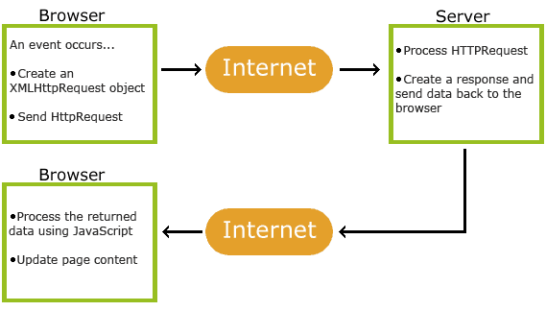
AJAX
AJAX = DOM Event + JavaScript + http Request + Internet + php + http Response + text/XML/JSON + DOM

Slide 43
AJAX
AJAX stands for Asynchronous JavaScript And XML.
AJAX is not a new programming language, but a technique for creating better, faster, and more interactive web applications.
With AJAX, your JavaScript can communicate directly with the server, using the JavaScript XMLHttpRequest object. With this object, your JavaScript can trade data with a web server, without reloading the page.
AJAX uses asynchronous data transfer (HTTP requests) between the browser and the web server, allowing web pages to request small bits of information from the server instead of whole pages.
The AJAX technique makes Internet applications smaller, faster and more user-friendly.
AJAX is a browser technology independent of web server software.

Slide 44
AJAX uses HTTP Requests
In traditional JavaScript coding, if you want to get any information from a database or a file on the server, or send user information to a server, you will have to make an HTML form and GET or POST data to the server. The user will have to click the "Submit" button to send/get the information, wait for the server to respond, then a new page will load with the results.
Because the server returns a new page each time the user submits input, traditional web applications can run slowly and tend to be less user-friendly.
With AJAX, your JavaScript communicates directly with the server, through the JavaScript XMLHttpRequest object
With an HTTP request, a web page can make a request to, and get a response from a web server - without reloading the page. The user will stay on the same page, and he or she will not notice that scripts request pages, or send data to a server in the background.

Slide 45
AJAX – Using XMLHttpRequest (XHR)
Scripting HTTP with XMLHttpRequest is a three-part process:
  Creating an XMLHttpRequest object
  Specifying and submitting your HTTP request to a web server
  Synchronously or asynchronously retrieving the server’s response
AJAX – One, Two, Three (See below)

Slide 46
One Object
The XMLHttpRequest object has never been standardized, and the process of creating one is different in Internet Explorer than on other platforms.
In most browsers, you create an XMLHttpRequest object with a simple constructor call:
  var request = new XMLHttpRequest();

Slide 47
Two Methods
The XMLHttpRequest object contains two important methods:
  open()
  send()

Slide 48
Three Properties
The XMLHttpRequest Object contains the following important properties:
  The onreadystatechange property contains function that will process the response from a server.
  The readyState property contains the status of the server’s response. ( 0 to 4)
  The status property contains the status of the web page. (200=ok; 404=page not found)
  The responseText property contains the data sent back from the server in string format.
  The responseXML property contains the data sent back from the server in XML format.
NOTE: Data will be either populated in responseText or responseXML property, but not both.

Slide 49
AJAX using XMLHttpRequest samples
http://fog.ccsf.edu/~hyip/cnit133/10/in_class_samples/ajax_sample.html
http://fog.ccsf.edu/~hyip/cnit133/10/in_class_samples/ajax_sample_2.html
http://fog.ccsf.edu/~hyip/cnit133/10/in_class_samples/ajax_sample_3.html
http://fog.ccsf.edu/~hyip/cnit133/10/samples/note.html

Slide 50
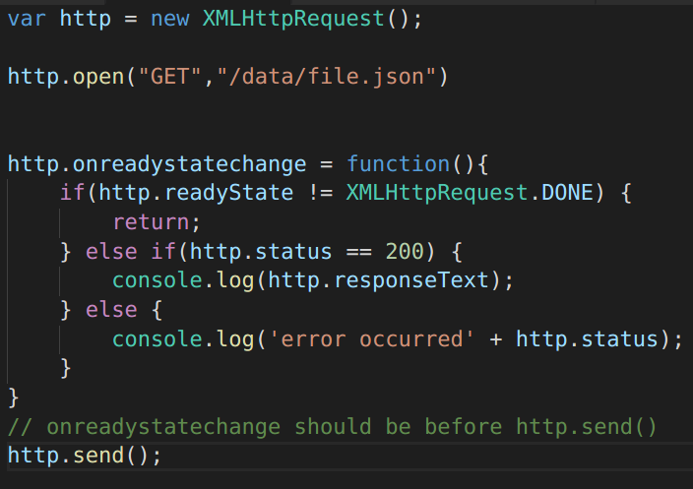
AJAX in Action

Slide 51
AJAX - using jQuery
jQuery provides several methods for AJAX functionality.
With the jQuery AJAX methods, you can request text, HTML, XML, or JSON from a remote server using both HTTP Get and HTTP Post - And you can load the external data directly into the selected HTML elements of your web page!
The ajax() method is used to perform an AJAX (asynchronous HTTP) request.
All jQuery AJAX methods use the ajax() method. This method is mostly used for requests where the other methods cannot be used.
$.ajax({name:value, name:value, ... })
jQuery AJAX samples:
https://fog.ccsf.edu/~hyip/cnit133/10/in_class_samples/ajax_sample_jquery.html
https://fog.ccsf.edu/~hyip/cnit133/10/in_class_samples/ajax_sample_2_jquery.html
https://fog.ccsf.edu/~hyip/cnit133/10/in_class_samples/ajax_sample_3_jquery.html
https://fog.ccsf.edu/~hyip/cnit133/10/samples/note_jquery.html

Slide 52
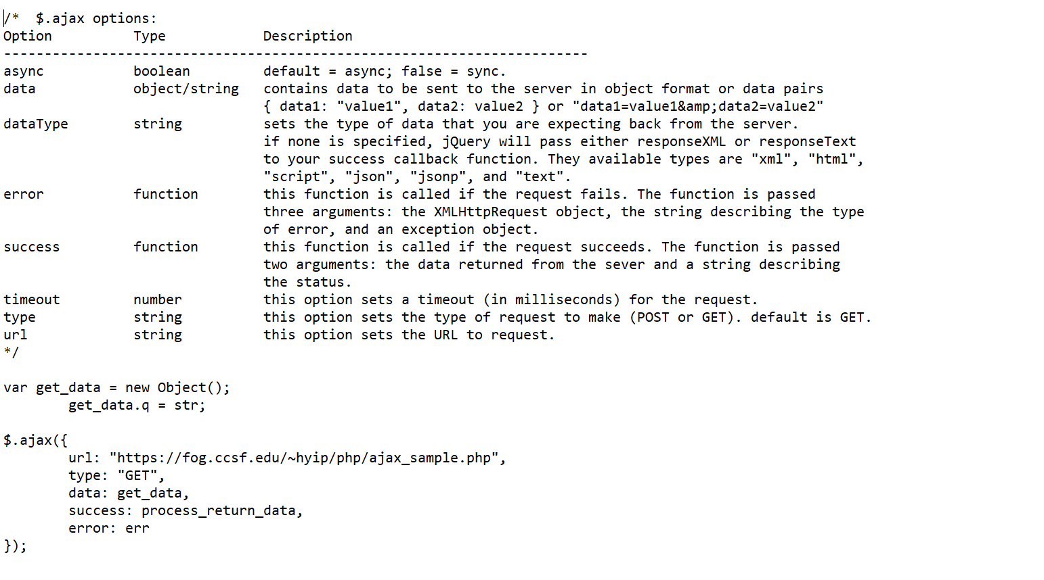
AJAX – using jQuery

Slide 53
AJAX – using fetch API
fetch() allows you to make network requests similar to XMLHttpRequest (XHR).
The Fetch API uses Promises, which enables a simpler and cleaner API, avoiding callback hell and having to remember the complex API of XMLHttpRequest.
The Fetch API has been available in the Service Worker global scope, and it has enabled in the window scope.
There is also a rather fetching polyfil by Github that you can use today.
AJAX using fetch samples:
https://www.comp.hkbu.edu.hk/~hansyip/ajax_fetch/address_fetch.html
https://www.comp.hkbu.edu.hk/~hansyip/ajax_fetch/name_fetch.html

Slide 54
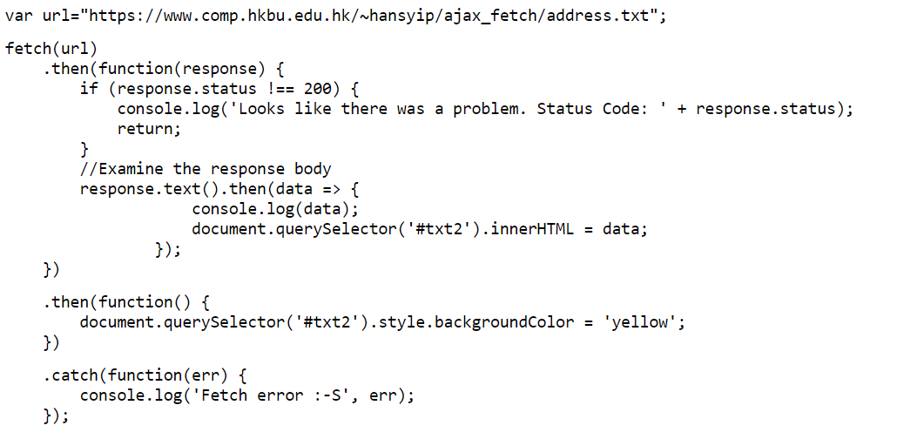
AJAX using Fetch – returning string
https://www.comp.hkbu.edu.hk/~hansyip/ajax_fetch/address_fetch.html

Slide 55
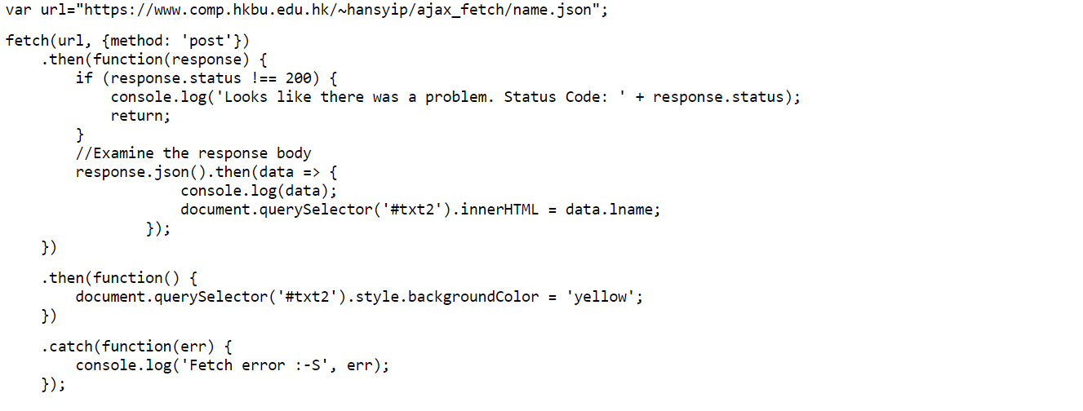
AJAX using Fetch – return JSON
https://www.comp.hkbu.edu.hk/~hansyip/ajax_fetch/name_fetch.html

