Slide 1

Database
Hans Yip

Slide 2
Learning Objectives
Database history – Hierarchical model, Network model, Relational model
Structure Query Language (SQL)
Relational Database Management System (RDBMS)
Relational Database Model
Database languages – SQL
  Data Manipulation Language (DML)
    Data Retrieval
    Data Modification
  Data Definition Language (DDL)
  Data Control Language (DCL)
Relational Operations
Oracle Database Structure

Slide 3
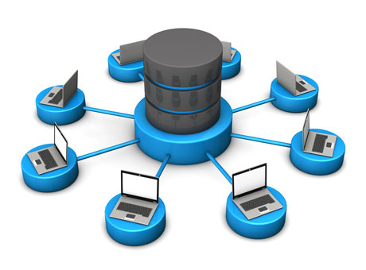
Database

Slide 4
Database History – Hierarchical DB
The Hierarchical Database Model
It grouped data in hierarchies of parent and child. A parent contained data, and each data element had related child data. (e.g. IBM’s IMS – Integrated Management System). For instance, customer data was a parent to sales data because each customer created a sales record whenever he or she shopped.

Slide 5
Database History – Network DB
The Network Database Model
Where data actually related to other data and did not need to be hierarchical (e.g. GE’s IDS – Integrated Data Store). For instance, a customer might live in a Zip code and there might be data on the Zip code. Instead of defining the Zip code as the parent of the customer, you simply linked it to the customer, yet this link was the only path you could follow to get combinations of your data.

Slide 6
Database History – Relational DB
The Relational Database Model
In 1970, Dr. E.F. Codd proposed taking the basis of relational algebra, and making it a defining paradigm for writing database software. The original works on relational theory were abstract. The original papers by Codd did not capture a lot of attention until IBM took an interest in this approach to databases. IBM created a series of design documents for a relational database called System/R and the relational language it called Structured Query Language (SQL).

Slide 7
Structure Query Language (SQL)
Structure Query Language (SQL), is a unified language for defining, querying, modifying, and controlling the data in a relational database.
SQL is a fourth-generation language. This means that the language describes what should be done, but not how to do it. To execute a delete statement, we don’t know how the database will actually determine which row should be deleted. Presumably, the DBMS will loop through all the rows in the database to determine which row to be deleted. But the details of this are hidden from us.
Third-generation languages, such as C and COBOL, are more procedural in natural. A program in a third-generation language (3GL) implements a step-by-step algorithm to solve the problem. For example, we will need to write the loop algorithm to perform the delete operation.

Slide 8
Relational Database Management (RDBMS)
To be considered fully relational, a relational database management system must:
Represent all information in the database as tables.
Keep the logical representation of data independent from its physical storage characteristics.
Use one high-level language for structuring, querying, and changing the information in the database (SQL).
Support the main relational operations (selection, projection, join) and set operations such as union, intersection, difference, and division.
Support views, which allow the user to specify alternative ways of looking at data in tables.
Provide a method for differentiating between unknown values (NULL) and zero or blank.
Support mechanisms for integrity, authorization, transactions, and recovery.

Slide 9
RDBMS Components
Two important pieces of an RDBMS architecture are the kernel, which is the software, and the data dictionary, which consists of the system-level data structures used by the kernel to manage the database.

Slide 10
Oracle RDBMS Relational Model

Slide 11
The Relational Database Model
A table (relation, file) is the basic unit of data storage in a database.
Tables are organized as rows (tuple, record) (horizontal) and columns (attribute, field) (vertical).
A database is a set of related tables forms a database.

Slide 12
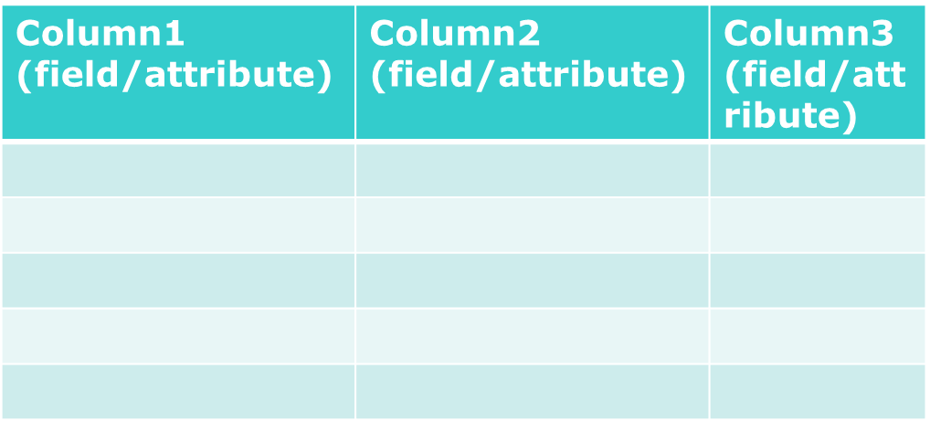
The Relational Database Model
Table (file/relation)
Row1 (record/tuple)
Row2 (record/tuple)

Slide 13
Database Languages
Data Manipulation Language (DML)
  Data retrieval (SELECT statement)
  Data modification (INSERT, UPDATE, DELETE statements)
Data Definition Language (DDL)
  CREATE, ALTER, DROP statements
Data Control Language (DCL)
  GRANT, REVOKE statements

Slide 14
Data Manipulation Language (DML)
1. Data retrieval (queries - select) means finding the particular data.
SELECT { (column1, column2,… ) | * }
FROM table_name
WHERE condition;

Slide 15
Data Manipulation Language (DML)
2. Data modification (insert, update, delete) means adding, removing, or changing the data.
INSERT INTO table_name
[(column1, column2,…)]
{VALUES (value1, value2,…) | query}
UPDATE table_name
SET { column1 = value1, column2 = value2,… }
WHERE condition;
DELETE FROM table_name
WHERE condition;

Slide 16
Data Definition Language (DDL)
Data Definition Language (DDL): allows you to create, alter, and drop objects like tables, indexes, and views.
CREATE TABLE table_name
(column1 datatype column_constraints,
column2 datatype , …)
table_constraints…;
ALTER TABLE table_name
{ADD | MODIFY (column1 datatype, column2 datatype, …) };
DROP TABLE table_name;

Slide 17
Data Control Language (DCL)
Data Control Language (DCL): allows you to coordinate the use of the database and maintain it in its most efficient state.
GRANT object_privilege
ON user.object
TO {user | role | PUBLIC};
REVOKE object_privilege
ON user.object
FROM {user | role | PUBLIC};

Slide 18
Relational Operations – Projection, Selection
Projection: The projection allows you to list which columns you want to see.
SELECT emp_id, emp_name
FROM emp;
Selection: The selection allows you to retrieve a subset of the rows in a table.
SELECT *
FROM emp
WHERE emp_id < 10;

Slide 19
Relational Operations - Join
Join: The join operation works on two or more tables at a time, combining the data so that you can compare and contrast information in your database.
SELECT ename, emp.deptno, dname
FROM emp, dept
WHERE emp.deptno = dept.deptno;

Slide 20
View
A view is an alternative way of looking at the data in one or more tables. Views are sometimes called virtual tables or derived tables. The data you see when you look at a view is not actually stored in the database the way data in “real” or base tables is.
It’s important to realize that a view is not a copy of the data in another table. When you change data through a view, you are changing the real thing.
CREATE [OR REPLACE]
VIEW view_name
AS query;
CREATE VIEW managers
AS
SELECT ename, job, sal
FROM emp
WHERE job = ‘MANAGER’;

Slide 21
Integrity
Integrity is a serious and complex issue in relational database management. In general, it means the consistency of the data in the database.
Entity integrity: ensures that every row in a table is unique. This is enforced via a not null primary key constraint. (no primary key be allowed to have a null value)
Referential integrity: ensures that a field value “foreign key” corresponds to a related field value “primary key”. (consistency among pieces of information that are repeated in more than one table)
Domain integrity: ensures that every field value is in a specified set of values.

Slide 22
Oracle Database Structure
Physical Database Structure: O/S files – data files, redo log files, and control files.
Logical Database Structure: tablespaces and database’s schema objects such as tables, views and indexes.
Note: Data files are grouped together to form a tablespace.

Slide 23
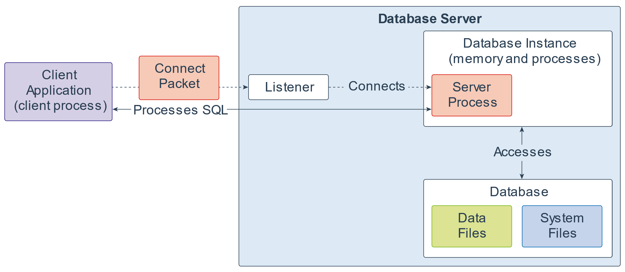
Oracle DB 19c Architecture
https://www.oracle.com/webfolder/technetwork/tutorials/architecture-diagrams/19/database-technical-architecture.html (Note: Oracle Database 19c, is the latest version of Oracle DB (as of Jan 2021), is part of the Database 12.2 “Family”.)

Slide 24
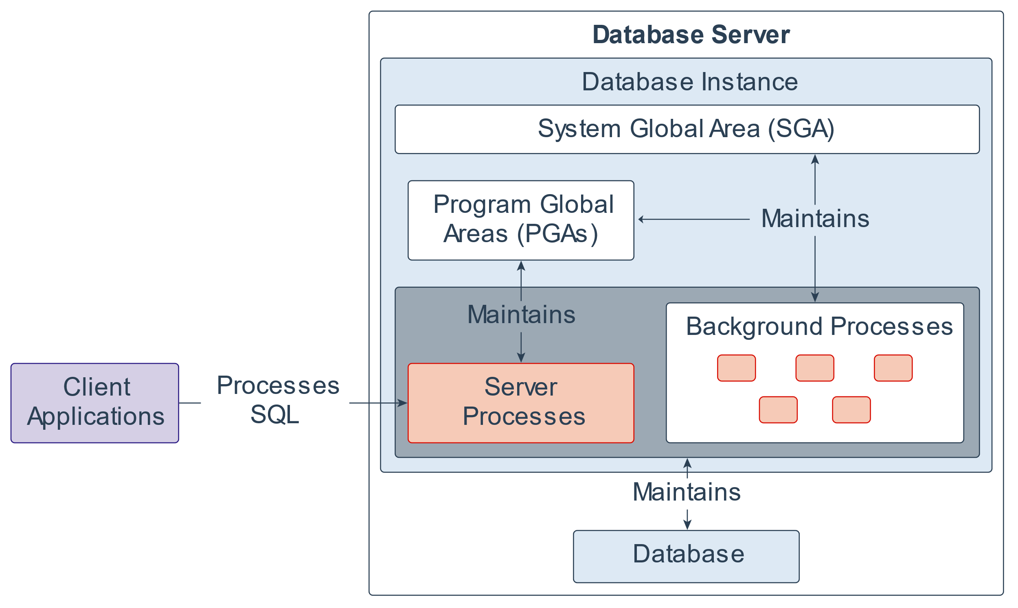
Oracle DB 19c Architecture – Oracle Instance
An Oracle Instance is a collection of background processes and system global area (SGA). Every time a database is started, a system global area (SGA) is being allocated and Oracle background processes are started.

Slide 25
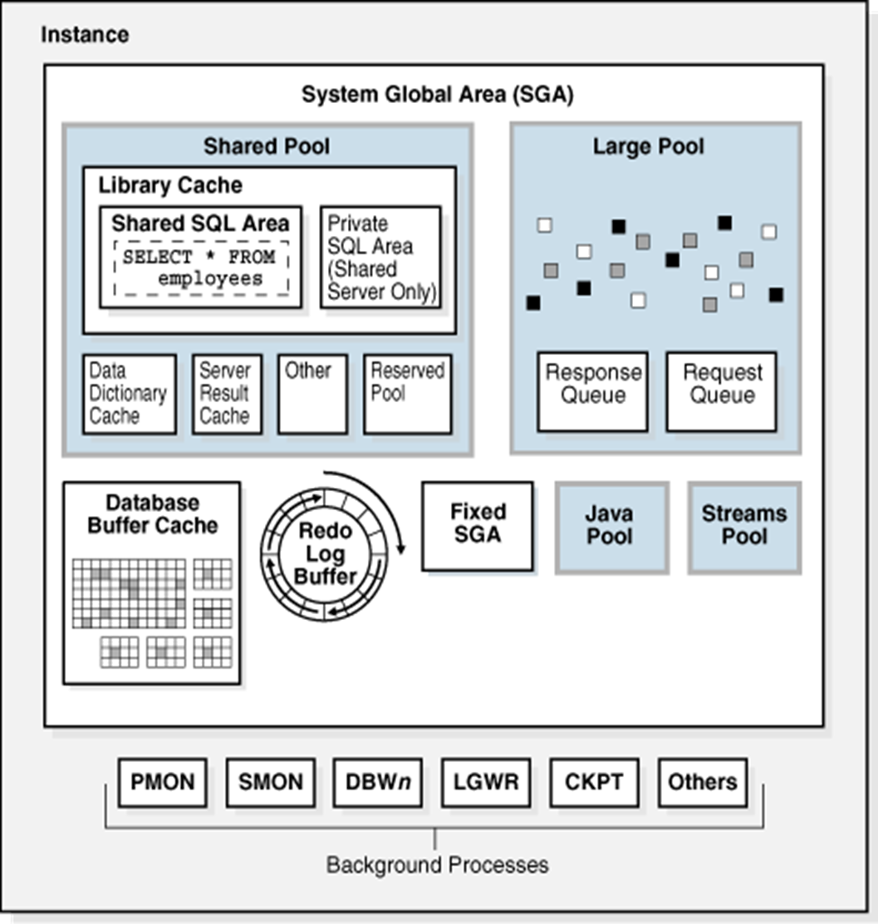
Oracle DB 19c Architecture – Oracle Instance

Slide 26
Oracle DB 19c Architecture – Processes
An Oracle instance has two types of processes:
User process: executes application program e.g. Oracle Form (Client process).
Oracle process (Server process):
  Server processes: interface between user process and Program Global Area (PGA).
  Background processes: interface between System Global Area (SGA), physical database files and Program Global Area (PGA).

Slide 27
Oracle DB 19c Architecture – Server Processes
Server processes: communicates with user processes. It also places data in the system global area (SGA).
The Server process contains a program global area (PGA) which is writable and non-shared.
The user session data in the PGA is memory allocated to hold session variables and arrays.
The stack space is additional memory in the PGA for a user’s session.
Cursors are used to record status information about a statement.

Slide 28
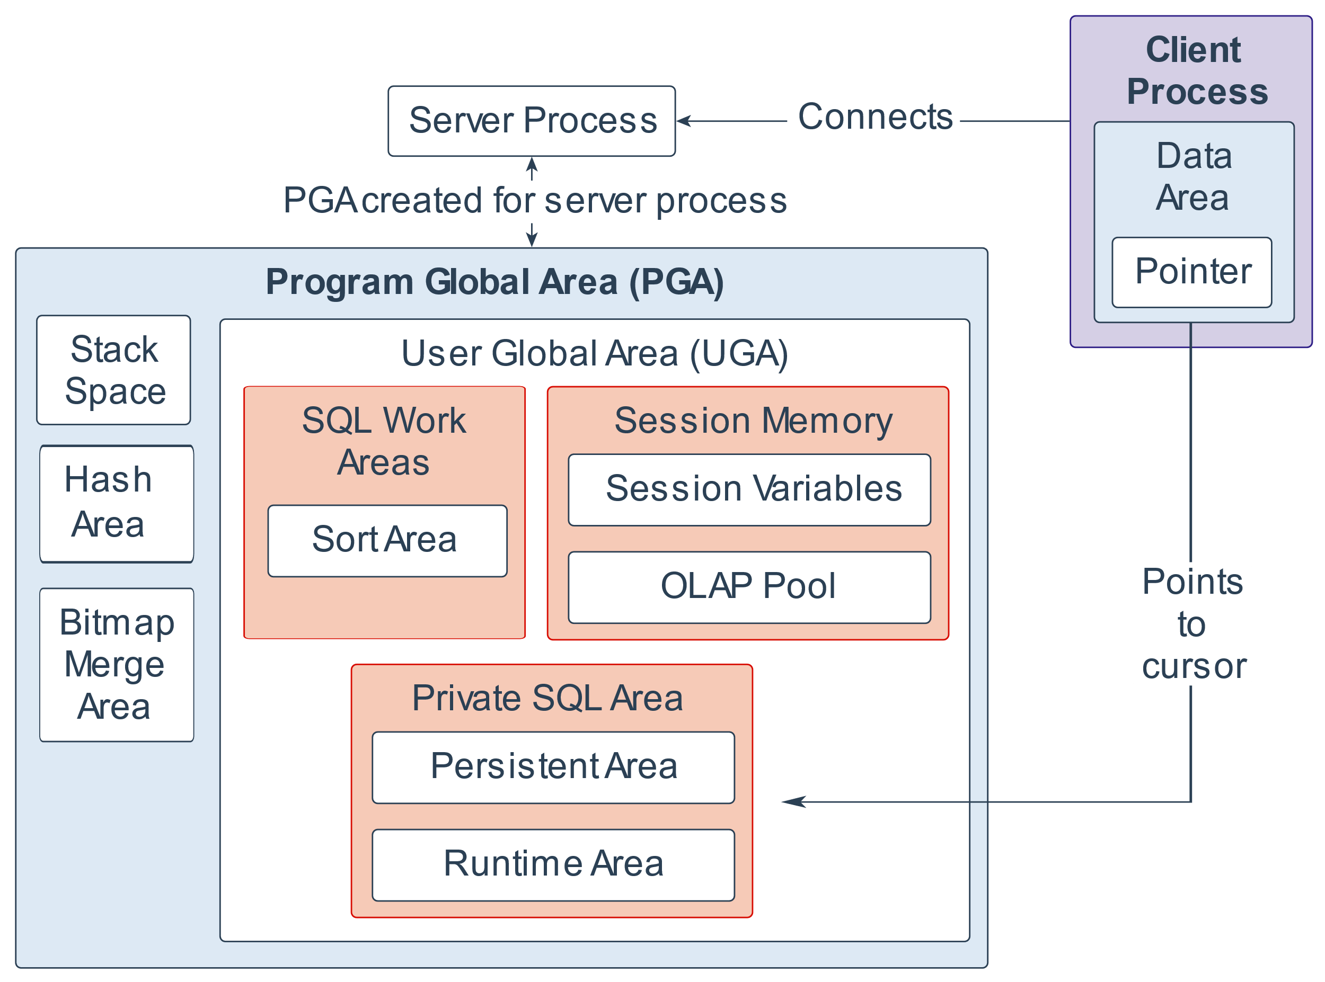
Oracle DB 19c Architecture – Server Processes

Slide 29
Oracle DB 19c Architecture – Background Processes
Background processes:
Database Writer (DBWR): writes modified blocks from the database buffer cache to the datafiles when the database buffer is almost full.
Log Writer (LGWR): writes redo log entries to the disk.
Checkpoint (CKPT): Checkpoint process signals to the DBWR to write all modified database buffers in the SGA to the datafiles. If not present, LGWR will take over the responsibilities.
System Monitor (SMON): performs instance recovery at instance startup. It also cleans up the temporary segments that are no longer in use and recovers dead transactions (it runs 5 to 10 minutes).
Process Monitor (PMON): recovers process recovery when a user process fails. It frees up all the resources that the failed process was using (it runs 5 to 10 minutes).
Archiver (ARCH): copies the online redo log files to the storage when they are full.
Recover (RECO): resolves distributed transactions that are pending due to a network or system failure in a distributed database.
Dispatcher (Dnnn): optional, responsible for routing requests from user processes to available shared server processes in a multi-threaded server configuration.
Lock (LCKn): Up to 10 lock processes are used for inter-instance locking when the Oracle parallel server is used.

Slide 30
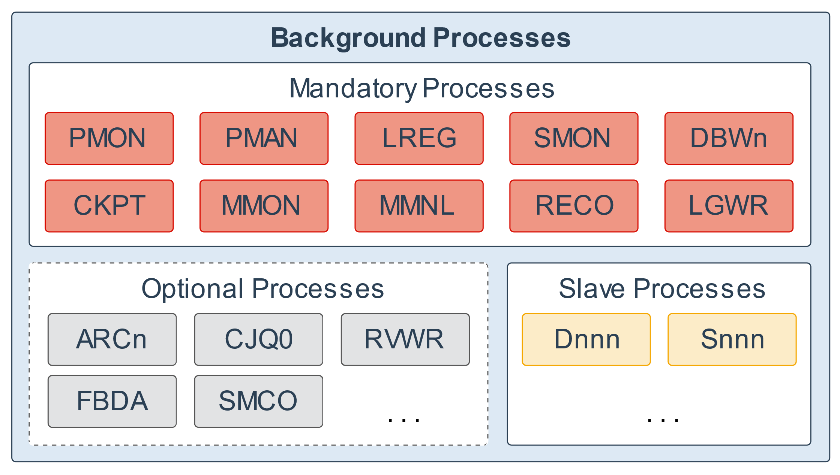
Oracle DB 19c Architecture – Background Processes

Slide 31
Oracle Database Processing
Process SQL read statement
Process SQL update statement
Process SQL commit statement
Process SQL checkpoint command

Slide 33
Process SQL (READ only) Statement
User process sends SQL statement to the Server process
The Server process parses the SQL statement (in PGA)
  Checks SQL statement already in shared pool or not
  Checks syntax
  Queries Data Dictionary for object resolution, security privileges and search path
  Determines execution plan “Parse tree”
The Server process executes the SQL statement (in SGA)
  Applies parse tree to data buffers
  Performs physical or logical reads
The Server process returns the result to the user process (in PGA)
  If SQL contains GROUP BY or ORDER BY clause then resulting data will be sorted in the Sort Area before returning to the clients.

Slide 34
Process SQL (UPDATE) Statement
User process sends UPDATE statement
Server process parses the UPDATE statement (in PGA)
Server process executes the UPDATE statement (in SGA)
  Searches the LRU (Least Recently Used), if data in memory, perform logical read; otherwise perform physical read
  Places exclusive locks on rows that are about to change
  Gets rollback blocks, and saves rollback data
  Records before image data in the redo log
  Applies changes to data block (this block is considered “dirty”)
  Records after image in the redo log
Server process sends update complete message to user process (in PGA)

Slide 35
Committing and Rolling Back Transaction
The changes made by the SQL statements that constitute a transaction can be either committed or rolled back.
Commit makes changes permanent.
Rollback undo changes from the last commit.

Slide 36
Process SQL (COMMIT) Statement
User issues a COMMIT command
A commit record is written in the redo log
LGWR writes the redo log buffers to the current log file
The user is informed that the transaction has been committed
Resource locks are released
DBWR writes the database block (including rollback segments) to disk

Slide 37
Process SQL CHECKPOINT
During a checkpoint, LGWR flushes the redo log buffer and DBWR writes all modified database buffers from SGA to disk.
Then the Checkpoint (CHPT) process marks the database and control files with a timestamp. The time necessary for instance recovery is reduced because only the changes since the last checkpoint need to be applied.

Slide 38
Other Oracle Database Structures
The SYSTEM tablespace must exist in order for the database to run. It contains the data dictionary, a set of internal system tables. In addition, user tablespaces should exist for applications.
A tablespace is a logical repository for physically grouped data. Each tablespace stores its data in one or more data files. One or more physical blocks on disk correspond to a logical block or Oracle database block.
Space is allocated when an object is created and when it grows. It is allocated in sets of contiguous database blocks called extends.
A segment is a set of one or more extents that contains all data for an object in a tablespace. There are data, index, rollback and temporary extents.

Slide 39
Other Oracle Database Structures
An index is a database object that stores the row’s index value and the corresponding physical address (rowid). It is a mechanism for providing fast access to rows.
A cluster stores related rows in the same data block. It these related rows are often retrieved together, then clustering can improve performance since the Oracle processes move data in blocks.
A transaction log stores internal data used for database recovery.
PL/SQL contains procedural extensions to SQL, e.g. conditions or loops.
A procedure is a collection of SQL and PL/SQL statements which comprise a unit of application code.

Slide 40
Other Oracle Database Structures
A database trigger is a PL/SQL block associated with the DML operation on a specific table.
A database instance is a collection of memory structures (System Global Area – SGA) and processes (Background processes) that work together to provide multiple user access to an Oracle database.
When foreground processes (user and server processes) request information, data is moved into a large memory area, called the System Global Area (SGA). If it is changed there, then background processes make sure the modified data blocks are written to disk.
A schedma is a logical collection of objects. It is owned by an Oracle user.
A privilege is the right to perform a particular operation on a specific object.
A role is a group of privileges which simplify security administration.

