Slide 1

Apple ios - Swift
Hans Yip

Slide 2
Learning Objectives
What is Swift?
Swift project

Slide 3

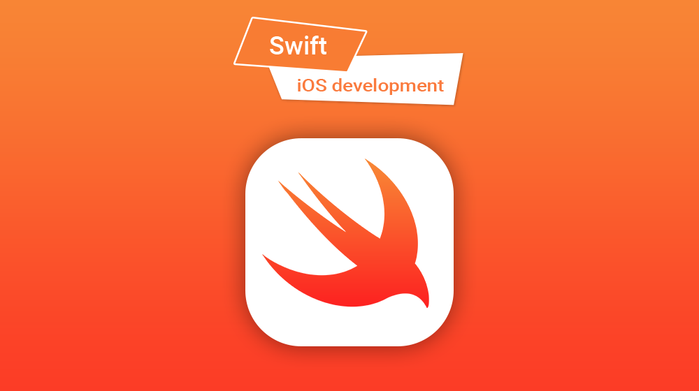
iOS Swift

Slide 4
What is Swift?
Swift: is a powerful and intuitive programming language for macOS, iOS, watchOS and tvOS.
Writing Swift code is interactive and fun, the syntax is concise yet expressive, and Swift includes modern features developers love.
Swift code is safe by design, yet also produces software that runs lightning-fast.

Slide 5
About Swift Project
Swift is a general-purpose programming language built using a modern approach to safety, performance, and software design patterns.
The goal of the Swift project is to create the best available language for uses ranging from systems programming, to mobile and desktop apps, scaling up to cloud services.
Most importantly, Swift is designed to make writing and maintaining correct programs easier for the developer.

Slide 6
About Swift Project
To achieve this goal, the most obvious way to write Swift code must also be:
Safe. The most obvious way to write code should also behave in a safe manner. Undefined behavior is the enemy of safety, and developer mistakes should be caught before software is in production. Opting for safety sometimes means Swift will feel strict, but we believe that clarity saves time in the long run.
Fast. Swift is intended as a replacement for C-based languages (C, C++, and Objective-C). As such, Swift must be comparable to those languages in performance for most tasks. Performance must also be predictable and consistent, not just fast in short bursts that require clean-up later. There are lots of languages with novel features — being fast is rare.

Slide 7
About Swift Project
Expressive. Swift benefits from decades of advancement in computer science to offer syntax that is a joy to use, with modern features developers expect. But Swift is never done. We will monitor language advancements and embrace what works, continually evolving to make Swift even better.
NOTE: Tools can make programming so much more powerful, like Swift-based playgrounds do in Xcode, or a web-based REPL can when working with Linux server-side code.
https://swift.org/about/#swiftorg-and-open-source

