Slide 1

MIT app inventor
Hans Yip

Slide 2
Learning Objectives
What is MIT App Inventor

Slide 3

MIT App Inventor

Slide 4
What is MIT App Inventor?
MIT App Inventor is a visual programming environment that allows everyone to build functional apps for Android smartphones and tablets.
http://appinventor.mit.edu/explore/about-us.html

Slide 5
Getting Started with MIT App Inventor 2
App Inventor is a cloud-based tool in which you can build apps right in your web browser. (SaaS)
The App Inventor Software, or “service” is at http://ai2.appinventor.mit.edu
This website offers all the support you will need to learn how to build your own apps.
http://appinventor.mit.edu/explore/get-started.html
NOTE: a Google account is required.

Slide 6
Components of MIT App Inventor
App Inventor consists of the Designer and the Blocks Editor.
App Inventor Designer: Design the App’s User Interface by arranging both on- and off- screen components.
App Inventor Blocks Editor: Program the App’s behavior by putting blocks together.
http://appinventor.mit.edu/explore/designer-blocks.html

Slide 7
Beginner Tutorials
With these beginning-friendly tutorials, you will learn the basics of programming apps for Android.
http://appinventor.mit.edu/explore/ai2/beginner-videos.html

Slide 8
Before you start your first Android app
Download the following files:
Codi picture: codi.jpg (Right-click and Save)
Bee sound: Bee-Sound.mp3 (Right-click and Save)
You should have a google account

Slide 9
Your First Android App
Go to http://ai2.appinventor.mit.edu
Logon using your google account.
Click “Start new project”
Enter project name: “HelloCodi”, then click “OK”
There are four sections: Palette, Viewer, Components, Properties
Two buttons on the upper right-hand corner showing that you are in “Designer” screen. (Design your User Interface (UI)).
The “Blocks” screen is used for building the app.

Slide 10
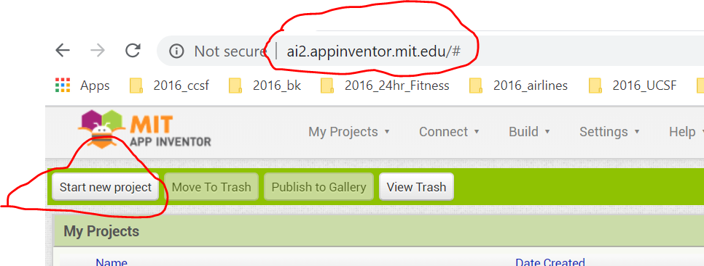
Logon to MIT App Inventor

Slide 11
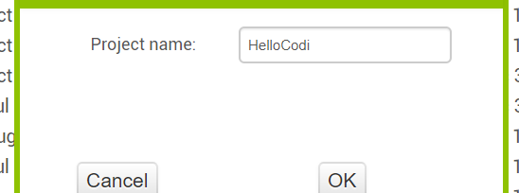
Enter Project Name

Slide 12
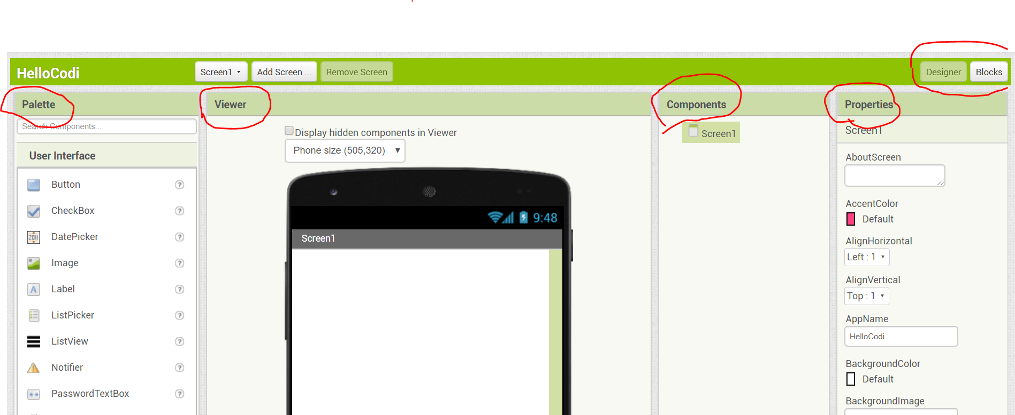
Ready to design the app

Slide 13
Design the UI
From the Palette, User Interface section, click and drag the “Button” to the mobile phone in the middle
Upload the codi.jpg file: From the Properties, click “image”, then click “Upload File”
Click “Choose File”, then click codi.jpg file to upload, click “OK” (codi.jpg will be uploaded)
From the Properties section, Text box, erase the text “Text for Button1” so that it will not blocking your codi.jpg)
From the Palette, User Interface section, drag and drop “Label” put it under the codi.jpg,
From the Properties, change the followings:
  Text box: enter “Touch the Bee!”
  FontSize: enter 50
  BackgroundColor: Click the box, and select “Cyan”
  TextColor: Click and select “Blue”

Slide 14
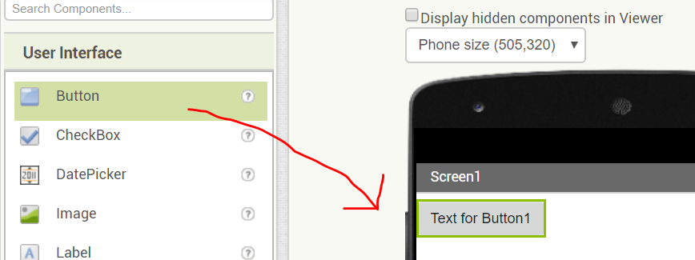
Create Button

Slide 15

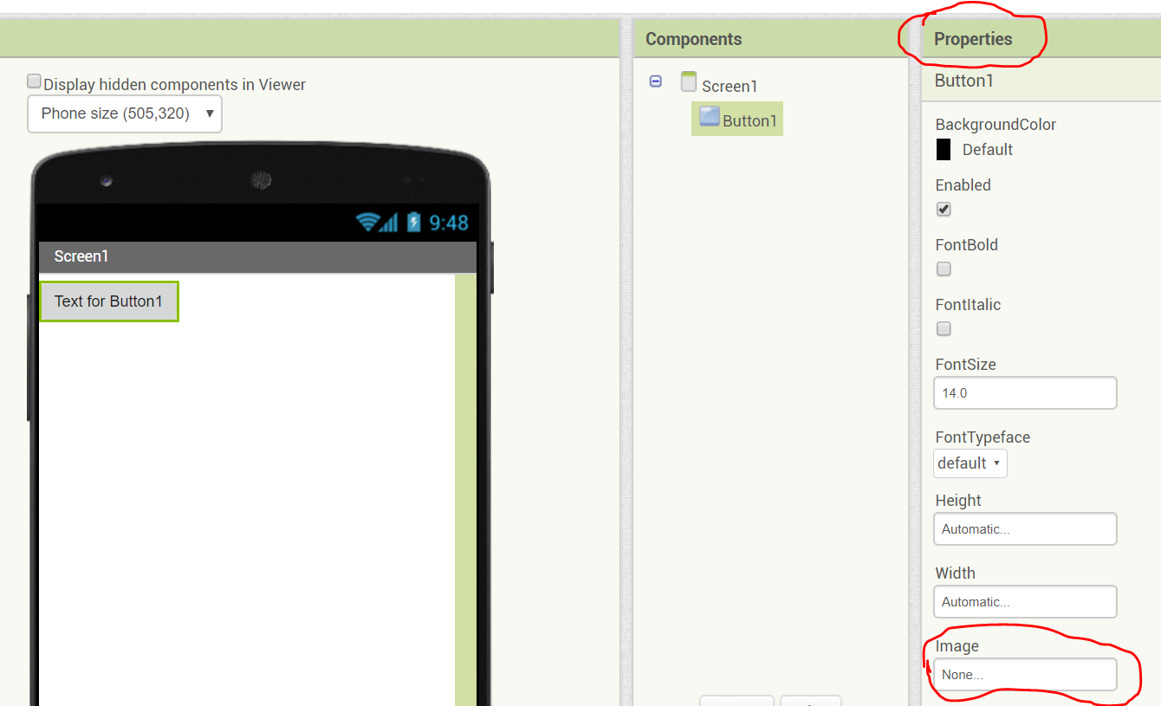
Upload codi.jpg

Slide 16
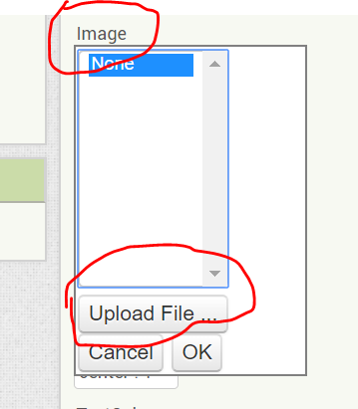
Click Upload File

Slide 17
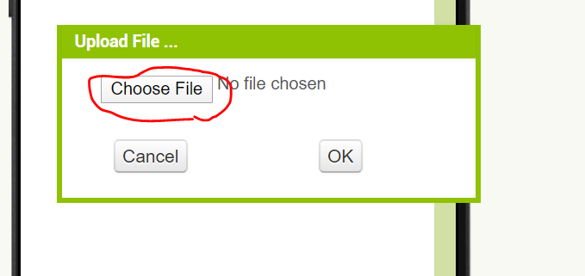
Choose File

Slide 18
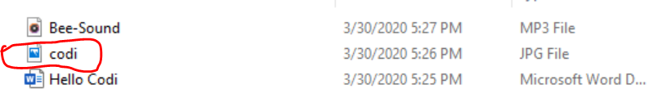
Click codi.jpg

Slide 19
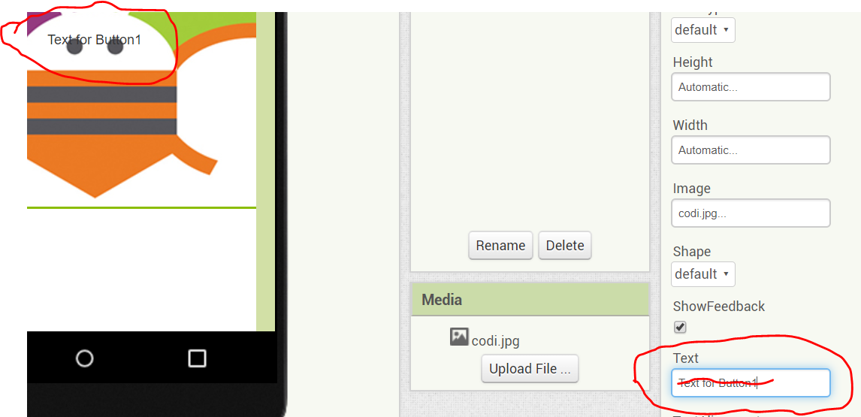
Clear up the text box

Slide 20
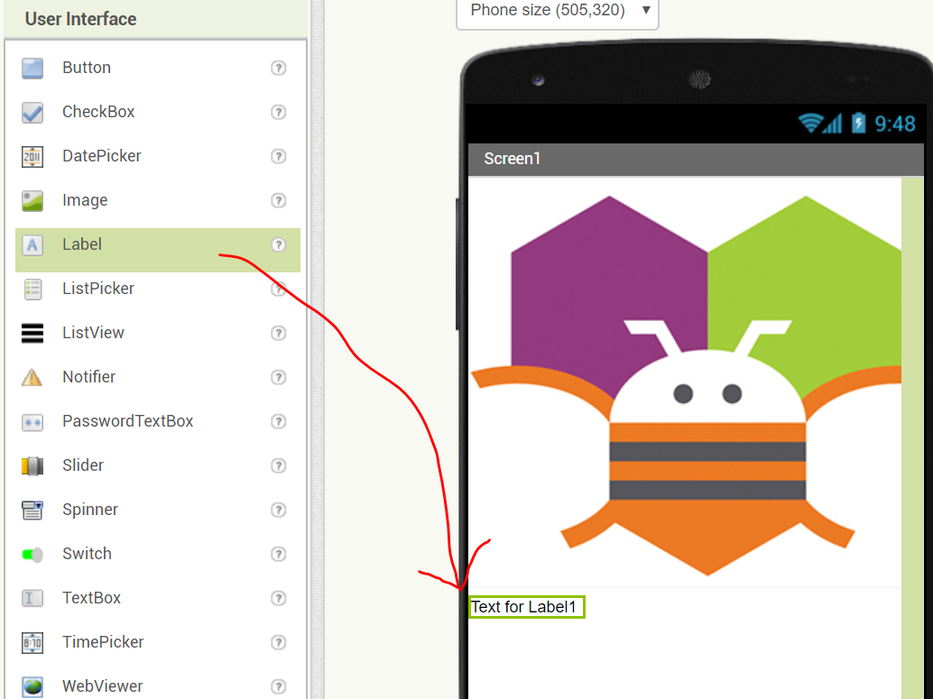
Add Label

Slide 21
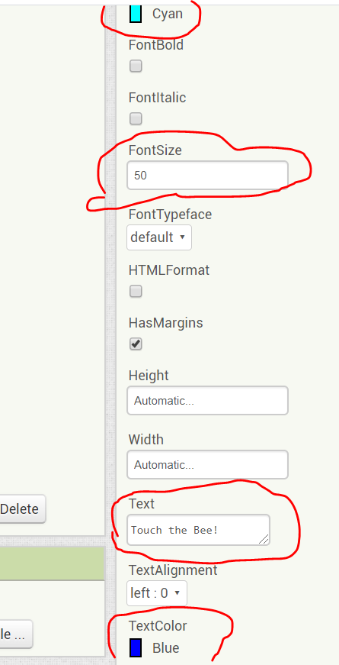
Modify Label

Slide 22
Add sound
From the Palette, Media section, drag and drop the “Sound” below the “Touch the Bee!” label (it will automatically move the “Sound1” object below the phone and marked as “Non-visible components”
From the Properties, click “Source”, then click “Upload File…”
Then, click “Choose File” button, select Bee-Sound.mp3, then click “OK”

Slide 23
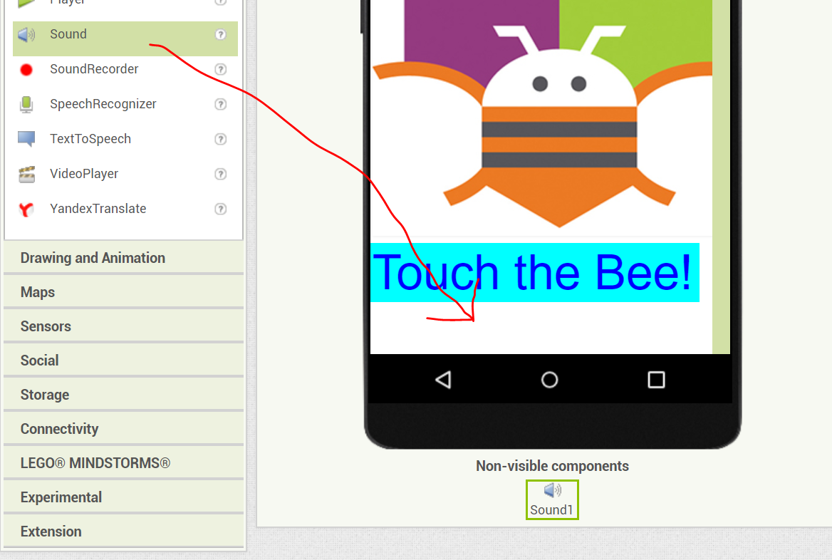
Add Sound

Slide 24
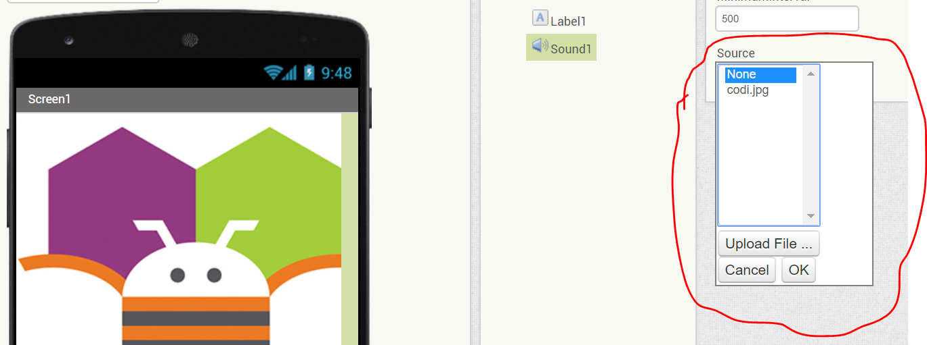
Upload sound file

Slide 25
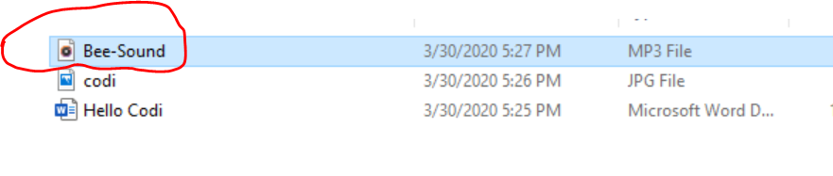
Upload sound file

Slide 26
Programming with the Blocks Editor
Click “Blocks” button from the upper right-hand corner to start programming
From the Blocks section, click “Button1”, drag and drop “When Button1.Click….do” to “Viewer” section
From the Blocks section, click “Sound1”, drag and drop “Call Sound1.Play” inside the “When Button1.Click…do”

Slide 27
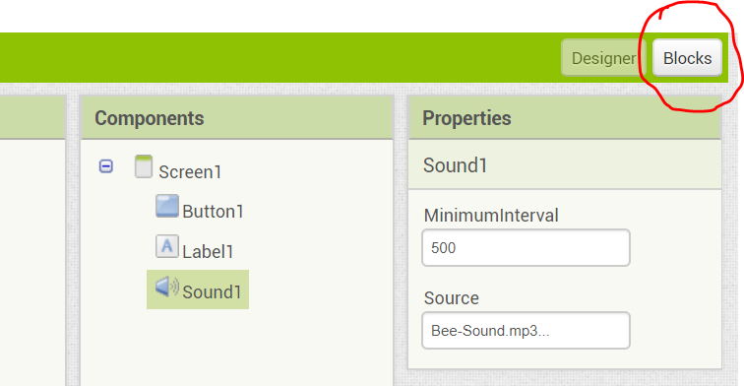
Go to Blocks Editor

Slide 28
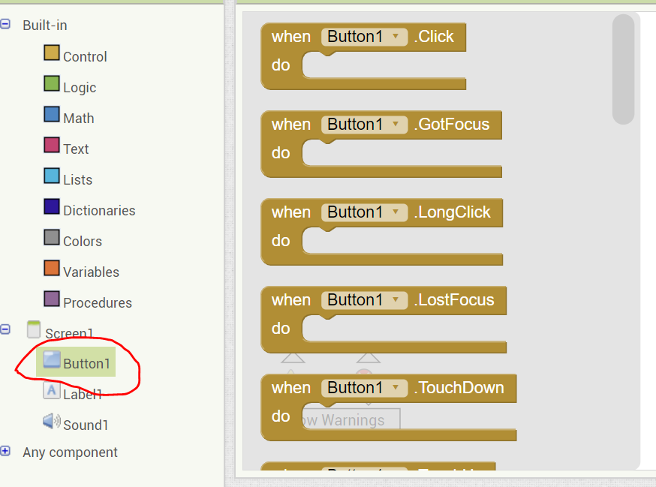
Program Button1

Slide 29
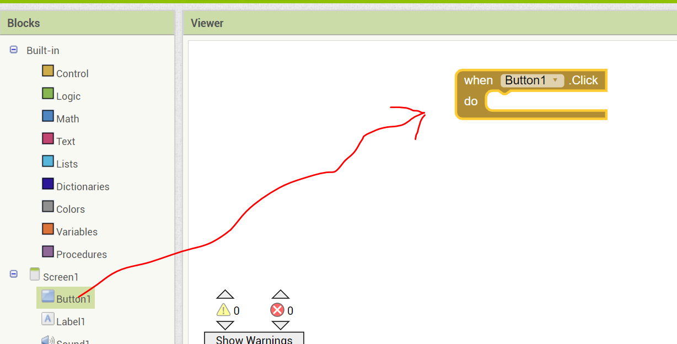
When Button1.Click

Slide 30
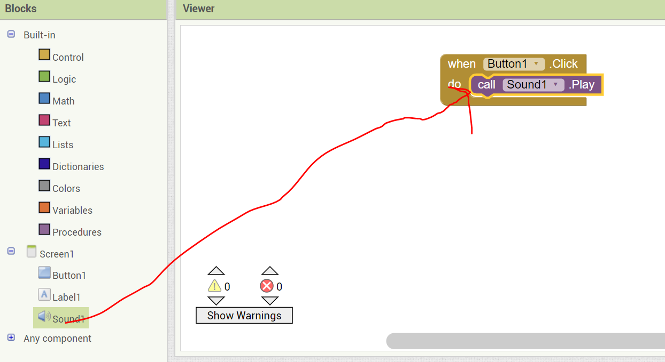
Call Sound.Play

Slide 31
Compile the app
Click “Designer” from the upper right-hand corner
Click “Build” to compile the app, and select “Save .apk to my computer”
Connect your Android device to your computer using USB cable
Then, copy the app “HelloCodi.apk” to your Android device
From your Android device, look for that file “HelloCodi.apk”, click to install the app into your Android device.
Once installed, you can open the app, and click the Bee to hear the bee fly.
NOTE: You may need to update the security settings to allow this new app to be installed in your Android device.

Slide 32
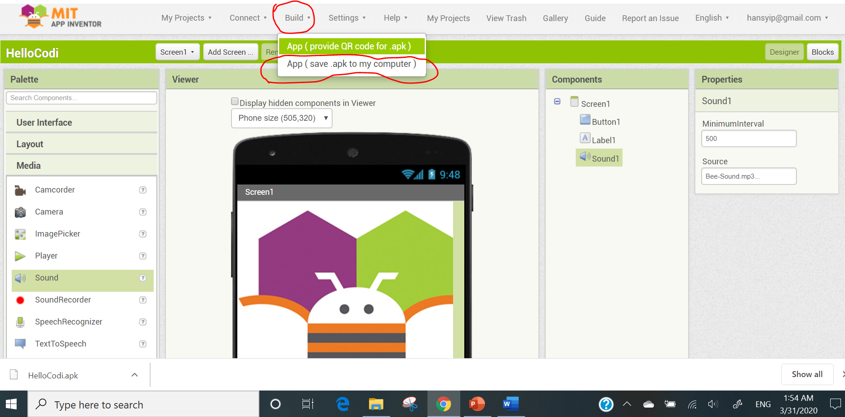
Build the app

Slide 33
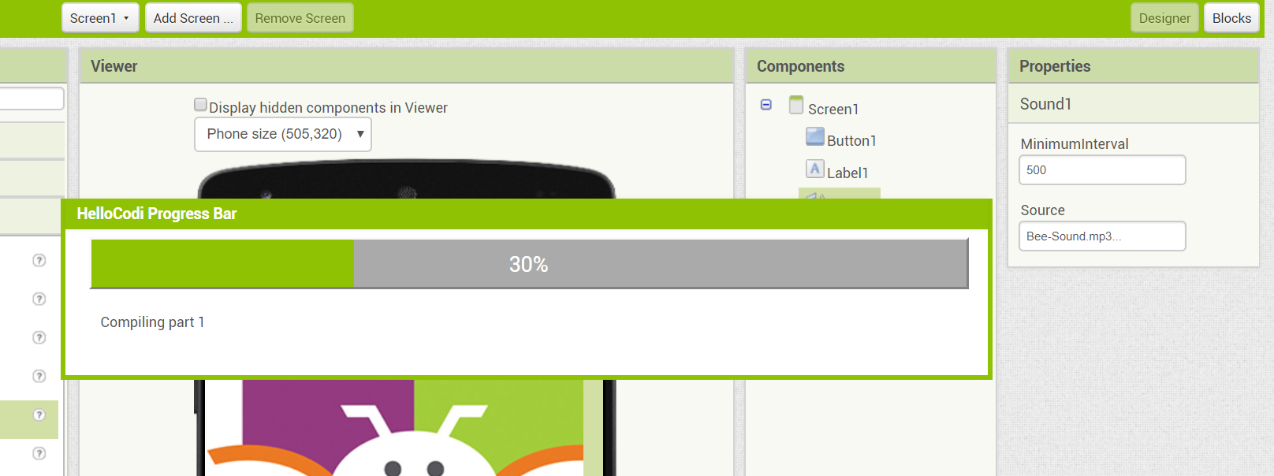
Compiling the app

Slide 34
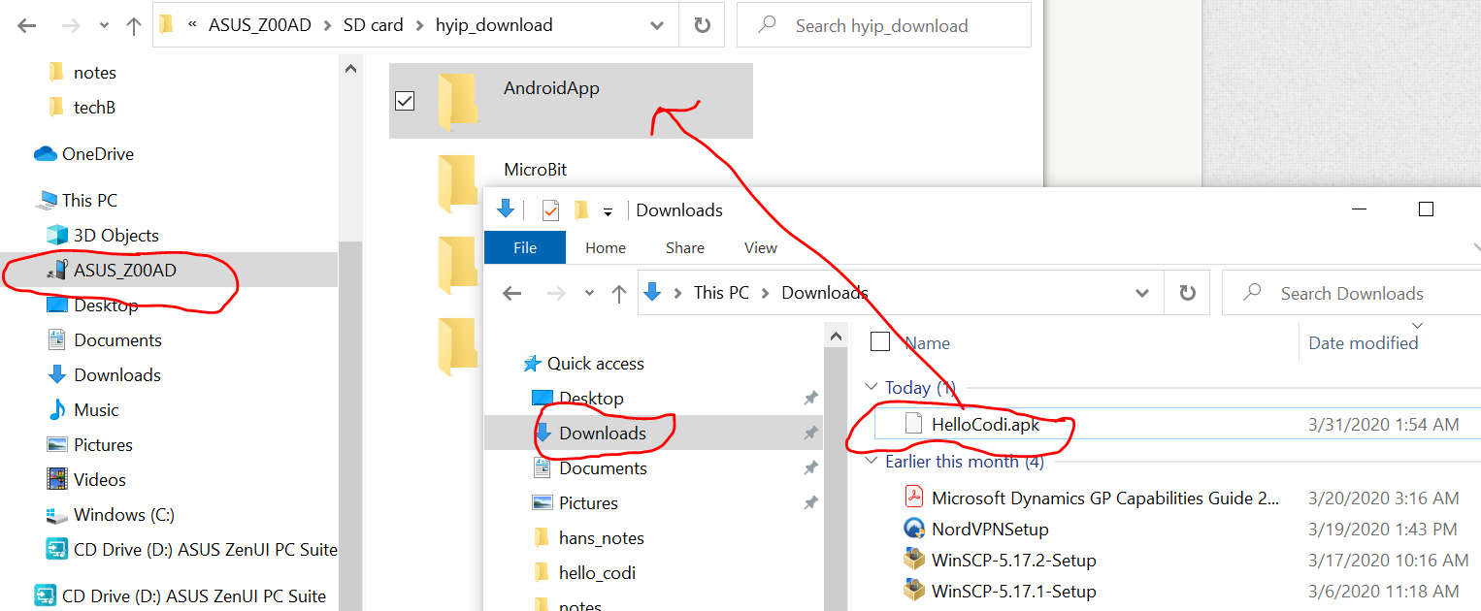
Copy the app to your Android device

