Slide 1
Android studio
Hans Yip

Slide 2
Learning Objectives
What is Android?
Android architecture
Development process
Android Studio
How to install Android Studio
How to write and test your first Android app

Slide 3
What is Android?
Android is an open source and Linux-based operating system for mobile devices such as smartphones and tablet computers.
Android was developed by the Open Handset Alliance, led by Google, and other companies.

Slide 4
What is Android? (by Google)
Android is an operating system and programming platform developed by Google for mobile phones and other mobile devices, such as tablets.
It can run on many different devices from many different manufacturers. Android includes a software development kit (SDK) that helps you write original code and assemble software modules to create apps for Android users.
Android also provides a marketplace to distribute apps.
All together, Android represents an ecosystem for mobile apps.

Slide 5
Android Architecture
Android provides a rich development architecture.
You don't need to know much about the components of this architecture, but it is useful to know what is available in the system for your app to use.
The following diagram shows the major components of the Android stack—the operating system and development architecture.

Slide 6
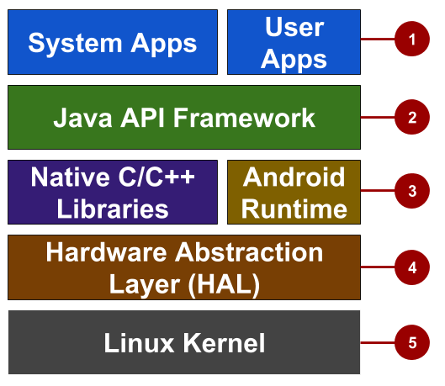
Android Architecture

Slide 7
Android Architecture
Apps: Your apps live at this level, along with core system apps for email, SMS messaging, calendars, internet browsing, and contacts.
Java API framework: All features for Android development, such as UI components, resource management, and lifecycle management, are available through application programming interfaces (APIs). You don't need to know the details of how the APIs work. You only need to learn how to use them.
Libraries and Android runtime: Each app runs in its own process, with its own instance of the Android runtime. Android includes a set of core runtime libraries that provide most of the functionality of the Java programming language. Many core Android system components and services are built from native code that require native libraries written in C and C++. These native libraries are available to apps through the Java API framework.

Slide 8
Android Architecture
4. Hardware abstraction layer (HAL): This layer provides standard interfaces that expose device hardware capabilities to the higher-level Java API framework. The HAL consists of multiple library modules, each of which implements an interface for a specific type of hardware component, such as the camera or Bluetooth module.
5. Linux kernel: The foundation of the Android platform is the Linux kernel. The layers above the Linux kernel rely on the Linux kernel for threading, low-level memory management, and other underlying functionality. Using a Linux kernel enables Android to take advantage of Linux-based security features and allows device manufacturers to develop hardware drivers for a well-known kernel.

Slide 9
The Development Process
An Android app project begins with an idea and a definition of the requirements necessary to realize that idea.
You may want to sketch user interfaces (UIs) for the various app functions. To show what a UI would look like and how it would work, use drawings, mockups, and prototypes.

Slide 10
The Development Process
When you are ready to start coding, you use Android Studio to go through the following steps:

Slide 11
The Development Process
Create the project in Android Studio and choose an appropriate template.
Define a layout for each screen that has UI elements. You can place UI elements on the screen using the layout editor, or you can write code directly in the Extensible Markup Language (XML).
Write code using the Java programming language. Create source code for all of the app's components.
Build and run the app on real and virtual devices. Use the default build configuration or create custom builds for different versions of your app.©
Test and debug the app's logic and UI.
Publish the app by assembling the final APK (package file) and distributing it through channels such as Google Play.

Slide 13
Install Android Studio
Please refer to the lab documents

Slide 14
Write and test your Android app
Please refer to the lab documents.

Slide 15
References
https://www.tutorialspoint.com/android/index.htm
https://google-developer-training.github.io/android-developer-fundamentals-course-concepts-v2/

