Slide 1
microservice
Hans Yip

Slide 2
Learning Objectives
What is microservice?
Characteristics of Microservice
Microservice vs Monolithic applications
Amazon AWS microservices
Microsoft Azure microserivces

Slide 3
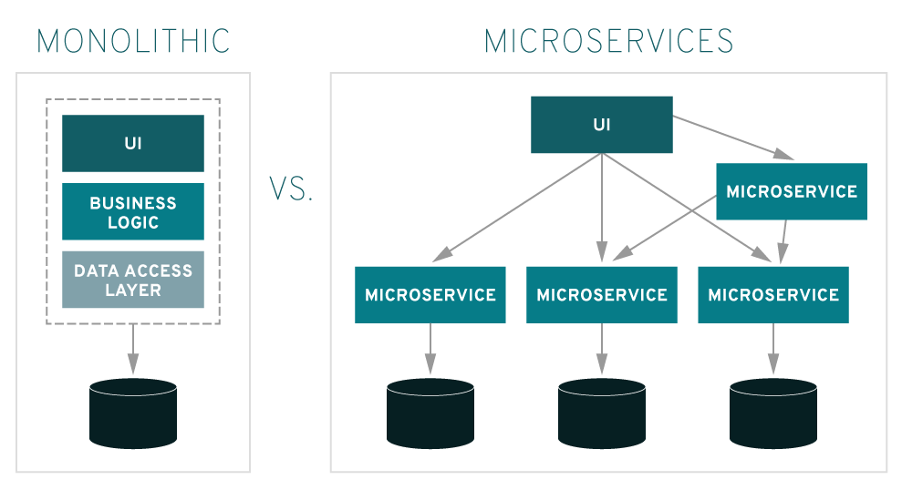
What is Microservice?

Slide 4
What is microservice?
microService: is an architectural style in which applications are composed from loosely coupled API services with automated lifecycles.
NOTE: Microservice is a variant of the SOA (Service-oriented architecture) architectural style that structures an application as a collection of loosely coupled services.

Slide 5
Without MicroService
PAST
Complex, single-unit, Monolithic solutions

Slide 6
With MicroService
FUTURE
Cloud & microService based, SaaS solutions

Slide 7
Characteristics of microService
Behavior: Deployed Independently & Frequently.
Control: Easily Scale Development.
Reusability: Services are built for reusable.
Resiliency: Independently Affected & Highly Observable (easy to id the problem). (Easy to recover)

Slide 8
MicroServices vs Monolithic Applications
Traditional software development processes (waterfall) usually result in relatively large teams working on a single, monolithic deployment artifact.
There are some issues with the traditional approaches:
no single developer (or group of developers) understands the entirety of the application.
Limited re-use is realized across monolithic applications.
Scaling monolithic applications can be challenging.

Slide 9
MicroServices vs Monolithic Applications
A microservice architecture with cloud deployment technologies and API management provides an alternate approach to software development. The monolith is instead “broken up” into a set of independent services that are deployed and maintained separately.
This has the following advantages:
Services are encouraged to be small. (less time to develop, and easy to deploy)
Services using standard interface protocol can be consumed and re-used by other services.
Services exist as independent deployment artifacts and can be scaled independently.

Slide 10
MicroServices vs Monolithic Applications
The tradeoff of this flexibility is complexity. Managing a multitude of distributed services at scale is difficult:
Services potentially are too granular . (good documentation is needed, so that easy to search for them, and easy to id the impact during services downtime. Testing may be complex).
Degrading performance during heavy use of services.

Slide 11
Amazon AWS with Microservices
Microservices: are an architectural and organizational approach to software development where software is composed of small independent services that communicate over well-defined APIs. These services are owned by small, self-contained teams.
Microservices architectures make applications easier to scale and faster to develop, enabling innovation and accelerating time-to-market for new features.

Slide 12
Amazon AWS with Microservices
Two ways to set up Microservices with Amazon AWS:
Microservices with Amazon Elastic Container Service (Containers).
Microservices with AWS Lamda (Serverless).
For more information, please refer to: https://aws.amazon.com/microservices/

Slide 13
Microsoft Azure with Microservices
A microservices architecture consists of a collection of small, autonomous services. Each service is self-contained and should implement a single business capability.
Microsoft Azure Microservices components:
Clients: are users of the microservices.
Management: is responsible for placing services on nodes, identifying failures, rebalancing services across nodes, and so forth.
Service Discovery: maintains a list of services and which nodes they are located on. Enables service lookup to find the endpoint for a service.
API Gateway: is the entry point for clients. Clients don't call services directly. Instead, they call the API gateway, which forwards the call to the appropriate services on the back end. The API gateway might aggregate the responses from several services and return the aggregated response.

Slide 14
Microsoft Azure with Microservices
Two ways to use Microsoft Azure with Microservices:
Microservices using Azure Container Service.
Microservices using Azure Service Fabric.
For more information, please refer to: https://docs.microsoft.com/en-us/azure/architecture/guide/architecture-styles/microservices

Slide 15
References
http://searchmicroservices.techtarget.com/definition/microservices
http://searchmicroservices.techtarget.com/definition/service-oriented-architecture-SOA
https://martinfowler.com/articles/microservices.html
https://www.mulesoft.com/

