Slide 1
Agile software development process
Hans Yip

Slide 2
Learning Objectives
What is Agile?
What is the problem with SDLC?
The Agile Manifesto

Slide 3
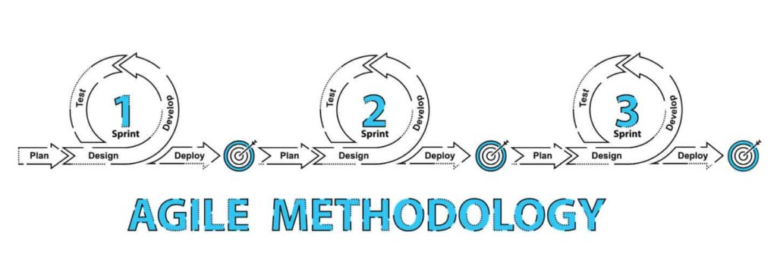
Agile Project Management

Slide 4
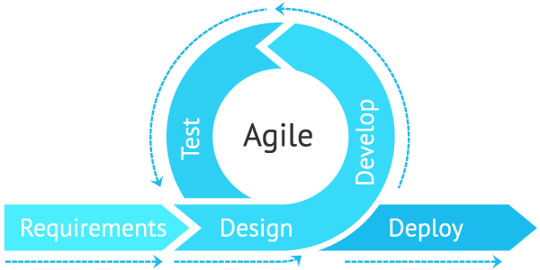
What is Agile?

Slide 5
What is Agile?
Agile software development: describes a set of values and principles for software development under which requirements and solutions evolve through the collaborative effort of self-organizing cross-functional teams. (Wiki)
Agile is a way of producing software in short iterations on a continuous delivery schedule. Other areas of focus include self-organizing teams, simplicity, sustainable pace of development, and change based on customer feedback. (IBM)

Slide 6
What is Agile?
Backlog
Plan
Build
Test
Plan
Build
Test
Plan
Build
Test
Iteration 1
Iteration 2
Iteration n
Software due date

Slide 7
What is the problem with SDLC?
Traditional software development such as SDLC/Waterfall, normally requires several months for planning and writing specifications, and multiple months for coding and testing the software. By the time you completed the software, it might be months or years behind what you clients were asking for. Change of requirements would prolong the project further.
On the other hand, one of the principles of Agile is response to change of requirements.

Slide 8
The Agile Manifesto
In 2001, a group of seventeen IT professionals (consultants and developers) gathered at Snowbird, Utah.
The outcome of that meeting was “The Agile Manifesto”:
Individuals and interactions over process and tools.
Working software over comprehensive documentation.
Customer collaboration over contract negotiation.
Responding to change over following a plan.

Slide 9
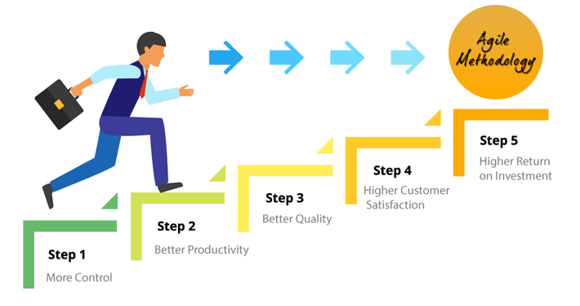
Benefits of Agile

Slide 10
References
http://www.agilemanifesto.org.
https://www.ibm.com/developerworks/rational/library/mar07/pollice/index.html
https://www.ibm.com/cloud/garage/content/culture/practice_agile_principles/

