Slide 1
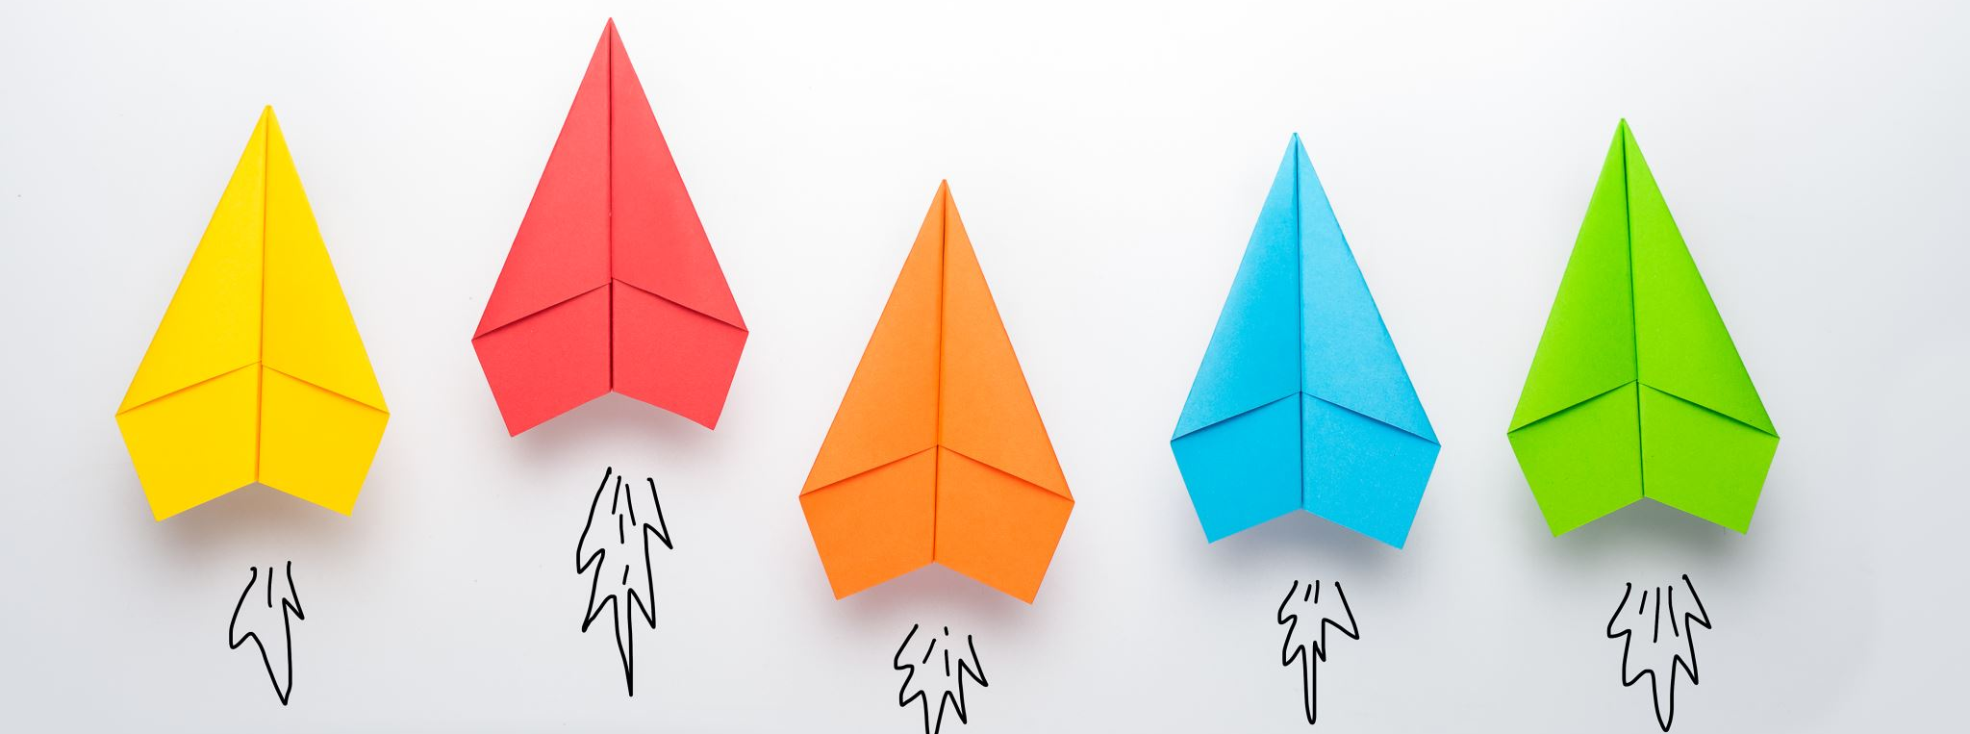
Waterfall vs Agile
Hans Yip

Slide 2
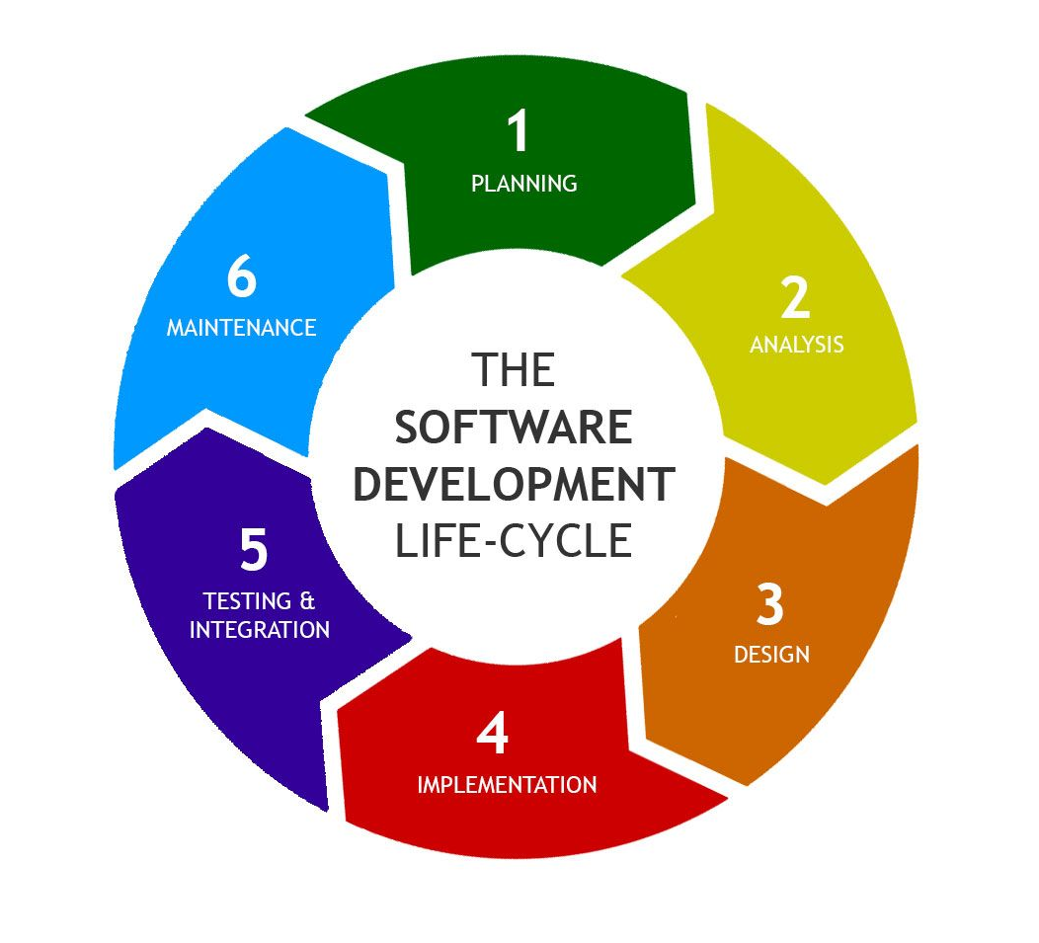
Software Development Life Cycle (SDLC) (Waterfall)

Slide 3
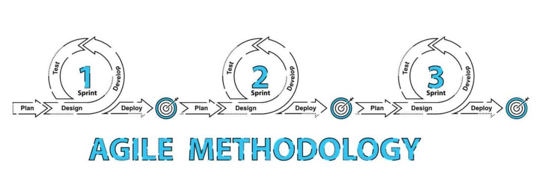
Agile Development Process

Slide 4
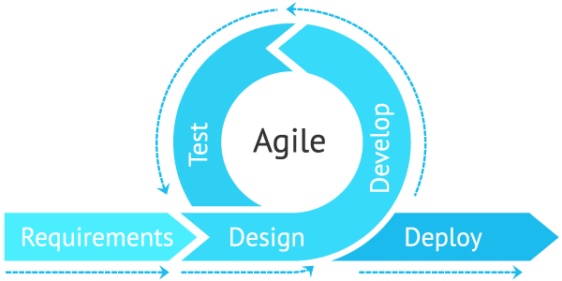
Agile

Slide 6
Waterfall and Agile Comparison
 | SDLC | Agile
Process | Water fall process, divided into phases (analysis, design, building, testing, migration) | Use of iterations, each iteration consists of – Plan, Build, Test.
Concentration | Process, documentations | Response to changes, team work, collaboration
Time to complete | Longer | Fixed due date
Advantage | High quality products | React to market
Disadvantage | Longer to complete, costly | Poor quality
Good for | Steady/stable requirements, mission critical applications, such as HR, Sales, Inventory, etc… Core applications. | New products, products that require constant change of requirements, products that has a fixed due date, such as smartphone, smartwatch, etc.. New products.

