Slide 1
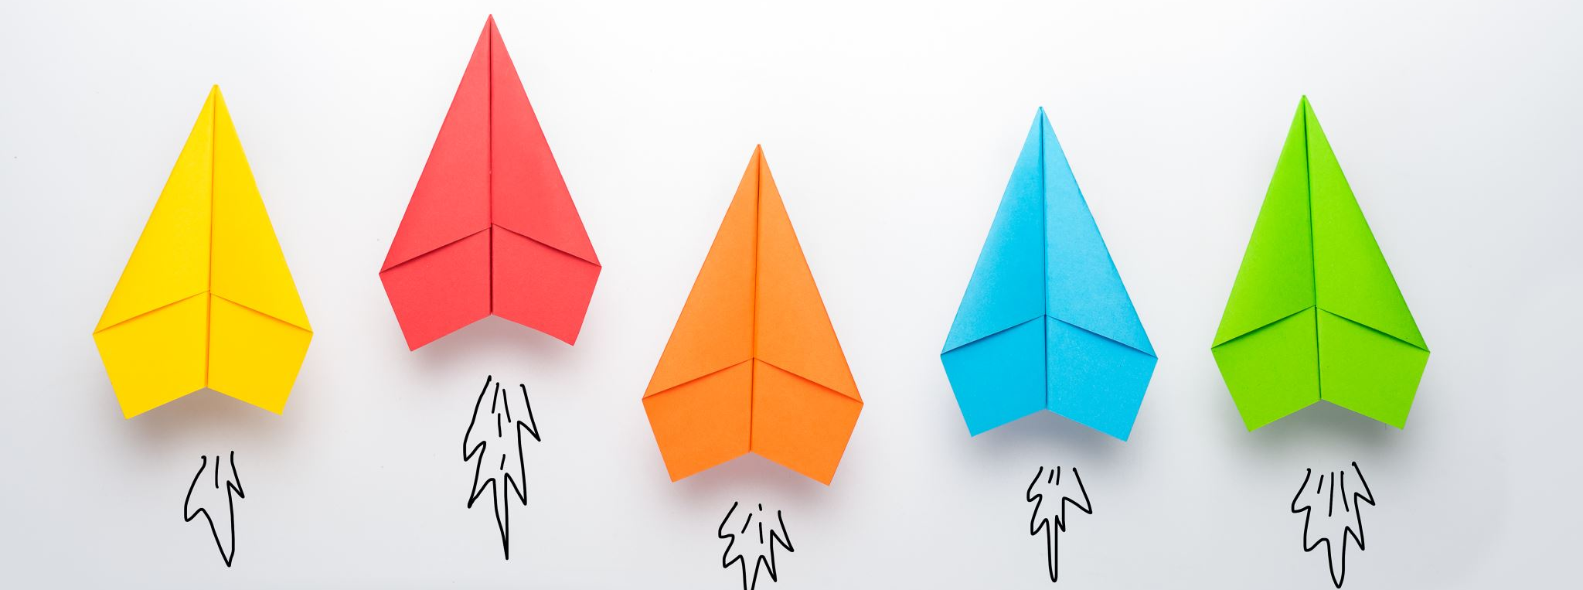
Future technologies
Hans Yip

Slide 2
Learning Objectives
Future Technologies

Slide 3
Future Technologies
Car: AI + GPS + network + technologies = automatic driver
Life: AI + voice + network + technologies = smart home
What about? Smart hospitals, smart schools, smart shops, smart police station, smart dental office, etc…
California new law: for DUI, need to install and pass breath test before can start the car. Other than breath, needs to use bio recognitions etc…

Slide 4
Future Technologies
Smart ID, smart pay, etc…
Virtual Bank
Deepfake, Deep Learning, Machine Learning

