Slide 1
Module 1, Section 2: Cloud Economics
© 2018, Amazon Web Services, Inc. or its Affiliates. All rights reserved.
Notes:
Welcome to Module 1, Section 2 – Cloud Economics.

Slide 2
What’s In This Module
Part 1: Fundamentals of Pricing
Part 2: Total Cost of Ownership (TCO)
Notes:
In this module, we are going to discuss the economics of cloud computing.
Part one will introduce you to the fundamentals of pricing, and in part two we’ll review total cost of ownership.

Slide 3
Module Overview
Review and understand the service pricing philosophy and the elements of cloud Total Cost of Ownership (TCO):
Understand the AWS pricing philosophy.
Review fundamental pricing characteristics.
Understand the elements of Total Cost of Ownership.
Notes:
Upon completing this module, you’ll understand the Amazon Web Services pricing philosophy, review fundamental pricing characteristics and understand the elements of total cost of ownership, which is used to calculate the total cost of purchasing and operating a technology product during its useful life. Total cost of ownership gives businesses a framework to evaluate competing solutions to a problem and will be part of cloud conversations with your business partners.

Slide 4
Part 1: Fundamentals of AWS Pricing
Notes:
Introducing Part 1: Fundamentals of AWS Pricing.

Slide 5
AWS Pricing Fundamentals
Three fundamental drivers of cost with AWS:
Compute
Storage
Outbound data transfer
(In most cases) No charge:
Inbound data transfer
Data transfer between services within the same region
Charge for aggregated outbound data transfer
Notes:
There are three fundamental drivers of cost with AWS: compute, storage, and outbound data transfer. These characteristics vary somewhat, depending on the AWS product and pricing model you choose.
In most cases, there is no charge for inbound data transfer or for data transfer between other AWS services within the same AWS Region. There are some exceptions, so be sure to verify data transfer rates before you begin to use the AWS service.
Outbound data transfer is aggregated across services and then charged at the outbound data transfer rate. This charge appears on the monthly statement as AWS Data Transfer Out.

Slide 6
AWS Pricing Model
AWS Pricing Policy:
While the number and types of services offered by AWS have increased dramatically, our philosophy on pricing has not changed: at the end of each month, you pay for what you use, You can start or stop using a product at any time. No long-term contracts required.
Pay for what you use
Pay less when you reserve
Pay less when you use more
Pay even less as AWS grows
Notes:
This philosophy is what underlies AWS pricing. While the number and types of services offered by AWS have increased dramatically, our philosophy on pricing has not changed. At the end of each month, you pay for what you use. You can start or stop using a product at any time. No long-term contracts are required.
AWS offers a range of cloud computing services. For each service, you pay for exactly the amount of resources you actually need. This utility-style pricing model includes:
Pay for what you use,
Pay less when you reserve,
Pay less when you use more, and
Pay even less as AWS grows
Let’s take a closer look at these core concepts of pricing. Select the link to review the AWS pricing white paper.
https://d0.awsstatic.com/whitepapers/aws_pricing_overview.pdf

Slide 7
Pay for What You Use
Pay only for the services you consume, with no large upfront expenses.
Lower variable costs
Adapt to changing business needs
Benefits:
Adapt to changing business needs
Redirect focus on innovation and invention
Notes:
Unless you build data centers for a living, you have likely spent too much time and money building them. With AWS, you pay only for the services you consume with no large upfront expenses. You’re able to lower variable costs, so you no longer need to dedicate valuable resources to building costly infrastructure, including purchasing servers, software licenses, or leasing facilities.
Quickly adapt to changing business needs and redirect your focus on innovation and invention by paying only for what you use and for as long as you need it. All AWS services are available on demand, require no long-term contracts, and have no complex licensing dependencies.

Slide 8
Pay Less When You Reserve
Invest in Reserved Instances (RIs):
Save up to 75%
Options:
All Up-front Reserved Instance (AURI) → largest discount
Partial Up-front Reserved Instance (PURI) → lower discounts
No Upfront Payments Reserved Instance (NURI) → smaller discount
Benefits:
Minimize risk
Predictably manage budgets
Comply with policies that require longer-term commitments
Notes:
For certain services like Amazon EC2 and Amazon RDS, you can invest in reserved capacity. With Reserved Instances, you can save up to 75 percent over equivalent on-demand capacity. Reserved Instances are available in 3 options:
All up-front reserved instance (or AURI)
Partial up-front reserved instance (or PURI), and
No upfront payments reserved instance (or NURI)
When you buy Reserved Instances, the larger the upfront payment, the greater the discount. To maximize your savings, you can pay all up-front and receive the largest discount. Partial up-front RIs offer lower discounts but give you the option to spend less up front. Lastly, you can choose to spend nothing up front and receive a smaller discount, allowing you to free up capital to spend in other projects.
By using reserved capacity, your organization can minimize risks, more predictably manage budgets, and comply with policies that require longer-term commitments.

Slide 9
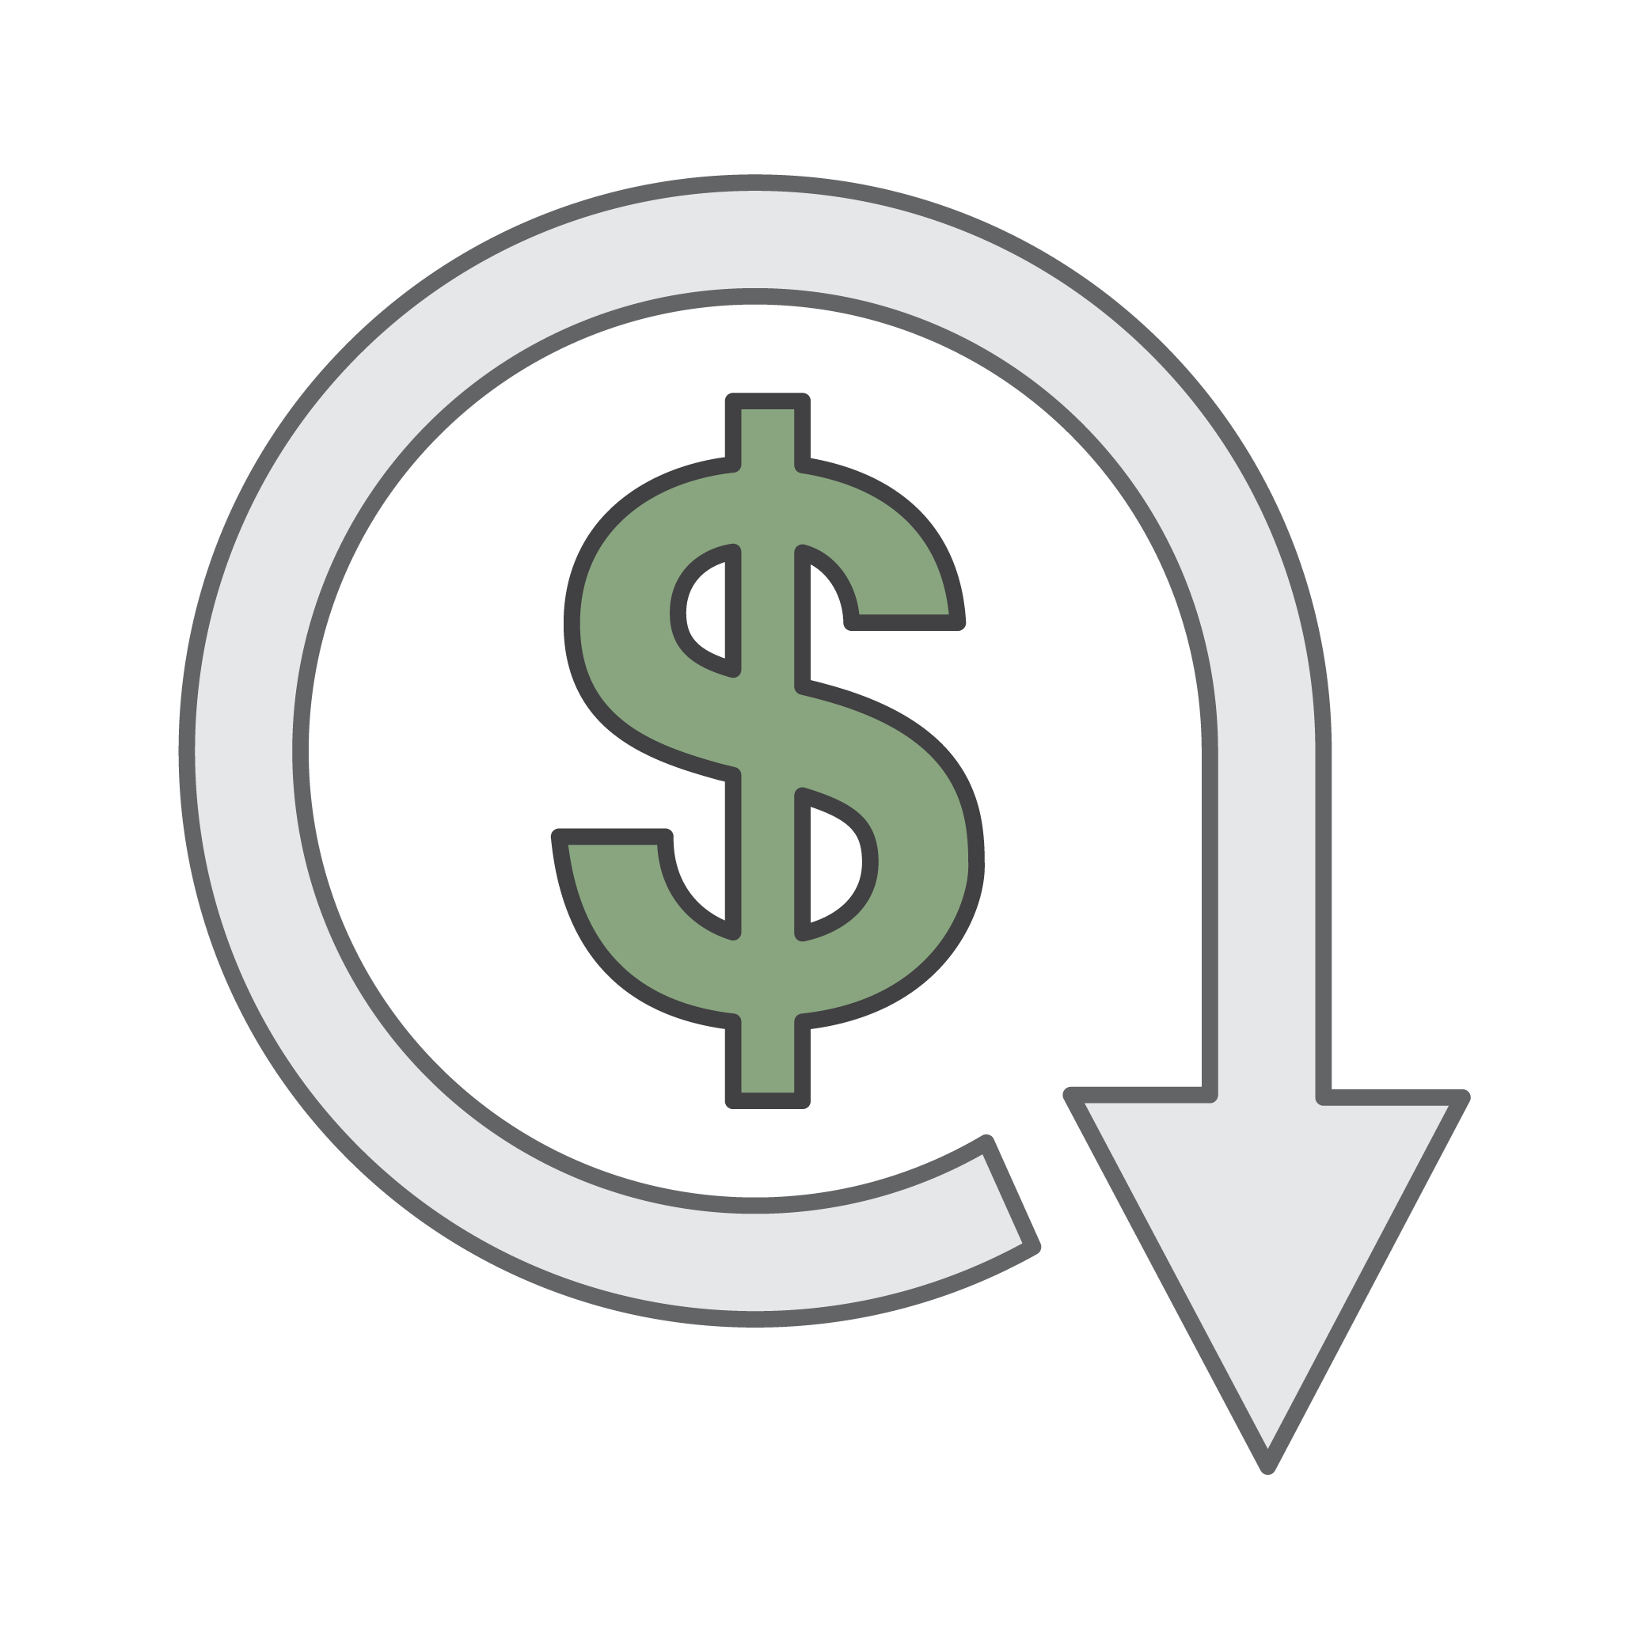
Pay Less By Using More
Realize volume-based discounts:
Savings as usage increases.
Tiered pricing for services (for example, Amazon S3, EBS, EFS) → the more you use, the less you pay per GB.
Data transfer IN is always free.
Multiple storage services deliver lower storage costs based on needs.
Benefits:
Choosing the right combination of storage options helps you reduce cost while preserving performance, security, and durability.
Notes:
With AWS, you can get volume based discounts and realize important savings as your usage increases. For services like Amazon S3, pricing is tiered, meaning the more you use, the less you pay per GB. In addition, data transfer IN is always free of charge. Multiple storage services deliver lower storage costs based on your needs. As a result, as your AWS usage needs increase, you benefit from the economies of scale that allow you to increase adoption and keep costs under control.
As your organization evolves, AWS also gives you options to acquire services that help you address your business needs. For example, the AWS storage services portfolio offers options to help you lower pricing based on how frequently you access data and the performance you need to retrieve it. To optimize your savings, choose the right combination of storage solutions that help you reduce costs while preserving performance, security and durability.

Slide 10
Pay Even Less as AWS Grows
As AWS grows:
AWS is focused on lowering cost of doing business.
Results in AWS passing savings from economies of scale to you.
Since 2006, AWS has LOWERED PRICING 61 times.
Future higher performing resources replace current resources for no extra charge.
Notes:
AWS is constantly focused on reducing data center hardware costs, improving operational efficiencies, lowering power consumption, and generally lowering the cost of doing business.
These optimizations and AWS’s substantial and growing economies of scale result in passing savings back to you in the form of lower pricing. Since 2006, AWS has lowered pricing 61 times!
Another benefit of AWS growth is that future, higher performing resources replace current ones for no extra charge.

Slide 11
Custom Pricing
Meet varying needs through custom pricing.
Available for high-volume projects with unique requirements.
Notes:
AWS realizes that every customer has different needs. If none of the AWS pricing models work for your project, custom pricing is available for high-volume projects with unique requirements.

Slide 12
AWS Free Tier
AWS Free Tier helps customers get started in the cloud.
Limitations:
Only new customers
Up to one year
Applicable to only certain services and options
For more details: www.aws.amazon.com/free
Notes:
To help new AWS customers get started in the cloud, AWS offers a free usage tier for new customers up to one year, applicable to certain services and options. If you’re a new AWS customer, you can run a free Amazon EC2 T1 micro instance for a year, while also leveraging a free usage tier for Amazon S3, Amazon Elastic Block Store, Elastic Load Balancing, AWS data transfer, and other AWS services. Select the link for more details.
https://aws.amazon.com/free/

Slide 13
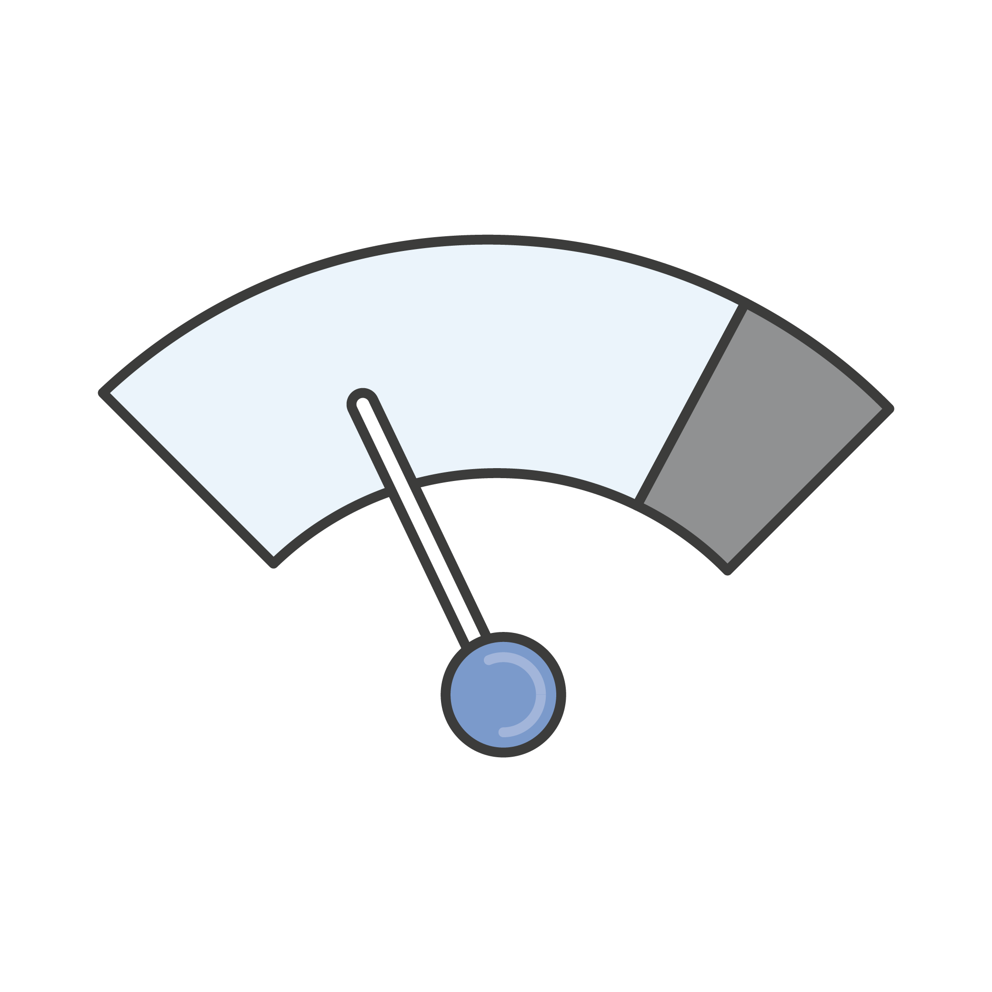
No Charge
AWS services for no additional charge:
Amazon VPC
AWS Identity and Access Management (IAM)
Consolidated Billing
AWS Elastic Beanstalk**
AWS CloudFormation**
Automatic Scaling**
AWS OpsWorks**
**Note: There may be charges associated with other AWS services used in conjunction with these services.
Notes:
AWS also offers a variety of services for no additional charge.
Amazon VPC lets you provision a logically isolated section of the AWS Cloud where you can launch AWS resources in a virtual network that you define.
AWS Identity and Access Management (or IAM) controls your users’ access to AWS services and resources.
Consolidated Billing is a billing feature in AWS Organizations to consolidate payment for multiple AWS accounts or multiple AISPL accounts. Consolidated billing provides:
One bill for multiple accounts.
The ability to easily track each account’s charges.
The opportunity to decrease charges as a result of volume pricing discounts from combined usage.
And you can consolidate all of your accounts using Consolidated Billing and get tiered benefits.
AWS Elastic Beanstalk is an even easier way for you to quickly deploy and manage applications in the AWS cloud.
AWS CloudFormation gives developers and systems administrators an easy way to create a collection of related AWS resources and provision them in an orderly and predictable fashion.
Automatic Scaling automatically adds or removes resources according to conditions you define. The resources you are using increase seamlessly during demand spikes to maintain performance and decrease automatically during demand lulls to minimize costs.
AWS OpsWorks is an application management service that makes it easy to deploy and operate applications of all shapes and sizes.
Note that although there is no charge for these services, there may be charges associated with other AWS services used in conjunction with these services. For example, when auto scaling additional EC2 instances, there will be charges for those instances.

Slide 14
In Review
There is no charge for:
Inbound data transfer
Data transfer between services within the same region
Pay for what you use.
Start and stop any time.
No long-term contracts required.
Some services are free, but AWS services used in conjunction with these services are not.
Notes:
In summary, while the number and types of services offered by AWS have increased dramatically, our philosophy on pricing has not changed. At the end of each month, you pay only for what you use, and you can start or stop using a product at any time. No long-term contracts are required.
The best way to estimate costs is to examine the fundamental characteristics for each AWS service, estimate your usage for each characteristic, and then map that usage to the prices posted on the website. The service pricing strategy gives you tremendous flexibility to choose the services you need for each project and to pay only for what you use.
There are a number of free AWS services, including:
Amazon VPC,
Elastic Beanstalk,
AWS CloudFormation,
IAM,
Automatic Scaling,
AWS OpsWorks, and
Consolidated Billing
While the services themselves are free, the resources that they provision are not. Additionally, there is no charge for inbound data or data transfer between services within the same region; however, outbound data transfer costs are tiered. Select the links to learn more.
http://aws.amazon.com/pricing/.
https://d0.awsstatic.com/whitepapers/aws_pricing_overview.pdf.

Slide 15
Part 2: Total Cost of Ownership (TCO)
Notes:
Now that you understand the AWS pricing philosophy and how different AWS services are priced, let’s take a look at Part 2: Total Cost of Ownership.
In addition to prices, businesses often want to understand the total cost of ownership, which is a financial estimate that helps buyers and owners determine the direct and indirect costs of a product or system. It reflects the purchase price of an asset plus the costs of operation. Total cost of ownership information is especially helpful when you are making the decision of whether or not to deploy on Amazon Web Services.
Let’s move forward to the final part of our economic discussion and review both TCO and the TCO Calculator.

Slide 16
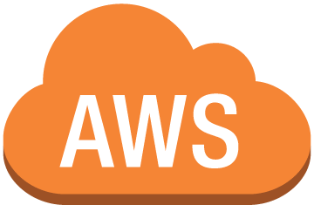
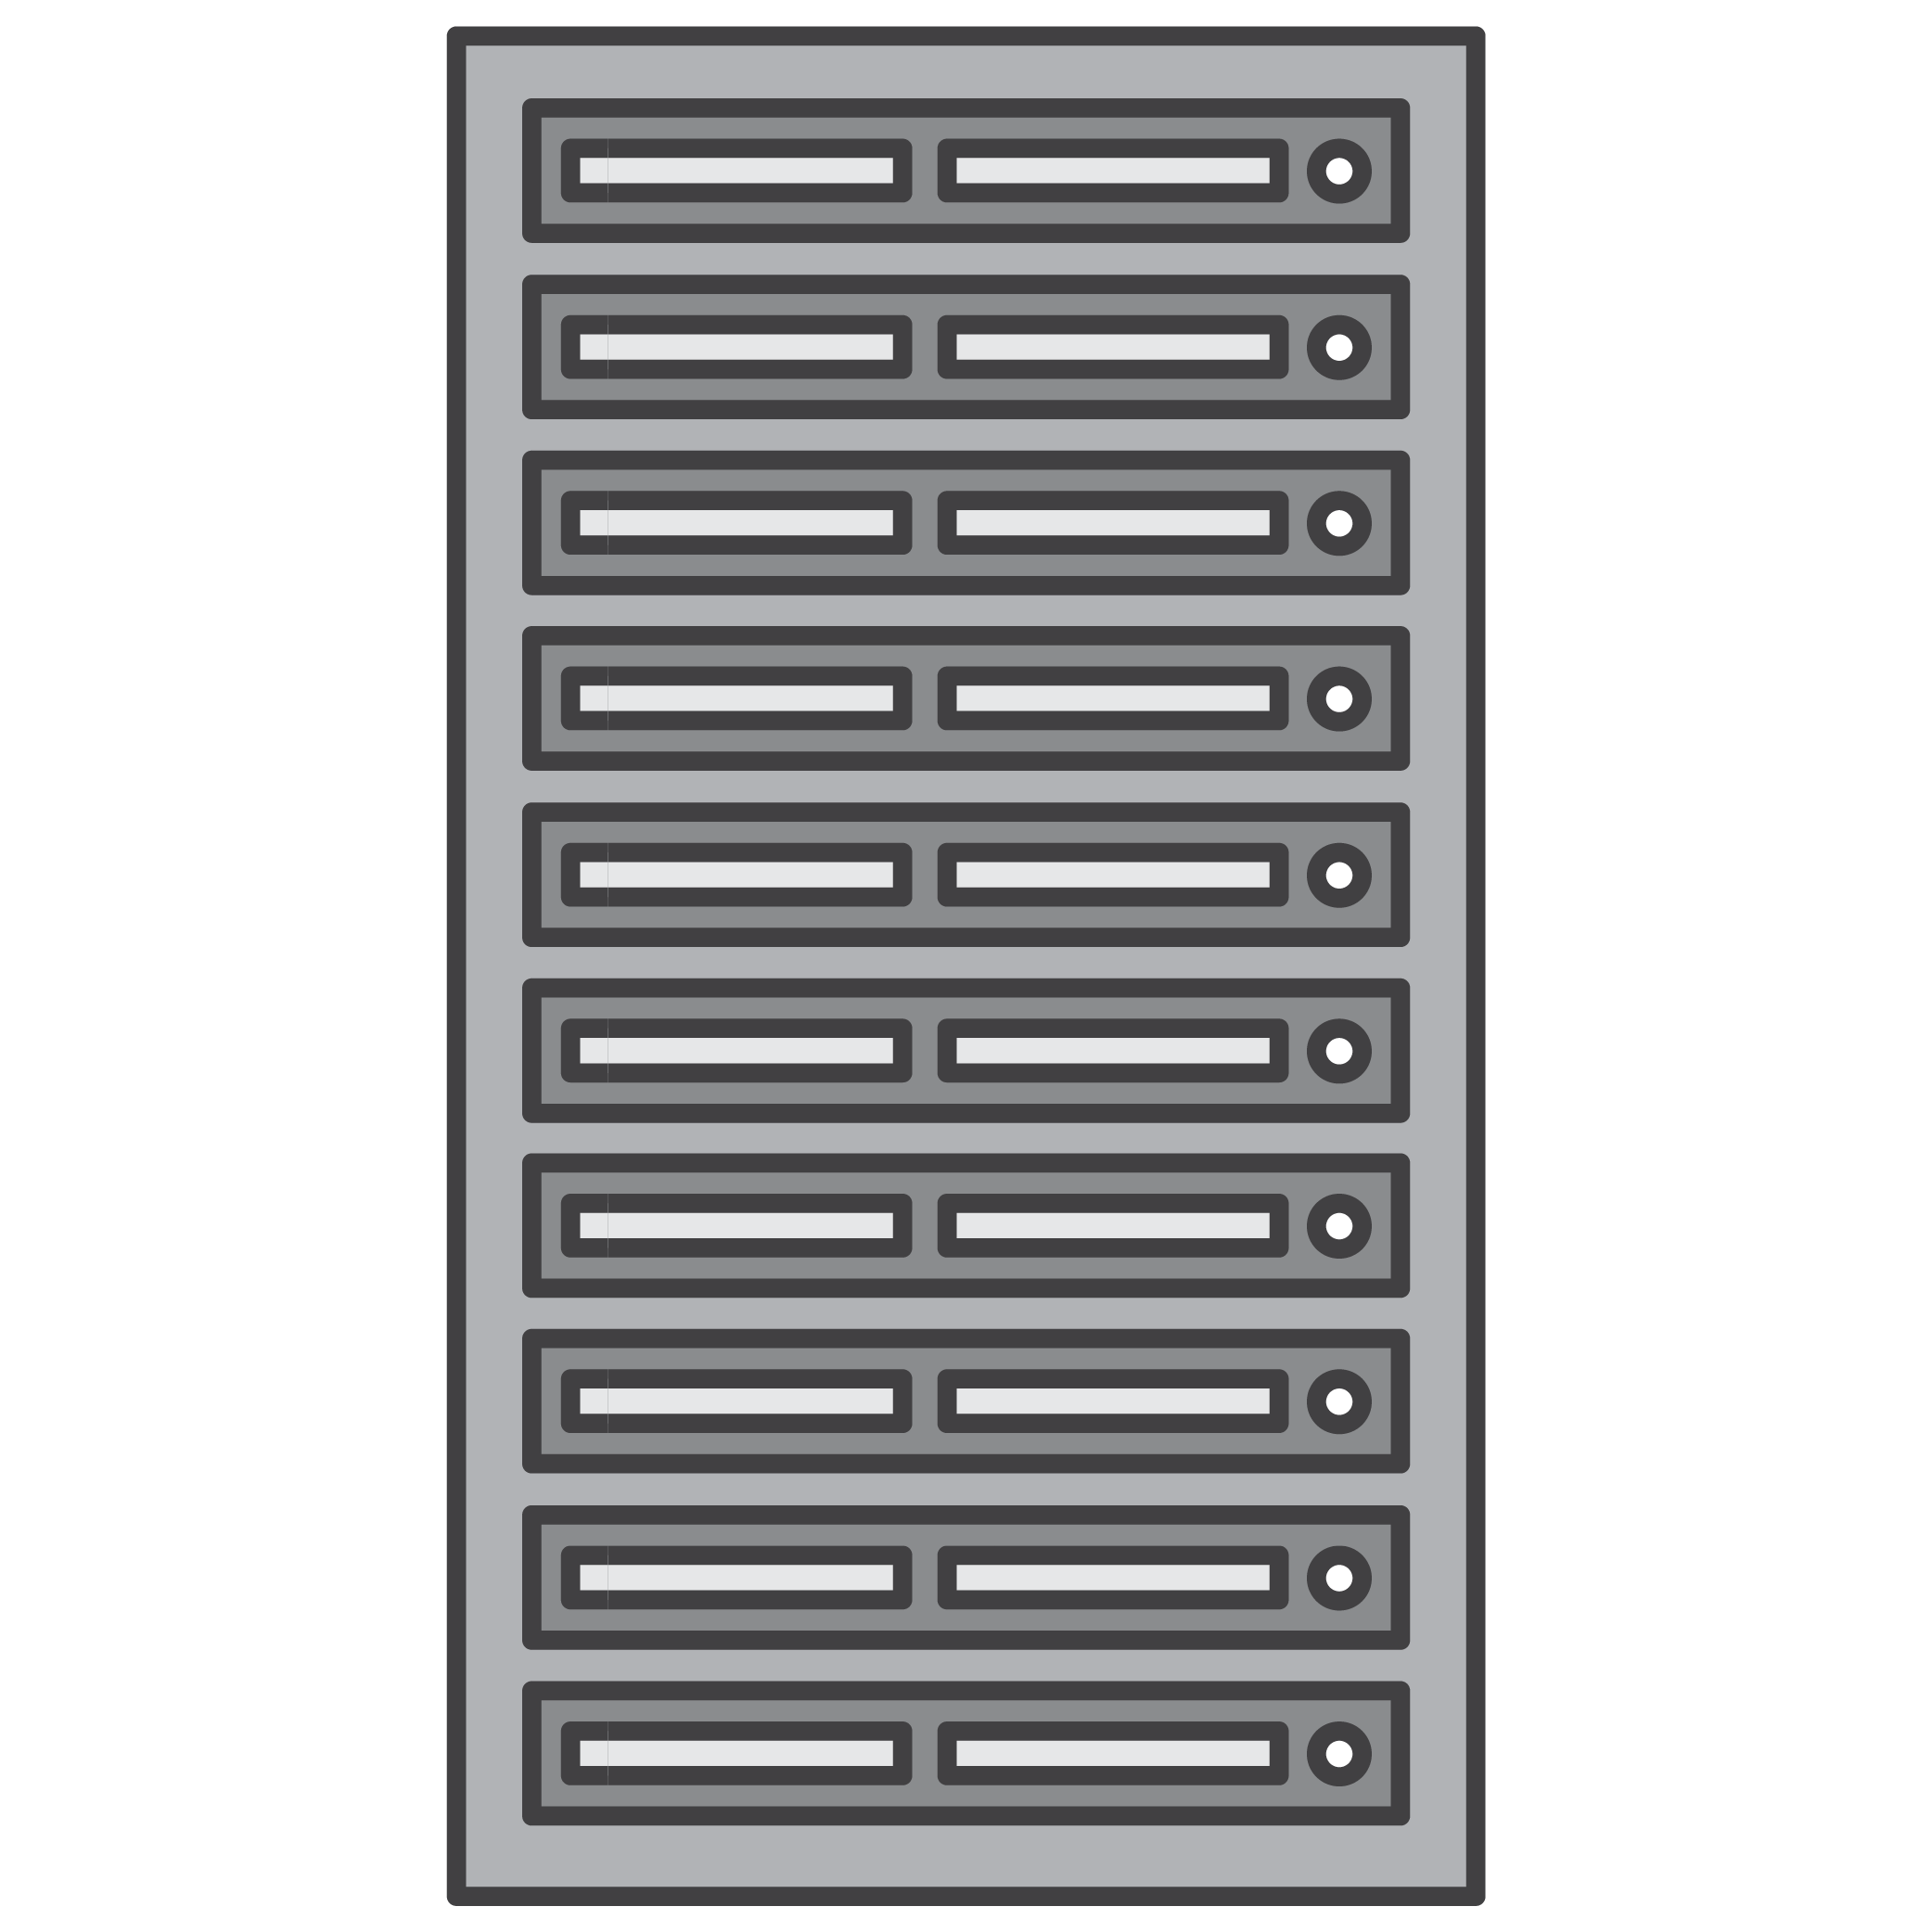
On-Premises versus Cloud
Traditional Infrastructure
AWS Cloud
≠
Resources and Administration
No Up Front Expense -- Pay for what you use
Improve Time to Market & Agility
Equipment
Scale Up and Down
Self-service Infrastructure
Contracts
Cost
Notes:
On-premises versus cloud is a question being asked by many businesses. The difference between these two options is how they are deployed.
An on-premises infrastructure is installed locally on a company’s own computers and servers. There are several fixed costs, also known as capital expenses, associated with the traditional infrastructure including facilities, hardware, licenses, and maintenance staff. Scaling up can be expensive and time consuming. Scaling down does not reduce fixed costs.
A cloud infrastructure is purchased from a service provider who builds and maintains the facilities, hardware, and maintenance staff. A customer pays for what is used. Scaling up or down is simple. Costs are easy to estimate because they depend on service usage.
It is difficult to compare an on-premises IT delivery model with the AWS cloud. The two are so very different that they use different languages.
On-premises IT is a discussion based on capital expenditure, long planning cycles, and multiple components to buy, build, manage, and refresh over time.
AWS is a discussion about flexibility, agility, and consumption based costs.
So, how can we identify the best option?

Slide 17
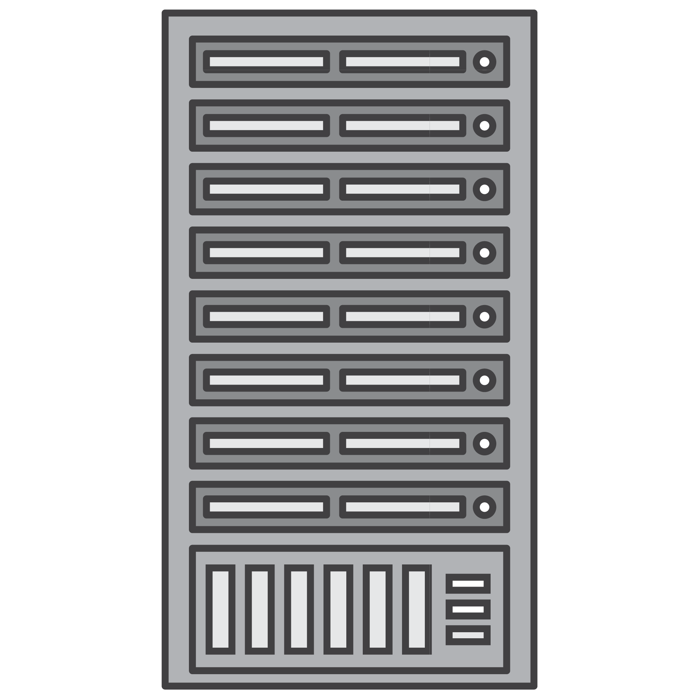
What is Total Cost of Ownership (TCO)?
Total Cost of Ownership (TCO) is the financial estimate to help identify direct and indirect costs of a system.
Why use TCO?
To compare the costs of running an entire infrastructure environment or specific workload on-premises versus on AWS.
To budget and build the business case for moving to the cloud.
Notes:
We can identify the best option by comparing the on-premises solution to a cloud solution. Total Cost of Ownership (or TCO) is a tool that can be used for this comparison. TCO is a financial estimate intended to help buyers and owners determine the direct and indirect costs of a product or system. TCO includes the cost of a service plus all the costs associated with owning the service.
In the cloud environment, TCO is used for comparing the costs of running an entire infrastructure environment for a specific workload in an on-premises or co-location facility, to the same workload running on a cloud-based infrastructure. This comparison is done for budgeting purposes or to build a business case for business decisions regarding the optimal deployment solution.

Slide 18
TCO Considerations
1
Hardware—server, Rack Chassis PDUs, Tor Switches (+Maintenance)
Software—OS, Virtualization Licenses
(+Maintenance)
Facilities Cost
Server Costs
Space
Power
Cooling
2
Hardware—storage Disks, San/Fc Switches
Storage Admin Costs
Facilities Cost
Storage Costs
Space
Power
Cooling
3
Network Hardware—LAN Switches, Load Balancer
Bandwidth Costs
Network Admin Costs
Facilities Cost
Network Costs
Space
Power
Cooling
4
IT Labor Costs
Server Admin
Notes:
So, what are some of the costs associated with data center management? These costs include:
Server costs for both hardware and software, along and facilities costs to house the equipment.
Storage costs are associated with the hardware, administration and facilities.
Network costs are similar to the storage costs and include hardware, administration, and facilities costs.
And IT labor costs that are required to administer the entire solution.
When comparing an on-premises to cloud solution, it is important to accurately assess the true costs of both options. With the Cloud, most costs are upfront and readily calculated. For example, cloud providers give transparent pricing based on different usage metrics, such as RAM, storage, and bandwidth, among others. Pricing is frequently fixed per unit of time.
Customers gain certainty over pricing and are then able to readily calculate costs based on several different usage estimates.
Compare this to on-premise technology. Although they are sometimes difficult to determine, calculations of in-house costs must take into account all:
Direct costs that accompany running a server like power, floor space, storage, and IT operations to manage those resources
Indirect costs of running a server like network and storage infrastructure
Please note that this diagram is conceptual and does not include every cost item. For example, depending on the solution you are implementing, software costs can include database, management, and middle-tier costs. Facilities costs can include upgrades, maintenance, building security, taxes, and so on. IT labor costs can include security admin and application admin costs. This is an abbreviated list to demonstrate the type of costs that are involved in data center maintenance.

Slide 19
On-Premises versus All-In Cloud
You could save 96% a year by moving your infrastructure to AWS.
Your three year total savings would be $159,913.
3 Year Total Cost of Ownership
 | On-Premises | AWS
Server | $91,922 | $2,547
Storage | $67,840 | $4,963
Network | $7,660 | $-------
IT – Labor | $ ---------- | $-------
Total | $167, 422 | $7,509
AWS cost includes business level support
Notes:
Let’s take a look at a cost comparison. This example shows a cost comparison for an on-premises and cloud solution over 3 years. For this comparison, two similar environments were constructed to represent the on-premises and AWS environments. Note that additional direct and indirect costs associated with the on-premises solution have not been included. The components of the on-premises solution include:
1 virtual machine with 4 CPUs, 16 GB of RAM, and a Linux operating system
Average utilization is 100%
Optimized by RAM
The components of a comparable AWS environment include:
1 m4.xlarge instance with 4 CPUs, 16 GB of RAM
The Instance type is a 3 year partial upfront reserved instance
The on-premises 3-year total cost is $167,422. The AWS Cloud 3-year total cost is $7,509, which is a 96% savings over the on-premises solution. Thus, the 3-year total savings on cloud infrastructure would be $159,913. This comparison helps a business clearly understand the differences between the alternatives.
So, what is the difference in the costs?
Remember, the on-premises solution is “predicted” and then continues to incur costs whether or not the capacity is utilized.
In contrast, the AWS solution is commissioned when needed and decommissioned when the resources are no longer in use, resulting in the lower overall costs.

Slide 20
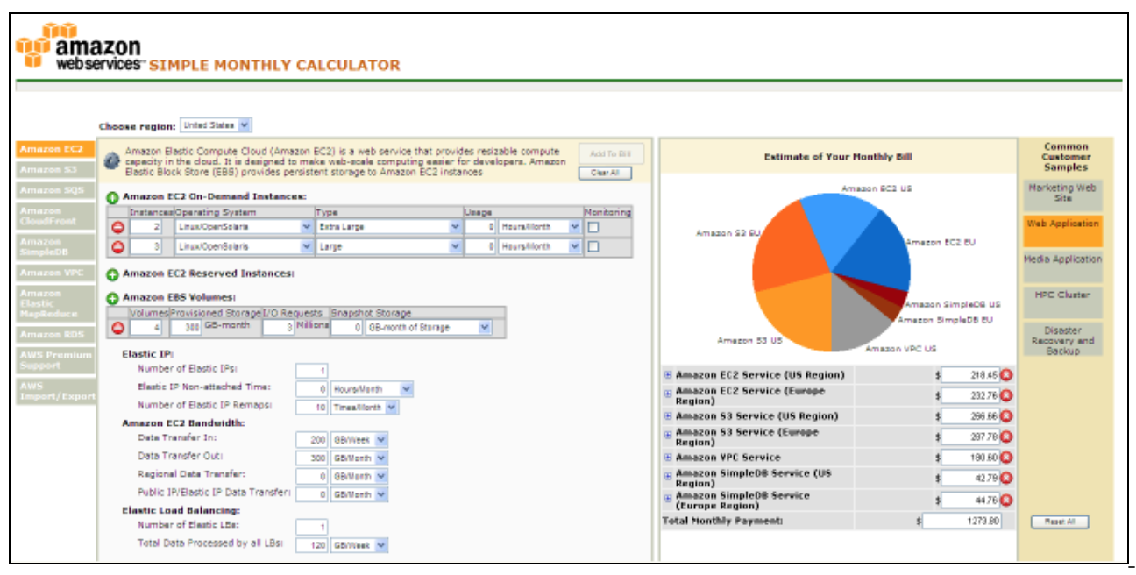
AWS Simple Monthly Calculator
Use the Simple Monthly Calculator to:
Estimate monthly costs
Identify opportunities to reduce monthly costs
Use templates to compare services and deployment models
Access the Simple Monthly Calculator.
http://calculator.s3.amazonaws.com/index.html
Notes:
There are tools available to assist you with these comparisons. The AWS Simple Monthly Calculator helps estimate a monthly AWS bill. Using this tool, you can add, modify and remove services from your 'bill' and it will recalculate the estimated monthly charges automatically.
The calculator incorporates a wide array of pricing calculations across all services in all regions. It also shows a breakdown of features for each service in each region.
The Simple Monthly Calculator is a tool that helps you:
Estimate monthly services costs when using AWS
Identify opportunities for cost reduction
And use templates to model solutions to compare services and deployment models
The calculator also shows common customer samples and their usage. You can click on the “Disaster Recovery and Backup” sample or “Web Application” sample and see the uses of each service. Select the link to launch the Simple Monthly calculator.

Slide 21
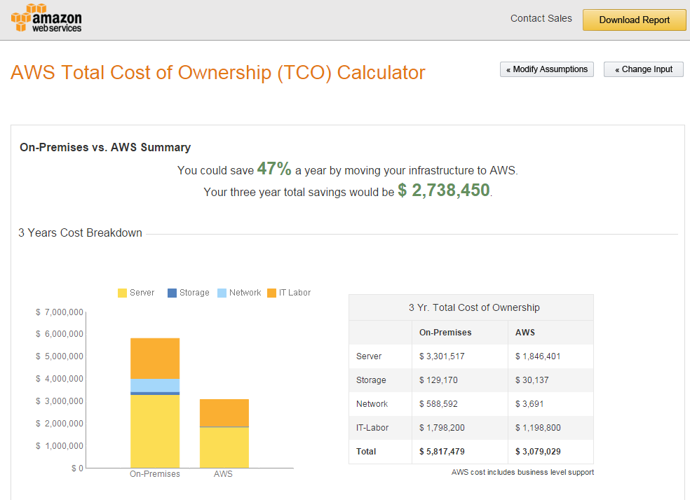
AWS TCO Calculator
Use the TCO Calculator to:
Estimate cost savings
Use detailed reports
Modify assumptions
Accessing the TCO Calculator:
https://awstcocalculator.com
Notes:
The AWS TCO Calculator helps you evaluate the total cost of ownership of a solution. Eliminating the need to invest in large capital expenditures, or capex, and providing a pay-as-you-go model that empowers you to invest in the capacity you need, and use it only when you require it, helps reduce total cost of ownership.
The TCO calculator is a tool that helps you:
Estimate cost savings when using AWS
Uses a detailed set of reports, which can be used in executive presentations.
And modify assumptions that best meets your needs.
An additional benefit of the calculator includes the ability to weigh the financial considerations of owning and operating a data center versus using a cloud infrastructure. Also, the TCO calculator explains the assumptions and the methodology behind the calculations.
Select the link to launch the TCO calculator. https://awstcocalculator.com

Slide 22
Additional Benefit Considerations
Hard Benefits
Reduced spending on compute, storage, networking, security
Avoidance of hardware and software purchases (CapEx)
Reductions in operational costs, backup and disaster recovery
Reduction in operations personnel
Soft Benefits
Reuse of service and applications that allow you to define, and redefine solutions using the same cloud service
Increased developer productivity
Improved customer satisfaction
Improved employee morale
Agile business processes able to quickly respond to new and emerging opportunities
Increase global reach
Notes:
Hard benefits include reduced spending on compute, storage, networking and security. Avoid hardware and software purchases and reductions in operational costs, backup and disaster recovery and a reduction in operations personnel.
Cloud Total Cost of Ownership defines what will be spent on the technology after adoption - or what it costs to “run the engine”. Typically, a TCO analysis looks at the “as is” on-premises infrastructure and compares this with the cost of the “to be” infrastructure state in the cloud. While this is easy to calculate, it may only provide a narrow view of the total financial impact of moving to the cloud.
A Return on Investment analysis can be used to determine the value generated while taking spending and saving into consideration. This analysis starts by identifying the hard benefits in terms of direct and visible cost reductions and efficiency improvements.
Next, soft savings are identified. Soft savings are value points that are challenging to accurately quantify but can be more valuable than the hard savings. It is important for you to understand both hard and soft benefits to understand the full value of cloud. Soft benefits include:
Reusing service and applications that allow you to define, and redefine solutions using the same cloud service
Increased developer productivity
Improved customer satisfaction
Improved employee morale
Agile business processes able to quickly respond to new and emerging opportunities, and
Increased global reach
Now, let’s review a case study from Delaware North to see an actual TCO example.

Slide 23
Case Study: Total Cost of Ownership
Background:
Growing global company with over 200 locations
500 million customers, $3 billion annual revenue
Notes:
Background:
Delaware North originated in 1915 as a peanut and popcorn concessions vendor; today, it’s a major food and hospitality company. Although the company deliberately keeps a low profile, it is a leader in the food-service and hospitality industry.
Delaware North serves more than 500 million customers annually at more than 200 locations around the world, including venues as diverse as the Kennedy Space Center in Florida, London Heathrow Airport, Kings Canyon Resort in Australia, and the Green Bay Packers’ Lambeau Field in Wisconsin. This global presence has turned Delaware North into a $3 billion enterprise.

Slide 24
Case Study: Total Cost of Ownership
Background:
Growing global company with over 200 locations
500 million customers, $3 billion annual revenue
Challenge:
Meet demand to rapidly deploy new solutions
Constantly upgrade aging equipment
Notes:
The company’s on-premises data center was becoming too expensive and inefficient to support its global business operations.
Kevin Quinlivan, Delaware North’s Chief Information Officer, says, “As the company continued to grow, the demand to rapidly deploy new solutions to meet customer requirements increased as well. This fact, combined with the need to constantly upgrade aging equipment, required an even greater commitment of resources on our part. We had to find a better strategy.” Delaware North turned to AWS for a solution.

Slide 25
Case Study: Total Cost of Ownership
Background:
Growing global company with over 200 locations
500 million customers, $3 billion annual revenue
Challenge:
Meet demand to rapidly deploy new solutions
Constantly upgrade aging equipment
Criteria:
Broad solution to handle all workloads
Ability to modify processes to improve efficiency and lower costs
Eliminate busy work (e.g. patching software)
Achieve a positive return on investment (ROI)
Notes:
After a successful migration of about 50 websites to AWS in 2013, Delaware North evaluated the cost benefit and total cost of ownership to move their IT infrastructure to AWS. Their focus was to answer C-Suite level business demands for measurable benefits that could convince an executive committee that the AWS cloud was the right approach. The evaluation process centered on three criteria:
First, a cloud solution needed a broad set of technologies that could handle all of Delaware North’s enterprise workloads while delivering support for critical functions.
From an operational perspective, Delaware North wanted the features and flexibility to modify core IT processes to improve efficiencies and lower costs. This included eliminating redundant or time-consuming tasks like patching software and pushing test and development tasks through outdated systems that, in the past, added months to the deployment of new services.
Finally, financial requirements needed to demonstrate a return on investment with a solid cost-benefit justification for moving away from their existing data center environment.

Slide 26
Case Study: Total Cost of Ownership
Background:
Growing global company with over 200 locations
500 million customers, $3 billion annual revenue
Challenge:
Meet demand to rapidly deploy new solutions
Constantly upgrade aging equipment
Criteria:
Broad solution to handle all workloads
Ability to modify processes to improve efficiency and lower costs
Eliminate busy work (e.g. patching software)
Achieve a positive return on investment (ROI)
Solution:
Moved its on-premises data center to AWS • Eliminated 205 servers (90%) • Moved nearly all apps to AWS
Three-year Amazon EC2 Reserved Instances
Notes:
A cost comparison completed by Delaware North demonstrated that it could save 3.5 million dollars based on a five-year run rate by moving its on-premises data center to AWS and using three-year Amazon EC2 Reserved Instances and Reserved Instance renewals.
Quinlivan noted that the deep technology stack available on AWS was more than sufficient to meet the company’s technical and operational requirements. The pricing structure of the AWS offerings, which includes paying only for what is used, provided total cost of ownership benefits which was presented to senior leaders.
Quinlivan stated, “We compared the costs of keeping our on-premises data center versus moving to the AWS cloud, measuring basic infrastructure items such as hardware cost and maintenance.” He also says “We estimate that moving to AWS will save us at least $3.5 million over five years by reducing our server hardware by more than 90 percent. However, the cost savings will likely be greater due to additional benefits, like the increased compute capacity we can get using AWS. That lets us continually add more and larger workloads than we could using a traditional data center infrastructure, and achieve savings by only paying for what we use.”
Delaware North moved almost all of its applications to AWS, including enterprise software such as its Fiorano middleware, Crystal Reports and QLIK business intelligence solutions, its Citrix virtual desktop system, and Microsoft System Center Configuration Manager, which is used to manage workstations. The most dramatic physical change was the elimination of 205 servers. Everything running on that hardware was migrated to AWS. The IT department decided to keep about 20 servers on-premises at the new headquarters building to run communications and file-and-print tasks.
“We erred on the side of caution to ensure there is no latency with these tasks, but once we reach a certain comfort level, we may move these to the cloud as well,” says Brian Mercer, Senior Software Architect for the project.

Slide 27
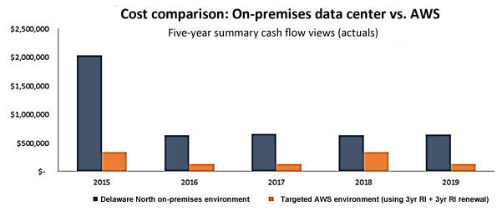
Case Study: Total Cost of Ownership
Notes:
This chart displays the cost comparison done by Delaware North showing the costs of their on-premises environment and the proposed AWS environment. The estimates showed a $3.5 million based on a five-year run rate by moving from an on-premises data center to AWS.

Slide 28
Case Study: Total Cost of Ownership
Business Goals: Growth
Enhanced 24/7 business
Operational efficiency
Results:
Resource Optimization
Robust security compliance
Enhanced disaster recovery
Increased computing capacity
Speed to Market
One day to provision new businesses
Just minutes to push out a service
Operational Efficiency
Continuous cost optimization and reduction
Notes:
Six months into its cloud migration, Delaware North was realizing benefits in addition to its data center consolidation, including cost-effective security compliance, enhanced disaster recovery, and faster deployment times for new services. “Robust security in a retail environment is critical for us because of our many retail operations, and AWS is enormously helpful for that,” says Brian Mercer, the senior software architect for the project. “By leveraging the security best practices of AWS, we’ve been able to eliminate a lot of compliance tasks that in the past took up valuable time and money.” He adds that the company also has increased its disaster recovery capabilities at a lower cost than what was available in its previous data center deployment. “It significantly improved our business continuity capabilities, including seamless failovers,” he says. The solution is also helping Delaware North operate with greater speed and agility. For example, it can bring in new businesses - either through contracts or acquisitions - and get them online much faster than in the past by eliminating the need for traditional IT procurement and provisioning. It used to take between two and three weeks to provision new business units; now it takes one day. The Delaware North IT team is also using AWS to overhaul its operations by eliminating outdated and cumbersome processes, cleaning up documentation, and leveraging the benefits of running test and development tasks in combination with rapid deployment of services through the cloud. “Our DevOps team can now spin up the resources to push out a service in just minutes, compared to the weeks it used to take,” says Brian Mercer. “With AWS, we can respond much faster to business needs. And we can start repurposing time and resources to deliver more value and services to our internal teams and to our customers.”

Slide 29
Resources to Get You Started
AWS Economics Center
http://aws.amazon.com/economics/
AWS TCO Calculator
https://awstcocalculator.com
Simple Monthly Calculator
https://calculator.s3.amazonaws.com/index.html
Case studies and research
http://aws.amazon.com/economics/
Notes:
If you are interested in learning more, there are a number of resources available. Here are some links for you to look at later. Try out the simple online calculator, and access additional resources.

Slide 30
In Review
TCO is a valuable tool.
The AWS Simple Monthly Calculator can be used to provide accurate cost estimates.
The AWS TCO Calculator can be used to estimate cost savings.
The TCO Calculator:
Detailed reports with 3-year TCO comparison by cost categories
Executive reports
Assumptions that can be tailored to business needs
Notes:
In summary, the total cost of ownership is a valuable tool that can be used to understand and compare the costs associated to different deployments. AWS provides the AWS Simple Monthly Calculator and the TCO Calculator to assist you with the calculations needed to estimate cost savings.
Use the AWS Simple Monthly Calculator to:
Estimate monthly costs
Identify opportunities to reduce monthly costs, and
Use templates to compare services and deployment models
Use the TCO Calculator to:
Analyze detailed reports that show a 3-year TCO comparison by cost categories
Reports that are appropriate for inclusion in executive presentations, and
The ability to modify assumptions for business needs

Slide 31
Module 1.0.2 Review:
Explored the fundamental of AWS pricing
Reviewed TCO concepts
Introduced the AWS Simple Monthly Calculator and the TCO Calculator
Up Next…
Complete:
Knowledge Assessment
Notes:
In review, we:
Explored the fundamental of AWS pricing
Reviewed the Total Cost of Ownership concepts, and
Introduced the AWS Simple Monthly Calculator and the AWS TCO calculator.
To complete this module, complete the knowledge assessment.

Slide 32
Up Next: Unit 1.0.3 – AWS Global Infrastructure Overview Review AWS Global Infrastructure Understand Managed vs Unmanaged Services
Notes:
Next, we’ll review the AWS Global Infrastructure and understand managed versus unmanaged services.

Slide 33
Thanks for participating!
© 2018 Amazon Web Services, Inc. or its affiliates. All rights reserved. This work may not be reproduced or redistributed, in whole or in part, without prior written permission from Amazon Web Services, Inc. Commercial copying, lending, or selling is prohibited. Corrections or feedback on the course, please email us at: aws-course-feedback@amazon.com. For all other questions, contact us at: https://aws.amazon.com/contact-us/aws-training/. All trademarks are the property of their owners.
Notes:
Thanks for participating! You may now exit this module.

