Slide 1

Com 1008 an overview of cloud computing (Non-Technical)
Hans Yip

Slide 2
Learning Objectives
Introduction
  Virtualization for Cloud Computing
What is virtualization?
Benefits of virtualization
Types of virtualization
What is virtual machine?
What is server virtualization?
What is hypervisor/virtual machine monitor (VMM)?
Sample hypervisor: Vmware ESXI, Citrix Xen server, Ubuntu KVM

Slide 3
Virtualization for Cloud Computing
Virtualization is the enabling technology and creates virtual machines that allows a single machine to act as if it were many machines.
Benefits of virtualization for cloud computing: Reduces capital expenses and maintenance costs through server consolidation, reduces physical space needed in data centers. Resource Management, Migration, Maintainability, High availability and Fault tolerance are other benefits.
A virtual machine, known as a guest, is a software computer (emulation of a computer system) that provide the same functionality as physical computer.
A physical machine, known as a host, is a computer that converts into multiple virtual machines.
[Copied from “Virtualization for Cloud Computing”, Dr. Sanjay Ahuja, PhD (University of North Florida)]

Slide 4

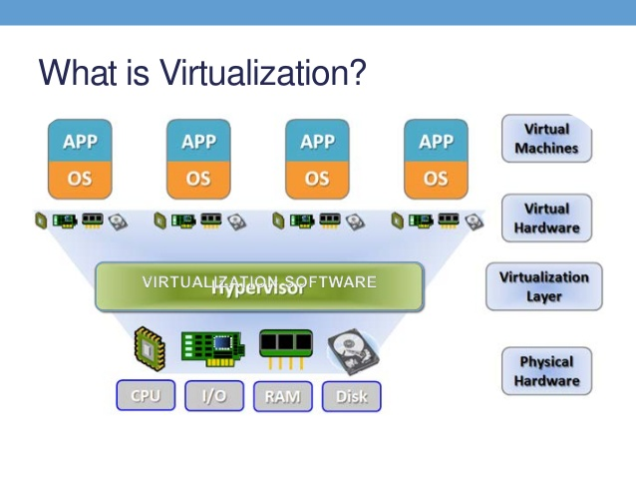
What is Virtualization?

Slide 5
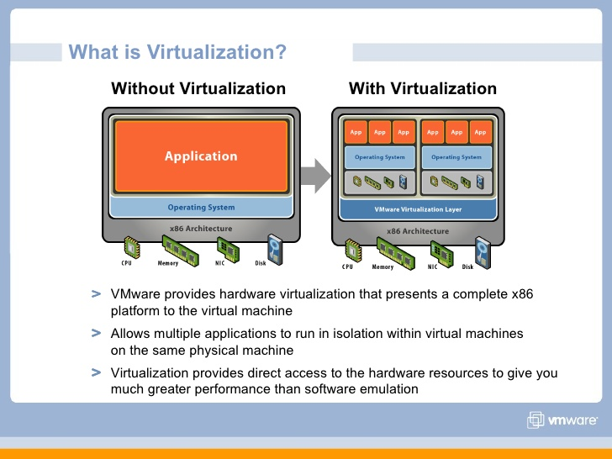
What is Virtualization
The term virtualization broadly describes the separation of a resource or request for a service from the underlying physical delivery of that service.
With virtual memory, for example, computer software gains access to more memory than is physically installed, via the background swapping of data to disk storage.
Similarly, virtualization techniques can be applied to other IT infrastructure layers - including networks, storage, laptop or server hardware, operating systems and applications.
[Copied from VMWare Virtualization.pdf]

Slide 6
2 Virtual Machines in One Physical Machine

Slide 7
Why Virtualization?
Lots of servers:
  Web servers
  Mail servers
  Database servers
  File servers
  Proxy servers
  Application servers
  and many others, etc…
[Copied from “Virtualization Techniques for Cloud Computing”, Prof Chih-Hung Wu (National University of Kaohsiung)]

Slide 8
Why Virtualization?
Problems caused by lots of servers:
  The data-center is FULL
    Full of under-utilized servers
    Complicated in management
  Power consumption
    Greater wattage per unit area than ever
    Electricity overload
    Cooling at capacity
  Environmental problem
    Green IT
[Copied from “Virtualization Techniques for Cloud Computing”, Prof Chih-Hung Wu (National University of Kaohsiung)]

Slide 9
Why now?
Hardware evolution
  Faster CPU clock than ever
  More CPU cores in a single chip
    4-core CPU already in the market
    6- or 8- core CPUs will be there soon
  Multi-core architectures make parallel processing more realizable
  Virtualization support on chip from CPU manufacturers (Intel VT-x; AMD’s AMD-V)
Software maturity
  Available and stable open-sourced software
    OS, DB, Web server, Java, PHP, gcc, etc
  Established and mature software standards
    Web service, XML, SOAP, COM, etc
[Copied from “Virtualization Techniques for Cloud Computing”, Prof Chih-Hung Wu (National University of Kaohsiung)]

Slide 10
Only Focus on Platform/Server Virtualization
In this course we mainly focus on Platform virtualization which is mostly related to cloud-computing

Slide 11
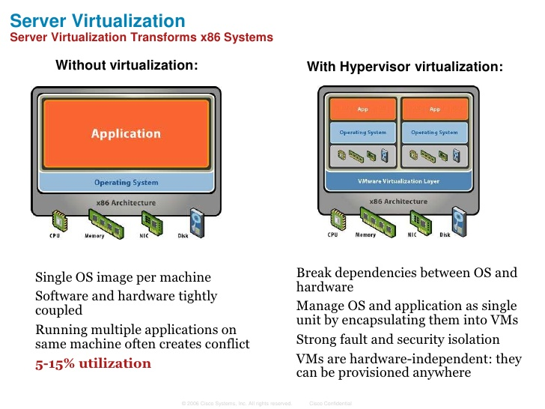
What is Server Virtualization?
Server virtualization is used to mask server resources from server users. This can include the number and identity of operating systems, processors, and individual physical servers.
[https://www.vmware.com/topics/glossary/content/server-virtualization]

Slide 12
Server Virtualization Definition
Server virtualization is the process of dividing a physical server into multiple unique and isolated virtual servers by means of a software application. Each virtual server can run its own operating systems independently.
[https://www.vmware.com/topics/glossary/content/server-virtualization]

Slide 13
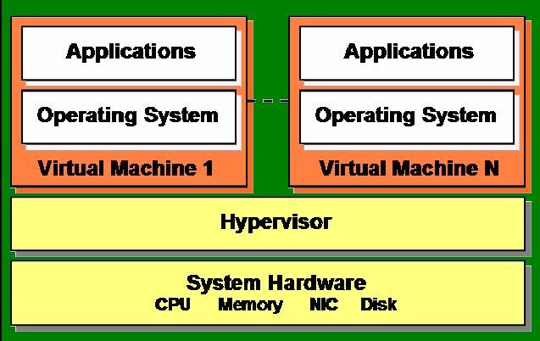
What is a Hypervisor /Virtual Machine Monitor (VMM)?
Hypervisor plays an important role in the virtualization scenario by virtualization of hardware. It provides support for running multiple operating systems concurrently in virtual servers created within a physical server.
The virtualization layer is the software responsible for hosting and managing all VMs. The virtualization layer is a hypervisor running directly on the hardware.
Example: VMWare, Xen, KVM.
[Copied from “Virtualization for Cloud Computing”, Dr. Sanjay Ahuja, PhD (University of North Florida)]

Slide 14
High-level types of Virtualization
Hardware-assisted virtualization
O/S-level virtualization
Software-level virtualization

Slide 15
Hardware-assisted Virtualization
Hardware-assisted Virtualization: the hardware provides architectural support that facilitates building a virtual machine monitor and allows guest OSes to be run in isolation. (no hypervisor)
Special CPU form Intel and AMD.

Slide 16
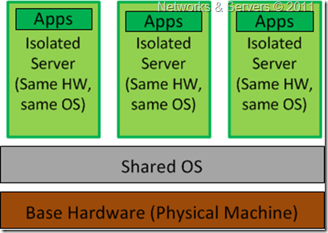
O/S-Level Virtualization
Homogeneous environment
a physical server is virtualized at the operating system level, enabling multiple isolated and secure virtualized servers to run on a single physical server.
Host O/S = guest O/S
No hypervisor

Slide 17
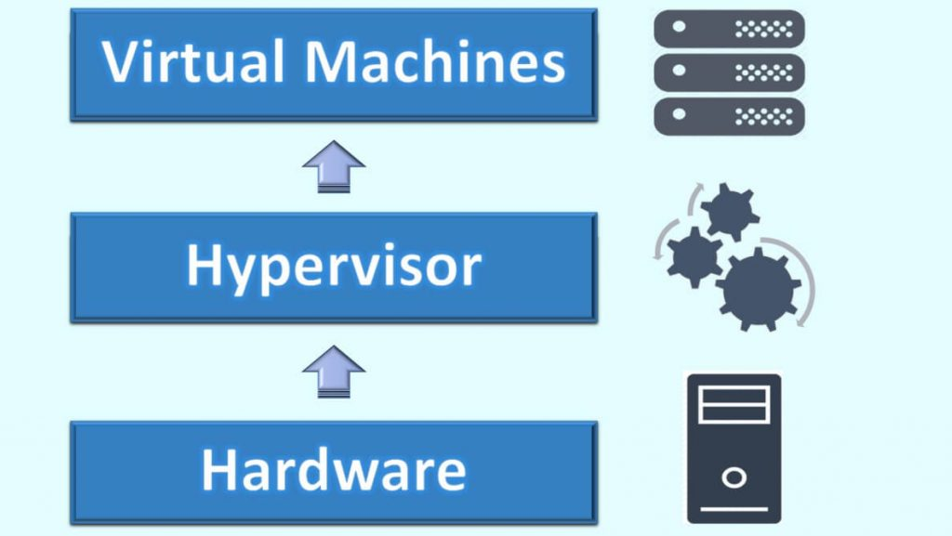
Software-Level Virtualization
AKA Virtual Machine Monitor (VMM)
Uses a hypervisor (software)
Hypervisor - a type of software that directly communicates with a physical server's disk space and CPU.
The hypervisor monitors the physical server's resources and keeps each virtual server independent.

Slide 18
Virtualization References
https://www.vmware.com/pdf/virtualization.pdf
https://searchvmware.techtarget.com/definition/VMware
https://www.vmware.com/topics/glossary/content/virtual-machine
https://www.vmware.com/topics/glossary/content/server-virtualization
https://www.pcmag.com/encyclopedia/term/59102/paravirtualization
https://computer.howstuffworks.com/server-virtualization2.htm
https://www.geeksforgeeks.org/types-of-server-virtualization-in-computer-network/
https://www.vmware.com/pdf/virtualization.pdf
https://www.w3schools.in/cloud-computing/cloud-computing/#
https://searchservervirtualization.techtarget.com/definition/hardware-assisted-virtualization
https://docs.oracle.com/cd/E26996_01/E18549/html/VMUSG1010.html
https://en.m.wikipedia.org/wiki/Hardware-assisted_virtualization
https://en.m.wikipedia.org/wiki/Virtual_machine

Slide 19



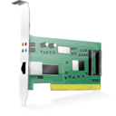


VMware ESXI
Hardware
VM
VM
VM
Bare Metal Approach.
Full virtualization.
Proven technology.
Used for secure and robust virtualization solutions for virtual data centers and cloud infrastructures.
Takes advantage of support for hardware assisted virtualization for 64-bit OS on Intel processors.
Hypervisor

Slide 20

Citrix Xen Server
Hardware
Open source; bare metal.
Offers both Hardware Assisted Virtualization (HVM) and Para-Virtualization (PV)
Needs virtualization support in the CPU for HVM.
Xen loads an initial OS which runs as a privileged guest called “domain 0”.
The domain 0 OS, typically a Linux or UNIX variant, can talk directly to the system hardware (whereas the other guests cannot) and also talk directly to the hypervisor itself. It allocates and maps hardware resources for other guest domains.
Domain Zero Guest
VM
VM
Hypervisor

Slide 21
Ubuntu KVM
Hardware
1. Linux Applications
2. KVM Management
Console
Kernel based virtual machine (Kernel Based VM)
Open source.
Kernel-level extension to Linux.
Full virtualization.
Supports full virtualization and hence does not need hardware assisted virtualization support in the CPU.
[https://www.linux-kvm.org/page/Main_Page]
NOTE: KVM is extension of Linux Kernel that turns Linux Kernel into a type 1 bare-metal hypervisor, while the overall system is type II because the host O/S is still fully functional and the other VM’s are standard Linux processes.
VM
VM
Linux
Linux Kernel
KVM

Slide 22
Comparison of Virtualizations
Virtualization | Characteristics
Hardware-assisted virtualization | the hardware provides architectural support that facilitates building a virtual machine monitor and allows guest OSes to be run in isolation. (no hypervisor)
O/S-Level virtualization (Homogeneous environment) | a physical server is virtualized at the operating system level, enabling multiple isolated and secure virtualized servers to run on a single physical server. (host O/S = guest O/S, no hypervisor, share kernel)

Slide 23
Comparison of Virtualizations
Virtualization | Charateristics
High-level language (Software) Virtualization (use of hypervisor)
Hypervisor types: (1) Full virtualization | uses a hypervisor, a type of software that directly communicates with a physical server's disk space and CPU (Not a X86 server). The hypervisor monitors the physical server's resources and keeps each virtual server independent and unaware of the other virtual servers.
(2) Para-virtualization | involves the entire network working together as a cohesive unit. Since each operating system on the virtual servers is aware of one another in para-virtualization, the hypervisor does not need to use as much processing power to manage the operating systems. It requires to modify the guest O/S.

Slide 24
Comparison of Virtualizations
Hypervisor implementation approaches: (1) Hypervisor approach (native or bare metal approach)(Type 1 hypervisor) | a hypervisor architecture is the first layer of software installed on a clean x86-based system (hence it is often referred to as a “bare metal” approach). Since it has direct access to the hardware resources, a hypervisor is more efficient than hosted architectures, enabling greater scalability, robustness and performance.
(2) Hosted approach (Type 2 hypervisor) | a hypervisor, provides partitioning services on top of a standard operating system and supports the broadest range of hardware configurations. (3 layers: host O/S, hypervisor, guest O/S). It may run slower than type 1 hypervisor.

Slide 25
Virtualization – where are we going?
Full Virtualization with Binary Translation is currently the most established and reliable virtualization technology available today.
It will continue to be a useful technique for years to come as newer and faster hardware continues to advance binary translation performance for unmodified guest OSes, however, hardware assisted virtualization is where virtualization is going with processor para-virtualization being a performance enhancing stopgap along the way.
Intel and AMD’s first generation hardware assist features released in 2006 are the first step in removing the need for hypervisors.
Hardware Assist is the Future of Virtualization, but the Real Gains Have Yet to Arrive.

Slide 26
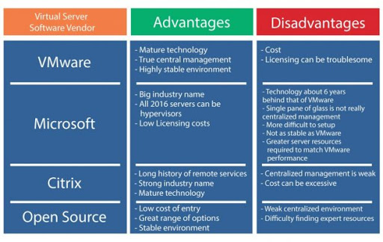
Comparison of Virtualization Vendors

Slide 27
Questions
What is Virtualization for Cloud Computing?
What are the benefits of virtualization for Cloud Computing?
What are the causes of virtualization?
What are the types of virtualization?
What is server virtualization?
What is Virtual Machine?
What is hypervisor/Virtual Machine Monitor (VMM)?
What is Vmware ESXI, Centrix XEN server, Ubuntu KVM?

