Slide 1

Com 1008 an overview of cloud computing
Hans Yip

Slide 2
Learning Objectives
Introduction
  Virtualization for Cloud Computing
What is virtualization?
Benefits of virtualization
Types of virtualization
What is virtual machine?
  Process virtual machine
  System virtual machine
    Hardware level virtualization: Hardware-assisted virtualization
    OS-level virtualization: Homogeneous environment
    Software level virtualization: Hypervisor types (Full virtualization, Para-virtualization); implementation approaches (type I/Bare metal, type II/hosted approach)
What is server virtualization?
What is hypervisor/virtual machine monitor (VMM)?
Binary translation and direct execution
Sample hypervisor: Vmware ESXI, Citrix Xen server, Ubuntu KVM

Slide 3
Virtualization for Cloud Computing
Virtualization is the enabling technology and creates virtual machines that allows a single machine to act as if it were many machines.
Benefits of virtualization for cloud computing: Reduces capital expenses and maintenance costs through server consolidation, reduces physical space needed in data centers. Resource Management, Migration, Maintainability, High availability and Fault tolerance are other benefits.
[Copied from “Virtualization for Cloud Computing”, Dr. Sanjay Ahuja, PhD (University of North Florida)]

Slide 4
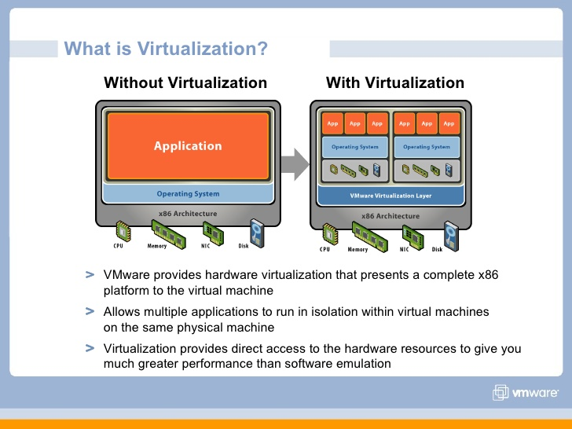
What is Virtualization
The term virtualization broadly describes the separation of a resource or request for a service from the underlying physical delivery of that service.
With virtual memory, for example, computer software gains access to more memory than is physically installed, via the background swapping of data to disk storage.
Similarly, virtualization techniques can be applied to other IT infrastructure layers - including networks, storage, laptop or server hardware, operating systems and applications.
[Copied from VMWare Virtualization.pdf]

Slide 5
Why Virtualization?
Lots of servers:
  Web servers
  Mail servers
  Database servers
  File servers
  Proxy servers
  Application servers
  and many others, etc…
[Copied from “Virtualization Techniques for Cloud Computing”, Prof Chih-Hung Wu (National University of Kaohsiung)]

Slide 6
Why Virtualization?
Problems caused by lots of servers:
  The data-center is FULL
    Full of under-utilized servers
    Complicated in management
  Power consumption
    Greater wattage per unit area than ever
    Electricity overload
    Cooling at capacity
  Environmental problem
    Green IT
[Copied from “Virtualization Techniques for Cloud Computing”, Prof Chih-Hung Wu (National University of Kaohsiung)]

Slide 7
Why now?
Hardware evolution
  Faster CPU clock than ever
  More CPU cores in a single chip
    4-core CPU already in the market
    6- or 8- core CPUs will be there soon
  Multi-core architectures make parallel processing more realizable
  Virtualization support on chip from CPU manufacturers (Intel VT-x; AMD’s AMD-V)
Software maturity
  Available and stable open-sourced software
    OS, DB, Web server, Java, PHP, gcc, etc
  Established and mature software standards
    Web service, XML, SOAP, COM, etc
[Copied from “Virtualization Techniques for Cloud Computing”, Prof Chih-Hung Wu (National University of Kaohsiung)]

Slide 8
Types of Virtualization
Virtual memory
Desktop virtualization
Platform virtualization (Server virtualization)
  Hardware-assisted virtualization: Hardware supports virtualization (special CPU)
  OS-level virtualization: (Homogeneous environment) host O/S = guest O/S
  Full virtualization: use hypervisor which is directly communicate with hardware
  Para-virtualization: use hypervisor, guest O/S will be modified
  Hosted environment (e.g. User-mode Linux): use hypervisor and hosted O/S
Resource virtualization:
  Storage virtualization
  Network virtualization
Application virtualization/Portable application
  Cross-platform virtualization
  Emulation or simulation
  Hosted Virtual Desktop
[Copied from “Virtualization Techniques for Cloud Computing”, Prof Chih-Hung Wu (National University of Kaohsiung)]

Slide 9
What is a Virtual Machine?
A virtual machine, known as a guest, is a software computer (emulation of a computer system) that provide the same functionality as physical computer.
There are two types of virtual machines:
  Process Layer (Virtual Machine), AKA Application Virtual Machine: Execute computer programs in a platform-independent environment. It masks the information of the underlying hardware or operating system. This allows the program to be executed in the same fashion on any platform. (e.g. Java Virtual Machine (JVM): Java interpreter executes Java byte code)
  System Layer (Virtual Machine): Support the sharing of a host computer’s physical resources between multiple virtual machines. (grew out of time-sharing, IBM CP/CMS, CP-40, System 360 in 1963 - simulation)
    Hardware Level Virtualization: Hardware-assisted Virtualization (IBM mainframe, x86 processors)
    OS-level Virtualization: does not use hypervisor, host O/S acts as hypervisor
    Software Level (High-level Language) Virtualization: Hosted approach and Hypervisor (Bare metal) approach
[https://en.m.wikipedia.org/wiki/Virtual_machine]
[https://www.vmware.com/topics/glossary/content/virtual-machine]

Slide 10
2 Virtual Machines in One Physical Machine

Slide 11
Hardware Level Virtualization
Hardware-assisted virtualization: the hardware provides architectural support that facilitates building a virtual machine monitor and allows guest OSes to be run in isolation.^{[19]}
Hardware-assisted virtualization was first introduced on the IBM System/370 in 1972, for use with VM/370, the first virtual machine operating system offered by IBM as an official product.
In 2005 and 2006, Intel and AMD provided additional hardware to support virtualization.

Slide 12
Operating-system Level Virtualization
OS-Level Virtualization (homogeneous environment): a physical server is virtualized at the operating system level, enabling multiple isolated and secure virtualized servers to run on a single physical server.
The "guest" operating system environments share the same running instance of the operating system as the host system.
Thus, the same operating system kernel is also used to implement the "guest" environments, and applications running in a given "guest" environment view it as a stand-alone system.
The pioneer implementation was FreeBSD jails

Slide 13
Software Level Virtualization
High-level Language Virtualization: use of Hypervisors
Hypervisor Types:
  Full Virtualization: Full virtualization uses a hypervisor, a type of software that directly communicates with a physical server's disk space and CPU. (No modification of guest OS)
  Para-virtualization: The modification of the source code of an OS in order to run as a guest OS in a virtual machine (VM) environment. Calls to the hardware from the guest OS are replaced with calls to the VM monitor (VMM). Several operating systems, such as Linux, OpenBSD, FreeBSD and OpenSolaris, were paravirtualized for the Xen VM monitor (see Xen).
Hypervisor implementation approaches:
  Hypervisor approach (native or bare metal approach) (type 1 hypervisor): a hypervisor architecture is the first layer of software installed on a clean x86-based system (hence it is often referred to as a “bare metal” approach). Since it has direct access to the hardware resources, a hypervisor is more efficient than hosted architectures, enabling greater scalability, robustness and performance.
  Hosted approach (type II hypervisor): A hosted approach provides partitioning services on top of a standard operating system and supports the broadest range of hardware configurations. (3 layers: hosted O/S, hypervisor, guest O/S)

Slide 14
Only Focus on Platform/Server Virtualization
In this course we mainly focus on Platform virtualization which is mostly related to cloud-computing
  Full virtualization
    Binary translation and Direct execution
  Para-virtualization
  OS-level virtualization
  Hardware-assisted virtualization
[Copied from “Virtualization Techniques for Cloud Computing”, Prof Chih-Hung Wu (National University of Kaohsiung)]

Slide 15
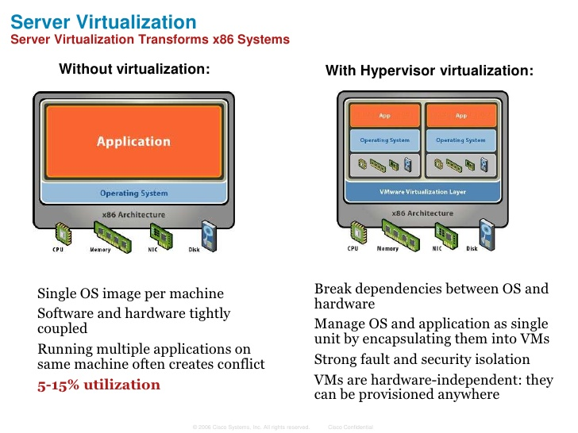
What is Server Virtualization?
Server virtualization is used to mask server resources from server users. This can include the number and identity of operating systems, processors, and individual physical servers.
[https://www.vmware.com/topics/glossary/content/server-virtualization]

Slide 16
Server Virtualization Definition
Server virtualization is the process of dividing a physical server into multiple unique and isolated virtual servers by means of a software application. Each virtual server can run its own operating systems independently.
[https://www.vmware.com/topics/glossary/content/server-virtualization]

Slide 17
Three Kinds of Server Virtualization
Full Virtualization: Full virtualization uses a hypervisor, a type of software that directly communicates with a physical server's disk space and CPU. The hypervisor monitors the physical server's resources and keeps each virtual server independent and unaware of the other virtual servers. It also relays resources from physical server to the connect virtual server as it runs applications. The biggest limitation of using full virtualization is that a hypervisor has its own processing needs. This can slow down applications and impact server performance.
Para-Virtualization: Unlike full virtualization, para-virtualization involves the entire network working together as a cohesive unit. Since each operating system on the virtual servers is aware of one another in para-virtualization, the hypervisor does not need to use as much processing power to manage the operating systems. It requires to modify the guest O/S.
OS-Level Virtualization: Unlike full and para-virtualization, OS-level visualization does not use a hypervisor. Instead, the virtualization capability, which is part of the physical server operating system, performs all the tasks of a hypervisor. However, all the virtual servers must run that same operating system in this server virtualization method.
[https://www.vmware.com/topics/glossary/content/server-virtualization]

Slide 18
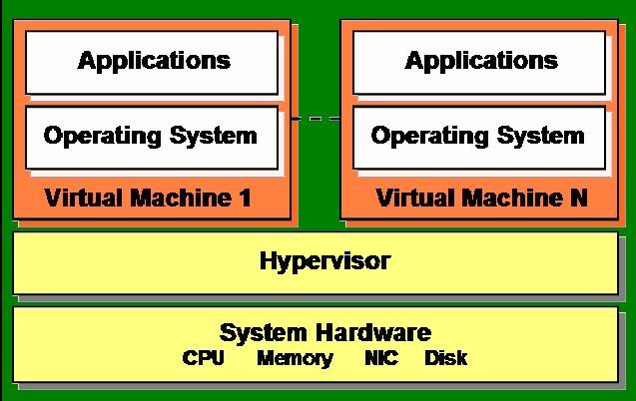
What is a Hypervisor /Virtual Machine Monitor (VMM)?
Hypervisor plays an important role in the virtualization scenario by virtualization of hardware. It provides support for running multiple operating systems concurrently in virtual servers created within a physical server.
The virtualization layer is the software responsible for hosting and managing all VMs. The virtualization layer is a hypervisor running directly on the hardware.
Example: VMWare, Xen, KVM.
[Copied from “Virtualization for Cloud Computing”, Dr. Sanjay Ahuja, PhD (University of North Florida)]

Slide 19
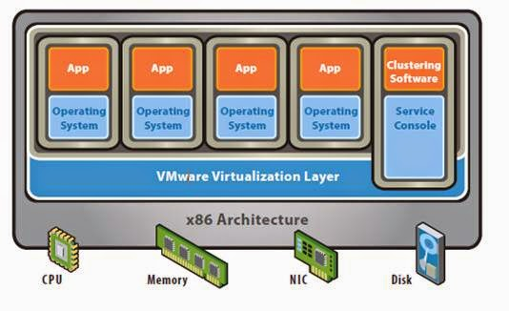
Full Virtualization
Enables hypervisors to run an unmodified guest operating system (e.g. Windows 2003 or XP).
Guest OS is not aware that it is being virtualized.
E.g.: VMware uses a combination of direct execution and binary translation techniques to achieve full virtualization of server systems.
[Copied from “Virtualization for Cloud Computing”, Dr. Sanjay Ahuja, PhD (University of North Florida)]

Slide 20
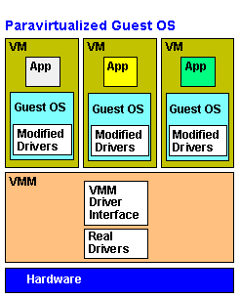
Para-Virtualization
Para virtualization
Involves explicitly modifying guest operating system (e.g. SUSE Linux Enterprise Server 11) so that it is aware of being virtualized to allow near native performance.
Improves performance.
Lower overhead.
E.g.: Xen supports both Hardware Assisted Virtualization (HVM) and Para-Virtualization (PV). Oracle VM is built upon Xen technology, using the Xen hypervisor.
[Copied from “Virtualization for Cloud Computing”, Dr. Sanjay Ahuja, PhD (University of North Florida)]

Slide 21
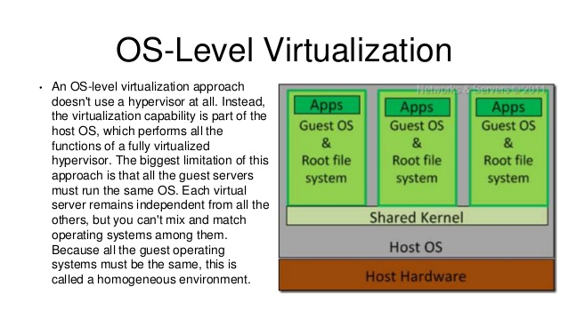
OS-Level Virtualization
OS-level virtualization
  Does not use hypervisor
  kernel of an OS allows for multiple isolated user-space instances, instead of just one.
  Each OS instance looks and feels like a real server
[Copied from “Virtualization Techniques for Cloud Computing”, Prof Chih-Hung Wu (National University of Kaohsiung)]

Slide 22
Two Hypervisor Implementation approaches
Hypervisor approach (native or bare metal approach) (type I hypervisor): a hypervisor architecture is the first layer of software installed on a clean x86-based system (hence it is often referred to as a “bare metal” approach). Since it has direct access to the hardware resources, a hypervisor is more efficient than hosted architectures, enabling greater scalability, robustness and performance.
Hosted approach (type II hypervisor): a hosted approach provides partitioning services on top of a standard operating system and supports the broadest range of hardware configurations. (3 layers: host O/S, hypervisor, guest O/S)

Slide 23
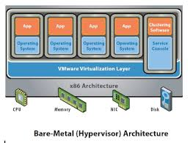
Bare Metal Approach (Type I hypervisor)
Type I Hypervisor.
Runs directly on the system hardware.
May require hardware assisted virtualization technology support by the CPU.
Limited set of hardware drivers provided by the hypervisor vendor.
E.g.: Xen, VMWare ESXi

Slide 24
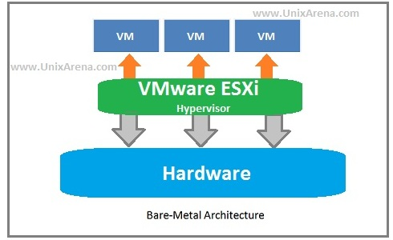
Bare-Metal Architecture

Slide 25
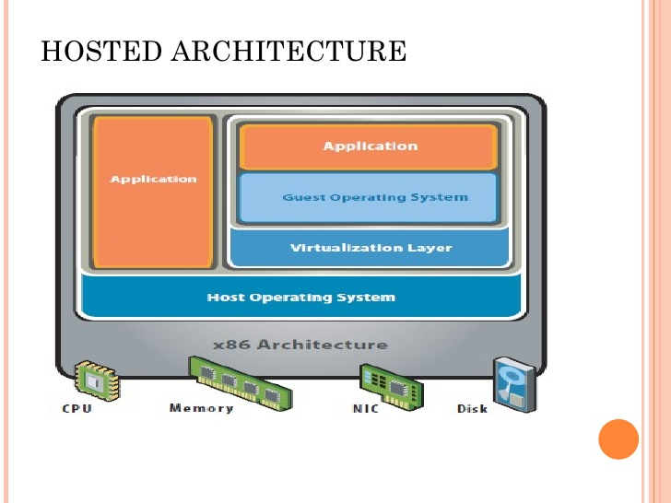
Hosted Approach (Type II hypervisor)
Type II Hypervisor.
Runs virtual machines on top of a host OS (windows, Unix etc.)
Relies on host OS for physical resource management.
Host operating system provides drivers for communicating with the server hardware.
E.g.: VirtualBox

Slide 26

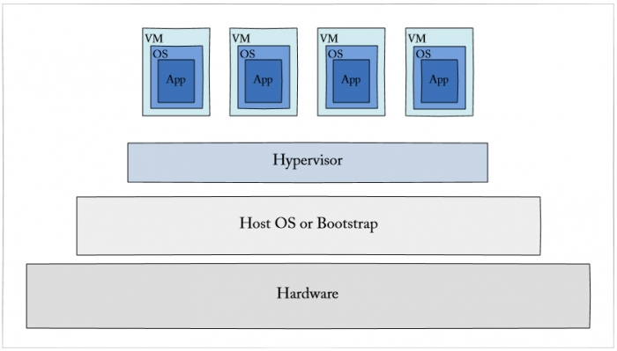
Hosted Approach (Type 2 hypervisor)

Slide 27
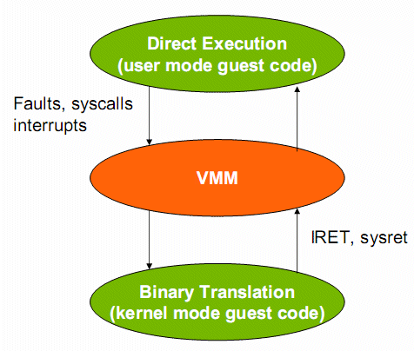
Binary Translation and Direct Execution
Binary translation. Binary translation is one specific approach to implementing full virtualization that does not require hardware virtualization features. It involves examining the executable code of the virtual guest for "unsafe" instructions, translating these into "safe" equivalents, and then executing the translated code. Alternatives to binary translation are binary patching, and full system emulation.
Direct execution. This is a mode that can be combined with binary translation. With direct execution, most code is executed directly on the CPU, and only the code that needs to be translated is actually translated.
[https://blogs.oracle.com/ravello/nested-virtualization-with-binary-translation]

Slide 28
Virtualization References
https://www.vmware.com/pdf/virtualization.pdf
https://searchvmware.techtarget.com/definition/VMware
https://www.vmware.com/topics/glossary/content/virtual-machine
https://www.vmware.com/topics/glossary/content/server-virtualization
https://www.pcmag.com/encyclopedia/term/59102/paravirtualization
https://computer.howstuffworks.com/server-virtualization2.htm
https://www.geeksforgeeks.org/types-of-server-virtualization-in-computer-network/
https://www.vmware.com/pdf/virtualization.pdf
https://www.w3schools.in/cloud-computing/cloud-computing/#
https://searchservervirtualization.techtarget.com/definition/hardware-assisted-virtualization
https://docs.oracle.com/cd/E26996_01/E18549/html/VMUSG1010.html
https://en.m.wikipedia.org/wiki/Hardware-assisted_virtualization
https://en.m.wikipedia.org/wiki/Virtual_machine

Slide 29



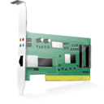


VMware ESXI
Hardware
VM
VM
VM
Bare Metal Approach.
Full virtualization.
Proven technology.
Used for secure and robust virtualization solutions for virtual data centers and cloud infrastructures.
Takes advantage of support for hardware assisted virtualization for 64-bit OS on Intel processors.
Hypervisor

Slide 30

Citrix Xen Server
Hardware
Open source; bare metal.
Offers both Hardware Assisted Virtualization (HVM) and Para-Virtualization (PV)
Needs virtualization support in the CPU for HVM.
Xen loads an initial OS which runs as a privileged guest called “domain 0”.
The domain 0 OS, typically a Linux or UNIX variant, can talk directly to the system hardware (whereas the other guests cannot) and also talk directly to the hypervisor itself. It allocates and maps hardware resources for other guest domains.
Domain Zero Guest
VM
VM
Hypervisor

Slide 31
Ubuntu KVM
Hardware
1. Linux Applications
2. KVM Management
Console
Kernel based virtual machine (Kernel Based VM)
Open source.
Kernel-level extension to Linux.
Full virtualization.
Supports full virtualization and hence does not need hardware assisted virtualization support in the CPU.
[https://www.linux-kvm.org/page/Main_Page]
NOTE: KVM is extension of Linux Kernel that turns Linux Kernel into a type 1 bare-metal hypervisor, while the overall system is type II because the host O/S is still fully functional and the other VM’s are standard Linux processes.
VM
VM
Linux
Linux Kernel
KVM

Slide 32
Comparison of Virtualizations
Virtualization | Characteristics
Hardware-assisted virtualization | the hardware provides architectural support that facilitates building a virtual machine monitor and allows guest OSes to be run in isolation. (no hypervisor)
O/S-Level virtualization (Homogeneous environment) | a physical server is virtualized at the operating system level, enabling multiple isolated and secure virtualized servers to run on a single physical server. (host O/S = guest O/S, no hypervisor, share kernel)

Slide 33
Comparison of Virtualizations
Virtualization | Charateristics
High-level language (Software) Virtualization (use of hypervisor)
Hypervisor types: (1) Full virtualization | uses a hypervisor, a type of software that directly communicates with a physical server's disk space and CPU (Not a X86 server). The hypervisor monitors the physical server's resources and keeps each virtual server independent and unaware of the other virtual servers.
(2) Para-virtualization | involves the entire network working together as a cohesive unit. Since each operating system on the virtual servers is aware of one another in para-virtualization, the hypervisor does not need to use as much processing power to manage the operating systems. It requires to modify the guest O/S.

Slide 34
Comparison of Virtualizations
Hypervisor implementation approaches: (1) Hypervisor approach (native or bare metal approach)(Type 1 hypervisor) | a hypervisor architecture is the first layer of software installed on a clean x86-based system (hence it is often referred to as a “bare metal” approach). Since it has direct access to the hardware resources, a hypervisor is more efficient than hosted architectures, enabling greater scalability, robustness and performance.
(2) Hosted approach (Type 2 hypervisor) | a hypervisor, provides partitioning services on top of a standard operating system and supports the broadest range of hardware configurations. (3 layers: host O/S, hypervisor, guest O/S). It may run slower than type 1 hypervisor.

Slide 35
Virtualization – where are we going?
Full Virtualization with Binary Translation is currently the most established and reliable virtualization technology available today.
It will continue to be a useful technique for years to come as newer and faster hardware continues to advance binary translation performance for unmodified guest OSes, however, hardware assisted virtualization is where virtualization is going with processor para-virtualization being a performance enhancing stopgap along the way.
Intel and AMD’s first generation hardware assist features released in 2006 are the first step in removing the need for hypervisors.
Hardware Assist is the Future of Virtualization, but the Real Gains Have Yet to Arrive.

Slide 36
Questions
What is Virtualization?
What are the benefits of virtualization for Cloud Computing?
What are the causes of virtualization?
What are the types of virtualization?
What is server virtualization?
What is Virtual Machine, and what are the types of VM?
What is hypervisor? (provide examples of hypervisor)
What is software level virtualization? How many types of hypervisor?
What is binary translation, and direct execution?
What is Vmware ESXI, Centrix XEN server, Ubuntu KVM?

