Slide 1
Com 1008 an overview of cloud computing (non-technical)
Hans Yip

Slide 2
Learning Objectives
How to run Windows or Windows Programs on your Mac?
What is Oracle VM VirtualBox?
Install and setup VirtualBox 6.1.4 Platform Packages with Microsoft Windows 10 ISO file (64-bit) on your Mac (lab)

Slide 3
How to Run Windows or Windows Programs on your Mac?
On a Mac, you have three options to run Windows and Windows applications:
Run Windows and Windows applications locally:
To dual-boot between macOS and Windows, use Apple's Boot Camp. This approach provides the most compatibility with Windows software and peripherals, but does not allow you to run Windows and macOS applications at the same time.
To run Windows in a virtual machine within macOS, use Parallels Desktop, VMware Fusion, or VirtualBox. This method will allow you to run Mac and Windows applications concurrently, though the virtual machine does not support as much Windows functionality as a dual-boot configuration. (You must install Windows O/S in the Mac)
To run Windows programs without having to install Windows itself, use a Windows compatibility layer, such as CrossOver Mac. This option typically offers good functionality for a limited set of Windows applications.

Slide 4
What is Oracle VM VirtualBox?
Oracle VM VirtualBox is a cross-platform virtualization application.
For one thing, it installs on your existing Intel or AMD-based computers, whether they are running Windows, Mac OS X, Linux, or Oracle Solaris operating systems (OSes).
Secondly, it extends the capabilities of your existing computer so that it can run multiple OSes, inside multiple virtual machines, at the same time.
As an example, you can run Windows and Linux on your Mac, run Windows Server 2016 on your Linux server, run Linux on your Windows PC, and so on, all alongside your existing applications. You can install and run as many virtual machines as you like. The only practical limits are disk space and memory.
Oracle VM VirtualBox is deceptively simple yet also very powerful. It can run everywhere from small embedded systems or desktop class machines all the way up to datacenter deployments and even Cloud environments.

Slide 5
Install and setup VirtualBox 6.1.4 Platform Packages on your Mac
Video: https://www.youtube.com/watch?v=ogtSW0wDo4E
Or Video: https://www.youtube.com/watch?v=lEvM-No4eQo
Download VirtualBox 6.1.4 Platform Packages (126MB)
Go to https://www.virtualbox.org/
Click “Download VirtualBox 6.1” (or from left-hand menu, click “Downloads”, then “OS X hosts”)
Click “OS X hosts” to download
Filename: VirtualBox-6.1.4-136177-OSX.dmg (126MB)

Slide 6
Download Oracle VM VirtualBox 6.1.4

Slide 7
Download Oracle VM VirtualBox 6.1.4

Slide 8
Install and setup VirtualBox 6.1.4 Platform Packages on your Mac
Install VirtualBox 6.1.4 Platform Packages on your Mac:
Double click the downloaded file to install VirtualBox 6.1.4.
Follow the screen prints to complete the installation of VirtualBox on your Mac.

Slide 9
Install VirtualBox 6.1.4

Slide 10
Install VirtualBox 6.1.4

Slide 11
Install VirtualBox 6.1.4

Slide 12
For Using Windows to create the installation file
Download the “MediaCreationTool1909” (18.3MB)
Create the bootable flash drive (for a fresh installation)
OR create the ISO file for installation (for virtualization installation)

Slide 13
For Using Windows to create the installation file
Go to https://www.microsoft.com/en-us/software-download/windows10
Click “Download tool now” (use this tool to create installation media USB Flash drive. Make sure you have a blank USB Flash drive with at least 8GB of space) OR create a windows10 ISO file for installation.
Double click the downloaded file “MediaCreationToll1909”. (Or Right click your mouse then select “Run as administrator”) (you need to be an administrator to run this tool)
Select “Accept” to agree with the license term
On the “What do you want to do?” page, Select “Installation media for another PC”, and then select “Next”
Select the language, edition, and architecture (64-bit) for Windows 10, select Windows 10 edition

Slide 14
For Using Windows to create the installation file
Select which media you want to use:
USB Flash drive (Attach a blank USB flash drive with at least 8GB. Any content on the flash drive will be deleted) [select this one if you need to create a bootable flash drive] (Don’t select this one]
ISO file (Save as an ISO file) (3.97GB) {select this one as we need to use the ISO file}
File name: windows10.iso (I saved the file in my flash drive)

Slide 15
Download media tool

Slide 16
Double click the file to create ISO file

Slide 17
Accept License terms

Slide 18
Create installation media

Slide 19
select windows 10 edition

Slide 20
Select ISO file

Slide 21
Save file as windows10.iso

Slide 22
For Using Mac to create the Installation File
Go to https://www.microsoft.com/en-us/software-download/windows10
Select “Windows10” as edition
Select “English” as language
Select “64-bit Download” to start download the file (the file is available for 24 hours only)

Slide 23
Create win10

Slide 24
Create file

Slide 25
Create file

Slide 26
Create file

Slide 27
Ready to Install Windows 10 on Mac
From your Mac, do the following:

Slide 28
Install Windows10 on Mac using ISO file
Click “VirtualBox” from Launchpad on your Mac
Click “New” from the top
Enter Name: Windows 10 VM
Enter Machine Folder: “/Users/hansyip/VirtualBox VMs“
Enter Type: “Microsoft Windows”
Enter Version: “Windows 10 (64-bit)”

Slide 29
Install Windows 10 on Mac

Slide 30
Install Windows 10 on Mac Click “NEW”

Slide 31
Install Windows 10 on Mac Enter virtual machine name

Slide 32
Install Windows 10 on Mac using ISO file
Memory Size: 2048 MB
Hard disk:
Select “Create a virtual hard disk now”
Hard disk file type:
Select “VDI (VirtualBox Disk Image)

Slide 33
Install Windows 10 on Mac enter Memory size

Slide 34
Install Windows 10 on Mac select hard disk

Slide 35
Install Windows 10 on Mac select hard disk file type

Slide 36
Install Windows 10 on Mac using ISO file
Storage on physical hard disk
Select “Dynamically allocated”
File location and size: (by default)
/Users/hansyip/VirtualBox VMs/Windows 10 VM/Windows 10 VM.vdi
Hard disk is (by default): Select “50GB”

Slide 37
Install Windows 10 on Mac Select dynamically allocated

Slide 38
Install Windows 10 on Mac select file location and size

Slide 39
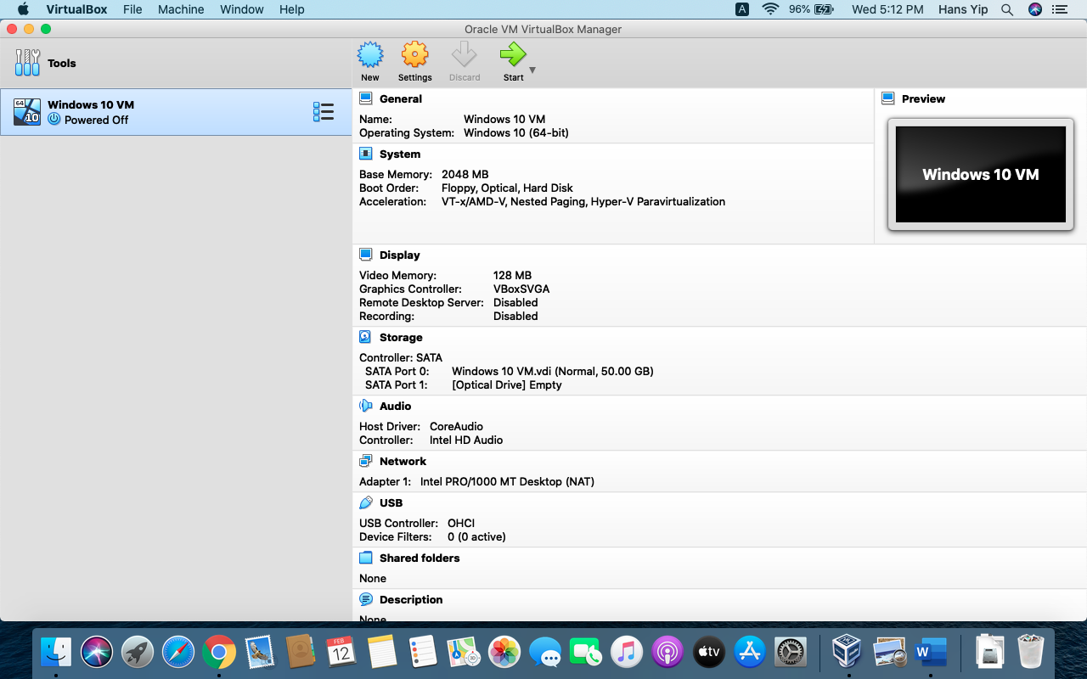
Install windows10 on mac part 1 vm set up

Slide 40
Install Windows 10 on Mac using ISO file
Allow VirtualBox receiving keystrokes from any application (may pop up for you to set the permission)

Slide 41
Install Windows 10 on Mac allow VB receive keystrokes

Slide 42
Install Windows 10 on Mac unlock and set permission

Slide 43
Install Windows 10 on Mac set permission

Slide 44
Install Windows 10 on Mac using ISO file
Click “Settings” from the top
Click “Storage” from the top menu

Slide 45
Install Windows 10 on Mac click settings

Slide 46
Install Windows 10 on Mac click storage

Slide 47
Install Windows 10 on Mac using ISO file
Select “Empty” on the left-hand side
On the “Optical Drive” right-hand side, click the blue bell shape, select “Choose a disk file…”
Click “Start” to install Windows 10
Then, follow the Windows 10 installation using “default” options all the time.

Slide 48
Install Windows 10 on Mac select “Empty”

Slide 49
Install Windows 10 on Mac choose a disk file

Slide 50
Install Windows 10 on Mac select the iso file

Slide 51
Install Windows 10 on Mac Select the ISO file

Slide 52
Install Windows 10 on Mac

Slide 53
Install Windows 10 on Mac click start to install windows 10

Slide 54
Windows date command
To verify you have installed VirtualBox and Windows, perform the following:
From the cmd terminal:
Issue command date/T, and screen print the result

Slide 55
Windows date command

Slide 56
Windows time command
From the cmd terminal:
Issue command time/T, and screen print the result

Slide 57
Windows time command

Slide 58
References
http://osxdaily.com/2015/03/25/install-run-windows-10-mac-virtualbox-os-x/ how to install win10
https://www.virtualbox.org/
https://www.youtube.com/watch?v=lEvM-No4eQo
https://www.youtube.com/watch?v=ogtSW0wDo4E
https://www.virtualbox.org/manual/ch01.html
https://kb.iu.edu/d/ahjj
https://www.virtualbox.org/manual/ch01.html

