Slide 1
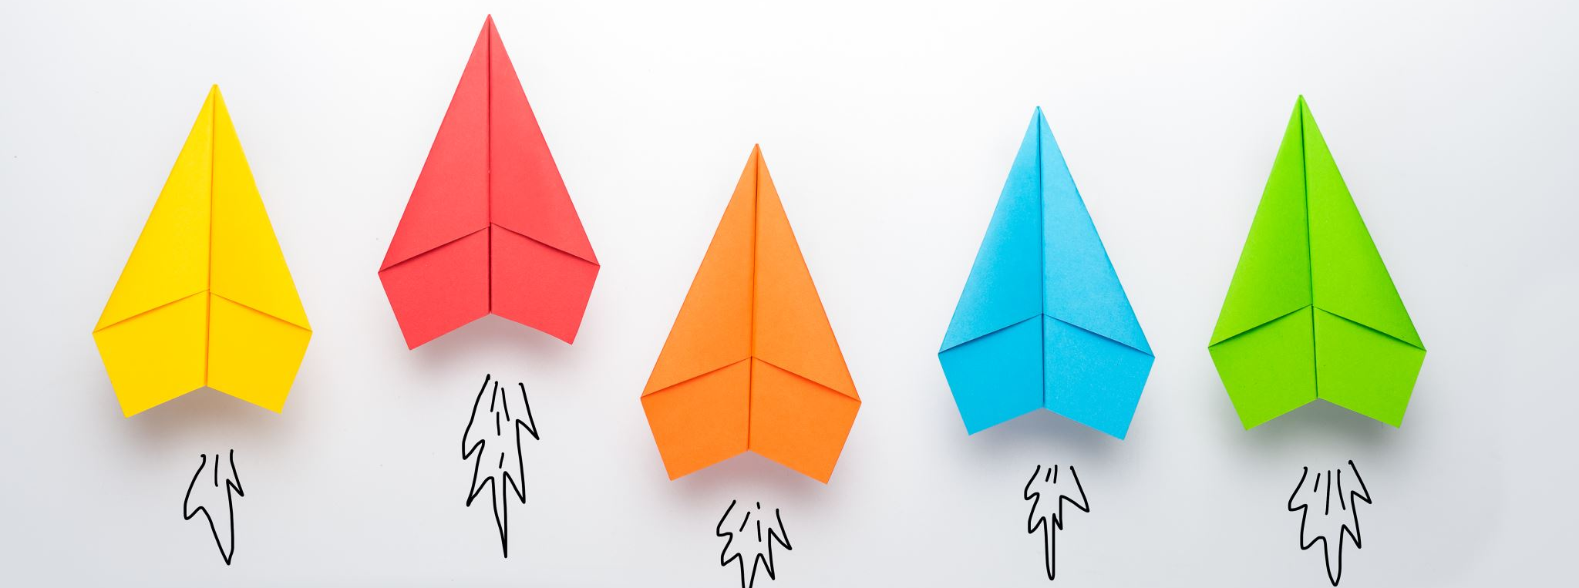
Com 1008 an overview of cloud computing
Hans Yip

Slide 2
Learning Objectives
History and Development
Mainframe and thin client computing
Data centers

Slide 3
History of Computer
First Generation Computer (1946-1954):
Limitations of First Generation Computer:
They used valves or vacuum tubes as their main electronic component.
They were large in size, slow in processing and had less storage capacity.
They consumed lots of electricity and produced lots of heat.
Their computing capabilities were limited.
They were not so accurate and reliable.
They used machine level language for programming.
They were very expensive.
Example: ENIAC, UNIVAC, IBM 650 etc
http://ecomputernotes.com/fundamental/introduction-to-computer/what-are-different-computer-generations-explain-in-brief

Slide 4
History of Computer
Second Generation (1955-1964): (Mainframe and Super-computer)
The second-generation computer used transistors for CPU components & ferrite cores for main memory & magnetic disks for secondary memory. They used high-level languages such as FORTRAN (1956), ALGOL (1960) & COBOL (1960 - 1961). I/O processor was included to control I/O operations.
Features:
Transistors were used instead of Vacuum Tube.
Processing speed is faster than First Generation Computers (Micro Second)
Smaller in Size (51 square feet)
The input and output devices were faster.
Example: IBM 1400 and 7000 Series, Control Data 3600 etc.

Slide 5
History of Computer
Third Generation (1964-1977) (Mainframe and Super-computer)
By the development of a small chip consisting of the capacity of the 300 transistors. These ICs are popularly known as Chips. A single IC has many transistors, registers and capacitors built on a single thin slice of silicon. So it is quite obvious that the size of the computer got further reduced.
Higher level language such as BASIC (Beginners All purpose Symbolic Instruction Code) was developed during this period. Computers of this generation were small in size, low cost, large memory and processing speed is very high. Very soon ICs Were replaced by LSI (Large Scale Integration), which consisted about 100 components. An IC containing about 100 components is called LSI.
Features:
They used Integrated Circuit (IC) chips in place of the transistors.
Semi conductor memory devices were used.
The size was greatly reduced, the speed of processing was high, they were more accurate and reliable.
Large Scale Integration (LSI) and Very Large Scale Integration (VLSI) were also developed.
The mini computers were introduced in this generation.
They used high level language for programming.
Example: IBM 360, IBM 370 etc.

Slide 6
History of Computer
Fourth Generation (1970) Micro-computer
An IC containing about 100 components is called LSI (Large Scale Integration) and the one, which has more than 1000 such components, is called as VLSI (Very Large Scale Integration). It uses large scale Integrated Circuits (LSIC) built on a single silicon chip called microprocessors. Due to the development of microprocessor it is possible to place computer’s central processing unit (CPU) on single chip. These computers are called microcomputers. Later very large scale Integrated Circuits (VLSIC) replaced LSICs. Thus the computer which was occupying a very large room in earlier days can now be placed on a table. OS-such as MS-DOS, UNIX, Apple’s Macintosh were available. Object oriented language, C++ etc were developed.
Features:
They used Microprocessor (VLSI) as their main switching element.
They are also called as micro computers or personal computers.
Their size varies from desktop to laptop or palmtop.
They have very high speed of processing; they are 100% accurate, reliable, diligent and versatile.
They have very large storage capacity.
Example: IBM PC, Apple-Macintosh etc.

Slide 7
History of Computer
Fifth Generation (1991 – continued) tablet, smart phone
5th generation computers use ULSI (Ultra-Large Scale Integration) chips. Millions of transistors are placed in a single IC in ULSI chips. 64 bit microprocessors have been developed during this period.
Memory chips and flash memory up to 1 GB, hard disks up to 600 GB & optical disks up to 50 GB have been developed. fifth generation digital computer will be Artificial intelligence.

Slide 8
Classification of Computers
Super Computer has internally large storage capacity and computing speed. Which are at least Ten Times faster than other computer. Why the speed of trundle compeering major millions of operation per second. The Super Computer is rotated in terms of million instructions per second. An operation is made up numerous instructions. Super Computer are the largest, Fastest and Expensive Computer System in the world. Many smalls computers cheap works to perform million of arithmetic operation per second.
Famous Super Computers are –
· CRAYX-MP
· CRAY-2
· CRAY-3
· ETA-10
https://www.quora.com/What-are-the-different-types-of-computers

Slide 9
Classification of Computers
Mainframe: A computer with a large storage capacity and very fast speed of processing compare to Micro or Mini Computer. They Support a large numbers of terminals for used by a verity of users. They are several organizations such as Bank, Insurance Company, Hospital and Railway etc. Main Frame Computer is Very Large computer.
The Main Characteristic of “Main Frame Computers”
Many people can be use the machine at the same time.
Qualified operator and programmer are required for operation.
Support a wide range of peripherals & Have a large storage capacity.

Slide 10
Classification of Computers
A Mini Computer is a medium size i.e. more costly and power full then a Micro Computer. An Important distinction between a Micro Computer and “Mini Computer” is usually design to serve to multiples users. A system that support Multiples users. This process is also called Time Sharing system. Mini Computer is less efficient and store less data then the Main Frame Computer.
The Main Characteristic of “Mini Computers” are:-
Have a limited range of peripherals device.
Limited software is used.
Can be directly operated by the users.

Slide 11
Classification of Computers
A “Micro Computer” is generally purpose of processing system functionally etc. It is the smaller to any other large system. Micro Computer is the self contain units and usually design for used by one person at a time. Since “Micro Computer” can be usually include too large Computer. They Form a very important segment of integrated information system.
The common Characteristics of Micro Computers are:-
I Cheap and easy for use.
II. Have a limit input and output device.
III. Have a low storage capacity.
IV. Limited range of software can be use.
Note: including tablets, and smart phones

Slide 12
What is Thin Client?
Thin clients are computer terminals or software programs that rely on an external computer to perform work. The thin client accepts inputs into the system and displays the results of those inputs on its screen; the actual computations are performed on a distant server.
Thin clients perform much like the “dumb" serial terminals of the past, only now thin clients run as clients of Windows or other operating systems.
https://www.brighthub.com/environment/green-computing/articles/71173.aspx

Slide 13
Thin Client History
Thin client was the description of a computer terminal popularized by Oracle beginning in 1993. Because Oracle is server oriented software, clients do not require much in the way of computing power.
Significant savings could be realized with Oracle over other models such as Microsoft’s that focused on computational power residing on the desktop.
Although the term, "thin client", began in the 1990s, thin client history dates back way before then.
Known as "dumb terminals", the early thin clients were first used to interface with mainframe computers. Serial connections with the mainframe were used to send keystrokes to it and to display the results. All the programming and data were stored on the mainframe, with virtually no computational power residing with the terminal itself.
The advent of the PC in the 1980s and the decreased cost of computational power resulted in a new emphasis on localized, rather than centralized processing. This emphasis required operating systems and software to be installed and maintained on each individual computer. This sacrificed the centralized administration, security, and programming of the mainframe/dumb terminal configuration, ushering in the host of issues many deal with today.

Slide 14
Thin Client History
Modern IT has come full circle. By provisioning centralized data security, backups and network / system administration, thin clients offer considerable flexibility and cost savings over traditional PC networks, while making it easier to monitor employee use of network resources. High speed networks enable thin clients to access Windows applications as fast as they would run on a local machine.
Thin clients can now come in different forms. Besides a traditional computer terminal, wireless thin clients are now deployed for use on LANs and cellular networks. Thin clients can also run as software on a networked PC. Ultra-thin clients expand on the thin client concept, but take it a step further by eliminating the need for a full operating system. An ultra-thin client comes equipped with a basic operating environment that allows configures the network and display options for the unit.

Slide 15
What is a Data Center?
At its simplest, a data center is a physical facility that organizations use to house their critical applications and data. A data center's design is based on a network of computing and storage resources that enable the delivery of shared applications and data.
https://www.cisco.com/c/en/us/solutions/data-center-virtualization/what-is-a-data-center.html

Slide 16
What defines a modern data center?
Modern data centers are very different than they were just a short time ago. Infrastructure has shifted from traditional on-premises physical servers to virtualized infrastructure that supports applications and workloads across pools of physical infrastructure and into a multicloud environment.
In this era, the modern data center is wherever its data and applications are. It stretches across multiple public and private clouds to the edge of the network via mobile devices and embedded computing. In this constantly shifting environment, the data center must reflect the intentions of users and applications.

Slide 17
What are the core components of a data center?
Data center design includes routers, switches, firewalls, storage systems, servers, and application delivery controllers. Because these components store and manage business-critical data and applications, data center security is critical in data center design. Together, they provide:
Network infrastructure. This connects servers (physical and virtualized), data center services, storage, and external connectivity to end-user locations.
Storage infrastructure. Data is the fuel of the modern data center. Storage systems are used to hold this valuable commodity.
Computing resources. Applications are the engines of a data center. These servers provide the processing, memory, local storage, and network connectivity that drive applications.

Slide 18
Types of data centers
Many types of data centers and service models are available. Their classification depends on whether they are owned by one or many organizations, how they fit (if they fit) into the topology of other data centers, what technologies they use for computing and storage, and even their energy efficiency. There are four main types of data centers:
Enterprise data centers: These are built, owned, and operated by companies and are optimized for their end users. Most often they are housed on the corporate campus.
Managed services data centers: These data centers are managed by a third party (or a managed services provider) on behalf of a company. The company leases the equipment and infrastructure instead of buying it.
Colocation data centers: In colocation ("colo") data centers, a company rents space within a data center owned by others and located off company premises. The colocation data center hosts the infrastructure--building, cooling, bandwidth, security, etc. while the company provides and manages the components, including servers, storage, and firewalls.
Cloud data centers: In this off-premises form of data center, data and applications are hosted by a cloud services provider such as Amazon Web Services (AWS), Microsoft (Azure), or IBM Cloud.
NOTE: Discover more about data centers and what the future will bring to them and your network.

Slide 19
Summary of IT Technologies
1960, Mainframe, Super-computer, punch card type-writer, punch card reader, dumb terminal. e.g. IBM System/360, CRAY
1970, Mini-computer (mid range computer), personal computer, Apple computer
1980, Client server architecture, Networking, server, workstation
1990, Internet, web
2000, cell phone, cloud computing, big data, thin client
2010, tablet, smart phone

Slide 20
Questions
What are the five generations of computer, and what are the features?
What are the types of computer?
What is think client?
What is data center, and what are the types of data centers?

Slide 21
References
https://homepage.cs.uri.edu/faculty/wolfe/book/Readings/Reading03.htm
https://www.computerhistory.org/timeline/computers/
https://www.livescience.com/20718-computer-history.html
https://www.suse.com/c/mainframe-gnulinux-thin-client-advantages-methodology/
https://www.brighthub.com/environment/green-computing/articles/71173.aspx
https://www.quora.com/What-are-the-different-types-of-computers
http://ecomputernotes.com/fundamental/introduction-to-computer/minicomputer
https://www.cisco.com/c/en/us/solutions/data-center-virtualization/what-is-a-data-center.html

