Slide 1
Com 1008 an overview of cloud computing
Hans Yip

Slide 2
Learning Objectives
History and Development
As-a-service models: IaaS, PaaS, SaaS
Cloud deployment models: private, public, and hybrid clouds
Benefits of Cloud Computing
Cloud platform:
Microsoft Azure
Amazon Web Services (AWS)

Slide 3
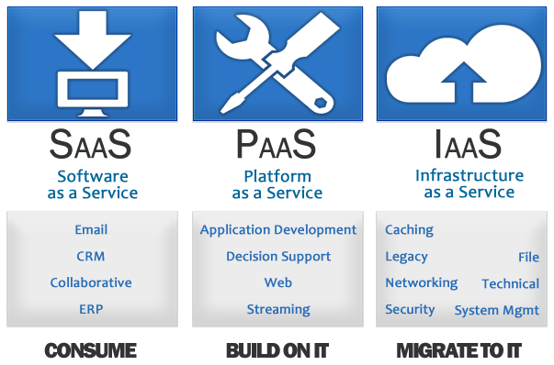
Cloud Service Models

Slide 4
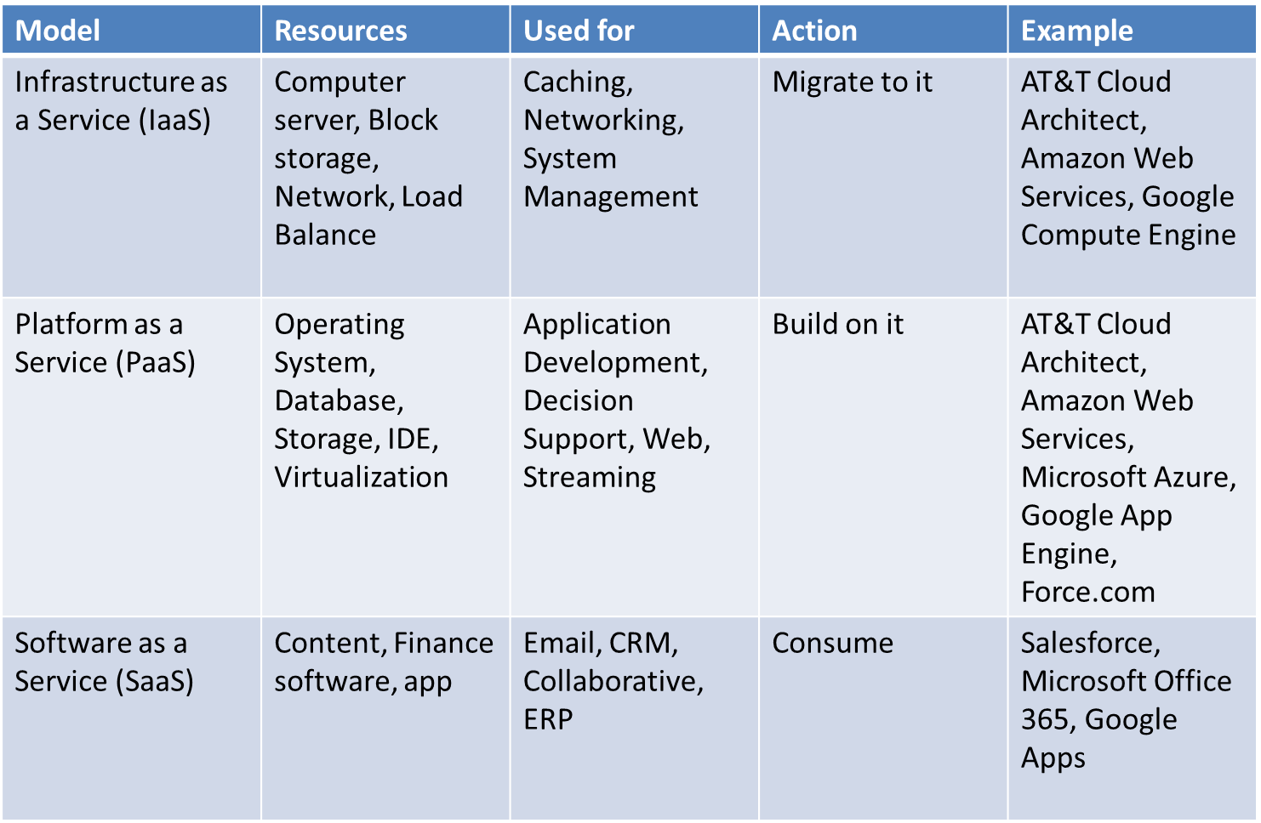
Cloud Service Models

Slide 5
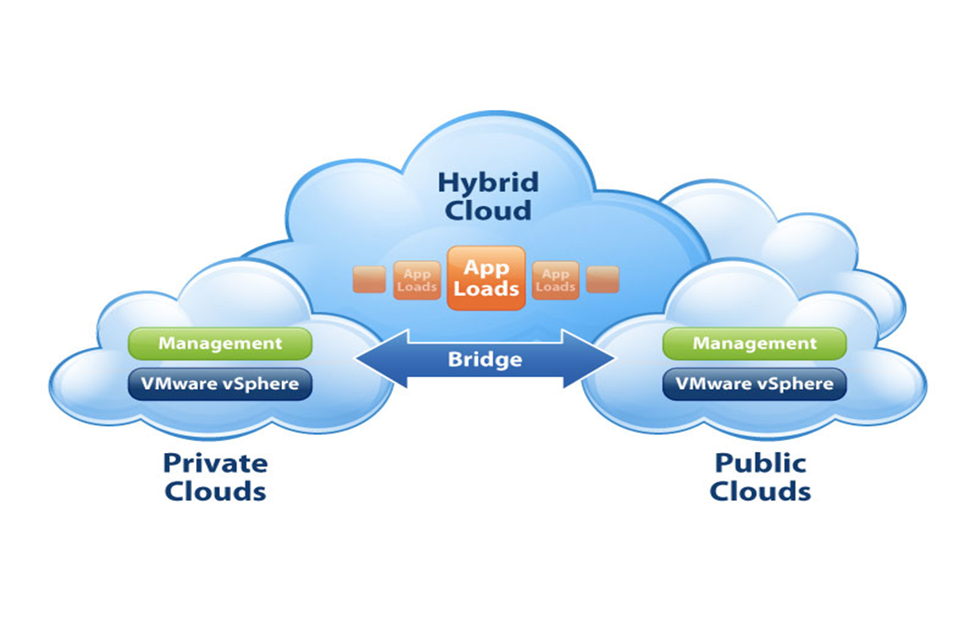
Cloud Deployment Models

Slide 6
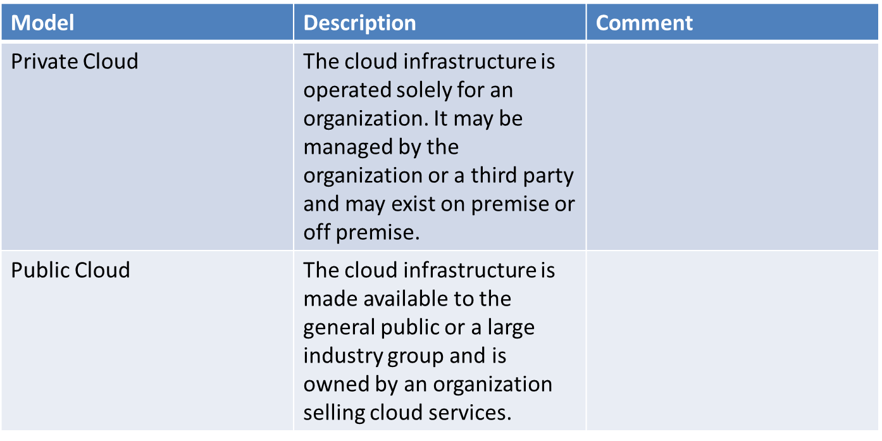
Cloud Deployment Models

Slide 7
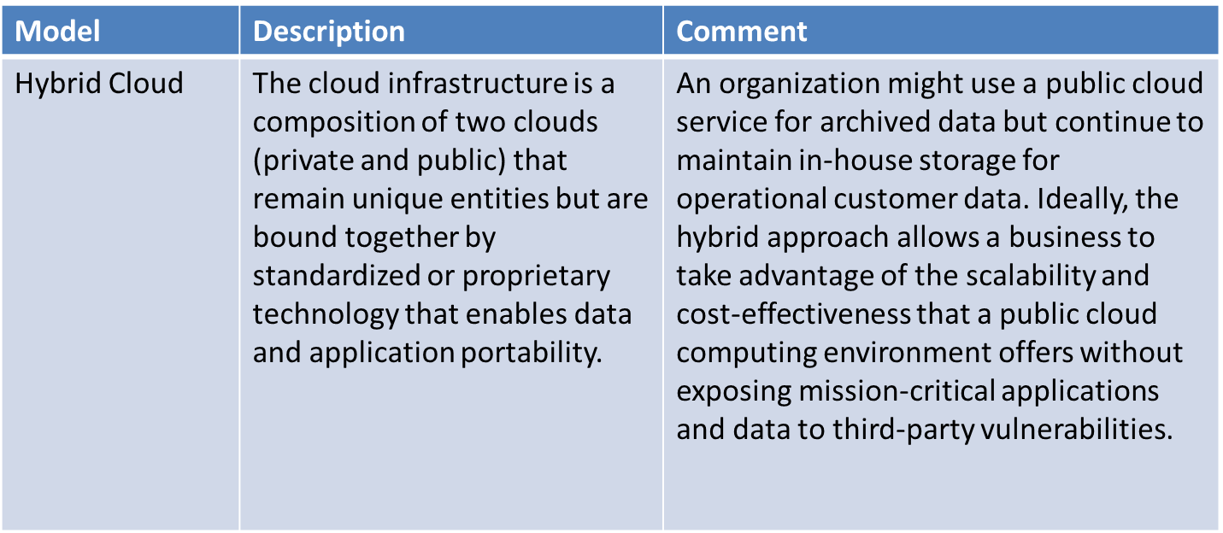
Cloud Deployment Models

Slide 8
Benefits of Cloud Computing
Cloud computing is a big shift from the traditional way businesses think about IT resources.
Here are 6 common reasons organizations are turning to cloud computing services:
1. Cost: Cloud computing eliminates the capital expense of buying hardware and software and setting up and running on-site datacenters—the racks of servers, the round-the-clock electricity for power and cooling, the IT experts for managing the infrastructure. It adds up fast.
2. Speed: Most cloud computing services are provided self service and on demand, so even vast amounts of computing resources can be provisioned in minutes, typically with just a few mouse clicks, giving businesses a lot of flexibility and taking the pressure off capacity planning.

Slide 9
Benefits of Cloud Computing
Global Scale: The benefits of cloud computing services include the ability to scale elastically. In cloud speak, that means delivering the right amount of IT resources—for example, more or less computing power, storage, bandwidth—right when its needed, and from the right geographic location.
Productivity: On-site datacenters typically require a lot of “racking and stacking”—hardware set up, software patching, and other time-consuming IT management chores. Cloud computing removes the need for many of these tasks, so IT teams can spend time on achieving more important business goals.

Slide 10
Benefits of Cloud Computing
Performance: The biggest cloud computing services run on a worldwide network of secure datacenters, which are regularly upgraded to the latest generation of fast and efficient computing hardware. This offers several benefits over a single corporate datacenter, including reduced network latency for applications and greater economies of scale.
6. Reliability: Cloud computing makes data backup, disaster recovery, and business continuity easier and less expensive, because data can be mirrored at multiple redundant sites on the cloud provider’s network.

Slide 11
Microsoft Cloud Computing - Azure
What is Azure?
Azure is a comprehensive set of cloud services that developers and IT professionals use to build, deploy, and manage applications through our global network of datacenters. Integrated tools, DevOps, and a marketplace support you in efficiently building anything from simple mobile apps to internet-scale solutions.

Slide 12
Microsoft Azure Solutions
Microsoft Azure providing the following solutions:
Digital marketing: Connect with customers worldwide with digital campaigns that are personalized and scalable.
Mobile: Reach your customers everywhere, on every device, with a single mobile app build.
E-commerce: Give customers what they want with a personalized, scalable, and secure shopping experience.
LOB applications: Modernize your internal line of business (LOB) apps to meet today’s IT challenges.
SharePoint on Azure: Deploy SharePoint servers rapidly and scale as needed with a cost-effective infrastructure.

Slide 13
Microsoft Azure Solutions
Dynamics on Azure: Fuel business growth by bringing together enterprise resource planning (ERP) and cloud services.
SAP on Azure: Bring cloud scale and agility to your mission-critical SAP workloads.
Red Hat on Azure: Achieve hybrid cloud agility for your enterprise with Red Hat solutions on Azure.
DevOps: Bring together people, processes and products to enable continuous delivery of value to your end users.
Development and test: Simplify and speed up the process of building and testing applications across every platform.
Monitoring: Gain visibility into the health, performance, and utilization of your applications, workloads, and infrastructure.
Business intelligence: Drive better, faster decision making by analyzing your data for deeper insights

Slide 14
Microsoft Azure Solutions
Big data and analytics: Make the most informed decision possible by analyzing all of the data you need in real time.
Data warehouse: Handle exponential data growth without leaving security, scalability, or analytics behind.
Business SaaS apps: Use business insights and intelligence from Azure to build software as a service (SaaS) apps.
Hybrid integration: Seamlessly integrate applications, data, and processes across both on-premises and cloud.
Backup and archive: Protect your data and applications no matter where they reside to avoid costly business interruptions.
Disaster recovery: Protect all your major IT systems while ensuring apps work when you need them most.

Slide 15
Microsoft Azure Solutions
Internet of Things: Create the Internet of Your Things by connecting your devices, assets, and sensors to collect untapped data.
Digital Media: Deliver high-quality videos to your customers anywhere, anytime, on any device.
High Performance computing: Tap into unlimited resources to scale your high performance computing (HPC) jobs.
Blockchain: Quickly develop and deploy distributed apps on the blockchain of your choice.
Microservice applications: Deliver scalable, reliable applications faster to meet the ever-changing demands of your customers.
Gaming: Build, quickly launch, and reliably scale your games across platforms, and refine based on analytics.

Slide 16
Microsoft Azure Solutions
Mainframe migration: Gain reliability, agility, and scalability by bringing your mission-critical mainframe applications to the cloud.
Serverless computing: Build apps faster, focusing on innovation instead of infrastructure management

Slide 17
Amazon Cloud Computing - AWS
What is Amazon Web Services (AWS)?
Amazon Web Services (AWS) is a secure cloud services platform, offering compute power, database storage, content delivery and other functionality to help businesses scale and grow. Users are leveraging AWS cloud products and solutions to build sophisticated applications with increased flexibility, scalability and reliability.

Slide 18
Amazon AWS Solutions
Amazon AWS provides the following solutions:
Websites: Reliable, highly scalable, and low cost website and web application hosting.
Backup and recovery: Durable, cost-effective options for backup and disaster recovery.
Archiving: Affordable solutions for data archiving from gigabytes to petabytes.
DevOps: Rapidly and reliably build and deliver products using DevOps practices.
Big data: Build and deploy highly scalable and secure Big Data applications fast.
Serverless computing: Build and run applications without thinking about servers.

Slide 19
Amazon AWS Solutions
High performance computing: Enhanced networking and cloud-scale clusters for complex problems.
Internet of Things: Easily scale to billions of devices and trillions of messages.
Business applications: Simplify management and lower the cost of existing business applications.
Content delivery: Accelerate websites, APIs, and video content.
Mobile services: A range of services to help you develop mobile apps that can scale to hundreds of millions of users globally.
Scientific computing: Analyze, store, and share massive data sets.
E-Commerce: Drive small or large e-commerce businesses with our highly scalable, secure, solutions for online sales and retail.

Slide 20
Questions
What are the cloud service models?
What are cloud deployment models?
What is Azure?
What is Amazon Web Services (AWS)?

Slide 21
References
https://azure.microsoft.com/en-us/overview/what-is-cloud-computing/
https://aws.amazon.com/what-is-cloud-computing/

