Slide 1
Com 1008 an overview of cloud computing
Hans Yip

Slide 2
Learning Objectives
What is Smartphone?
Mobile Operating Systems
Generic Mobile platform
Android platform
iOS platform
Windows mobile platform

Slide 3
What is Smartphone?
What is Smartphone?
A smartphone is a cellphone combined with a handheld computer in which you can make phone calls and other computer functions such as internet access and capable of running downloaded apps.

Slide 4
What is Mobile Operating System?
What is mobile operating system? (Mobile OS)
A mobile operating system (Mobile OS) is an Operating System for smartphones, tablets, or other mobile devices.

Slide 5
Major Mobile Operating System

Slide 6
Generic Mobile Platform
Applications
Core libraries
Operating System
Hardware

Slide 7
Generic Mobile Platform
Generic mobile platform consists of:
Application layer: This is the top layer where apps will be executed and interacted with users.
Core libraries layer: This layer provides device functionality that developers use to create apps.
Operating system layer: This layer is responsible for translating programming instructions into machine language the device understand.
Hardware layer: This layer is the physical device, including the screen, buttons, switches, and so on. The result is a stack of resources that apps can access.

Slide 8
Android Platform
Applications
Home
Contacts
Phone
Browser
Your apps
Application framework
Activity manager
Window manager
Content providers
View system
Package manager
Telephony manager
Resource manager
Location manager
Notification manager
Libraries
Android runtime
Surface manager
Media framework
SQLite
Core Libraries
Dalvik virtual machine
OpenGL/ES
FreeType
Webkit
SGL
SSL
libc
Linux kernel
Display driver
Camera driver
Flash memory driver
Binder (IPC) driver
keypad driver
Wi-Fi driver
Audio driver
Power management

Slide 9
iOS Platform
Cocoa Touch
Media
Core services
Core OS

Slide 10
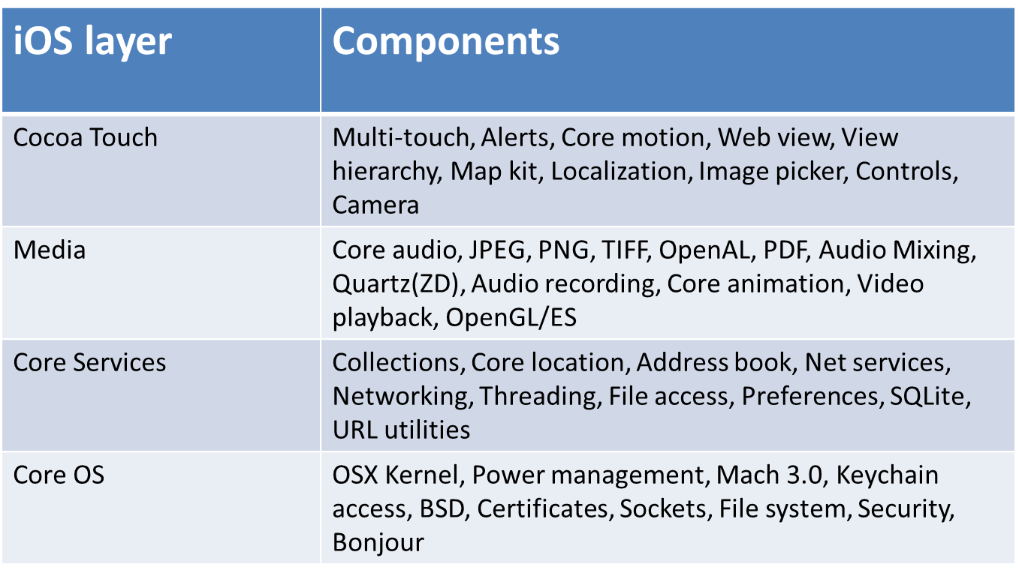
iOS Platform

Slide 11
Window Phone 7 Platform

