Slide 1
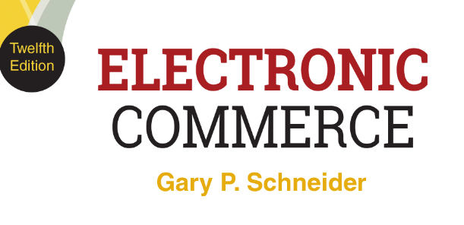
CHAPTER 1
Introduction to Electronic Commerce
© 2017 Cengage Learning®. May not be scanned, copied or duplicated, or posted to a publicly accessible website, in whole or in part, except for use as permitted in a license distributed with a certain product or service or otherwise on a password-protected website or school-approved learning management system for classroom use.
.
Notes:
1

Slide 2
Learning Objectives
In this chapter, you will learn:
What electronic commerce is and how it has evolved in three waves of development
Why companies concentrate on revenue models and the analysis of business processes instead of business models when they undertake electronic commerce initiatives
How to identify opportunities for and barriers to electronic commerce initiatives
2

Slide 3
Learning Objectives (cont’d.)
How economic forces have led to the development and continued growth of electronic commerce
How businesses use value chains and SWOT analysis to identify electronic commerce opportunities
How the international nature of electronic commerce affects its growth and development
3
Notes:
3

Slide 4
Introduction
Introduction
Introduction
Electronic commerce began in the United States
China the leader in online retail sales since 2013
More and more sales being made on smartphones
China is the world’s largest potential online market
Active Internet users and upward economic growth
Buyers use U.S. and domestic sites and are influenced by online reviews and discussions (Amazon and eBay; JD.com and Tmall)
Has led to online review sites and seller participation in Chinese chat and messaging sites

Slide 5
Introduction (cont’d.)
Sellers in China must account for regional differences within a diverse country
Distribution and delivery difficult without well-developed roads and standardized shipping practices
Some sellers have created their own distribution systems
Chapter addresses how online businesses have emerged and grown to accommodate various cultures and infrastructure challenges around the world

Slide 6
The Evolution of Electronic Commerce
Electronic commerce history
Rapid growth from mid-1990s to 2000
“Dot-com boom” followed by “dot-com bust”
2000 to 2003: Overly gloomy news reports (bad news and reports related to E-commerce during this time)
2003: Signs of profound rebirth
Sales and profit growth returned
Electronic commerce grew faster than overall economy and became a larger part of the total economy
6

Slide 7
The Evolution of Electronic Commerce
Electronic commerce history (cont’d.)
2008 general recession
Electronic commerce suffered far less than most of economy
From 2003 to the present
Electronic commerce has expanded more in good times and contracted less in bad times than other economic sectors
7

Slide 8
Electronic Commerce and Electronic Business
Electronic commerce (or e-commerce)
Shopping on the Web
Businesses trading with other businesses
Internal company processes that companies use to support their buying, selling, hiring, planning, and other activities
Broader term: electronic business (e-business)
Includes all business activities using Internet technologies
Internet and World Wide Web (Web)
Wireless transmissions on mobile telephone networks
Dot-com (pure dot-com)
Businesses operating only online
8

Slide 9
Categories of Electronic Commerce
Business-to-consumer (B2C)
Consumer shopping on the Web
Business-to-business (B2B): e-procurement
Transactions conducted between Web businesses
Supply management (procurement) departments
Negotiate purchase transactions with suppliers
Business processes
Use of Internet technologies within the business
9

Slide 10
Business Processes
Business activity is a task performed by a worker doing his or her job
May or may not be related to a transaction
Transaction is an exchange of value
Purchase, sale, or conversion of raw materials into finished product
Involves at least one business activity
Business processes are groups of logical, related, sequential activities and transactions
Web helps people work more effectively
For example, the business process of shipping goods to customers might include a number of activities (or tasks, or transactions), such as inspecting the goods, packing the goods, negotiating with a freight company to deliver the goods, creating and printing the shipping documents, loading the goods onto the truck, and sending payment to the freight company.
Telecommuting or telework is allowing employees to work at home or from other locations instead of travelling to an office.

Slide 11
Relative Size of Electronic Commerce Elements
Rough approximation shown in Figure 1-1
Dollar volume and number of transactions
B2B much greater than B2C
Number of transactions
Supporting business processes greater than B2C and B2B combined

Slide 12
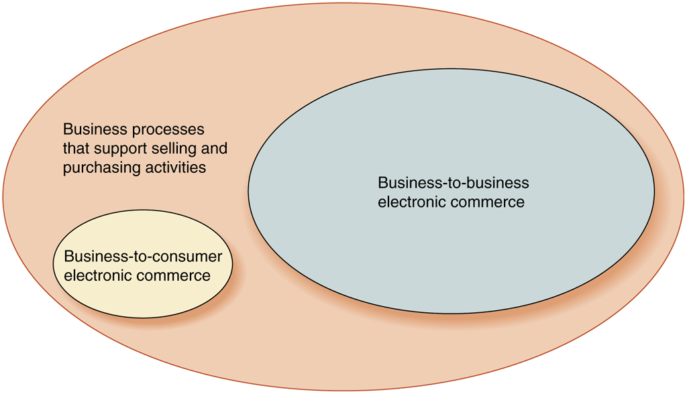
© Cengage Learning 2017
FIGURE 1-1 Elements of electronic commerce

Slide 13
Relative Size of Electronic Commerce Elements (cont’d.)
Consumer-to-consumer (C2C)
Individuals buying and selling among themselves
Web auction site
C2C sales included in B2C category
Seller acts as a business (for transaction purposes)
Business-to-government (B2G)
Business transactions with government agencies
Paying taxes, filing required reports
B2G transactions included in B2B discussions
13

Slide 14
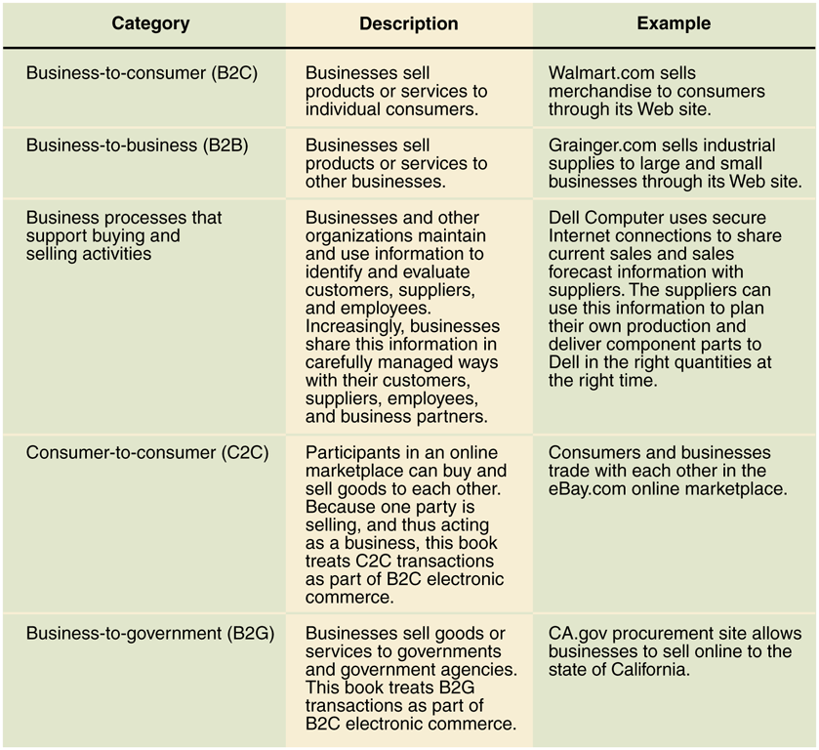
© Cengage Learning 2017
FIGURE 1-2 Electronic commerce categories

Slide 15
Early Electronic Commerce
Electronic Funds Transfers (EFTs)
Wire transfers
Electronic transmissions of account exchange information over private communications networks
Electronic Data Interchange (EDI)
Business-to-business transmission of computer-readable data in standard format
Standard transmitting formats benefits
Reduces errors, avoids printing and mailing costs and eliminates need to reenter data
15

Slide 16
Early Electronic Commerce (cont’d.)
Trading partners
Businesses engaging in EDI with each other
EDI pioneers (example: General Electric, Sears, and Walmart) improved purchasing processes and supplier relationships
Pioneers faced high implementation costs
Value-added network (VAN)
Independent firm offering EDI connection and transaction-forwarding services
EDI continues to be a large portion of B2B electronic commerce
16

Slide 17
The First Wave of Electronic Commerce, 1995-2003
1997 to 2000
More than 12,000 Internet businesses were started
2000 to 2003
More than 5,000 start-ups went out of business
Extensive coverage of “dot.com bust”
$200 billion spent on bailing out and starting businesses
Set the stage for significant future growth
17

Slide 18
The Second Wave of Electronic Commerce, 2004-2009
Expanding international scope
Established companies used own funds to finance gradual expansion
Faster, less expensive Internet technologies available
Increase in broadband connections a key element of the B2C component of this wave
E-mail became an integral part of marketing and customer contact
Renewed interest in Internet advertising
18

Slide 19
The Second Wave of Electronic Commerce, 2004-2009 (cont’d.)
Promise of available technologies fulfilled
Legal distribution of music, video, and other digital products
Web 2.0 technologies
Users participate in creating and modifying content on third party Web sites
Shift in online business strategy
Away from the first-mover advantage which is expensive and not always successful to a smart-follower strategy
“Second mouse gets the cheese”
19

Slide 20
The Third Wave of Electronic Commerce, 2010 - Present
Factors in the third wave
Critical mass of mobile users with powerful devices
Increased availability of smartphones and tablets
Mobile apps used for over 40% of online sales
Increase in electronic commerce activity
Growing number of people using handheld devices to access the Internet
Widespread participation in social networking
Businesses can use social commerce to advertise, promote or suggest specific products and services

Slide 21
The Third Wave of Electronic Commerce, 2010 - Present
Factors in the third wave (cont’d)
Increased online participation by smaller businesses in sales, purchasing, and capital-raising activities
Crowdsourcing
Sophisticated analysis of data companies collect about online customers
Big data and data analytics
Increased integration of tracking technologies into B2B electronic commerce and the management of business processes within companies
RFID devices and biometric technologies

Slide 22
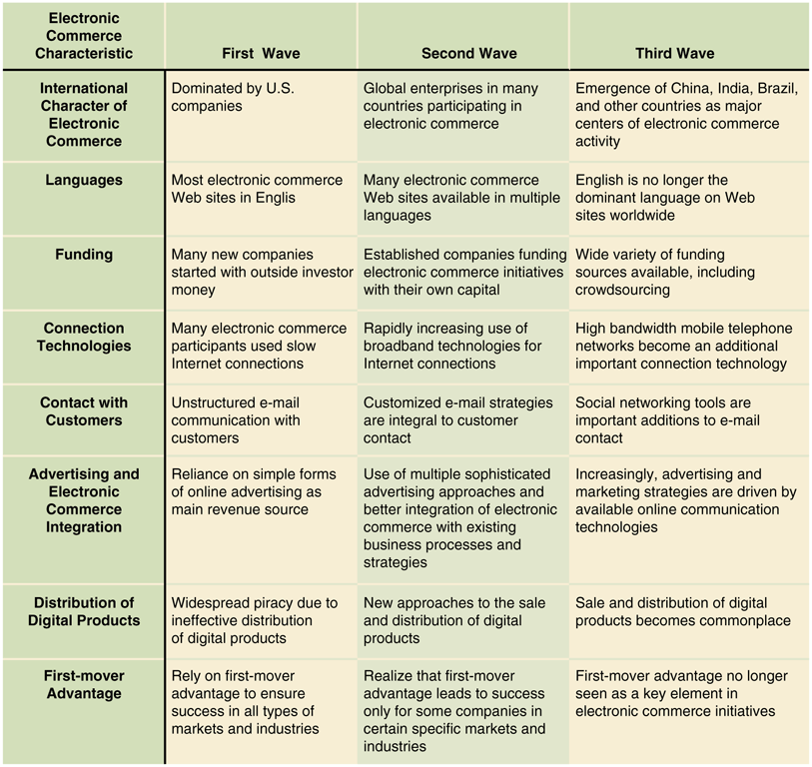
© Cengage Learning 2017
FIGURE 1-3 Key characteristics of the first three waves of electronic commerce

Slide 23
Business Models, Revenue Models, and Business Processes
Business model
Set of processes combined to achieve company goal
In the first wave of electronic commerce, investors sought Internet-driven business models
Expectations of rapid sales growth, market dominance
Successful “dot-com” business models emulated
Led to many business failures
Michael Porter argued business models did not exist
23

Slide 24
Business Models, Revenue Models, and Business Processes (cont’d.)
Instead of copying model, companies should examine their business elements
Streamline, enhance, or replace with Internet technology driven processes
Revenue model
Specific collection of business processes used to identify, market and make sales to customers
Classifies revenue-generating activities for communication and analysis purposes
24

Slide 25
Focus on Specific Business Processes
Examples of business processes
Purchasing raw materials or goods for resale
Converting materials and labor into finished goods
Managing transportation and logistics
Hiring and training employees
Managing business finances
Identify processes that benefit from ecommerce technologies
Not all processes can be improved with technology
Firms can use it to help them adapt to change
25

Slide 26
Role of Merchandising
Combination of store design, layout, and product display knowledge
Salespeople have skills to identify customer needs and meet them
Merchandising and personal selling skills can be difficult to practice remotely
Companies must be able to transfer these skills to have Web site success
Some products are easier to sell on the Internet than others
26

Slide 27
Product/Process Suitability to Electronic Commerce
Some products good candidates for electronic commerce
Customers do not need to experience physical characteristics before purchase
Technology has made more processes suitable for electronic commerce
Commodity items are standardized, well-known products only differentiated by price
Must have attractive shipping profile to sell online
Includes books, clothing, shoes, kitchen accessories and other small household items

Slide 28
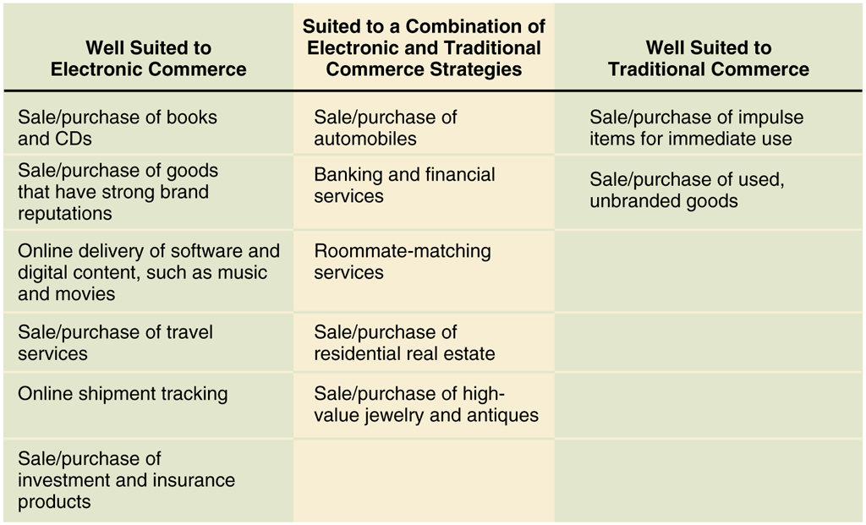
© Cengage Learning 2017
FIGURE 1-5 Business process suitability to type of commerce

Slide 29
Product/Process Suitability to Electronic Commerce (cont’d.)
Easier-to-sell products have:
Strong brand reputation
Appeal to small but geographically diverse groups
Traditional commerce better for:
Products relying on personal selling skills
Transactions involving large amounts of money
Combination of electronic and traditional commerce strategies best when:
Business process includes both commodity and personal inspection aspects
29

Slide 30
Opportunities for Electronic Commerce
Electronic commerce can help increase profits and sales and decrease business costs
Virtual community
Gathering of people sharing a common interest
E-commerce purchasing opportunities
Identify new suppliers and business partners
Efficiently obtain competitive bid information
Increase speed, information exchange accuracy
Wider range of choices available 24 hours a day

Slide 31
Opportunities for Electronic Commerce (cont’d.)
Benefits extend to general society
Lower costs to issue and secure
Electronic payments of tax refunds
Public retirement
Welfare support
Provides faster transmission
Provides fraud, theft loss protection
Electronic payments easier to audit and monitor
Telecommuting reduces traffic, pollution
Products and services available in remote areas
31

Slide 32
Electronic Commerce: Current Barriers
Poor choices for electronic commerce
Perishable foods and high-cost, unique items
Four barriers
Need for critical mass of customers with appropriate technology
Unpredictability in costs and revenues
Insufficient tools for hardware and software integration
Cultural and legal barriers
32

Slide 33
Economic Forces and Electronic Commerce
Economics
Study how people allocate scarce resources
Markets
Potential sellers come into contact with buyers
Medium of exchange available (currency or barter)
Hierarchical business organizations
Firms or companies
Transaction costs
Motivation for moving economic activity to hierarchically structured firms
33

Slide 34
Transaction Costs
Total costs a buyer and seller incur while gathering information and negotiating purchase-and-sale transaction
Costs include:
Brokerage fees and sales commissions
Cost of information search and acquisition
Sweater dealer example (Figure 1-6)
34

Slide 35
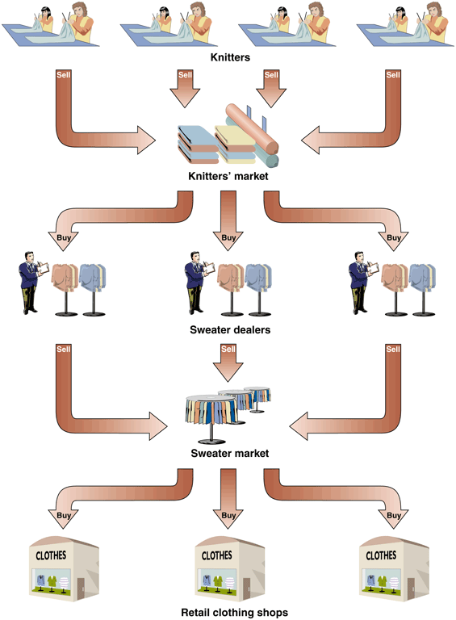
© Cengage Learning 2017
FIGURE 1-6 Market form of economic organization

Slide 36
Markets and Hierarchies
Coase’s analysis of high transaction costs
Hierarchical organizations replace market-negotiated transactions
Supervision and worker-monitoring elements
Vertical integration sweater example (Figure 1-7)
Oliver Williamson (extended Coase’s analysis)
Complex manufacturing, assembly operations
Hierarchically organized, vertically integrated
Manufacturing innovations increased monitoring activities’ efficiency and effectiveness
36

Slide 37
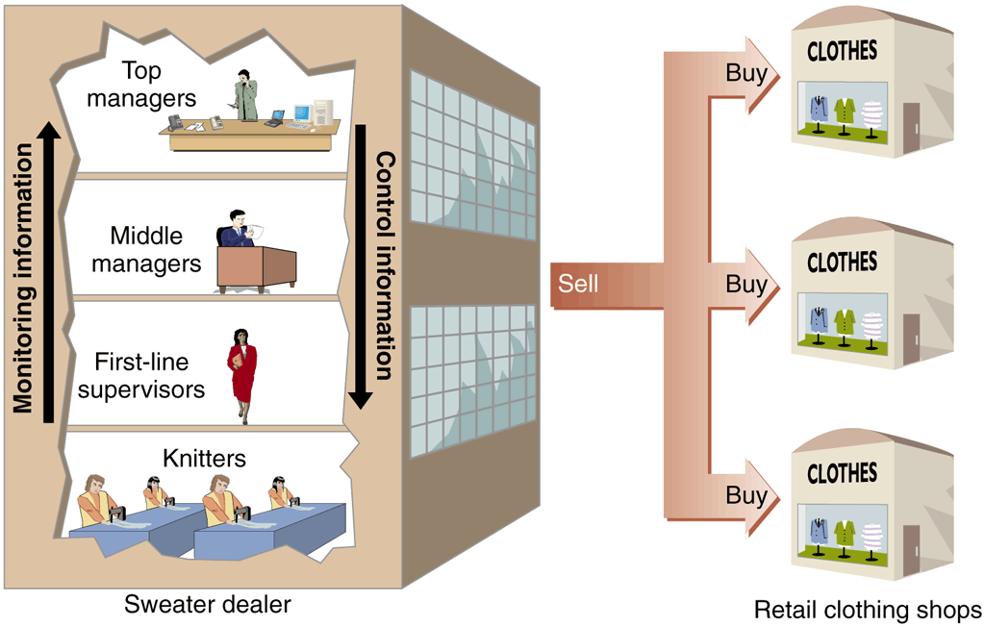
© Cengage Learning 2017
FIGURE 1-7 Hierarchical form of economic organization

Slide 38
Markets and Hierarchies (cont’d.)
Strategic business unit (business unit)
Part of a company large enough to manage itself
Small enough to quickly respond to business environment changes
Exception to hierarchy trend
Commodities

Slide 39
Using Electronic Commerce to Reduce Transaction Costs
Electronic commerce can
Improve flow of information
Increase coordination of actions
Change attractiveness of vertical integration
Example: employment transaction
Telecommuting reduces or eliminates transaction costs
39

Slide 40
Network Economic Structures
Neither market nor hierarchy
Strategic alliances (strategic partnerships)
Coordinate strategies, resources, skill sets by forming long-term relationships based on shared purposes
Strategic partners come together for specific projects
Network organizations well suited to information-intensive technology industries
Electronic commerce makes networks easier to construct and maintain
Castells predicts economic networks will become the organizing structure for social interactions
40

Slide 41
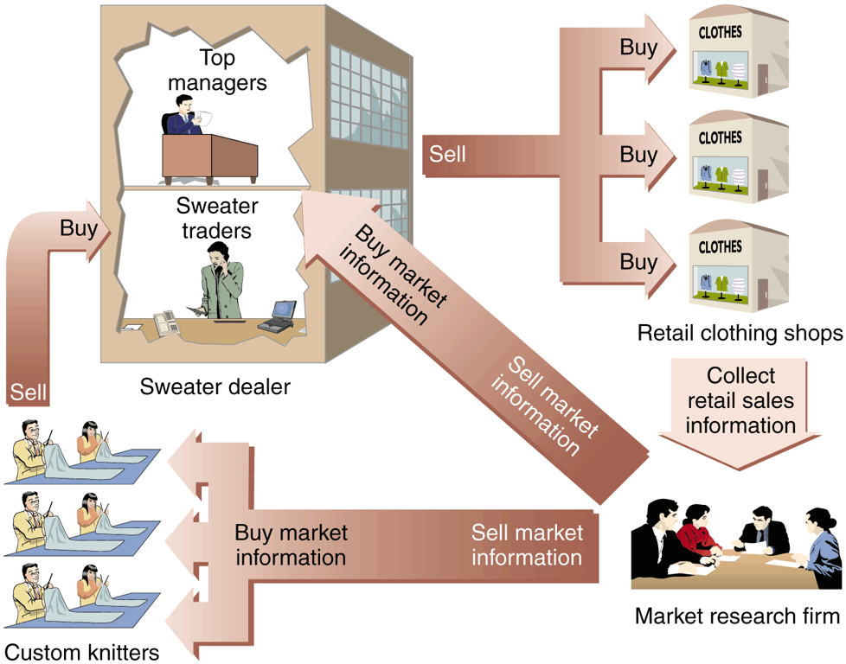
© Cengage Learning 2017
FIGURE 1-8 Network form of economic organization

Slide 42
Network Effects
Law of diminishing returns
Activities yield less value as consumption amount increases
Example: hamburger consumption
Network effect
Exception to law of diminishing returns
As more people or organizations participate in network, the value to each participant increases
Examples: Landline phones, e-mail
42

Slide 43
Identifying Electronic Commerce Opportunities
Focus on specific business processes
Break business down
Series of value-adding activities that combine to meet firm’s goals
Business activities conducted by firms of all sizes
Firm
Multiple business units owned by a common set of shareholders
Industry
Multiple firms selling similar products to similar customers
43

Slide 44
Strategic Business Unit Value Chains
Value chain
Organizing strategic business unit activities to design, produce, promote, market, deliver, and support the products or services
Michael Porter includes supporting activities such as human resource management and purchasing
Strategic business unit primary activities
Design, identify customers, purchase materials and supplies, manufacture product or create service, market and sell, deliver, provide after-sale service and support

Slide 45
Strategic Business Unit Value Chains (cont’d.)
Importance of primary activities depends on:
Product or service
Customers
Central corporate organization support activities
Finance and administration
Human resource
Technology development

Slide 46
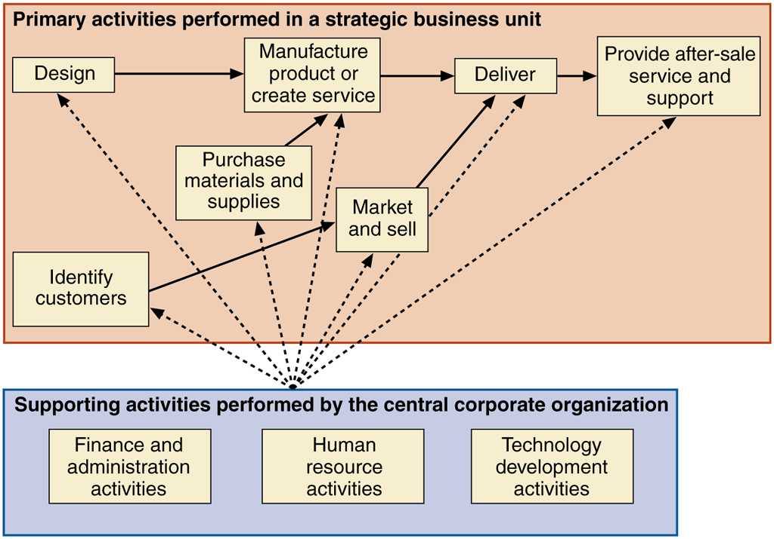
© Cengage Learning 2017
FIGURE 1-9 Value chain for a strategic business unit

Slide 47
Industry Value Chains
Examine where strategic business unit fits within industry
Porter’s value system
Describes larger activities stream into which particular business unit’s value chain is embedded
Industry value chain refers to value systems
Awareness of businesses value chain activities
Allows identification of new opportunities
Useful way to think about general business strategy

Slide 48
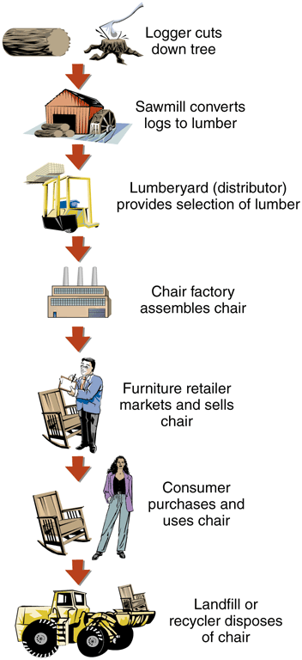
© Cengage Learning 2017
FIGURE 1-10 Industry value chain for a strategic business unit

Slide 49
SWOT Analysis: Evaluating Business Unit Opportunities
Define SWOT (strengths, weaknesses, opportunities, and threats)
First look into business unit
Identify strengths and weaknesses
Then review operating environment
Identify opportunities and threats presented
Take advantage of opportunities
Build on strengths
Avoid threats
Compensate for weaknesses

Slide 50
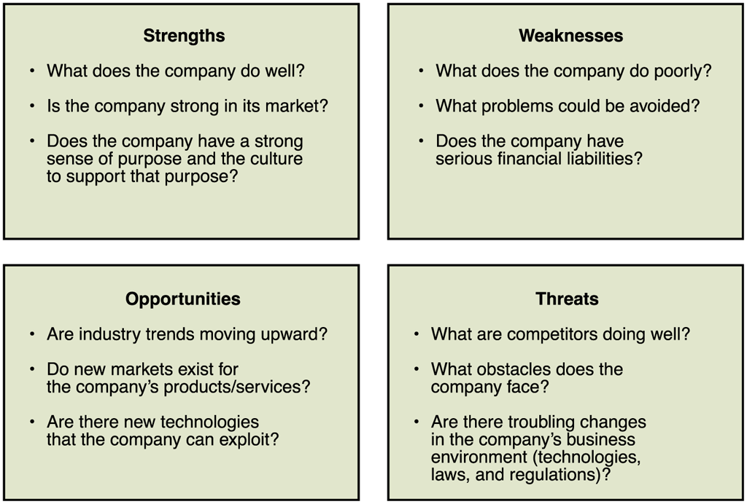
© Cengage Learning 2017
FIGURE 1-11 SWOT analysis questions

Slide 51
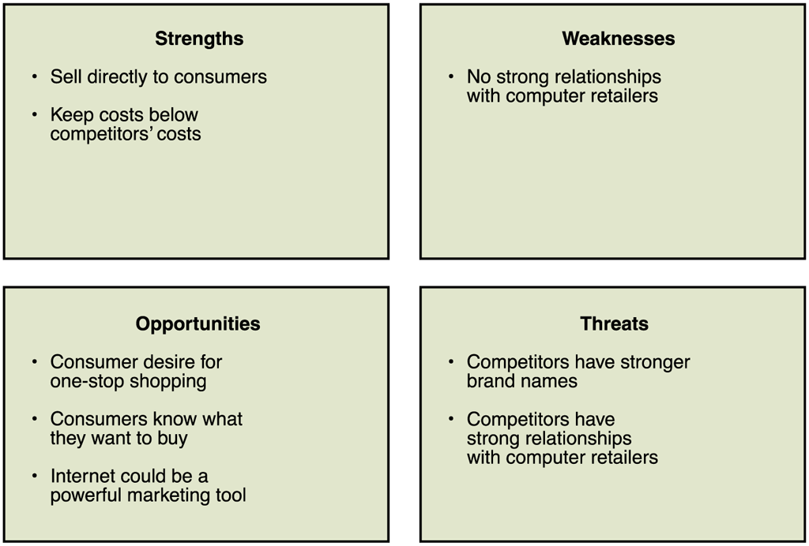
© Cengage Learning 2017
FIGURE 1-12 Results of Dell’s SWOT analysis

Slide 52
International Nature of Electronic Commerce
Internet connects computers worldwide
When companies use Web to improve business process they automatically operate in global environment
Third wave
Rapidly increasing proportion outside US
China, India, and Brazil have seen enormous recent growth
Key issues in international commerce include trust, culture, language, government and infrastructure

Slide 53
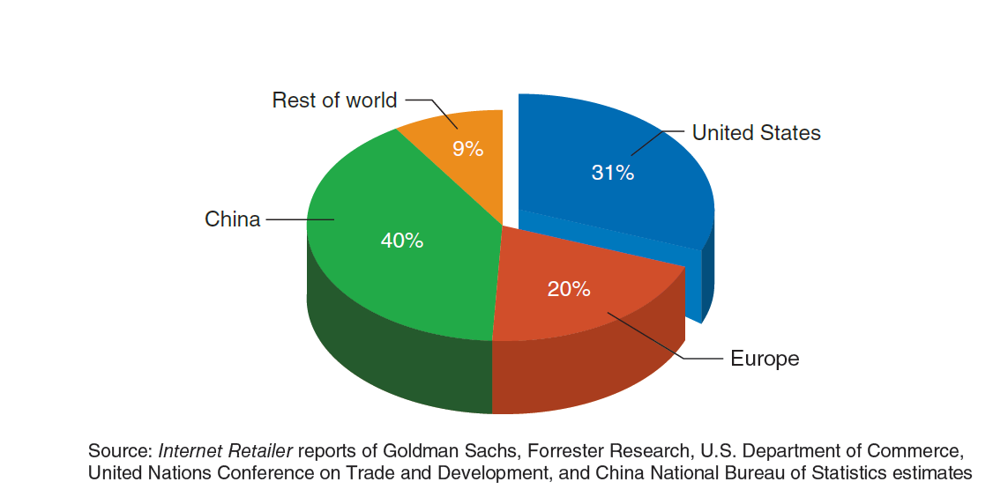
© Cengage Learning 2017
FIGURE 1-13 Proportion of online B2C sales by geographic region, 2014

Slide 54
Trust Issues on the Web
Important for all businesses to establish trusting relationships with customers
Companies can rely on established brand names
Challenging for new companies because anonymity exists when trying to establish a Web presence
Plan for establishing credibility is essential
Sellers cannot assume site visitors will know they are trustworthy
Business must overcome distrust in Web “strangers”

Slide 55
Language Issues
Business must adapt to local cultures
“Think globally, act locally”
Provide local language versions of Web site as customers are more likely to buy from sites in own language
Websites available in English only have declined dramatically to about 25% of total sites
Languages may require multiple translations for separate dialects
Localization means a translation considers multiple elements of the local environment

Slide 56
Cultural Issues
Important element of business trust is anticipating how the other party to a transaction will act in specific circumstances
Culture is the combination of language and customs
Varies across national boundaries, regions within nations
Care must be taken in choosing packaging, product names, icons used to represent common actions and even colors
Japanese shoppers resisted US sites for years because of their resistance to use of credit cards

Slide 57
Culture and Government
Some areas have cultural environments inhospitable to online discussions that occur on the Internet
May lead to government controls that limit electronic commerce development
Many countries filter available Web content and some have denounced the Internet
Countries such as the People’s Republic of China and Singapore traditionally control access to information but want to reap the benefits of electronic commerce
Result has been many regulations and requirements

Slide 58
Infrastructure Issues
Computers and software connected to Internet and the related communications networks
Outside the U.S. the telecommunications industry is either government owned or regulated
Inhibits development or limits expansion
High local telephone connection costs affect online behavior
Over half of all Websites turn away international orders because of no process to handle them
Problem is increasing globally

Slide 59
Infrastructure Issues (cont’d.)
Freight forwarder arranges international transactions’ shipping and insurance
Customs broker arranges tariff payment and compliance with international shipping laws
Bonded warehouse is a secure location that holds international shipments until customs requirements or payments satisfied
Handling international transactions paperwork has an annual cost of $700 billion
Software automates some paperwork

Slide 60
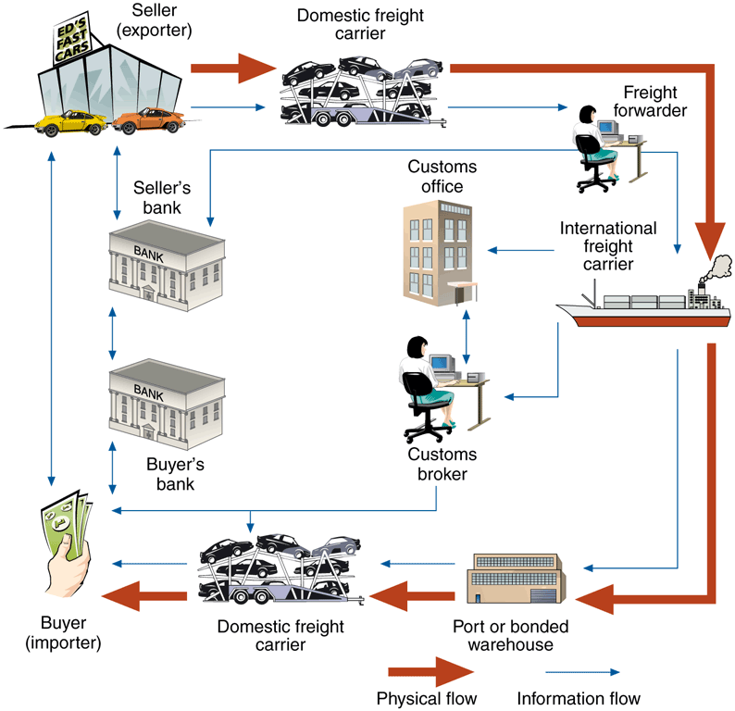
© Cengage Learning 2017
FIGURE 1-14 Parties involved in a typical international trade transaction

