Slide 1
CHAPTER 2
Technology Infrastructure: The Internet and the World Wide Web
© 2017 Cengage Learning®. May not be scanned, copied or duplicated, or posted to a publicly accessible website, in whole or in part, except for use as permitted in a license distributed with a certain product or service or otherwise on a password-protected website or school-approved learning management system for classroom use.
.
Notes:
1

Slide 2
Learning Objectives
In this chapter, you will learn:
About the origin, growth, and current structure of the Internet
How packet-switched networks are combined to form the Internet
How Internet, e-mail, and Web protocols work
About Internet addressing and how Web domain names are constructed
2
Notes:
2

Slide 3
Learning Objectives (cont’d.)
About the history and use of markup languages on the Web
How HTML tags and links work
About the cost and performance of Internet connections technologies
About Internet2 and the Semantic Web
3
Notes:
3

Slide 4
Introduction
More Internet users are using smartphones or tablets
High mobile device usage is taxing existing technologies and threatening to overloading networks
Current solution is for wireless providers to add more cell phone towers
Expensive and locations can be hard to find
With mobile data traffic expected to triple by 2018, the search for alternatives is underway
pCell technology creates a network of personal cells based on each device

Slide 5
The Internet and the World Wide Web
Computer network is any technology allowing people to connect computers to each other
internet (small “i”) is a group of interconnected computer networks
Internet (capital “I”) connects networks all over the world
World Wide Web (Web) is a subset of Internet computers that are connected to each other
Includes easy-to-use interfaces
5

Slide 6
Origins of the Internet
Early 1960s
Defense Department nuclear attack concerns
Powerful computers (large mainframes)
Leased telephone company lines established a single connection between sender and receiver
Single connection risk solution
Communicate using multiple channels (packets)
1969 Advanced Research Projects Agency (ARPA)
Packet network connected four computers
ARPANET: earliest network (became the Internet)
Academic research use (1970s and 1980s)

Slide 7
New Uses for the Internet
E-mail (1972) became widely used quickly
Military and education research users continued to grow and mailing lists first appeared
1979: Usenet (User’s News Network) created
Continues today with newsgroups
Network applications improved and tested by an increasing number of users from 1979 to 1989
Security problems recognized
1980s: personal computer use explosion
Academic and research networks merged into the Internet

Slide 8
Commercial Use of the Internet
National Science Foundation (NSF)
Provided funding
Prohibited commercial network traffic so businesses turned to commercial e-mail providers
Larger firms built networks (leased telephone lines)
1989: NSF permitted two commercial e-mail services (MCI Mail and CompuServe)
Commercial enterprises could send e-mail
Research, education communities sent e-mail directly to MCI Mail and CompuServe

Slide 9
Growth of the Internet
In 1991 the NSF further eased commercial Internet activity restrictions
Privatization of the Internet completed in 1995
Operations turned over to privately owned companies
Internet based on four network access points (NAPs)
Network access providers sell Internet access rights directly and through Internet service providers (ISPs)
Consistent and dramatic growth in the number of Internet hosts (computers directly connected to the Internet) to more than 1 billion today

Slide 10
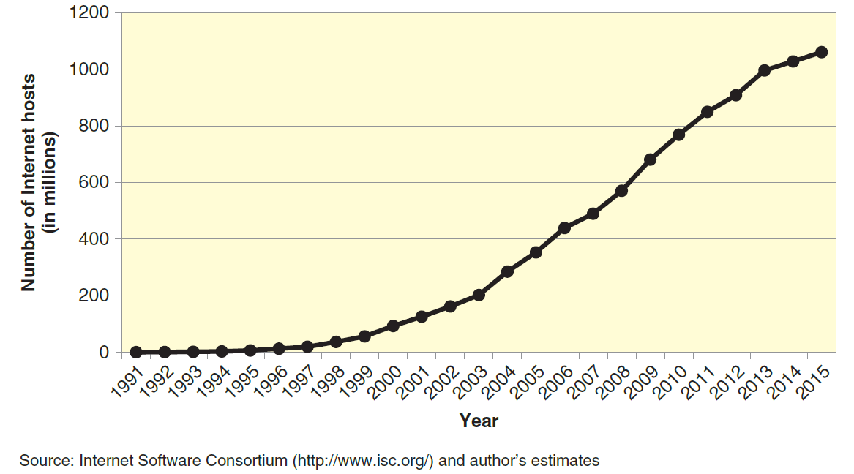
© Cengage Learning 2017
FIGURE 2-1 Growth of the Internet

Slide 11
The Internet of Things
Connection of devices not used by persons is rapidly increasing
Switches, optical scanners, and sensors can be connected to the Internet and used to automatically manage environmental or security issues
Some business transactions can be conducted without human intervention
The Internet of things is the term used for these devices and automatic transaction processing
Estimated 10 billion devices now and expected to reach 40 billion by 2020

Slide 12
Packet-Switched Networks
Local area network (LAN) is a network of computers located close together
Wide area network (WAN) is a network of computers connected over greater distances
Telephone call establishes a single connection path between caller and receiver then transmits data along that single path or circuit
Circuit switching is centrally controlled, single-connection model
Not resistant to failure because a break in any circuit causes interruption and data loss

Slide 13
Packet-Switched Networks (cont’d.)
Packet-switched network breaks files and e-mail messages into small pieces called packets
Labelled electronically with origin, sequences and destination addresses
Travel along interconnected networks until reaching destination
Can take different paths
May arrive out of order
Destination computer
Collects packets
Reassembles original file or e-mail message

Slide 14
Routing Packets
Routing computers forward each packet
Routers, gateway computers, border or edge routers
Routing algorithms are applied to information stored in routing tables or configuration tables
Hubs, switches, and bridges move packets from one part of the network to another
Routers connect networks to other networks and usually perform the required translation function
Internet backbone are telecommunication lines and routers between Internet’s main collecting points

Slide 15
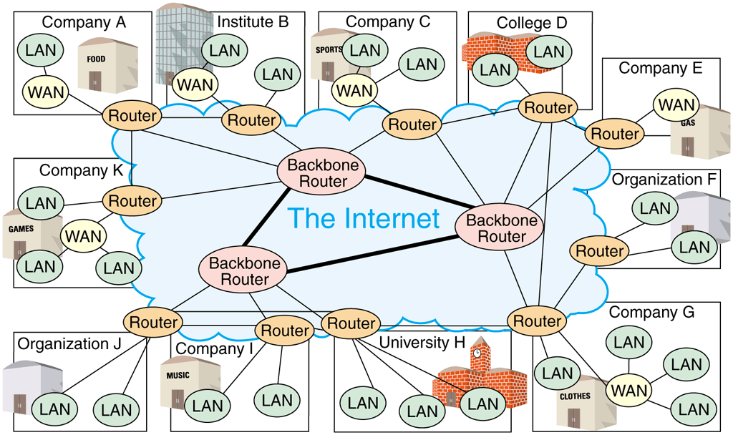
© Cengage Learning 2017
FIGURE 2-2 Router-based architecture of the Internet

Slide 16
Public and Private Networks
Public network is available to the public and does not provide much security as part of its basic structure
Private network is a leased-line connection between two companies that physically connects their computers or networks together
Leased line is a permanent telephone connection between two points
Advantage: security
Drawback: cost

Slide 17
Virtual Private Network (VPN)
Connection via public networks to send data in a way that protects it as well as a private network at a lower cost
Uses IP tunneling (encapsulation) system to create a private passageway through public Internet
Encapsulation encrypts packet content and places it inside another packet
IP wrapper: outer packet
“Virtual” since connection seems permanent but is actually a temporary connection

Slide 18
Intranets and Extranets
Intranet
An Internet within the boundaries of the organization
Interconnected private networks
Extranet
An Internet that extends beyond the organization and incorporates networks of outside entities
Technologies (public networks, private networks, or VPNs)
Independent of organizational boundaries

Slide 19
Internet Protocols
Protocol is a collection of rules across a network
Computers that communicate with each other must use same protocol for data transmission
ARPANET: Network Control Protocol (NCP)
Proprietary architecture (closed architecture)
Manufacturer creates own protocol
Open architecture (Internet core)
Uses common protocol
Four key message-handling rules
Contributed to the Internet’s success

Slide 20
TCP/IP
Refers to the two main protocols used by the Internet today
Transmission Control Protocol (TCP)
Controls message or file disassembly into packets before Internet transmission
Controls packet reassembly into original formats at destinations
Internet Protocol (IP)
Specifies addressing details for each packet
Labels packet with origination and destination addresses

Slide 21
IP Addressing
Internet Protocol version 4 (IPv4) used since 1981
IP address is a 32-bit number identifying computers
Computers use base 2 (binary) number system
Digit: 0 or a 1 (on or off condition)
Four billion different addresses
Router breaks message into packets that contain source and destination IP address
With dotted decimal notation IP addresses appear as four numbers separated by periods
Three NFP organizations assign IP addresses

Slide 22
IP Addressing (cont’d.)
ARIN Whois server returns IP address list owned by an organization in North America
New devices creating high demand for IP addresses
Subnetting is the use of reserved private IP LAN (WAN) addresses to provide more space
Last IPv4 addresses allocated summer 2015
Internet Protocol version 6 (IPv6) replaces IPv4 and uses 128-bit number for addresses
Available addresses: 34 followed by 37 zeros
More complex hexadecimal (16) notation system

Slide 23
Electronic Mail Protocols
Electronic mail (e-mail) must be formatted according to common set of rules
Most organizations use a client/server structure
E-mail server computer devoted to e-mail handling
Software stores and forwards e-mail messages
E-mail client software reads and sends e-mail
Communicates with e-mail server software
Many e-mail services are offered by Web sites
Standardization and rules are essential
Two common protocols are used for e-mail

Slide 24
Electronic Mail Protocols (cont’d.)
Simple Mail Transfer Protocol (SMTP) specifies mail message format, and describes mail administration and transmission
Post Office Protocol (POP) messages send mail to user’s computer and either deletes or does not delete it or asks if new mail has arrived
Multipurpose Internet Mail Extensions (MIME) is a set of rules for handling binary files
Interactive Mail Access Protocol (IMAP) performs the same basic POP functions but has some additional features

Slide 25
Web Page Request and Delivery Protocols
Web client computers run Web client software (Web browser software)
Examples include Google Chrome, Microsoft Internet Explorer, Apple Safari and Mozilla Firefox
Sends Web page file requests to other computers (Web servers)
Web server computer runs Web server software
Receives requests from many different Web clients and send back files
Client/server architecture
Combination: client and Web server computers

Slide 26
Web Page Request and Delivery Protocols (cont’d.)
Hypertext Transfer Protocol (HTTP)
Internet Web page file delivery rules
Web page request using Web browser
User types protocol name
Followed by “//:” characters before the domain name
Uniform Resource Locator (URL)
Combination: protocol name, domain name
Locates resources (Web page) on another computer (Web server)

Slide 27
Emergence of the World Wide Web
Web
Software running on Internet-connected computers
Generates network traffic
Web software: largest single traffic category
Outpaces: e-mail, file transfers, and other data transmission traffic
Web resulted from new ways of thinking about information storage and retrieval
Key technological Web elements
Hypertext
Graphical user interfaces

Slide 28
The Development of Hypertext
1945: Vannevar Bush: The Atlantic Monthly article
Visionary ideas: future technology uses (Memex)
1960s: Ted Nelson described a page-linking system
Douglas Engelbart: experimental hypertext system
1987: Nelson published Literary Machines
Outlined project Xanadu an online global hypertext publishing and commerce system
1989: Tim Berners-Lee proposed development project to provide data-sharing functionality
Developed hypertext server program code

Slide 29
The Development of Hypertext (cont’d.)
Hypertext server stores files written in Hypertext Markup Language (HTML) which is used for the creation of Web pages
Called Web servers today
HTML is a language that includes a set of codes (tags) attached to text
Describes relationships among text elements
Hypertext link (hyperlink)
Points to another location
Same or another HTML document

Slide 30
Graphical Interfaces for Hypertext
Web browser
Software lets users read (browse) HTML documents and move from one HTML document to another through text formatted with hypertext link tags in file
Graphical user interface (GUI)
Presents program control functions, output to users, and input from users
Pictures, icons, and other graphical elements

Slide 31
The World Wide Web
World Wide Web: Berners-Lee’s name for system of hyperlinked HTML documents
Quick acceptance in scientific research community
1993: GUI program (Mosaic) that could read HTML
Used HTML hyperlinks for page-to-page navigation
First Web browser widely available for personal computers and still in use today
Easy access to Internet information through system of pages connected by hypertext links
Profit-making potential recognized by businesses

Slide 32
The World Wide Web (cont’d.)
Netscape Communications founded in 1994
Netscape Navigator Web browser (based on Mosaic)
Microsoft: Internet Explorer (most widely used)
Mozilla Firefox: Netscape Navigator descendant
Number of Web sites has grown more rapid growth than the Internet itself
More than 800 million Web sites
Over a trillion individual Web pages
2010 to 2011: number of Web sites doubled

Slide 33
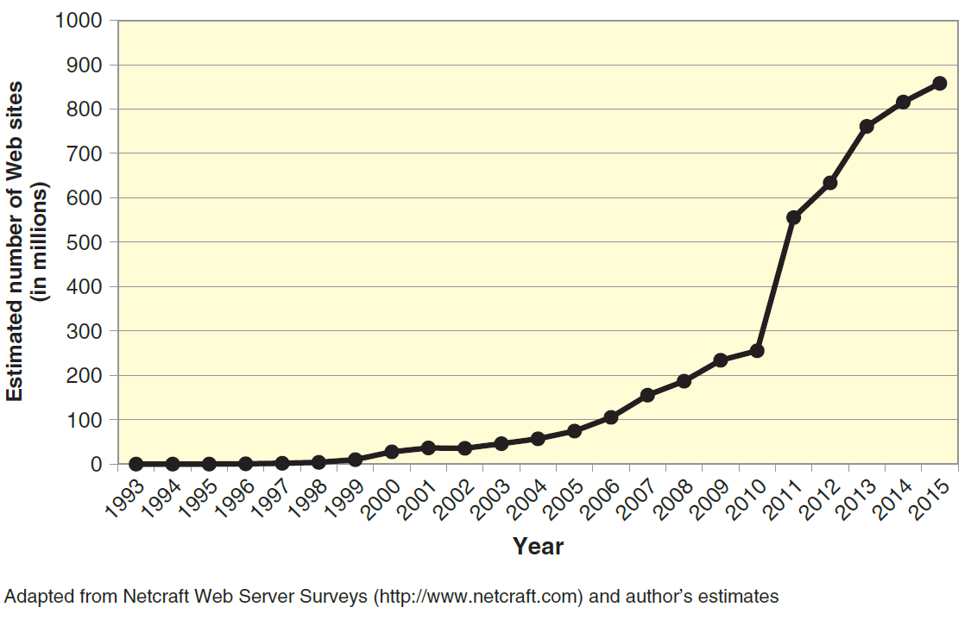
© Cengage Learning 2017
FIGURE 2-3 Growth of the World Wide Web

Slide 34
The Deep Web
Web provides access to customized pages created in response to a user’s query
Pull content from databases
Example: search for “online business” book on Amazon.com
Deep Web: Store of information available through the Web
Potentially trillions of Web pages available using deep Web
Difficult or impossible to search because available data that is never requested remains hidden

Slide 35
Domain Names
Dotted decimal notation difficult to remember
Domain names are sets of words assigned to specific IP addresses
Example: www.sandiego.edu
Contains three parts separated by periods
Top-level domain (TLD): rightmost part
Generic top-level domains (gTLDs)
Sponsored top-level domains (sTLD)
Internet Corporation for Assigned Names and Numbers (ICANN)

Slide 36
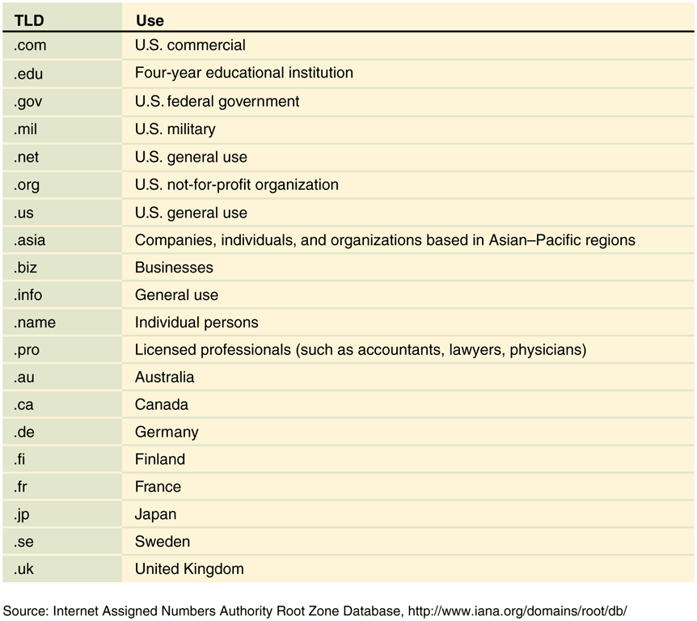
© Cengage Learning 2017
FIGURE 2-4 Commonly used domain names

Slide 37
Markup Languages and the Web
Text markup language specifies a set of tags inserted into text
Markup tags (tags) provide formatting instructions Web client software understands
Most commonly used markup language is HTML
Subset of Generalized Markup Language (SGML)
World Wide Web Consortium (W3C) maintains Web standards
Extensible Hypertext Markup Language (XHTML)
HTML version 4.0 reformulation as XML application

Slide 38
Hypertext Markup Language
Hypertext elements are text elements related to each other
HTML is the prevalent markup language to create Web documents
W3C HTML Working Group page maintains detailed HTML versions and related topic information
HTML version 5.0 was released in 2014
SGML is a metalanguage that can be used to define other languages
Extensible Markup Language (XML) was derived from SGML and is used to tag shared information

Slide 39
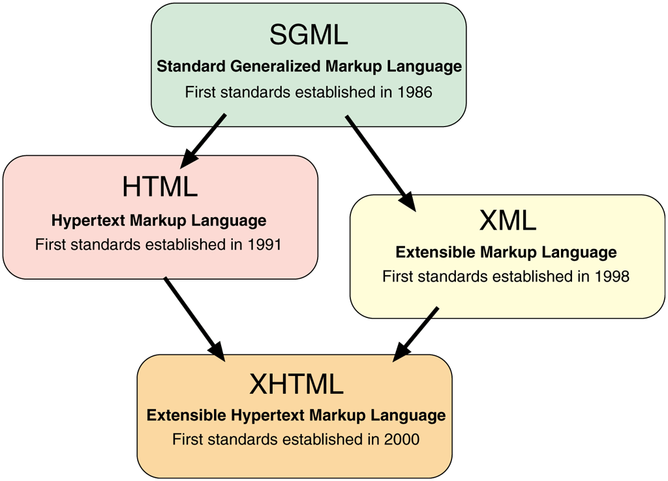
© Cengage Learning 2017
FIGURE 2-5 Development of markup languages

Slide 40
HTML Tags
Interpreted by the Web browser and used to format the display of text enclosed by the tags
Enclosed in angle brackets (<>)
Most have an opening tag and closing tag that format the text between them
Closing tag is preceded by slash within the angle brackets (</>)
User may customize tag interpretations so that different browsers display tagged text differently
Tags are generally written in lowercase letters

Slide 41
HTML Tags (cont’d.)
One-sided tags require opening tag only
Common example is the tag that creates a line break
Some two-sided tags have an optional closing tag
Common example is the paragraph tag
Opening tag may contain one or more property modifiers that refines how the tag operates
Other frequently used HTML tags allow Web designers to include graphics and format text as tables

Slide 42
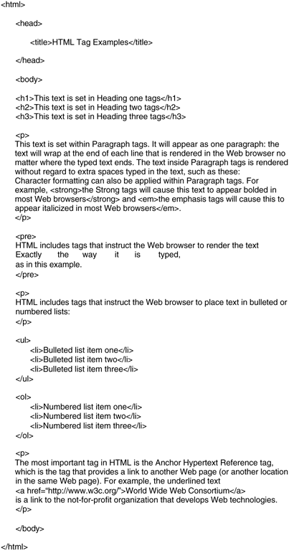
FIGURE 2-6 Text marked up with HTML tags
© Cengage Learning 2017

Slide 43
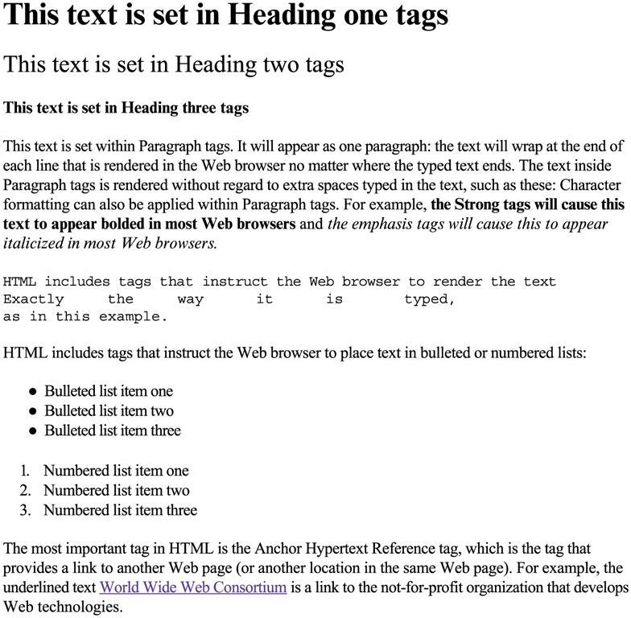
© Cengage Learning 2017
FIGURE 2-7 Text marked up with HTML tags as it appears in a Web browser

Slide 44
HTML Links
Hyperlinks on interlinked pages form a “web” of those pages
Linear hyperlink structure reads Web page in serial fashion
Works well when customer fills out form
Hierarchical hyperlink structure uses an introductory page (home page, start page) that links to other pages
Site map often available for hierarchical sites
HTML creates hyperlinks using HTML anchor tags

Slide 45
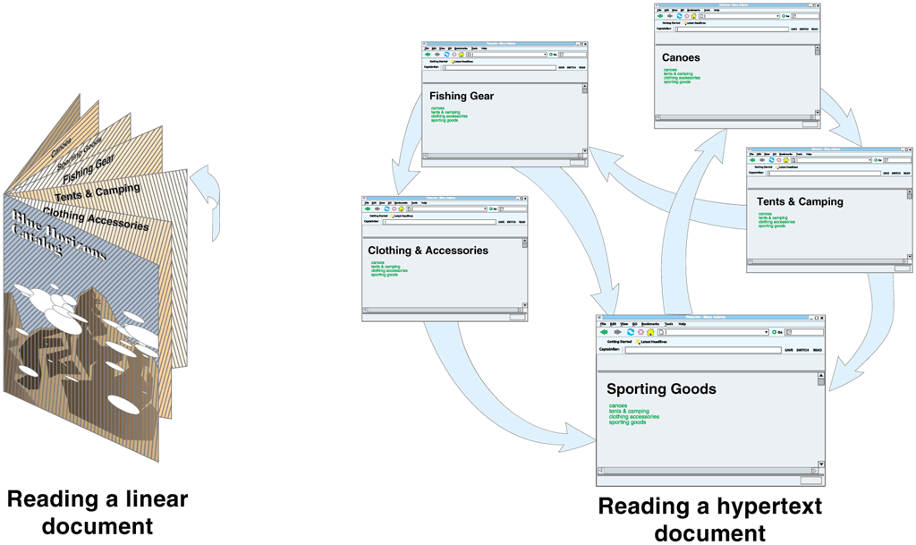
© Cengage Learning 2017
FIGURE 2-8 Linear vs. nonlinear paths through documents

Slide 46
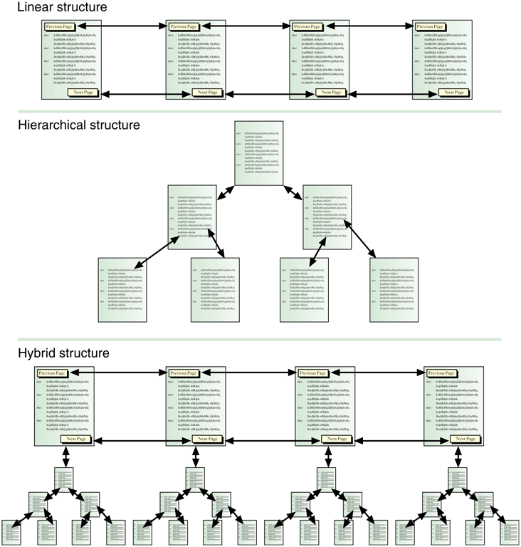
© Cengage Learning 2017
FIGURE 2-9 Three common Web page organization structures

Slide 47
Cascading Style Sheets
Style sheet is a set of instructions that gives Web developers control over displayed page formatting
Usually stored in a separate file and referenced using HTML style tag
May be included in Web page’s HTML file
Cascading style sheets (CSS) can be applied to each Web page, one on top of the other

Slide 48
Extensible Markup Language (XML)
HTML not a good tool for presenting large amounts of business data so designers turned to XML
Uses paired start and stop tags to define the structure of a collection of data
Includes data-management capabilities HTML cannot provide
Greatest strength (and weakness) of XML is that it allows users to define their own tags
Many companies have agreed to common standards for XML tags (data-type definitions (DTDs) or XML schemas) which are available for many industries

Slide 49
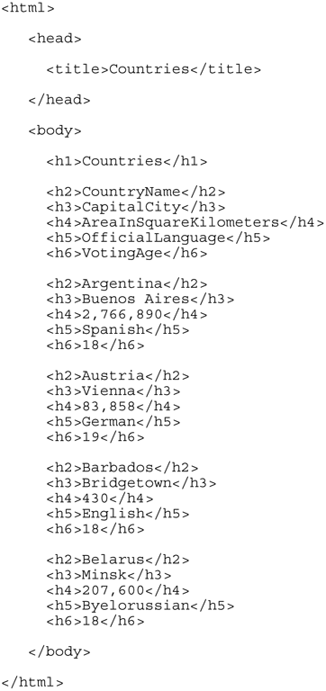
FIGURE 2-10 Country list data marked up with HTML tags
© Cengage Learning 2017

Slide 50
FIGURE 2-11 Country list data as it appears in a Web browser
© Cengage Learning 2017

Slide 51
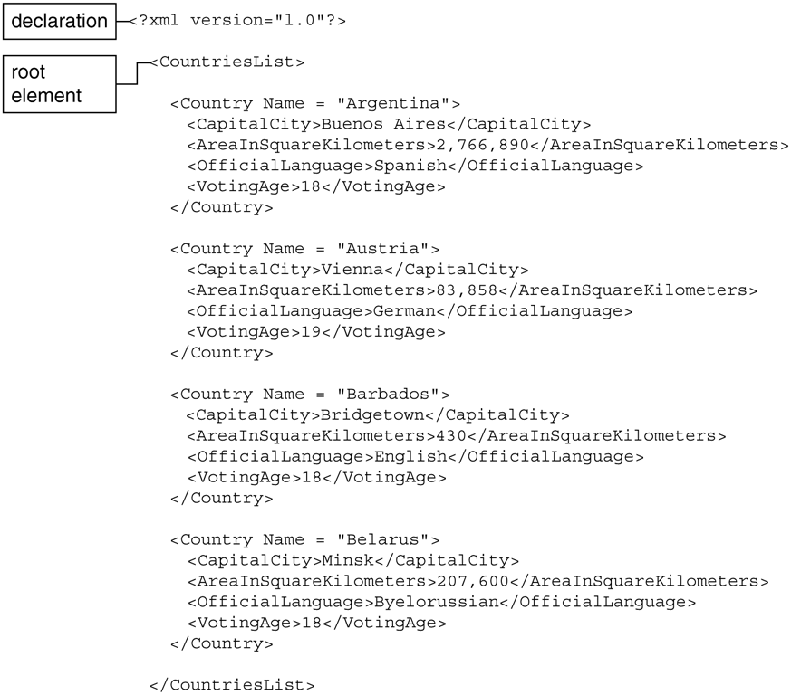
© Cengage Learning 2017
FIGURE 2-12 Country list data marked up with XML tags

Slide 52
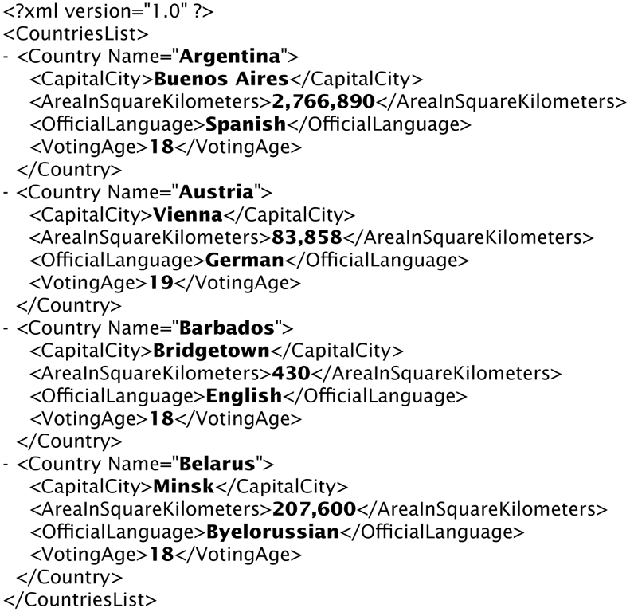
© Cengage Learning 2017
FIGURE 2-13 Country list data marked up with XML displayed in a Web browser

Slide 53
Extensible Markup Language (XML) (cont’d.)
Available DTDs or XML schemas include
LegalXML for the legal profession
MathML for mathematical and scientific information
Extensible Business Reporting Language (XBRL) for accounting and financial information standards
Set of XML tag definitions called an XML vocabulary
XML files usually not intended to display in browser
Extensible Stylesheet Language (XSL) contains formatting instructions
XML parsers format XML file for device screen

Slide 54
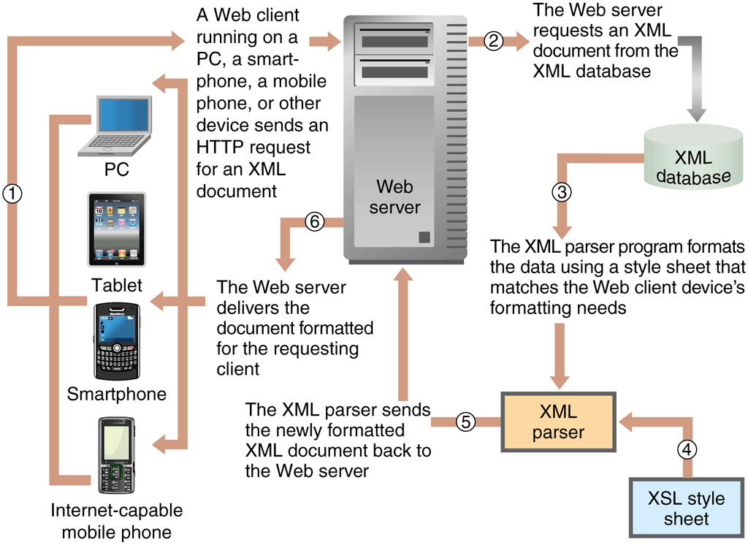
© Cengage Learning 2017
FIGURE 2-14 Processing requests for Web pages from an XML database

Slide 55
Internet Connection Options
Internet is a set of interconnected networks
Organizations connect computers using a network
Many families have their home computers connected using a network
Mobile phones are connected to the wireless phone service provider’s network
Internet access providers (IAPs) or ISPs
Provide Internet access to individuals, businesses, other organizations
Offer several connection options

Slide 56
Connectivity Overview
Common connection options are voice-grade telephone lines, various types of broadband connections, leased lines, wireless
Bandwidth is the amount of data traveling through communication medium per unit of time
Net bandwidth is actual data transmitted per second
Symmetric connections provide the same bandwidth both directions
Asymmetric connections provide different bandwidths for each direction

Slide 57
Connectivity Overview
Two bandwidth types in an asymmetric connection are
Upstream bandwidth (upload bandwidth) is a measure of amount of information that can travel from the user to the Internet in a given amount of time
Downstream bandwidth (download, downlink bandwidth) is a measure of amount of information from the Internet to user in a given amount of time

Slide 58
Voice-Grade Telephone Connections
Used in early days of Web
Plain old telephone service (POTS) uses existing telephone lines, analog modem
Bandwidth between 28 and 56 Kbps
Total most people use higher bandwidth connection options
Speeds greater than 200 Kbps are called broadband services

Slide 59
Broadband Services
Digital Subscriber Line (DSL) is a higher grade of telephone service that does not use a modem
Asymmetric digital subscriber line (ADSL) bandwidths from 100 to 640 Kbps upstream and 1 to 15 Mbps downstream
DSL: Private line with no competing traffic
Cable modems connect to the television cable
Bandwidths from client to server: 500 Kbps to 15 Mbps with downstream as high as 10 Mbps
Connection bandwidths vary with number of subscribers competing for shared resource

Slide 60
Leased-Line Connections
Large firms can connect to an ISP using higher bandwidths leased from telecommunications carriers
Classified by equivalent number of telephone lines included which are more expensive than other options
DS0 (digital signal zero) carries one digital signal (56 Kbps); T1 line (DS1) carries 24 DS0 lines (1.544 Mbps); T3 (DS3): 44.736 Mbps
Technologies used include frame relay, asynchronous transfer mode (ATM) and optical fiber (instead of copper wire)
Bandwidth determined by fiber-optic cable class

Slide 61
Wireless Ethernet (Wi-Fi)
Most common wireless connection technology that is also called 802.11
Latest version is 802.11ac with bandwidth ranges up to 2.5 Gbps and a range of 500 feet
Speed impacted by objects the signals pass through
Wireless access point (WAP) transmits packets between Wi-Fi-equipped computers and other devices within range
Devices capable of roaming or shifting from one WAP to another without human intervention
Hot sports are WAPs open to the public

Slide 62
Personal Area Networks (Piconets)
Bluetooth is a low-bandwidth technology (722 Kbps) designed for personal use over short distances
Useful for wireless synchronization and printing
Devices consume very little power and can discover one another and exchange information automatically
Ultra Wideband (UWB) provides bandwidth up to 480 Mbps and connections over short distances
Future personal area networking applications
ZigBee is a low bandwidth technology with applications designed for energy management and remote controls for consumer electronics

Slide 63
Fixed-Point Wireless
Used in rural areas without cable service
System of repeaters used to forward radio signal from ISP to customers
Repeaters are transmitter-receiver devices (transceivers)
Uses mesh routing
Directly transmits Wi-Fi packets through short-range transceivers (hundreds or thousands)
Located close to each other

Slide 64
Satellite Microwave
Made connections to the Internet possible for the first time in many rural areas
Use microwave transmitters that provide upload bandwidths in the range of 120 Kbps to 5 Mbps and downloads in the 1-16 Mbps range
Installation cost has decreased due to improved technologies that allow self-installation
Offered by airlines
Once the only wireless Internet access available, but many other options now exist

Slide 65
Mobile Telephone Networks
Number of mobile phones in 2014 (almost 8 billion) exceeded population for the first time in history
Short message service (SMS) protocol
Send and receive short text messages
Third-generation (3G) wireless technology
2 Mbps download/800 Kbps upload speeds
Fourth-generation (4G) technology
Long Term Evolution (LTE) and Worldwide Interoperability for Microwave Access (WiMAX) offer 14 Mbps download/ 8Mbps upload speeds

Slide 66
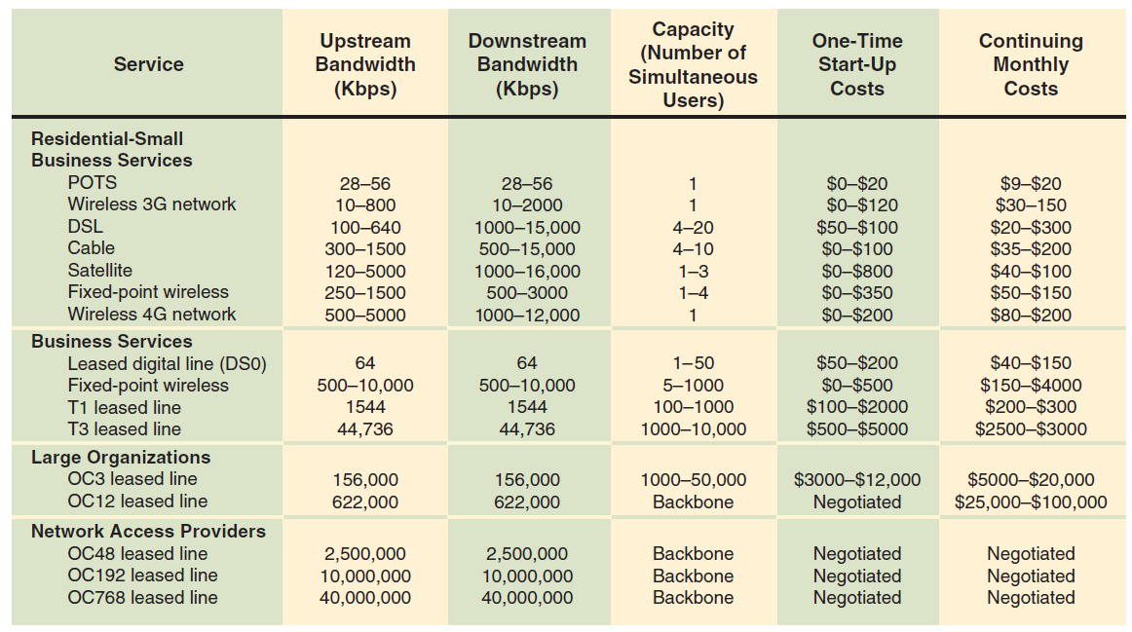
© Cengage Learning 2017
FIGURE 2-15 Internet connection options

Slide 67
Internet2 and the Semantic Web
Internet2 is an advanced research network created in 1996 as a replacement for ARPANET laboratory
Experimental networking technologies test bed
High end of the bandwidth spectrum (10 Gbps)
Used by universities, medical schools, CERN
Focus: mainly technology development

Slide 68
Internet2 and the Semantic Web (cont’d.)
Semantic Web project has a goal of blending technologies and information
Web pages tagged (using XML) with meanings
Uses software agents (intelligent programs) to read XML tags, determine meaning of words
Resource description framework (RDF)
Set of XML syntax standards
Development of Semantic Web will take many years
Start with ontologies for specific subjects

