Slide 1
CHAPTER 3
Selling on the Web
© 2017 Cengage Learning®. May not be scanned, copied or duplicated, or posted to a publicly accessible website, in whole or in part, except for use as permitted in a license distributed with a certain product or service or otherwise on a password-protected website or school-approved learning management system for classroom use.
.
Notes:
1

Slide 2
Learning Objectives
In this chapter, you will learn about:
What a revenue model is and how companies use various revenue models
What characteristics identify specific revenue models
How some companies experiment with alternative revenue models to achieve success
About revenue strategy choices that companies face when selling online

Slide 3
Learning Objectives (cont’d.)
How to create an effective business presence on the Web
What factors enhance Web site usability
How companies use the Web to connect with customers
3
Notes:
3

Slide 4
Introduction
Given the demand for photo and video storage, offering storage service would seem like an ideal online business
Decreasing cost of storage space and high-bandwidth Internet connections.
Many businesses do offer free or low-cost services
Digital storage and Internet connections are commodities, so it would be difficult for any of them to compete as the lowest-cost provider.
Competition will be on features offered, not cost.

Slide 5
Introduction (cont’d.)
In 2015, Google launched Google Photos
Designed to provide the most wanted features
Google’s developers combined technical capabilities with research on how customers interact with technology
By combining their technology with customer information, development team could enable the service to organize photos automatically

Slide 6
Revenue Models for Online Business
Web business revenue-generating models
Web catalog
Digital content
Advertising-supported
Advertising-subscription mixed
Fee-based
Same model can work for both sale types
Business-to-consumer (B2C)
Business-to-business (B2B)

Slide 7
Web Catalog Revenue Models
Adapted from mail-order (catalog) model
Seller establishes brand image
Printed information mailed to prospective buyers
Orders placed by mail or phone
Expands traditional model
Replaces or supplements print catalogs
Orders placed through Web site
Creates additional sales outlet for existing companies

Slide 8
Discount Retailers: Getting a Great Deal Online
Some discounters began as retail operations online, e.g., Buy.com which is now Rakuten
Borrowed low-cost strategy used by traditional discount retailers
Traditional retailers now using Web catalog revenue model: Costco, Kmart, and Walmart
All have found online sales to be important to overall revenues and profits

Slide 9
Using Multiple Marketing Channels
Allows more customers to be reached at a lower cost
Marketing channel examples
Physical stores
Web sites
Mailed catalogs or newspaper insert

Slide 10
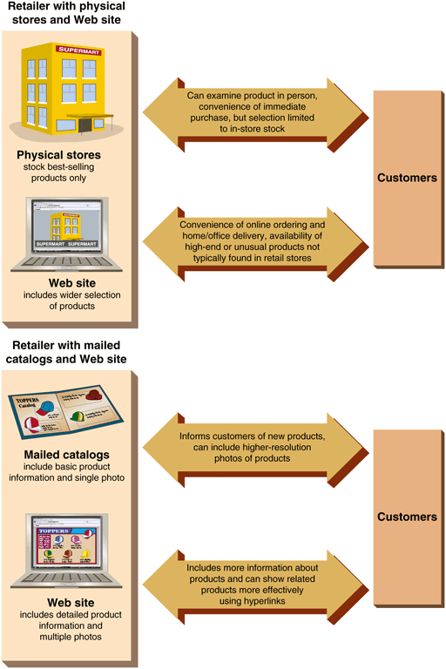
© Cengage Learning 2017
FIGURE 3-1 Combining marketing channels: Two retailer examples
10

Slide 11
Adding the Personal Touch
Many adapted catalog sales model to Web
Display clothing photos categorized by type
Prices, sizes, colors, and tailoring details
Want customers to examine clothing online and place orders through Web site
Lands’ End online Web shopping assistance
Lands’ End Live (1999)
Some sites offer text and video chat

Slide 12
Adding the Personal Touch (cont’d.)
Personal shopper is an intelligent agent program that learns preferences and makes suggestions
Virtual model
Graphic image built from customer measurements that allows customers to try clothes
Increased sales and decreased returns for companies that use virtual fitting rooms
Problem with varying computer monitor color settings
Solutions: Send fabric swatch on request and/or offer generous return policies

Slide 13
Fee-for-Content Revenue Models
Firms owning written information or information rights
Embrace the Web as a highly efficient distribution mechanism
Use the digital content revenue model
Sell rights to access information they own
Legal, academic, business and technical content
LexisNexis: offers variety of information services for lawyers and law enforcement officials
Subscriptions and individual access rights to online academic journals and other publications

Slide 14
Fee-for-Content Revenue Models (cont’d)
Academic information aggregation services
Purchase and resell rights in subscription packages to schools, libraries, companies, and not-for-profit institutions
Electronic books are available from several providers in various formats
Sales grew rapidly starting in 2011 and have now declined to about 23% of total book sales in the U.S. but popularity growing in other countries
Physical and electronic books will coexist for years to come

Slide 15
Online Music
Recording industry slow to embrace
Largest stores: Amazon MP3, Apple’s iTunes, Google Play
Subscription services to stream music
Pandora Internet Radio, Spotify, Rhapsody
Early complications
No single store offers all music
Individual stores promote their own music file formats
Some artists/recording companies partner with specific store or boycott online sales altogether

Slide 16
Online Music (cont’d.)
Digital Rights Management (DRM) software
Intended to curtail music piracy
Amazon MP3 store
First to offer DRM-free MP3 format
Music industry
Reports increased sales in 2013 for the first time in 14 years

Slide 17
Online Video
Sold or rented and either downloaded or streamed
Past limitations were file size, cannibalizing other sales and technological barriers
Overcoming the issues
New technologies improving delivery
Companies incorporating online distribution into revenue strategy
Video delivery technologies becoming transparent
Many pay and free providers including Netflix, Amazon, Hulu, HBO, Showtime and YouTube

Slide 18
Advertising-Supported Revenue Models
Used by United States broadcast network television
Provides free programming and advertising messages
Supports network operations sufficiently
Online advertising challenges
Difficulty measuring and charging site visitor views
Keeping visitors at site and attracting repeat visitors (stickiness) to expose to them to more advertising
Obtaining large advertiser interest
Requires demographic information collection
Characteristics set used to group visitors

Slide 19
Advertising-Supported Revenue Models (cont’d.)
Can obtain large advertiser interest by:
Using a specialized information Web site
Draw a specialized audience advertisers want to reach
Examples: The Huffington Post, the Drudge Report and HowStuffWorks
Web portal (portal) is a site used as a launching point to enter the Web
Almost always includes a Web directory or search engine and often includes other features
Web directory is a list of hyperlinks to Web pages

Slide 20
Advertising-Supported Revenue Models (cont’d.)
General interest strategy
Examples: Yahoo!, Google, Bing
Presents search term-triggered advertising on each page
Specific knowledge domain
Examples: C-NET and Kayak
Targeted advertising
20

Slide 21
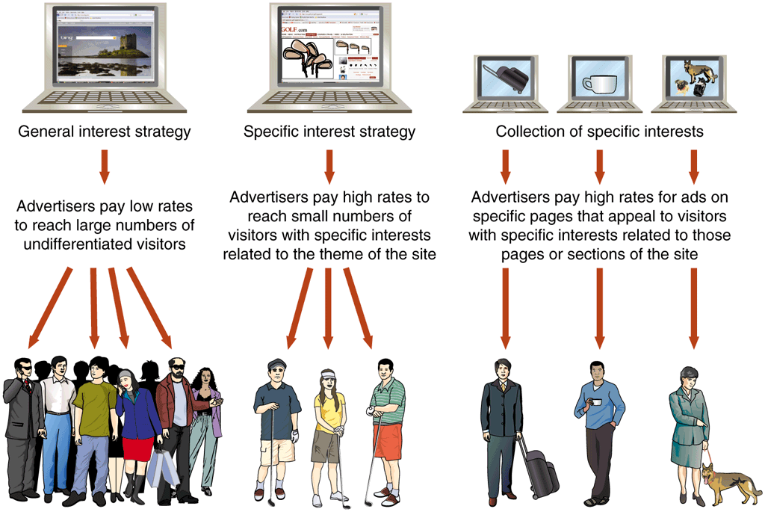
© Cengage Learning 2017
FIGURE 3-2 Three strategies for an advertising-supported revenue model

Slide 22
Advertising-Supported Newspapers
Newspapers or magazines publish online version of print content
Sell advertising to cover Web site costs
Newspaper’s Web presence
Provides greater exposure and advertising audience
Can divert sales from the print edition
Mixed-revenue model
Some content free, other content for purchase
Paywall is the point at which fees begin

Slide 23
Advertising-Supported Online Classified Ad Sites
Targeted classified advertising sites can command higher rates than general advertising
Growth of classified advertising Web sites such as Craigslist has been very bad for newspapers
Web employment sites have been the most successful targeted classified advertising category
Examples: CareerBuilder.com, and Monster.com
Used vehicle sites such as AutoTrader.com
Similar sites take paid advertising from individuals and companies to sell cars, motorcycles and boats

Slide 24
Advertising-Subscription Mixed Revenue Models
Subscribers pay fee and accept limited advertising
Varying levels of success
Examples: Wall Street Journal and New York Times
ESPN leverages brand name from cable TV
Sells advertising; offers free information and also collects subscription revenue for its Insider service
Consumers Union (ConsumerReports.org)
Subscription-supported site with no advertising
Provides some free information to attract subscribers and fulfill mission

Slide 25
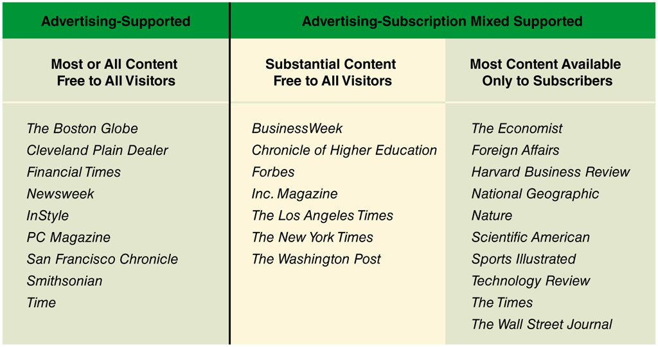
© Cengage Learning 2017
FIGURE 3-3 Revenue models used by online editions of newspapers and magazines
25

Slide 26
Fee-for-Transaction Revenue Models
Service fee charged based on transaction number or size
Web site offers visitor transaction information and services formerly provided by a human agent
Disintermediation occurs when an intermediary (human agent) is removed from the value chain
Reintermediation is the introduction of a new intermediary (fee-for-transaction Web site) into a value chain

Slide 27
Stock Brokerage Firms: Two Rounds of Disintermediation
Original full-line brokers charged relatively high commissions and provided free advice
1970s: Deregulation resulted in discount brokers
Fast trades, low commissions, no advice
1990s: New online firms took business from discount brokers
Firms such as Etrade offered advice and fast, low cost trade execution
Brokerage firms that survived the 2008 financial criris and remain today do most of their business online

Slide 28
Insurance Brokers
Quotesmith began business in 1984 as a policy-quoting service for independent brokers
Begin offering Internet policy price quotes directly to public (1996) and disintermediated independent insurance agents
The General (General Automobile Insurance Services) Web site provides options for those who have trouble getting insured
Successful in this niche of the market
Most major companies offer information and policies for sale on their websites

Slide 29
Event Tickets
Web allows event promoters to sell tickets from one virtual location to customers worldwide
Established agencies like Ticketmaster earn a fee on every ticket sold
Web created secondary ticket market (StubHub)
Brokers connecting ticket owners with buyers
Earn fees on tickets resold for others, buy ticket blocks
Easy-to-find central marketplace, facilitating buyer-seller negotiations

Slide 30
Online Banking and Financial Services
No physical product so easy to offer on Web
Slow to take off due to concerns about security
Trust has increased and 84% of U.S. households use online banking services
Existing banks started offering services online and new online banks started that had no bank affiliation
Less costly to provide services online
Features offered online
Bill presentment service
Account aggregation tools

Slide 31
Travel
Traditional travel agency revenue model was receive fee for facilitating a transaction
Online travel sites generate revenue through
Commissions, buying and selling airline seats and hotel rooms, and advertising
Traditional travel agents squeezed out
Surviving smaller travel agency strategies
Specialize in cruises with very successful websites
Reintermediation strategy focuses on specific groups of travelers

Slide 32
Automobile Sales
Firms such as Edmunds.com provide information service to car buyers
Customer selects specific car, site determines price and finds local dealer willing to sell OR
Firm locates local dealers willing to sell car at a small premium over dealer’s nominal cost
Buyer purchases car without negotiating with salesperson
Firms are disintermediating individual salespeople and reducing transaction cots
Web site: new intermediary (reintermediation)

Slide 33
Real Estate and Mortgage Loans
Brokerage firms and individual real estate brokers use Web sites to solicit business
Most real estate brokers have strong online presence including information on properties
National Association of Realtors site (Realtor.com)
No online transactions but joins buyers with sellers
2008 financial crisis dramatically reduced number of mortgage brokers in business
Several continue to do business online
Industry is resistant to disintermediation caused by online technologies

Slide 34
Fee-for-Service Revenue Models
Increasing variety of fee-based Web services
Fee based on service value and range from games and entertainment to financial advice and professional services
Growing number of online game sites that relied on advertising in the past now have premium games
Sold and downloaded or subscription fee
“Hook and pay” strategy offers limited game for free and small fee for additional game play
Fastest growing segment is development of games to be played as apps on mobile devices

Slide 35
Fee-for-Service Revenue Models – Professional Services
State laws prohibit some practices on the Web
Patients or clients may set appointments online and some professionals do online consultations
Patient/client privacy concerns
Law on the Web offers legal consultations to United Kingdom residents
CPA and lawyer directories available online in U.S.
Many Websites provide general health information and some now offer online mental health services
Some conditions easier to treat online

Slide 36
Free for Many, Fee for a Few
Economics of manufacturing
Different for physical and digital products
Unit cost high percentage of physical products
Unit cost very small for digital products
Leads to a different revenue model
Offer basic product to many for free
Charge a fee to some for differentiated products
Examples: Yahoo e-mail accounts
Inverse logic applied to physical products: free samples to entice sales (cookie samples)

Slide 37
Changing Strategies: Revenue Models in Transition
Companies must change revenue model to meet needs of new and changing Web users
Some companies created e-commerce Web sites
Needed many years to grow large enough to become profitable (CNN and ESPN)
Some companies changed model or went out of business
Case studies of strategies that evolved from experience and adaptations to change

Slide 38
Subscription to Advertising-Supported Model
Slate magazine started as an upscale news and current events site
Success expectations were high
Experienced writers and editors
Begin charging an annual subscription fee after a limited free introductory period
Subscription fees did not cover operating costs
Now an advertising-supported site and part of the Bing portal
Likely value to Microsoft is increase to the portal’s stickiness

Slide 39
Advertising-Supported to Advertising-Subscription Mixed Model
Salon.com
Acclaimed for innovative content
Initially operated as an advertising-supported site
Needed additional money to continue operations
Now offers optional subscription version
Annual fee for Salon Core (premium)
Free of advertising
Additional content
Downloadable content

Slide 40
Advertising-Supported to Subscription Model
Northern Light search engine includes a database
Results include Web site links and abstracts of its owned content
Initial revenue source advertising-supported model plus a fee-based information access service
Advertising revenue was insufficient to cover service
Converted to new subscription-supported revenue model with subscriptions to large corporate clients
Main products today include Business News, Discovery, SinglePoint and MI Analyst Text Analytics

Slide 41
Multiple Changes to Revenue Models
Encyclopedia Britannica initial Web offerings (1994)
Britannica Internet Guide was free
Encyclopedia Britannica Online has a subscription fee or was offered as part of the CD package but subscription fees were low
Converted to free advertiser-supported site (1999)
Advertising revenues insufficient to generate profit
Returned to mixed model in 2001
Subscriptions are the major revenue source with additional revenue from online product store sales

Slide 42
Multiple Changes to Revenue Models (cont’d.)
New York Times Web site started as the mid 1990’s as purely advertising supported
Subscription fee for premium crosswords, chess column and archived articles
2005: Additional content required subscription
2007: Return to advertising-supported free access
2011: Complex mixed revenue model
2012: Announced apparent success of new model
Hope mixed revenue model will provide acceptable balance between print and online to keep the newspaper operating

Slide 43
Channel Conflict and Cannibalization
Concerns that Web sales activities will take away sales from existing outlets and networks
In 2000 Levi stopped selling products online because of channel conflict and cannibalization
Have started online sales again due to agreement that Web sales are insignificant
Provides Store Links for those who prefer to shop in person
Maytag stopped online sales and now provides information and links to retailers

Slide 44
Channel Conflict and Cannibalization (cont’d.)
Eddie Bauer was selling through catalogs and retail stores when it started selling on the Web
Online purchases returnable at retail stores
Required manager compensation and bonus plans adjustments to support Web site
Retail managers credited for each Web site returned
Catalog managers credited for existing customers who purchased through Web site
Overall sales increased through the coordinated efforts
Channel cooperation made it successful

Slide 45
Strategic Alliances
Two or more companies join forces to undertake an activity over long time period
Relationship Levi’s created with retail partners
Amazon.com has formed several strategic alliances
Target to sell clothing
CDnow to sell music CDs
Many smaller companies to offer their products for sale on the Amazon Web site

Slide 46
Luxury Goods Strategies
Products can be difficult to sell online
Customers want to see product in person or touch
Brands hesitated selling online for fear of alienating upscale physical stores that sold products
Some sites limit online offerings
Chanel only offers fragrance and skincare only
Calvin Klein only sells ready-to-wear on Web site
Jewelry sales have grown rapidly in recent years
Blue Nile, Ice.com, and Costco are successful due to availability of independent appraisal certificates and “No questions asked” return policies

Slide 47
Overstock Sales Strategies
Selling overstock items as clearance specials on Web sites have allowed retailers like Lands’ End to close some of its physical outlet stores
Many retail Web sites include link to separate sections for overstock or clearance items
Online store reaches more people than a physical store with frequent updates possible
Websites such as Overstock.com are devoted entirely to the sale of overstocked items purchased from other retailers
© 2017 Cengage Learning®. May not be scanned, copied or duplicated, or posted to a publicly accessible website, in whole or in part, except for use as permitted in a license distributed with a certain product or service or otherwise on a password-protected website or school-approved learning management system for classroom use.
47

Slide 48
Creating an Effective Business Presence Online
Public image conveyed to stakeholders
Stakeholders include customers, suppliers, employees, stockholders, neighbors, and general public
Most companies not concerned about image until they grow to a significant size
Effective Web presence critical even for smallest and newest Web operating firms

Slide 49
Identifying Web Presence Goals
Business physical space focuses on very specific objectives
Not image driven
Must satisfy many business needs
Often fails to convey a good presence
Web business sites intentionally create distinctive presences
Good Web site design provides effective image-creation/ image-enhancing features

Slide 50
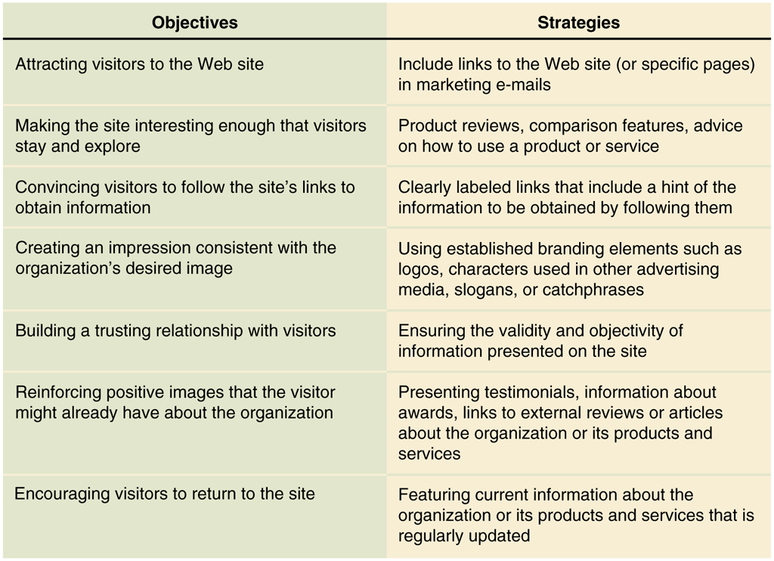
© Cengage Learning 2017
FIGURE 3-5 Web presence objectives and strategies

Slide 51
Making Web Presence Consistent with Brand Image
Different firms, even within the same industry, establish different Web presence goals
Coca Cola Web site pages usually include trusted corporate image (Coke bottle)
Pepsi Web site pages contain hyperlinks to activities and product-related promotions
Web presence conveys image company wants to present
Most auto manufacturers’ Web sites convey a consistent brad image
51

Slide 52
Not-For-Profit Organizations
Web sites’ key goals is information dissemination
Successful site key elements
Integrate information dissemination with fund-raising
Provide two-way contact channel
American Civil Liberties Union (ACLU)
Serves many different constituencies
Web sites used to stay in touch with existing stakeholders and identify new opportunities for serving them

Slide 53
Web Site Usability
Few businesses accomplish all goals with current Web presences
Most fail to provide visitors sufficient interactive contact opportunities
Can improve Web presence by making sites accessible to more people and easier to use
Web sites needs to encourage visitors’ trust and foster feelings of loyalty toward the organization

Slide 54
How the Web is Different
Simple mid-1990s Web sites conveyed basic business information
No market research conducted to determine what visitors wanted or infrastructure needs
Failure to understand how Web differs from other presence-building media continues as a reason why businesses do not achieve Web objectives
Web sites designed to create an organization’s presence include links to standard information set
Success dependent on how this information offered

Slide 55
Varied Motivations of Web Site Visitors
Visitors arrive for many different reasons including
Learning about company products or services
Buying products or services
Obtaining warranty, service, and repair policy information
Obtaining general company information
Obtaining financial information
Identifying people and obtaining contact information
Following a link for related information
Addressing needs helps convert visitors into customers

Slide 56
Making Web Sites Accessible
Need to build interface flexibility options
W3C Accessibility Initiative site offers useful links regarding disabilities
Good site design lets visitors choose among information attributes
Controversial Web site design issues
Adobe Flash software use which cannot be rendered in HTML and do not work on Apple iPhones/iPads
Some specific tasks do lend themselves to animated Web pages

Slide 57
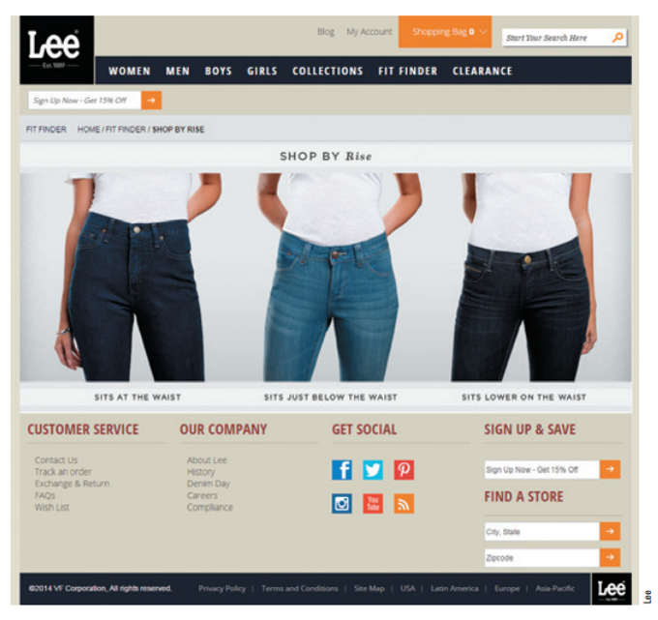
FIGURE 3-6 Lee® Jeans FitFinder Flash animation

Slide 58
© Cengage Learning 2017
FIGURE 3-7 Accessibility goals for business Web sites

Slide 59
Trust and Loyalty
5% increase in customer loyalty can yield profit increases of 25% to 80%
Service element can be a powerful differentiating factor customers will pay extra for
Delivery, order handling, help selecting product, and after-sale support
Repeated satisfactory service builds customer loyalty
Customer service weaknesses
No integration between call centers and Web sites
Growing disappointment in e-mail responsiveness

Slide 60
Usability Testing
Testing/evaluation of Web site to ensure ease of use by visitors
Avoids Web site frustration (difficulty and confusion) where customers leave site without buying anything
Simple site usability changes can increase customer satisfaction and sales
Contact information and call center staffing
Focus groups provide info about customer needs
Usability testing cost is low compared to Web site design costs

Slide 61
Customer-Centric Web Site Design
Important part of successful electronic business operation
Focus on meeting all site visitors’ needs
Guidelines for site design and access
Makes visitors’ Web experiences more efficient, effective, memorable
Special considerations for mobile devices
Web designers should create sites focused on customer buying process rather than company’s perspective

Slide 62
The Nature of Communication on the Web
Communication modes
Personal contact (prospecting) model
Employees individually search for, qualify, and contact potential customers
Mass media delivers messages by broadcasting them to potential customers
Addressable media are advertising efforts directed to known addressee
Internet occupies a central space in the continuum of media choices

Slide 63
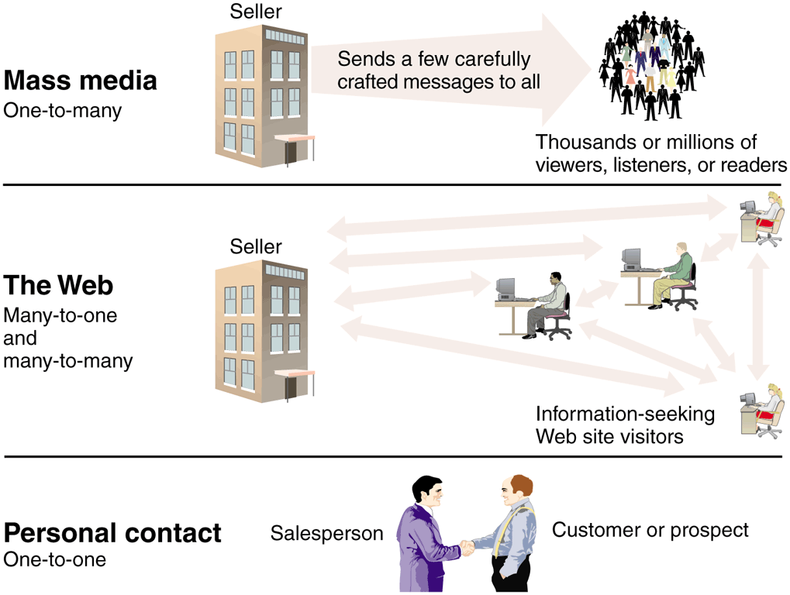
© Cengage Learning 2017
FIGURE 3-9 Business communication modes

Slide 64
The Nature of Communication on the Web (cont’d.)
Characteristics of communication modes
Mass media: one-to-many communication model
Seller is active; buyer is passive
Personal contact: one-to-one communication model
Interchange in framework of existing trust relationship
The Web: one-to-one, many-to-one, and many-to-many communication models
Buyer as active participant in determining length, depth, and scope of search

