Slide 1
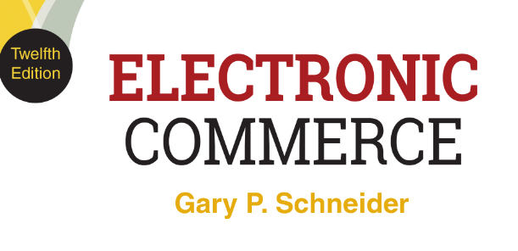
CHAPTER 4
Marketing on the Web
© 2017 Cengage Learning®. May not be scanned, copied or duplicated, or posted to a publicly accessible website, in whole or in part, except for use as permitted in a license distributed with a certain product or service or otherwise on a password-protected website or school-approved learning management system for classroom use.
.
Notes:
1

Slide 2
Learning Objectives
In this chapter, you will learn:
How firms use product-based and customer-based marketing strategies
Strategies for communicating with different market segments
To identify customer’s characteristics as they move through the customer relationship life cycle
How online advertising has developed and grown
2
2
Notes:
2

Slide 3
Learning Objectives (cont’d.)
About e-mail marketing strategies
About technology-enabled customer relationship management
How to create and maintain brands on the Web
How businesses use social media in viral marketing campaigns
About search engine positioning tactics and domain name selection strategies
3
3
Notes:
3

Slide 4
Introduction
When household products were purchased primarily by women, ads depicting the father as inept might have made sense
Men now take a larger role in these decisions and companies have turned away from adverting that makes a joke of men’s experiences
In 2012 Kimberly-Clark faced a firestorm of criticism for portraying men as incompetent caregivers
Company now regularly engages with “dad-focused” social media outlets and participates in the annual Dad 2.0 Summit

Slide 5
The Four Ps of Marketing
Product is the physical item or service sold
Brand is the customers’ product perception
Price is amount customer pays for product
Customer value is customer benefits minus total cost
Promotion includes any means to spread word about product
Place (distribution) is the need to have products or services available in many different locations
Getting right products to the right places at the best time to sell them
5
5
Notes:
5

Slide 6
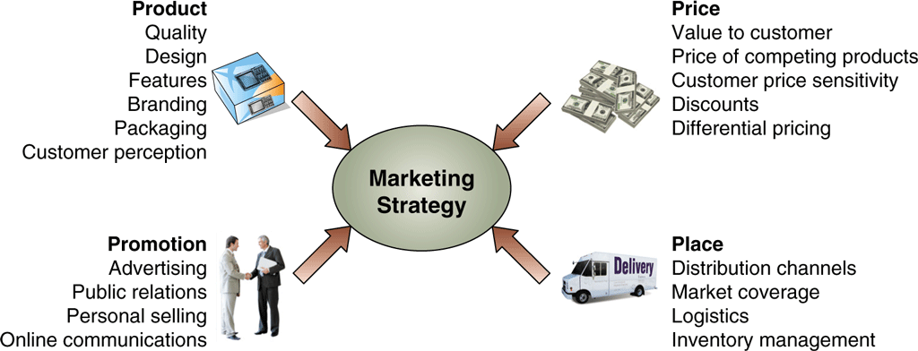
© Cengage Learning 2017
FIGURE 4-1 The four Ps of marketing contribute to marketing strategy

Slide 7
Product-Based Marketing Strategies
Managers often think in terms of products and services sold
Works well when customers think of needs in terms of product categories
Web site examples: Office Depot, Staples, Sears
Not an efficient Web site design when customers look to fulfill a specific need
Design Web site to meet individual customer needs
Offer alternative shopping paths
7

Slide 8
Customer-Based Marketing Strategies
Web sites designed to meet various types of customers’ specific needs
Initial step is to identify customer groups sharing common characteristics (demographic)
Make site more accessible and useful for each group
Companies need to take view beyond internal perspective
Current university Web sites focus design on needs of stakeholders (current students, prospective students, parents of students, potential donors, faculty)
8

Slide 9
Communicating with Different Market Segments
Media selection or choosing where to market and advertise a company can be critical for an on-line only firm
No physical presence
Only customer contact made through image projected through media and Web site
Online firm challenge is to obtain customer trust with no physical presence
9

Slide 10
Trust, Complexity, and Media Choice
The Web is a very broad, intermediate step between mass media and personal contact
Web communication offers advantages of personal contact selling with mass media cost savings
Mass media advertising offers lowest trust level but many companies still use it successfully
Product complexity is a factor in media choice
Many companies use blogs to communicate
Blogs and social media allow companies to engage in two-way communications that more closely resemble the high-trust personal contact communication mode
10

Slide 11
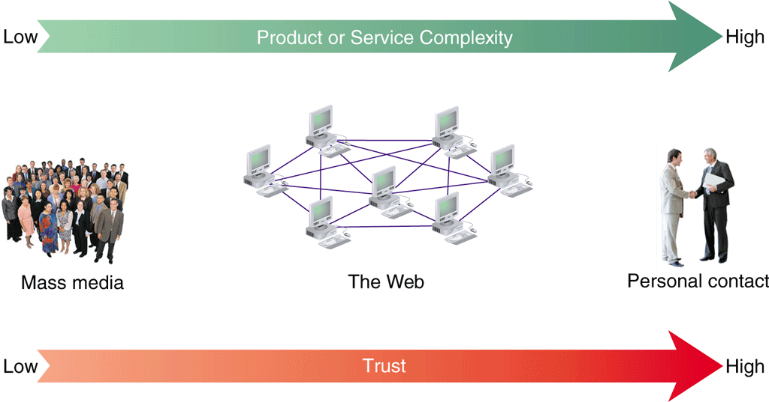
© Cengage Learning 2017
FIGURE 4-2 Trust in three communication modes
11

Slide 12
Market Segmentation
Divides potential customer pool into segments defined by customer characteristics
Micromarketing is the practice of targeting very small market segments
Hampered by cost increases
Three categories to identify market segments
Geographic segmentation
Demographic segmentation
Psychographic segmentation
Television advertisers use all three categories
12

Slide 13
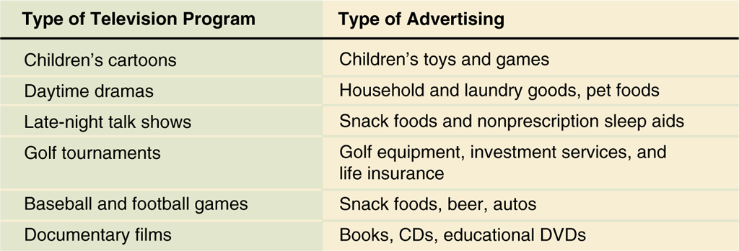
© Cengage Learning 2017
FIGURE 4-3 Television advertising messages tailored to program audience
13

Slide 14
Market Segmentation on the Web
Web presents an opportunity for different store environments online
Juicy Couture site targets young, fashion-conscious buyers while Talbots site targets older, more established buyers
Retail stores have limited floor and display space
Must convey one particular message
Web stores can provide separate virtual spaces for different market segments
14

Slide 15
Offering Customers a Choice on the Web
One-to-one marketing offers products and services matched to needs of a particular customer
Example: Dell
Offers several different ways to do business
Home page links for each major customer group
Specific products, product categories links available
Dell Premier accounts
High level of customer-based market segmentation
15

Slide 16
Segmentation Using Customer Behavior
Same person requires different combinations of products and services depending on the occasion
Behavioral segmentation is the creation of separate customer experiences based on behavior
Called occasion segmentation when based on things happening at a specific time or occasion
Much easier in the online world to design a single Web site that meets the needs of visitors in different behavioral modes
Customizing visitor experiences to match site usage or visitor type is usage based market segmentation
16

Slide 17
Browsers
Some visitors just surf or browse sites
Web site must offer something to pique visitors’ interest
Trigger words prompt visitors to stay and investigate products or services
Links to explanations or instructions helpful for this type of visitor
Include extra content related to products and services
Visitors who develop a favorable impression are more likely to buy or bookmark site for a return visit
17

Slide 18
Buyers
Ready to make a purchase right away
Site should offer a direct route into purchase transaction
Shopping cart is the part of the Web site that keeps track of items selected for purchase and automates purchasing process
Page should offers link back into shopping area and allow shoppers to create an account
Primary goal is to get buyer to shopping cart as quickly as possible
18

Slide 19
Shoppers
Motivated to buy but looking for more information before purchase
Offer comparison tools, product reviews, and features lists
Person may visit a Web site one day as a brower and return later as a shopper or buyer
People do not retain behavioral categories from one visit to the next even for the same Web site
19

Slide 20
Alternative Models
McKinsey & Company’s six behavior-based categories
Simplifiers (convenience)
Surfers (find information, explore new ideas, or shop)
Bargainers (search for good deals)
Connectors (stay in touch with other people)
Routiners (return to same sites over and over)
Sportsters (spend time on sports, entertainment sites)
Must identify groups and formulate ways of generating revenue
20

Slide 21
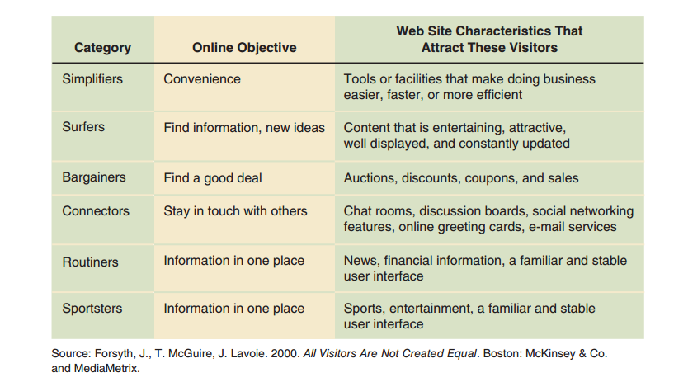
FIGURE 4-4 Web site visitor categories based on a behavioral segmentation study
21

Slide 22
Customer Relationship Intensity and Life-Cycle Segmentation
One-to-one marketing and usage-based segmentation strengthen companies’ relationships with customers
Good customer experiences create feelings of intense loyalty
Typical five-stage model of customer loyalty
First four stages show increase in relationship intensity: awareness, exploration, familiarity, commitment
In the fifth stage (separation), decline occurs and the relationship terminates
22

Slide 23
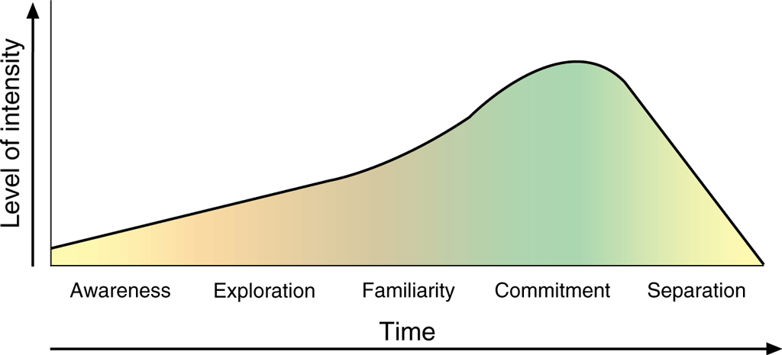
© Cengage Learning 2017
FIGURE 4-5 Five stages of customer loyalty
23

Slide 24
Customer Relationship Intensity and Life-Cycle Segmentation (cont’d.)
Touchpoints are online and offline customer contact points
Goal of providing similar levels and quality of service at all touchpoints is touchpoint consistency
Characteristics of the five stages
Awareness: customers recognize company name, product
Exploration: customers learn more about company, products

Slide 25
Customer Relationship Intensity and Life-Cycle Segmentation (cont’d.)
Characteristics of the five stages (cont’d.)
Familiarity
Customers have completed several transactions
Customers aware of returns and credits policies
Customers aware of pricing flexibility
Customers just as likely to shop competitors
Commitment
Customers experience highly satisfactory encounters
Customers develop fierce loyalty or strong preference
25

Slide 26
Customer Relationship Intensity and Life-Cycle Segmentation (cont’d.)
Characteristics of the five stages (cont’d.)
Separation
Conditions that made relationship valuable change
Parties enter separation stage
Goal is to move customers into the commitment stage as quickly as possible and keep them there as long as possible
Only want to see customers move into the separation stage if they are costing more to serve than they are worth
26

Slide 27
Customer Acquisition: The Funnel Model
Conceptual tool used to understand the overall nature of a marketing strategy
Also provides a clear structure for evaluating specific strategy elements
Similar to customer life-cycle model but less abstract
Better job at showing effectiveness of two or more specific strategies
27

Slide 28
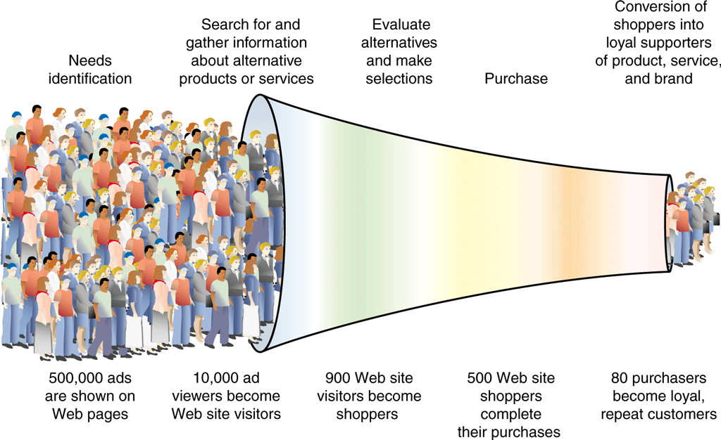
© Cengage Learning 2017
FIGURE 4-6 Funnel model of customer acquisition
28

Slide 29
Costs of Customer Acquisition, Conversion, and Retention
Benefits of acquiring new visitors are different for Web businesses with different revenue models
Acquisition cost is the amount of money spent to bring one customer to the site
Conversion is converting a visitor into a customer
Conversion cost is the total amount of money a site spends to induce a visitor to purchase, subscribe or register
Retained customers return to site after purchase
Retention cost is the cost of inducing customers to return to a Web site and buy again

Slide 30
Advertising on the Web
Can use five-stage customer loyalty model
Awareness stage: message should inform
Exploration stage: message should explain how product works and encourage switching brands
Familiarity stage: message should convince customers to purchase products or request a call
Commitment stage: message should reinforce good feelings and remind customers to buy
Separation stage customers not targeted in ads
Online ads should be coordinated with existing advertising efforts
30

Slide 31
Display Ads
Small rectangular object with stationary or moving graphic also called banner ads
Includes hyperlink to advertiser’s Web site
Versatile: informative and persuasive functions
Attention-grabbing ads include audio and video
Created using Shockwave, Java, Flash
Interactive marketing unit (IMU) ad formats
Voluntary standard ad sizes
Universal ad package (UAP)
31

Slide 32
Display Ads (cont’d.)
Leaderboard ad is designed to span Web page top or bottom
Skyscraper ad is designed to be placed on the side of a Web page
Remains visible as user scrolls through page
Two sizes of rectangle ads
Advertising agencies and web site design firms create display ads for online clients
Price range $50 to more than $8000 depending on complexity
32

Slide 33
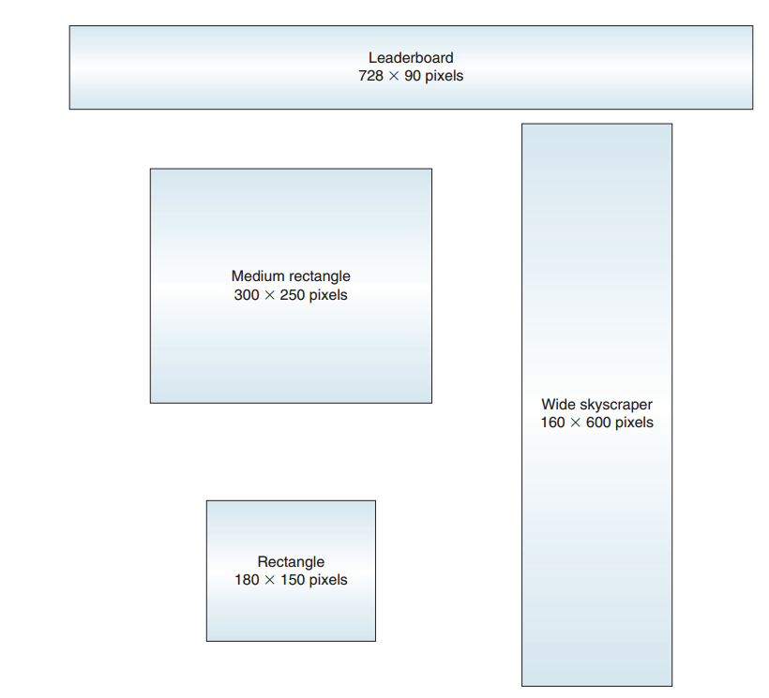
© Cengage Learning 2017
FIGURE 4-7 Interactive Advertising Bureau Universal Ad Package format standards
33

Slide 34
Display Ad Placement
Use an ad exchange network which coordinates ad sharing
Find Web sites appealing to company’s market segments and pay sites to carry ad
Most companies use an ad agency to negotiate rates and help with ad placement
Use a display advertising network as a broker between advertisers and Web sites that carry ads
Large networks such as DoubleClick (Google) offer may of the same services as ad agencies
34

Slide 35
New Strategies for Display Ads
Click through rates .3 to .5 percent
Research suggests Web site visitors are influenced by ads they don’t click but advertisers reluctant to pay for ads that don’t produce measurable results
Approaches
Animated GIFs with moving elements
Display rich media effects (video clips)
Add interactive effects (Java programs) that respond to user’s click with some acton
Ads appearing to be dialog boxes
35

Slide 36
© Cengage Learning 2017
FIGURE 4-8 Disguised display ads
36

Slide 37
Intrusive Ad Formats
Pop-up ad appears in its own window when user opens/closes Web page and require the user to click a small close button in the window of the ad
Annoying and may create lasting bad will, but many advertisers find them to be effective
Ad-blocking software prevents display ads and pop-up ads from loading
Interstitial ads open in their own browser page when a user clicks to load a page
May close automatically or require user to close
Larger and more annoying than pop-up ads
37

Slide 38
Rich Media and Video Ad Formats
Generate graphical activity that “floats” over the Web page itself
Always contain moving graphics and usually include audio and video elements
Video ads are a form of rich media ad used on Web sites that deliver video
Either free standing or integrated into videos the site visitor selects to watch
A pre-roll video ad requires a visitor to view all or part of an ad before the content selected plays
Most video ads are 10 to 30 seconds long
38

Slide 39
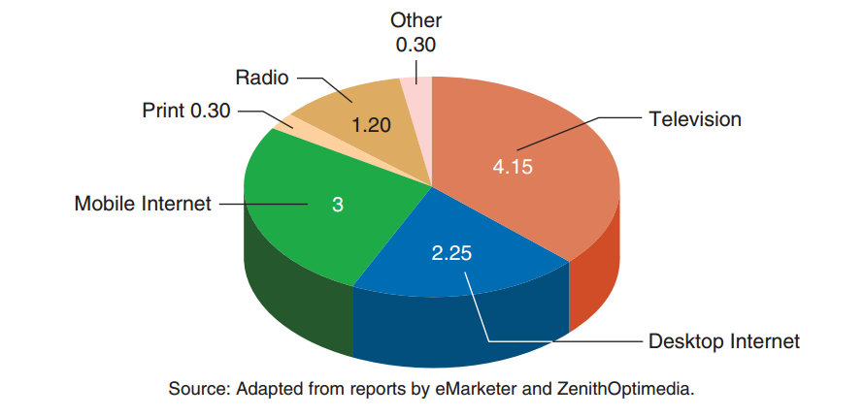
© Cengage Learning 2017
FIGURE 4-9 Average time spent (hours per day) with various media, 2016 population estimates
39

Slide 40
Text Ads
Short promotional message with no graphic elements
Usually placed along Web page top or right side
Google found these ads to be less obtrusive than display ads but very effective
Criticized for including unobtrusive ads on its pages, Google now clearly labels ads to prevent confusion
Inline text ad are text in stories displayed as hyperlinks
40

Slide 41
Mobile Device Advertising
Tremendous usage growth for mobile devices connected to Internet
Some mobile software applications (mobile apps) include advertising element
Messages displayed from advertisers
Part of the app screen or in a separate screen
Mobile apps’ advertising space marketed in same way as Web sites’ banner advertising

Slide 42
Site Sponsorships
Web sites offer advertisers opportunity to sponsor all (or parts) of their sites
More subtle way of promoting products
Goals similar to sporting event sponsors, television program sponsors
Tie company (product) name to an event (set of information)
Ethical concerns raised if sponsor allowed to create content or weave advertising into site’s content
Should always be clearly identified as advertisement
42

Slide 43
Online Advertising Cost and Effectiveness
Issue of measuring Web site effectiveness has become important
Pricing metric is cost per thousand (CPM) for mass media advertising
“M” from Roman numeral for “thousand”
Dollar amount paid for every thousand people in the estimated audience
Cost per click (CPC) is an alternative to CPM
Charge is for click
43

Slide 44
Online Advertising Cost and Effectiveness (cont’d.)
Visit is when visitor requests a page from a Web site
Trial visit is the first time a particular visitor loads a Web site page
Repeat visit is subsequent page loads
Each page loaded by visitor counts as a page view
If page contains an ad, called an ad view
Some Web pages have display ads that load
Each time the display ad loads is an impression
If visitor clicks the display ad, action is a click or click-through
44

Slide 45
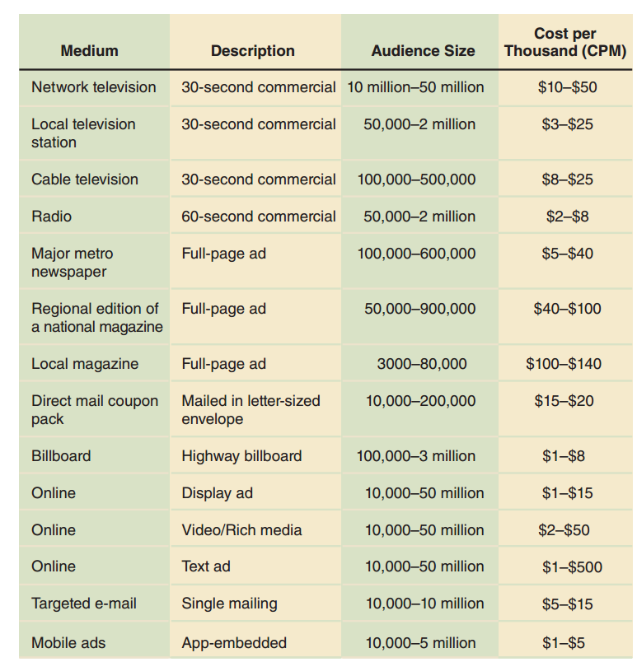
© Cengage Learning 2017
FIGURE 4-10 CPM rates for advertising in various media
45

Slide 46
Online Advertising Cost and Effectiveness (cont’d.)
Difficult for companies to gauge the cost and benefits of advertising on the Web
Many have developed new metrics to evaluate the number of desired outcomes advertising yields
Number of new visitors who buy for the first time after arriving via a click-through can be used to calculate advertising cost of acquiring a customer on the Web
Most analysts agree that online advertising is much more effective if properly targeted
46

Slide 47
E-Mail Marketing / Unsolicited Commercial E-mail (UCE, Spam)
Can be a powerful element of advertising strategy
Used to announce new products or features
Used to announce sales on existing products
Unsolicited Commercial E-mail (UCE, Spam, bulk mail) is electronic junk mail
Includes solicitations, ads or e-mail chain letters
Wastes time, disk space, and consumes large amounts of Internet capacity
Key element to avoid engaging in spam
Obtain customer approval prior to sending
47

Slide 48
Permission Marketing
Conversion rate is the percentage of recipients responding to an ad or promotion
Ranges from 10% to more than 30% on requested e-mail messages
Opt-in e-mail is the practice of sending e-mail messages to people who request information
Part of permission marketing strategy
Example companies: ConstantContact, Yesmail, Return Path
48

Slide 49
Combining Content and Advertising
Using articles, news stories of interest to specific market segments increases acceptance of e-mail
Advertisers send content by using hyperlinks inserted into e-mail messages
Takes customers to advertiser’s Web site content
Easier to induce customer to stay on the site and consider making purchases
Coordination across media outlets is an important element in any marketing strategy
Other marketing efforts undertaken at the same time should be consistent with the e-mail’s message
49

Slide 50
Outsourcing E-Mail Processing
Number of customers opting in to information-laden e-mails can outgrow capacity of an information technology staff
An e-mail processing service provider will manage an e-mail campaign at cost of 1-5 cents per address
Many companies will also help clients purchase lists of e-mail addresses from companies that compile lists
50

Slide 51
Technology-Enabled Customer Relationship Management
Clickstream is the information that a Web site can gather about its visitors
Technology-enabled relationship management occurs when firm obtains information on customer behavior, preferences, needs and buying patterns to
Set prices, negotiate terms, tailor promotions, add product features, customize customer relationship
Also called Customer relationship management (CRM), technology-enabled customer relationship management or electronic customer relationship management (eCRM)
51

Slide 52
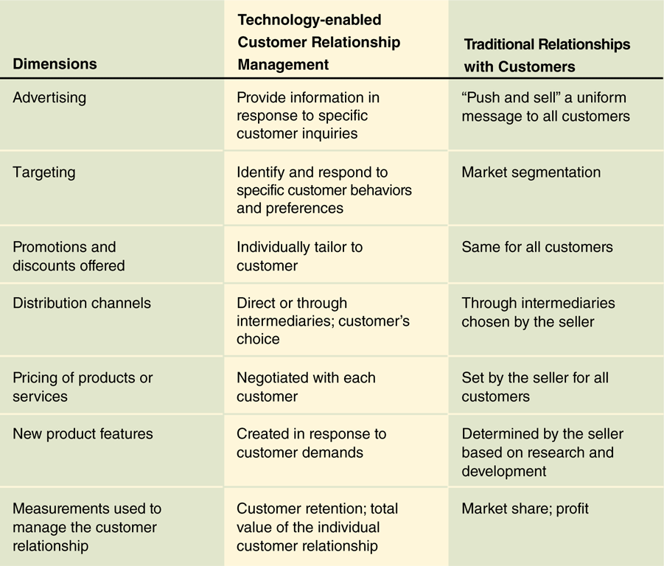
© Cengage Learning 2017
FIGURE 4-11 Technology-enabled relationship management
and traditional customer relationships
52

Slide 53
CRM as a Source of Value
Marketspace is commerce in the information world
Value creation requires different processes in the marketspace
Information itself a source of value
Use information to create new value for customers
Should provide customized, value-added digital products and services in the marketspace
Early CRM systems failed due to being overly complex and requiring too much staff time
Recently, companies have had more success with systems that are less ambitious
53

Slide 54
CRM as a Source of Value (cont’d.)
Good CRM systems gather information from every customer touchpoint
Multiple sources of information about customers, their preferences, their behavior is entered into a large database called a data warehouse
Data mining (analytical processing) examines stored information and looks for patterns
Statistical modeling is a technique that tests CRM analysts’ theories about relationships among customer and sales data elements
54

Slide 55
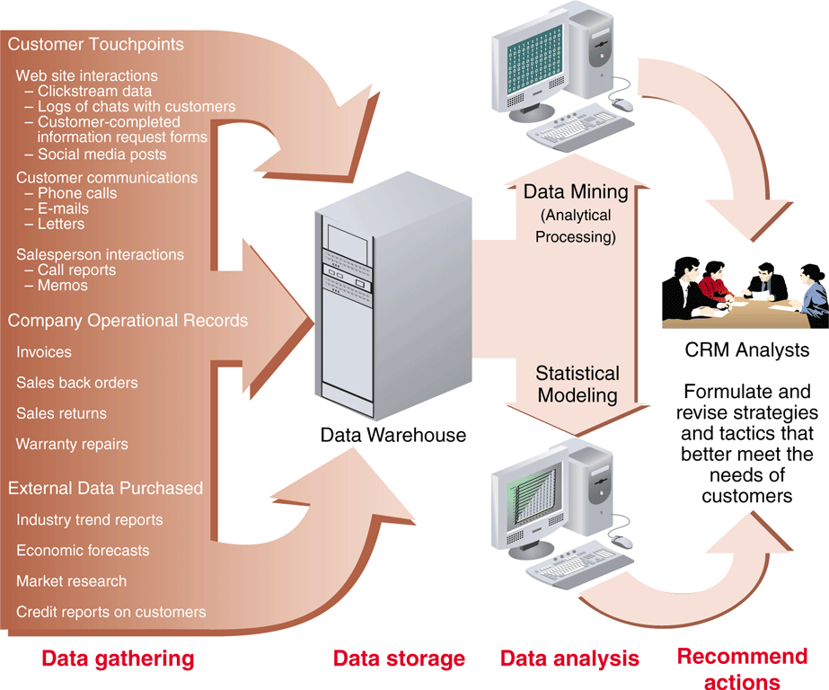
© Cengage Learning 2017
FIGURE 4-10 Elements of a typical CRM system
55

Slide 56
Creating and Maintaining Brands on the Web / Elements of Branding
Branded products easier to advertise and promote
Each product carries reputation of the brand name
Value far exceeds cost of creating them
Three key brand elements
Product differentiation clearly distinguishes product
Relevance is degree to which product offers utility to a potential customer
Perceived value (key element) occurs when customer perceives a value in buying product
Environmental changes cause brands to lose value
56

Slide 57
© Cengage Learning 2017
FIGURE 4-13 Elements of a brand
57

Slide 58
Emotional Branding vs. Rational Branding
Emotional appeals work well on television, radio, billboards and print
Ad targets in passive information acceptance mode
Difficult to convey on Web which is an active medium controlled by customer
Rational branding offers to help Web users in some way in exchange for viewing an ad
Relies on cognitive appeal of specific help offered
58

Slide 59
Affiliate Marketing Strategies
One firm’s Web site (affiliate site) includes descriptions, reviews, ratings, other information about a product linked to another firm’s site that offers the item for sale
Affiliate site receives a commission for every visitor who follows a link to the seller’s site
Affiliate saves expense of handling inventory, advertising and promoting product, transaction processing
Amazon.com was one of the first to create a successful affiliate marketing program on the Web
59

Slide 60
Affiliate Commissions / Cause Marketing
Pay-per-click pays commission each time a visitor clicks the link and loads the seller’s page
Pay-per-conversion pays when visitor becomes a qualified prospect or customer
Affiliate program broker serves as a clearinghouse for sites interested in affiliate programs
Cause marketing benefits a charitable organization
Affiliate site created to benefit charity
Sponsoring company makes a donation when a visitor clinks a link
Higher click-through rates than typical ads
60

Slide 61
Viral Marketing Strategies and Social Media
Viral marketing relies on existing customers to tell prospective customers about products or service
BlueMountain Arts electronic greeting cards include a link to the greeting card site
Social media marketing is best done using an indirect approach
Encourage community to discuss the desirability of a product or service
Web site followers on a company’s discussion activity are called fans
61

Slide 62
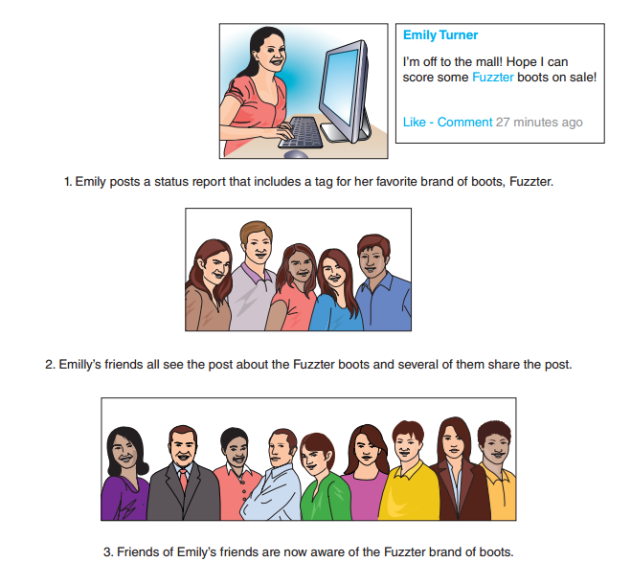
© Cengage Learning 2017
FIGURE 4-14 Viral marketing through social media
62

Slide 63
Search Engine Positioning and Domain Names
Ways that potential customers find Web sites
Referral by a friend
A link on a referring Web site
Referral by an affiliate marketing partner
Site’s URL in print advertisement, television
Unintentional visit after mistyping similar URL
Use of a search engine or directory Web site
63

Slide 64
Search Engines and Web Directories
Web site that helps people find things on the Web
Spider (crawler, robot, bot) program automatically searches Web for potentially interesting Web pages
Index (database) is the storage element
Search utility takes search terms entered by visitors and finds matching Web page entries
Search engine ranking uses factors to decide which URLs appear first on searches for a search term
Search engine positioning (optimization, placement) is the art and science of having a particular URL listed near the top of a search engine
64

Slide 65
Paid Search Engine Inclusion and Placement
Paid placement (sponsorship, search term sponsorship) offers the option of purchasing a top listing on results page for a particular search term
Another option is to buy display ad space at the top of search results pages that include certain terms
Search engine positioning is a complex subject
Some sites use search engine placement brokers to sell ads and Google uses their AdWords program
Contextual advertising is ads placed in proximity to related content and localized advertising is ads related to location on search results
65

Slide 66
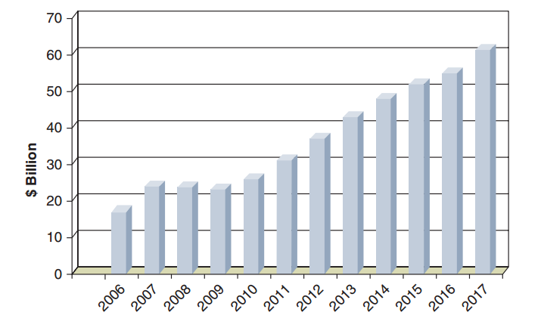
FIGURE 4-15 U.S. online advertising expenditures, actual and projected
Source: Adapted from reports by ClickZ, eMarketer, Forrester Research, Nielsen, and Internet Retailer
66

Slide 67
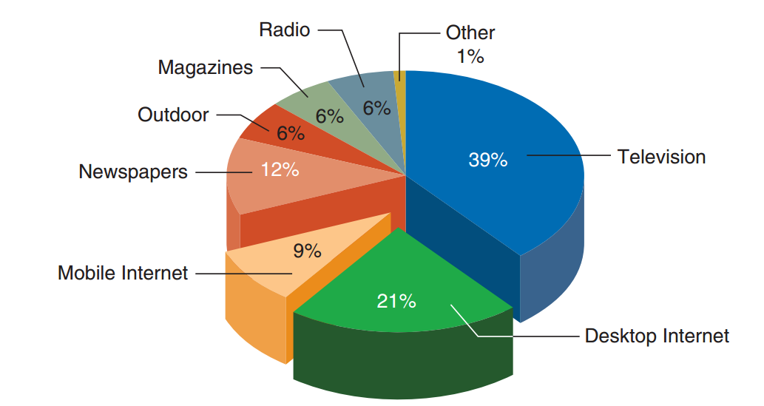
FIGURE 4-16 Global advertising expenditures by medium, 2016 estimates
Source: Adapted from reports by eMarketer, Nielsen, and ZenithOptimedia
67

Slide 68
Web Site Naming Issues
URLs should reflect company name or reputation
Important part of establishing Web presence
Troublesome domain names can lead to purchasing more suitable domain names
www.iflyswa.com changed to www.southwest.com
www.delta-air.com changed to www.delta.com
Companies often buy more than one domain name to ensure users find the intended site
Prevents problems due to misspelled words
Many companies have different names or forms of names associated with them
68

Slide 69
Buying, Selling, and Leasing Domain Names
Artuframe purchased the URL art.com and had a 30% increase in site traffic the next day
When company failed, the domain name was bought by another art company who had a 100% increase in site visitors the first month
Market for domain names continues to be active
Names that include general topic terms often bring high prices
Many invested in highly desirable domain names
Leasing the rights to domain names is an option that is usually done through URL brokers

Slide 70
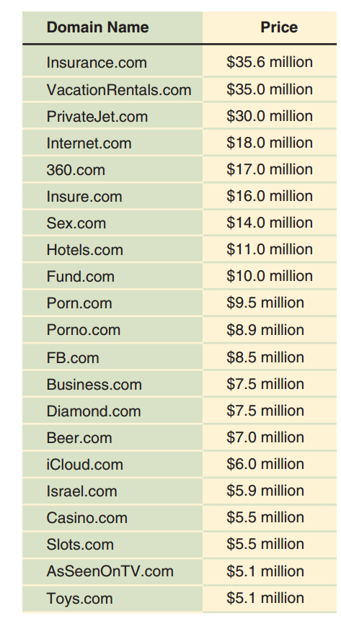
FIGURE 4-17 Domain names that sold for more than $5 million
© Cengage Learning 2017

Slide 71
URL Brokers and Registrars
Broker sell, lease, auction valuable domain names
Unissued or unused domain names can be purchased from a domain registrar
Internet Corporation for Assigned Names and Numbers (ICANN) maintains accredited registrars list
Registrars offer domain name search tools
Domain name parking (domain name hosting)
Service permitting domain name purchaser to maintain simple Web site so the domain name remains in use
Fees much lower than a typical Web site
71

