Slide 1
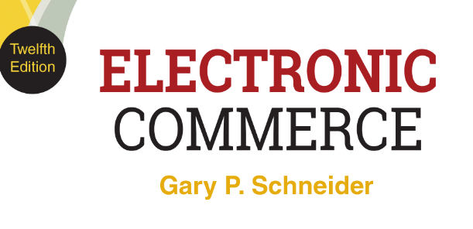
CHAPTER 5
Business-to-Business Activities: Improving Efficiency and Reducing Costs
© 2017 Cengage Learning®. May not be scanned, copied or duplicated, or posted to a publicly accessible website, in whole or in part, except for use as permitted in a license distributed with a certain product or service or otherwise on a password-protected website or school-approved learning management system for classroom use.
.
Notes:
1

Slide 2
Learning Objectives
In this chapter, you will learn:
How businesses use the Internet to improve purchasing, logistics, and other support activities
How the Internet facilitates implementation of outsourcing and offshoring business strategies
How electronic data interchange works and how it has evolved using Internet technologies
Notes:
2

Slide 3
Learning Objectives (cont’d.)
What supply chain management is and how businesses are using Internet technologies to improve it
How the various types of online business marketplaces operate to make B2B transactions easier and more efficient
3
Notes:
3
3

Slide 4
Introduction
After a year of working in Ghana teaching English, Leila Janah started Samasource in 2008
Links workers in developing countries with companies who need work done
Has lifted more than 6,500 African, Asian and Haitian workers above the poverty line
Cost-effective for businesses
Builds worker knowledge and skills in less developed countries and gives low-income workers in developed countries similar opportunities
Use of the Internet to do good around the world

Slide 5
Outsourcing and Offshoring
Outsourcing is using other organizations to perform specific activities
Typically used for manufacturing
Offshoring is outsourcing done by organizations in other countries
Business process offshoring includes purchasing, research and development, record keeping, information management
Impact sourcing (smart sourcing) is offshoring done by or through not-for-profit organizations

Slide 6
Purchasing Activities
Identify and evaluate vendors, select specific products, place orders, resolve any issues after receipt of goods or services
Supply chain is the part of industry value chain preceding a particular strategic business unit
Includes all activities undertaken by every predecessor in the value chain to design, produce, promote, market, deliver, support each individual component of a product or service
Traditionally purchasing department buys components at lowest price possible via bidding

Slide 7
Purchasing Activities (cont’d.)
Procurement includes all purchasing activities, monitoring all purchase transaction elements and managing and developing supplier relationships
Also called supply chain management
Procurement staff have high product knowledge to identify and evaluate appropriate suppliers
Sourcing is identifying suppliers and determining qualifications
e-sourcing is the use of Internet technologies in sourcing activities

Slide 8
Purchasing Activities (cont’d.)
Business purchasing process is more complex than most consumer purchasing processes
Spend is the total yearly dollar amount for goods and services purchased
Managing spend is an important function and can be a key component in overall profitability
Institute for Supply Management (ISM) is the main organization for procurement professionals

Slide 9
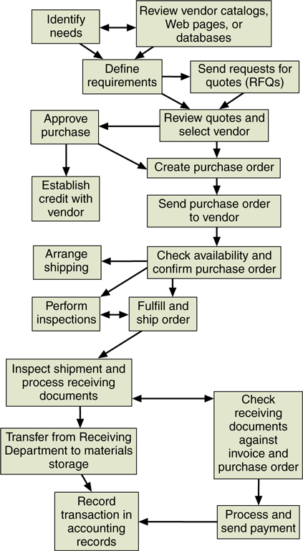
FIGURE 5-1 Steps in a typical business purchasing process
© Cengage Learning 2017

Slide 10
Direct vs. Indirect Materials Purchasing
Direct materials become part of finished product
Direct materials purchasing
Replenishment purchasing (contract purchasing)
Company negotiates long-term material contracts
Spot purchasing
Purchases made in loosely organized (spot) market
If demand exceeds contract purchasing estimates
Indirect materials are all other materials company purchases
Includes factory supplies and replacement parts for machinery

Slide 11
Direct vs. Indirect Materials Purchasing (cont’d.)
Maintenance, repair, and operating (MRO) supplies are indirect materials purchased on a recurring basis
Standard items (commodities) with price as main criterion
Purchasing cards (p-cards) allow managers to make multiple small purchases with cost-tracking information sent to procurement
Leading suppliers
MRO: McMaster-Carr, W.W. Grainger,
Office Depot, Staples, Digi-Key, Newark.com

Slide 12
Logistics Activities
Classic objective is to provide the right goods in the right quantities in the right place at the right time
Managing materials, supplies and finished goods
Web and the Internet providing increasing number of opportunities to better manage activities
Third-party logistics (3PL) provider operates a customer’s materials movement activities
Marriage of GPS and portable computing with the Internet is an example of second-wave e-commerce
Third-wave e-commerce supported by smart phones

Slide 13
Business Process Support Activities
Finance and administration, human resources (HR), technology development
Human resources, payroll, retirement plan servicing often outsourced by small/midsized companies
Common support activity is training
May be handled by HR or individual departments
Knowledge management is the intentional collection and classification; dissemination of information about a company and its products and processes
13

Slide 14
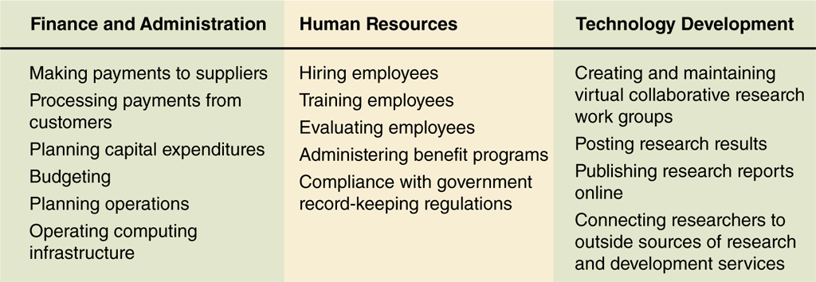
© Cengage Learning 2017
FIGURE 5-2 Categories of support activities

Slide 15
E-Government
Use of Internet technologies by governments and government agencies
Enhances functions performed for stakeholders and businesslike activity operations
U.S. government Financial Management Service (FMS) uses Pay.gov to handle activity
Bureau of Public Debt: TreasuryDirect site
Also used in other countries
U.S. states and cities usually have sites
Information about laws and regulations, licenses, jobs, tourism and more

Slide 16
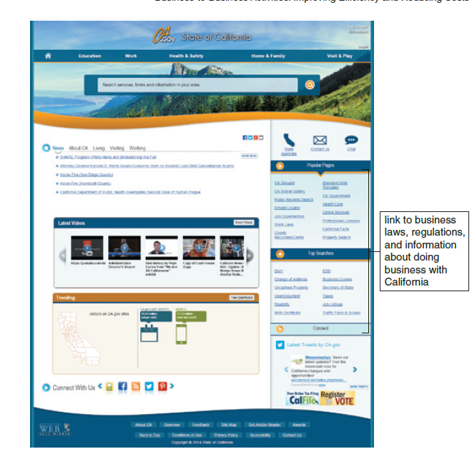
FIGURE 5-3 State of California portal site
© 2012 State of California

Slide 17
Network Model of Economic Organization in Purchasing: Supply Webs
Trend in purchasing, logistics, and support activities is the shift from hierarchical structures toward network structures
Procurement departments being given new tools to negotiate and possibly form strategic alliances
Supply Web is replacing the term “supply chain”
Parallel lines interconnect to form a Web or network configuration
Roots of Web technology for B2B transactions lie in a hierarchically structured approach to inter-firm information transfer: electronic data exchange

Slide 18
Electronic Data Interchange
Computer-to-computer business information transfer using a standard format
Businesses exchanging info are trading partners
EDI compatible firms exchange data in specific standard formats
Often transaction data but can include other information related to transactions
Most B2B e-commerce adapted from EDI or based on EDI principles
Dominant technology for electronic B2B transactions

Slide 19
Early Business Information Interchange Efforts
The need to create formal business transaction records began in the late 1800s and early 1900s
Companies were using computers for recording internal transactions by the 1950s
Information flows between companies on paper which was slow, inefficient, redundant and unreliable
In the 1960s businesses with volume transactions exchanged info on punched cards or magnetic tape
In the 1960s and 1970s technologies improved and intercompany information could be transferred over telephone lines

Slide 20
Early Business Information Interchange Efforts (cont’d.)
Information transfer agreements between trading partners increased efficiency but not ideal
Incompatible data translation limited participation
Freight and shipping companies joined together in 1968 to create a standardized information set
Used a computer file transmittable to any freight company adopting the standard
Benefits limited to members of industries that created standard-setting groups
Full realization of EDI economies and efficiencies required standards for all companies in all industries

Slide 21
Emergence of Broader Standards: The Birth of EDI
American National Standards Institute (ANSI) is the coordinating body for standards in the U.S.
Accredited Standards Committee X12 (ASC X12) develops and maintains EDI standards
Data Interchange Standards Association (DISA) is the administrative body coordinating ASC X12 activities
Transaction sets are names of the formats for specific business data interchanges
EDI for Administration, Commerce, and Transport (EDIFACT, or UN/EDIFACT)

Slide 22
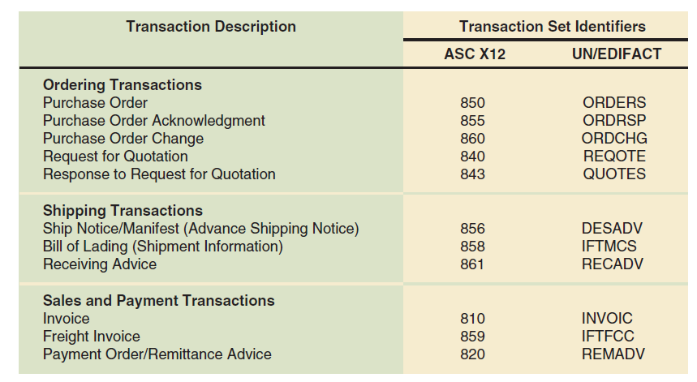
© Cengage Learning 2017
FIGURE 5-4 Commonly used EDI transaction sets

Slide 23
How EDI Works
Basic idea: straightforward
Implementation: complicated
Example:
Company replacing metal-cutting machine
Steps to purchase using paper-based system
Steps to purchase using EDI

Slide 24
Paper-Based Purchasing Process
Buyer and vendor not using integrated software for business processes so each information processing step results in paper document
Must be delivered to department handling next step
Paper-based information transfer
Mail, courier, fax
Information flows shown in Figure 5-5

Slide 25
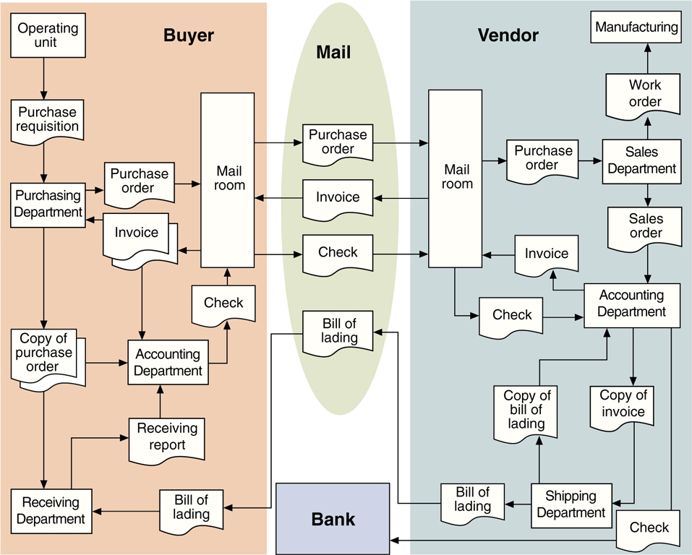
© Cengage Learning 2017
FIGURE 5-5 Information flows in a paper-based purchasing process

Slide 26
EDI Purchasing Process
Mail service replaced with EDI network data communications
Paper flows within buyer’s and vendor’s organizations replaced with computers running EDI translation software
Information flows shown in Figure 5-6

Slide 27
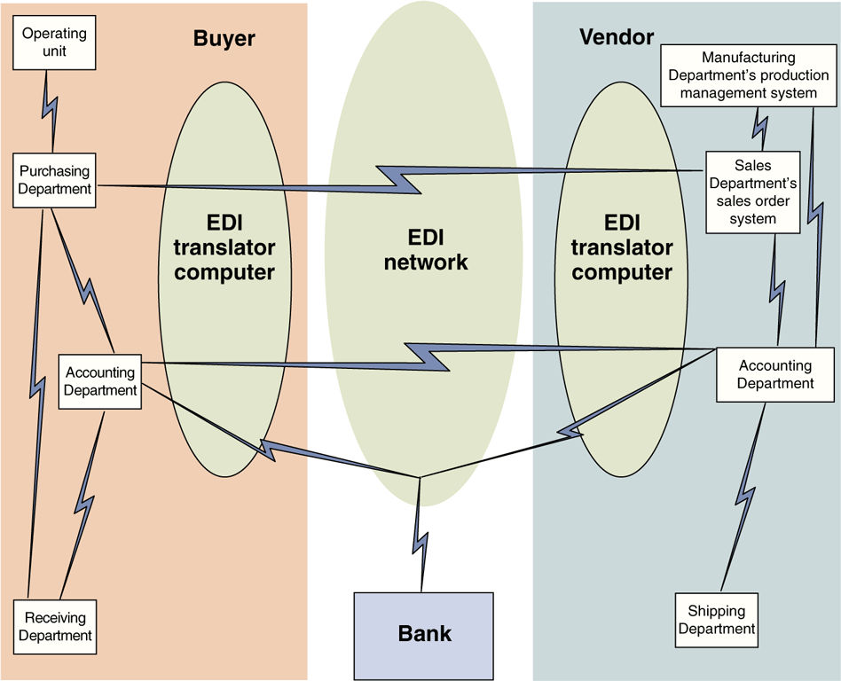
© Cengage Learning 2017
FIGURE 5-6 Information flows in an EDI purchasing process

Slide 28
Value-Added Networks
Trading partners can implement the EDI network and EDI translation processes in several ways
Each way uses one of two basic approaches
Direct connection EDI requires each business to operate its own on-site EDI translator computer
Connected directly to each other using leased lines
Few companies use direct connection EDI because dedicated leased lines are expensive

Slide 29
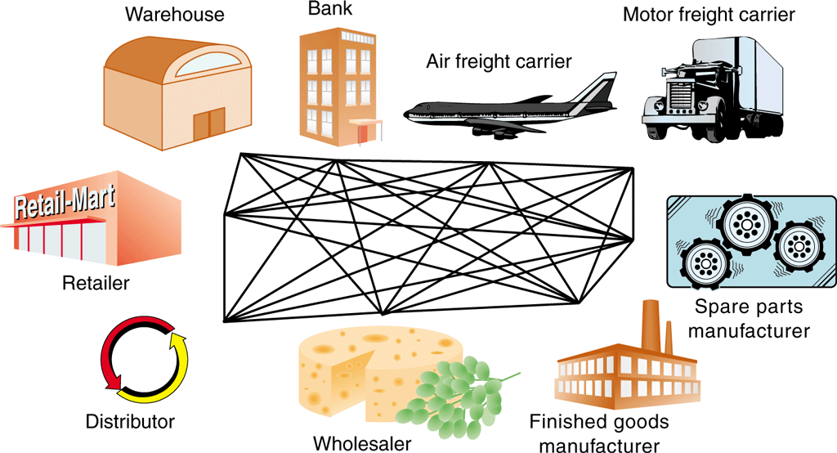
© Cengage Learning 2017
FIGURE 5-7 Direct connection EDI

Slide 30
Value-Added Networks (cont’d.)
Company may use a value-added network (VAN)
Receives, stores, forwards electronic messages containing EDI transaction sets
With indirect connection EDI trading partners use VAN to retrieve EDI-formatted messages
Must install compatible EDI translator software
Trading partners pass messages through the VAN instead of directly connecting computers
30

Slide 31
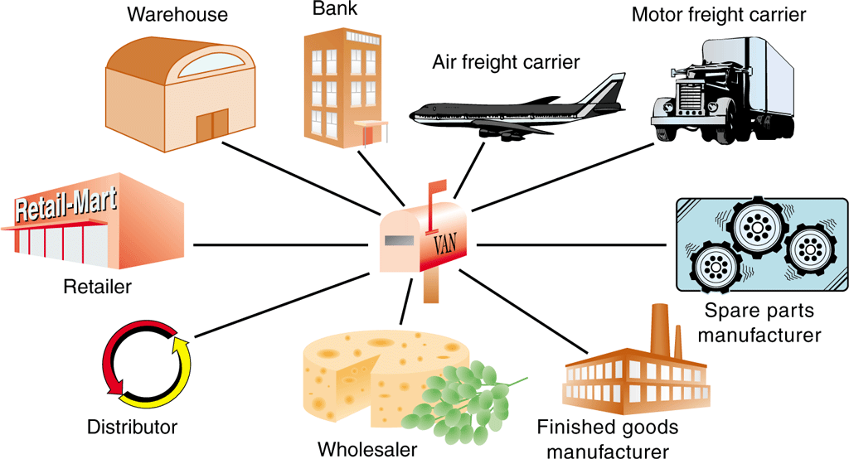
© Cengage Learning 2017
FIGURE 5-8 Indirect connection EDI through a VAN
31

Slide 32
Value-Added Networks (cont’d.)
Advantages of a VAN
Need to support one communications protocol and the VAN provides translation between different transaction sets
VAN performs automatic compliance checking and records message activity in an audit log
Helps establish nonrepudiation: ability to establish that a particular transaction actually occurred
Cost used to be a disadvantage, now much lower
Internet presents low-cost communications medium used by VAN services

Slide 33
Value-Added Networks (cont’d.)
EDI on the Internet called Internet EDI, Web EDI, or open EDI
Internet is open architect network
EDIINT (Electronic Data Interchange-Internet Integration, EDI-INT) is the most common protocol for Internet EDI transaction sets
EDI exchanges encoded using AS2 (Applicability Statement 2) or AS3 (Applicability Statement 3)
Secure electronic receipts returned to senders for every transaction which helps establish repudiation

Slide 34
EDI Payments
EDI transaction sets provide instructions to trading partner’s bank
Negotiable instruments, the electronic equivalent of checks
Electronic funds transfers (EFTs) is the movement of money from one bank account to another
Executed using an Automated clearing house (ACH) system which is used by service banks to manage accounts with each other
Operated by U.S. Federal Reserve Banks, private ACHs

Slide 35
Supply Chain Management Using Internet Technologies
Supply chain management is the job of managing integration of company supply management and logistics activities
Across multiple participants in a particular product’s supply chain
Ultimate goal is to achieve higher-quality or lower-cost product at the end of the chain

Slide 36
Value Creation in the Supply Chain
Engaging suppliers in cooperative relationships can lead to better, faster, cheaper service to customers
Company goes beyond its limits and creates a new network form among members of the supply chain
Use of technology to improve operational efficiency is supply chain competition
Can help implement management techniques
Just-in-time reduces inventory and lean production focus on eliminating waste and unnecessary processes
Originally developed as a way to reduce cost
Now adds benefits to the ultimate consumer

Slide 37
Value Creation in the Supply Chain (cont’d.)
Requires establishment of long-term relationship with a small number of capable tier-one suppliers
Tier-one suppliers develop relationships with tier-two suppliers who provide components and raw materials
Tier-three suppliers provide components and raw materials to tier-two suppliers
Key element is trust among the supply alliance
Buyers expect annual price reductions, quality improvements from suppliers at each stage
Ideally each level of supplier can share the benefits of reduced cost and more efficient operations

Slide 38
Value Creation in the Supply Chain (cont’d.)
Key coordination effort is a consistent production strategy adopted by all supply chain participants
How competitive advantage is achieved, such as efficient processing or market-responsive flexibility
Clear communications and quick response are key elements of successful supply chain management
Adaptive supply chain exists when company uses technology to quick respond to change in market demand and supplier conditions
Leads to higher efficiency, lower costs and greater profits

Slide 39
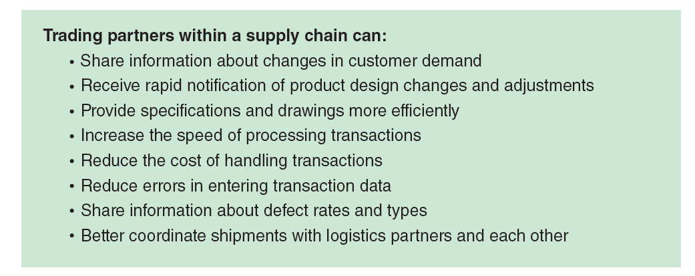
© Cengage Learning 2017
FIGURE 5-9 Advantages of using Internet technologies in supply chain management

Slide 40
Increasing Supply Chain Efficiency and Cooperation
Using Internet and Web technologies to manage supply chains can yield increases in efficiency and cooperation throughout the chain
Increase process speed, reduce costs, coordinate design effort and increase manufacturing flexibility
Allows response to changes in quantity and nature of ultimate consumer demand
Using Internet technologies, as Boeing and other firms do, to integrate the design, development, construction, testing, and refinement of products is called collaborative commerce

Slide 41
Materials-Tracking Technologies
Challenging task to track materials as they move from one company to another or within a company
Optical scanners and bar codes track movement of materials and integration with EDI is now prevalent
Manages inventory flows and forecasts materials needs across the supply chain
Real-time location systems (RTLS) are bar code tracking system used by fulfillment centers
Second wave of electronic commerce includes new types of tracking integrated with Internet-based materials-tracking systems

Slide 42
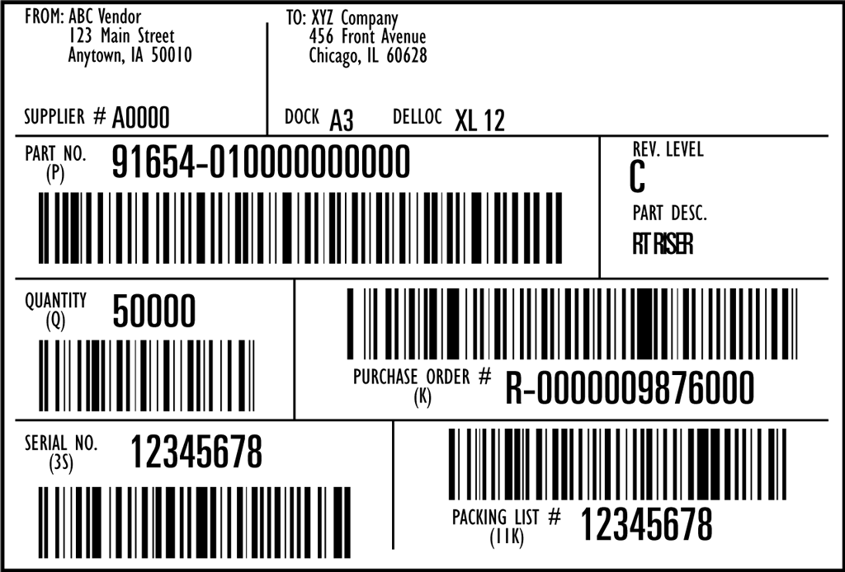
© Cengage Learning 2017
FIGURE 5-10 Shipping label with bar-coded elements from EDI transaction set 856, Advance Ship Notification

Slide 43
Materials-Tracking Technologies (cont’d.)
Radio Frequency Identification Devices (RFIDs)
Small chips using radio transmissions track inventory quicker and more accurately than bar codes
Active RFIDs have their own power supply
Passive RFID tags are inexpensive and small and do not need a power source
Goal is to help reduce lost sales from stockouts
Industry observers believe RFID tagging in retail will become widespread starting in 2017 when many retailers plans to have them in all locations

Slide 44
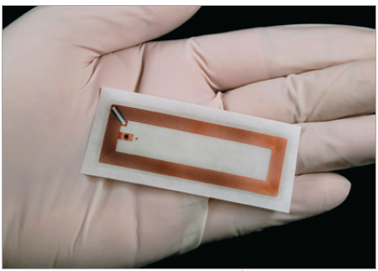
© Albert Lozano/Shutterstock.com
FIGURE 5-11 Passive RFID Tag

Slide 45
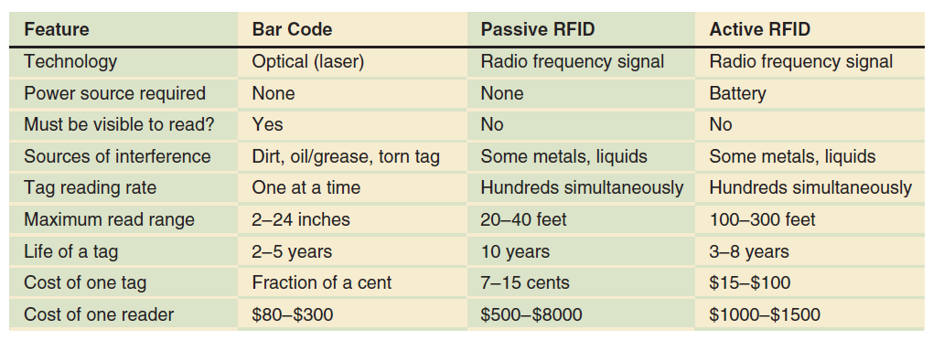
© Cengage Learning 2017
FIGURE 5-12 Key features of bar code, passive RFID, and active RFID technologies

Slide 46
Creating an Ultimate Consumer Orientation in the Supply Chain
One main goal of supply chain management is to help each company focus on meeting needs of consumer at the end of the supply chain
Ultimate consumer orientation difficult to maintain
Michelin North America pioneered use of Internet technology to go beyond next step in its value chain
1995: launched online business initiative BIB NET
Allowed dealer access to tire specifications, inventory status, and promotional information
Saved money for Michelin and gave dealers better service making them more likely to recommend tires

Slide 47
Building and Maintaining Trust in the Supply Chain
Major issue in forming supply chain alliances is developing trust
Key elements are continual communication and information sharing
Internet and the Web provide excellent ways to communicate and share information and offer new avenues for building trust
Provides easy, inexpensive contact with customers
Gives buyers instant access to sales representatives
Provides comprehensive information quickly

Slide 48
Online Business Marketplaces and Portals
Vertical portals are industry-focused hubs
Offer marketplaces and auctions for contact and business transactions
Doorway (or portal) to the Internet for industry members
Vertically integrated: each hub services just one industry

Slide 49
Independent Industry Marketplaces
First vertical portals were trading exchanges focused on a particular industry
Independent industry marketplaces
Industry marketplaces: focused on a single industry
Independent exchanges: not controlled by established buyer or seller in the industry
Public marketplaces: open to new buyers and sellers just entering the industry
Ventro opened industry marketplace Chemdex
Trade in bulk chemicals

Slide 50
Independent Industry Marketplaces (cont’d.)
By mid-2000s, more than 2200 independent exchanges
Today fewer than 100 industry marketplaces still operating due to lack of profitability
By 2010, various forms of B2B marketplace models gradually replaced independent marketplaces
In 2012 Amazon.com launched AmazonSupply that is now part of Amazon Business Marketplace
Google followed with Google Shopping for Suppliers, which was later folded into its Google Shopping site

Slide 51
Private Stores and Customer Portals
Large established sellers feared industry marketplaces would dilute their negotiating power
Many had already invested heavily in Web sites they believed would meet customer needs better
Password protected private stores for major customers with price reductions on some products
Customer portal sites offer private stores along with other services that would be needlessly duplicated in sellers participated in industry marketplaces

Slide 52
Private Company Marketplaces
Large companies purchasing from relatively small vendors exert power in purchasing negotiations
E-procurement software allows companies to manage purchasing function through Web interface
Automates authorizations, other steps and usually includes marketplace functions
When industry marketplaces opened for business, these large companies were reluctant to abandon their e-procurement software investment
Force suppliers to deal with them on their terms rather than negotiate with industry marketplace

Slide 53
Private Company Marketplaces (cont’d.)
Private company marketplace is a marketplace providing auctions, request for quote postings, other features similar to those of e-procurement software
Many have expanded to include functions allowing supply chain participants to manage multiple functions
Manufacturing, tier-one and tier-two suppliers, distribution centers, transportation, orders, invoicing and payment
Expanded arrangements are called private industrial networks or private trading exchanges

Slide 54
Industry Consortia-Sponsored Marketplaces
Some companies have strong negotiating positions but not enough power to force suppliers to deal with them through a private company marketplace
Industry consortia-sponsored marketplace is a marketplace formed by several large buyers in a particular industry
Characteristics of five general marketplace forms in B2B electronic commerce today
Shown in Figure 5-13

Slide 55
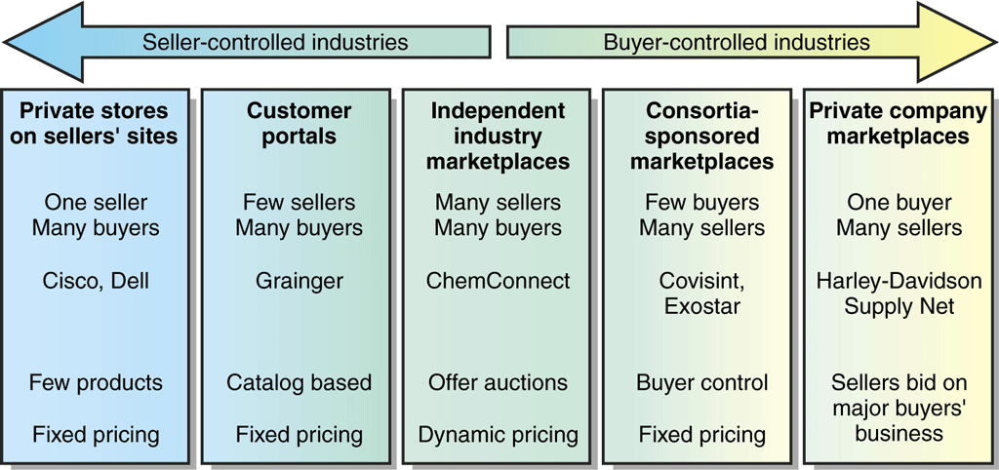
Adapted from: Raisch, W. 2001. The eMarketplce, p. 225
FIGURE 5-13 Characteristics of B2B marketplaces

