Slide 1
CHAPTER 6
Social Networking, Mobile Commerce, and Online Auctions
© 2017 Cengage Learning®. May not be scanned, copied or duplicated, or posted to a publicly accessible website, in whole or in part, except for use as permitted in a license distributed with a certain product or service or otherwise on a password-protected website or school-approved learning management system for classroom use.
.
Notes:
1

Slide 2
Learning Objectives
In this chapter, you will learn:
How social networking emerged from virtual communities
How social networking Web sites earn revenue
How companies use social networking tools in online business activities
About mobile technologies that are now used to do business online
How auctions and auction-related businesses are conducted online
2
Notes:
2

Slide 3
Introduction
Case study: Starbucks
Views social media as an extension of the customer relationship
Integrates mobile technology by accepting payments from mobile phones
Provides mobile device app to let customers manage loyalty program benefits
Serves as a social media observer rather than actively advertising

Slide 4
From Virtual Communities to Social Networks
Online Web communities are not limited by geography
Individuals and companies with common interests meet online and discuss issues, share information, generate ideas, and develop valuable relationships
Companies make money by serving as relationship facilitators
Combine Internet’s transaction cost-reduction potential with a communication facilitator role
4
4
Notes:
4
4

Slide 5
Virtual Communities
Virtual community is a gathering place for people and businesses with no physical existence
Began online even before the Internet was in use
Bulletin board systems (BBSs) allowed users to connect via phone lines to read and post messages
Mostly free, but some charged a fee
Usenet newsgroups were message posting areas a set of interconnected computers devoted to storing information on specific topics
Substantial social interaction with communication and relationships similar to physical communities
5

Slide 6
Early Web Communities
1985: WELL (“whole earth ‘lectronic link”)
Bought by Salon.com in 1999 and continues to operate as a monthly subscription service
1995: Beverly Hills Internet virtual community site
Offered webcams, free Web site space and links
Grew into GeoCities and purchased by Yahoo! in 1999 for $5 billion but closed in 2009
1995-2001: Other companies offered similar advertising-supported virtual communities
These early communities evolved into social networking sites that emerged in the late 1990s

Slide 7
Social Networking Emerges
As the Internet and Web grew many communities found their purpose as a place to share online communication began to fade
Instead of a single bond of using the Internet, users finding a variety of common interests for interaction
Social networking sites allow individuals to:
Create and publish a profile and a list of other users with whom they share a connection (or connections)
Control the list and monitor similar lists made by other users
7

Slide 8
Social Networking Emerges (cont’d.)
Early social networking sites included Six Degrees (1997), Friendster (2002), Tribe.net and MySpace
Facebook emerged in 2006 and overtook MySpace as the leading social network site worldwide
More than a billion users and $6 billion in revenues
Other sites include Google+, GREE (Japan), and Renren and QQ (China)
LinkedIn dedicated to facilitating business contacts
Twitter allows users send short messages (tweets) to other users who sign up to follow their messages
8

Slide 9
Social Networking Emerges (cont’d.)
Basic idea behind many social networking sites is that people are invited to join by existing members
Site provides directory (without contact information)
Communication does not occur until intended recipient approves the contact
Some social networks focused around specific interests or capabilities
Flickr, Pinterest, Instagram, CafeMom, Snapchat
The expansion of social networking sites into all corners of the world with successful sites in local languages emerging in many countries
9

Slide 10
© Cengage Learning 2017
FIGURE 6-1 Social networking Web sites

Slide 11
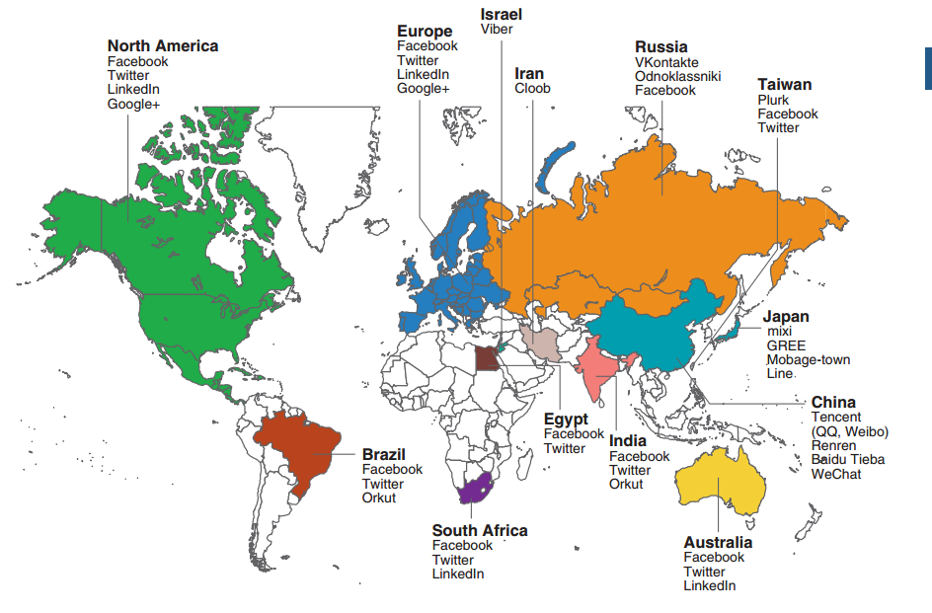
© Cengage Learning 2017
FIGURE 6-2 Leading social networking sites around the world

Slide 12
Web Logs (Blogs), Microblogs and Participatory Journalism
Web sites containing individual commentary on current events or specific issues
Form of social networking site
Twitter is a very informal microblog with tweets limited to 140 characters
Early blogs focused on technology topics or topics on which people had strong beliefs
The 2004 election saw blogs used as a political networking tool
Communicating messages, organizing volunteers, raising money, meetups
12

Slide 13
Web Logs (Blogs), Microblogs and Participatory Journalism (cont’d.)
Based on success of social media, retailers embraced blogs to engage visitors not ready to buy
Marketing and supply managers saw social networking benefits of enhancing B2B relationships
Participatory journalism is the trend towards having readers help write their own news
Blogs can become businesses in themselves
Must generate financial support (fees, advertising)
13

Slide 14
Location-Aware Mobile Social Networks
Traveling Internet connection opens up social media possibilities that integrate with a user’s specific location
Mobile devices transmit their location to Web sites
Sites use location information to provide customized advertising and other services
In 2015, about 35% of social media users tagged their posts with location info and 82% of mobile users obtained directions or other location information
Examples: Foursquare, Facebook, Google+

Slide 15
Business Uses of Social Networking
Businesses criticized for using social media interactions into thinly-disguised advertising
Experts agree social media should be managed differently than advertising efforts
Managed effectively, social media engagement can provide much more info about customers
Brooks Running contributes to social media discussions dedicated to fitness and does not sell products directly
Campbell’s Soup discussion areas focusing on what soup can do for the family

Slide 16
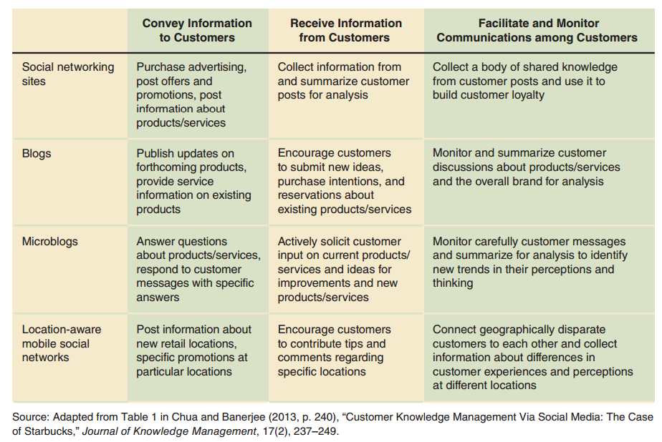
Figure 6-3 Social media strategies for business

Slide 17
Social Shopping Sites
Craigslist started as information resource for San Francisco residents
Expanded to other cities and several other countries
Operated as a not-for-profit foundation with all postings other than help-wanted ads free
Etsy is a place to buy and sell handmade items
Poshmark is devoted to women’s clothing and fashion accessories and optimized for mobile phone users

Slide 18
Idea-Based Social Networking
Social networking sites form communities based on connections among people
Abstract communities based on the connections between ideas are called idea-based social media
People who participate are engaging in idea-based social networking
The Delicious site calls itself a “social bookmarks manager”
18

Slide 19
Virtual Learning Networks
Distance learning platforms for student-instructor interaction (Blackboard)
Tools include bulletin boards, chat rooms, drawing boards
Massive Open Online Courses (MOOC) became widely known in 2012 with the formation of Coursera and Udacity
Many schools are launching MOOCs or using them in some way but issue with low completion rates (in some cases lower than 2%)
19

Slide 20
Open-Source Software
Some open-source software is devoted to development of virtual learning communities including Moodle and uPortal
Developed by a community of programmers who make it available at no cost
Other programmers use, work with and improve the software
Early and successful example of a virtual community we would now call a social network

Slide 21
Revenue Models for Social Networking Sites
Late 1990s revenue created by selling advertising
Used by virtual communities, search engine sites, Web directories
In 1998 a wave of purchases and mergers occurred
New sites used advertising-only revenue model
Included features offered by virtual community sites, search engine sites, Web directories, other information-providing and entertainment sites
Web portal goal: every Web user’s doorway to Web
21

Slide 22
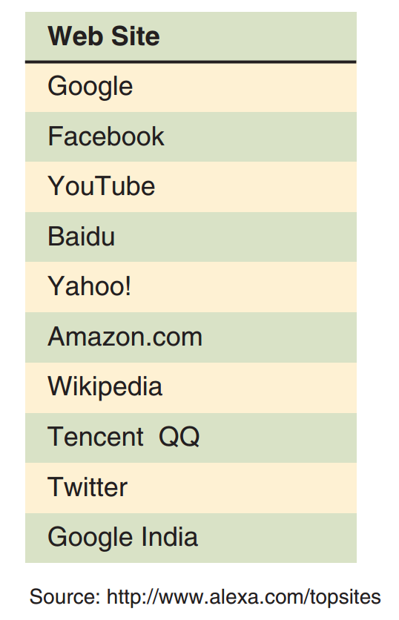
Figure 6-4 Popularity of leading Web sites

Slide 23
Advertising-Supported Social Networking Sites
Visitors spend more time at portal sites than other types of Web sites which is attractive to advertisers
Other types of social networking sites also draw visitors who spend considerable time at the site
Smaller sites with specialized appeal can draw enough visitors to generate significant advertising revenue
Example: I Can Has Cheezburger site
Figure 6-5 shows recent and projected worldwide social network spending on advertising
23

Slide 24
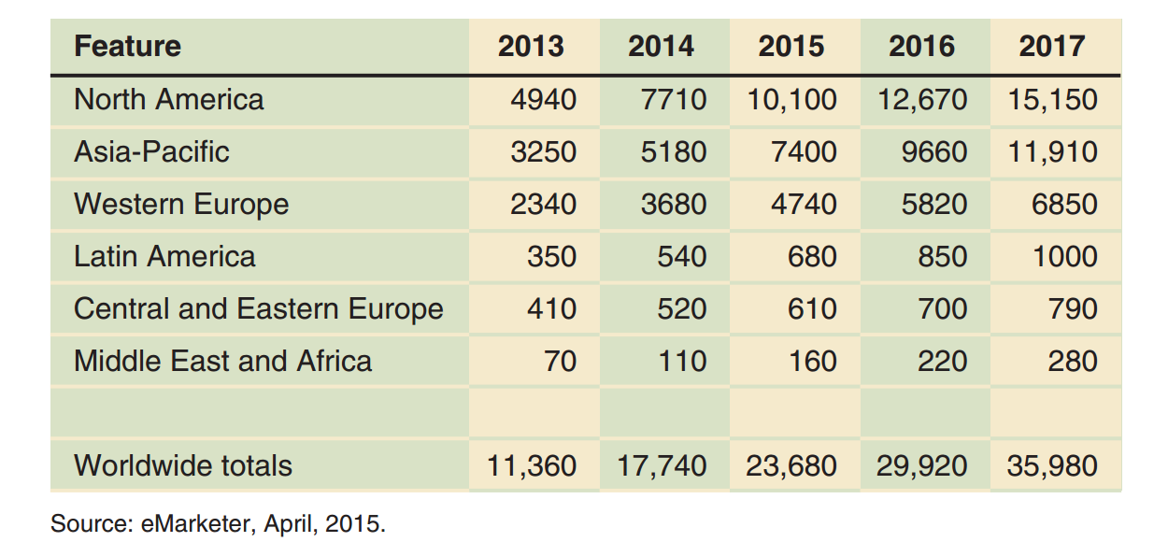
Figure 6-5 Worldwide social network spending, recent years and projects (in millions of U.S. dollars)

Slide 25
Mixed-Revenue and Fee-For-Service Social Networking Sites
Most social networking sites use advertising but some charge a fee for some services
Examples: Yahoo! All-Star Games package, Yahoo! premium e-mail service
Monetizing is converting site visitors into fee-paying subscribers or purchasers of services
Concern: visitor backlash
Examples of sites that used a mixed-revenue model are the financial information sites The Motley Fool and TheStreet.com
25

Slide 26
Fee-Based Social Networking
Google Answers site was an early attempt to monetize social networking by charging a fee for a specific service
Questions answered for a fee from 2002 to 2006
Similar free services such as Yahoo! Answers, Amazon (Askville) generate advertising revenue
Uclue (paid researchers earn 75% of total fee)
Advocates claim better quality of questions and answers
Both approaches show how Web sites can generate revenue by providing virtual community interaction
26

Slide 27
Microlending Sites
Function as clearinghouses for microlending activity
Microlending is lending small amounts of money to people starting or operating small businesses (especially in developing countries)
Key element is working within a social network of borrowers who support each other, and an element of pressure to repay
Examples: Kiva and MicroPlace
Business start-ups in prosperous economies are now using this technique
27

Slide 28
Crowdfunding Sites
Small businesses can sell partial ownership in ventures to investors around the world
Examples: Kickstarter, IndieGoGo
Relies on many people investing a small amount
Reduces risk to individual investors while providing substantial equity for new ventures
Reward-based crowdfunding investors pay in advance for products and services to be delivered after they are made with invested funds
Used by artists and charitable organizations to help complete a specific project

Slide 29
Internal Social Networking
Provide social interaction among organization’s employees
Also includes important information for employees
Run on organization’s intranet
Saves money by replacing printed distribution
Provided easy access to employee information
Good for geographically dispersed employees
Many companies are now adding wireless connectivity for employees who are traveling
29

Slide 30
Mobile Commerce
Short messaging service (SMS) is usually called texting and allows mobile phone users to send short text messages to each other
United States developments allowing phones to be used as Web browsers occurred in 2008
High-speed mobile telephone network availability grew dramatically
Manufacturers offered range of smart phones with Web browser, large screens, operating system, ability to run applications
Potential for mobile commerce (m-commerce)
30

Slide 31
Mobile Phones
Internet-capable phones first caught on in Japan and Southeast Asia
Telecommunication companies there offered high-capacity mobile phone networks before U.S.
NTT DoCoMo, Japan’s largest phone company, pioneered mobile commerce in 2000
In the U.S. the introduction of smart phones and high-capacity networks began appearing in 2008
Apple iPhone and Android phones opened the door for serious U.S. mobile commerce for the first time
31

Slide 32
Tablet Devices
Smaller than laptop computer, larger than phone
Connect to the Internet wirelessly through phone carrier service or local network
Phablets - large phones with high-resolution screens
By 2015 more tablets sold than personal computers
Wireless Application Protocol (WAP) allows HTML Web pages to be displayed on small-screen devices
Optional due to larger, high resolution screens and phablets where normal pages can be displayed
Touchscreen controls now prevalent

Slide 33
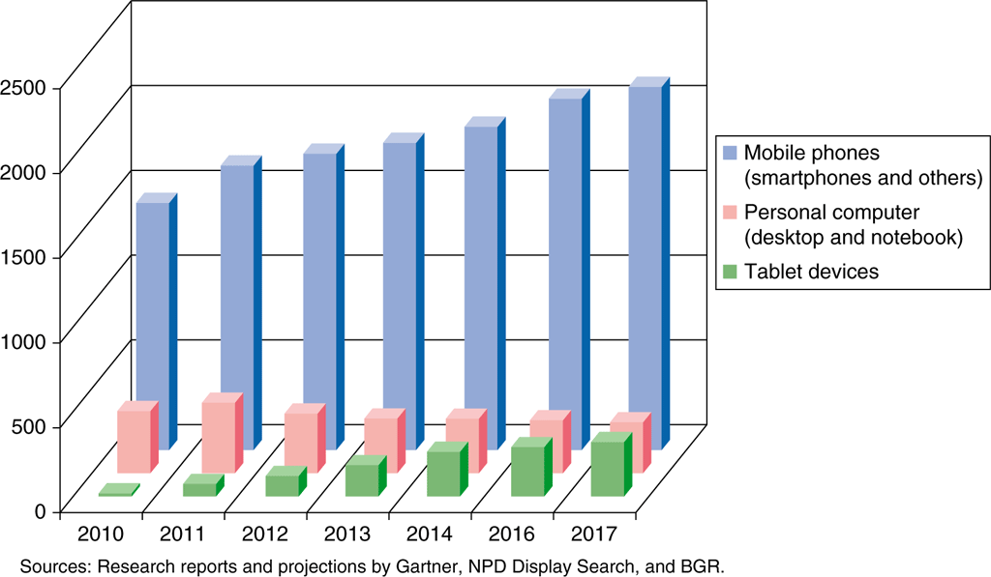
FIGURE 6-6 Actual and projected sales of personal computers, tablet devices, and mobile phones (in millions of units)

Slide 34
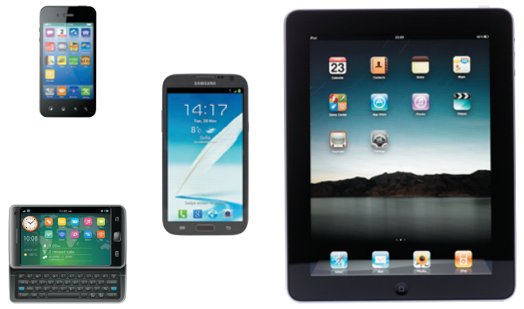
© Maxx-Studio/Shutterstock.com
© iStockphoto.com/pixelfit
© Okeksiy Mark/Shutterstock.com
© iStockphoto.com/macroworld
FIGURE 6-7 Mobile devices, including smartphones, tablets and phablets

Slide 35
Mobile Device Operating Systems
Apple/BlackBerry use proprietary operating systems
HTC, Motorola and Samsung once created their own operating systems and software applications
Now use a standard operating system provided by a third party such as Android and Windows Phone
Google’s Android is most popular and fastest growing third-party, open source, operating system
Modifying operating system generally voids warranty
Jailbreaking (Apple iPhone modification)
Rooting (Android modification)
35

Slide 36
Mobile Apps
Today most mobile phones use a common operating system due to a change in the way software applications are developed and sold
Apple App Store and GooglePlay sell apps
Some developed and sold by independent software developers under a revenue sharing agreement
Some apps provide a gateway to a company’s Web site and some sold for a small fee
Most sell for $1 - $5
Games, puzzles, productivity tools, reference works

Slide 37
Mobile Apps (cont’d.)
Some media sites offer free access to online content through apps while others sell subscriptions
Some mobile apps include advertising in their revenue model
Mobile device use for banking and financial services is growing
Hospitals and clinics are providing apps to give doctors information for treating patients
Phones’ global positioning satellite (GPS) service capabilities create mobile business opportunities
37

Slide 38
Mobile Payment Apps
Mobile wallets are mobile phones that function as credit cards (available since 2004 in Japan)
Other countries have seen significant adoptions of mobile phone apps that make payments
Widespread credit card use in U.S. has limited the popularity of mobile device payment apps
2011: Phone readers made available to retailers by American Express, Visa, MasterCard
2013: Google Wallet use increased
2015: Starbucks attributed growth to customers using its order and pay mobile app

Slide 39
Online Auctions
Perfect business opportunity for the Web
Auction site charges both buyers and sellers to participate and sells advertising
Targeted advertising opportunities available
Online auctions capitalize on Internet’s strength
Bring together geographically dispersed people sharing narrow interests
Create a natural social network

Slide 40
Auction Basics
Auctions date from Babylon in 500 B.C.
Common activity in 17th century England
Seller offers item for sale and provides information to potential buyers, but does not establish a price
Potential buyers (bidders) offer the price they are willing to pay (bids)
Private valuations are the amounts buyers are willing to pay
Auctioneer manages auction process
Shill bidders make bids on behalf of the seller and may artificially inflate the price

Slide 41
English Auctions
Bidders publicly announce successively higher bids until no higher bid is forthcoming
Item sold to highest bidder (at bidder’s price)
Called ascending-price auction, open auction or open-outcry auction as bids are publicly announced
Minimum bid is the beginning price
If no bidders willing to pay, item is not sold
Reserve price is seller’s minimum price
If not met, item is not sold

Slide 42
English Auction (cont’d.)
Yankee auctions offer multiple units of an item for sale and allow bidders to specify desired quantity
Highest bidder allotted bid quantity
Remaining items allocated to next highest bidders until all items distributed
Bidders all pay lowest successful bidder price
Drawbacks for both buyers and sellers
Winning bidders tend not to bid their full private valuation so seller does not obtain maximum price
Bidders risk getting caught up in the excitement and bidding more than private valuation (winner’s curse)

Slide 43
Dutch Auctions
Form of open auction where bidding starts at a high price and drops until bidder accepts price
Also called descending-price auctions
Seller offers a number of similar items for sale
Common implementation is to use a clock (price drops with each tick)
First bidders to stop the clock becomes the winning bidder and if items remain, the clock is restarted
Often better for the seller because buyer will not let bid drop much below valuation for fear of losing

Slide 44
First-Price Sealed Bid Auctions / Second-Price Sealed-Bid Auctions
Sealed-bid auction bidders submit bids independently
First-price sealed-bid auction the highest bidder wins
If multiple items auctioned, next highest bidders awarded remaining items at their bid price
Second-price sealed-bid auction is same as first-price sealed-bid auction except highest bidder awarded item at second-highest bidder price
Commonly called Vickrey auctions
Yields higher seller returns
Encourages bidders to bid private valuation amounts
Reduces tendency for bidder collusion

Slide 45
Open-Outcry Double Auctions / Double Auctions
Open-outcry double auctions
Buy and sell offers shouted by traders in trading pit
Each commodity, stock option traded in own pit which can become quite frenzied
Double auction buyer and sellers each submit combined price-quantity bids to auctioneer
Either sealed-bid or open-outcry
Auctioneer matches offers (starting with the lowest seller’s offer and highest buyer’s offer)
Used by New York Stock Exchange but now mostly via an electronic system

Slide 46
Reverse (Seller-Bid) Auctions
Multiple sellers submit price bids to an auctioneer who represents single buyer
Bids for given amount of specific item to purchase
Prices go down as bidding continues until no seller willing to bid lower
Most involve businesses as buyers and sellers
In many business reverse auctions, buyer acts as auctioneer and screens sellers before they can participate

Slide 47
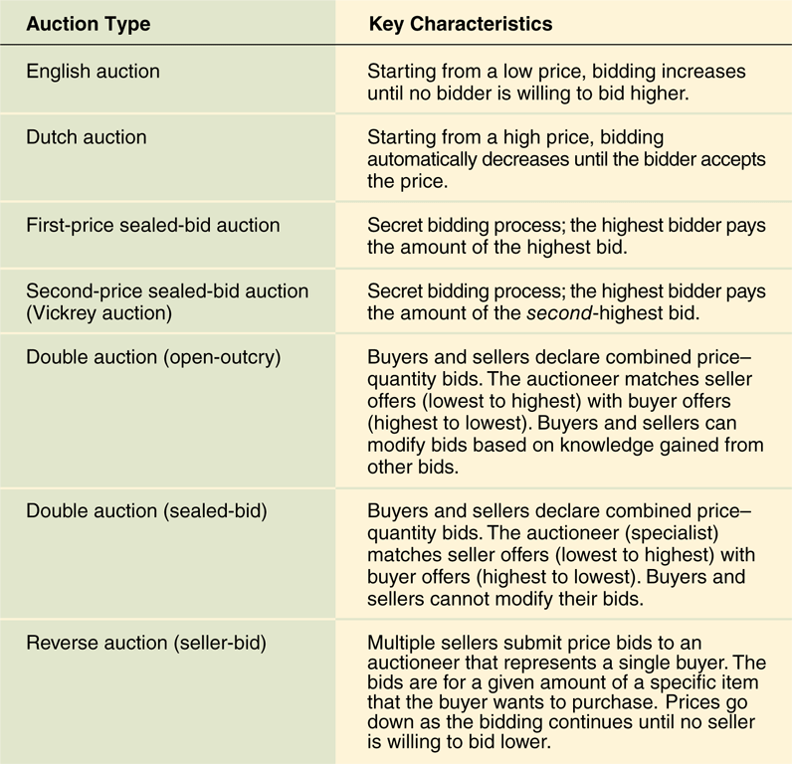
© Cengage Learning 2017
FIGURE 6-9 Key characteristics of seven major auction types

Slide 48
Online Auctions and Related Businesses
Online auction business is rapidly changing
Three auction Web site categories
General consumer auctions
Specialty consumer auctions
Business-to-business auctions
Varying opinions on categorizing consumer auctions
Business-to-consumer
Consumer-to-consumer
Consumer-to-business

Slide 49
General Consumer Auctions
eBay is most successful consumer auction Web site
Registration required, seller fees, rating system
Seller’s risk: buyer uses stolen credit card; buyer fails to conclude transaction
Buyer’s risk: no item delivery; misrepresented item
Most common format on eBay is English auction
Seller may set reserve price
Bidders listed, bids not disclosed (until auction end)
Continually updated high bid amount displayed
Private auction option available

Slide 50
General Consumer Auctions (cont’d.)
eBay private auction site does not identify bidders
eBay only notifies seller and highest bidder
eBay’s Dutch auction is actually a Yankee auction
Minimum bid increment is the amount by which one bid must exceed previous bid
Bidder’s proxy bid automatically increases to next highest-increment needed up to maximum specified bid (may cause bidding to rise rapidly)
eBay stores allow sellers to show sale and auction items as a way to generate additional profits

Slide 51
General Consumer Auctions: The Lock-In Effect
Economic structure of online markets is biased against new entrants
Markets become more efficient as number of buyers and sellers increase
New auction participants are more likely to patronize established sites like eBay (the lock-in effect)
eBay is dominant in the U.S. but Yahoo! was the first major online auction site in Japan and holds more than 90% of the market
eBay maintains low market share (less than 5%)

Slide 52
Specialty Consumer Auctions / Consumer Reverse Auctions
Some firms identified special interest markets
Created specialized Web auction sites to meet the needs of that market segment
Some companies created sites allowing visitors to describe items and services they wanted to buy
Requests routed to participating merchants who offered item at a specific price (reverse-bid)
None were successful and all have closed
Priceline.com is seen as a seller-bid auction site
Completes many transactions from inventory purchased from airlines, car rental agencies and hotels

Slide 53
Group Shopping and Coupon Sites
On group purchasing or group shopping sites the seller posts an item with a tentative price
Buyers enter bids to buy one unit (no price provided) and site negotiates with seller for lower price
Posted price decreases if number of bids increases
Encourages seller to offer a quantity discount (similar to a reverse auction)
Works well for reputable, non-perishable branded products but sellers not always interested
No advantage and fear of cannibalizing other sales
Successful sites: Groupon, LivingSocial, Gilt

Slide 54
Business-to-Business Auctions
Evolved to meet specific existing need such as excess inventory disposal (manufacturing)
Liquidation specialists: find buyers for unusable items
Liquidation brokers: firms that finds buyers for items
Online auctions are logical extensions
Large company model: Business creates its own auction site to sell excess inventory
Small company model: Third-party Web auction site takes the place of the liquidation broker
Third model: Resembles consumer online auctions
Also used to fill temporary employment openings

Slide 55
Business-to-Business Reverse Auctions
Many electronic marketplaces that conduct B2B transactions include reverse auctions
Owens Corning has reduced purchasing costs for reverse auction purchases by an average of 10%
Reverse auctions cause suppliers to compete or price alone which may impact quality
May be useful for commodity items
Replaces trusting relationships with bidding
Large, powerful suppliers in some industries refuse to participate which may make the auction impossible
Can be efficient when high competition exists

Slide 56
© Cengage Learning 2017
FIGURE 6-10 Supply chain characteristics and reverse auctions

Slide 57
Auction Escrow Services
Buyers’ common concern is reliability of the seller
When purchasing high-value items, an escrow service can be used to protect buyer’s interest
Independent party holds payment until buyer receives item and is satisfied with it
Some escrow services take delivery and perform the inspection (qualified to do so)
Fee charged may make service too expensive
Bidders in low-price auctions should check seller’s record (rating) on the auction site and other sites

Slide 58
Auction Directory and Information Services / Auction Software
eCommerceBytes publishes articles about auction industry developments and provides guidance to new participants
Price Watch lists current selling prices for computer hardware, software, and electronics to help with bidding strategies
Companies such as AuctionHawk and Vendio sell auction management software for buyers and sellers
Helps seller manage auctions and automate tasks
Sniping software places last second winning bids (snipes) for buyers

