Slide 1
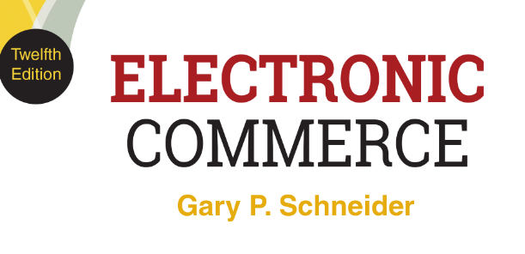
CHAPTER 7
The Environment of Electronic Commerce: Legal, Ethical, and Tax Issues
© 2017 Cengage Learning®. May not be scanned, copied or duplicated, or posted to a publicly accessible website, in whole or in part, except for use as permitted in a license distributed with a certain product or service or otherwise on a password-protected website or school-approved learning management system for classroom use.
.
Notes:
1

Slide 2
Learning Objectives
In this chapter, you will learn:
How the legal environment affects electronic commerce activities
What elements combine to form an online business contract
When copyright, patent, and trademark laws govern the use of intellectual property online
How the Internet has opened doors for online crime, terrorism, and warfare
2
Notes:
2

Slide 3
Learning Objectives (cont’d.)
What ethics issues arise for companies conducting electronic commerce
Ways to resolve conflicts between companies’ desire to collect and use their customers’ data and the privacy rights of those customers
How taxes are levied on electronic commerce activities

Slide 4
Introduction
Apple App Store gives iPhone and iPad users an easy way to purchase apps generating more than $10 billion in revenue for Apple each year
In 2013 Apple agreed to refund charges made due to their 15 minute purchase authorization clause
FTC investigation led to Apple paying $32.5 million in claims and changing the 15 minute purchase terms
In 2015 the FTC began another investigation against Apple for potential anticompetitive practices
Investigation is ongoing and could lead to a U.S. Justice Department investigation

Slide 5
The Legal Environment of Electronic Commerce
All businesses must comply with the same laws and regulations and face the same set of penalties
Web businesses face additional complicating factors
Web extends reach beyond traditional boundaries
Subject to more laws more quickly than brick-and-mortar business
More interactive and complex customer relationships
Online communications facilitate strategic alliances and supply web relationships
Law violations or ethical breaches can lead to rapid and intense reactions almost instantly

Slide 6
Borders and Jurisdiction
In the physical world of traditional commerce, territorial borders clearly mark the range of culture and reach of applicable laws
Geographic influences of culture limit acceptable ethical behavior and affect laws both directly and indirectly
Relationship between geographic and legal boundaries defined by four variables
Power, effects, legitimacy, notice

Slide 7
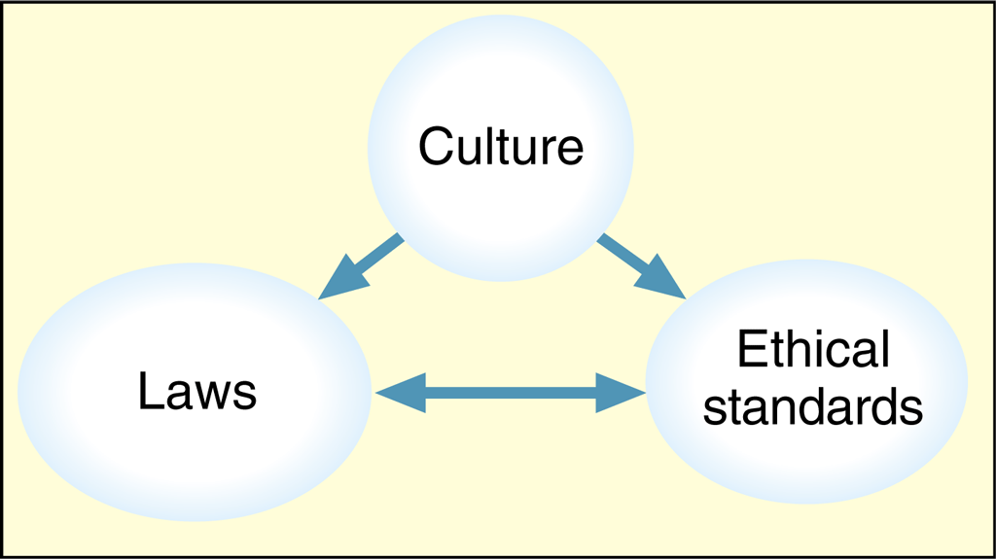
© Cengage Learning 2017
FIGURE 7-1 Culture helps determine laws and ethical standards

Slide 8
Power and Effects
Power is the form of control over physical space and people and objects that reside in that space
Defining characteristic of statehood
Jurisdiction is government’s ability to exercise power
Limited to that which is accepted by the geographical culture
Effects are the impact of a person’s behavior
Generally stronger on things that are physically closer
Laws based on traditional effects-based measures do not work as well for online businesses

Slide 9
Legitimacy and Notice
Legitimacy is the idea that those subject to laws should have some role in formulating them
Online businesses face a variety of regulations
Notice is the expression of a change in rules
Easy for physical boundaries but not easy online
Constructive notice of new laws and norms is received when an international border is crossed
Ignorance of law: not sustainable defense
Creates problems for online businesses when unknown customers from other countries access Web sites

Slide 10
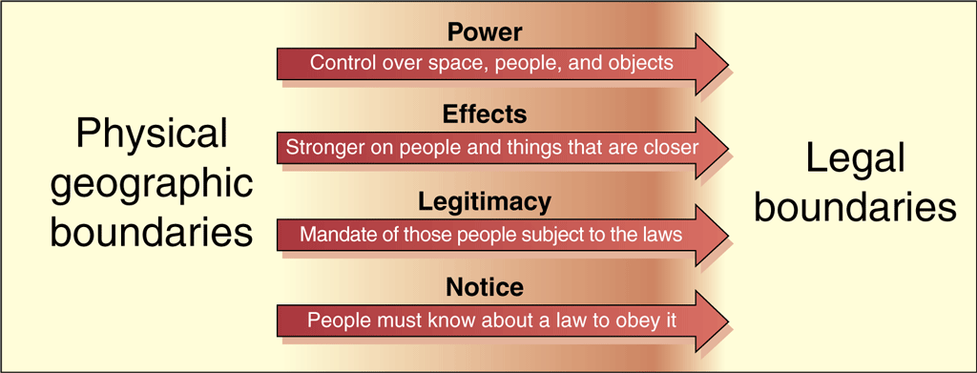
© Cengage Learning 2017
FIGURE 7-2 Physical geographic boundaries lead to legal boundaries

Slide 11
Jurisdiction on the Internet
Difficult due to lack of geographic boundaries
Governments enforcing Internet business conduct laws must establish jurisdiction over conduct
Contract is a promise between two or more entities providing for an exchange of value between them
Breach of contract occurs if either party does not comply with contract terms
Tort is an intentional negligent action taken by a legal entity that causes harm to another legal entity
Sufficient jurisdiction requires both subject-matter jurisdiction and personal jurisdiction

Slide 12
Subject-Matter and Personal Jurisdiction
Subject-matter jurisdiction is a court’s authority to decide particular dispute type
U.S. federal courts have subject-matter jurisdiction over issues governed by federal laws
U.S. state courts have subject-matter jurisdiction over issues governed by state laws
Rules are clear and easy to apply (few disputes)
Personal jurisdiction is determined by residence of the parties
If defendant is a state resident where is court located the determination is straightforward

Slide 13
Personal Jurisdiction (cont’d.)
An out-of-state person or corporation can voluntarily submit to a state court jurisdiction
Forum selection clause indicates a contract will be enforced according to a particular state’s laws
Long-arm statutes create personal jurisdiction over nonresidents committing tortious acts
Tortious acts an exceptions to personal jurisdiction
Negligent tort is unintentionally selling a harmful product
Intentional tort is knowingly or recklessly causing injury to a buyer
13

Slide 14
© Cengage Learning 2017
FIGURE 7-3 A typical forum selection clause

Slide 15
Jurisdiction in International Commerce
Governed by treaties between countries in dispute
U.S. determines personal jurisdiction for foreigners in the same manner as domestic long-arm statutes
Non-U.S. entities can be sued in U.S. courts
Foreign courts can enforce U.S. court system decisions against U.S. corporations and individuals
Judicial comity is enforcing other countries’ laws out of a sense of comity (friendly civility)
Complex issue that is rapidly changing and should be considered when conducting business online

Slide 16
Conflict of Laws
Business governed by various federal, state, and local laws
Conflict of laws occurs when laws address the same issues in different ways
Online businesses span many localities, states and usually look to federal laws for guidance
May lead to problems with state and local laws
Example: direct wine sales industry
More information: Free the Grapes wine industry trade association Web site

Slide 17
Contracting and Contract Enforcement in Electronic Commerce
Contract is formed when one party accepts the Offer of another party
Offer is a commitment with certain terms made to another party that can be revoked
Acceptance is the expression of willingness to take offer including all stated terms
Consideration is the agreed-upon exchange of something valuable such as money, property, or future services
Implied contract can be formed when parties act as if a contract exists, even if unwritten

Slide 18
Creating Contracts: Offers and Acceptances
Every type of agreement or exchange between parties is a type of contract
Example: consumer buying item at a supermarket
Key element of traditional and Internet business
Internet communication offers and acceptances
Occur by exchanging e-mail, engaging in EDI, and filling out Web page forms
Can be combined with traditional methods
Courts tend to view offers and acceptances as actions that occur within a particular context

Slide 19
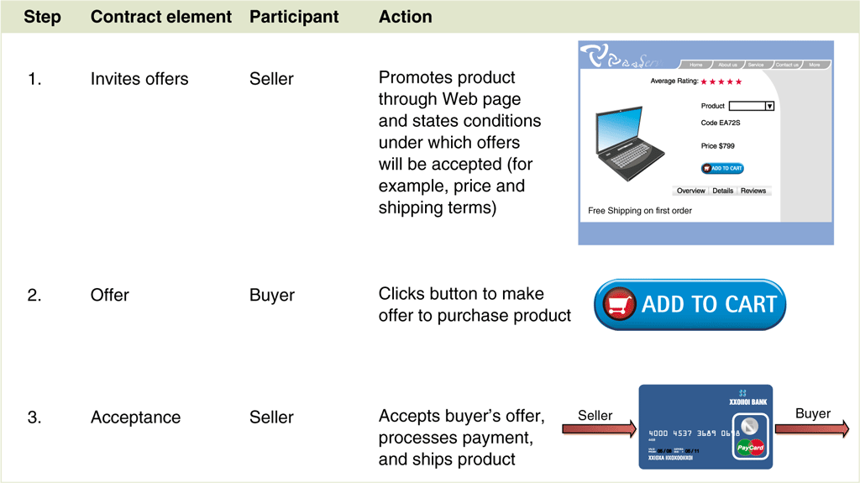
© Cengage Learning 2017
FIGURE 7-4 Contracting process in an online sale

Slide 20
Click-Wrap and Web-Wrap Contract Acceptances
End-user license agreements (EULAs)
User must accept contract user before installing software which may happen when “Agree” is clicked
Shrink-wrap acceptance was used in the past with contract accepted by removing plastic shrink wrap on software box
Click-wrap acceptance happens by clicking a button on the Web site
Web-wrap acceptance or browser-wrap acceptance occurs by simply using the Web site
20

Slide 21
Terms of Service Agreements
Many sites have stated rules visitors must follow even though the visitors are not aware of them
Terms of service (ToS) agreements are detailed rules and regulations
Limit Web site owner’s liability for what one might do with site information
Site visitor held to terms of service by simply using site

Slide 22
Creating Written Contracts on the Web
Many contracts valid even if not in writing or signed
Statute of Frauds (state laws) specify contracts that must be written and signed
Applies to sale of goods over $500 and contracts with actions that cannot be completed within one year
For electronic commerce a writing exists if contract terms reduced to some tangible form
Signature is any symbol executed or adopted for the purpose of authenticating a writing
22

Slide 23
Implied Warranties and Warranty Disclaimers on the Web
Implied warranty is a promise to which the seller can be held even though seller did not make an explicit statement of that promise
Law establishes basic elements of a transaction in any contract to sell goods or services
Warranty disclaimer is a statement declaring that the seller will not honor some or all implied warranties
Must be made conspicuously and in writing
Only legally effective if obvious and easy for a Web site buyer to find

Slide 24
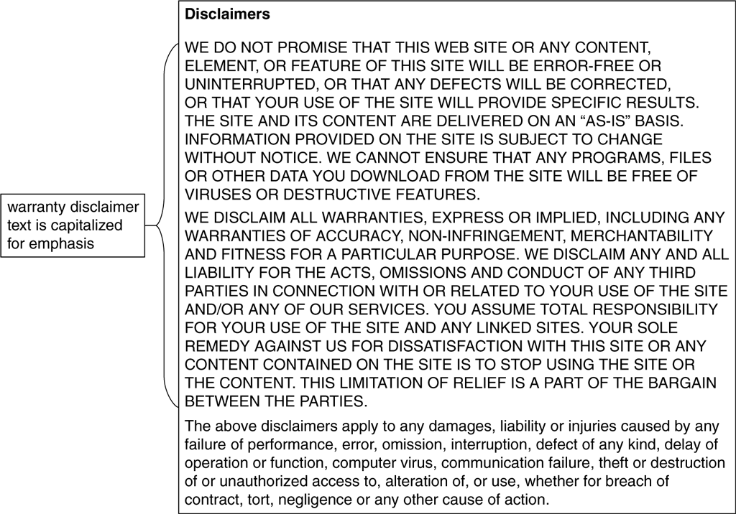
© Cengage Learning 2017
FIGURE 7-5 A Web site warranty disclaimer

Slide 25
Authority to Form Contracts
Contract formed when offer accepted for consideration
Problems with acceptance by an imposter (forgery) or someone without authority to bind company
Electronic commerce technology provides means to avoid deception such as use of digital signatures
Authority to bind issue arises when employee accepts a contract and company later asserts employee was not authorized
In physical world transactions check public information on file or copies corporate certificates or resolutions
Physical methods time consuming and awkward online

Slide 26
Use and Protection of Intellectual Property in Online Business
Intellectual property includes all products of the human mind, both tangible and intangible
Protections afforded by copyrights and patents, trademarks registration, service marks
Right of publicity is the limited right to control others’ commercial use of an individual’s name, image, likeness, and identifying aspect of identity
Limited by U.S. First Amendment provisions
Online businesses must avoid infringement of intellectual property rights by using unauthorized content on Web sites or in domain names

Slide 27
Copyright Issues
Copyright is a right granted by government to the author (creator) of literary or artistic work
Gives author (creator) sole and exclusive right to the work (print, publish, sell) for a specific length of time
Includes virtually all forms of artistic or intellectual expression
Idea contained in an expression cannot be copyrighted (for example, mathematical calculations)
Collection of facts van be copyrighted if arrangement rises to level of an original work
Example: Yahoo! Web Directory

Slide 28
Copyright Issues (cont’d.)
U.S. law no longer requires registration
Work created after 1989 is copyrighted automatically by virtue of copyright law
Most U.S. Web pages protected by automatic copyright provision (create an original work)
Copying page generally an allowable use
Fair use of a copyrighted work is an exemption from infringement
Allows copying it for use in criticism, comment, news reporting, teaching, scholarship, or research

Slide 29
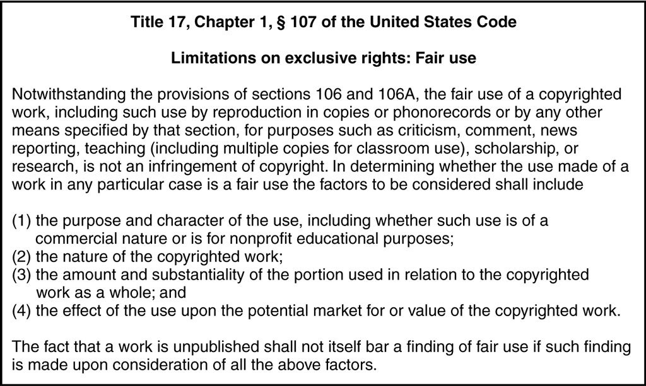
FIGURE 7-6 U.S. law governing the fair-use exception

Slide 30
Copyright Issues (cont’d.)
Specific factors in fair use
Nonprofit educational uses have better chance of qualifying than commercial uses
Court may consider painting using different standards than sound recording
Small sections qualify when entire work might not
Court may consider amount of damage caused to value of copyrighted work
Good Web site sources to determine fair use
University of Texas Copyright Crash Course
Stanford Copyright & Fair Use

Slide 31
Copyright Issues (cont’d.)
Copyright law difficult to apply due to elements such as fair use
Internet has made situation worse
Vicarious copyright infringement occurs when an entity capable of supervising infringing activity obtains a financial benefit from it
Example: Napster held liable for failing to monitor its network and indirect profit from the infringement
Music purchased in digital form is often sold with specific restrictions on copying and sharing, even for personal use

Slide 32
Patent Issues
Patent is an exclusive right granted by government to an individual to make, use, and sell an invention
Protection for 20 years in the United States or inventor can patent the design for 14 year
Invention must be genuine, novel, and useful
Not obvious given current technology state
Software patents not considered useful because technology obsolete before patent protection secured
Process is expensive and takes several years

Slide 33
Patent Issues (cont’d.)
Business process patent protects specific set of procedures for conducting a particular business activity
Enforcing rights not clear (Amazon vs. Barnes and Noble and MercExchange vs. Ebay)
Only common in the United States
Patent assertion entities or patent trolls purchase patents they believe are being infringed
Threaten to sue infringers for cash settlement
Several governments have introduced legislation to limit patent trolls with limited success

Slide 34
Trademark Issues
Trademark is a distinctive mark, device, motto, or implement that a company affixes to goods it produces for identification purposes
Service mark identifies the services provided
Registered with governments (state and/or federal)
Trade name is the name business uses for identify
Protected under common law, not trademark law
Statutory law arises when elected legislative bodies pass laws (statutes)
Web site designers must not use any trademarked name, logo, or other mark without permission

Slide 35
Domain Names and Intellectual Property Issues
Cybersquatting is registering a trademarked domain name hoping owner will pay money to acquire URL
Prevented by the U.S. Anticybersquatting Consumer Protection Act since 1999
Disputes settled by the World Intellectual Property Organization but critics claim enforcement has not been consistent
Rules in favor of trademark owner over 90% of the time
No central authority for decision appeals

Slide 36
Domain Names and Intellectual Property Issues (cont’d.)
Name changing (typosquatting) occurs when someone purposely registers misspelled variations of well-known domain names
Name stealing is unauthorized changes to domain name ownership
Domain name ownership change occurs when information maintained by public domain registrar changed in registrar’s database
Allows name stealer to manipulate the site
Occurs when safeguards not in place
Main purpose is to harass site owner

Slide 37
Protecting Intellectual Property Online
Digital watermark is a digital code or stream embedded undetectably in digital image or audio file
Can be encrypted to protect contents
Examples: Verance and Digimarc
Copy control is an electronic mechanism limiting number of copies
Example: Blue Spike

Slide 38
Defamation
Defamatory statement is false and injures reputation of another person or company
Product disparagement when statement injures product or service reputation
Web sites must consider specific laws before making negative, evaluative statements about products
Designers must avoid potential defamation liability by not altering photos or images
Exceptions in U.S. for defamatory statements about public figures (not in other countries)
Per se defamation occurs when statements are so negative that injury is assumed

Slide 39
Deceptive Trade Practices
Manipulation of trademarked objects constitutes infringement of trademark holder’s rights
Fictional characters can be trademarked
Web sites with links to other sites must not imply a relationship with companies sponsoring other sites unless it actually exists
Trademark protection prevents buyer confusion regarding trademark holder’s products or services
Trademark dilution is the reduction of distinctive trademark quality by alternative uses

Slide 40
Advertising Regulation
Federal Trade Commission (FTC) regulates advertising, publishes regulations, and investigates false advertising claims in the United States
Web site includes links to advertising regulations
Advertising claims that mislead substantial number of consumers in a material way are illegal in the U.S.
FTC accepts referred investigations from organizations like the Better Business Bureau
FTC policies include information on what is permitted in advertising

Slide 41
Advertising Regulation (cont’d.)
Policy statements cover specific areas
Bait advertising
Consumer lending and leasing
Endorsements and testimonials
Energy consumption statements for home appliances
Guarantees and warranties
Prices
Other agencies regulate online advertising
Food and Drug Administration (FDA); Bureau of Alcohol, Tobacco, and Firearms (BATF); Department of Transportation (DOT)

Slide 42
Online Crime: Jurisdiction Issues
Web crimes are online versions of physical world crimes and new online crimes
Theft, stalking, pornography distribution, gambling
Commandeering computer to attack other computers
Law enforcement jurisdiction obstacles
Prosecuting across international boundaries difficult
Advance fee fraud
Distribution of pornographic material
Online gambling
Unlawful Internet Gambling Enforcement Act (UIGEA) of 2006 provides clearer jurisdiction

Slide 43
New Types of Crime Online
Difficult to apply pre-Internet laws to criminal actions on the Internet
Most stalker laws are triggered by physical action which are not effective against online stalkers
Cyberbullying is using technology to harass, humiliate, threaten, or embarrass another
Laws have lagged behind technology but states are starting to pass laws that address online offenses
Sexting is sending sexually explicit messages or photos using a mobile phone
Can lead to serious criminal liability if minors involved
43

Slide 44
New Types of Crime Online (cont’d.)
Infiltrating competitor computer systems with intent of stealing data, creating operational disruptions
Criminal extortion example: Myron Tereshchuk was convicted for threatening MicroPatent with confidential client information disclosure
National Retail Federation partnered with eBay and FBI to combat stolen items from being sold online
Internet can help law enforcement track criminals
Some brag on social networking sites or leave clues in online profiles

Slide 45
Online Warfare and Terrorism
New age of terrorism and warfare using the Internet
Considerable number of Web sites are operated by hate groups and terrorist organizations
Instructions for creating biological weapons
Help terrorist groups recruit new members online
Thousands of downloadable terrorist training films
U.S. Department of Homeland Security and Interpol are devoting considerable resources to monitoring online terrorist activities and coordinating antiterrorism efforts
Sustained terrorist effort could slow down major transaction-processing center processing

Slide 46
Ethical Issues
Web sites conducting electronic commerce should adhere to same ethical standards other businesses follow
Failure to do so will result in damaged reputation, long-term loss of trust, and loss of business
Web advertising or promotion should include only true statements and omit misleading information
Product comparisons should be supported by verifiable information

Slide 47
Ethics and Online Business Practices
An ethical lapse reported and passed among customers can seriously affect company’s reputation
Examples: Amazon.com arrangements with publishers for book promotions, eBay firearm sales, Apple Apps store software approval time
Organizations face an ethical issues when collecting e-mail addresses from site visitors
In the U.S., no legal obligation to limit the use of information collected on Web sites
May use information for any purpose, including sale
Concern of individuals and privacy right advocates

Slide 48
Privacy Rights and Obligations
Issue of online privacy continuing to evolve
Many legal and privacy issues are unsettled and remain hotly debated in various forums
Electronic Communications Privacy Act of 1986 is the main law governing privacy on the Internet today
Written pre-Internet to deal with telephone lines
No law enacted to address online privacy has survived constitutional challenge
1999 FTC report concluded no federal laws regarding privacy were needed
Created privacy advocacy group outrage

Slide 49
Privacy Rights and Obligations (cont’d.)
Direct Marketing Association (DMA) established a set of privacy standards for members
Lobbies on behalf of members who do not want any privacy laws that would impact business
Significant ethics issues in online privacy area
Laws not keeping pace with Internet, Web growth
Nature and degree of personal information recorded threatens visitors privacy rights
Many examples of personal information lost or stolen
Security breaches continue to increase

Slide 50
Privacy Rights and Obligations (cont’d.)
Worldwide cultural differences provide different electronic commerce privacy expectations
Most European countries prohibit companies from exchanging data without express consent
Major controversy in U.S. is opt-in vs. opt-out issue
Opt-out: Common method where customer must deny permission or opt-out of having their information used
Opt-in: Less common method where customer must specifically give permission to have information used
Preferable as it gives customer privacy protection

Slide 51
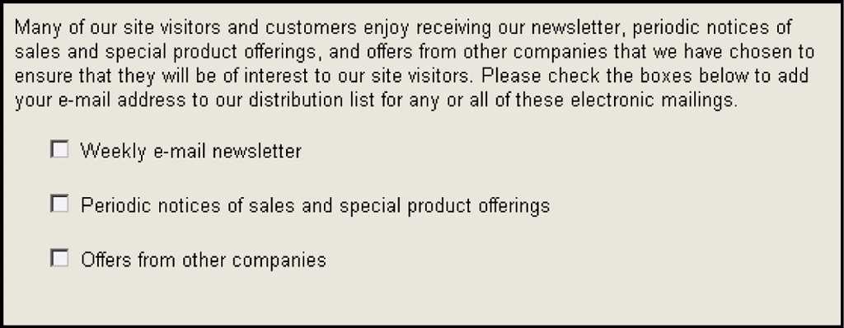
© Cengage Learning 2017
Figure 7-7 Example Web page showing opt-in choices

Slide 52
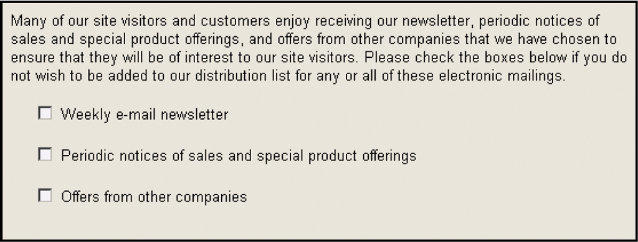
© Cengage Learning 2015
Figure 7-8 Example Web page showing opt-out choices

Slide 53
Privacy Rights and Obligations (cont’d.)
Privacy advocates urge electronic commerce Web sites to be conservative and follow guidelines
Use data collected for improved customer service or other customer benefits
Do not provide customer data to others outside your company without customer’s permission
Clearly describe and explain what data is collected and how it is used
Give customers the right to have their data deleted
Train employees how to keep data secure

Slide 54
Communications with Children
Additional privacy considerations arise when Web sites attract and communicate with children
Children are considered less capable of evaluating information sharing and transaction risks
Concerns arise about their ability to read and evaluate privacy statements and consent to providing personal information
In most countries people under 18 or 21are not considered adults
Specific laws for children’s privacy rights define a child as person below the age of 12 or 13
54

Slide 55
Communications with Children (cont’d.)
1998: Children’s Online Protection Act (COPA)
Unconstitutional: restricted lawful material access
Children’s Online Privacy Protection Act of 1998
Successful: COPPA does not regulate content
2001: Children’s Internet Protection Act (CIPA)
Federally funded schools install filtering software
Companies with Web sties appealing to children must be careful to comply with laws governing interaction
Examples: Disney and Sanrio

Slide 56
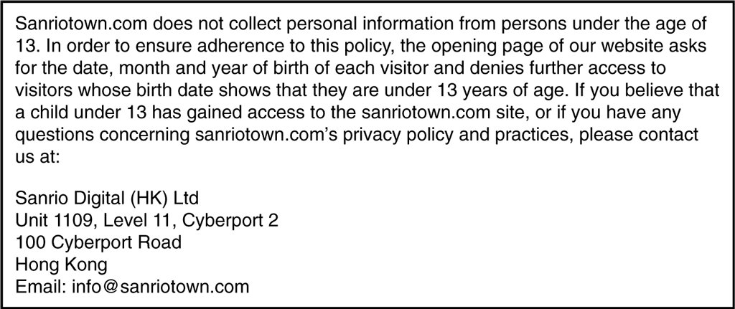
FIGURE 7-9 Sanrio’s approach to COPPA compliance

Slide 57
Communications with Children (cont’d.)
2013: FTC rules clarifications
Post clear and comprehensive online privacy policy
Notice to parents and verifiable parental consent
Give parents choice of allowing data collection without disclosure to third parties
Provide parents access to their child’s information
Have option to have it deleted
Give parents opportunity to prevent further data collection
Take steps to main information’s confidentiality, security, and integrity

Slide 58
Taxation and Electronic Commerce
Web businesses must comply with multiple tax laws
Several types of taxes
Income taxes levied on net income
Transaction taxes (transfer taxes) levied on products or services company sells or uses
Sales taxes, use taxes, excise taxes
Property taxes levied on personal property, real estate

Slide 59
Nexus
Connection between tax-paying entity and government
Similar concept to personal jurisdiction
Activities creating nexus (United States) are determined by state law that vary from state to state
Frequent litigation has resulted in fairly complex laws
Determining nexus difficult if company conducts few activities in the state
Business conducted in more than one country
May establish nexus with a country and be liiable for filing tax returns in that country

Slide 60
U.S. Income Taxes
Internal Revenue Service (IRS) is charged with administering tax laws
Any verifiable increase in company wealth is subject to federal taxation
A company must pay federal income tax if is has a U.S.-based Web site generating income
Web site maintained by U.S. company must pay taxes on income generated outside the United States
Credit given for taxes paid to foreign countries to reduce double taxation of foreign earnings
Most states also levy income taxes on businesses

Slide 61
U.S. State Sales Taxes
Transaction tax on goods sold to consumers, usually called a sales tax
Businesses establishing nexus with a state must file sales tax returns and remit sales tax collected from customers
Business not required to collect taxes from out-of-state customers unless nexus established
Use tax is a tax levied by a state on property used in that state that was not purchased in that state

Slide 62
U.S. State Sales Taxes (cont’d.)
Large companies use complex software to manage sales tax obligations
Purchasers exempt from sales tax include charitable organizations and businesses buying resale items
Amazon laws require online retailers to collect taxes on sales made in their states
Supreme Court refused to hear a case challenging these laws which are being considered in many states
Streamlined Sales and Use Tax Agreement (SSUTA) would simplifies state sales taxes

Slide 63
Import Tariffs
Countries regulate import and export of goods
Sometimes goods can only be imported if tariff paid
Tariff (customs duty, duty) is a tax levied on products as they enter country
Many reasons for imposing tariffs
Goods ordered online are subject to tariffs when crossing international borders
Products delivered online are also subject to tariffs
Example: downloaded software

Slide 64
European Union Value Added Taxes
European Union (EU) uses transaction taxes with Value Added Tax (VAT) the most common
2003: VAT applied to sales of digital goods
EU-based companies must collect VAT on digital good sales no matter where in EU products are sold
Non-EU companies selling in the EU must register with EU tax authorities and collect and remit VAT if sales include digital goods delivered into the EU
New 2015 rules require non-EU sellers to collect VAT at rate levied in buyer’s country prompting many to sell goods directly to a EU distributor for resale

