Slide 1
CHAPTER 8
Web Server Hardware and Software
© 2017 Cengage Learning®. May not be scanned, copied or duplicated, or posted to a publicly accessible website, in whole or in part, except for use as permitted in a license distributed with a certain product or service or otherwise on a password-protected website or school-approved learning management system for classroom use.
.
Notes:
1

Slide 2
Learning Objectives
In this chapter, you will learn:
How a Web server performs its basic functions
What operating system and server software is used on Web servers
How to identify and manage e-mail and spam control issues
How commonly used Internet and Web site utility programs work
What hardware online businesses use to power their Web sites
How cloud computing and content delivery networks are providing new Web infrastructure
2
Notes:
2

Slide 3
Introduction
Case study: Israel’s Channel 2 News
Produces news content and programming for other Channel 2 shows, Web sites and its mobile device app
Web site and mobile app offer many high-resolution photographs and video chips
Online news organizations face wide variation in user interest levels and need for Internet bandwidth
Breaking news events lead to high demands on the Web site and mobile app and can result in system overload
Peak periods in news business can be unpredictable
As a solution, Channel 2 uses Google Cloud Computing to store content

Slide 4
Web Server Basics
Client/server architectures used in LANs, WANs, Web
Server computers have more memory and larger, faster disk drives than the client computers they serve
Web browser: a type of Web client software
Platform neutrality is the ability of a network to connect devices using different operating systems
Critical in rapid spread, widespread Web acceptance
Web server’s main job to respond to Web client requests
Main elements: Hardware, operating system software, and Web server software

Slide 5
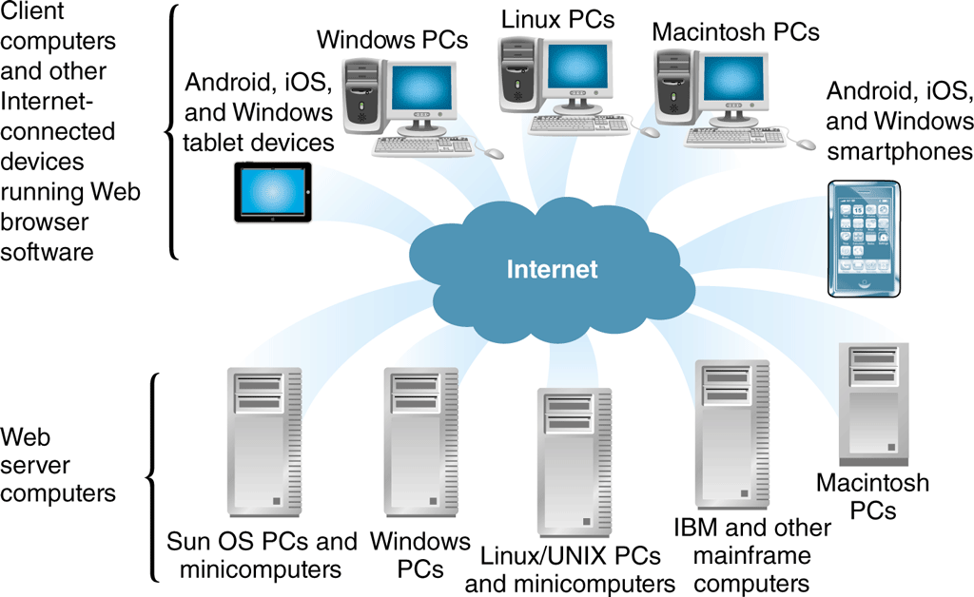
© Cengage Learning 2017
FIGURE 8-1 Platform neutrality of the Web

Slide 6
Dynamic Content Generation
Static page is an unchanging page retrieved from stored Web server file(s)
Dynamic page created in response to user request
Customized pages give user an interactive experience
Client-side scripting software operates on the Web client (browser) and changes Web page display in response to a user’s actions (JavaScript or Adobe Flash)
Server-side scripting program runs on a Web server and creates Web page in response to request for specific information from a Web client

Slide 7
Dynamic Content Generation (cont’d.)
Software tools to create dynamic Web pages
Microsoft ASP.NET, Apache Software Foundation Hypertext Preprocessor (PHP) and Adobe ColdFusion
AJAX (asynchronous JavaScript and XML) creates interactive Web sites that look like applications
Ruby on Rails, Scala and Python (scripting language) are used to accomplish the same objectives
Many Web sites use more than one language and/or development framework to accomplish specific objectives

Slide 8
Multiple Meanings of “Server”
Server is any computer providing files or making programs available to other computers connected to it through a network
Server software makes files and programs available
May be part of the operating system (OS) and be referred to as server software (confusing)
Some servers connected to Internet via a router
Runs Web server software that makes server’s files available to other computers and called a Web server
E-mail server: handles incoming and outgoing e-mail

Slide 9
Multiple Meanings of “Server” (cont’d.)
Database server runs database management software
Transaction server runs accounting and inventory management software
“Server” describes several types of computer hardware and software
Context needed to determine the intended meaning

Slide 10
Web Client/Server Architectures
Web browser requests files from Web server and uses the Internet as the transportation medium
Request formatted by browser using HTTP and sent to server computer
Server receives request, retrieves requested Web page file, formats using HTTP, and sends back to client over the Internet
Client Web browser software displays page
Repeating process of request, response, display
Web page with graphics can be slow because each page element requires separate request and response

Slide 11
Web Client/Server Architectures (cont’d.)
Basic model is two-tier client/server architecture
One client and one server computer
Request message is the Web client message sent to request file(s) from a Web server that consists of three major parts
Request line contains command, target resource name, protocol name, version number
Optional request headers contain file type information client accepts
Optional entity body is used to pass bulk information to server
11

Slide 12
© Cengage Learning 2017
FIGURE 8-2 Message flows in a two-tier client/server network

Slide 13
Web Client/Server Architectures (cont’d.)
Server receiving request message executes command included in message
Retrieves Web page file from disk and creates a response message to send back to client
Identical in structure to request message (slightly different function)
Response header line indicates server HTTP version, response status, status information explanation
Response header field returns information describing server’s attributes
Entity body returns HTML page requested by the client machine

Slide 14
Web Client/Server Architectures (cont’d.)
Three-tier architecture allows additional processing before server responds to client’s request
Often includes databases and related software applications that supply information to the Web server
Web server uses software applications’ output when responding to client requests
N-tier architectures have more than three tiers
Track customer purchases stored in shopping carts
Look up sales tax rates, ;keep track of customer preferences, update in-stock inventory databases
Keep product catalog current

Slide 15
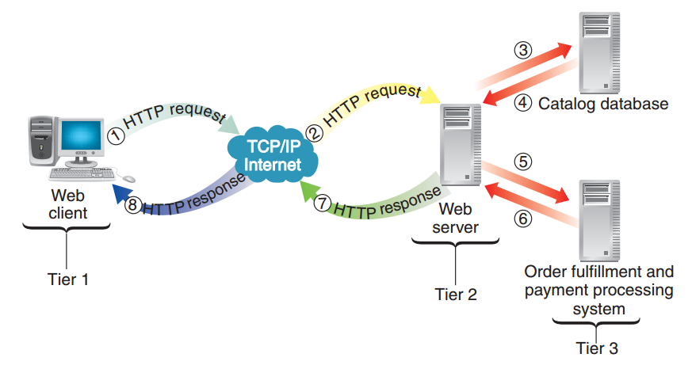
© Cengage Learning 2017
FIGURE 8-3 Message flows in a three-tier client/server network

Slide 16
Operating Systems for Web Servers
Operating system tasks include running programs, allocating computer resources to programs, and proving input and output services
Required for a computer to run programs
Larger system responsibilities include tracking multiple users, ensuring no interference
Web server operating systems software run on Microsoft Windows Server products, Linux or UNIX-based operating systems

Slide 17
Operating Systems for Web Servers (cont’d.)
Some companies consider Microsoft operating system simpler to use than UNIX based systems
Some concerns about security weaknesses caused by tight integration of Microsoft products
Linux is open-source, fast, efficient, easy to install
Can be downloaded free from the Web but most companies buy it through a commercial distributor for the additional utilities and support
Mandriva, Red Hat, SuSE Linux Enterprise
Oracle sells Web server hardware with its UNIX-based operating system Solaris
17

Slide 18
Web Server Software
Commonly used programs are Apache HTTP Server and Microsoft Internet Information Server (IIS)
Some businesses, such as Google, wrote their own
Apache dominant Web server software since 1996
Free and user-supported with other services available
Microsoft IIS bundled with Microsoft Windows Server OS and runs only on Windows systems
Used on many intranets, and small and large sites that have adopted Microsoft products as standard
ISS is free but OS it comes with can be expensive

Slide 19
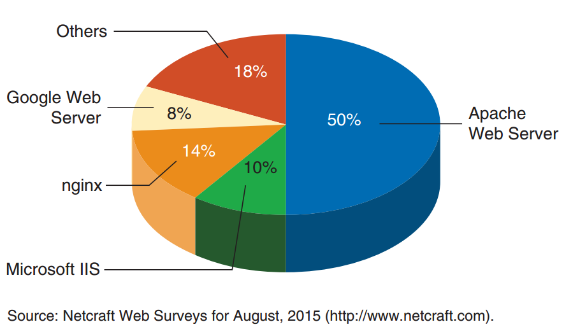
FIGURE 8-4 Percent of active Web sites that use major Web server software products

Slide 20
Electronic Mail (E-Mail) and E-Mail Benefits and Drawback
E-mail used to gather information, execute transactions and perform electronic commerce tasks
Reason people originally attracted to the Internet
Conveys messages in seconds with attachments often the most important message part
Most popular form of business communication
Drawbacks include the time spent answering e-mails
Burdensome and can take 2 hours per day
Email attachments can be or contain a computer virus
Most frustrating and expensive problem is spam

Slide 21
Spam and Solutions to the Spam Problem
In 2009, the peak year for spam, one 24-hour period showed 220 billion spam e-mail messages sent
Spam growth has leveled off and legal and technical solutions will continue to reduce it
Benefits reaped by spammers still make it attractive
Reducing spam approaches require passing laws and technical changes in Internet mail-handling systems
Approaches under existing laws and technologies require cooperation by organizations
Some tactics can be taken by individual e-mail users

Slide 22
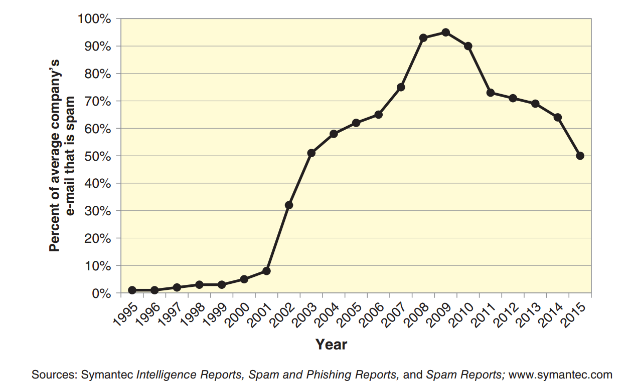
FIGURE 8-5 Spam as a proportion of all business e-mail

Slide 23
Individual User Antispam Tactics
Using a complex e-mail address reduces the chance that a spammer can automatically generate it
Downside is that a complex address can be hard to remember
Control e-mail address exposure
Spammer software robots search for e-mail addresses on discussion boards, in chat rooms, other online sources that use email
Use multiple e-mail addresses
Switch to another if spammers use one
Use filtering techniques based on contents

Slide 24
Basic Content Filtering
Content-filtering techniques differ in terms of content elements examined, spam indications and how strictly message classification rules applied
Basic content filters examine e-mail headers
Client-level filtering: individual users’ computers
Server-level filtering: mail server computers
Black list spam filter looks for known spammers in incoming messages’ From addresses
White list spam filter looks for good sender From addresses in incoming messages
High false positives rate

Slide 25
Challenge-Response Content Filtering
Compares all incoming messages to a white list
If sender is not on the white list, automated e-mail response sent (challenge)
Challenge asks sender to reply to e-mail (response)
Reply must contain response to a challenge presented in the e-mail
Designed so human can respond easily
More information
Carnegie Mellon University CAPTCHA Project site
Drawback is potential abuse

Slide 26
© Cengage Learning 2017
FIGURE 8-6 Example of a challenge that uses distorted letters and numbers

Slide 27
Advanced Content Filtering
Looks for spam indicators in entire e-mail message
Indicator identified: message’s spam “score” raised
Indicator types are words, word pairs, certain HTML codes, information about where word occurs
Spammers stop including defined indicators
Bayesian revision statistical technique uses additional knowledge to revise earlier probability estimates
Naïve Bayesian filter software allows users to review messages and indicate if message is spam (not spam)
Software gradually learns to identify spam and is correct about 95% of the time after training

Slide 28
Legal Solutions
January 2004: U.S. CAN-SPAM law went into effect
Spam decreased first two months, but returned to previous levels after no threat of federal prosecution
Prohibits misleading e-mail message address header information, deceptive subject headers and transfer of email addresses
Some spammers have been prosecuted, fined and received jail time
Many use servers outside U.S. (jurisdiction issues)
Legal solutions have had only limited success
Expensive to prosecute spammers

Slide 29
Technical Solutions
Internet design did not include mechanisms ensuring e-mail sender identity would be know to recipient
Internet’s communication protocol designed to be a polite set of rules where a sending computer waits for acknowledgement that message was received
Originating computer will slow if acknowledgement is delayed (must continue to scan for it) and will not send more messages until acknowledgment received
Defending (receiving) company must develop way to identify computers sending spam and delay acknowledgement

Slide 30
Technical Solutions (cont’d.)
Computer being spammed can also launch a return attack called teergrubing (“tar pit”)
Send e-mail messages back to suspected spamming computer with the objective of setting a trap that drags down its ability to send spam
Concern is that counterattack might violate laws
Ultimate spam solution could come from new e-mail protocols providing absolute verification of e-mail message source
Currently most effective solutions have been coordinated efforts to identify and block spammers

Slide 31
Web Site Utility Programs
TCP/IP supports utility programs (tools)
Run on Web server or client computers
E-mail: earliest Internet utility program
Most important utility
Key element in electronic commerce strategies

Slide 32
Tracert and Other Route-Tracing Programs
Tracert (TRACE RouTe) sends data packets to every computer on path between one computer and another and clocks packets’ round-trip times
Provides indication of time message needs to travel from one computer to another and back
Ensures remote computer online and pinpoints data traffic congestion
Calculates and displays the number of hops between computers and time to traverse entire one-way path

Slide 33
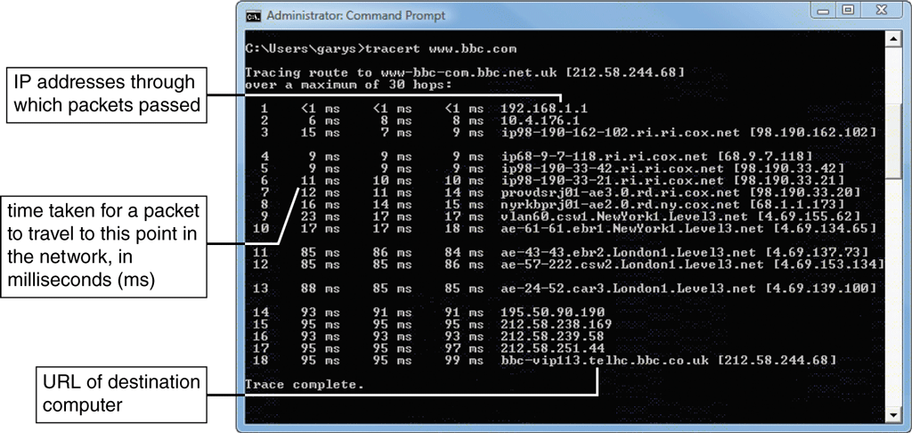
© Cengage Learning 2017
FIGURE 8-7 Tracing a path between two computers on the Internet

Slide 34
Telnet and FTP Utilities and Indexing and Searching Utility Programs
Telnet program allows a person using one computer to access files and run programs on a second computer connected to the Internet
File Transfer Protocol (FTP) is the part of the TCP/IP rules that defines formats used to transfer files between TCP/IP connected computers
Search engines and indexing programs are important elements of many Web servers
When a browser requests a Web site search, engine compares index terms to the requester’s search terms to find matching documents

Slide 35
Data Analysis Software
Web servers capture visitor information and places it into a Web log file (grows quickly)
Third-party Web log file analysis programs summarize information in the file
Query log file and return gross summary information or accumulating details
Popular Web log file analysis programs
Adobe Analytics, Google Analytics, WebTrends

Slide 36
Link-Checking Utilities
Dead link displays an error message rather than Web page when clicked
Sites with many dead links are said to have link rot
Link checker utility examines each site page and reports URLs that no longer exists
Identifies orphan files which are files on Web server not linked to a page
Also includes script checking and HTML validation
Adobe Dreamweaver includes link-checking program
Free standing link-checking programs include Elsop LinkScan and LinxCop

Slide 37
Remote Server Administration
Web site administrator controls Web site from any Internet connected computers
Monitor server activity and manipulate server from wherever administrator happens to be
LabTech Software includes remote administration, link-checking, HTML troubleshooting, site-monitoring and other utility programs
Useful in managing the operations on the Web

Slide 38
Web Server Hardware
Wide variety of computer brands, types, sizes used by organizations to host online operations
Small companies run Web sites on desktop PCs
Most online business operations are operated on computers designed for site hosting
Businesses select specific hardware and software elements based on site’s functionality, expected visitors, number and size of pages and graphics

Slide 39
Server Computers
Generally have more memory, larger (faster) hard disk drives and faster processors than typical desktop computers
Many Web server computers use multiple processors
Most companies spend $2,000-$50,000 on an individual Web server with large organizations spending millions on server hardware
May be housed in freestanding cases but most are installed in equipment racks
Blade servers are servers-on-a-card
Small in size: 300 installed in single 6-foot rack

Slide 40
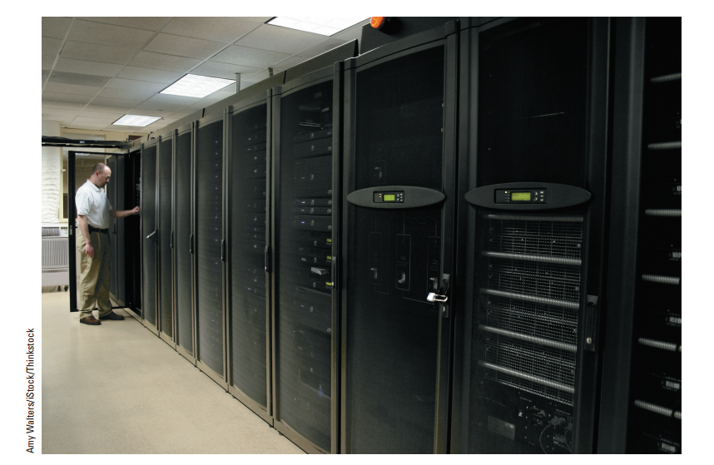
FIGURE 8-8 Rack-mounted blade servers

Slide 41
Web Servers and Green Computing
Significant electrical power needs for operating servers and cooling the room where servers housed
Green computing is efforts to reduce environmental impact of large computing installations
Novel approaches using natural cooling
Google server facility in Finland
Facebook server in Lulea, Sweden
Other companies: Hewlett-Packard, FedEx, Harris Corporation

Slide 42
Web Server Performance Evaluation
Benchmarking is testing to compare hardware and software performance and includes many elements
Hardware, operating system software, server software, connection speed, user capacity, type of Web pages delivered and connection bandwidth
Users server can handle important, hard to measure
Throughput is the number of HTTP requests hardware and software process in a unit of time
Response time is time server requires to process one request
Independent testing and benchmarks available

Slide 43
Web Server Hardware Architectures
Electronic commerce Web sites use tiered architecture to divide work of serving Web pages
May use more than one computer within each tier
Server farms are large collections of servers lined up row after row
Centralized architecture uses a few expensive, fast computers and more sensitive to technical problems
Requires adequate backup plans

Slide 44
Web Server Hardware Architectures (cont’d.)
Distributed architecture (decentralized architecture) uses many less-powerful, less-expensive computers
Spreads risk over large number of servers
Requires additional hubs or switches to connect servers to each and the Internet
Requires cost of load balancing to assign the workload efficiently

Slide 45
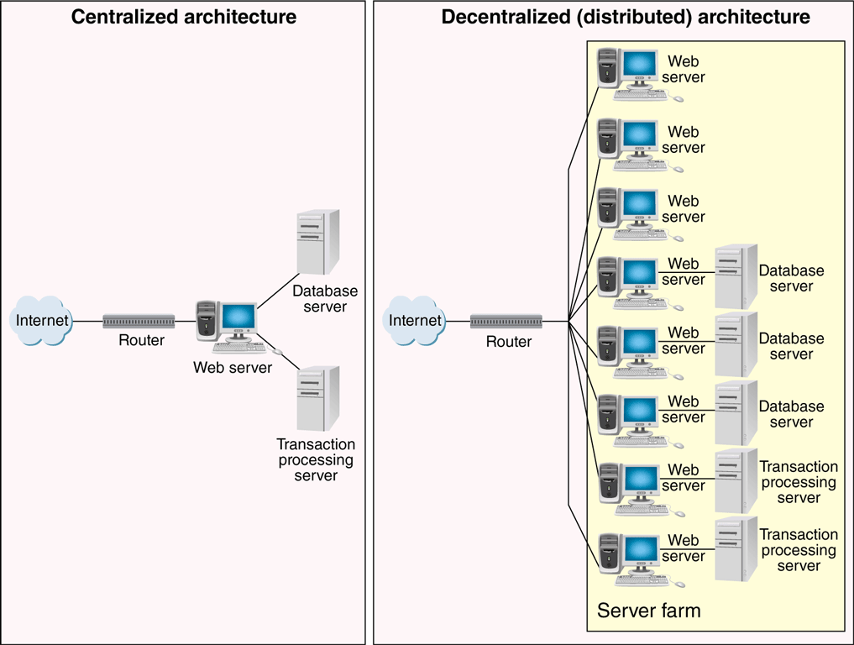
© Cengage Learning 2017
FIGURE 8-9 Centralized and decentralized Web site architectures

Slide 46
Load-Balancing Systems
Load-balancing switch is network hardware that monitors server workloads and assigns incoming Web traffic to the server with most available capacity
Simple load-balancing system traffic enters through site’s router and encounters load-balancing switch which directs traffic to best Web server
More complex load-balancing systems incoming Web traffic directed to groups of dedicated Web servers
Groups organized by specific functions
Cost of load-balancing systems range from about $2,000 (simple) to $15,000 - $40,000 (complex)

Slide 47
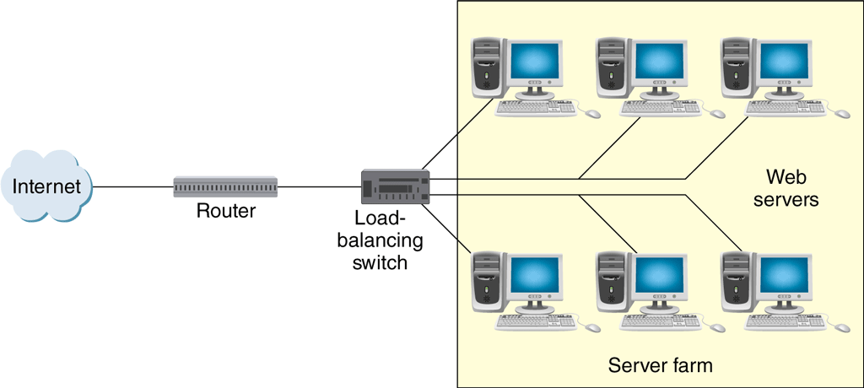
© Cengage Learning 2017
FIGURE 8-10 Basic load-balancing system

Slide 48
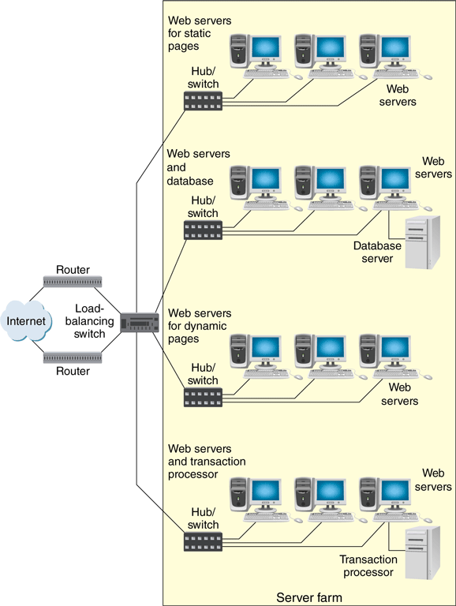
FIGURE 8-11 Complex load balancing system
© Cengage Learning 2017

Slide 49
Cloud Computing
To reduce costs and effort many businesses are outsourcing entire networks using cloud computing
Allows multiple organizations to share a network of servers and software giving businesses access to computers, storage and backup at lower cost
Sometimes called infrastructure as a service (IaaS) or platform as a service (PaaS)
Resources can be allocated dynamically as needed
Some larger firms use hybrid cloud computing
Move large-volume, routine work to cloud provider and maintain more sensitive data and processes internally

Slide 50
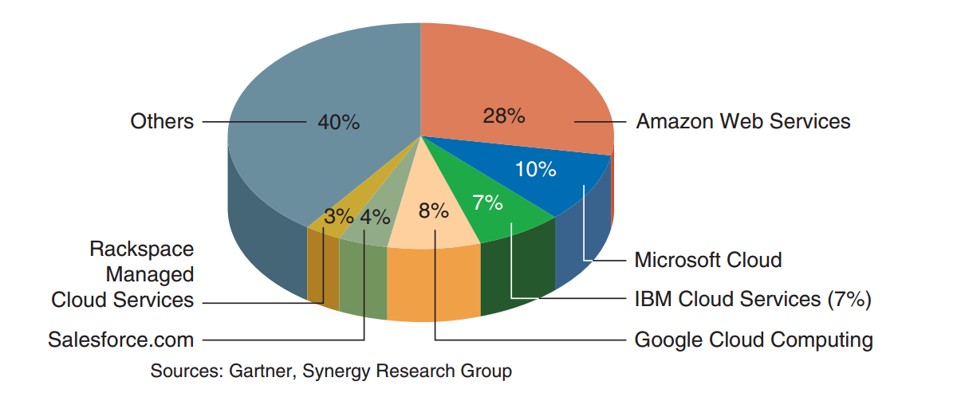
FIGURE 8-12 Cloud computing provider global market share, 2015
© Cengage Learning 2015

Slide 51
Content Delivery Networks
Latency occurs when a transmission delay is caused by network inability to handle full traffic load
Problem for businesses that rely on Internet to deliver large audio and video files to customers
To prevent latency, online businesses have turned to content delivery networks
Service that stores large file contents on multiple servers throughout the Internet for a fee
Large file requests routed to nearest server with a stored copy of the file

Slide 52
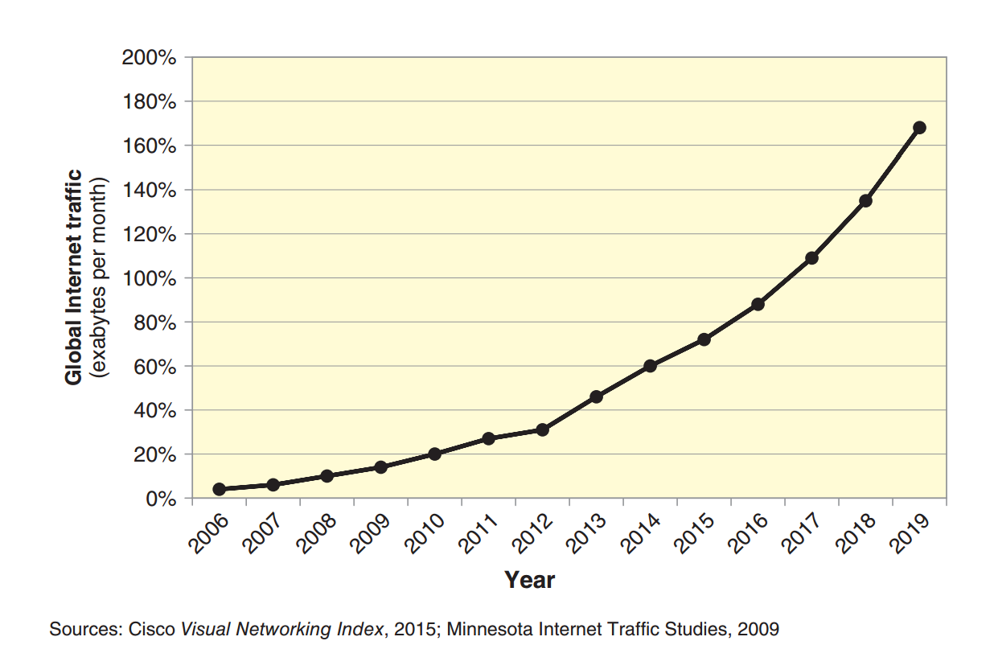
FIGURE 8-13 Growth of Internet traffic, actual and projected

