Slide 1

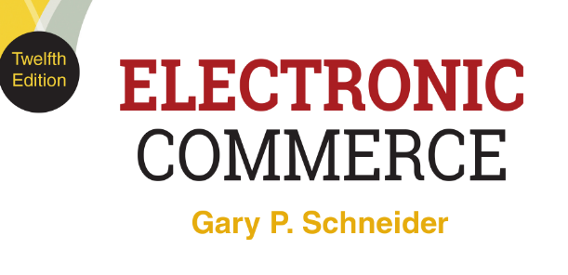
CHAPTER 9
Electronic Commerce
Software
© 2017 Cengage Learning®. May not be scanned, copied or duplicated, or posted to a publicly accessible website, in whole or in part, except for use as permitted in a license distributed with a certain product or service or otherwise on a password-protected website or school-approved learning management system for classroom use.
.
Notes:
1

Slide 2
Learning Objectives
In this chapter, you will learn:
How to find and evaluate Web-hosting services
What functions are performed by electronic commerce software
How electronic commerce software works with database and ERP software
What enterprise application integration and Web services are and how they can be used with electronic commerce software
2
Notes:
2

Slide 3
Learning Objectives (cont’d.)
Which types of electronic commerce software are used by small, medium, and large businesses
How electronic commerce software works with customer relationships management, knowledge management, and supply chain management software
3
Notes:
3

Slide 4
Introduction
Case study: Harry Barker
  Sells pet products online
  Prepared in advance for an expected increase in online orders from a Good Morning America segment
    Added an additional Web server
    Hired additional temporary staff
    Created a customer Web page
  Company followed up to measure how well it met new customer expectations

Slide 5
Web Hosting Alternatives
Self-hosting is running servers in-house
  Most often used by large companies
Third-party Web-hosting service providers offer Web services, electronic commerce functions
  Often used by midsize, smaller companies
Commerce service providers (CSPs) provide Internet access and Web-hosting services
  Offer Web server management and rent application software
  Also called Managed service providers (MSPs) or Application service providers (ASPs)

Slide 6
Web Hosting Alternatives (cont’d.)
Web-hosting service options
  Shared hosting means client's Web site on a server hosting other Web sites simultaneously
  Dedicated hosting means the client Web server not shared with other clients
    Service provider owns and maintains server hardware, leases it to client, and provides Internet
With co-location (collocation or colocation) service the provider rents physical space to client with a reliable power supply, Internet connection
  Clients install/maintain server hardware and software

Slide 7
Web Hosting Alternatives (cont’d.)
Web server-hosting decisions
  Hardware platform and software combination
    Should be upgradable when site’s Web traffic increases
  Scalable hardware and software combinations
    Adaptable to meet changing requirements

Slide 8
Basic Functions of Electronic Commerce Software
All electronic commerce solutions must provide
  Catalog display, shopping cart capabilities and transaction processing
Larger complex sites may include software with added features and capabilities

Slide 9
Catalog Display Software
Catalog organizes goods and services being sold
  May organize by logical departments
    Web store advantage is a single product may appear in multiple categories
Catalog is a listing of goods and services
  Static catalog is a simple list written in HTML
    Must edit HTML to add or delete items
  Dynamic catalog stores information in a database with photos, detailed descriptions and a search tool for locating item and determining availability
  Both located in third tier of Web site architecture

Slide 10
Shopping Cart Software
Early electronic commerce used forms-based shopping
  Shoppers selected items by filling out online forms which was awkward if ordering more than one or two items and error prone
Electronic shopping carts are now standard
  Keep track of items customer selected and allows them to view cart contents, add and remove items
  Ordering requires a simple click which executes the purchase transaction
    Screen asks for billing and shipping information

Slide 11
Shopping Cart Software (cont’d.)
Web is a stateless system that does not retain information from one transmission to another
  Shopping cart software must store information
    Cookies allows information to be stored and retrieved
    If browser does not allow cookie storage software automatically assigns temporary number
Dynamic pricing management software adjusts prices in real time based on variables seller chooses
Promotion management software allows sellers to create special offers on specific products

Slide 12
Shopping Cart Software (cont’d.)
Fulfillment integration software connects seller’s shopping cart to fulfillment provider’s computer
  Shipping automatically triggered at completed sale
Product review management software allows customers to post reviews of products
Product recommendation triggers are tools that respond to customer’s product selection
  Provides suggestions for related products, refills
Abandoned cart management software enables shopping cart to be retained for later when customer session is terminated

Slide 13
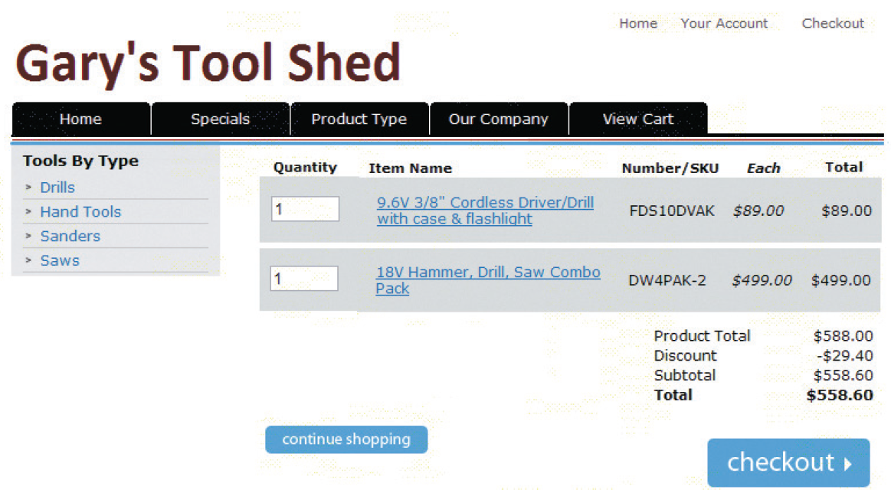
© Cengage Learning 2017
FIGURE 9-1 Typical shopping cart page
13

Slide 14
Transaction Processing
Occurs when shopper proceeds to virtual checkout counter by clicking the checkout button
  Electronic commerce software performs calculations
Web browser software and seller’s Web server software switch into secure communication state
  Electronic commerce software communicates with accounting software sales and inventory modules
  FedEx and UPS shipping rate software integrates with electronic commerce software
Other calculations include coupons, promotions, time-sensitive offers

Slide 15
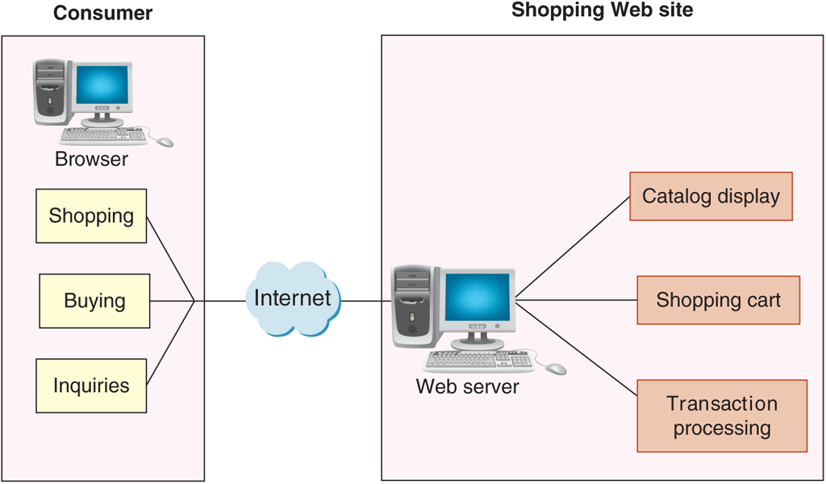
© Cengage Learning 2017
FIGURE 9-2 Basic electronic commerce site architecture
15

Slide 16
How Electronic Commerce Software Works with Other Software
Most large companies with electronic commerce operations also have substantial business activity unrelated to electronic commerce
  Important to integrate electronic commerce activities into the company’s other operations
Basic information system element is a collection of databases

Slide 17
Databases
Highly structured information stored on a computer
Business rules are how the company does business
Database management software allows users to enter, edit, update, retrieve database information
Distributed information systems are large systems storing data in many different physical locations
  Distributed database systems are databases within distributed information systems
MySQL database is open-source software owned by Oracle and maintained by group of programmers
17

Slide 18
Middleware
Middleware takes sales and inventory shipments information from electronic commerce software
  Transmits to accounting and inventory management software
  Companies can write their own or purchase customized middleware
Interoperability is making information systems work together
Middleware cost range is $30,000 to several millions
  Depending on complexity and existing systems

Slide 19
Enterprise Application Integration
Application software (application) is a program that performs specific function like creating invoices
Application server (computer) takes request messages received by Web server
  Runs application program performing action based on request message’s contents
  Actions determined by business logic rules such as verifying customer password upon log in
Enterprise application integration is a creation of links among scattered applications so business logic can be interconnected

Slide 20
Enterprise Application Integration (cont’d.)
As information is transferred from one application to another program data formats differ
  Must edit and reformat often using XML data feeds
Page-based application systems return pages generated by scripts containing rules
  Present data on Web page with the business logic
Component-based application systems separate presentation logic from business logic
  Logic components created and maintained separately
    Updating and changing system elements much easier

Slide 21
Integration with ERP Systems
Enterprise resource planning (ERP) software are business systems integrating all facets of a business
  Accounting, logistics, manufacturing, marketing, planning, project management, and treasury functions
Two major ERP vendors: Oracle and SAP
  ERP software installation costs between $1 million and $10 million for a midsize company
Smaller online businesses can purchase products like NetSuite that offer ERP system subscriptions
  Called software as a service (SaaS)
21

Slide 22
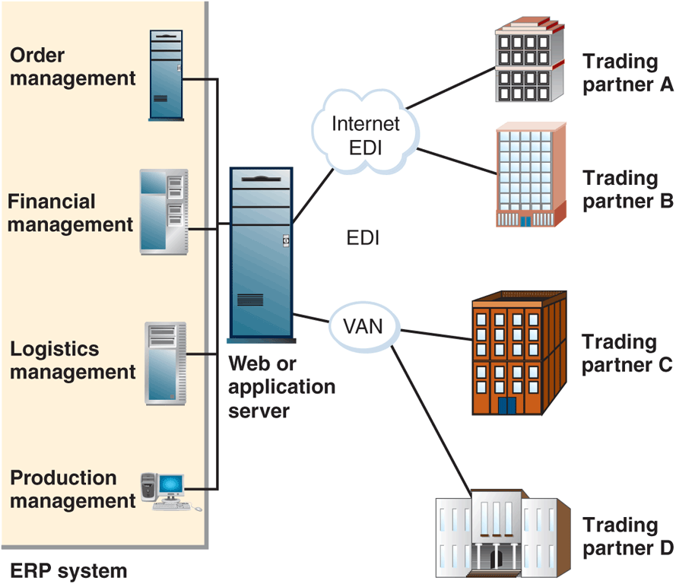
© Cengage Learning 2017
FIGURE 9-3 ERP system integration with EDI
22

Slide 23
Web Services
Software systems supporting interoperable
machine-to-machine interaction over a network
  Set of software and technologies allowing computers to use the Web to interact with each other directly
  Does not require human operators directing the specific interactions
Application program interface (API) is a general name for the ways programs interconnect with each other
  Web APIs: interaction over the Web

Slide 24
What Web Services Can Do and How Web Services Work
Offer improved customer service, reduced costs
Transmit XML-tagged data from one enterprise integrated application to another
Provide data feeds between two different companies
Programmers write software accessing business application logic units without knowing details
  Allows communication between programs written in different languages on different platforms
    Example task: transaction processing
  Can be combined with other Web services for complex tasks

Slide 25
How Web Services Work (cont’d.)
Machine-to-machine communication was originally accomplished with HTML but now most are XML
First Web services information sources programmers incorporated into software applications
More advanced example is purchasing software used to obtain vendor price information
  Purchasing agent authorizes transaction and Web services submits order and tracks until delivered
As Web servers become more sophisticated, they can often make decisions themselves

Slide 26
Web Services Specifications
Simple Object Access Protocol (SOAP) is a message-passing protocol
  Defines how to send marked up data from one software application to another across a network
Utilizes three rule sets
  Communication rules included in SOAP specification
  Web Services Description Language (WSDL) describes logic unit characteristics of each Web service
  Universal Description, Discovery, and Integration Specification (UDDI) woks as address book to identify Web services locations and associated descriptions

Slide 27
REST and RESTful Design
Representational State Transfer (REST)
  Principle describing how the Web uses networking architecture to identify and locate Web pages and elements making up those Web pages
RESTful design (RESTful applications) are Web services built on the REST model
  Transfers structured information from one Web location to another
  Services accessible at a specific address
  More than half of all Web services today are RESTful applications
27

Slide 28
Electronic Commerce for Small and Midsize Businesses: Basic CSPs
Use of service provider’s shared or dedicated hosting services
  Shifts staffing burden from company to Web host
  Spread costs over all hosted businesses
  Host provider keeps server working through storms and power outages
CSPs offer free or low-cost e-commerce software
  Less than $20 per month with software built into site
CSP examples
  Gate.com, ProHosting.com, 1&1 Internet, Yahoo!

Slide 29
Mall-Style CSPs
Provide small businesses with basic Web site, online store design tools, templates and easy-to-use interfaces
  Low monthly fee, one-time setup fees and percentage (or fixed) amount for each transaction
  Shopping cart software and payment processing
Two-main mall-style CSPs are Amazon services for business and eBay stores for businesses
  No long term commitment and few up-front costs

Slide 30
Estimating Operating Expenses for a Small Web Business
Cost to become operational between $400 and $8200
  Assumes less than 100 items for sale and business already has computer and Internet access
  Figure 9-4 shows the range of estimates for first-year expenses for a small business owners
Self-hosting include one time basic server and router costs of $2000 to $10,000 plus annual costs
  Basic Internet connection: $480 to $1,800
  Secure server room: $5000
  Required technicians: $50,000 to $100,000
  Annual total costs: $60,000 to $100,000

Slide 31
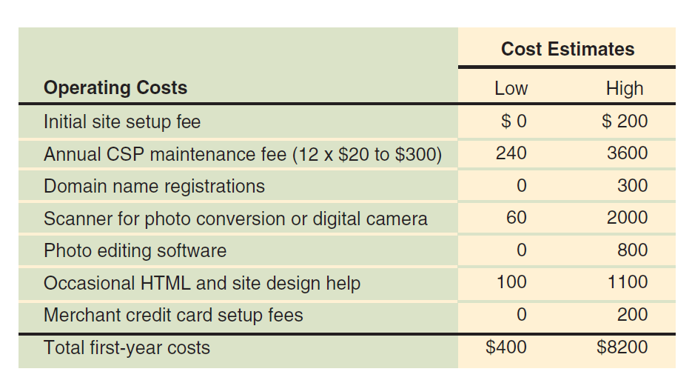
© Cengage Learning 2017
FIGURE 9-4 Approximate costs to put a small store online

Slide 32
Electronic Commerce Software for Midsize Businesses: Web Site Development Tools
Possible to use Web page creation and site management tools from Chapter 2
After Web site creation add purchased software elements and create the middleware
32

Slide 33
Midrange Electronic Commerce Software
Costs $5000 to $200,000
Operating costs range $1000 to $30,000 annually
Offers connectivity to database or ERP systems that store inventory information
Intershop offers midrange packages
  Include search and catalog capabilities, electronic shopping carts, credit card processing and connection to back-end businesses and databases
  Setup wizards, catalog tools, data management functions and built-in templates are included
  Manage storefronts with Web browser interface
33

Slide 34
Midrange Electronic Commerce Software (cont’d.)
IBM WebSphere Commerce Professional is a family of software components
  Includes catalog templates, setup wizards, advanced catalog tools
  Provides link with existing corporate systems
    Inventory databases, procurement systems
  Customization requires programmers with JavaScript, Java or C++ expertise
  Costs between $50,000 and $300,000 depending on number of servers and options

Slide 35
Electronic Commerce Software for Large Businesses
Larger business requirement many of the same advanced capabilities as midsize firms
  Need ability to handle higher transaction loads and dedicated software applications to handle specific online business elements
Enterprise-class commerce software is used in large online business operations
  Encompasses all areas of the business or enterprise
  Provides tools for B2B and B2C commerce
  Interacts with wide variety of existing systems
  Costs: $200,000 to $10 million

Slide 36
Enterprise-Class Electronic Commerce Software
Requires several dedicated computers, Web server system, firewalls
  IBM WebSphere Commerce Enterprise, Oracle E-Business Suite and Broadvision
Provides tools for linking to and supporting supply and purchasing activities
  Secure transaction processing and fulfillment
  Interaction with firm’s inventory system to issue purchase orders
  Generate accounting entries
  Download electronic goods directly from site

Slide 37
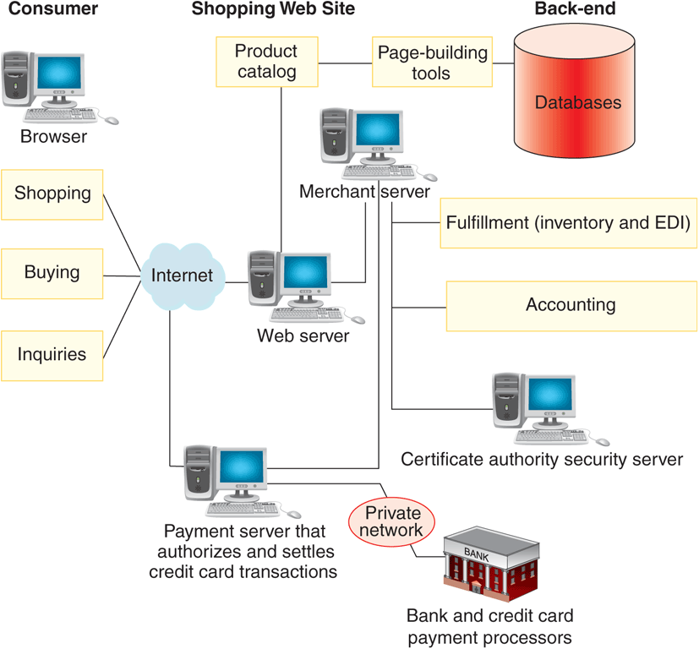
© Cengage Learning 2017
FIGURE 9-5 Typical enterprise-class electronic commerce architecture

Slide 38
Content Management Software
Helps control large amounts of text, graphics, media files that have become crucial to doing business
  Increased use of social media and networking as part of online business operations
Software should be tested before commitment
  Straightforward procedures for regular maintenance
  Facilitates typical content creation tasks
Leading providers include IBM and Oracle
  Costs between $50,000 and $500,000
  Can cost 3 to 4 times that amount to customize, configure and implement

Slide 39
Knowledge Management Software
Systems that manage knowledge itself rather than the documentary representations of that knowledge
  Collect, organize and share knowledge
  Enhance collaboration and preserve knowledge gained through information use to benefit future users
Tools to read documents and conduct searches
  Use proprietary semantic, statistical algorithms
Collects knowledge elements by extracting them from normal interactions users have with information
Implementation costs $10,000 to $1 million or more

Slide 40
Supply Chain Management Software
Helps coordinate planning and operations with supply chain partners
  SCM planning software develops coordinated demand forecasts
  SCM execution software helps with warehouse and transportation management
SCM software components manage demand and supply planning and demand fulfillment
Cost of SCM software implementations varies tremendously based on number of locations
  Range from under $300,000 to $5 million

Slide 41
Customer Relationship Management Software
Goal is to understand customer’s specific needs and customize product or service to meet those needs
  Idea is if customer needs are met exactly they will pay more for goods or services
Software must obtain data from operations software and gather data about customer activities
  Use data to conduct analytical activities
Basic form of CRM uses customer information to sell more goods or services
Advanced form of CRM delivers attractive, positive customer experiences

Slide 42
Customer Relationship Management Software (cont’d.)
Important in maintaining customer loyalty when purchase process is long and complex
From 1996 to 2000 companies spent millions to buy systems and restructure customer strategies
  Bad experiences led to a change in thinking
Now used to solve smaller, more specific problems
  Popular target is call center operations
Some companies create their own but most buy a software package
  Prices start around $2000 and large implementations can cost millions

Slide 43
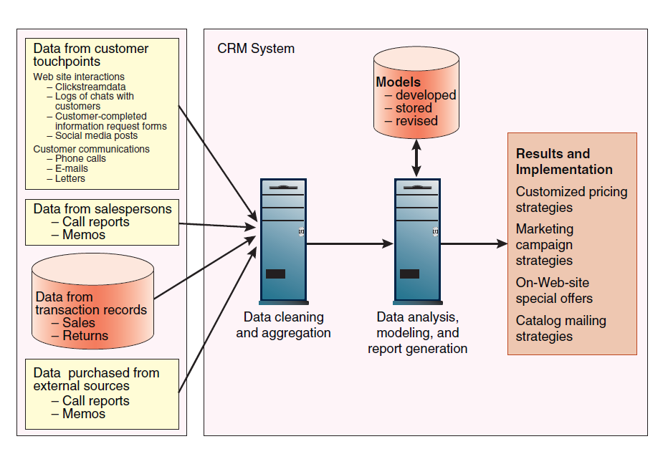
© Cengage Learning 2017
FIGURE 9-6 Elements of a CRM system

