Slide 1
Com 3105 E-Commerce Application Development
Hans Yip

Slide 2
Learning Objectives
Chapter 2 - Technology Infrastructure: Internet and the World Wide Web
About the origin, growth, and current structure of the Internet
How packet-switched networks are combined to form the Internet
How Internet, e-mail, and Web protocols work
About Internet addressing and how Web domain names are constructed
About the history and use of markup languages on the Web
How HTML tags and links work
About the cost and performance of Internet connections technologies
About Internet2 and the Semantic Web

Slide 3
Introduction of Internet
Network Architecture – Client/Server architecture.
A client is defined as a requester of services.
A server is defined as the provider of services.
PC + PC => LAN (Local Area Network)
LAN + LAN => MAN (Metropolitan Area Network)
MAN + MAN => WAN (Wide Area Network)
WAN + WAN => Internet
NOTE: Internet is the largest WAN in the world.

Slide 4
History of Internet
On February 7, 1958, US Department of Defense established the Advanced Research Projects Agency (ARPA), later renamed the Defense Advanced Research Projects Agency (DARPA).
Two main goals for this networking project are:
Allowed scientists at different physical locations to share information and work together on military and scientific projects.
Could function even if part of the network were disabled or destroyed by a disaster such as a nuclear attack.
By December 1969, the agency created a decentralized computer network known as ARPAnet.
This network linked four computers located at the UCLA, Standard Research Institute, the UC Santa Barbara, and the University of Utah
Each of these computers served as a host on the network.
A host, more commonly known today as a server, is any computer that provides services and connections to other computers on a network.

Slide 5
ARPANet
University of Utah
Stanford Research Institute
University of California Santa Barbara
University of California Los Angeles

Slide 6
New Technologies from this Project
Packet switching (from Circuit Switching)
Email was implemented in 1972
Telnet Protocol for remote logon
File Transfer Protocol (FTP)
In 1989, Tim Berners-Lee and his colleagues at the European Particle Physics Laboratory CERN proposed the concept of linking documents with hypertext, and he created Hypertext Transfer Protocol (HTTP). (Creation of World Wide Web)
In 1993, the introduction of Mosaic, the first graphical web browser (Netscape Navigator)

Slide 7
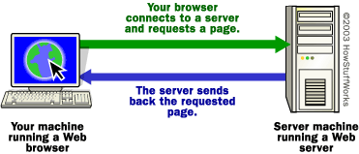
How Does Internet Work?

Slide 8
How does Internet Work?
Internet uses a client/server networking principle
When you enter the URL (http://www.mywebpage.com/myfile.html) of a web page into your browser and click “GO”
The browser breaks the URL (Uniform Resource Locator) into three parts:
The protocol (“http”)
The server name (“www.mywebpage.com”)
The file name (“myfile.html”)
The browser makes a request to the Domain Name Server with the server name which translates the server name www.mywebpage.com into an IP address.

Slide 9
How does Internet Work?
The browser then uses the IP address connecting to the server machine on port 80.
Following the HTTP protocol, the browser creates a HTTP request with a GET request to the server, asking for the file myfile.html (cookies may be sent from browser to server with the HTTP request)
The web server then sent a HTTP response with the HTML text for the web page to the browser (cookies may also be sent from server to browser in the header for the page)
The browser reads and interprets the HTML tags and formats the page onto your screen.

Slide 10
How does Internet Work?

Slide 11
How does Internet Work?

Slide 12
How does Internet Work?

Slide 13
A map of domain name ownership at street level for downtown San Francisco

Slide 14
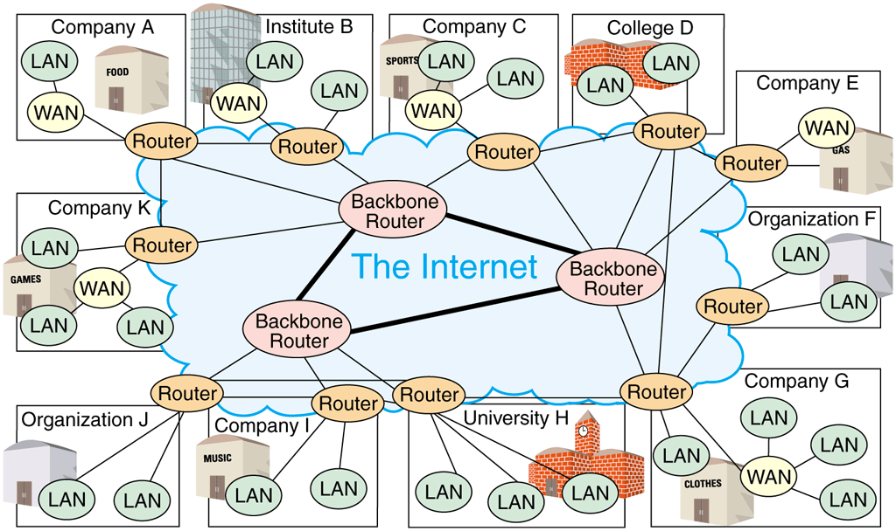
Router-based Architecture of the Internet

Slide 15
The Browsers
There are different web browsers in the market:
Mozilla: Firefox for Windows & Linux
Microsoft: Internet Explorer for Windows (Edge for Windows 10)
Netscape for Windows
Opera for mobile phones (Opera developed in Norway as a research project in 1994)
Safari for Apple

Slide 16
The Web Server
The Web Server is not only “looking up a file” (static web page).
It can process information and generate a page based on the specifics of the query
Dynamic web pages are generated by software such as CGI (Common Gate Interface)
Common Web servers:
Microsoft IIS (Internet Information Services)
Apache

Slide 17
What is?
Web Pages: contain HTML coding.
Web Site: a collection of web pages.
Web servers: Program that interpret HTTP requests and deliver the appropriate web page to your browser.
Server-Side Programming: Programs that run on the server computer.
Web Browsers: Program on the client computer that use to interpret and display web pages.
Client-Side Programming: Programs that run on the client side.
DNS (Domain Name Service): Convert Domain name into IP address.
HTTP Requests: transmit from browser to server with method information (GET/POST) to request a web page.
HTTP Responses: return from server to browser with status codes (200 – ok, 204 – no content, 401 – not authorized, 403 – forbidden, 404 – not found, etc…)
HTML Forms: web page contain fields where you can enter information. (<form></form>, <input />, <select></select>, <option></option>, etc…)
GET and POST Requests:
GET: encodes the message it sends into a query string, which is appended to the URL .
POST: sends its message in the message body of the request. (data is encoded and sent via an HTTP request).

Slide 18
The Internet and World Wide Web
Computer network is any technology allowing people to connect computers to each other
internet (small “i”) is a group of interconnected computer networks
Internet (capital “I”) connects networks all over the world
The Internet is a global network of computers and mobile devices that allows individuals and businesses around the world to share information and other resources and conduct business transactions.
host - is a computer or device directly connected to the Internet.
Online - When a user connects to the Internet.
A protocol is a standard or set of rules that computer network devices follow when transmitting and receiving data.
Every computer and device connected to the Internet uses Transmission Control Protocol/ Internet Protocol (TCP/IP).

Slide 19
The Internet and World Wide Web
IP Address (Internet Protocol Address): is a sequence of numbers that uniquely identifies the location of each computer or device connected to the Internet.
Domain name: is a text-based name that corresponds to the IP address of a server that hosts a website.
DNS server translates the domain name to its associated IP address.
IPv4 -----------------> 74.125.224.72
IPv6 -----------------> 2001:4860:4860::8844
Domain name ----> google.com

Slide 20
Domain Name

Slide 21
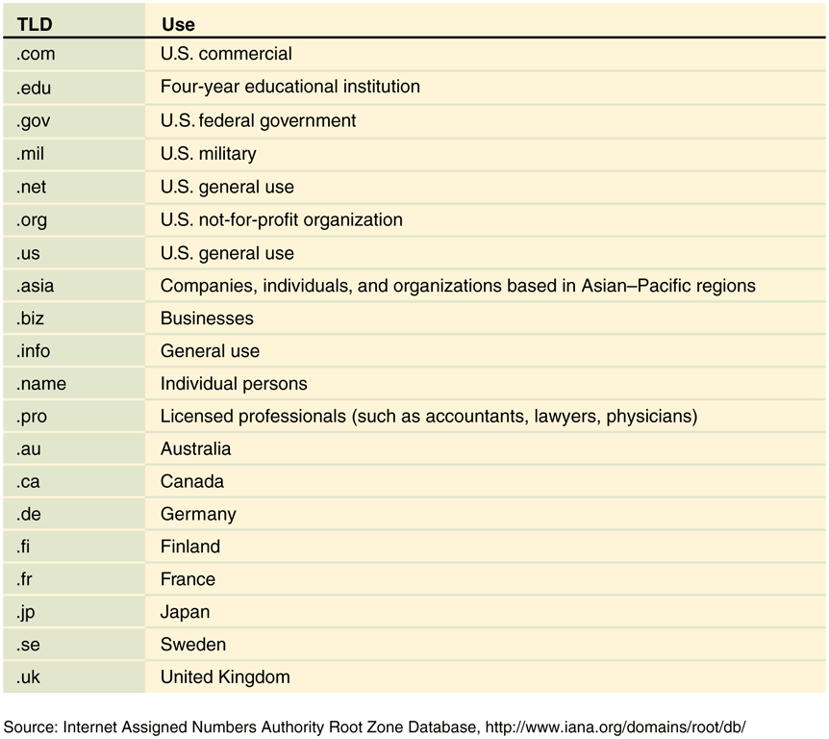
Commonly Used Domain Names

Slide 22
The Internet
Blogs – are locations that people can share ideas and information.
Millions of people go online to share ideas and information by hosting and participating in blogs — a process called blogging.
Video sharing websites, sometimes called video blogging websites, such as YouTube and Vimeo, allow users to share and comment on personal and professional videos.
Microblogging is sending brief text messages to subscribers, such as by using Twitter or other services to share status updates, links to articles, photos, and more.

Slide 23
Internet Activities
Browsing and searching for information.
Communicating with others through email, text or video chat, social networking, instant messaging, mailing lists, blogs and microblogs, and other media.
Downloading and uploading files.
Accessing remote computers or servers.
Conducting business activities.
Online shopping and bill payment.

Slide 24
Downloading and Uploading Files
One of the most useful Internet activities is downloading files from a server or uploading files to a server.
A server is a computer on a network used to store files.
The Internet standard or protocol that you use to upload or download music, software, word processing, picture, and other files to a server is the File Transfer Protocol (FTP).
Remote data access, storage, software access, and collaboration technologies are all aspects of cloud computing.

Slide 25
Remote Computing Technologies
Virtual Private Network (VPN) - A VPN provides a secure, encrypted connection between a remote user and a local area network.
Web conferencing or video calling allows remote employees to participate in meetings, training sessions, and more.

Slide 26
Conducting Business Activities
Although people often use the terms e-business and e-commerce interchangeably.
E-business refers to any use of the Internet to conduct a company’s business.
E-commerce refers to Internet use for the purpose of generating sales of goods or services, or creating and maintaining customer relations.
E-commerce websites can be categorized by the participants involved in the transactions:
Business-to-consumer (B2C)
Business-to-business (B2B)
Business-to-employee (B2E)
Consumer-to-consumer (C2C)

Slide 27
Email and Other Communication Tools
Online Communication | Description | Users must be online at the same time or not
Email | Users send and receive text with or without attached files | No
Instant messaging (IM) and mobile instant messaging (MIM) | Two or more users take turns exchanging brief messages | Yes
Internet Relay Chat (IRC) or chatting | Users type text into a chat window; all users can see what other users type | Yes
Massive multiplayer online games (MMOGs) | Many users play online games simultaneously, and can compete and interact with people all over the world | Yes

Slide 28
Email and Other Communication Tools
Online Communication | Description | Must users be online at the same time or not
Newsgroups and mailing lists | Users subscribe to a newsgroup discussion or mailing list on a certain topic and receive messages about that topic | No
Social bookmarking | Users share web links to articles, videos, photographs, and webpages, and can use tags to organize their bookmarks | No
Social networking | Users share status updates, microblogs, photos and video, links, and personal commentary using a variety of online tools | No

Slide 29
Other Internet Services
Email (Electronic mail): is the transmission of messages and files via a computer network.
An email client is any program used to create, send, and receive email messages.
To use some email clients, you download and install the program or app on your computer or mobile device and instruct it to manage your incoming email from a server or a web-based email service.
When you install an email client, you must set it up to sync and download email from your email address.

Slide 30
Email

Slide 31
Email

Slide 32
Email
Email messages travel over the Internet using the same packet-switching technology and TCP/IP suite that govern all communications over the Internet.
An email client might use the following protocols to interact with mail servers when sending and receiving messages:
SMTP (Simple Mail Transfer Protocol) for sending email.
POP (Post Office Protocol) for receiving email.
IMAP (Internet Message Access Protocol) for receiving email.
HTTP (Hypertext Transfer Protocol) for web-based email.

Slide 33
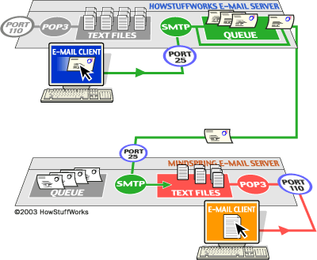
Email Client and Server
NOTE: SMTP server listens on port 25, POP3 listens on port 110 and IMAP listens on port 143

Slide 34
Other Internet Services
VoIP, short for Voice over IP (Internet Protocol): enables users to speak to other users via their Internet connection. (Skype)

Slide 35
World Wide Web
The World Wide Web, commonly called the web, is a subset of the Internet.
The web includes a vast collection of documents called webpages, which can include text, pictures, sound, animation, or video.
A website is a collection of related webpages.
A markup language is a coding system that uses tags to provide instructions about the appearance, structure, and formatting of a document.
Webpages use markup languages to define the layout and/or content of the pages.
Web designers use Hypertext Markup Language (HTML) codes to define the layout and structure of a webpage.
The HTML markup language uses predefined codes called HTML tags to define the format and organization of webpage elements.

Slide 36
World Wide Web
Cascading style sheets (CSS) are documents that specify design aspects of a webpage, such as fonts and colors.
You can create a webpage using a simple text editor program, such as Notepad, or using WYSIWYG (What You See Is What You Get) web authoring software, such as Adobe Dreamweaver or an online content management system, such as WordPress.
To share a webpage or website with others, you must upload, or publish, it to a web server so that other users may access it.
A web server is a computer that stores webpages.
You can access and view webpages using a software program called a web browser, or browser.
Popular browsers for laptops and PCs include Google ChromeTM, Mozilla Firefox, Microsoft Internet Explorer (Edge for Windows 10), and Apple Safari.

Slide 37
World Wide Web
Webpages connect to other webpages using hyperlinks.
A hyperlink, or link, is text or a picture on a webpage that you tap or click to view a different location on the same webpage, another webpage at the same website, a webpage at a different website, or to an email address, or PDF document.
Exploring the web by moving from one webpage to another is sometimes called browsing or surfing the web.
A search tool is a web-based resource that helps you find specific information on the web.
One type of search tool is a search engine, such as Google or Bing, which you can use to search for webpages that contain specific keywords or phrases.

Slide 38
History of Internet
On February 7, 1958, Department of Defense (DoD) created the Advanced Research Project Agency (ARPA).
Phone systems work by using a technology known as circuit switching.
Circuit switching allows a caller to dial a number to establish and maintain a private circuit across the wires.
In 1961, Leonard Kleinrock, a scholar at the University of California, Los Angeles (UCLA), wrote his doctoral dissertation and outlined the idea of data networking and packet switching.
Packet switching involves separating data from a sending computer or device into small units known as packets, sending each packet independently over cables, and then reassembling the packets on the receiving computer or device.
NOTE: Each packet even can follow different routes to its destination.

Slide 39
History of Internet
In 1966, ARPA funded a new network of computers, called ARPANET.
The computer at UCLA is the first computer on ARPANET.
The computer at the Stanford Research Institute (SRI) is the second on ARPANET.
By December 1969, the University of California Santa Barbara and the University of Utah joined the ARPANET network, making these four university connections the foundation of the global network known today as the Internet.
In 1972, Robert Kahn and Vinton Cerf developed two new protocols for ARPANET, TCP and IP.

Slide 40
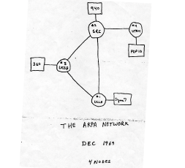
The Arpa network

Slide 41
History of Internet
Transmission Control Protocol (TCP) provided flow control over the network and error checking for lost packets. Internet Protocol (IP) addressed and sent the packets.
NOTE: In 1983, DARPA (Defense Advanced Research Projects Agency) mandated the use of this suite of communications protocols, referred to as TCP/IP. Since then, every computer and device connected to the Internet has used TCP/IP to communicate.
Late in 1971, Ray Tomlinson, a scientist at Bolt Beranek and Newman (BBN), developed the first email program that could send and receive messages to and from remote computers.
1975 brought the first mailing list, titled SF-Lovers, for science fiction fans among the ARPA community.
A mailing list allows participants to send a single message to the list, which then automatically routes the message to every other participant.

Slide 42
History of Internet
In 1985, the National Science Foundation (NSF) established a new network called NSFNet.
backbone is the main long-distance lines and the hardware that connect computers to the Internet.
By 1990, the success of the NSFNet led to the shutdown of ARPANET. NSFNet became the main network linking universities and research facilities.
The military portion of ARPANET became a separate network called MILNET, which is now known as NIPRNET (Nonsecure Internet Protocol Router Network).
In the mid-1990s it became common to use English-language names to identify computer hosts, rather than the long series of numbers originally used.
In 1995, the NSF moved the connections from the original NSFNet backbone to a commercial Internet backbone supported by commercial network providers.

Slide 43
History of World Wide Web
In the early 1990s, Tim Berners-Lee, who was working at CERN in Switzerland, envisioned the use of hyperlinks to make connections between related ideas in separate documents.
Hypertext, which is a system of hyperlinks that allows users to tap or click on a word to jump to another location.
With the help of his CERN colleague Robert Cailliau, Berners-Lee created three technologies:
created HTML, used to create documents that can include text, graphics, and links.
created a special software program to read and display HTML documents, the first browser known as WorldWideWeb (spelled with no spaces).
created Hypertext Transfer Protocol (HTTP), a protocol that defines how HTML documents transmit to a browser.

Slide 44
History of World Wide Web
Marc Andreessen and Eric Bina, two University of Illinois graduate students employed at the university’s National Center for Supercomputing Applications (NCSA), created the Mosaic browser in March 1993.
The next year, Andreessen and Jim Clark founded a new company, Netscape Communications.
During the summer of 1994, the company created the first commercial browser, called Netscape Navigator.

Slide 45
Connecting to the Internet
A local area network (LAN) connects computers using cables or wireless capabilities within a building or campus so users can share data and resources.
An Internet service provider (ISP) is a business that has a permanent Internet connection and provides temporary Internet connections to individuals and companies.
A mobile service provider, sometimes called a wireless data provider, offers wireless Internet access to computers and mobile devices that have wireless capabilities.
ISPs are classified either as regional or national:
A regional ISP provides Internet access for customers (individuals or businesses) in a specific geographic area.
A national ISP provides Internet access in most major cities and towns nationwide. National ISPs may offer more services and generally have larger technical support staffs than regional ISPs.

Slide 46
Connecting to the Internet
The speed of an Internet connection depends on bandwidth, which is the capacity of the communications channel.
The speed at which data travels from one device to another is the transfer rate.
Transfer rates measure the number of bits the line can transmit in one second (expressed as bits per second, or Bps).
Transfer rates range from thousands of bits per second (kilobits per second or KBps) to millions of bits per second (megabits per second or MBps), and even billions of bits per second (gigabits per second, or GBps).

Slide 47
Connection Methods (Wired)
CABLE: Cable television (CATV) lines enable home or business users to connect to the Internet over the same coaxial cable that delivers television transmissions.
Cable Internet connections require a coaxial cable, a line splitter that divides the television signals from the data signals, a cable modem, and a network expansion card inside the computer.
A cable modem is a particular type of modem used for high-speed cable connections.

Slide 48
Connection Methods (Wired)
DIGITAL DEDICATED LINES: Unlike a dial-up line in which the connection is reestablished each time it is used, a dedicated line is a constant connection between two communications devices that uses the local phone network.
Three popular types of digital dedicated lines are:
Integrated Services Digital Network (ISDN) lines
digital subscriber lines (DSL)
T-carrier lines

Slide 49
Connection Methods (Wired)
Integrated Services Digital Network (ISDN) is a set of standards for digital transmission of data over standard copper phone lines.
With ISDN, the same phone line that could carry only one computer signal now can carry three or more signals at once, through the same line, using a technique called multiplexing.
Multiplexing allows for more data to transmit at the same time over the same line.

Slide 50
Connection Methods (Wired)
Digital subscriber line (DSL) is another digital line alternative for the small business or home user.
A DSL transmits at fast speeds on existing standard copper phone wiring. Some of the DSL installations can provide a dial tone, so you can use the line for both voice and data.
An asymmetrical digital subscriber line (ADSL) is a type of DSL that supports faster transmissions when receiving data than when sending data. ADSL is ideal for Internet access because users generally download more data from the Internet than they upload.

Slide 51
Connection Methods (Wired)
A T-carrier line is any of several types of digital lines that carry multiple signals over a single communications line. Whereas a standard dial-up phone line carries only one signal, digital T-carrier lines use multiplexing so that multiple signals can share the phone line. T-carrier lines provide extremely fast data transfer rates.
The most popular T-carrier line is the T-1 line. Businesses often use T-1 lines to connect to the Internet.
A fractional T-1 line is a less-expensive, slower connection option for homeowners and small businesses. Instead of a single owner, multiple users share a fractional T-1.
A T-3 line is equal in speed to 28 T-1 lines. T-3 lines are the most expensive connection method. Main users of T-3 lines include large companies, phone companies, and service providers connecting to the Internet backbone.

Slide 52
Connection Methods from Home (Wired)

Slide 53
Connection Methods (Wireless)
WIRELESS FIDELITY (Wi-Fi) is a family of wireless networking standards that uses radio waves to allow a computer to communicate with other computers on a local area network or the Internet.
A Wi-Fi network may be password protected or open to the public.
A hotspot is a specific geographic location in which a wireless access point provides public Internet access.
A hotspot typically covers a 100-foot range from the wireless access point, although some may provide a greater range.
A wireless access point is a hardware device with an antenna that is connected to a wired network and is used to send and receive radio waves to and from notebook computers or other wireless devices.

Slide 54
Connection Methods (Wireless)
Satellite Internet access comes in two varieties: one-way and two-way.
One-way satellite access uses the satellite for downloading data, and uses a slow, regular phone line and modem for uploading data.
A better alternative is two-way satellite access, which uses the faster satellite connection for both uploading and downloading data.
Satellite Internet access can be expensive both in monthly access fees and equipment costs, but satellite access may be the only alternative in rural areas.

Slide 55
Connection Methods (Wireless – Mobile Network)
Third-generation (3G) wireless technology
2 Mbps download/800 Kbps upload speeds
Fourth-generation (4G) technology
Long Term Evolution (LTE) and Worldwide Interoperability for Microwave Access (WiMAX) offer 14 Mbps download/ 8Mbps upload speeds

Slide 56
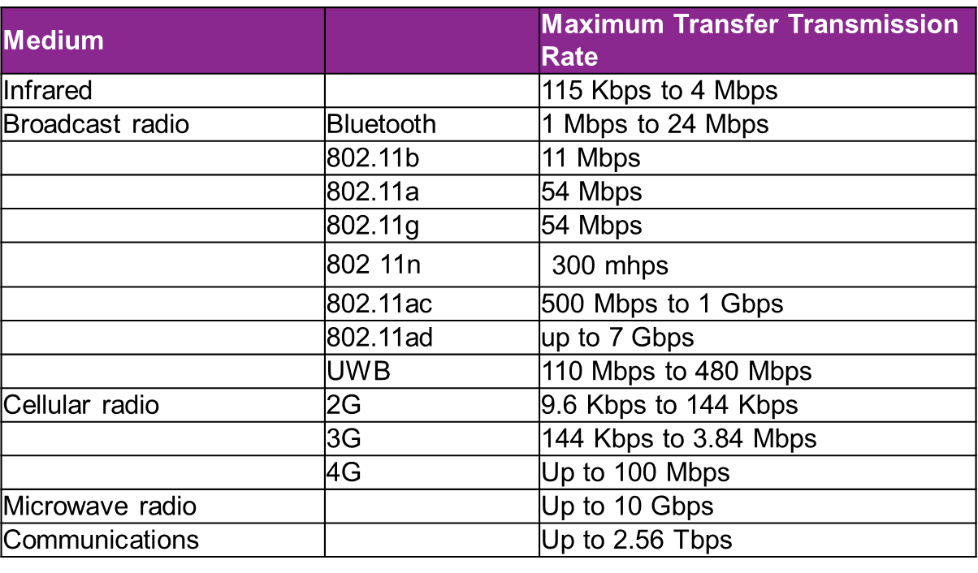
Wireless Transmission Media Transfer Rates

Slide 57
Connection Methods from Home (Wireless)

Slide 58
Internet2 and the Semantic Web
Internet2 is an advanced research network created in 1996 as a replacement for ARPANET laboratory
Experimental networking technologies test bed
High end of the bandwidth spectrum (10 Gbps)
Used by universities, medical schools, CERN
Focus: mainly technology development
Semantic Web project has a goal of blending technologies and information
Web pages tagged (using XML) with meanings
Uses software agents (intelligent programs) to read XML tags, determine meaning of words
Resource description framework (RDF)
Set of XML syntax standards
Development of Semantic Web will take many years
Start with ontologies for specific subjects

Slide 59
Questions
What are the causes of APRAnet? What are the new features from APRAnet?
What is Domain Name, Domain Name Server (DNS), Top-level domain name (TLD)? (Explain with example)
What technology is Internet? What is static web page? What is dynamic web page?
What is URL? Explain with example how the browser handle the URL.
What is VPN? What is VoIP?
What is Hypertext Markup Language (HTML)? What is Cascading Style Sheet (CSS)? What is Hyperlink and what is it used for?
What is APRAnet? How many servers to begin with and what are they?
What is HTTP? What is TCP/IP? What is ISP?
How to connect to Internet wired and wireless? What are the methods?

Slide 60
References
https://www.darpa.mil/about-us/darpa-history-and-timeline
https://www.history.com/news/who-invented-the-internet
Schneider, G. P. (2017). Electronic Commerce (12th ed.). Boston: Thomson Course Technology
Vermaat, M. E. (2018). Discovering Computers 2018: Digital Technology, Data, and Devices. Publisher: Cengage Learning

