Slide 1

Com 3105 E-Commerce Application Development
Hans Yip

Slide 2
Learning Objectives
Purchasing, Logistics, and Business Support Processes
Electronic Data Interchange
Supply Chain Management Using Internet Technologies

Slide 3
Some business background for you
Basic business functions
The business environment
Common types of Information System for business

Slide 4
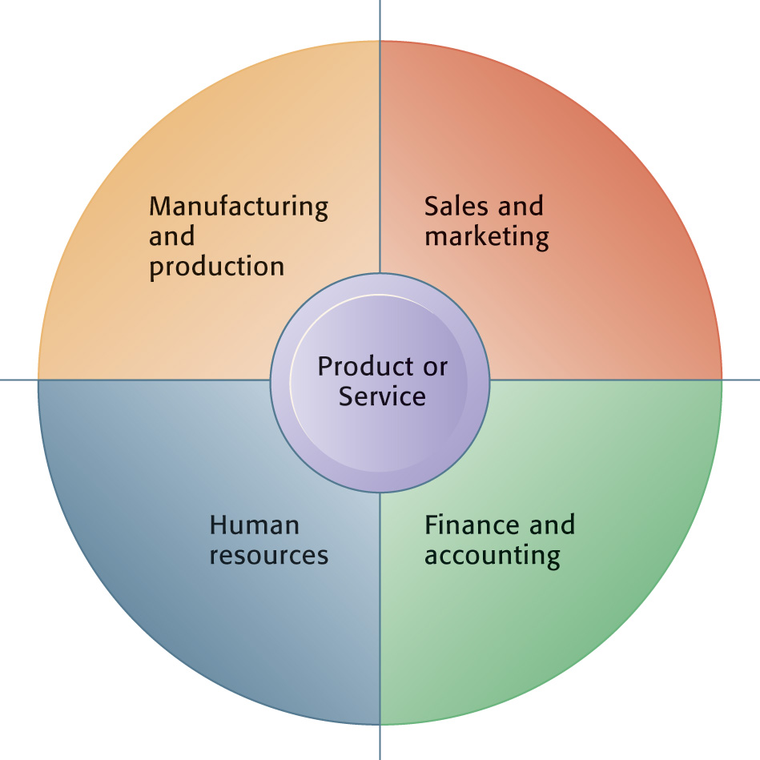
Basic Business Functions
A business consists of four basic functions in order to be successful.
In a successful business, the four basic functions will work seamlessly together to serve five entities:
  Suppliers
  Customers
  Employees
  Invoices/payments
  Products and services

Slide 5
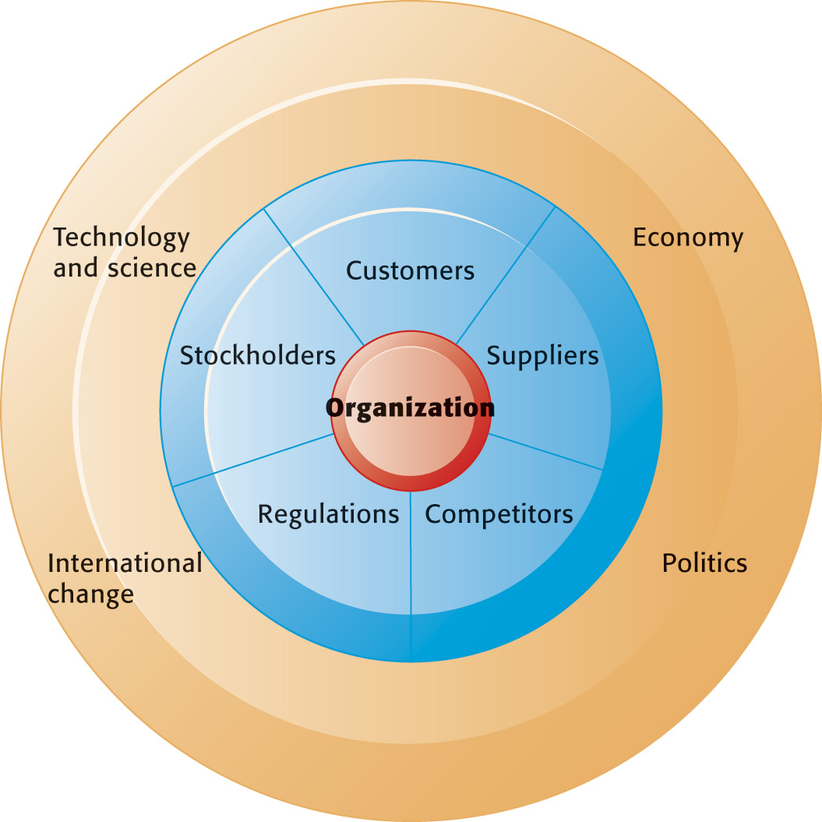
The Business Environment
Every business will have to deal with all of these environmental entities.

Slide 6
Common Types of Information System
There are four major enterprise applications typically used to make an organization success.
  Supply Chain Management Systems (SCM)
  Customer Relationship Management Systems (CRM)
  Knowledge Management systems (KMS)
  Enterprise Systems (AKA Enterprise Resource Planning (ERP))

Slide 7
Supply Chain Management Systems (SCM)
Supply chain management systems offer new opportunities for companies to integrate data and information with their suppliers and ultimately, lower costs for everyone.

Slide 8
Customer Relationship Management Systems (CRM)
The ideal CRM system provides end-to-end customer care from receipt of order through product delivery.
CRM also helps a firm cut the costs of keeping good customers by supplying the entire organization with a consolidated view of the customers’ needs.
Unprofitable customers are more easily identified with a CRM system and the time and energy spent can be retargeted to more profitable customers.

Slide 9
Knowledge Management Systems (KMS)
Knowledge management systems (KMS) enable organizations to better manage processes for capturing and applying knowledge and expertise.

Slide 10
Enterprise Systems
Enterprise systems (also known as enterprise resource planning (ERP) systems) are used to bridge the communication gap between all departments (Island of data) and all users of information within a company.

Slide 11
Purchasing, Logistics, and Business Support Processes
In this chapter, you will learn how companies use electronic commerce to improve their business processes, including purchasing and logistics primary activities and all of the processes relating to their support activities (which include finance and administration, human resources, and technology development).
Although the work might not seem as creative as designing a Web site or developing an advertising campaign, the potential earnings impact of cost reductions and business process improvements in purchasing, logistics, and support activities is tremendous.

Slide 12
Outsourcing and Offshoring
The use of other organizations to perform specific activities is called outsourcing.
For example, U.S,-based companies such as Paychex and TriNet handle payroll, human resources, health insurance, and other employee benefit plans for thousands of companies that have decided to outsource those business processes.
When the outsourcing is done by organizations in other countries, it is often called offshoring.
For example, Apple or Motorola would offshore the manufacture of their U.S.-designed mobile phones by having them manufactured and assembled in less-developed Asian countries.

Slide 13
Purchasing Activities
Purchasing activities include identifying and evaluating vendors, selecting specific products, placing orders, and resolving any issues that arise after receiving the ordered goods or services.
These issues may include late deliveries, incorrect quantities, incorrect items, and defective items.
By monitoring all relevant elements of purchase transactions, purchasing managers can play an important role in maintaining and improving product quality and reducing costs.
In chapter 1, you learned how companies can organize their strategic business unit activities using an industry value chain.
The part of an industry value chain that precedes a particular strategic business unit is called that business unit’s supply chain.

Slide 14
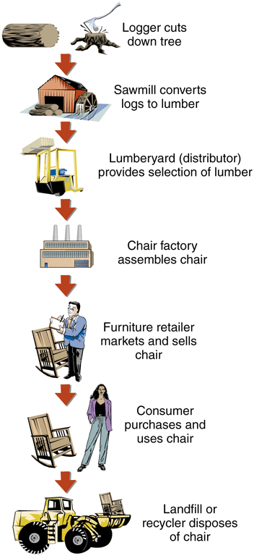
Industry Value Chain

Slide 15
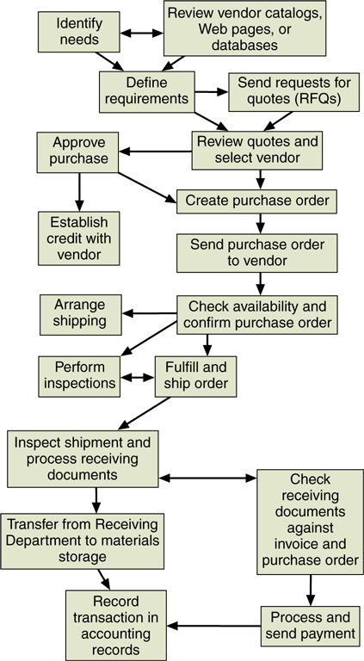
Steps in a Typical Business Purchasing Process

Slide 16
Direct VS. Indirect Materials Purchasing
Direct materials are those materials that become part of the finished product in a manufacturing process.
Steel manufacturers, for example, consider the iron ore.
There are two types of direct materials purchasing:
  Replenishment purchasing (or contract purchasing): the company negotiates long-term contracts for most of the materials that it will need.
  If demand is higher than the estimate need, it must buy additional materials during the year. These purchases are made in a loosely organized market, and companies that have excess materials that they purchased on contract. This market is called a spot market.
  Buying from this market is called Spot purchasing, the second type of direct materials purchasing.
Indirect materials are all other materials that the company purchases, including factory supplies (office supplies) such as sandpaper, hand tools, and replacement parts for manufacturing machinery.

Slide 17
Logistics Activities
The classic objective of logistics is to provide the right goods in the right quantities in the right place at the right time.
Logistics activities include managing the inbound movements of materials and supplies and the outbound movements of finished goods and services.
Thus, receiving warehousing, controlling inventory, scheduling and controlling vehicles, and distributing finished goods are all logistics activities.
The Web and the Internet are providing an increasing number of opportunities to manage these activities better as they lower transaction costs and provide constant connectivity between firms engaged in logistics management.
Web-enabled automated warehousing operations are saving companies millions of dollars each year.

Slide 18
E-Government
Governments perform many important functions for the individual citizens, businesses, and other organizations that they serve.
Many of these functions can be enhanced by the use of online technologies.
Governments also perform businesslike activities; for example, they employ people, buy supplies from vendors, and distribute benefit payments of many kinds.
Citizens can download blank tax forms, passport applications, and other documents from government Web sites.
Government entities also collect a variety of taxes and fees from their constituents and can use the the Internet to make that process more efficient.
The use of Internet technologies by governments and government agencies to perform these functions is often called e-government.

Slide 19
Electronic Data Interchange
Electronic data interchange (EDI) is a computer-to-computer transfer of business information between two businesses that uses a standard format of some kind.
The two businesses that are exchanging information are trading partners.
Firms that exchange data in specific standard formats are said to be EDI compatible.
The business information exchanged is often transaction data; however, it can also include other information related to transactions, such as price quotes, invoices, purchase orders, requests for quotations, bulls of lading, and receiving reports.
EDI was the first form of electronic commerce to be widely used in business – beginning some 20 years before anyone used the term electronic commerce, and it continues to be an important part of B2B.
Understanding EDI is important because most B2B electronic commerce is based on EDI or adapted from EDI.
It is also important because EDI is still the single most commonly used technology in online B2B transactions.

Slide 20
History of EDI (Early Business Information Interchange Efforts)
By the 1950s, companies were using computers to keep records of internal transactions, but information flows between businesses required paper documents (purchase orders, invoices, bills of landing, checks, remittance advices, and so on) because one company’s computers could not communicate with other companies’ computers.
This kind of data flow was slow, inefficient, expensive, redundant and unreliable.
By the 1960s, businesses with large transaction volumes had begun exchanging information with each other by shipping punched cards or reels of magnetic tape.
During the 1960s and 1970s, data communications technologies improved, allowing businesses to transfer data over telephone lines.
In 1968, a number of freight and shipping companies joined together to create a standardized information set that included all the data elements that shippers commonly included on bills of landing, freight invoices, shipping manifests, and other paper forms, and converted those information into a computer file that they could send to any freight company that adopted the standard.
These industry-specific data interchange standards were helpful, but companies was looking for standards that could be used in all industries.

Slide 21
History of EDI (Emergence of Broader Standards: The Birth of EDI)
In 1979, the American National Standards Institute (ANSI) chartered a new committees to develop uniform EDI standards.
This committee is called the Accredited Standards Committee X12 (ASC X12).
The administrative body that coordinates ASC X12 activities is the Data Interchange Standards Association (DISA).
The ASC X12 standard currently includes specifications for several hundred transaction sets.
The X12 standards were quickly adopted by major firms in the United States, but not in other countries.
In the mid-1980s, the United Nations Economic Commission for Europe invited North American and European EDI experts to work together on designing a common set of EDI standards.
In 1987, the United Nations published its first standards under the title EDI for Administration, Commerce, and Transport (EDIFACT, or UN/EDIFACT).
The DISA and the UN/EDIFACT group have attempted to develop a single common set of international standards several times since 2000; however, not succeeded.
Today, both standards continue to exist. Companies that do business worldwide must either make their EDI software work with both standards or use a conversion software.

Slide 22

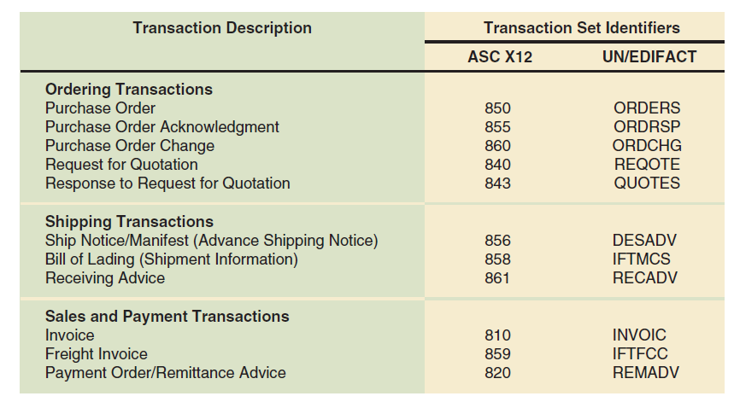
Commonly Used EDI Transaction Sets

Slide 23
How EDI Works
Basic idea: straightforward
Implementation: complicated
For example, consider a company that needs a replacement for one of its metal-cutting machines.
  Steps to purchase using paper-based system
  Steps to purchase using EDI
NOTE: it is assumed that the vendor uses its own vehicles instead of a common carrier to deliver the purchased machine.

Slide 24
Paper-Based Purchasing Process
Buyer and vendor not using integrated software for business processes so each information processing step results in paper document
Paper-based information transfer
    Mail, courier, fax
Information flows shown in Figure 5-5

Slide 25
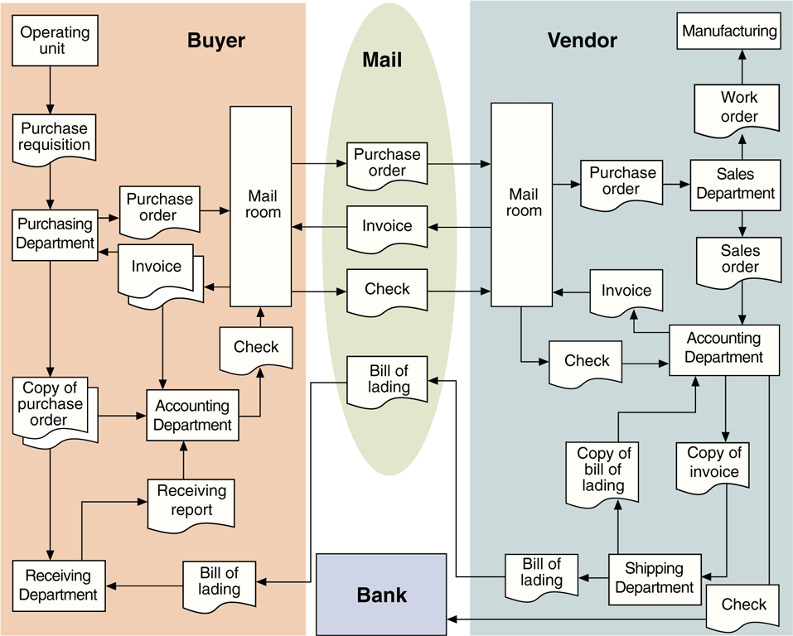
Information Flows in a Paper-Based Purchasing Process

Slide 26
EDI Purchasing Process
Mail service replaced with EDI network data communications
  Paper flows within buyer’s and vendor’s organizations replaced with computers running EDI translation software
  Information flows shown in Figure 5-6

Slide 27
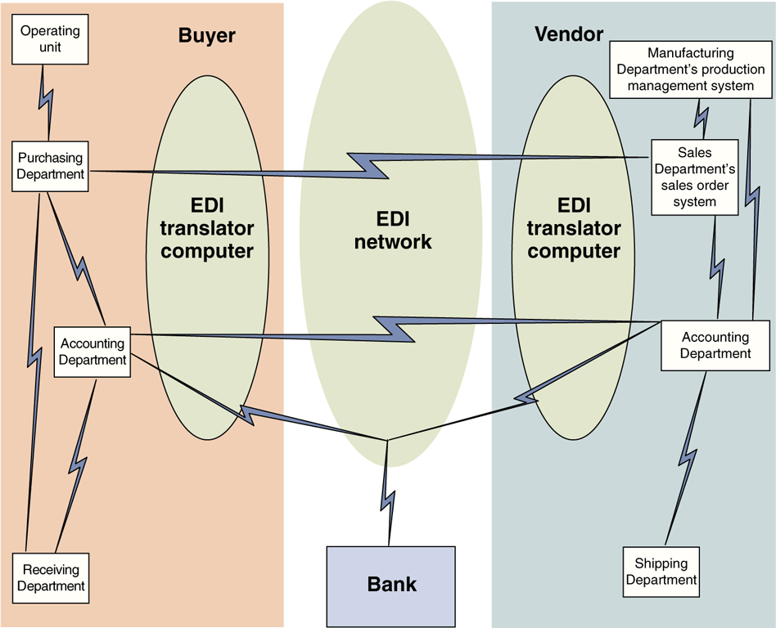
Information Flows in an EDI Purchasing Process

Slide 28
Value-Added Networks (VAN)
Trading partners can implement the EDI network and EDI translation processes in several ways.
Each of these ways uses one of two basic approaches: direct connection or indirect connection.
The first approach, called direct connection EDI, requires each business in the network to operate its own on-site EDI translator computer.
Because dedicated leased-lines are expensive, only a few very large companies still use direct connection EDI.

Slide 29
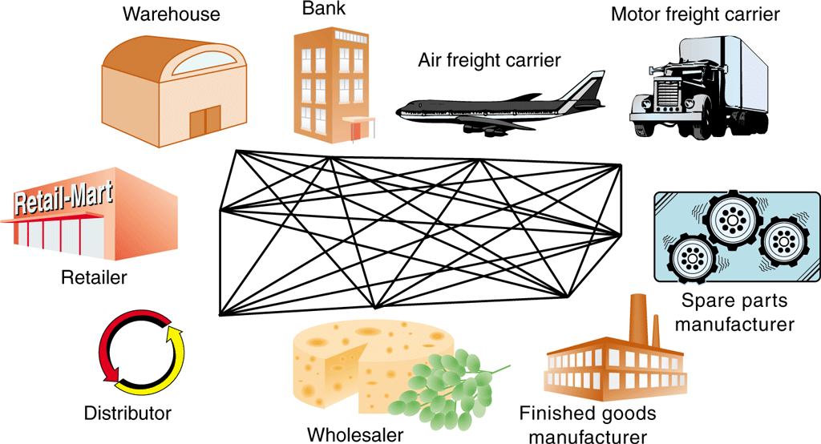
Direct Connection EDI

Slide 30
Value-Added Networks (VAN)
Instead of connecting directly to each of its trading partners, a company might decide to use the services of a value-added network (VAN).
A value-added network (VAN) is a company that provides communications equipment, software, and skills needed to receive, store, and forward electronic messages that contain EDI transaction sets.
To use the services of a VAN, a company must install EDI translator software that is compatible with the VAN.
To send an EDI transaction set to a trading partner, the VAN customer connects to the VAN using a dedicated telecommunications line and then forwards the EDI-formatted message to the VAN.
The VAN logs the message and delivers it to the trading partner’s mailbox on the VAN computer.
The trading partner then dials in to the VAN and retrieves its EDI-formatted messages from that mailbox.
This approach is called indirect connection EDI because the trading partners pass messages through the VAN instead of connecting their computers directly to each other.

Slide 31
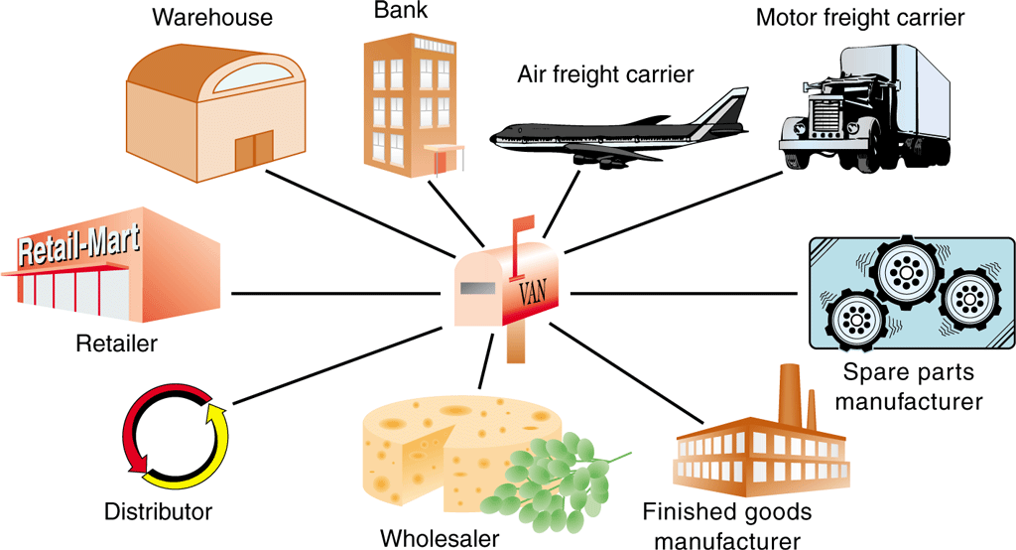
Indirect Connection EDI Through a VAN

Slide 32
VAN services Today
Because EDI transactions are business contracts and often involve large amounts of money, the existence of an independent audit log helps establish nonrepudiation.
Nonrepudiation is the ability to establish that a particular transaction actually occurred. It prevents either party from repudiating, or denying, the transaction’s validity or existence.
In the past, VANs had one serious disadvantage: cost.
Most VANs required an enrollment fee, a monthly maintenance fee, and a transaction fee.
The up-front cost of implementing indirect connection EDI, including software, VAN enrollment fee, and hardware.
Today, VAN costs are much lower because VANs use the Internet instead of leased telecommunication lines.
Many companies that provide VAN services today all use the Internet as their main data communication technology.
EDI on the Internet is called Internet EDI or Web EDI. It is also called open EDI because the Internet is an open architecture network.
The EDIINT (Electronic Data Interchange-Internet Integration) set of protocols is the most common set used for the exchange of EDI transaction sets over the Internet.

Slide 33
EDI Payments
Some EDI transaction sets provide instructions to a trading partner’s bank.
These transaction sets are negotiable instruments; that is, they are the electronic equivalent of checks.
All banks have the ability to perform electronic funds transfers (EFTs).
When EFTs involve two banks, they are executed using an automated clearing house (ACH) system, which is a service that banks use to manage their accounts with each other.

Slide 34
Supply Chain Management Using Internet Technologies
When companies integrate their supply management and logistics activities across multiple participants in a particular product’s supply chain, the job of managing that integration is called supply chain management.
The ultimate goal of supply chain management is to achieve a higher quality or lower-cost product at the end of the chain.

Slide 35
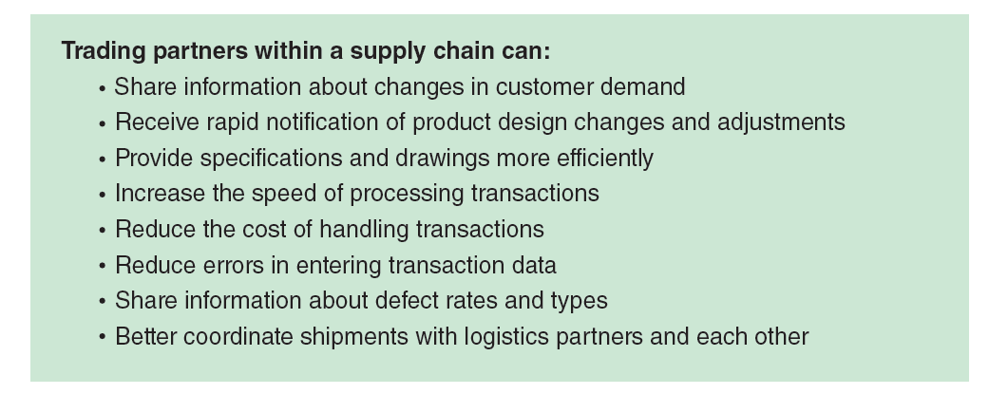
Advantages of Using Internet Technologies in Supply Chain Management

Slide 36
Materials-Tracking Technologies
Companies have been using optical scanners and bar codes for many years to help track the movement of materials.
Figure 5-10 shows a typical bar-coded shipping label that is used in the auto industry.
Each bar-coded element is a representation of an element of the ASC X12 transaction set number 856, Advance Shipping Notice.
Five of the 856 transaction set’s elements are bar coded including Part Number, Quantity Shipped, Purchase Order Number, Serial Number, and Packing List Number).

Slide 37
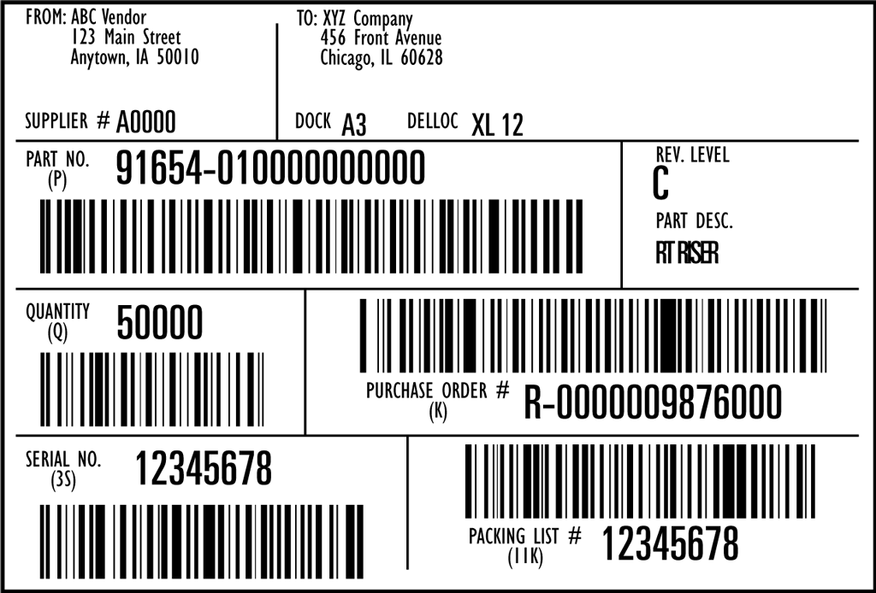
Shipping Label with Bar-coded Elements from EDI Transaction Set 856, Advance Shipping Notice

Slide 38
Radio Frequency Identification Devices (RFID)
In the second wave of electronic commerce, companies are integrating new types of tracking into their Internet-based materials-tracking systems.
The most promising technology now being used is radio frequency identification devices (RFIDs), which are small chips that use radio transmissions to track inventory.
RFIDs that have their own power supply are called active RFIDs.
A passive RFID, which can be made cheaply and in very small sizes, does not need a power source.
It receives a radio signal form a nearby transmitter and extracts a tiny amount of power from that signal.
It uses the power it extracts to send a signal back to the transmitter. That signal includes information about the inventory item to which the RFID has been affixed.
Passive RFIDs are small enough to be installed on the face of credit cards or sewn into clothing items.

Slide 39
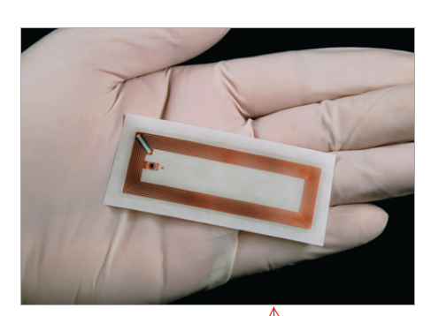
Passive RFID tag

Slide 40
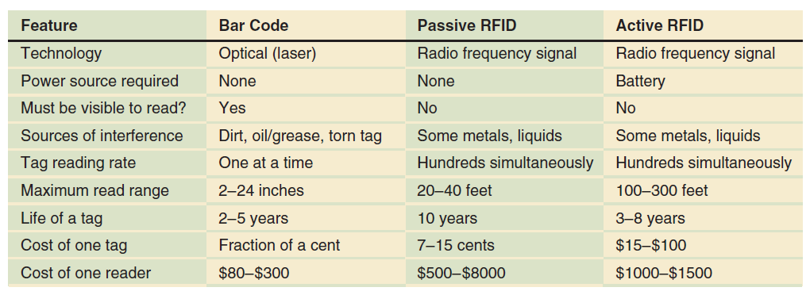
Key Features of Bar Code, Passive RFID, and Active RFID technologies

Slide 41
Questions
What is Outsourcing?
What is Offshoring?
What is the difference between Outsourcing and Offshoring?
What is Direct and Indirect materials purchasing?
What are considered logistics activities?
What is E-government?
What is Electronic Data Interchange (EDI)?
What are the two types of EDI connections?
What is value-added network (VAN)?
What are the three material-tracking technologies? (what are the difference?)

Slide 42
References
Laudon, K., Essentials of MIS 12th Edition (2017), Pearson, ISBN: 9780134474014
https://blog.atlasrfidstore.com/active-rfid-vs-passive-rfid

