Slide 1
Com 3105 E-Commerce Application Development
Hans Yip

Slide 2
Learning Objectives
Web Server Basics
Dynamic Content Generation
Multiple meanings of Web Server
Cloud Computing

Slide 3
Web Server Basics
Client/server architectures used in LANs, WANs, Web
Server computers have more memory and larger, faster disk drives than the client computers they serve
Web browser: a type of Web client software
Platform neutrality is the ability of a network to connect devices using different operating systems
Critical in rapid spread, widespread Web acceptance
Web server’s main job to respond to Web client requests
Main elements: Hardware, operating system software, and Web server software

Slide 4
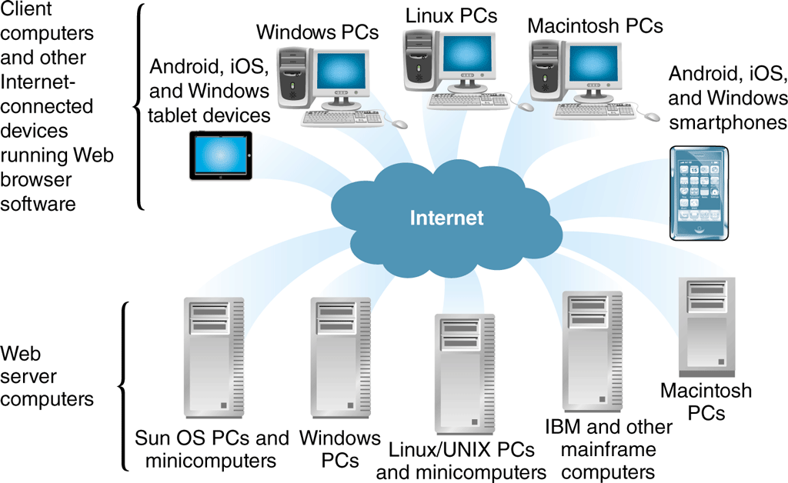
Platform Neutrality of the Web

Slide 5
Dynamic Content Generation
Static page is an unchanging page retrieved from stored Web server file(s)
Dynamic page created in response to user request
Customized pages give user an interactive experience
Client-side scripting software operates on the Web client (browser) and changes Web page display in response to a user’s actions (JavaScript or Adobe Flash)
Server-side scripting program runs on a Web server and creates Web page in response to request for specific information from a Web client

Slide 6
Dynamic Content Generation
Software tools to create dynamic Web pages
Microsoft ASP.NET, Apache Software Foundation Hypertext Preprocessor (PHP) and Adobe ColdFusion
AJAX (asynchronous JavaScript and XML) creates interactive Web sites that look like applications
Ruby on Rails, Scala and Python (scripting language) are used to accomplish the same objectives
Many Web sites use more than one language and/or development framework to accomplish specific objectives

Slide 7
Multiple Meanings of “Server”
Server is any computer providing files or making programs available to other computers connected to it through a network
Server software makes files and programs available
May be part of the operating system (OS) and be referred to as server software (confusing)
Some servers connected to Internet via a router
Runs Web server software that makes server’s files available to other computers and called a Web server
E-mail server: handles incoming and outgoing e-mail
Database server runs database management software
Transaction server runs accounting and inventory management software

Slide 8
Web Client/Server Architectures
Basic model is two-tier client/server architecture
One client and one server computer

Slide 9
Two-tier Client/server architecture

Slide 10
Web Client/Server Architectures
Three-tier architecture allows additional processing before server responds to client’s request
Often includes databases and related software applications that supply information to the Web server
Web server uses software applications’ output when responding to client requests
N-tier architectures have more than three tiers
Track customer purchases stored in shopping carts
Look up sales tax rates
keep track of customer preferences, update in-stock inventory databases
Keep product catalog current

Slide 11
Three-tier Architecture

Slide 12
Web Server Software
Commonly used programs are Apache HTTP Server and Microsoft Internet Information Server (IIS)
Some businesses, such as Google, wrote their own
Apache dominant Web server software since 1996
Free and user-supported with other services available
Microsoft IIS bundled with Microsoft Windows Server OS and runs only on Windows systems
Used on many intranets, and small and large sites that have adopted Microsoft products as standard
ISS is free but OS it comes with can be expensive

Slide 13
Web Server Hardware
Wide variety of computer brands, types, sizes used by organizations to host online operations
Small companies run Web sites on desktop PCs
Most online business operations are operated on computers designed for site hosting
Businesses select specific hardware and software elements based on site’s functionality, expected visitors, number and size of pages and graphics

Slide 14
Server Computers
Generally have more memory, larger (faster) hard disk drives and faster processors than typical desktop computers
Many Web server computers use multiple processors
Most companies spend $2,000-$50,000 on an individual Web server with large organizations spending millions on server hardware
May be housed in freestanding cases but most are installed in equipment racks
Blade servers are servers-on-a-card
Small in size: 300 installed in single 6-foot rack

Slide 15
Rack-mounted blade servers

Slide 16
Web Servers and Green Computing
Significant electrical power needs for operating servers and cooling the room where servers housed
Green computing is efforts to reduce environmental impact of large computing installations
Novel approaches using natural cooling
Google server facility in Finland
Facebook server in Lulea, Sweden
Other companies: Hewlett-Packard, FedEx, Harris Corporation

Slide 17
Web Server Hardware Architectures
Electronic commerce Web sites use tiered architecture to divide work of serving Web pages
May use more than one computer within each tier
Server farms are large collections of servers lined up row after row
Centralized architecture uses a few expensive, fast computers and more sensitive to technical problems
Requires adequate backup plans

Slide 18
Web Server Hardware Architectures
Distributed architecture (decentralized architecture) uses many less-powerful, less-expensive computers
Spreads risk over large number of servers
Requires additional hubs or switches to connect servers to each and the Internet
Requires cost of load balancing to assign the workload efficiently

Slide 19
Centralized and Decentralized Web Site Architectures

Slide 20
Load-Balancing Systems
Load-balancing switch is network hardware that monitors server workloads and assigns incoming Web traffic to the server with most available capacity
Simple load-balancing system traffic enters through site’s router and encounters load-balancing switch which directs traffic to best Web server
More complex load-balancing systems incoming Web traffic directed to groups of dedicated Web servers
Groups organized by specific functions
Cost of load-balancing systems range from about $2,000 (simple) to $15,000 - $40,000 (complex)

Slide 21
Basic Load-balancing System

Slide 22
Complex Load-balancing System

Slide 23
Cloud Computing
To reduce costs and effort many businesses are outsourcing entire networks using cloud computing
Allows multiple organizations to share a network of servers and software giving businesses access to computers, storage and backup at lower cost
Sometimes called infrastructure as a service (IaaS) or platform as a service (PaaS)
Resources can be allocated dynamically as needed
Some larger firms use hybrid cloud computing
Move large-volume, routine work to cloud provider and maintain more sensitive data and processes internally

