Slide 1
Com 3105 E-Commerce Application Development
Hans Yip

Slide 2
Learning Objectives
How to find and evaluate Web-hosting services
What functions are performed by electronic commerce software
How electronic commerce software works with database and ERP software
What enterprise application integration and Web services are and how they can be used with electronic commerce software
Which types of electronic commerce software are used by small, medium, and large businesses
How electronic commerce software works with customer relationships management, knowledge management, and supply chain management software

Slide 3
Web Hosting
Self-hosting is running servers in-house
Most often used by large companies
Third-party Web-hosting service providers offer Web services, electronic commerce functions
Often used by midsize, smaller companies
Commerce service providers (CSPs) provide Internet access and Web-hosting services
Offer Web server management and rent application software
Also called Managed service providers (MSPs) or Application service providers (ASPs)

Slide 4
Web Hosting Alternatives
Web-hosting service options
Shared hosting means client's Web site on a server hosting other Web sites simultaneously
Dedicated hosting means the client Web server not shared with other clients
Service provider owns and maintains server hardware, leases it to client, and provides Internet
With co-location (collocation or colocation) service the provider rents physical space to client with a reliable power supply, Internet connection
Clients install/maintain server hardware and software

Slide 5
Basic Functions of Electronic Commerce Software
All electronic commerce solutions must provide
Catalog display, shopping cart capabilities and transaction processing
Larger complex sites may include software with added features and capabilities

Slide 6
Catalog Display Software
Catalog organizes goods and services being sold
May organize by logical departments
Web store advantage is a single product may appear in multiple categories
Catalog is a listing of goods and services
Static catalog is a simple list written in HTML
Must edit HTML to add or delete items
Dynamic catalog stores information in a database with photos, detailed descriptions and a search tool for locating item and determining availability
Both located in third tier of Web site architecture

Slide 7
Shopping Cart Software
Early electronic commerce used forms-based shopping
Shoppers selected items by filling out online forms which was awkward if ordering more than one or two items and error prone
Electronic shopping carts are now standard
Keep track of items customer selected and allows them to view cart contents, add and remove items
Ordering requires a simple click which executes the purchase transaction
Screen asks for billing and shipping information

Slide 8
Shopping Cart Software
Web is a stateless system that does not retain information from one transmission to another
Shopping cart software must store information
Cookies allows information to be stored and retrieved
Dynamic pricing management software adjusts prices in real time based on variables seller chooses
Promotion management software allows sellers to create special offers on specific products

Slide 9
Shopping Cart Software
Fulfillment integration software connects seller’s shopping cart to fulfillment provider’s computer
Shipping automatically triggered at completed sale
Product review management software allows customers to post reviews of products
Product recommendation triggers are tools that respond to customer’s product selection
Provides suggestions for related products, refills
Abandoned cart management software enables shopping cart to be retained for later when customer session is terminated

Slide 10
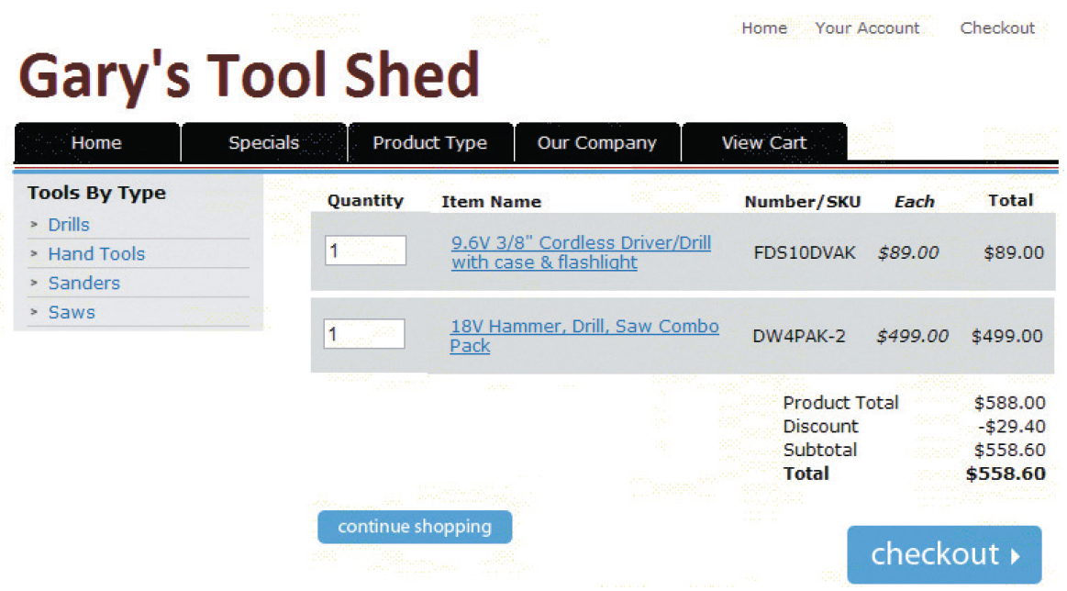
Typical Shopping Cart Page

Slide 11
Transaction Processing
Occurs when shopper proceeds to virtual checkout counter by clicking the checkout button
Electronic commerce software performs calculations
Web browser software and seller’s Web server software switch into secure communication state
Electronic commerce software communicates with accounting software sales and inventory modules
FedEx and UPS shipping rate software integrates with electronic commerce software
Other calculations include coupons, promotions, time-sensitive offers

Slide 12
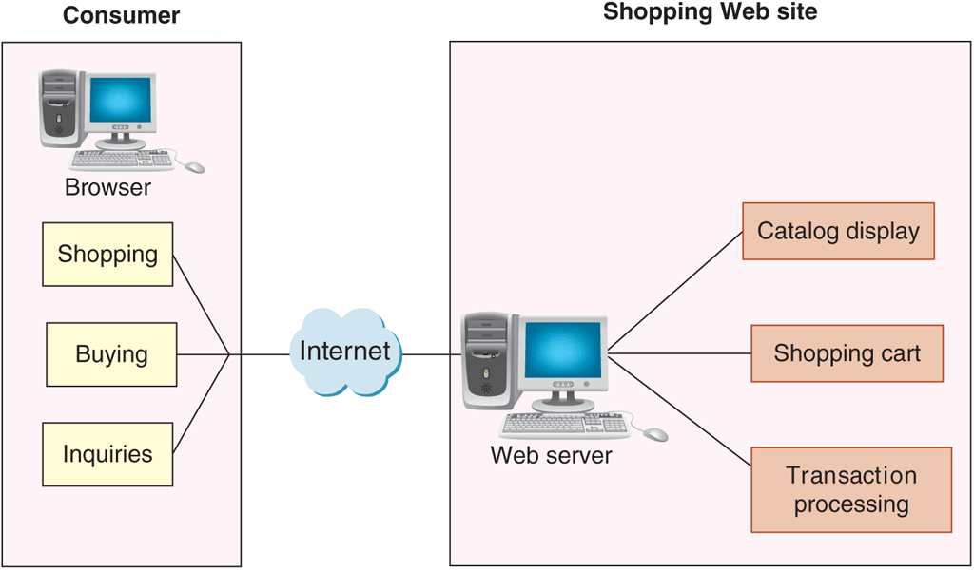
Basic Electronic Commerce Site Architecture

Slide 13
How Electronic Commerce Software Works with Other Software
Most large companies with electronic commerce operations also have substantial business activity unrelated to electronic commerce
Important to integrate electronic commerce activities into the company’s other operations
Basic information system element is a collection of databases

Slide 14
Databases
Highly structured information stored on a computer
Business rules are how the company does business
Database management software allows users to enter, edit, update, retrieve database information
Distributed information systems are large systems storing data in many different physical locations
Distributed database systems are databases within distributed information systems
MySQL database is open-source software owned by Oracle and maintained by group of programmers

Slide 15
Middleware
Middleware takes sales and inventory shipments information from electronic commerce software
Transmits to accounting and inventory management software
Companies can write their own or purchase customized middleware
Middleware cost range is $30,000 to several millions
Depending on complexity and existing systems

Slide 16
Enterprise Application Integration
Application software (application) is a program that performs specific function like creating invoices
Application server (computer) takes request messages received by Web server
Runs application program performing action based on request message’s contents
Actions determined by business logic rules such as verifying customer password upon log in
Enterprise application integration is a creation of links among scattered applications so business logic can be interconnected

Slide 17
Enterprise Application Integration
As information is transferred from one application to another program data formats differ
Must edit and reformat often using XML data feeds
Page-based application systems return pages generated by scripts containing rules
Present data on Web page with the business logic
Component-based application systems separate presentation logic from business logic
Logic components created and maintained separately
Updating and changing system elements much easier

Slide 18
Integration with ERP Systems
Enterprise resource planning (ERP) software are business systems integrating all facets of a business
Accounting, logistics, manufacturing, marketing, planning, project management, and treasury functions
Two major ERP vendors: Oracle and SAP
ERP software installation costs between $1 million and $10 million for a midsize company
Smaller online businesses can purchase products like NetSuite that offer ERP system subscriptions
Called software as a service (SaaS)

Slide 19
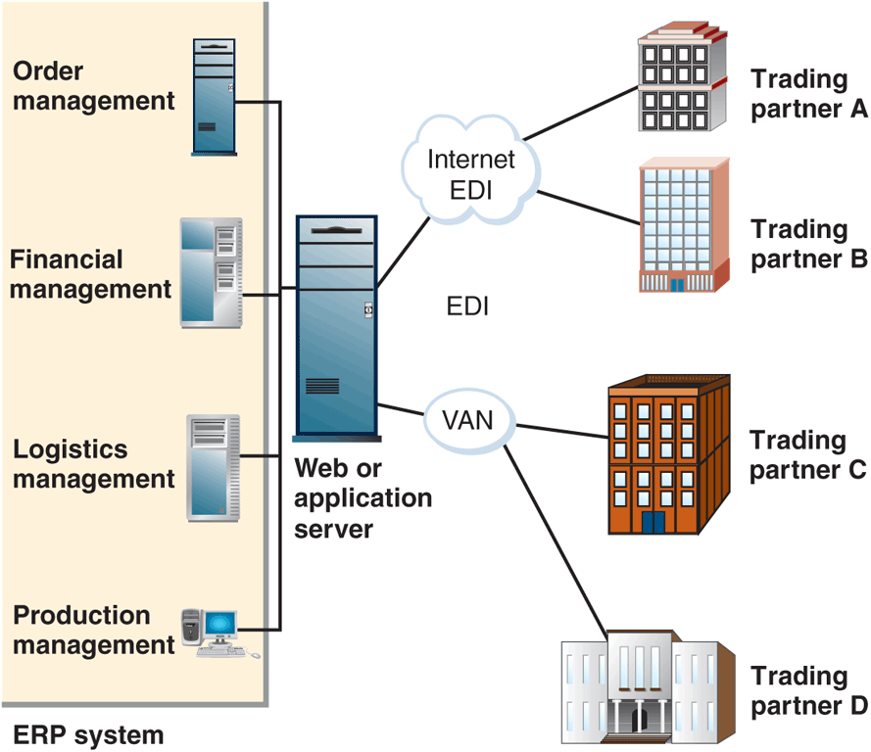
ERP System Integration with EDI

Slide 20
Web Services
Software systems supporting interoperable machine-to-machine interaction over a network
Set of software and technologies allowing computers to use the Web to interact with each other directly
Does not require human operators directing the specific interactions
Application program interface (API) is a general name for the ways programs interconnect with each other
Web APIs: interaction over the Web

Slide 21
How Web Services Work
Offer improved customer service, reduced costs
Transmit XML-tagged data from one enterprise integrated application to another
Provide data feeds between two different companies
Programmers write software accessing business application logic units without knowing details
Allows communication between programs written in different languages on different platforms
Example task: transaction processing
Can be combined with other Web services for complex tasks
More advanced example is purchasing software used to obtain vendor price information
Purchasing agent authorizes transaction and Web services submits order and tracks until delivered

Slide 22
Web Services Specifications
Simple Object Access Protocol (SOAP) is a message-passing protocol
Defines how to send marked up data from one software application to another across a network
Utilizes three rule sets
Communication rules included in SOAP specification
Web Services Description Language (WSDL) describes logic unit characteristics of each Web service
Universal Description, Discovery, and Integration Specification (UDDI) woks as address book to identify Web services locations and associated descriptions

Slide 23
REST and RESTful Design
Representational State Transfer (REST)
Principle describing how the Web uses networking architecture to identify and locate Web pages and elements making up those Web pages
RESTful design (RESTful applications) are Web services built on the REST model
Transfers structured information from one Web location to another
Services accessible at a specific address
More than half of all Web services today are RESTful applications

