Slide 1
Characterizing Multiplex Social Dynamics with Autonomy Oriented Computing
The 11th Postgraduate Research Symposium
PHD Student: Huang Lailei
Principal Supervisor: Prof. Jiming Liu
Co-supervisor: Dr. Li Chun Hung
Department of Computer Science, HKBU

Slide 2
Outline
Background
Research Topic
Research Problem
The AOC Approach
Current Progress
Conclusions & Future Work
Notes:
·talk about some background or the significance of the research topic
·then the topic itself will be explained in detail
·based on the proposed topic, we clarify the research problem
·to address the problem, we propose an AOC based method
·this an ongoing research progress
·future work

Slide 3
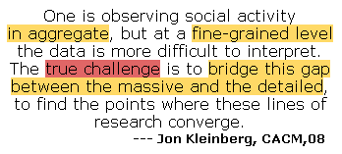
Background
local
?
global
Theoretical Significance
Practical Significance →
Notes:
重点
pyramid

Slide 4
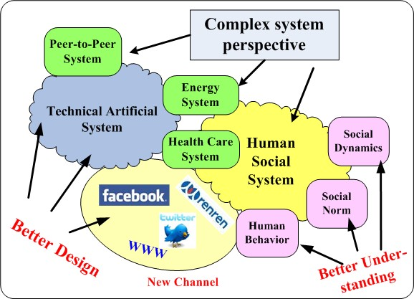
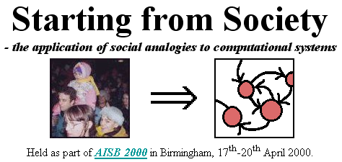
Background:
Basic Idea
Research Activities
http://cfpm.org/~bruce/sfs/
http://cfpm.org/sic/sic.html

Slide 5
Outline
Background
– Social behavior modeling with local global perspective.
Research Topic →
Notes:
·talk about some background or the significance of the research topic
·then the topic itself will be explained in detail
·based on the proposed topic, we clarify the research problem
·to address the problem, we propose an AOC based method
·this an ongoing research progress
·future work

Slide 6
Research Topic
Current Research Focus: “Multiplexity”.
[4] D. J. Watts. A twenty-first century science. Nature, 445:489, 2007.
Notes:
social science joint study from
digital age
joint effort from computer science, physicists etc
Nevertheless, the near future looks promising, especially if a few fundamental features of social networks can be emphasized.

Slide 7
Research Topic
What is “Multiplexity” ?
[5] R. J. Lewicki, D. J. Mcallister, and R. J. Bies. Trust and distrust: new relationships and realities.
Academy of Management Review, 23(3):438–458, 1998.
[6] L. M. Verbrugge. Multiplexity in adult friendships. Social Forces, 57(4):1286–1309, 1979.

Slide 8
Research Topic
How to characterize the multiplex effect?
The difficulty of empirical social interaction observation.
The KEY features of the multiplex social interactions
The perspective complex system.
A large number of heterogeneous entities
interact in different social contexts, and
generate different global social phenomena.
The Autonomy-Oriented Computing approach.
Bottom-up, Self-organized computing paradigm to model complex system and solve computational hard problem.
How to approach it?
[7] J. Liu. Autonomy-oriented computing (aoc): The nature and implications of a paradigm for self-organized computing (keynote talk).
in Proceeding of the 4th International Conference on Natural Computation(ICNC’08) and 5th International Conference on Fuzzy
Systems and Knowledge Discovery(FSKD’08), 2008.
Notes:
For the past 50 years or so, sociologists have thought deeply about the importance of interactions between people, institutions and markets in determining collective social behavior. They have even built a language — network analysis — to describe these interactions in quantitative terms.
But the objects of analysis, such as friendship ties, are hard to observe, especially for large numbers of people over extended periods of time. As a result, network data have historically comprised one-time snapshots, often for quite small groups.
Complexity view of human society: a large number of heterogeneous entities interaction at different contexts with different purposes.
Multiplexity: people interact locally through different social context with different purpose and generate coupled results
这里还需要elaboration一下
social interactions involve a large number of individuals with different purpose and incentive in different social context and generate different
large number of heterogeneous individuals, purposes, personalities
at different social contexts,
generate different global patterns (not at individual level) patterns.

Slide 9
Outline
Background
– Social behavior modeling with local global perspective.
Research Topic
– the Multiplex social dynamics
Research Problem →
Notes:
·talk about some background or the significance of the research topic
·then the topic itself will be explained in detail
·based on the proposed topic, we clarify the research problem
·to address the problem, we propose an AOC based method
·this an ongoing research progress
·future work

Slide 10
Research Problem
To specify the topic to a research problem, we need to:
clarify the social interaction contexts.
formally model the defined social interactions.
most importantly, formally propose the multiplex coupling mechanism.
clearly define the global measurements.
observe the multiplex effect from the local/global perspective, e.g.
How the local behavior in one social interaction can affect the global performance of the other social dynamic process?
The framework
The baseline model
5 Steps

Slide 11
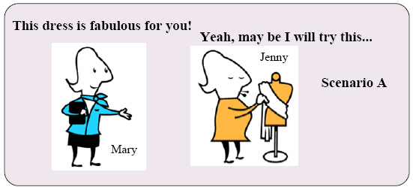
Social Interaction Clarification
Step 1
Two social contexts
Nature：
cultural interaction
Peer influence among individuals.
Social resource searching and sharing.
Resource sharing interaction
[8] R. Axelrod. The dissemination of culture. Journal of Conflict Resolution, 41(2):203–226, 1997.
[9] G. Lai, N. Lin, and S.-Y. Leung. Network resources, contact resources, and status attainment. Social Networks, 20:159–178, 1998.

Slide 12
Social Interaction Clarification
Motivation to choose these two types of social interactions
representativeness
prevailing in daily life
relatedness
sociological literatures supporting [10][11]
comparability
related modeling work exists
[10] G. Plickert, R. R.Cote, and B. Wellman. It’s not who you know, it’s how you know them:who exchanges what with whom. Scoial Networks, 29(3):405–429, 2007.
[11] O. Lizardo. How cultural tastes shape personal networks. American Sociological Review, 71(5):778–807, 2006.

Slide 13
Social Interaction Clarification – Related work
Axelord Culture Dissemination Models [8]
Persistence of culture diversity
Assumptions & limitations
Kleinberg Decentralized Search Model [12]
Navigability of social network (Milgram Experiment)
Assumptions & limitations
Open & dynamic
system-level & no autonomy
local-view
not open & no dynamic & no incentive
Still Mystery [2]
[8]R. Axelrod. The dissemination of culture. Journal of Conflict Resolution, 41(2):203–226, 1997.
[12]J. Kleinberg. The small-world phenomenon: an algorithmic perspective. In Proceedings of the 32nd ACM Symposium on Theory of Computing, pages 163–170, 2000.
[2] J. Kleinberg. The convergence of social and technological network. Communications of the ACM, 51(11):66–72, 2008.
Notes:
这一部分进一步clarify，这一部分是关键！
not autonomous, are homogeneous in nature!
in real social life, people are purpose, the behavior differently in different scenarios (social contexts) even same contexts at different times.
this kind of hetegrogenity in atuonomous behavior and also interaction incentive, can we negelect them?
The algorithmic component of the model is based on Milgram's experiment. We start
with two arbitrary nodes in the network, denoted s and t; the goal is to transmit a message
from s to t in as few steps as possible. We study decentralized algorithms, mechanisms
whereby the message is passed sequentially from a current message holder to one of its (local
or long-range) contacts, using only local information. In particular, the message holder u in
a given step has knowledge of
(i) the set of local contacts among all nodes (i.e. the underlying grid structure);
(ii) the location, on the lattice, of the target t; and
(iii) the locations and long-range contacts of all nodes that have come in contact with the
message.

Slide 14
Outline
Background
– Social behavior modeling with local global perspective.
Research Topic
– The Multiplex social dynamics.
Research Problem
What is the multiplexity effect on cultural and resource sharing dynamic processes? (target measurements)
The AOC Approach &
Current Progress →
Notes:
·talk about some background or the significance of the research topic
·then the topic itself will be explained in detail
·based on the proposed topic, we clarify the research problem
·to address the problem, we propose an AOC based method
·this an ongoing research progress
·future work

Slide 15
The AOC Approach - Concerns
The need of the AOC Approach:
Suitable to the nature of the multiplexity social interactions.
Able to address assumptions that related work neglects.
Our purpose:
AOC-by-Prototyping - iteratively do the 5 steps until non-trivial & realistic local/global pattern be observed.
Current progress:
The AOC-MSD framework step2 & step3
The Baseline model step4 & step5
[13] J. Liu, X. Jin, and K. C. Tsui. Autonomy oriented computing (aoc): Formulating computational
systems with autonomous components. IEEE Transactions on Systems, Man, and Cybernetics,
Part A, 35(6):879–902, 2005.
Notes:
nontrivial: the cultural diversity can be

Slide 16
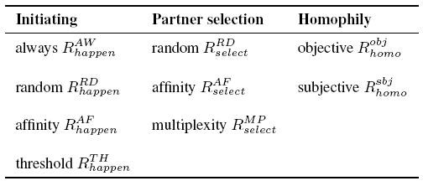
Current Progress1: AOC-MSD Framework
A. Social Entity Profile
B. Local Autonomy
An entity holds attributes related to both social interactions;
Cultural Vector
cultural similarity
Overlap of the cultural feature
Resource Memory
and behaves autonomously in the social interactions:
culture parameter
resource parameter
r denote a resource type
[8] R. Axelrod. The dissemination of culture. Journal of Conflict Resolution, 41(2):203–226, 1997.
Notes:
★entity -> heterogenous of cars vechicals
★autonomous behaviors -> the behaviors a vechical can do, stop, move, change line, the mechanism to guide these movements
★coupling relationship -> constrain on their behavior
constrain 1:
entity-entity: vechecial - vechecial
constrain 2:
entity-environment: e.g. concrete: the road, abstract: the traffic law
★：patterns emerge from the local autonomous interaction under the coupling relationship:
traffic jam.

Slide 17
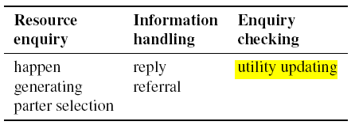
Current Progress1: AOC-MSD Framework
B. Local Autonomy
C. Coupling Relationship
Tie Strength based Multiplex Mechanism
Multiplexity: local behavior
coupling in essence.
affinity as cumulated result of cultural interaction.
trust as cumulated result of resource sharing interaction.
influencing times
adjustment coefficient
satisfying times

Slide 18
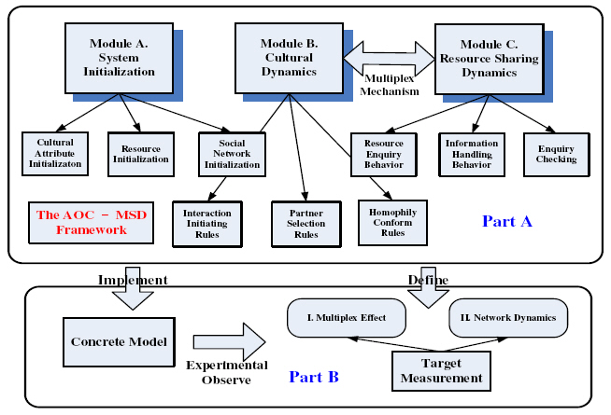
Current Progress1: AOC-MSD Framework
Overall View
Initial Implementation →

Slide 19
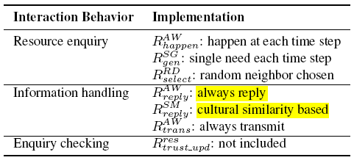
Current Progress2: The Baseline Model
Cultural Interaction Behavior
Resource Sharing Behavior
Initialization: 1.Network – 2D lattice; 2.Static – no network dynamic behavior.
1. Serial dynamics happen order
Behavior based
coupling
mechanism
2. Local behavior based coupling

Slide 20
Current Progress2: The Baseline Model
Target Measurements
Cultural Diversity
the average size of the largest cultural region normalized by the entity numbers <Smax>/N
Resource Utilization Efficiency
average resource access ratio
enquiry satisfied ratio:
-- the average number of resources accessible by all entities
-- fraction of all satisfied enquiry messages to the total generated messages
[8] R. Axelrod. The dissemination of culture. Journal of Conflict Resolution, 41(2):203–226, 1997.

Slide 21
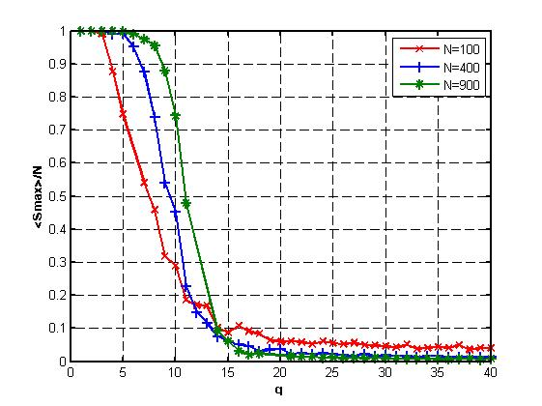
Current Progress2: Preliminary Results A
(2) change of diversity with diff q value
F_{c} = 3
A. Cultural Evolution
(1) Cultural Region Evolution
Convergence
[8] R. Axelrod. The dissemination of culture. Journal of Conflict Resolution, 41(2):203–226, 1997.

Slide 22
Current Progress2: Preliminary Results B
Average resource access ratio change
[ R_{c} = 1, eta = 1% ]
Enquiry satisfied ratio change
[ R_{c} = 1 ]
B. Resource Utilization Efficiency

Slide 23
Current Progress2: Preliminary Results C
C. Multiplex Effect
The effect of autonomous resource reply behavior on
the resource access ratio convergence.
[ N = 400, Fc = 3, q = 15, Rc = 1, eta = 1% ]
The effect of cultural diversity on the average resource access ratio convergence.

Slide 24
Conclusion and Future Work
Conclusion
Building an AOC framework to explore the Multiplexity effect on social dynamics.
Implementing a baseline model and designing a simple behavior coupling mechanism, based on which
we observe the effect of cultural diversity on the resource utilization efficiency.
Future Work
Refining the entity’s resource profile design.
Implementing the tie strength based multiplex mechanism and test the effect on two global measurements.
Incorporating the network dynamics in the local autonomy design.
Notes:
Considering the validation based on real-world data.

Slide 25
Reference
[1] M. S. Granovetter. The strength of weak ties. American Journal of Sociology, 78, 1973.
[2] J. Kleinberg. The convergence of social and technological network. Communications of the ACM, 51(11):66–72, 2008.
[3] J. Liu and K. Tsui. Toward nature-inspired computing. Communications of the ACM, 49:59–64, 2006.
[4] D. J. Watts. A twenty-first century science. Nature, 445:489, 2007.
[5] R. J. Lewicki, D. J. Mcallister, and R. J. Bies. Trust and distrust: new relationships and realities. Academy
of Management Review, 23(3):438–458, 1998.
[6] L. M. Verbrugge. Multiplexity in adult friendships. Social Forces, 57(4):1286–1309, 1979.
[7] J. Liu. Autonomy-oriented computing (aoc): The nature and implications of a paradigm for self-organized
computing (keynote talk). in Proceeding of the 4th International Conference on Natural Computation(ICNC’08)
and 5th International Conference on Fuzzy Systems and Knowledge Discovery(FSKD’08), 2008.
[8] R. Axelrod. The dissemination of culture. Journal of Conflict Resolution, 41(2):203 226, 1997.
[9] G. Lai, N. Lin, and S.-Y. Leung. Network resources, contact resources, and status attainment. Social Networks, 20:159–178, 1998.
[10] G. Plickert, R. R.Cote, and B. Wellman. It’s not who you know, it’s how you know them:who exchanges what with whom. Scoial Networks, 29(3):405–429, 2007.
[11] O. Lizardo. How cultural tastes shape personal networks. American Sociological Review, 71(5):778–807, 2006.
[12] J. Kleinberg. The small-world phenomenon: an algorithmic perspective. In Proceedings of the 32nd ACM Symposium on Theory of Computing, pages 163–170, 2000.
[13] J. Liu, X. Jin, and K. C. Tsui. Autonomy oriented computing (aoc): Formulating computational systems with autonomous components. IEEE Transactions on Systems, Man, and Cybernetics, Part A, 35(6):879–902, 2005.

Slide 26
Thank You Very Much!
Q&A

