Slide 1
AOC-Based Efficient Waiting Time Management in Hospital
11th Postgraduate Research Symposium
Student： Li Tao
Principal Supervisor： Prof. Jiming Liu
Co-Supervisor: Li Chen
Department of Computer Science
Hong Kong Baptist University

Slide 2
Outline
Motivation
Background
Challenges
Related Work
Objective
Problem Statement
AOC-Based Modeling for Distributed Dynamic Patient Scheduling
Future Work

Slide 3
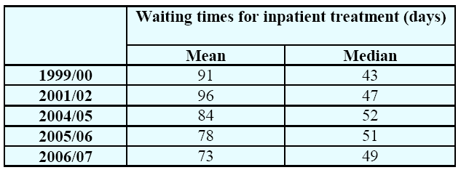
Background
A notorious and common problem in health care all over the world: Long waiting list or waiting time.
Example:
England:
Table 1: Mean and median inpatient waiting times, England, 1999/2000-2006/07. (Data is adopted from [1])
[1] Department of Health, Hospital Activity Statistics, 2007.

Slide 4
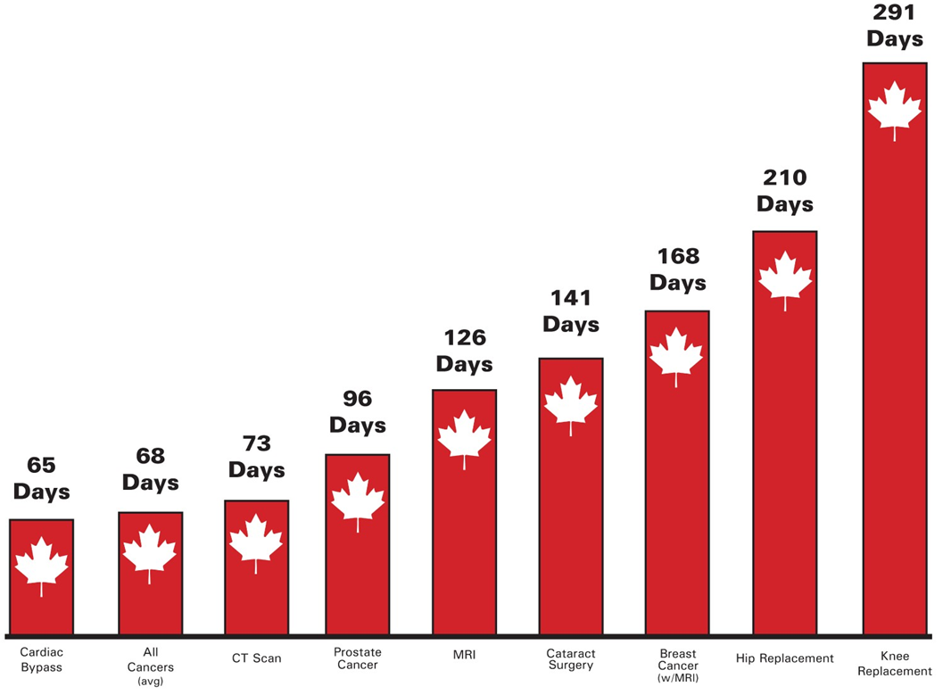
Background
Canada:
Figure 1: Wait times for common surgical procedures in Ontario, Canada.,2009
Data source[2])
[2] Canadian Ministry of Health & Long-Term Care. http://www.health.gov.on.ca/

Slide 5
Background
Long waiting time will result in bad things:
For patients:
Bear longer suffering
Increase interventions and cost due to delay in care
Decrease human productivity because of weak health
……
For hospitals:
Decrease the number of potential customers (means patients)
Decrease patient satisfaction and quality of care
Increase cost of providing services
……

Slide 6
Challenges (1)
Numerous causing factors for waiting time
Impersonal factors
Human factors

Slide 7
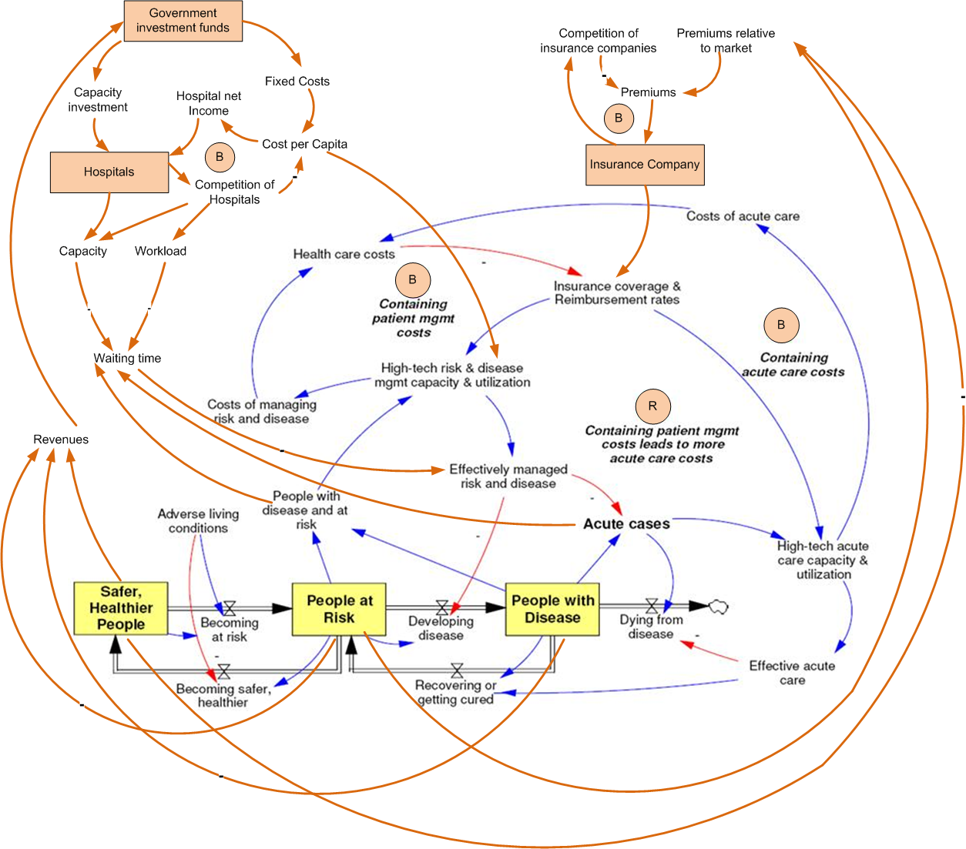
Figure 2: Causing factor of waiting time from system dynamics approach. (This graph is drawn based on the work of [3][4])
[3] G. Hirsch and S. Immediato. Microworlds and generic structures as resources for integrating care and improving health. System Dynamics Review, 15(3):315–330, 1999.
[4] G. Hirsch and S. Immediato. Design of simulators to enhance learning: Examples from a health care microworld, quebec city, canada.

Slide 8
Challenges (1)
Numerous causing factors for waiting time
Impersonal factors:
Scarce care resources
Inefficient patient scheduling
Unpredictable disease explosion
……
Human factors:
Dynamically changing patients’ behavior
Dynamically changing doctors’ behaviors
Redundant doctor-patient interaction
……

Slide 9
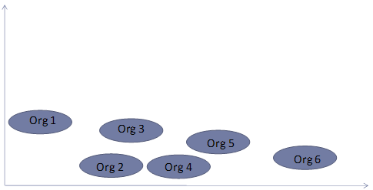
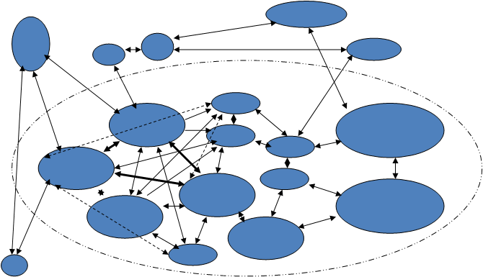
Challenges (2)——Complex in nature
Distributed health care resources
Dynamically changing demands
Independent organizations
Non-linear and dynamic coupling between organizations
Incomplete non-centralized information
Coupling intensity
Time
Space
Figure 3: Organizations/units and the space in between them.
Figure 4: Web of relations between agents within and outside the system.

Slide 10
Related Work
Mathematical modeling: e.g., Queuing Theory
Limitations:
Centralized manner
Regard health care system/hospitals as deterministic systems.
Too mathematically restrictive to be able to model all real-world situations exactly because the underlying assumptions of the theory do not always hold in the real world.
Takes average of all variables rather than the real numbers itself
Assumes stable service rate, arrival rate,…
Cannot characterize individuals’ behaviors
Cannot characterize relationships between local autonomy and global emergent behavior
Insufficient to tackle distributed patient scheduling problems involving patient dynamic behaviors in the real world
Notes:
Classic queueing theory is often too mathematically restrictive to be able to model all real-world situations exactly. This restriction arises because the underlying assumptions of the theory do not always hold in the real world. The complexity of production lines with product specific characteristics cannot be handled with mathematical models anymore. Therefore special tools like Plant Simulation have been developed to simulate, analyze, visualize and optimize time dynamic queueing line behavior.
For example; the mathematical models often assume infinite numbers of customers, infinite queue capacity, or no bounds on inter-arrival or service times, when it is quite apparent that these bounds must exist in reality. Often, although the bounds do exist, they can be safely ignored because the differences between the real-world and theory is not statistically significant, as the probability that such boundary situations might occur is remote compared to the expected normal situation. In other cases the theoretical solution may either prove intractable or insufficiently informative to be useful.
Alternative means of analysis have thus been devised in order to provide some insight into problems which do not fall under the mathematical scope of queueing theory, though they are often scenario-specific since they generally consist of computer simulations and/or of analysis of experimental data. See network traffic simulation.

Slide 11
Related Work
Top-down systems approach: e.g., System Dynamics
Limitations
Cannot characterize individuals’ behaviors
Cannot characterize relationships between local autonomy and global emergent behavior
Insufficient to tackle distributed patient scheduling problems involving patient dynamic behaviors in the real world

Slide 12
Objective
How to model and design mechanisms to solve a Distributed Dynamic Patient Scheduling (DDPS) problem based on AOC framework?
Questions need to answer:
Patient arrival and flow: E.g., what are the arrival patterns of patient according to time and season?
Manpower characteristics: E.g., what conditions may result in unanticipated doctors’ behaviors?
Structure of the health care system or hospital: E.g., Is the current structure efficient for health care system?
Adaptive and distributed patient scheduling: E.g., How to design a distributed self-organization mechanism considering dynamic attributes of patients and doctors?

Slide 13
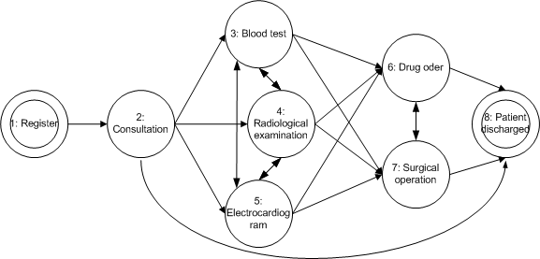
Problem Statement
Goal:
Hospital level definitions:
Loosely coupled but relatively independent n organizations which are organized as a temporal constraint network.
Stable capability: for organization i .
Figure 5: Illustration of organization network of hospital

Slide 14
Problem Statement
Patient level definitions:
Arrival: randomly
Do not consider other dynamic behaviors like reneging
Patient personal waiting time
Evaluation
Average waiting time in total
Median waiting time:

Slide 15
AOC-Based Modeling for DDPS
Entity e corresponding to an organization.
Environment
Global: a growing matrix includes Patient Treatment Information
is denoted as
Local: patient order of neighbors

Slide 16
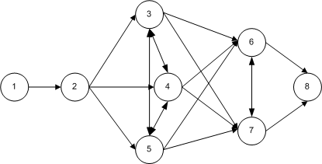
AOC-Based Modeling for DDPS
Behaviors of entity
Greedy selection behavior
Cooperative behavior
Competitive behavior
Competitive behavior
Cooperative behavior
Greedy selection behavior

Slide 17
Future Work
Fine-tune our AOC-based model and strategies to better match the situations considering more dynamic behaviors of patients and doctors in real world
Justify the efficiency and analyze the characteristics of this approach (e.g., robustness, scalability)
Study the structure of organizations in the health care system or hospital

Slide 18
Reference
[1] Civitas: Institute for the study of civil society. http://www.civitas.org.uk/nhs/nhsperformance.php.
[2] Department of health. http://www.performance.doh.gov.uk/waitingtimes/.
[3] Health canada. www.hc-sc.gc.ca.
[4] The Reform of Health Care Systems: A Review of Seventeen OECD Countries. OECD, 1994.
[5] D. Applegate and W. Cook. A computational study of the job-shop scheduling problem. ORSA Journal on Computing, 3, 1991.
[6] F. E. Cellier. Continuous. Springer-Verlag, New York, USA, 1991.
[7] S. Creemers and M. Lambrecht. Healthcare queueing models. Technical report, Katholieke Universiteit Leuven, 2008.
[8] L. Edgren. The meaning of integrated care: A systems approach. International Journal of Integrated Care, 8, 2008.
[9] S. Fomundam and J. Herrmann. A survey of queuing theory applications in healthcare. ISR Technical Report, 24, 2007.
[10] B. Gonazalez-Busto and R. Garcia. Waiting lists in spanish public hospitals: A system dynamics approach. System Dynamics Review, 15(3):201–224, 1999.
[11] J. Gubb. Why are we waiting: an analysis of waiting times in the nhs. http://www.civitas.org.uk/nhs/waitingtimes Jan 08.pdf.
[12] G. Hirsch and C. S. Immediato. Microworlds and generic structures as resources for integrating care and improving health. System Dynamics Review, 15(3):315–330, 1999.
[13] G. Hirsch and S. Immediato. Design of simulators to enhance learning: Examples from a health care microworld, quebec city, canada.

Slide 19
Reference
[14] M. Hoel and E. M. Sather. Public health care with waiting time: The role of supplementary private health care. Journal of Health Economics, 22(4):599–616, July 2003.
[15] J. Liu. Autonomy-oriented computing (aoc): The nature and implications of a paradigm for self-organized computing (keynote talk). 2008.
[16] J. Liu, X. Jin, and K. C. Tsui. Autonomy Oriented Computing: From Problem Solving to Complex Systems Modeling. Springer, 2005.
[17] J. Liu, H. Jing, and Y. Tang. Multi-agent oriented constraint satisfaction. Artificial Intelligence, 136(1):101–144, March 2008.
[18] J. Liu and K. C. Tsui. Toward nature-inspired computing. Communications of the ACM, 49(10):59–64, 2006.
[19] R. R. McDaniel and D. J. Driebe. Complexity science and health care management. Advances in Health Care Management, 2, 2001.
[20] R. E. Powell. Health care: A systems perspective. http://www.exponentialimprovement.com/cms/uploads/heal thcare4.pdf.
[21] L. Siciliani. Does more choice reduce waiting times. Health Economics, 14, 2005.
[22] L. Siciliani and S. Martin. An empirical analysis of the impact of choice on waiting times. Health Economics, 16, 2007.
[23] A. van Ackere and P. C. Smith. Towards a macro model of national health service waiting lists. System Dynamics Review, 15(3):225–252, 1999.

Slide 20
Thank You!

