Slide 1
Illumination Invariant Face Recognition based on the New Phase Local Features
Dan Zhang
Supervisor: Prof. Y. Y. Tang
11th PGDay

Slide 2
Contents
Motivation
Phase Congruency
- Phase congruency theory
- Calculate PC using monogenic filters
Monogenic Signals Obtained From BEMD
- Hilbert-Huang Transform
- The improved BEMD
- Monogenic features of BIMFs
Experimental Results
Conclusions

Slide 3
Illumination Invariant Face Recognition
“Illumination changes could be larger than the differences between individuals.”
Methods: Lambertian surface, illumination cone, quotient image, model-based method, etc.
Frequency domain methods:
  High-frequency components: robust to the illumination changes while low-frequency components are highly sensitive to.
  Phase local feature: Phase Congruency (PC) is robust to invariant to changes in image brightness or contrast

Slide 4
Hilbert Huang Transform (HHT) Framework
One Dimension
EMD
Hilbert Transform
Bidimension
BEMD
Riesz Transform
Analytical Signal
Monogenic Signal
Local Features (Amplitude, Phase Orientation, Phase Angle…)
Local Features (Instantaneous Frequency…)
Properties:
1D: data-driven, non-parametric
adaptive to the original signal, do not need
predetermined wavelet function, good at
handle non-stationary and nonlinear
Signals
2D: can capture more singular information
in high-frequency components

Slide 5
Motivation
1. From High-frequency Viewpoint
Earlier studies and our studies show that high-frequency
components are comparatively more robust to the
illumination changes, while the low frequency component is
sensitive to them. Generally, high-frequency component
only is enough for illumination invariant facial feature
extraction.

Slide 6
Motivation
2. From HHT Method Viewpoint
HHT theory provides us another efficient method to decompose signals
into different frequency IMFs components. Because of the data-driven
property and adaptiveness of the sifting process, it is able to capture more
representative features and especially more singular information in high-
frequency IMFs. It is reasonable to infer that the high-frequency
components obtained by HHT framework may have more discriminate
ability.
3. From Phase Feature Viewpoint
Phase information was found to be crucial to feature perception. Phase
congruency is a dimensionless quantity that is invariant to changes in
illumination.

Slide 7
Facial Feature Extraction Design
Input images
First 3 BIMFs
Weighted Phase Congruency
BEMD
Phase Congruency
Monogenic Signals

Slide 8

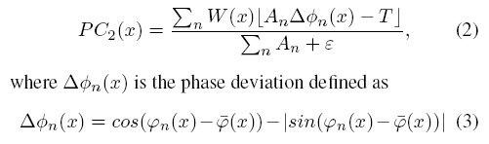
Phase Congruency (PC): PC Definitions
1. Morrone andOwens
Definition (1) does not offer satisfactory local features and it is
sensitive to noise.
2. P. Kovesi: more sensitive measure of PC

Slide 9


3. P. Kovesi: PC calculated by wavelet
: even-symmetric (cosine) and odd-symmetric (sine) wavelets at scale n
4. P. Kovesi: PC extended to 2D
use the 1D analysis over m orientations

Slide 10





Phase Congruency (PC): Calculate PC using Monogenic Filters
Riesz transform
Monogenic signal

Slide 11


Hilbert Huang Transform (HHT) Framework
Step1: Empirical Mode Decomposition (EMD)
Step 2: Hilbert Transform

Slide 12



HHT Framework extended to 2D
Bidimensional EMD (BEMD)

Slide 13
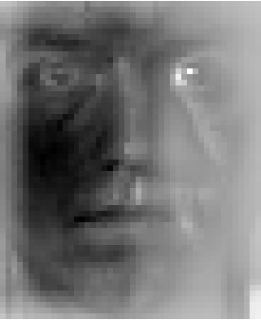
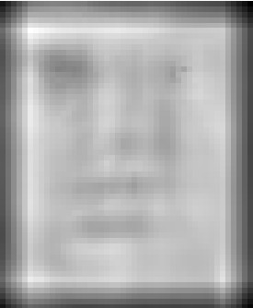

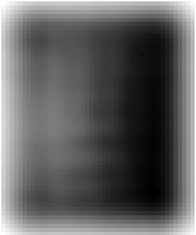
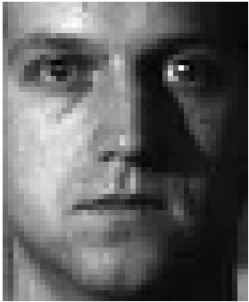
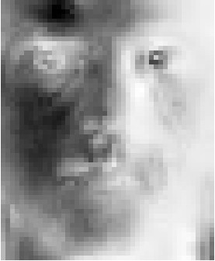
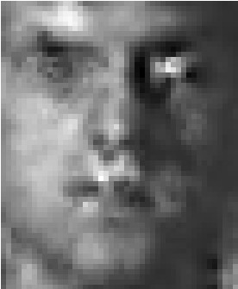
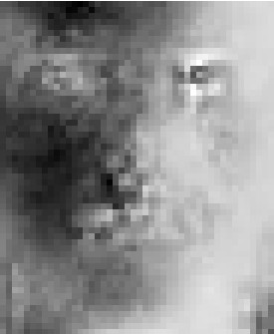

BIMFs
1st BIMF 2nd BIMF 3rd BIMF residue
Our Method
Surface
Interpolation
Method

Slide 14
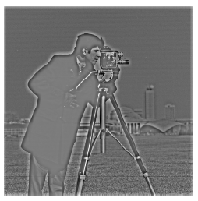
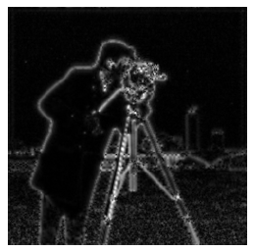
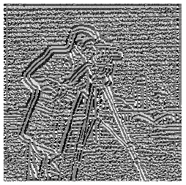
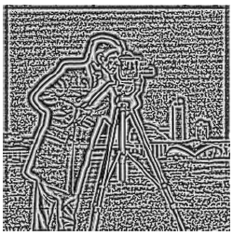
HHT Framework extended to 2D
Monogenic Features of BIMFs (2D analytical signal)
Row1,left: 1st BIMF
Row1, right: Amplitude
Row2,left: orientation
Row2, right: phase angle

Slide 15
PC Calculated using Monogenic Filters
PC of original face PC of 1st BIMF PC of 2nd BIMF PC of 3rd BIMF
Weighted PC

Slide 16
Feature Extraction Algorithm
Input images
First 3 BIMFs
Weighted Phase Congruency
BEMD
Phase Congruency
Monogenic Signals

Slide 17
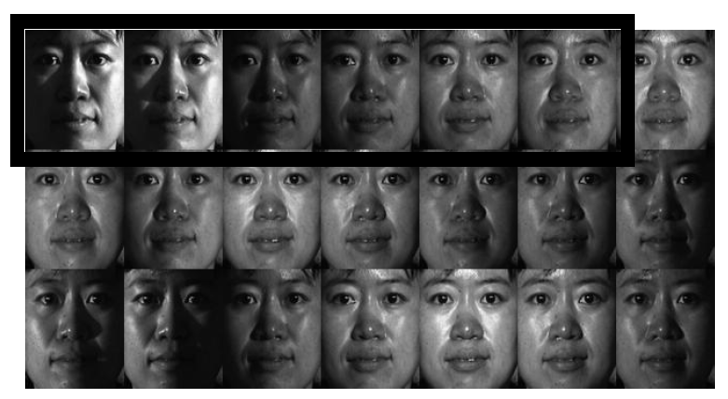

Face Database

Slide 18
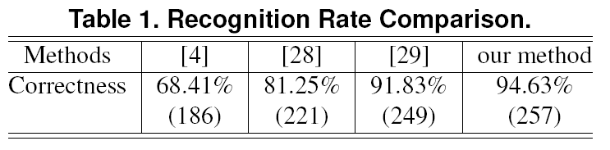

Slide 19
Conclusions
We use the phase congruency quantity based on the
BIMFs to address the illumination face recognition problem.
We firstly proposed a new BEMD method based on the improved
Evaluation of local mean, then apply the Riesz transform to get the
corresponding monogenic signals. Based on the new phase local
information obtained, PC is calculated. We combine the PC on
different BIMFs and use the weighted mean as the facial features
input to the classification process. Compared with other phase
Based face recognition method, our proposed method shows its
efficiency.

Slide 20
Thank you for attention!
15-Mar-2010

