Slide 1
Very Low Resolution Face Recognition Problem
Student : Mr. Wilman, Weiwen Zou
Supervisor: Prof. Pong C. Yuen
Co-supervisor: Prof. Jiming Liu
Date: 15th Mar 2009

Slide 2
Outline
Very low resolution (VLR) face recognition problem
Limitations of existing methods on VLR problem
Relationship Learning Based SR
Experiments and analysis
Conclusions and future work

Slide 3
Very Low Resolution Face recognition Problem

Slide 4
Very Low Resolution (VLR) Face Recognition Problem
Very Low Resolution Problem
Face recognition algorithms were proposed during last thirty years
These algorithms require large size of the face region
Empirical studies show that existing algorithms dose not get good performance, when image resolution is less than 32x32
When the face image smaller than 16 x 16 is used in FR system, we call this is very low resolution face recognition problem
VLR problem occurs in many applications,
Surveillance cameras in banks, super-market, etc,
Close-circuit TV in public streets
etc

Slide 5
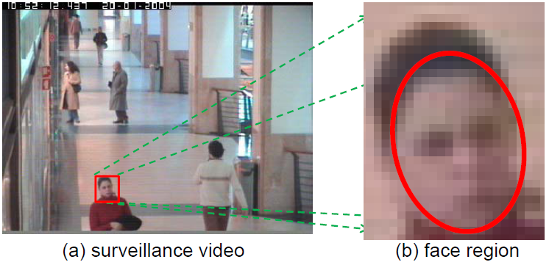
Very Low Resolution (VLR) Face Recognition Problem
The face region in surveillance video
Carries very limited information
Even hard for human to recognize
FR on small size face region is very challenging
Super-resolution algorithms were proposed
The image is extracted from CAVIA database

Slide 6
Current state of art

Slide 7
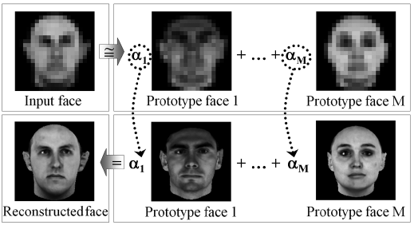
Super-resolutions (SR) algorithms on VLR
SR algorithms were proposed to
Enhance the resolution of images
From low resolution (LR) images and/or training images
Most of the face SR algorithms are learning based
Two approaches: Maximum a posterior (MAP) – based & Example - based
SR
MAP-based
example-based
Gaussian model
Markov
Subspace
This figure is extracted from [12]

Slide 8
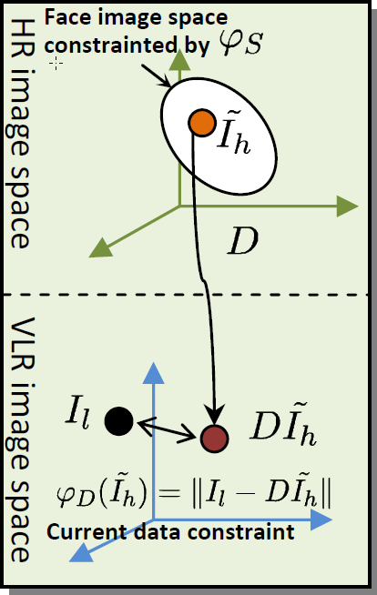
Limitations on existing SR algorithms
Existing SR algorithms can be formulated as a 2-contraint optimization problem
: data constraint
: algorithm-specific constraint
The high resolution (HR) image is recovered directly from the input low resolution (LR) image and training images
cannot fully make use of information of training data, such as label information
All existing methods make use of the same data constraint
measures error in LR image space
MAP-based approach employs data constraint to model the condition probability
example-based approach use data constraint implicitly to determine the weights for HR examples

Slide 9
Limitations on existing SR algorithms
Current data constraint does not work under VLR problem
Current data constraint measure the reconstruction error on LR image space
Only very little information contained in input data spase
Algorithm-specific constraint will dominate the data constraint
The reconstructed images may not look like the original one
This is not good from recognition perspective
U(e) is the solution space of e
Under VLR, even set C₁ = 0 , is too big
E.g. from 8x8 to 64x64, the dimension of
is > 4032, when original image space is 4096
cannot restrict the HR image well
does not work well
Image space

Slide 10
Relationship learning based face super resolution framework

Slide 11
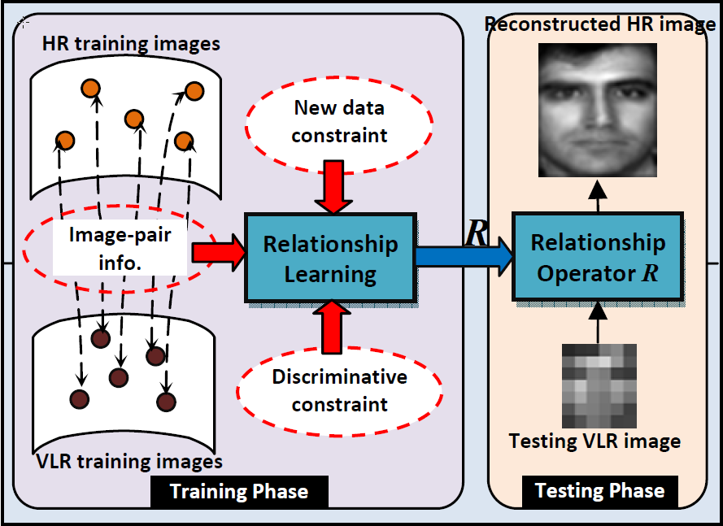
New Framework: Relationship Learning based face SR
Two phases:
Determine the relationship operator R
Reconstruct HR images by applying R on input image
Advantages:
New data constraint: measure error on HR space
Discriminative constraint: using the label information to enhance the discriminability
Fig. Illustrate the idea of proposed new face SR framework

Slide 12
Relationship Learning based Face SR Framework
Determine the R by minimizing the reconstruction error:
the error between the reconstructed HR image and original HR image
estimate this error by a new data constraint
Given N training image pairs
Given a testing image
HR image space VLR image space
new data constraint
R
=R( )

Slide 13
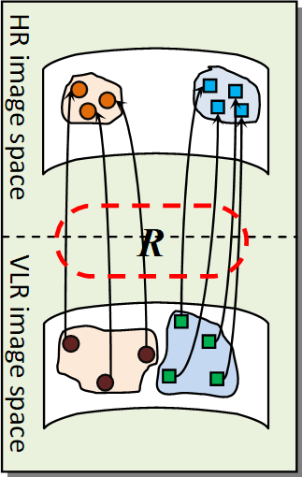
Discriminative Constraint
Enhance the discriminability of the image. The reconstructed HR image should:
far away from other classes
clustered to the same class
Discriminative Constraint

Slide 14
Experiments

Slide 15
Experimental Settings
Methodology
Experiment 1: evaluate the effectiveness of new data constraint
Perform new SR method, using only new data constraint
By image quality in terms of human visual quality and objective measurement (MSE, Entropy)
Experiment 2: evaluate the discriminability of the reconstructed HR images
Perform new SR method integrated with discriminative constraint
By recognition performance (rank 1 recognition rate , CMC)
Databases
CMU PIE: 21 lighting conditions with frontal view per class, total 68 classes, 13 for training
FRGC V2.0: 10 images per class / 311 classes / pose, lighting , expression, 8 for training
Surveillant Camera Face (SCface): 10 images per class / 130 classes , 5 for training

Slide 16
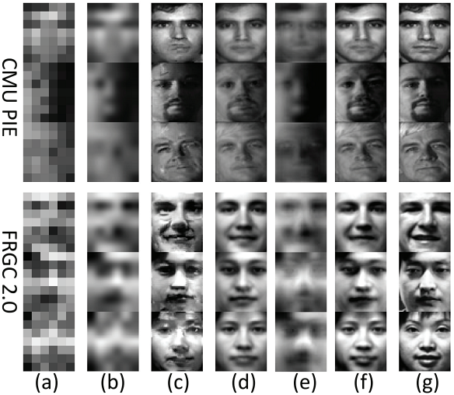
Result 1: Image Quality (by human visual)
(a) input VLR images
(b) Bi-cubic interpolation
(c) Hallucination Face
(d) Eigentransformation based Face SR
(e) Kernel prior based Face SR
(f) Proposed method
(g) Original HR images
LR 7 x 6 HR: 56 x 48

Slide 17
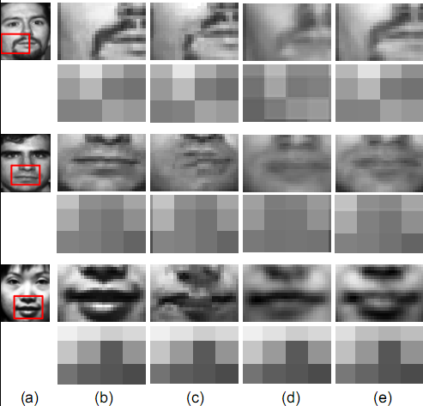
Result 2: Image Quality (by human visual)
(a) (b): original HR images
(c) Hallucination Face
(d) Eigentransofrmation based Face SR
(e) Proposed Method

Slide 18
Result 3: Image Quality (by objective measurement)
Mean Square Error
Image information entropy
Proposed new data constraint works better than the current data constraint

Slide 19
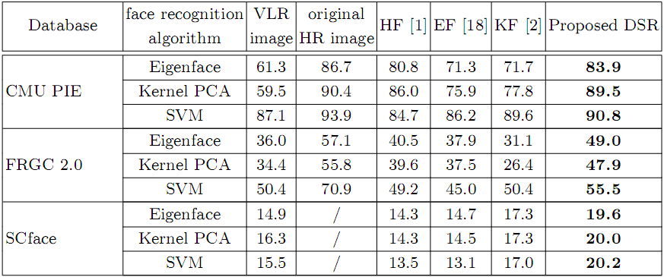
Result 4: Recognition Performance
Rank 1 recognition rate

Slide 20
Result 5: Recognition Performance (CMC)
CMC of CMU PIE
(a)Eigenface (b) Kernel PCA (c) SVM

Slide 21
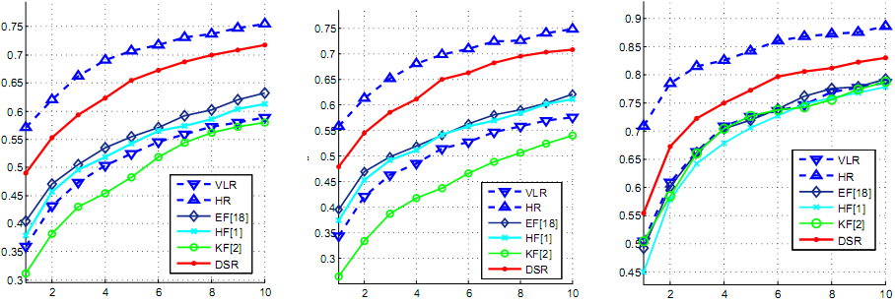
Result 5: Recognition Performance (CMC)
CMC of FRGC V2.0
(a)Eigenface (b) Kernel PCA (c) SVM

Slide 22
Result 5: Recognition Performance (CMC)
CMC of SCface
(a)Eigenface (b) Kernel PCA (c) SVM

Slide 23
Conclusions and future work

Slide 24
Conclusions and future work
Conclusions:
VLR problem is defined and discussed
A new face SR framework is proposed
New data constraint can be designed to measure error in HR image space
Discriminative constraint is integrated to enhance the discriminability
Experimental results on three databases show that
Can construct images with higher image quality
More discriminability
Future work
More better method to estimate the relationship operator (nonlinear mapping)
Noise / blurring should be modeled

Slide 25
THANK YOU
Q & A
www.presentationpoint.com

