Slide 1
Authenticating Top-k Queries in Location-based Services with Confidentiality
Qian Chen, Haibo Hu, Jianliang Xu
Hong Kong Baptist University

Slide 2
Big Data: Cloud-based Query System
Scalability
Elasticity
Self-manageability
Pay-per-use pricing
Cloud Service
Provider (SP)
Data &
Algorithm
“Yellow Duck”
Data Owner
Client

Slide 3
Untrustworthy Cloud Server
Incorrect results
Hacking attack
Incomplete search
Program bug
In favor of sponsor
Scalability
Elasticity
Self-manageability
Pay-per-use pricing
Cloud Service
Provider (SP)
Data &
Algorithm
“Yellow Duck”
Data Owner
Client
Authenticated Query Processing: Enable clients to verify the correctness of query results

Slide 4
Problem Formulation
Top-k Query $Q=<q,k>$, Dataset $D$
$D=\left\{r_{1},r_{2},r_{3},…\right\}, r_{i}=<λ,ω>$
$rank\left(r_{i},q\right)={α×\left|\left|r_{i}. λ−q\right|\right|}^{2}+{(1−α)×r}_{i}. ω^{2}$
Objectives:
Enable client to verify the correctness of query results (Query Authentication)
Soundness
Completeness
Preserve privacy of $r_{i}$ and $rank(r_{i},q)$ against client

Slide 5
Overview of System Model
Cloud Service
Provider (SP)
Data &
Algorithm
“Yellow Duck”
+ Authenticated Data Structure (ADS)
+ Verification Object (VO)
Data Owner
Client

Slide 6
Preliminaries: Merkle Hash Tree
Merkle Hash Tree (MHT)
$$N_{root}:h(N_{12}|N_{34})$$
?
Sign
Service Provider
$$sig(N_{root})$$
$$N_{12}:h(N_{1}|N_{2})$$
$$N_{34}:h(N_{3}|N_{4})$$
Dataset
MHT, $sig(Nroot)$
$$Q=[1, 10]$$
R$: \left\{d_{1},8\right\}$
$$VO: \{\left\{d_{2},12\right\},N34,$$
$$N_{1}:h(d_{1})$$
{1, 3, 4, 5}
$$sig(Nroot)\}$$
$$N_{2}:h(d_{2})$$
$$N_{3}:h(d_{3})$$
$$N_{4}:h(d_{4})$$
Data Owner
Client
$$d_{1}$$ | $$d_{2}$$ | $$d_{3}$$ | $$d_{4}$$
8 | 12 | 17 | 25
$$d_{1}$$ | $$d_{2}$$ | $$d_{3}$$ | $$d_{4}$$
8 | 12 | 17 | 25
Q=[1,10]
Dataset
Verify
Soundness: 8 $∈$[1,10]; root
Completeness: 12$∉$[1,10]

Slide 7
Private Comparison (SIGMOD ’05)
To verify $x≥1$ without knowing $x (x is d_{1}\text{’}\text{s} \text{value}\text{)}$
$$x≥1?$$
$$x−1≥0$$
Client
Verify:
$g\left(x\right)=g\left(x−1\right)\text{⊗}g\left(1\right)$
$sig(g(x))$
$$Q=[1, 10]$$
R$: \left\{d_{1}\right\}$
$$g\left(x−1\right),$$
$$sig(g\left(x\right))$$
SP
Client
DO
Service Provider
$$sig\left(g\left(x\right)\right),x$$
Data Owner
$$g\left(x\right) can be calculated$$
$$only when x≥0$$
To verify $rank\left(s,q\right)≥rank(t,q)$ in our problem

Slide 8
Main Contributions
Private Rank Comparison
Query Authentication Scheme
Geometric Solution:
Pre-signed Line (PLB)
Merkle R-tree
Scheme
Algebraic Solution:
Private Paillier (PPB)
Power Diagram
based Scheme

Slide 9
Geometric Solution: Pre-Signed Line (PLB)
Verify $rank\left(s,q\right)≥rank(t,q)$ without knowing s, t
public
$$A_{3}=A_{1}+A_{2}$$
private
$$o_{2}′$$
Apply $g(⋅)$
$$o_{2}$$
$$A_{3}$$
t
$$g(A_{3})=g(A_{1})⊗g(A_{2})$$
s
?
$$A_{2}$$
$$A_{1}$$
DO
SP
Client
$$o_{1}′$$
q
Pre-processing
$$o_{1}$$
$$(s+t)/2$$

Slide 10
Algebraic Solution: Private Paillier (PPB)
$\text{Verify} rank\left(s,q\right)≥rank(t,q) \text{without} \text{knowing} \text{s}\text{, }\text{t}$
$rank\left(s,q\right)−rank\left(t,q\right)=δ$, where $δ≥0$
$2x_{t}x_{q}+2y_{t}$ $y_{q}+{x_{s}}^{2}+{y_{s}}^{2}+{ω_{s}}^{2}=2x_{s}x_{q}+2y_{s} y_{q}+{x_{t}}^{2}+{y_{t}}^{2}+{ω_{t}}^{2}+δ$
$E\left(⋅\right)$ is additively homomorphic
${E\left(2x_{t}\right)}^{x_{q}}∙{E\left(2y_{t}\right)}^{y_{q}}∙E({x_{s}}^{2})$ $∙E({y_{s}}^{2})$ $∙{E(ω_{s}}^{2})={E\left(2x_{s}\right)}^{x_{q}}∙{E\left(2y_{s}\right)}^{y_{q}}∙E({x_{t}}^{2}) ∙E({y_{t}}^{2}) ∙{E(ω_{t}}^{2})∙E(δ)$
$E(δ)$ can be decomposed to some signed seeds
More flexible than PLB method, but heavier computation

Slide 11
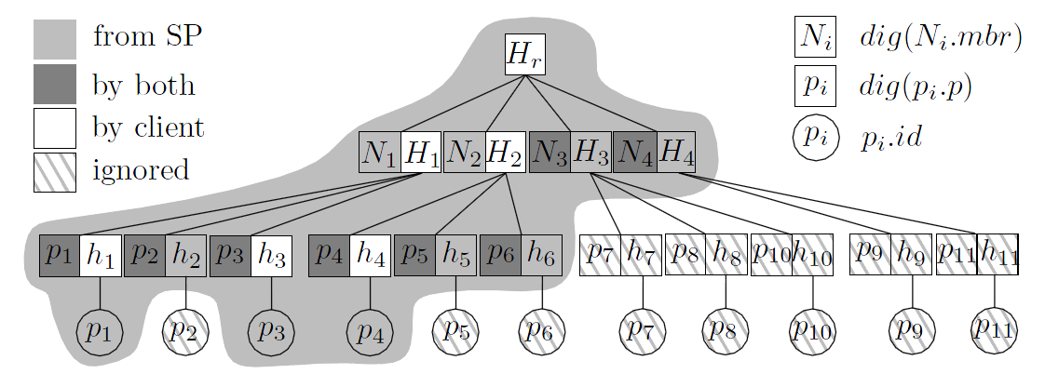
MR-Tree Scheme
Similar to Merkle Hash Tree
Soundness: private rank comparisons + root reconstruction
Completeness: boundary checking with private rank comparisons (PLB / PPB)

Slide 12
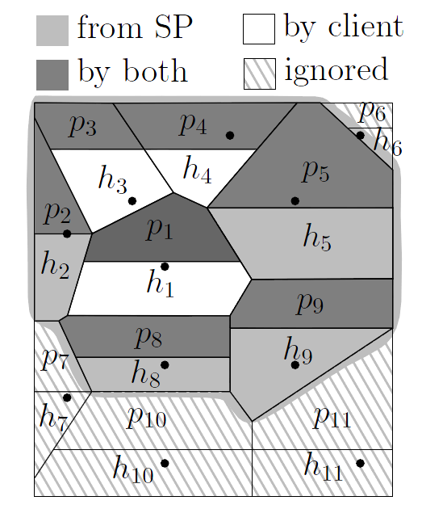
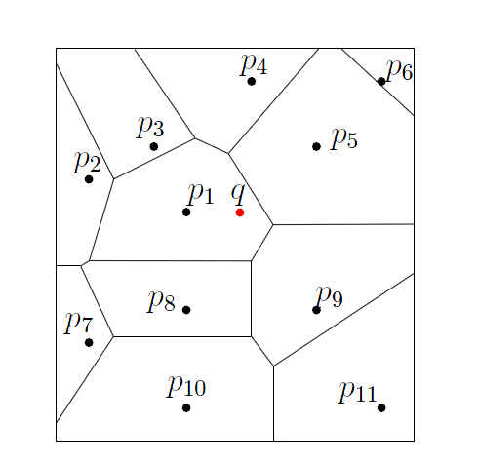
Power Diagram based Scheme

Slide 13
Security Analysis and Optimizations
Proven security through theoretical analysis
A new security model for continuous top-k queries
Guarantee semantic security with $γ$ radius
Optimizations:
DO offline strategy on pre-signed lines
SP online strategy on pre-signed lines

Slide 14
Experiment Settings
Dataset: Gowalla dataset in Stanford Large Network Dataset Collection
6,442,890 user check-ins
1,280,969 unique locations
Server: Dual 4-core Intel Xeon X5570 2.93GHz CPU and 32GB RAM, running GNU/Linux, OpenJDK 1.6
Client: Core 2 Quad processor and 4GB RAM, WinXP
Network: 2Mbps download and 1Mbps upload
Paillier (1024 bits), RSA (2048 bits)
h(): SHA-1 (160 bits)
g(): the one from [SIGMOD’05]

Slide 15
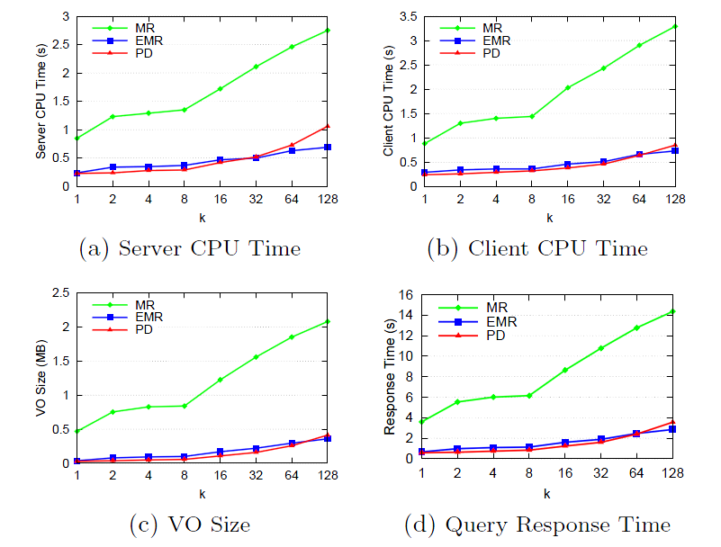
Performance Results
• MR: Merkle R-tree • EMR: Embeded Merkle R-tree • PD: Power Diagram
PD wins for small/medium queries; EMR good for large queries

Slide 16
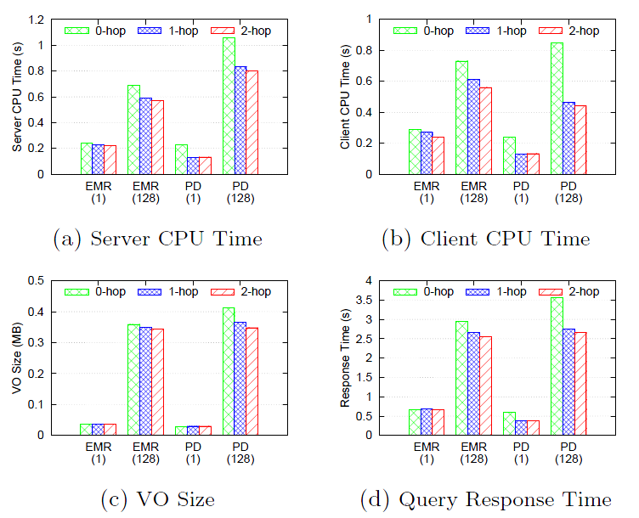
Effects of Optimizations
• 0-hop: No Optimization • 1-hop: Opt. with 1-hop Pre-signing
• 2-hop: Opt. with 2-hop Pre-signing
2-hop is a good tradeoff between offline cost and online performance

Slide 17
Conclusions
Designed two private ranking comparison functions
Proposed two privacy-preserving schemes to authenticate top-k results without disclosing object or ranking values
Experimentally validated the performance with proven security

Slide 18
Thanks ☺

