Slide 1
Authenticating
Location-based Services without Compromising Privacy
Haibo Hu Jianliang Xu Qian Chen Ziwei Yang
Hong Kong Baptist University

Slide 2
Motivating Example
A typical LBS business model consists of a location registry, a service provider (3rd party app.), and a client (typically mobile).

Slide 3
Motivating Example (Cont’d)
LBS service providers may not be trusted in terms of the service/query result
“nearby location-based restaurant browsing” may fake the number of diners in favor of “sponsored restaurants”
“online traffic monitoring” may provide delayed or inaccurate congestion reports to free users.
Our problem: the query client needs to authenticate the result of the service without disclosing user locations
Soundness
Completeness
Freshness

Slide 4
Roadmap
Motivation and Problem
Preliminary
Baseline R-tree based Scheme
Grid-file based Schemes
Analysis and Optimizations
Experimental Results
Conclusion

Slide 5
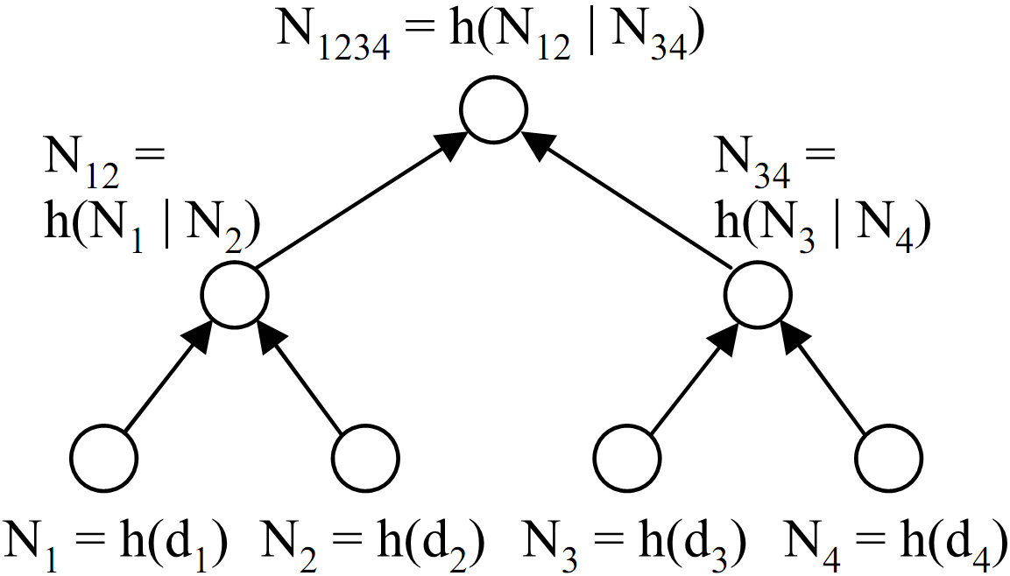
Background: Authentication on Indexed Data
In addition to the results, the server also sends a verification object (VO) to the client, based on which the client verifies the authenticity through some signature(s) from the data owner.
Merkle Hash Tree (1980)
VO includes the digests of N₁ and N₄ (i.e. h(d₁) and h(d₄)) and the signed root digest N₁₂₃₄.
The client computes h(d₁) and h(d₂), then N₁₂ = h( h(d₁) | h(d₂)), and finally N₁₂₃₄ = h( N₁₂ | N₃₄). This computed root digest is then compared with the signed root digest in the VO.
Signature Chaining (SC) [ICDE’04]
VO includes: (1) the signatures of d₂ and d₃, and (2) the boundary values d₁ and d₄.
The client verify: (1) the two boundary values fall outside the query range, and (2) all signatures are valid
To reduce bandwidth, signatures can be aggregated into a single signature.
Better for sorted data

Slide 6
Preliminary: Privacy-Preserving Authentication
1D range query [α, β] on B⁺-tree indexed data and the result is {r_{a}, r_{a+1}, …, r_{b}}
Authentication on the following 3 conditions
Soundness 1: r_{a}, r_{a+1}, … , r_{b} (and their ids) are not tampered with
Completeness: no other user has such x that α ≤ x ≤ β
Soundness 2: r_{a} ≥ α, r_{a-1}< α , r_{b} ≤ β, r_{b+1} > β.
[SIGMOD’05] Pang et al. designed a proof for verifying x ≥ y without disclosing x
The client and server jointly compute the digest g of value x:
the server first computes g(x-y) and sends it to the client,
The client then computes g(x) = g(x-y) ⊗ g(y), where ⊗ is a well defined operation on the digest.
The digest function g() has a nature that accepts only non-negative numbers.
As such, by sending g(x - y), the server proves x ≥ y.
Merkle or V B-tree
Hard if r_{i} cannot be disclosed

Slide 7
Verification Object for 1D Range Query

Slide 8
Roadmap
Motivation and Problem
Preliminary
Baseline R-tree based Scheme
Grid-file based Schemes
Analysis and Optimizations
Experimental Results
Conclusion

Slide 9
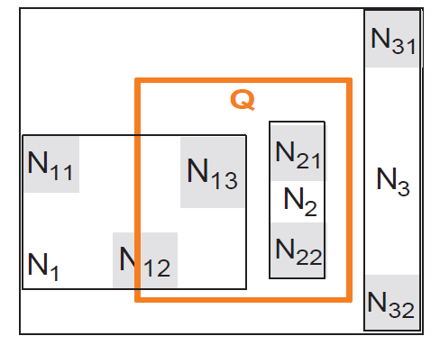
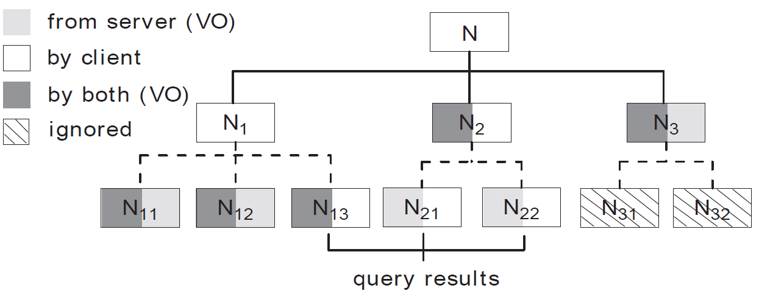
Verification for 2D Range Queries on R-tree
Challenge: leaf level entries of the index are not sorted.
Quick patch: boundary verification on every node where the query stops branching

Slide 10
Issues
Disclosure of Relative Positions
N₁₁ is to the west of Q because N₁₁’s x upper bound is compared with Q’s x lower bound
Big VO size for small query
As of all MHT-based schemes, a lot of digests of intermediate nodes must be sent to the client to compute the root digest.
An extreme case, Q is contained in only 1 leaf node. The total number of g()-related digest components is O(fh), where f = tree fanout, and h = tree depth

Slide 11
Eliminating the Disclosure of Relative Positions
Cause: “|” concatenation enforces order
Solution: replace “|” with an order insensitive (i.e., commutative) operator
Modular multiplication
Dig(x) = h( x₁ | x₂ | … | x_{m} ) →
Dig(x) = h( h(x₁) x h(x₂) x … x h(x_{m}) mod n), where n=pq, two large primes
The latter not also remove relative position disclosure, but also guarantees stronger authenticity
Hardness of quadratic residuosity problem
Irreversible and one-way hashing

Slide 12
Roadmap
Motivation and Problem
Preliminary
Baseline R-tree based Scheme
Grid-file based Schemes
Analysis and Optimizations
Experimental Results
Conclusion

Slide 13
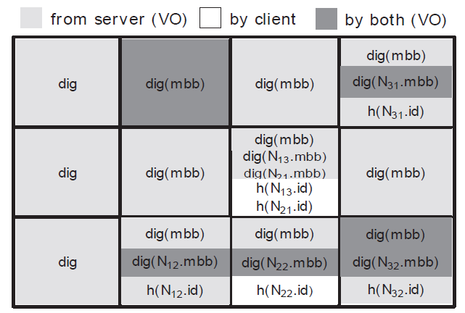
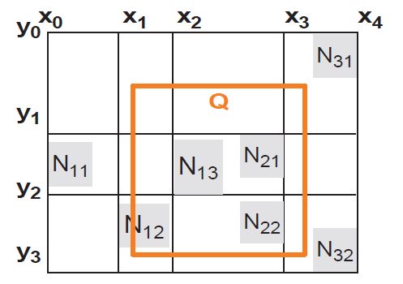
Reducing VO for Small Q: Grid-File Index
Grid-file index forces the index nodes to regain linearity by imposing an order on the grid cells.
Every cell is signed
The signature chains all neighboring 4 cells.

Slide 14
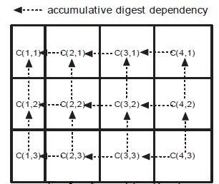
A Step Further: Accumulative Digest
Problems in grid-file index
Number of signatures sent to the client = number of cells
If updates are minimum, we can chain the cells in the digest level, instead of in the signature level
VO contains the signatures of
the bottom right cell, C(4,3).
the two cells that are immediate left and top to the top left cell: C(2,1)

Slide 15
Security Analysis
Threats:
the client may infer the locations of returned users from the VO
the SP dishonestly returning wrong results.
Security results obtained by proof by simulation
The R-tree based scheme privately authenticates the query result.
The grid/accu_grid based scheme privately authenticates the
query result if the grid is defined as a “loose grid”.

Slide 16
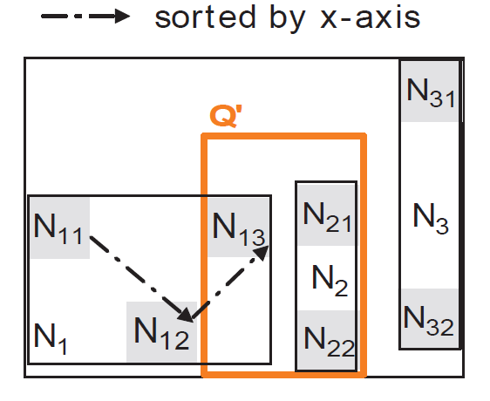
Optimization 1: Linear Ordering
Impose a linear order wherever no order exists
Simplest order is x (or y) order
Applicable to child nodes in R-tree or objects in a grid cell
Disadvantages:
Low locality
Cause rearranging entries when insertion

Slide 17
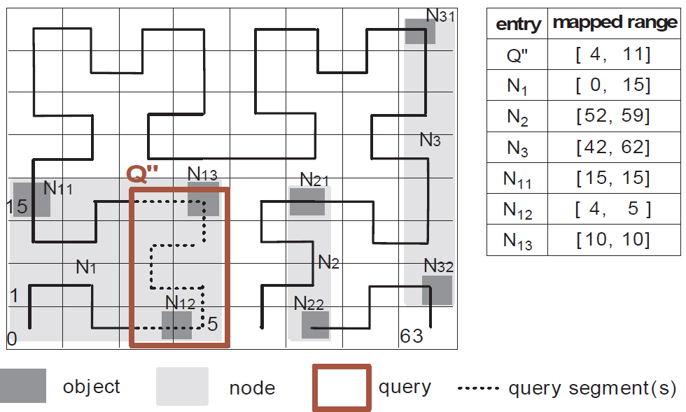
Optimization 2: Linear Embedding
Use global order instead of local order
Use Hilbert value for order to preserve locality

Slide 18
Roadmap
Motivation and Problem
Preliminary
Baseline R-tree based Scheme
Grid-file based Schemes
Analysis and Optimizations
Experimental Results
Conclusion

Slide 19
Experimental Settings
Dataset: California Roads @ MAF/TIGER database.
2,249,727 points
Server: Dual 4-core Intel Xeon X5570 2.93GHz CPU and 32GB RAM, running GNU/Linux, OpenJDK 1.6
Client: Core 2 Quad processor and 4GB RAM, WinXP
Network: 2Mbps download and 1Mbps upload
h() = SHA1 (160 bits)
g(), the same as [SIGMOD’05] from Pang et al.

Slide 20
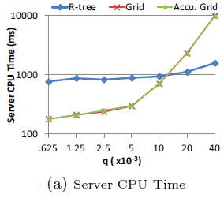
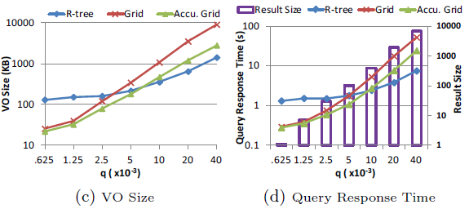
Basic Authentication Performance
T
The query response time indicates the winner is accu_grid for
small/medium queries, and is R-tree for extremely large queries.

Slide 21
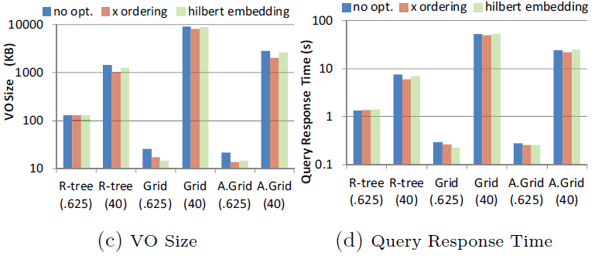
Performance with Optimizations
For small queries, the VO reduction is significant,
and the overall performance always improves.

Slide 22
Conclusion
Authenticable location-based services are essential to take the mobile service to a new level.
We propose a privacy-preserving solution to authenticate a range query result without disclosing the location of any user.
Some ongoing work:
We are investigating privacy-preserving authentication for k nearest neighbor queries.
May require a binary comparison protocol while both sides should preserve privacy.

