Slide 1
Authenticated Online Data Integration Services
Qian Chen, Haibo Hu, Jianliang Xu
Hong Kong Baptist University

Slide 2
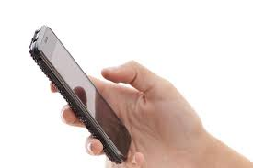
Data Integration Services
$$⋮$$
Integration
Server (IS)
Query
Result
Data Sources
Combining data from multiple sources
Providing users with a unified query interface
Client

Slide 3
Example: Metasearch Engines
CX105 | $617 | HK->MEL
CX135 | $617 | HK->MEL
CX105 | $617 | HK->MEL
CX135 | $617 | HK->MEL
QF30 | $594 | HK->MEL
QF98 | $698 | HK->MEL
MH73 | $691 | HK->MEL
MH79 | $699 | HK->MEL
Integration
Server (IS)
QF30 | $594 | HK->MEL
QF98 | $698 | HK->MEL
$$⋮$$
HK -> MEL
MH73 | $691 | HK->MEL
MH79 | $699 | HK->MEL
QF30
Price: $594
CX105
Price: $617
Airlines
Incorrect results
Hacking attack
Incomplete search
Program bug
In favor of sponsor
Client

Slide 4
More Examples
Meta-analysis
Life science research (e.g., virus spread and disease control) requires collection of disparate datasets
Example: DataNet
The server may be compromised by cyber attack
Collaborative data fusion
Online collaborative data platforms
Examples: Wikipedia, Wikisensing, Wikidata
May alter some critical results due to political or financial reasons
Authenticated Query Processing
Enable clients to verify the correctness of query results

Slide 5
Preliminaries: Merkle Hash Tree
Merkle Hash Tree (MHT)
$$N_{root}:h(N_{12}|N_{34})$$
?
Sign
Service Provider
$$sig(N_{root})$$
$$N_{12}:h(N_{1}|N_{2})$$
$$N_{34}:h(N_{3}|N_{4})$$
Dataset
MHT, $sig(Nroot)$
$$Q=[1, 1]$$
R$: \left\{d_{2},1\right\}$
$$VO: \{\left\{d_{1},0\right\},N34,$$
$$N_{1}:h(d_{1})$$
{1, 3, 4, 5}
$$sig(Nroot)\}$$
$$N_{2}:h(d_{2})$$
$$N_{3}:h(d_{3})$$
$$N_{4}:h(d_{4})$$
Data Owner
Client
$$d_{1}$$ | $$d_{2}$$ | $$d_{3}$$ | $$d_{4}$$
0 | 1 | 2 | 3
$$d_{1}$$ | $$d_{2}$$ | $$d_{3}$$ | $$d_{4}$$
0 | 1 | 2 | 3
Q=[1,1]
Verify
Dataset
Soundness: 1 $∈$[1,1]; root
Completeness: 0,$N_{34} ∉$[1,1]

Slide 6
Roadmap
Problem definition & challenges
Design intuition
Homomorphic secret sharing seal ($HS^{3}$)
Query authentication schemes
Prefix tree
Indexes: $HS^{3}$-G-tree & $HS^{3}$-R-tree
Experiments
Conclusion

Slide 7
Problem Definition
Integrated dataset $D=\left\{v_{1},v_{2},v_{3},…\right\}$
$v_{i}$ is from source $o_{i}$
Range Query $Q$
Objectives:
Enable authenticated query processing
Soundness
Completeness
Freshness
Minimize the verification overhead
Support efficient data/seal update

Slide 8
Challenges
Data collected from multiple sources independently
How to prove completeness
Minimize cost of authenticated query processing
Publicly verifiable
Client and data sources don’t share secret keys
A naïve solution
Server sends the whole dataset & signatures to the client
$\left\{\left(v_{1},sig\left(v_{1}\right)),(v_{2},sig\left(v_{2}\right)\right),…\right\}$
Do local search
Drawback: the overhead is linear to the dataset size

Slide 9
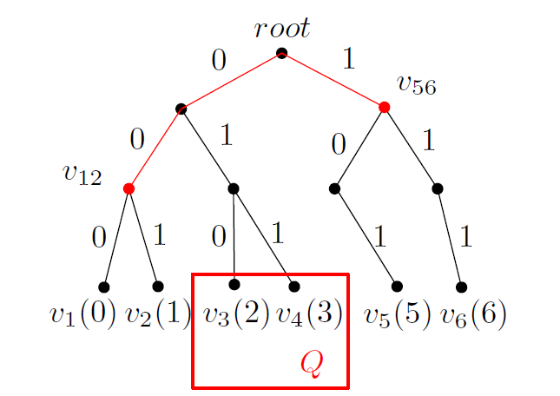
Design Intuition
Verify far-away non-result values without using the whole dataset
$v_{12}$ proves $v_{1},v_{2}$
$v_{56}$ proves $v_{5},v_{6}$
Issue: $v_{1}, …,v_{6}$ have sigs; $v_{12},v_{56}$ don’t
Need special signature
Prefix Tree based on $v_{1}$ to $v_{6}$

Slide 10
Design Intuition
Secret sharing scheme (completeness)
A secret $s$ among $n$ users
Each takes a piece of secret share $ss_{i}$
Final secret $s=\sum_{i=1}^{n}{ss_{i}}$
Each data source binds secret share with value
$o_{i}$ binds $ss_{i}$ with $v_{i}$
Total secret $s$ is recovered from all values
$prefix(v_{1},v_{2})$ has secret share $(ss_{1}+ss_{2})$

Slide 11
Main Contributions
Authenticated Prefix Tree
Homomorphic Secret
Sharing Seal ($HS^{3}$)
$HS^{3}$-G-Tree &
$HS^{3}$-R-Tree
Extended Queries
& Optimizations

Slide 12
Homomorphic Secret Sharing Seal
Content:
$h\left(⋅\right)$
$seal\left(v\right)=𝒢\left(v,ss_{i} \right)={\left(g^{ss_{i}}⋅g^{h\left(v_{(3)}\right)|h\left(v_{(2)}\right)|h(v_{(1)})}\right)}^{d} mod n$
Seal design
Seal is “additively” homomorphic
Seal can be folded by the integration server
$v_{1}=000⇒S_{1}=𝓖\left(000,ss_{1}\right) \text{from} o_{1}$
$v_{2}=001⇒S_{2}=𝓖\left(001,ss_{2}\right)$ from $o_{2}$
$seals\left(prefix\left(v_{1},v_{2}\right)\right)=𝓖\left(00,ss_{1}+ss_{2}\right)=S_{1}⊗S_{2}$

Slide 13
Seal Designs
Homomorphism
Completeness
Embedded a secret sharing scheme
Seal folding
Generate seals for internal nodes
Update efficient
Cancel out the old seals
RSA based signature
Publicly verifiable

Slide 14
Authenticated Prefix Tree
$$S_{root}=S_{12}⊗S_{34}$$
Integration
Server
Dataset
& Seals
$$S_{12}=seal_{1}⊗seal_{2}$$
$$S_{34}=seal_{3}⊗seal_{4}$$
0
1
Data Sources
R$: \left\{S_{2},d_{2},01\right\}$
VO$: \{\left\{S_{1},d_{1},00\right\},$ {$S34$,$1\}$}
$$Q=[1, 1]$$
$$seal (d_{1})$$
{1, 3, 4, 5}
$$seal(d_{2})$$
$$seal(d_{3})$$
$$seal(d_{4})$$
Client
$$d_{1}$$ | $$d_{2}$$ | $$d_{3}$$ | $$d_{4}$$
00 | 01 | 10 | 11
Data
Q=[1,1]
Verify
Soundness: $d_{2}$ $∈$[1,1]; $S_{1},S_{2},S_{34}$
Completeness: $d_{1}$,1$∉$[1,1]; secret

Slide 15
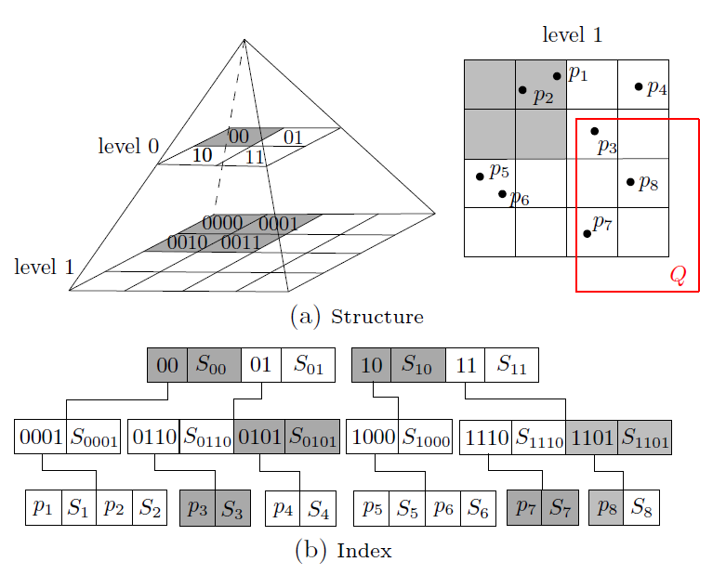
${HS}^{3}$-G-Tree
Efficient to update, but may deteriorate under skew distribution

Slide 16
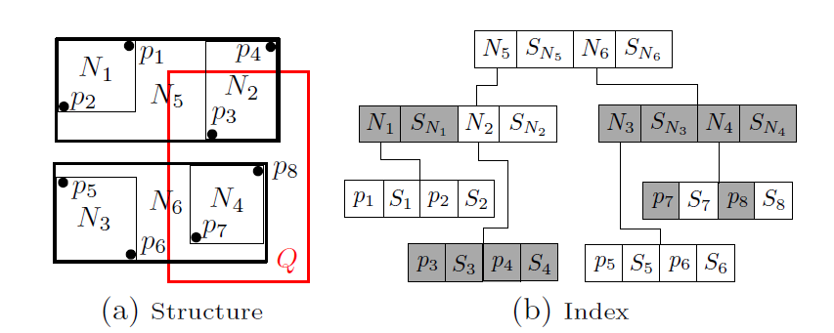
${HS}^{3}$-R-Tree
Tightly clustered, but an update may cause cascading tree reconstructions

Slide 17
More Analysis and Optimizations
Proven security with thorough theoretical analysis
Cost models for the query authentication schemes
Optimizations
${HS}^{3}$-G-Tree
More efficient update
Lazy-update
${HS}^{3}$-R-Tree
Reduce reconstruction
Loose bounds for data value
Extension to advanced queries: kNN, skyline

Slide 18
Experiment Settings
Dataset:
Gowalla dataset in Stanford Large Network Dataset Collection
6,442,890 user check-ins
1,280,969 unique locations with a non-spatial score
Weather dataset from NWS Cooperative Observer Program
10,000 volunteers report daily weather observation
Server: Dual 4-core Intel Xeon X5570 2.93GHz CPU and 32GB RAM, running GNU/Linux, OpenJDK 1.6
Client: Core 2 Quad processor and 4GB RAM, WinXP
RSA (2048 bits), AES(256 bits)
h(): SHA-1 (160 bits)

Slide 19
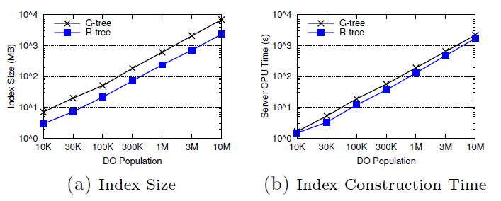
Server Construction Cost
• G-tree: $HS^{3}$-G-tree • R-tree: $HS^{3}$-R-tree
The construction cost is linear to the dataset size

Slide 20
Basic Query Auth Performance
• G-tree: $HS^{3}$-G-tree • R-tree: $HS^{3}$-R-tree
Both index trees outperform the naïve solution.
R-tree is better than G-tree since it is more compact.

Slide 21
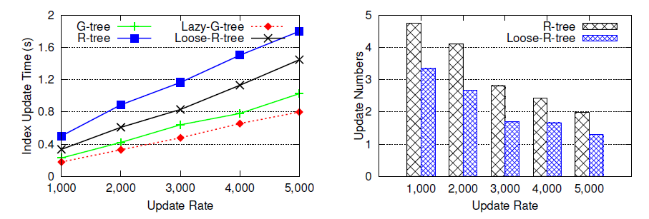
Index Update Performance
• G-tree: $HS^{3}$-G-tree • R-tree: $HS^{3}$-R-tree
• Lazy-G-tree: lazy-update G-tree
• Loose-R-tree: loosely-bounded R-tree
G-tree updates more efficiently than R-tree.
Both optimizations improve performance by 20-30%.

Slide 22
Summary of Contributions
Designed a novel signature homomorphic secret sharing seal ($HS^{3}$)
Proposed two indexes for authenticating multi-dimensional queries over integrated data
Extended to advanced queries, proposed update schemes, and provided formal cost models
Experimentally validated the performance with proven security

Slide 23
Thanks ☺

Slide 24
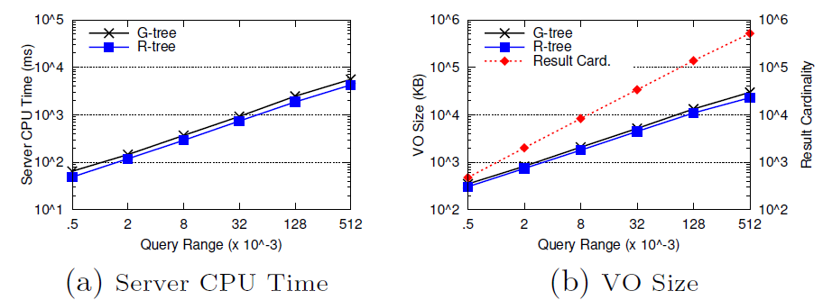
Varying Query Ranges
• G-tree: $HS^{3}$-G-tree • R-tree: $HS^{3}$-R-tree
Cost is linear to the query range (i.e., the result size )

Slide 25
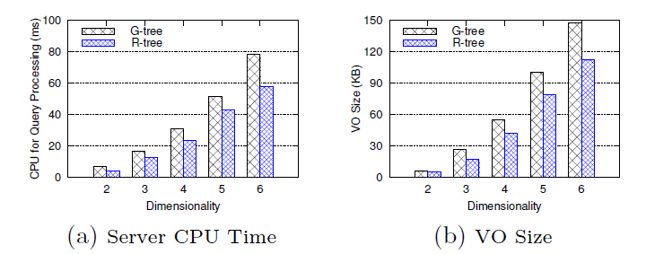
Varying Data Dimensionality
• G-tree: $HS^{3}$-G-tree • R-tree: $HS^{3}$-R-tree
G-tree deteriorates faster since R-tree is more compact

Slide 26
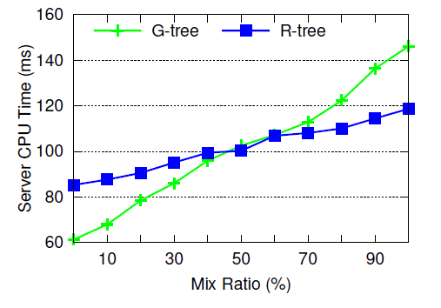
Mixed Workload
• G-tree: $HS^{3}$-G-tree • R-tree: $HS^{3}$-R-tree
G-tree wins when query ratio < 40%, R-tree wins for ratio > 60%

Slide 27
Preliminaries
Cryptographic hash function
$h\left(⋅\right)$ is Collision resistant
$m_{1}≠m_{2}$, hard to find $h\left(m_{1}\right)=h(m_{2})$
Secret sharing scheme
A secret $s$ among $n$ users
The key distributer generates random values $ss_{1},…,ss_{n−1}$ and distributes to $n−1$ users
The last one picks $ss_{n}=s−\sum_{i=1}^{n−1}{ss_{i}}$
$s=\sum_{i=1}^{n}{ss_{i}}$

Slide 28
Preliminaries
RSA signature
$sk=\left(n,d\right),pk=\left(n,e\right),n=p⋅q$
$e⋅d=1 mod φ\left(n\right)$
$sig\left(m\right)=h{\left(m\right)}^{d} mod n$
Signature verification: $h\left(m\right)=sig{\left(m\right)}^{e}$
RSA-based homomorphic Signature
$𝒢\left(r,h\left(m\right)\right)={\left(r⋅g^{h\left(m\right)}\right)}^{d} mod n$
$𝒢\left(r_{1},h\left(m_{1}\right)\right)⋅𝒢(r_{2},h(m_{2}))=𝒢(r_{1}⋅r_{2},h\left(m_{1}\right)+h(m_{2}))$

