Slide 1
Graph Convolutional Neural Networks
Huawei Shen
Institute of Computing Technology,
Chinese Academy of Sciences
2019.08.11

Slide 2
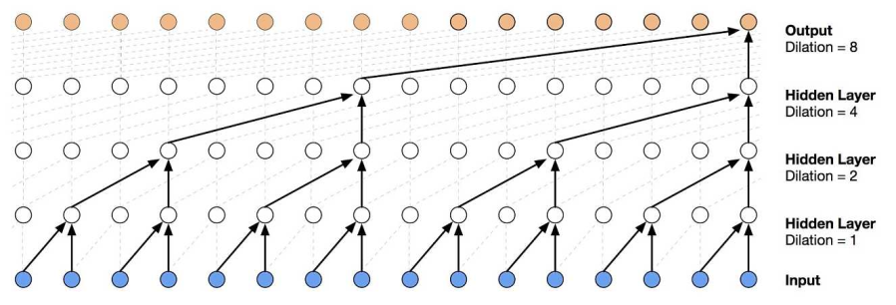
Convolutional Neural Network
Convolutional neural network (CNN) gains great success on Euclidean data, e.g., image, text, audio, and video
Image classification, object detection, machine translation
The power of CNN lies in
its ability to learn local stationary structures, via localized convolution filter, and compose them to form multi-scale hierarchical patterns
Convolutional neural networks on image
Temporal convolutional network
M. M. Bronstein, J. Bruna, Y. LeCun, A. Szlam, P. Vandergheynst. Geometric deep learning: going beyond Euclidean data. IEEE Signal Processing Magazine, 18-42, 2017.

Slide 3
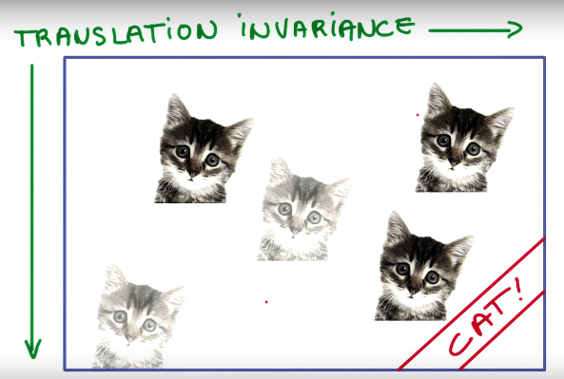
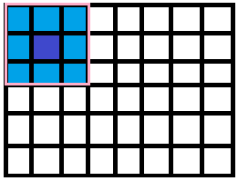
Convolutional Neural Network
Localized convolutional filters are translation- or shift-invariant
Which are able to recognize identical features independently of their spatial locations
One interesting problem is how to generalize convolution to non-Euclidean domain, e.g., graph?
Irregular structure of graph poses challenges for defining convolution
X-Shape
$$\begin{matrix}1 & 0 & 1 \\ 0 & 1 & 0 \\ 1 & 0 & 1\end{matrix}$$
Template Matching
$$\begin{matrix}1 & 0 & 1 \\ 0 & 1 & 0 \\ 1 & 0 & 1\end{matrix}$$
$$\begin{matrix}1 & 0 & 1 \\ 0 & 1 & 0 \\ 1 & 0 & 1\end{matrix}$$
LeCun, Y., Bengio, Y., and Hinton, G. Deep learning. Nature, 521(7553):436, 2015

Slide 4
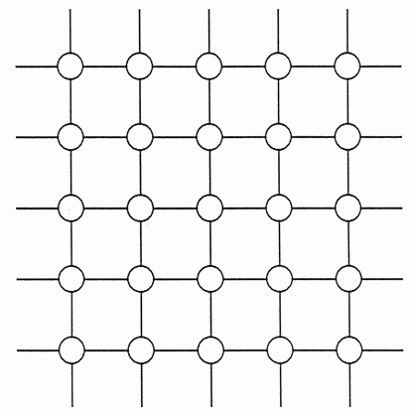
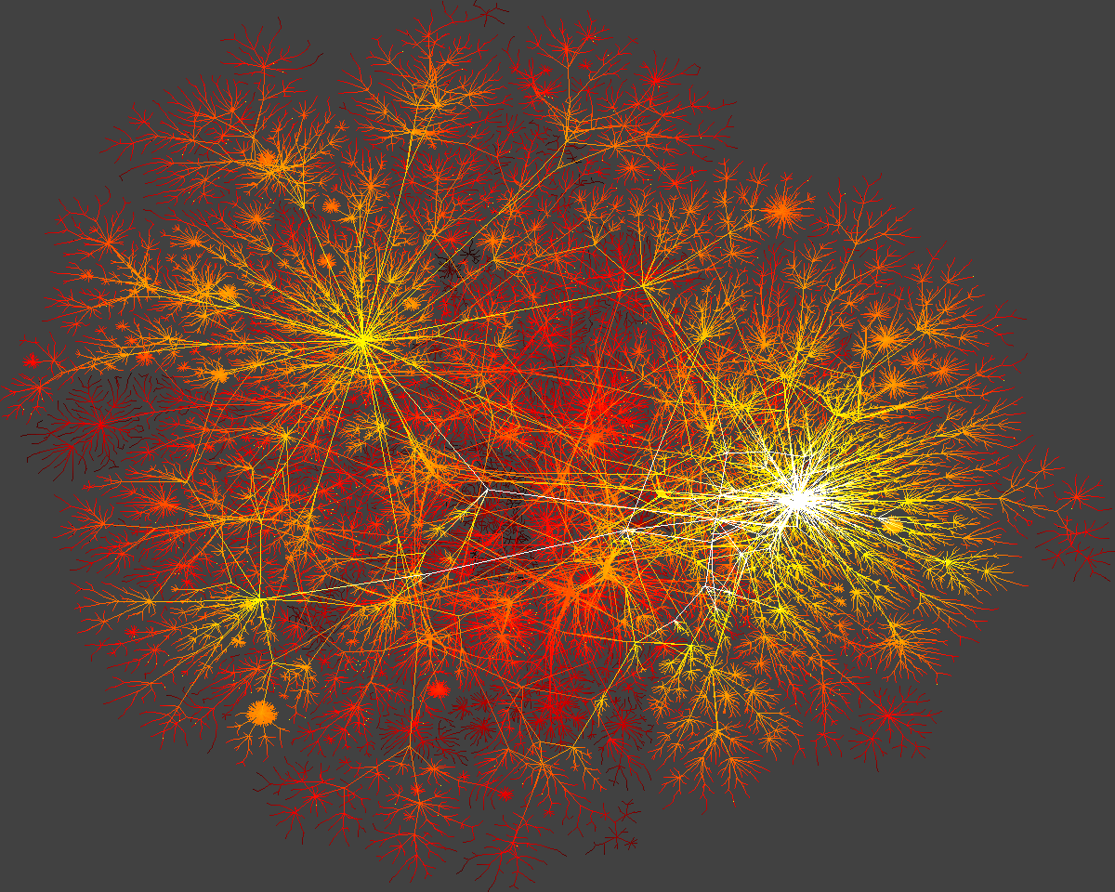
From CNN to graph CNN
Convolution is well defined in Euclidean data, grid-like network
Not straightforward to define convolution on irregular network, widely observed in real world
Grid-like network
Irregular networks

Slide 5
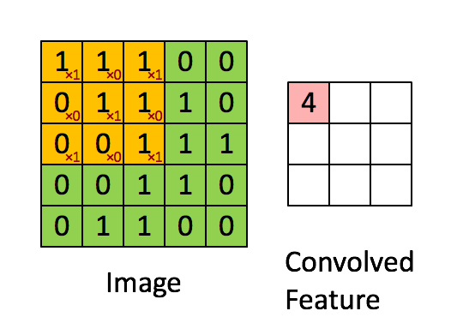
Convolution
Convolution is a mathematical operation on two functions, $f$ and $g$, to produce a third function $h$.
Defined as the integral, in continuous case, or sum, in discrete case, of the product of the two functions after one is reversed and shifted.
Continuous case
$$h\left(t\right)=\left(f∗g\right)\left(t\right)≝\int{f\left(t\right)g\left(t−τ\right)ⅆτ}$$
Discrete case
$$x$$
$$h\left(x, y\right) \\ =\left(f∗g\right)\left(x, y\right)$$
$$≝\sum_{m,n}{f\left(x−m,y−n\right)g\left(m,n\right)}$$
$g$= | $$g\left(1,1\right)$$ 1 | $$g\left(0,1\right)$$ 0 | $$g\left(−1,1\right)$$ 1
 | $$g\left(1,0\right)$$ 0 | $$g\left(0,0\right)$$ 1 | $$g\left(−1,0\right)$$ 0
 | $g\left(1,−1\right)$1 | $$g\left(0,−1\right)$$ 0 | $$g\left(−1,−1\right)$$ 1
$$y$$
$$h$$
$$f$$

Slide 6
Existing methods to define convolution
Spectral methods: define convolution in spectral domain
Convolution is defined via graph Fourier transform and convolution theorem.
The main challenge is that convolution filter defined in spectral domain is not localized in vertex domain.
Spatial methods: define convolution in the vertex domain
Convolution is defined as a weighted average function over all vertices located in the neighborhood of target vertex.
The main challenge is that the size of neighborhood varies remarkably across nodes, e.g., power-law degree distribution.

Slide 7
Spectral methods for
graph convolutional neural networks

Slide 8
Spectral methods
Given a graph $G=\left(V,E,W\right)$
$V$ is node set with $n=\left|V\right|$, $E$ is edge set, and $W∈R^{n×n}$ is the weighted adjacency matrix
Each node is associated with $d$ features, and $X∈R^{n×d}$ is the feature matrix of nodes, each column of $X$ is a signal defined over nodes
Graph Laplacian
$L=D−W$, where is a diagonal matrix with $D_{ii}=\sum_{j}{W_{ij}}$
Normalized graph Laplacian
where $I$ is the identity matrix.
$$L=I−D^{−\frac{1}{2}}WD^{−\frac{1}{2}}$$

Slide 9
Graph Fourier Transform
Fourier basis of graph $G$
The complete set of orthonormal eigenvectors ${\left\{u_{l}\right\}}_{l=0}^{n−1}$ of $L$, ordered by its non-negative eigenvalues ${\left\{λ_{l}\right\}}_{l=0}^{n−1}$
Graph Laplacian could be diagonalized as
where $U=\left[u_{0},⋯,u_{n−1}\right]$, and $Λ=diag\left(\left[u_{0},⋯,u_{n−1}\right]\right)$
Graph Fourier transform
Graph Fourier transform of a signal $x∈R^{n}$ is defined as
Graph Fourier inverse transform is
$$L=UΛU^{T}$$
$$\hat{x}=U^{T}x$$
$$x=U\hat{x}$$

Slide 10
Define convolution in spectral domain
Convolution theorem
The Fourier transform of a convolution of two signals is the point-wise product of their Fourier transforms
According to convolution theorem, given a signal $x$ as input and the other signal $y$ as filter, graph convolution $∗_{G}$could be written as
Here, the convolution filter in spectral domain is $U^{T}y$.
$$x ∗_{G} y=U\left(\left(U^{T}x\right)⨀\left(U^{T}y\right)\right)$$

Slide 11
Define convolution in spectral domain
Graph convolution in spectral domain
Let $U^{T}y={\left[θ_{0},⋯,θ_{n−1}\right]}^{T}$ and $g_{θ}=diag\left(\left[θ_{0},⋯,θ_{n−1}\right]\right)$, we have
$$x ∗_{G} y=U\left(\left(U^{T}x\right)⨀\left(U^{T}y\right)\right)$$
$$x ∗_{G} y=Ug_{θ}U^{T}x$$
Step 3
Graph Fourier
Inverse Transform
Step 2:
Convolution
in spectral domain
Step 1:
Graph
Fourier Transform
$$Ug_{θ}U^{T}x$$
$$g_{θ}U^{T}x$$
$$U^{T}x$$

Slide 12
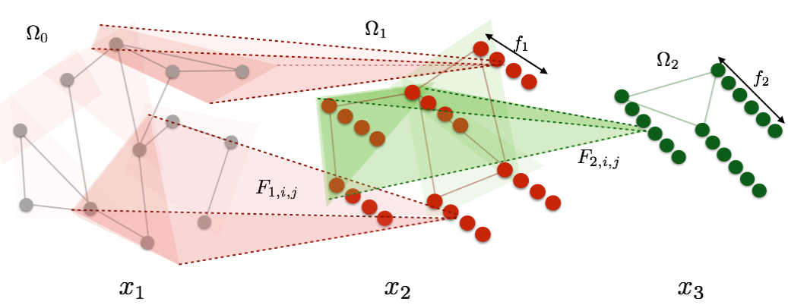
Spectral Graph CNN
Spectral Graph CNN
Signals in the $k$-th layer
$$x_{k+1,j}=h\left(\sum_{i=1}^{f_{k}}{UF_{k,i,j}U^{T}x_{k,i}}\right)$$
Filter in the $k$-th layer
$$j=1,⋯,f_{k+1}$$
Graph Fourier Transform
$$x^{∗}=U^{T}x$$
Graph Fourier Inverse Transform
$$x=Ux^{∗}$$
J. Bruna, W. Zaremba, A. Szlam, and Y. LeCun. Spectral networks and locally connected networks on graphs.
ICLR, 2014.

Slide 13
Shortcomings of Spectral graph CNN
Requiring eigen-decomposition of Laplacian matrix
Eigenvectors are explicitly used in convolution
High Computational cost
Multiplication with graph Fourier basis $U$ is $O\left(n^{2}\right)$
Not localized in vertex domain

Slide 14
ChebyNet: parameterizing filter
Parameterizing convolution filter via polynomial approximation
ChebyNet
$$g_{θ}=diag\left(\left[θ_{0},⋯,θ_{n−1}\right]\right)$$
$$g_{β}\left(Λ\right)=\sum_{k=0}^{K−1}{β_{k}Λ^{k}}$$
$$Λ=diag\left(λ_{1},λ_{2},⋯,λ_{n}\right)$$
$$x ∗_{G} y=U{g_{β}\left(Λ\right)U}^{T}x=\sum_{k=0}^{K−1}{β_{k}L^{k}x}$$
The number of free parameters reduces from $n$ to $K$
M. Defferrard, X. Bresson, P. Vandergheynst. Convolutional neural networks on graphs with fast localized spectral filtering. NeuraIPS, 2016.

Slide 15
ChebyNet vs. Spectral Graph CNN
Eigen-decomposition is not required
Computational cost is reduced from $O\left(n^{2}\right)$ to $O\left(\left|E\right|\right)$
Convolution is localized in vertex domain
Convolution is strictly localized in a ball of radius $K$, i.e., $K$ hops from the central vertex
$$x ∗_{G} y=U{g_{β}\left(Λ\right)U}^{T}x=\sum_{k=0}^{K−1}{β_{k}L^{k}x}$$
Is this method good enough? What could we do more?
M. Defferrard, X. Bresson, P. Vandergheynst. Convolutional neural networks on graphs with fast localized spectral filtering. NeuraIPS, 2016.

Slide 16
Our method:
Graph Wavelet Neural Network
(ICLR 2019)

Slide 17
Graph wavelet neural network
ChebyNet achieves localized convolutional via restricting the space of graph filters as a polynomial function of eigenvalue matrix $Λ$
We focus on the Fourier basis to achieve localized graph convolution
We propose to replace Fourier basis with wavelet basis
$$g_{θ}\left(Λ\right)=\sum_{k=0}^{K−1}{θ_{k}Λ^{k}}$$
$$x ∗_{G} y=Ug_{θ}U^{T}x$$

Slide 18
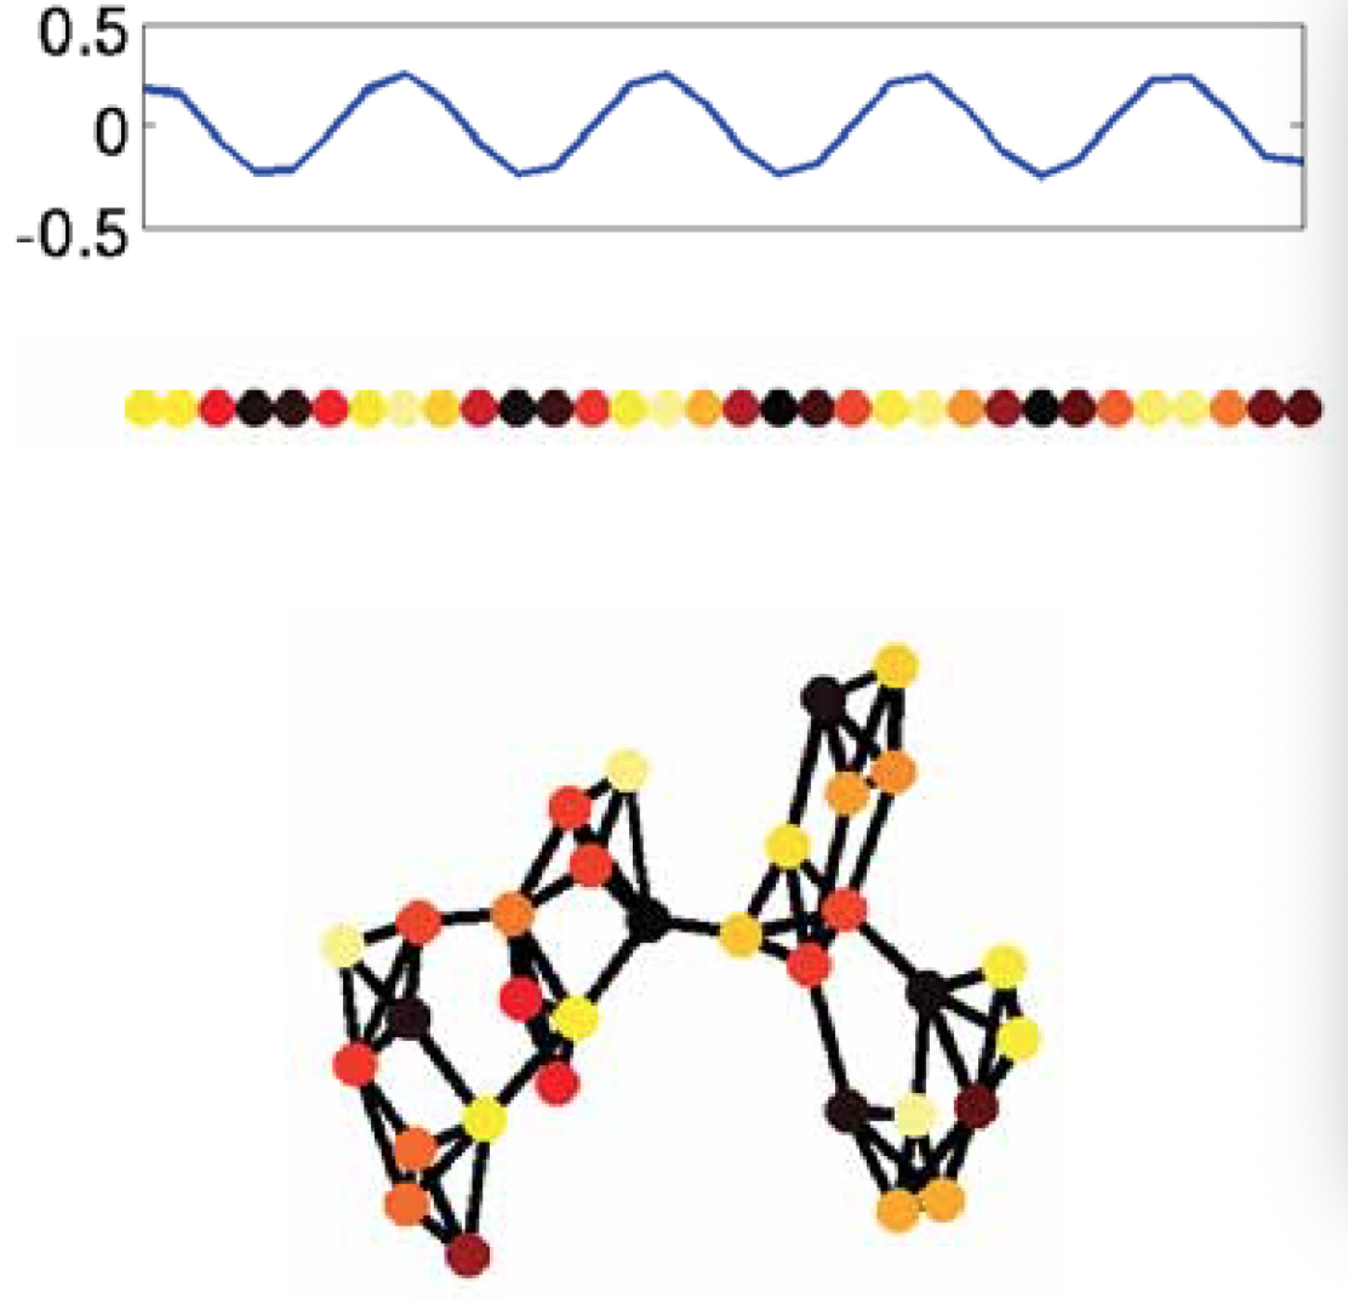
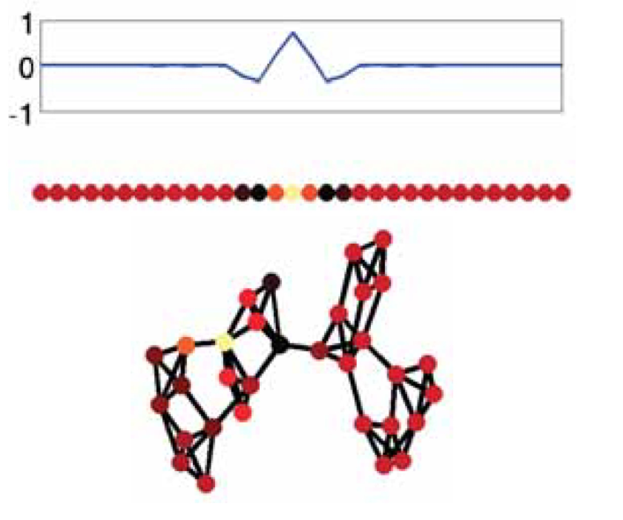
Fourier vs. Wavelet
Fourier Basis
Dense
Not localized
High Computational cost
Wavelet Basis
Sparse
Localized
Low Computational cost
Fourier basis：$U$
Wavelet basis：$ψ_{s}=Ue^{λs}U^{T}$
B. Xu, H. Shen, Q. Cao, Y. Qiu, X. Cheng. Graph wavelet neural network. ICLR 2019.

Slide 19
Graph wavelet neural network
Graph Wavelet Neural Network
Replace graph Fourier transform with graph wavelet transform
Graph Fourier transform
$$x^{∗}=U^{T}x$$
Inverse Fourier transform
$$x=Ux^{∗}$$
Graph Wavelet transform
$$x^{∗}={ψ_{s}}^{−1}x$$
Inverse Wavelet transform
$$x={ ψ}_{s}x^{∗}$$

Slide 20
Graph wavelet neural network (GWNN)
Graph convolution via wavelet transform
Graph wavelet neural network
Replacing basis
$$x_{k+1,j}=h\left(\sum_{i=1}^{p}{UF_{k,i,j}U^{T}x_{k,i}}\right)$$
$$x_{k+1,j}=h\left(\sum_{i=1}^{p}{ψ_{s}F_{k,i,j}ψ_{s}^{−1}x_{k,i}}\right)$$
$$j=1,⋯,q$$
Parameter complexity：$O\left(n∗p∗q\right)$

Slide 21
Reducing parameter complexity
Key idea:
Detaching graph convolution from feature transformation
$$x_{k+1,j}=h\left(\sum_{i=1}^{p}{ψ_{s}F_{k,i,j}ψ_{s}^{−1}x_{k,i}}\right)$$
$$j=1,⋯,q$$
$T∈R^{q×p}$
with $p∗q$ parameters
$F_{k}$ is a diagonal matrix
with $n$ parameters
$$y_{k,j}=\sum_{i=1}^{p}{T_{ji}x_{k,i}}$$
$$x_{k+1,j}=h\left(ψ_{s}F_{k}ψ_{s}^{−1}y_{k,j}\right)$$
Feature transformation
Graph convolution
The number of parameters reduces from $O\left(n∗p∗q\right)$ to $O\left(n+p∗q\right)$

Slide 22
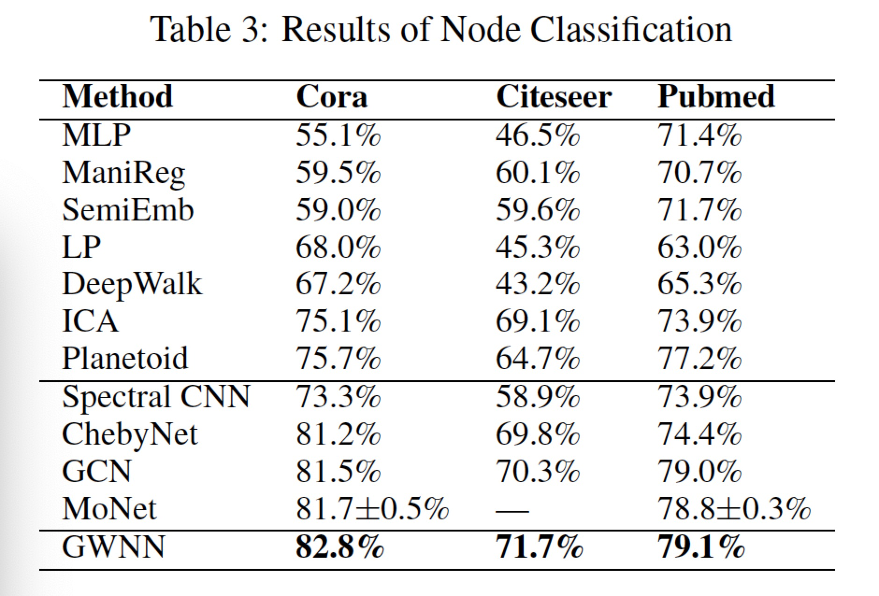
GWNN vs. ChebyNet
Benchmark datasets
Results at the task of node classification

Slide 23
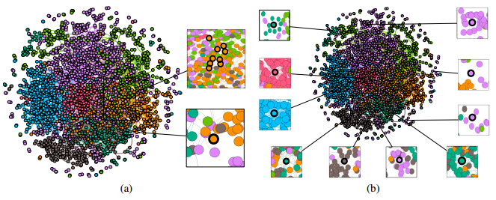
Graph wavelet neural network
Each Graph wavelet offers us a local view, i.e., from a center node, about the proximity for each pair of nodes
Wavelet offers us a better basis for defining graph convolutional networks in spectral domain

Slide 24
Spatial methods for
graph convolutional neural networks

Slide 25
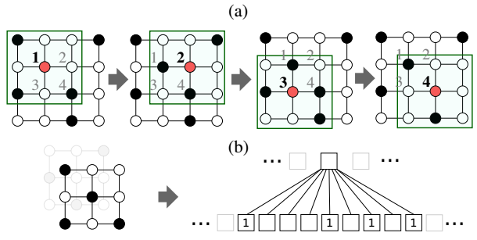
Spatial Methods for Graph CNN
By analogy
What can we learn from the architecture of standard convolutional neural network?
1. Determine
Neighborhood
2. Impose an order in
neighborhood
3. Parameter sharing
M. Niepert, M. Ahmed, K. Kutzkov. Learning Convolutional Neural Networks for Graphs. ICML, 2016.

Slide 26
Spatial Methods for Graph CNN
By analogy
For each node, select the fixed number of nodes as its neighboring nodes, according to certain proximity metric
Impose an order according to the proximity metric
Parameter sharing
1. Determine
Neighborhood
2. Impose an order in
neighborhood
3. Parameter sharing
M. Niepert, M. Ahmed, K. Kutzkov. Learning Convolutional Neural Networks for Graphs. ICML, 2016.

Slide 27
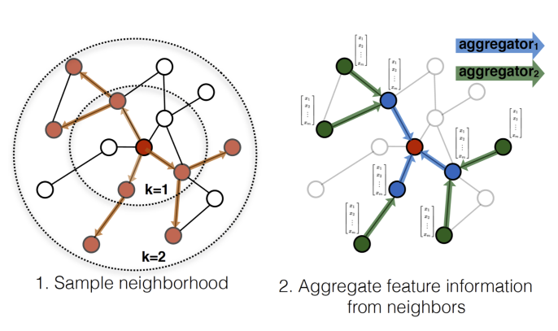
Spatial Methods for Graph CNN
GraphSAGE
Sampling neighbors
Aggregating neighbors
General framework of graph neural networks: Aggregate the information of neighboring nodes to update the representation of center node
GraphSAGE: Inductive Learning
W. L. Hamilton, R. Ying, J. Leskovec. Inductive Representation Learning on Large Graphs. NeuraIPS 2017

Slide 28
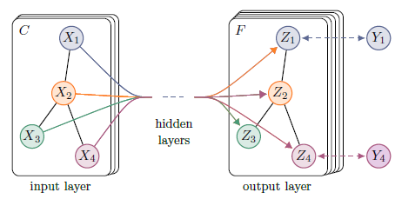
Spatial Methods for Graph CNN
GCN: Graph Convolution Network
Aggregating information from neighborhood via a normalized Laplacian matrix
Shared parameters are from feature transformation
A reduced version of ChebNet
Parameter for feature Transformation
T. N. Kipf, and M. Welling. Semi-supervised classification with graph convolutional networks. ICLR 2017

Slide 29
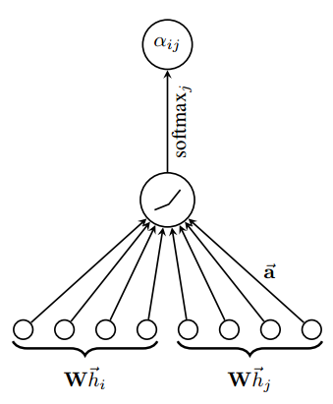
Spatial Methods for Graph CNN
GAT: Graph Attention Network
Learning the aggregation matrix, i.e., Laplacian matrix in GCN, via attention mechanism
Shared parameters contain two parts
Parameters for feature transformation
Parameters for attention
Parameter for feature Transformation
Parameter of Attention mechanism
Attention Mechanism in GAT
P. Velickovic, G. Cucurull, A. Casanova, A. Romero, P. Lio, Y. Bengio. Graph Attention Networks. NeuraIPS 2018.

Slide 30
Spatial Methods for Graph CNN
MoNet: A general framework for spatial methods
Define multiple kernel functions, parameterized or not, to measure the similarity between target node and other nodes
Convolution kernels are the weights of these kernel functions
Convolution kernel
F. Monti, D. Boscaini, J. Masci, E. Rodola, J. Svoboda, M. M. Bronstein. Geometric deep learning on graphs and manifolds using mixture model CNNs. CVPR 2017.

Slide 31
Our method:
Graph Convolutional Networks using Heat Kernel for Semi-supervised Learning
（IJCAI 2019, KRR-GSTR, August 15）

Slide 32
Spectral methods vs. Spatial methods
Connections
Spectral methods are special cases of spatial methods
Difference
Spectral methods define kernel functions via an explicit space transformation, i.e., projecting into spectral space
Spatial methods directly define kernel functions
Spectral
methods
Spatial Methods
Kernel function：
Characterizing the similarity or distance among nodes

Slide 33
Spectral methods: Recap
Spectral CNN
ChebNet
GCN
$$y=Ug_{θ}U^{T}x=\left(θ_{1}u_{1}u_{1}^{T}+θ_{2}u_{2}u_{2}^{T}+⋯+θ_{n}u_{n}u_{n}^{T}\right)x$$
$$y=\left(θ_{0}I+θ_{1}L+θ_{2}L^{2}+⋯+θ_{K−1}L^{K−1}\right)x$$
$$y=θ\left(I−L\right)x$$
Question:
Why GCN with less parameters performs better than ChebNet?

Slide 34
Graph Signal Processing: filter
Smoothness of a signal $x$ over graph is measured by
Basic filters
$u_{i}u_{i}^{T}\left(1≤i≤n\right)$ are a set of basic filters
For a graph signal $x$, the basic filter $u_{i}u_{i}^{T}$ only allows the component with frequency $λ_{i}$ passes
$$x^{T}Lx=\sum_{\left(u,v\right)∈E}{A_{uv}{\left(\frac{x_{u}}{\sqrt{d_{u}}}−\frac{x_{v}}{\sqrt{d_{v}}}\right)}^{2}}$$
$λ_{i}=u_{i}^{T}Lu_{i}$ can be viewed as the frequency of $u_{i}$
$x=α_{1}u_{1}+α_{2}u_{2}+⋯+α_{n}u_{n}$,
$$u_{i}u_{i}^{T}x=α_{i}u_{i}$$

Slide 35
Combined filters: High-pass vs. Low-pass
Combined filters
A linear combination of basic filters
$L^{k}$ is a combined filter with the coefficients ${\left\{λ_{i}^{k}\right\}}_{i=1}^{n}$
$L^{k}$ assign high coefficients to basic filters with high-frequency, i.e., $L^{k}$ is a high-pass filter
GCN only consider $k=0$ and $k=1$, avoiding the boosting effect to basic filters with high-frequency
Behaving as a low-pass combined filter
Explaining why GCN performs better than ChebNet
$$θ_{1}u_{1}u_{1}^{T}+θ_{2}u_{2}u_{2}^{T}+⋯+θ_{n}u_{n}u_{n}^{T}$$

Slide 36
Our method: GraphHeat
Low-pass combined filters
$\left\{e^{−skL}\right\}$, where $s$ is scaling parameter, and k is order
$e^{−sL}$ is heat kernel over graph, which defines the similarity among nodes via heat diffusion over graph
The basic filter $u_{i}u_{i}^{T}\left(1≤i≤n\right)$ has the coefficient $e^{−sλ_{i}}$, suppressing signals with high-frequency
$e^{−sL}=Ue^{−sΛ}U^{T}$, $Λ=diag\left(λ_{1},λ_{2},⋯,λ_{n}\right)$
B. Xu, H. Shen, Q. Cao, K. Cen, X. Cheng. Graph Convolutional Networks using Heat Kernel for Semi-supervised Learning, IJCAI 2019.

Slide 37
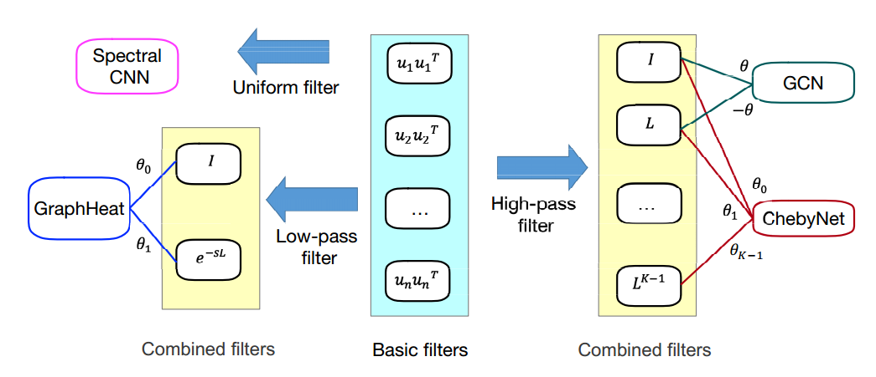
GraphHeat vs. baseline methods
Compared with baseline methods

Slide 38
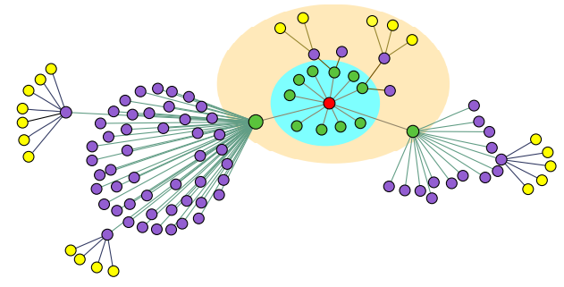
GraphHeat vs. baseline methods
Neighborhood
GCN and ChebNet determine neighborhood according to the hops away from center node, i.e., in an order-style
Nodes in different colors
GraphHeat determines neighborhood according to the similarity function by heat diffusion over graph
Nodes in different circles

Slide 39
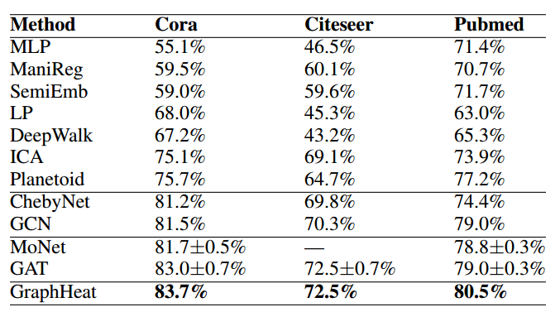
Experimental results
Results at the task of node classification
GraphHeat achieves state-of-the-art performance on the task of node classification on the three benchmark datasets

Slide 40
Graph Pooling

Slide 41
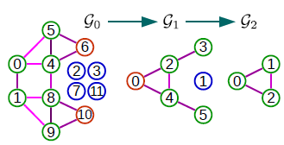
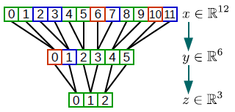
Graph Pooling via graph coarsening
Graph coarsening
Merging nodes into clusters and take each cluster as a super node
Node merging could be done a priori or during the training process of graph convolutional neural networks, e.g, DiffPooling
Ying, R., You, J., Morris, C., Ren, X., Hamilton, W. L., and Leskovec, J. Hierarchical graph representation learning with differentiable pooling, NeuraIPS 2018

Slide 42
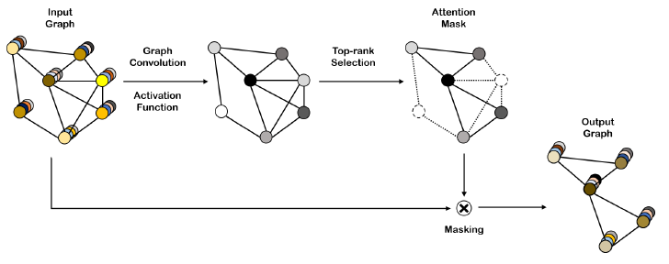
Graph pooling via node selection
Node selection
Learn a metric to quantity the importance of nodes and select several nodes according to the learned metric
J. Lee, I. Lee, J. Kang. Self-attention Graph Pooling, ICML 2019.

Slide 43
Discussions

Slide 44
Question 1: Does structure matters?
CNN learns stationary local patterns. How about graph CNN?
Both spectral methods and spatial methods fail to offer explicit clues or possibility to extract structural patterns
Instead, it seems that graph CNNs aim to learn the way in which features of neighboring nodes diffuse to the center node
Context representation
Explicitly correlate graph CNN with structural patterns, e.g., motif-based graph CNN, or graph CNN on heterogeneous networks

Slide 45
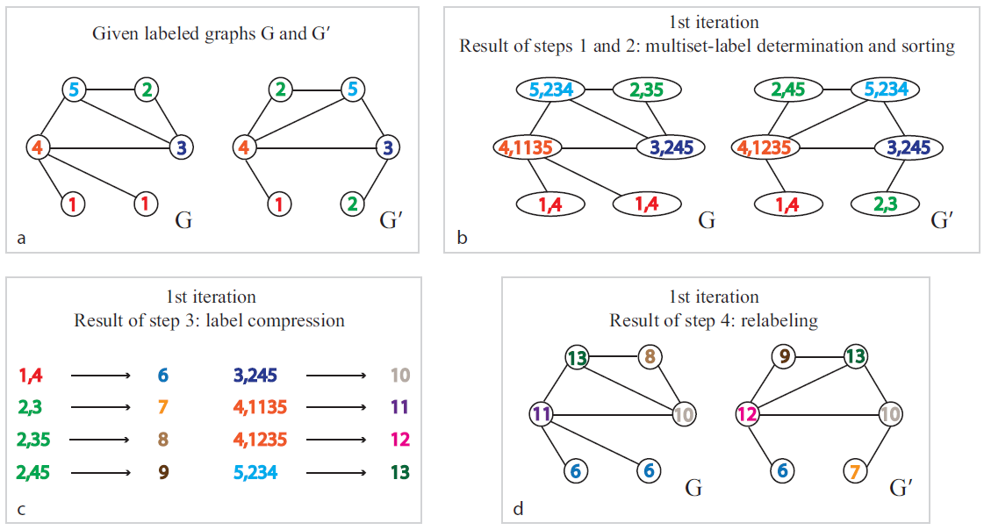
Question 2: Context representation?
Weisfeiler-Lehman isomorphism Test: WL Test
Is graph CNN a soft version of WL test, working on networks with real-value node attributes instead of discrete labels?
K. Xu, W. Hu, J. Leskovec, S. Jegelka, How powerful are graph neural networks? ICLR 2019.

Slide 46
Question 3: Future applications?
Three major scenarios
Node-level
Node classification: predict the label of nodes according to several labeled nodes and graph structure
Link prediction: predict the existence or occurrence of links among pairs of nodes
Graph-level
Graph classification: predict the label of graphs via learning a graph representation using graph CNN
Signal-level
Signal classification, similar to image classification which is signal-level scenario on a grid-like network

Slide 47
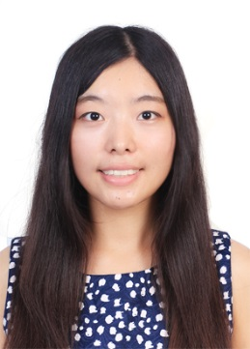
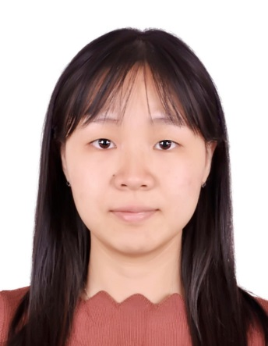
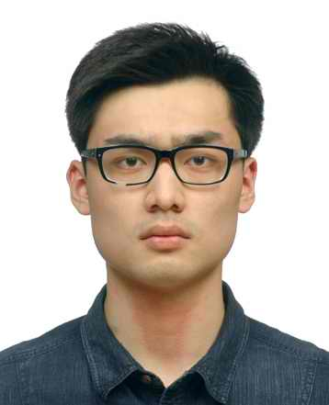
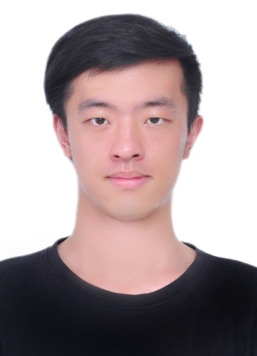
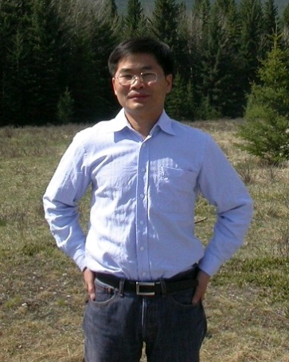
Acknowledgement
Bingbing Xu
Qi Cao
Keting Cen
Yunqi Qiu
Xueqi Cheng

Slide 48
Thank you for your attentions!

